Slide 1
National Housing Trends

Slide 2
America’s Choice of Best
Long Term Investment
Gallup 2017

Slide 3
$48,749
potential growth in family wealth over the next five years based solely on increased home equity
Increased home equity based on price appreciation projected by the Home Price Expectation Survey
Home Price Expectation Survey 2017 3Q
Notes:
https://pulsenomics.com/Q3_2017_HPE_Survey.php

Slide 4
The Cost of
RENTING vs. BUYING
HISTORICALLY:
NOW:
Percentage of Income Needed to Afford Median Rent
25.8%
29.2%
Percentage of Income Needed to Afford Median Home
21.0%
15.8%

Slide 6
Homeownership Rates
in the U.S. for the 3rd Quarter
Census
Notes:
https://www.census.gov/housing/hvs/files/currenthvspress.pdf

Slide 7
Housing Affordability Index
1990 to Today
Years when
distressed
properties
dominated
the market
NAR

Slide 8
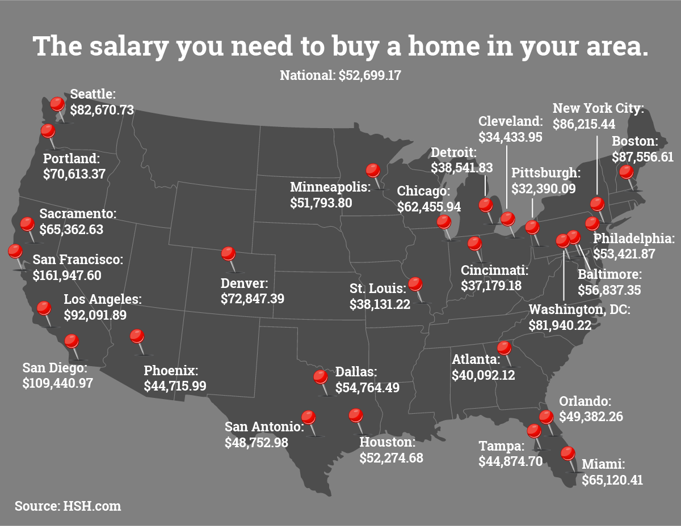

Slide 9
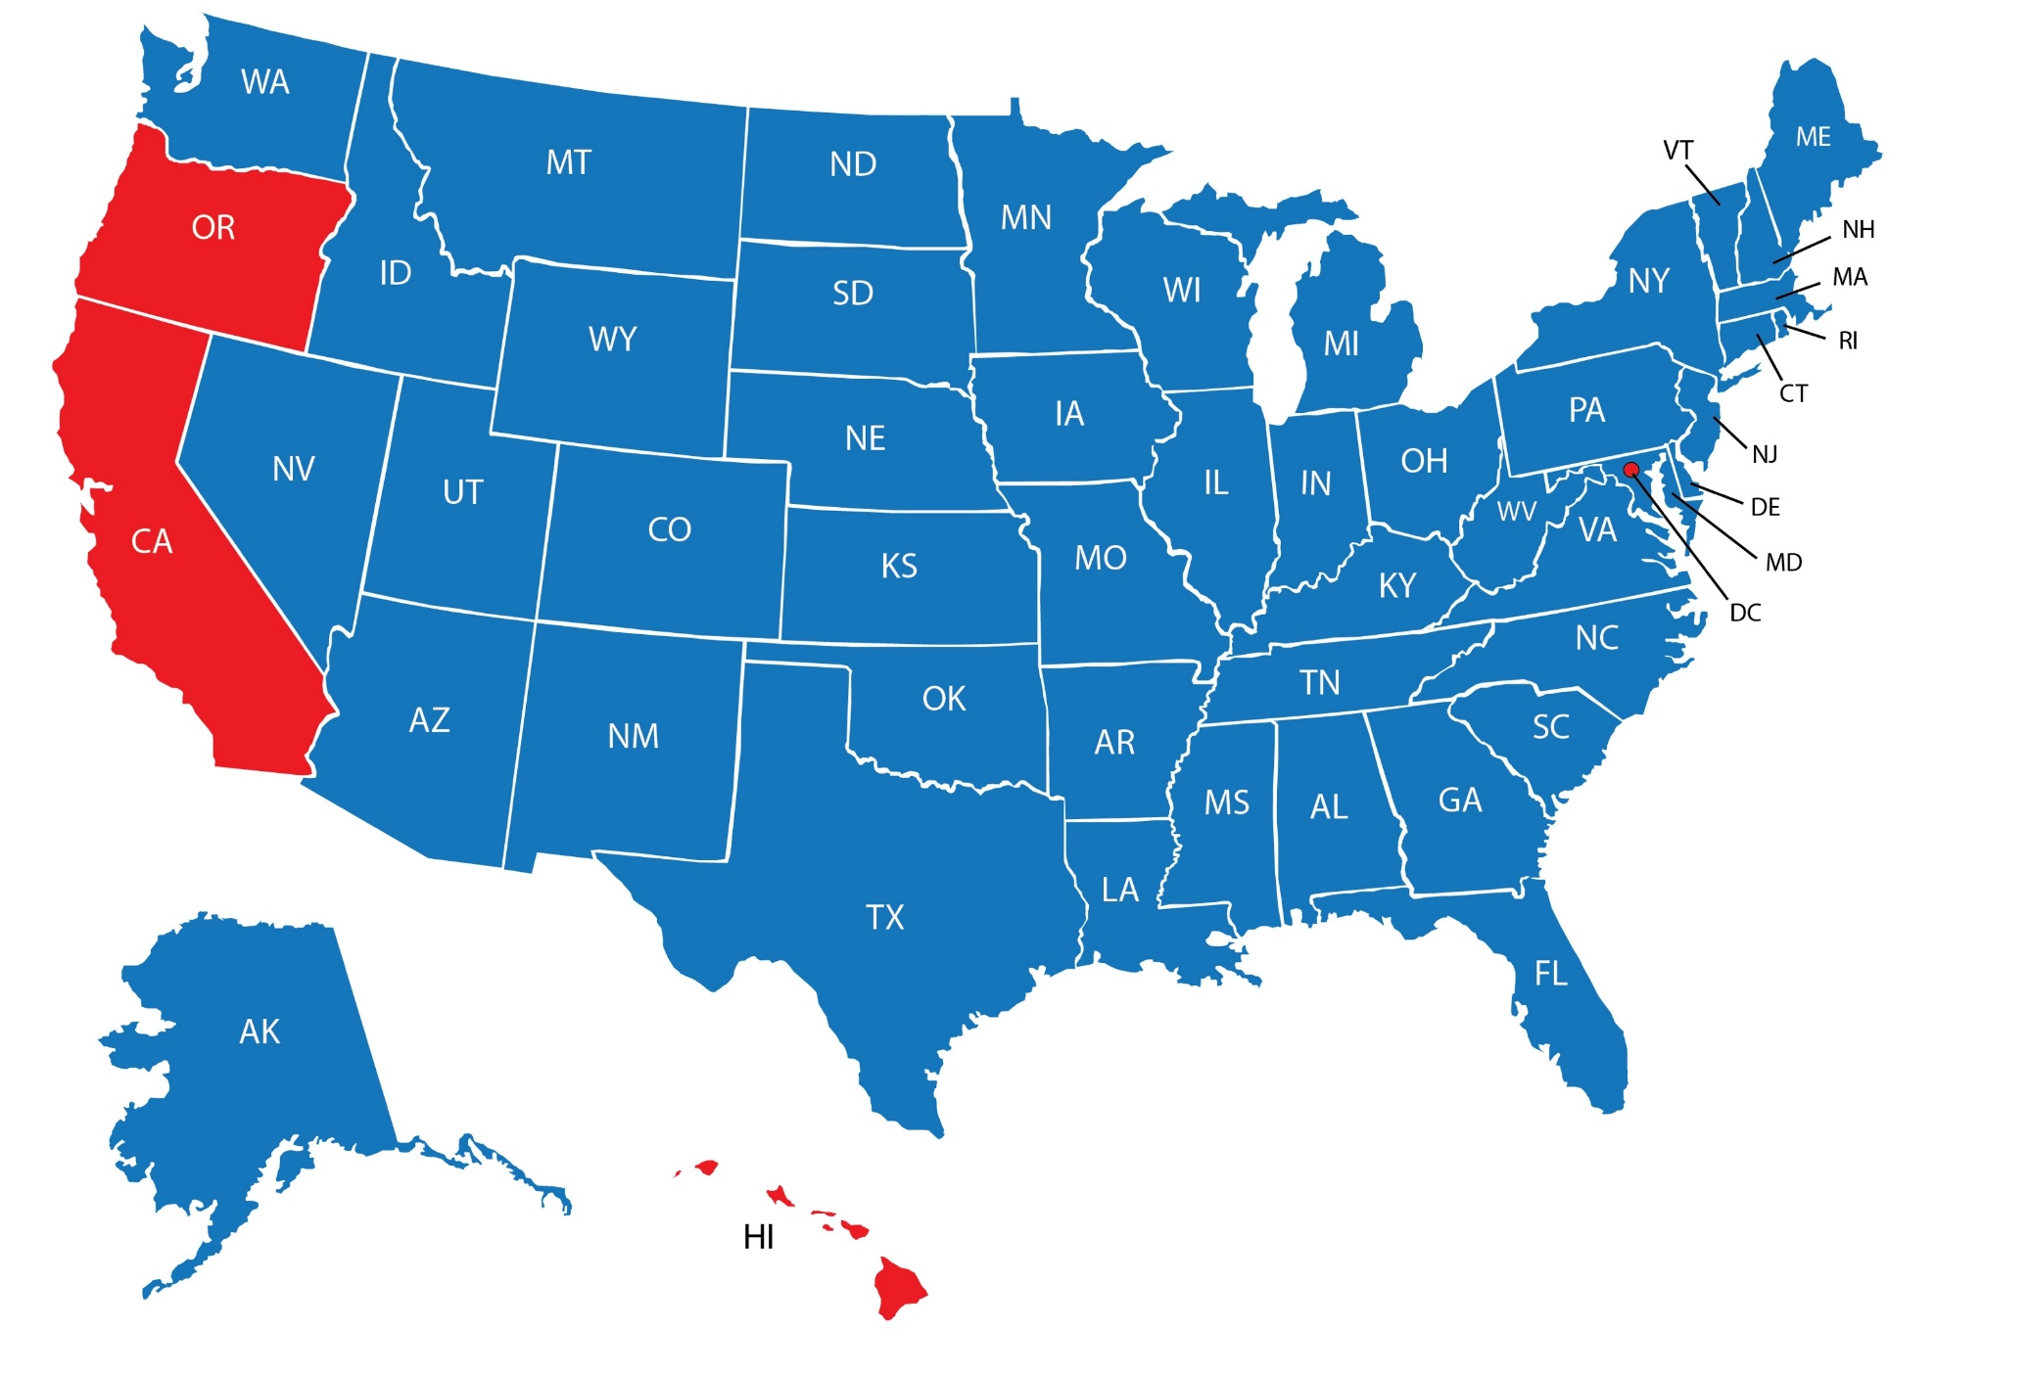
Home Affordability
Today compared to late 1990’s
More Affordable Today
Less Affordable Today
Black Knight
Notes:
http://www.bkfs.com/Data/DataReports/BKFS_MM_Jan2018_Report.pdf

Slide 10
Simply a Matter of Supply & Demand
December
2017
January
2018
February
2018
Year-over-Year Differences
Notes:
http://showingtime.com/showingtime-showing-index
https://www.nar.realtor/topics/existing-home-sales

Slide 11
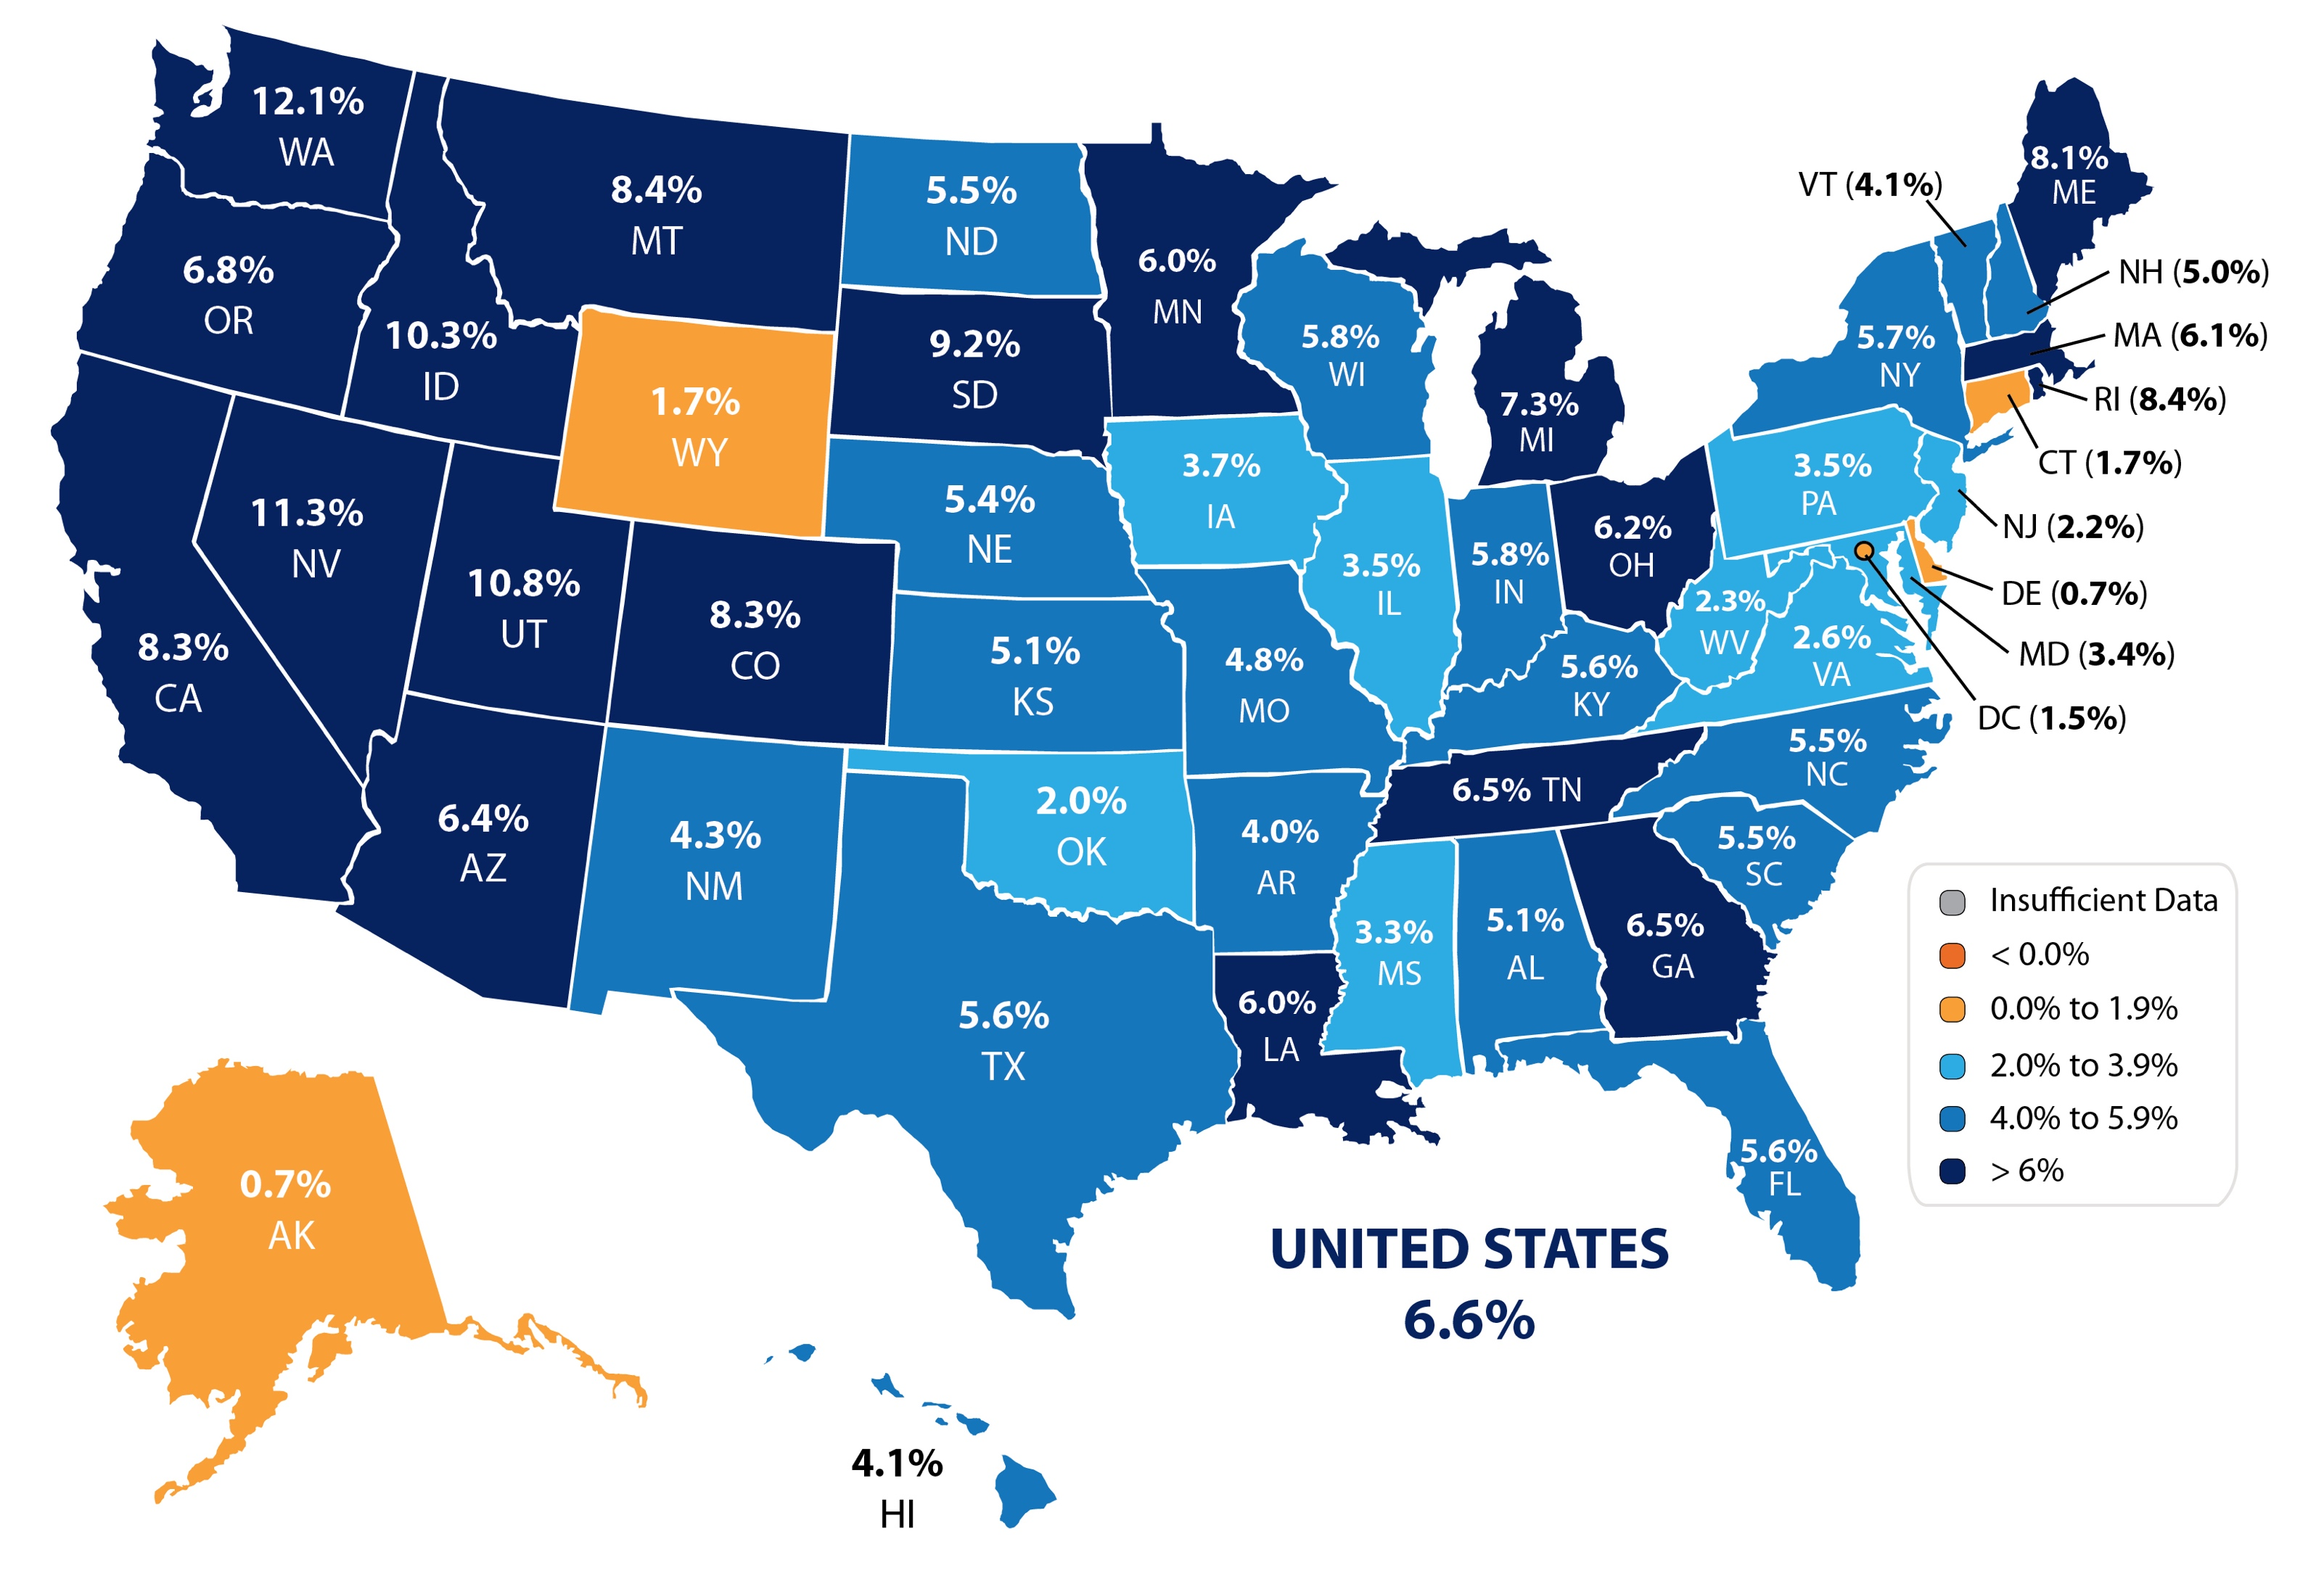
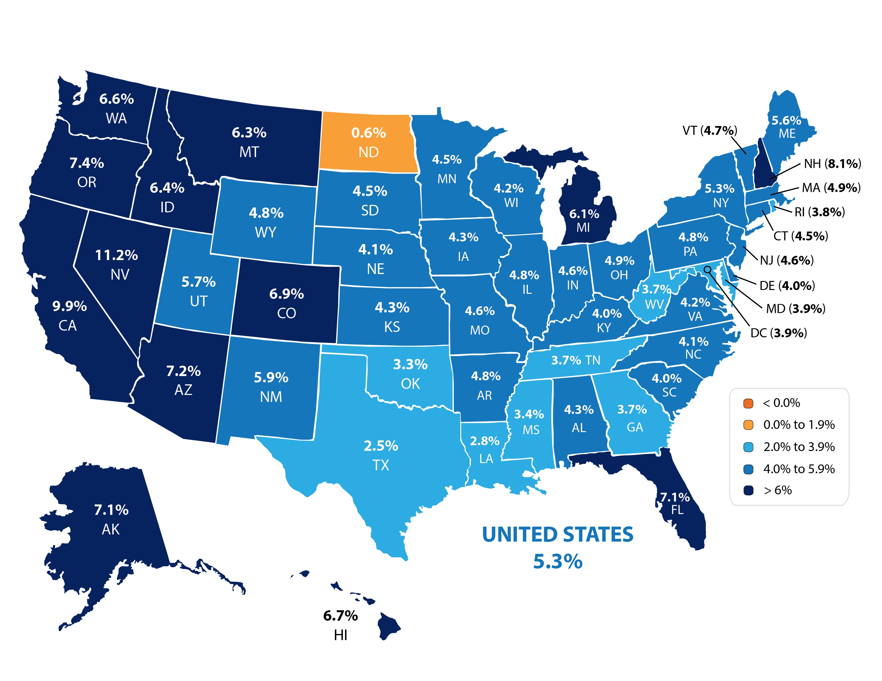
Actual Year-Over-Year % Change in Price
By State
CoreLogic
Notes:
http://www.corelogic.com/about-us/researchtrends/corelogic-home-price-insights.aspx

Slide 12
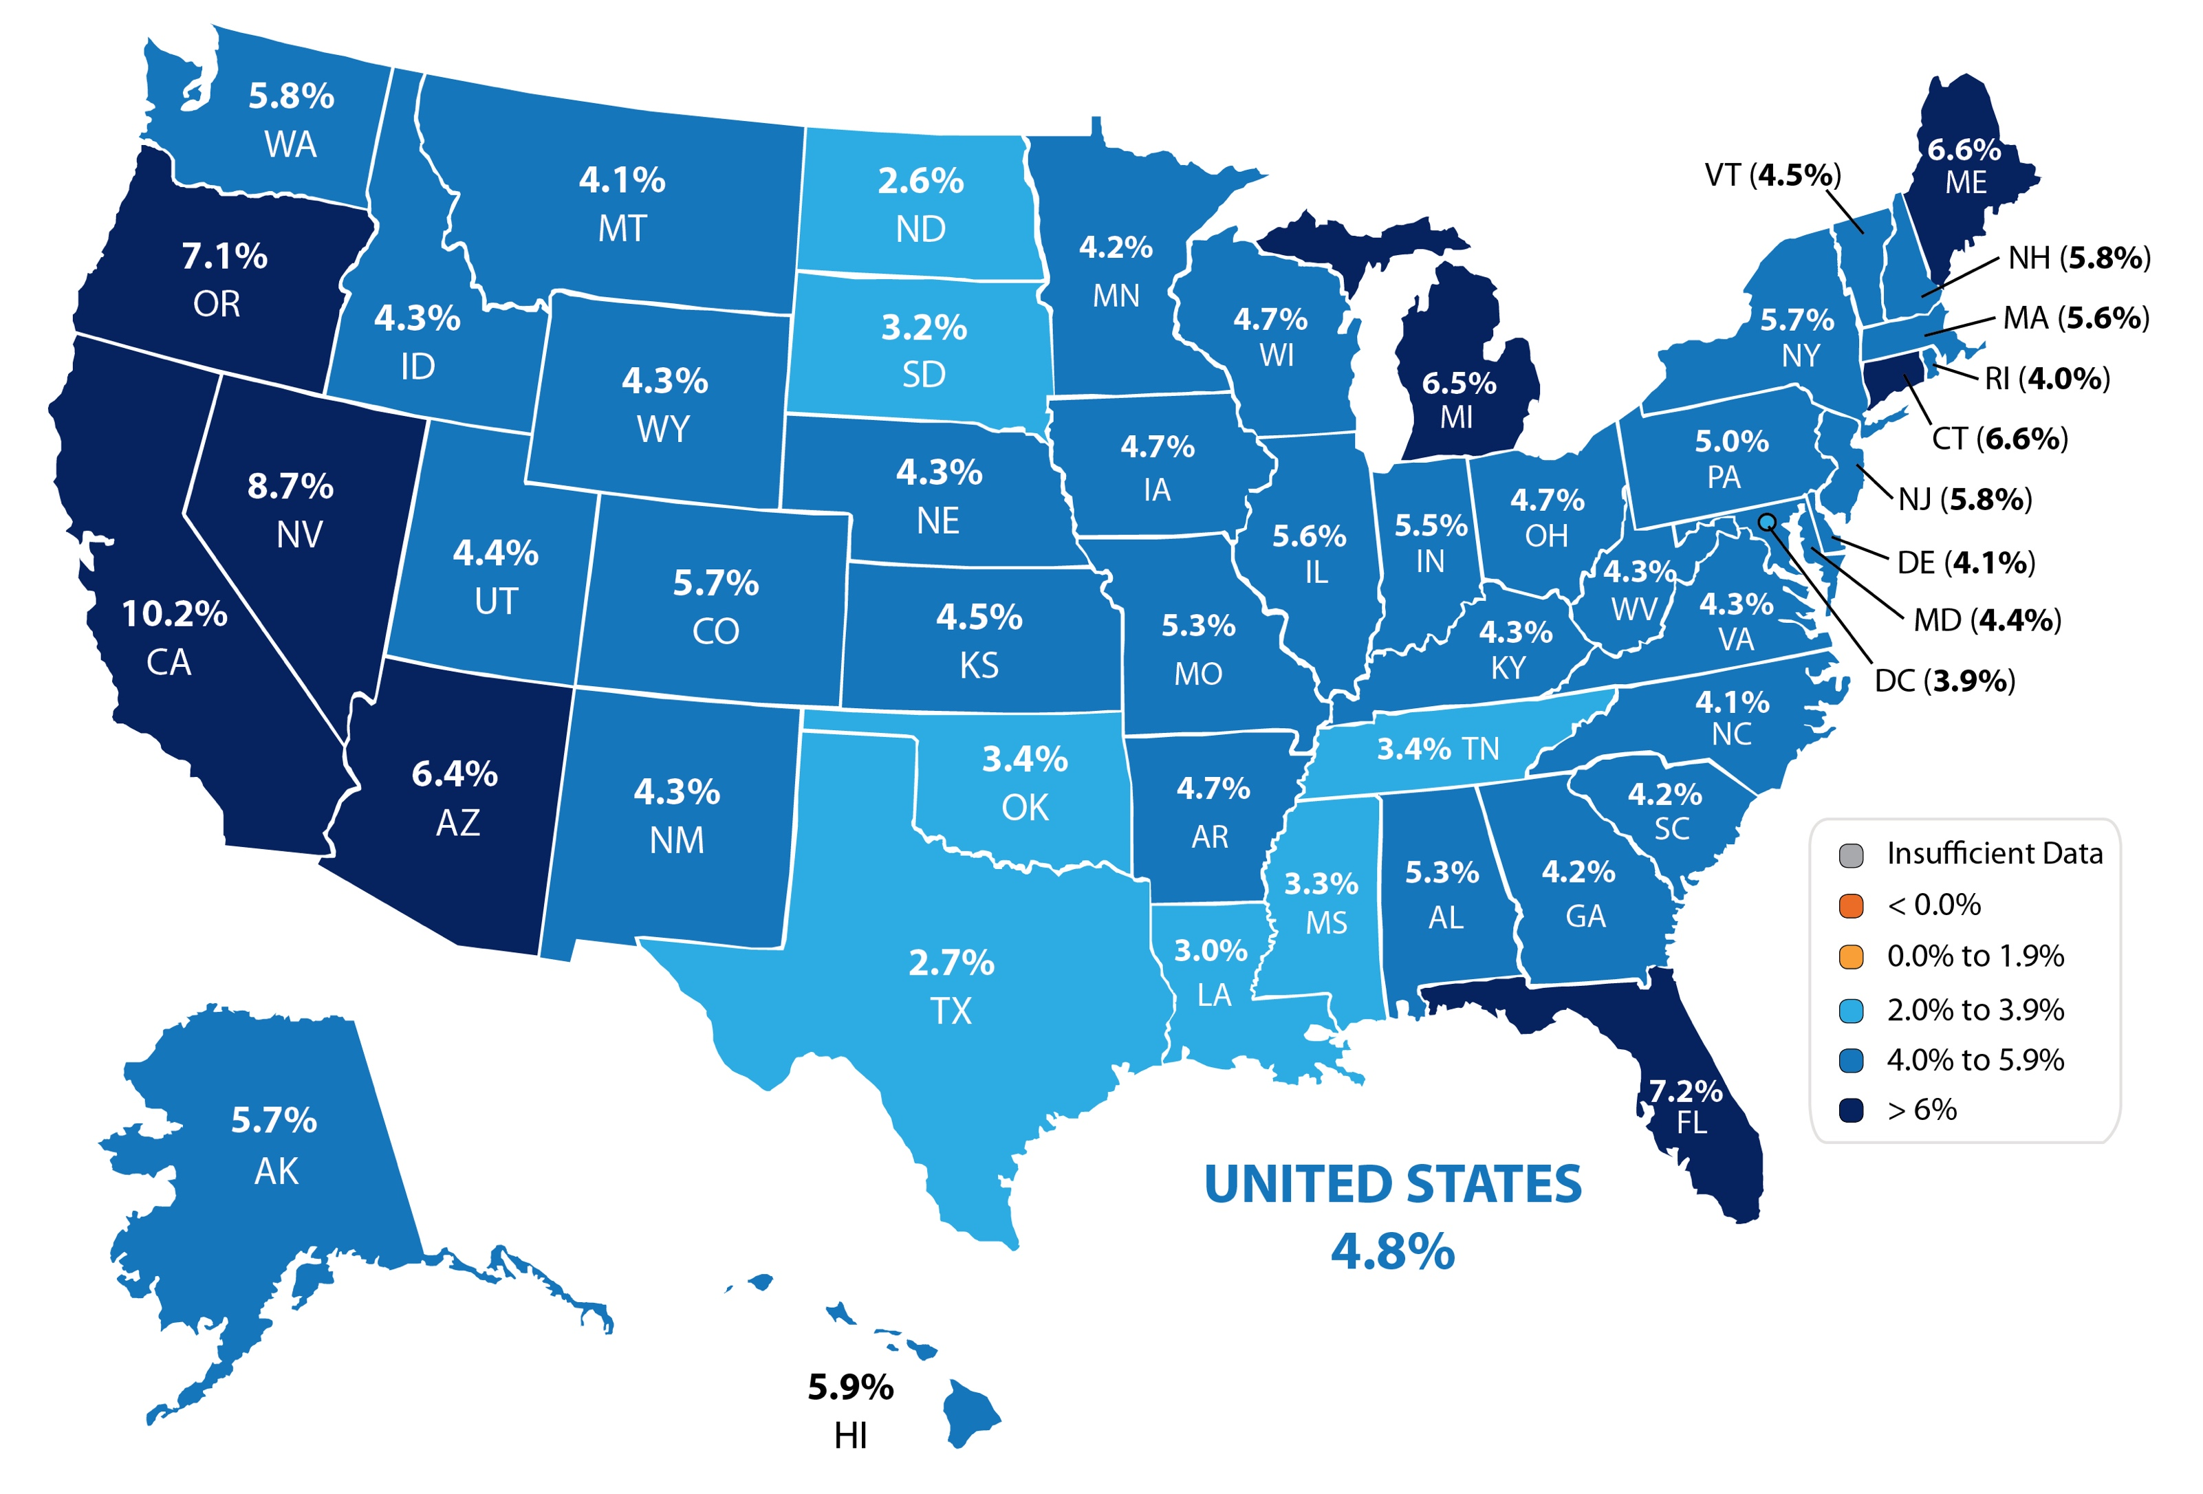
Forecasted Year-Over-Year % Change in Price
CoreLogic
Notes:
http://www.corelogic.com/about-us/researchtrends/corelogic-home-price-insights.aspx

Slide 13
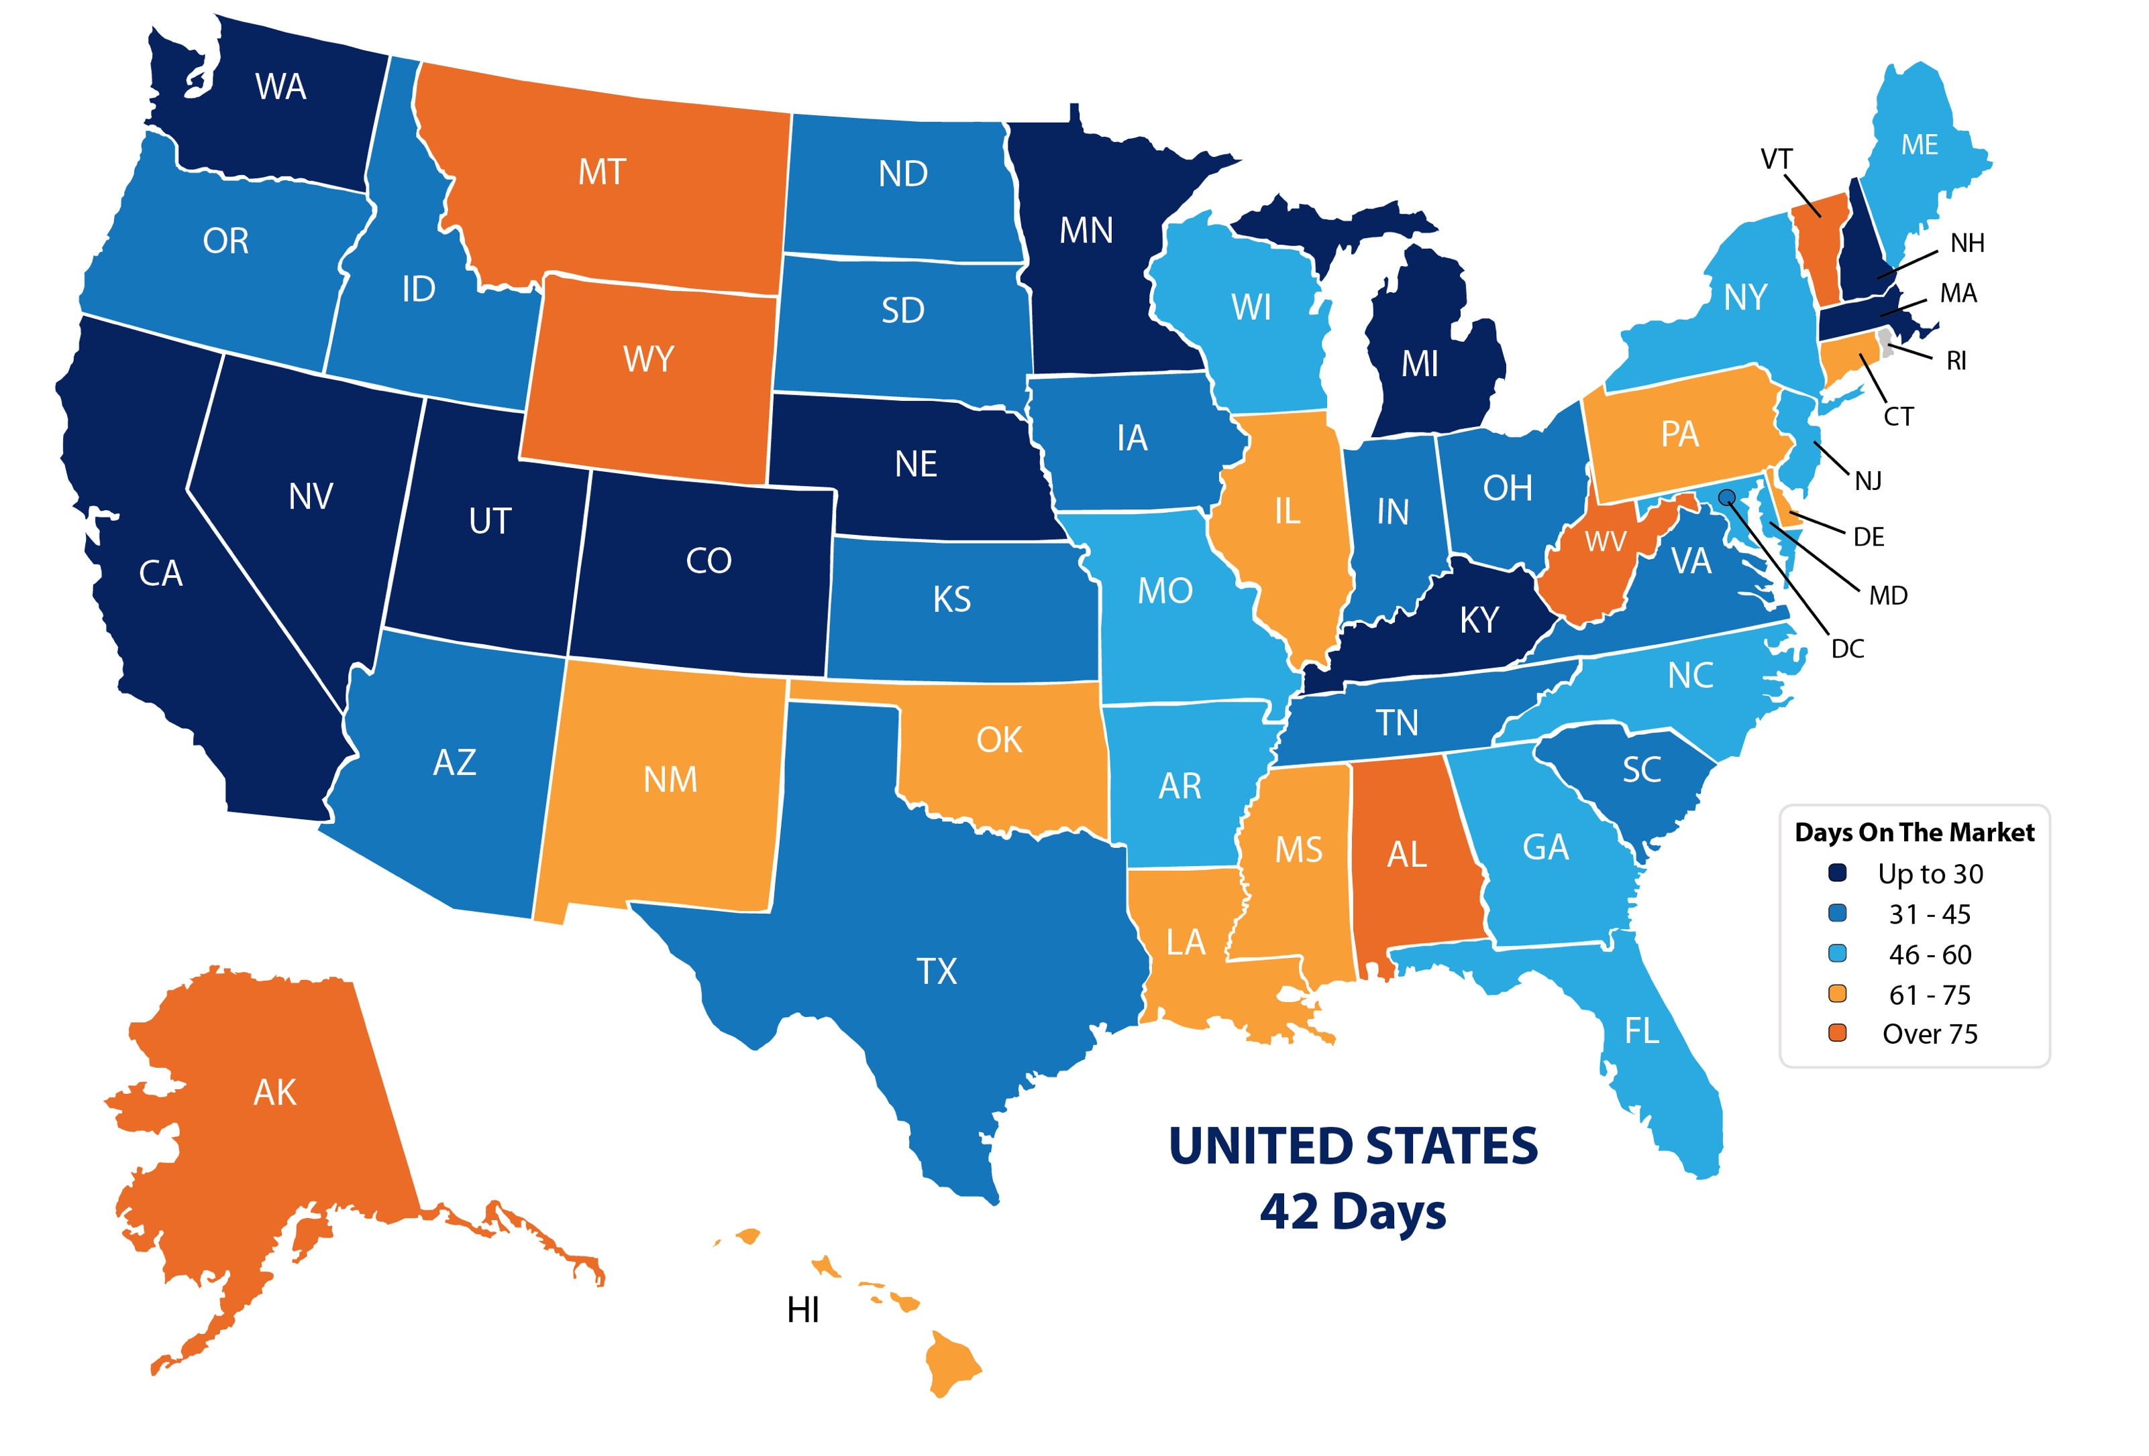
Average Days on the Market
NAR
Notes:
https://www.nar.realtor/reports/realtors-confidence-index

Slide 14
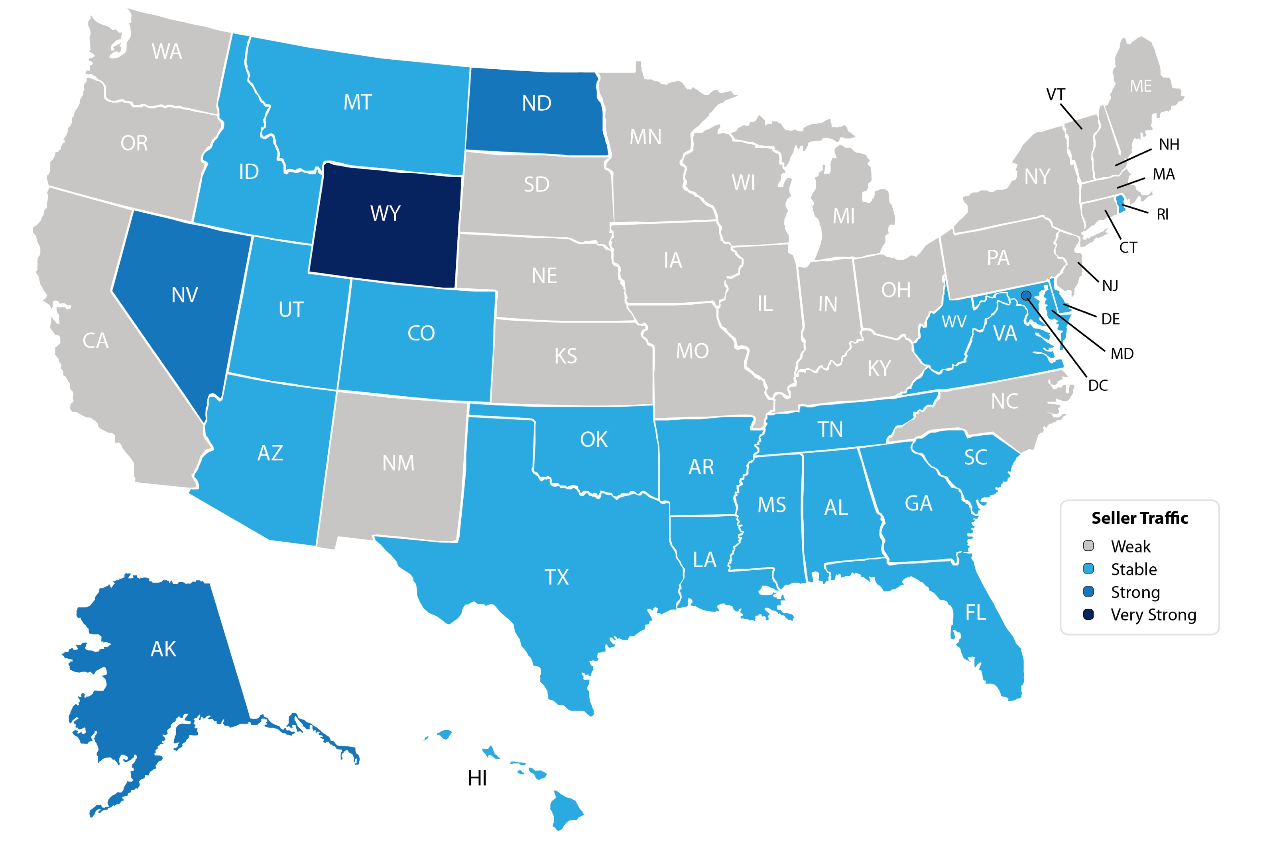
Seller Traffic
NAR
Notes:
https://www.nar.realtor/reports/realtors-confidence-index

Slide 15
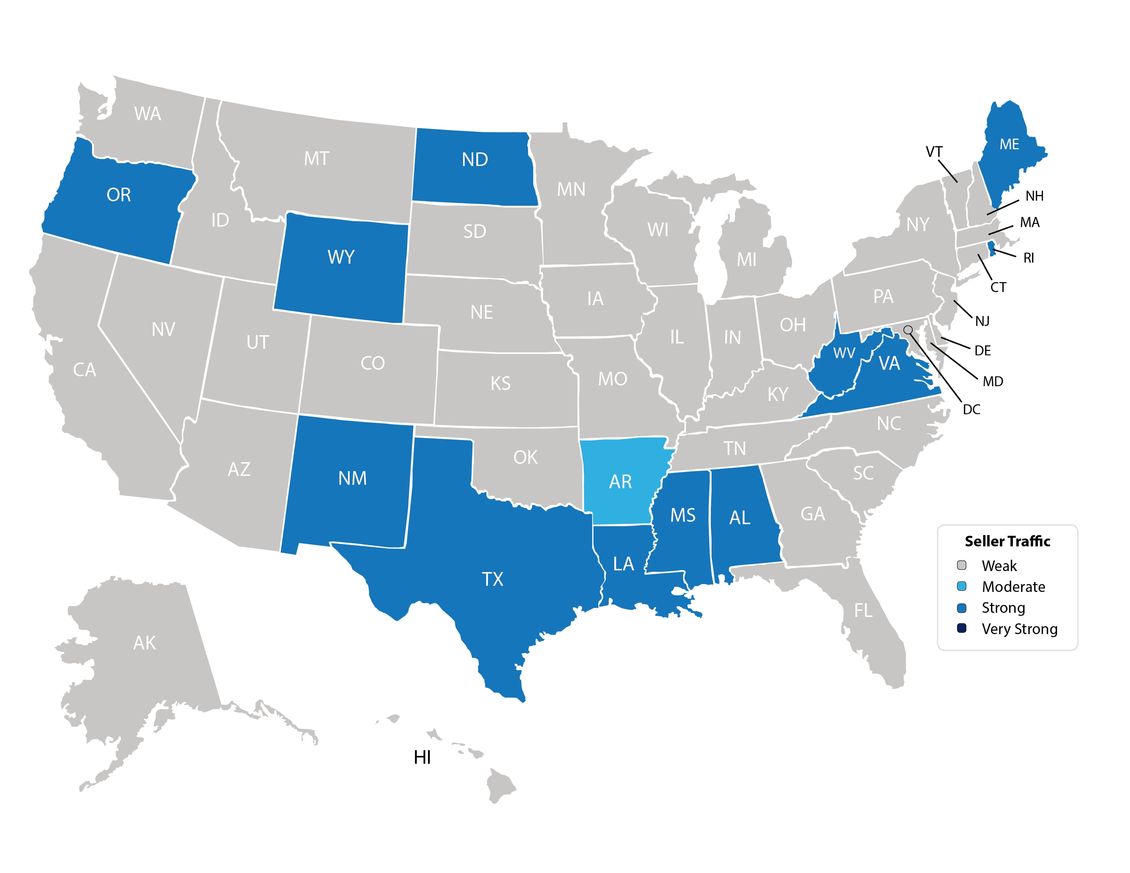
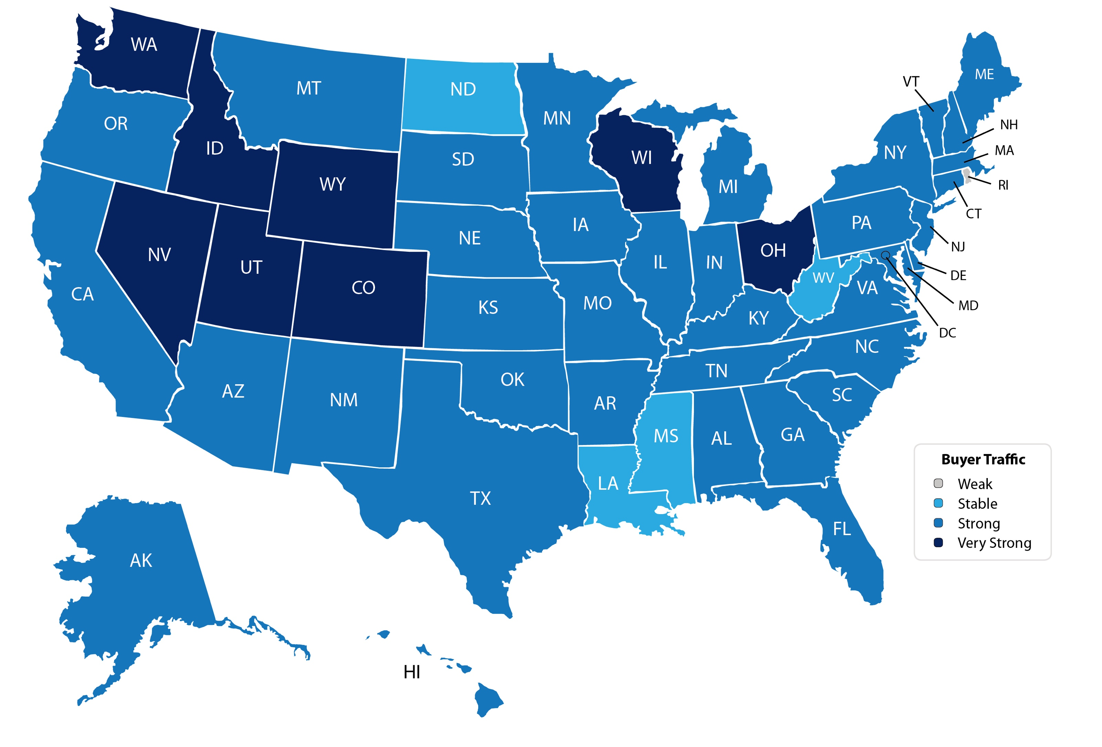
Buyer Traffic
NAR
Notes:
https://www.nar.realtor/reports/realtors-confidence-index

Slide 16
Foot Traffic
indicator of future sales
NAR 4/2018
Notes:
nar.realtor
http://nar.realtor/infographics/foot-traffic
"Every month SentriLock, LLC. provides NAR Research with data on the number of properties shown by a REALTOR®. Lockboxes made by SentriLock, LLC. are used in roughly a third of home showings across the nation. Foot traffic has a strong correlation with future contracts and home sales, so it can be viewed as a peek ahead at sales trends two to three months into the future."

Slide 17
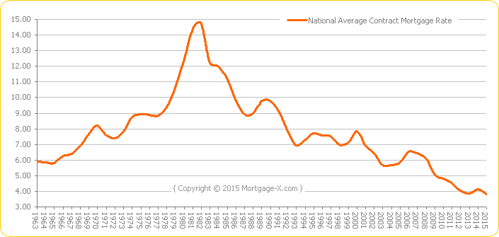
Historical Mortgage Rates Have Averaged Around 8%

Slide 18
Mortgage Rate Projections
Quarter | Fannie Mae | MBA | NAR | Average of All Three
2018 2Q | 4.4 | 4.6 | 4.4 | 4.47
2018 3Q | 4.5 | 4.7 | 4.5 | 4.57
2018 4Q | 4.5 | 4.9 | 4.6 | 4.67
2019 1Q | 4.5 | 5.0 | x.x | x.xx
4/2018
Notes:
http://www.freddiemac.com/research/pdf/201803-Outlook.pdf http://www.fanniemae.com/resources/file/research/emma/pdf/Housing_Forecast_031918.pdf https://www.mba.org/Downloads/Mtg%20Fin%20Forecast%20Mar%202018.pdf https://www.nar.realtor/sites/default/files/documents/forecast-02-2018-us-economic-outlook-02-13-2018.pdf

Slide 19
Mortgage Rates
Freddie Mac
30 Year Fixed Rate
2015
2016
2017
2018
- Actual
- Projected
Freddie Mac
Notes:
http://www.freddiemac.com/research/pdf/201803-Outlook.pdf

Slide 20
Increasing Mortgage Rates Make A Significant Difference In Home Affordability
Amount Of Mortgage | 3.5% Mortgage | 30-Year Cost | 5% Mortgage | 30-Year Cost | 8% Mortgage | 30-Year Cost
$200,000 | $898 | $323,280 | $1,073 | $386,280 | $1,467 | $528,120
$300,000 | $1,347 | $484,920 | $1,610 | $579,600 | $2,201 | $792,360
$400,000 | $1,796 | $646,560 | $2,147 | $772,920 | $2,935 | $1,056,600
$500,000 | $2,245 | $808,200 | $2,684 | $966,240 | $3,668 | $1,320,480
$1 million | $4,490 | $1,616,400 | $5,368 | $1,932,480 | $7,337 | $2,641,320

Slide 21
Mortgage Affordability
Buyer with median income buying a median priced home
Zillow
Notes:
https://www.zillow.com/research/q4-2017-affordability-rising-rates-18978/

Slide 22
Greater Metro Atlanta
Market
April 2018 Report With Results Through March 2018

Slide 23
Metro Atlanta Homes Sold
125,000 Homes Sold In 2006. 60,000 Homes Sold In 2010.
2018 YTD Closings 1.1% Lower Than 2017. Pendings Up 6.3%.
Notes:
PGR continues to grow our listing inventory market share. Our Advanced Property Marketing methodology and focused prospecting is making a difference.

Slide 24
Metro Atlanta 2013-2018 Closings
March Closings Up 31% Compared To February Closings.
March 2018 Closings Down 9.5% Compared To March 2017.
Notes:
PGR continues to grow our listing inventory market share. Our Advanced Property Marketing methodology and focused prospecting is making a difference.

Slide 25
Metro Atlanta Closings – March 2017 (Number Of Transactions By Price)
89% Of Transactions In $100K-$500K Price Range
Notes:
Months of supply is well below normal in many of our markets. We expect this to continue in 2013.

Slide 26
Metro Atlanta Closed Units By Price Point March 2018 Compared To March 2017
Notes:
Months of supply is well below normal in many of our markets. We expect this to continue in 2013.

Slide 27
Listed Inventory January 2012 – March 2018
Residential Detached, Metro Atlanta
Inventory Up 7% From Recent Bottom Of Feb. 2013
Inventory Up 4% From Last Month, Down 9.4% Compared To Last Year

Slide 28
Months of Inventory Change The Market Strategy
GREATER THAN
7 MONTHS
BETWEEN
6-7 MONTHS
LESS THAN
6 MONTHS
SELLERS
MARKET
Home prices
will appreciate
NEUTRAL
MARKET
Home prices
will only appreciate with inflation
BUYERS
MARKET
Home prices
will depreciate
Notes:
Realtor.org

Slide 29
Metro Atlanta Months of Inventory (March 2018, Based On Closed Sales)
6 Months Supply Is Considered Normal Market
Total Metro Atlanta “Months Of Inventory” Is 2.6 Months
Notes:
Months of supply is well below normal in many of our markets. We expect this to continue in 2013.

Slide 30
Metro Atlanta Monthly Average Sale Prices
ASP $305,000 In March. ASP $285,000 Last Month.
Up 7% From Last Month. Up 6.7% From Last March.
Notes:
PGR continues to grow our listing inventory market share. Our Advanced Property Marketing methodology and focused prospecting is making a difference.

Slide 31
Metro Atlanta Annual Average Sale Prices
Annual ASP Up 64% From Bottom Of 2011
Notes:
PGR continues to grow our listing inventory market share. Our Advanced Property Marketing methodology and focused prospecting is making a difference.

Slide 32
Case-Shiller Index For Metro Atlanta
Jan 2010 Through January 2018 (Reported March 27, 2018)
Home Values Up 71% From Recent Bottom Of March 2012.
Notes:
PGR continues to grow our listing inventory market share. Our Advanced Property Marketing methodology and focused prospecting is making a difference.

Slide 33
Case-Shiller Gain/ Loss For Metro Atlanta
Comparisons Based On The Latest Case Shiller Index Compared
To The Average Index For The Year Property Was Purchased.
Year Property Bought | Gain/ Loss
2001 | 29.79%
2002 | 24.98%
2003 | 21.04%
2004 | 16.92%
2005 | 11.34%
2006 | 6.23%
2007 | 5.55%
2008 | 15.37%
Year Property Bought | Gain/ Loss
2009 | 30.52%
2010 | 33.77%
2011 | 43.85%
2012 | 55.97%
2013 | 31.79%
2014 | 20.85%
2015 | 14.50%
2016 | 8.15%
Case Shiller Index For Metro Atlanta - January 2018 As Reported March 27, 2018. Local Markets And Price Points May Have Significantly Different Outcomes.
Notes:
PGR continues to grow our listing inventory market share. Our Advanced Property Marketing methodology and focused prospecting is making a difference.

Slide 34
Case-Shiller Home Values For Metro Atlanta
Peak For Values Was July 2007. Recent Bottom Was March 2012. Metro Average Home Values Back To Normal Trend Line.
Notes:
PGR continues to grow our listing inventory market share. Our Advanced Property Marketing methodology and focused prospecting is making a difference.

Slide 35
Berkshire Hathaway HomeServices Georgia Properties

Slide 36
YTD Closed Units – March 2018 FMLS Counties + Southern Crescent
Information Provided By Trendgraphix and BHHS GP Internal Reports.
Notes:
In the past three years, our company has consistently grown our market share in both listing inventory and the sales of that inventory. Today, we are Ranked #1 in both categories.

Slide 37
YTD Closed Volume – March 2018 FMLS Counties + Southern Crescent
($ Volume in Thousands)
Information Provided By Trendgraphix and BHHS GP Internal Reports.
Notes:
In the past three years, our company has consistently grown our market share in both listing inventory and the sales of that inventory. Today, we are Ranked #1 in both categories.

Slide 38
YTD Listed Inventory – March 2018 FMLS Counties + Southern Crescent
Information Provided By Trendgraphix and BHHS GP Internal Reports.
Notes:
In the past three years, our company has consistently grown our market share in both listing inventory and the sales of that inventory. Today, we are Ranked #1 in both categories.

Slide 39
Georgia Economic & Housing Trends

Slide 40
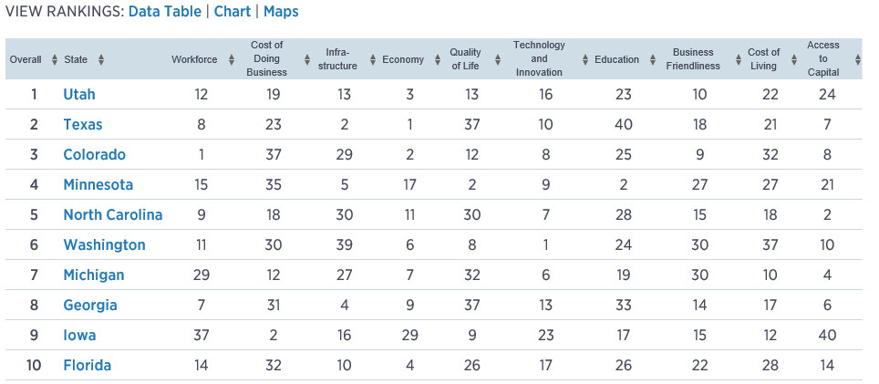
Top States For Business CNBC Survey

Slide 41
Buyers Moving To Atlanta!
Here is the Top 10 List including previous rank:
Atlanta (1)
Phoenix (4)
Tampa/Sarasota (2)
Dallas/Fort Worth (3)
Orlando (5)
Denver (7)
Houston (8)
Seattle (6)
Las Vegas (10)
Chicago (9)
Penske Truck Rental published their latest moving destination list and Atlanta was ranked #1 for the 6th year in a row. The trend of moving to the sunbelt has returned. Desirable attributes that help Metro Atlanta include a business friendly environment, low cost of living for a metro area, airport, moderate weather with 4 seasons and a high quality of life.

Slide 42
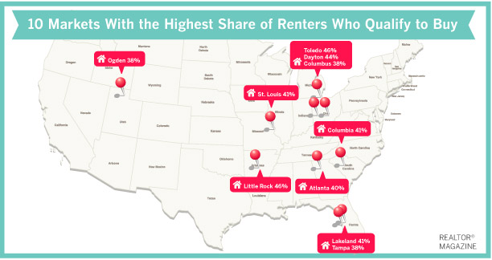
Top 10 Markets With Highest Share Of Renters Qualified To Buy
Toledo, Ohio: 46%
Little Rock, Ark.: 46%
Dayton, Ohio: 44%
Lakeland, Fla.: 41%
St. Louis, Mo.: 41%
Columbia, S.C.: 41%
Atlanta: 40%
Columbus, Ohio: 38%
Tampa, Fla.: 38%
Ogden, Utah: 38%

Slide 43
Baby Boomers Are Coming To Be Close To Their Children & Grandchildren.
 | Total Population | Rank of Share
 |  | Under 20 | 20-64 | 65+ | 25-39 | 45-59
Dallas | 6,144,489 | 3 | 9 | 25 | 1 | 24
Atlanta | 5,271,550 | 5 | 6 | 27 | 2 | 19
Phoenix | 4,179,427 | 4 | 24 | 15 | 3 | 26
Denver | 2,466,591 | 11 | 5 | 24 | 4 | 12
Riverside | 4,081,371 | 1 | 27 | 22 | 5 | 27
Houston | 5,629,127 | 2 | 10 | 26 | 6 | 21
Portland | 2,174,631 | 19 | 4 | 19 | 7 | 7
Seattle | 3,309,347 | 22 | 1 | 20 | 8 | 3
Sacramento | 2,091,120 | 12 | 13 | 14 | 9 | 20
Washington | 5,306,125 | 14 | 3 | 23 | 10 | 11
Los Angeles | 12,875,587 | 6 | 17 | 18 | 11 | 23
San Diego | 2,974,859 | 8 | 14 | 16 | 12 | 25
San Francisco | 4,203,898 | 26 | 2 | 10 | 13 | 4
Orlando | 2,032,496 | 18 | 15 | 8 | 14 | 22
Minneapolis | 3,208,212 | 10 | 7 | 21 | 15 | 6
Chicago | 9,522,879 | 7 | 16 | 17 | 16 | 18
New York | 18,815,988 | 21 | 12 | 6 | 17 | 15
Boston | 4,482,857 | 23 | 8 | 9 | 18 | 10
Cincinnati | 2,134,864 | 9 | 19 | 13 | 19 | 14
Baltimore | 2,668,056 | 17 | 11 | 11 | 20 | 9
Detroit | 4,467,592 | 13 | 18 | 12 | 21 | 5
Philadelphia | 5,827,962 | 16 | 21 | 5 | 22 | 13
St. Louis | 2,802,282 | 15 | 20 | 7 | 23 | 8
Miami | 5,413,212 | 24 | 26 | 3 | 24 | 17
Tampa | 2,723,949 | 25 | 25 | 1 | 25 | 16
Cleveland | 2,096,471 | 20 | 23 | 4 | 26 | 2
Pittsburgh | 2,355,712 | 27 | 22 | 2 | 27 | 1
Metro Atlanta Has The:
#2 Population Age 25-39
#5 Population Under 20
Source :Census Bureau

Slide 44
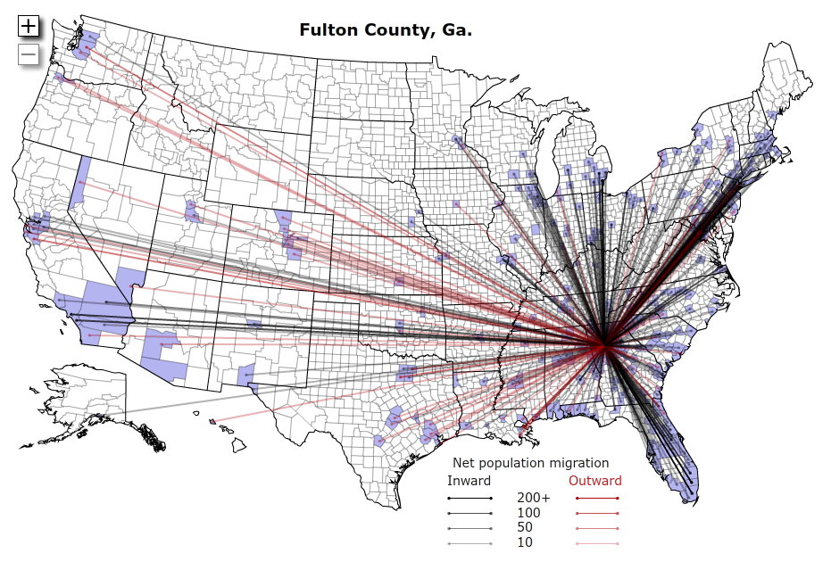
Rustbelt To Sunbelt

Slide 45
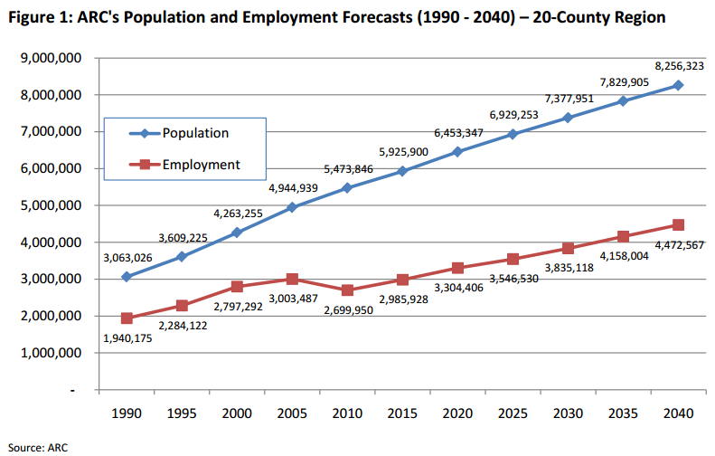
Population & Employment Growth Trends

Slide 46
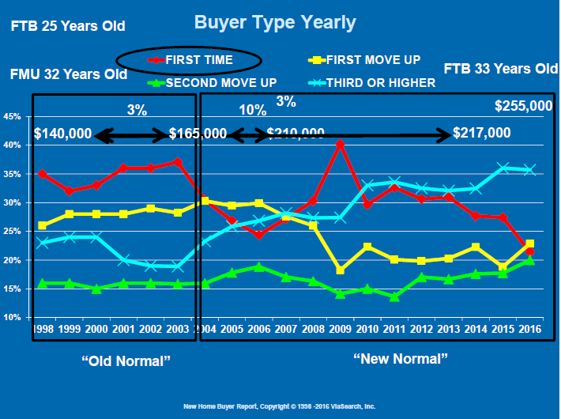

Slide 48
Population & Employment Growth Trends
U.S. Conference of Mayors Report predicts that Metro Atlanta will be the 6th largest city in the nation by 2046.
Metro Atlanta will grow from 5.8 million residents to 8.6 million residents.
That means 2.8 million people will move to our area!
This is great news for our long-term real estate values!

