Slide 1

TF
#TomFerry
Notes:
1. 60 units from SOI = 322,031 GCI Team
Personal production 41 units SOI $176,573 GCI SOI
2. 17 units closed YTD SOI Team = $91,759
Personal production 17 units closed YTD SOI = $85,561
94 units just under 21 million 481,883 GCI in 2017

Slide 2

TF
#TomFerry
Notes:
1. 60 units from SOI = 322,031 GCI Team
Personal production 41 units SOI $176,573 GCI SOI
2. 17 units closed YTD SOI Team = $91,759
Personal production 17 units closed YTD SOI = $85,561
94 units just under 21 million 481,883 GCI in 2017

Slide 3

CHANGE YOUR LIFE
TF
#TomFerry
Notes:
1. 60 units from SOI = 322,031 GCI Team
Personal production 41 units SOI $176,573 GCI SOI
2. 17 units closed YTD SOI Team = $91,759
Personal production 17 units closed YTD SOI = $85,561
94 units just under 21 million 481,883 GCI in 2017

Slide 4

TF
#TomFerry

Slide 5

TF
#TomFerry
Notes:
1. 60 units from SOI = 322,031 GCI Team
Personal production 41 units SOI $176,573 GCI SOI
2. 17 units closed YTD SOI Team = $91,759
Personal production 17 units closed YTD SOI = $85,561
94 units just under 21 million 481,883 GCI in 2017

Slide 6

TF
#TomFerry
Notes:
1. 60 units from SOI = 322,031 GCI Team
Personal production 41 units SOI $176,573 GCI SOI
2. 17 units closed YTD SOI Team = $91,759
Personal production 17 units closed YTD SOI = $85,561
94 units just under 21 million 481,883 GCI in 2017

Slide 7

TF
#TomFerry
Notes:
1. 60 units from SOI = 322,031 GCI Team
Personal production 41 units SOI $176,573 GCI SOI
2. 17 units closed YTD SOI Team = $91,759
Personal production 17 units closed YTD SOI = $85,561
94 units just under 21 million 481,883 GCI in 2017

Slide 8

TF
#TomFerry
Notes:
1. 60 units from SOI = 322,031 GCI Team
Personal production 41 units SOI $176,573 GCI SOI
2. 17 units closed YTD SOI Team = $91,759
Personal production 17 units closed YTD SOI = $85,561
94 units just under 21 million 481,883 GCI in 2017

Slide 9

TF
#TomFerry
Notes:
1. 60 units from SOI = 322,031 GCI Team
Personal production 41 units SOI $176,573 GCI SOI
2. 17 units closed YTD SOI Team = $91,759
Personal production 17 units closed YTD SOI = $85,561
94 units just under 21 million 481,883 GCI in 2017

Slide 10

TF
#TomFerry
Notes:
1. 60 units from SOI = 322,031 GCI Team
Personal production 41 units SOI $176,573 GCI SOI
2. 17 units closed YTD SOI Team = $91,759
Personal production 17 units closed YTD SOI = $85,561
94 units just under 21 million 481,883 GCI in 2017

Slide 11

TF
#TomFerry

Slide 12

TF
#TomFerry
Notes:
1. 60 units from SOI = 322,031 GCI Team
Personal production 41 units SOI $176,573 GCI SOI
2. 17 units closed YTD SOI Team = $91,759
Personal production 17 units closed YTD SOI = $85,561
94 units just under 21 million 481,883 GCI in 2017

Slide 13
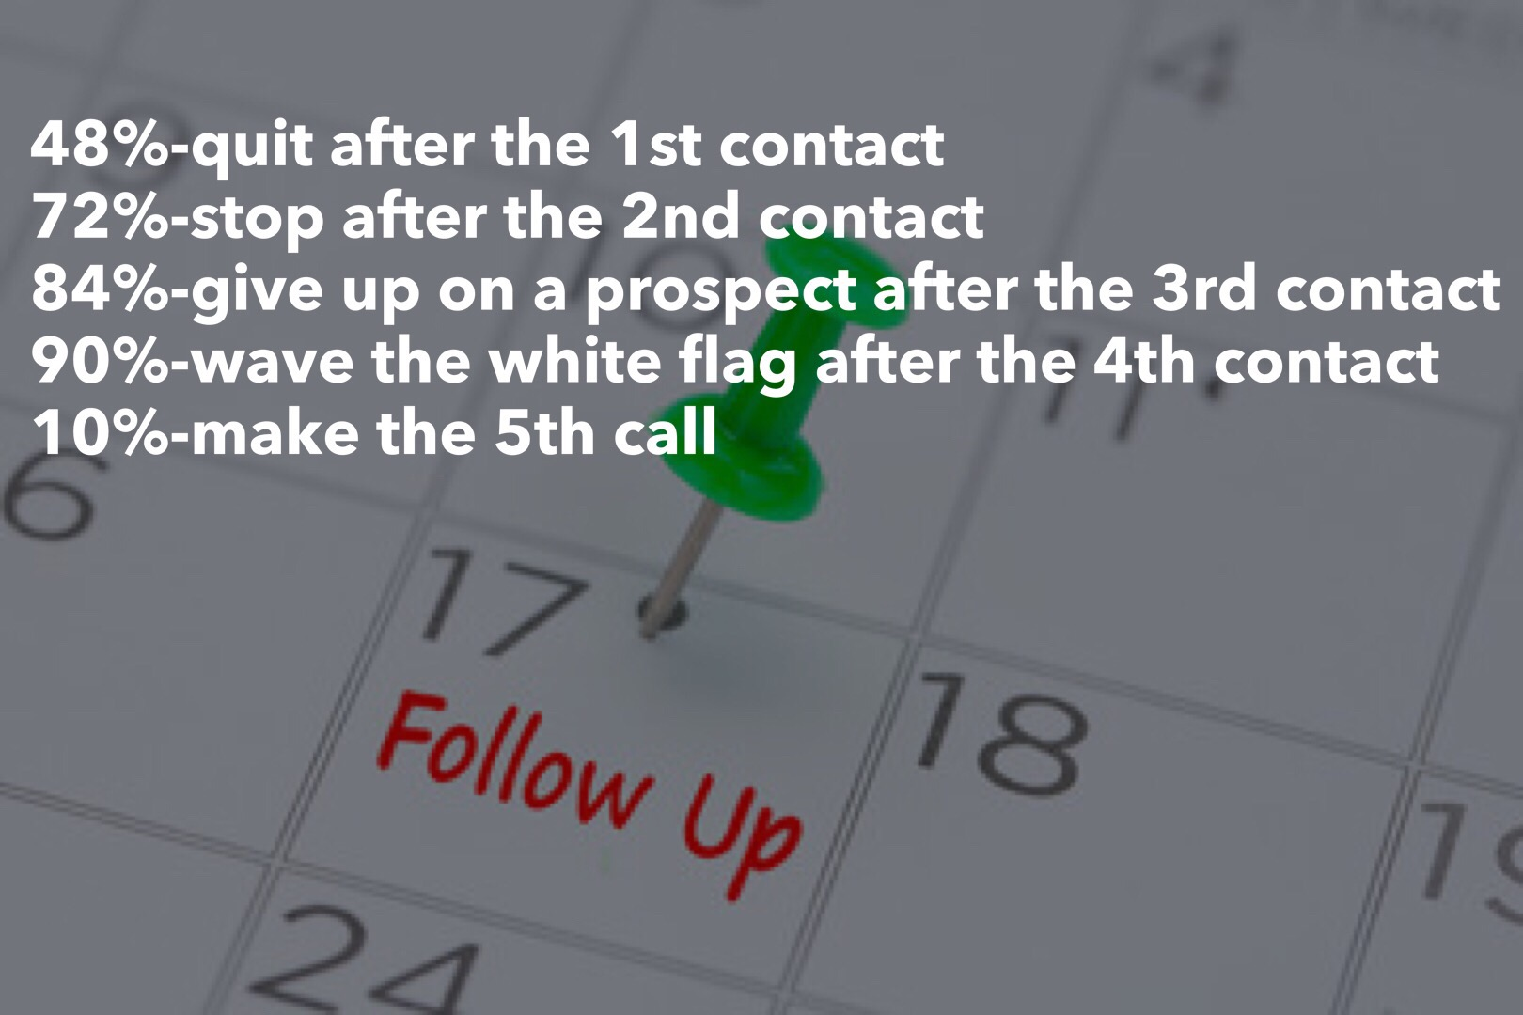
TF
#TomFerry

Slide 14
TF
#TomFerry
Notes:
1. 60 units from SOI = 322,031 GCI Team
Personal production 41 units SOI $176,573 GCI SOI
2. 17 units closed YTD SOI Team = $91,759
Personal production 17 units closed YTD SOI = $85,561
94 units just under 21 million 481,883 GCI in 2017

Slide 15

TF
#TomFerry
Notes:
1. 60 units from SOI = 322,031 GCI Team
Personal production 41 units SOI $176,573 GCI SOI
2. 17 units closed YTD SOI Team = $91,759
Personal production 17 units closed YTD SOI = $85,561
94 units just under 21 million 481,883 GCI in 2017

Slide 16
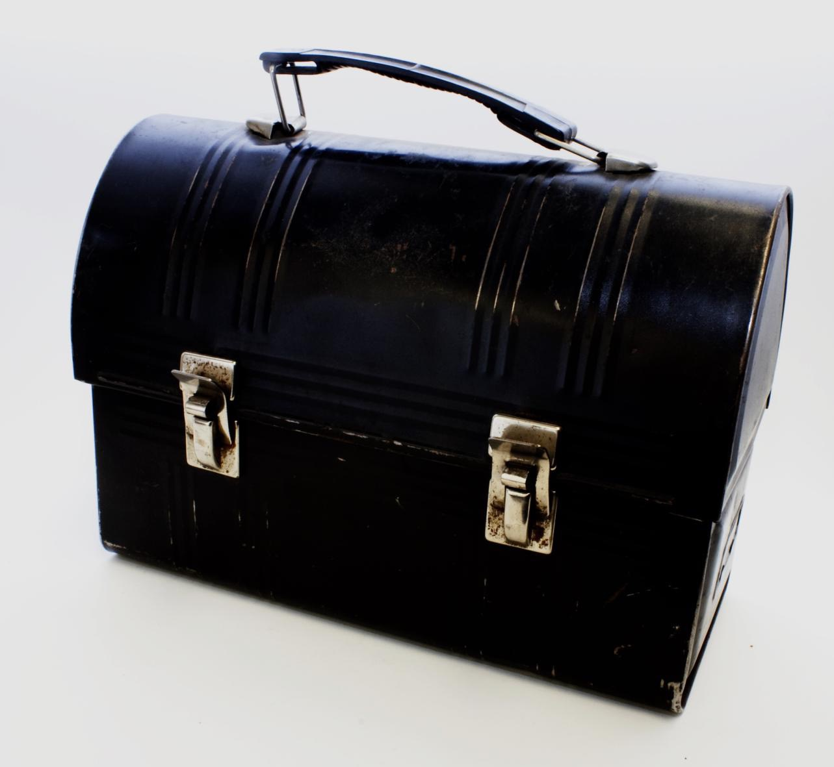
TF
#TomFerry
Notes:
1. 60 units from SOI = 322,031 GCI Team
Personal production 41 units SOI $176,573 GCI SOI
2. 17 units closed YTD SOI Team = $91,759
Personal production 17 units closed YTD SOI = $85,561
94 units just under 21 million 481,883 GCI in 2017

Slide 17

TF
#TomFerry
Notes:
1. 60 units from SOI = 322,031 GCI Team
Personal production 41 units SOI $176,573 GCI SOI
2. 17 units closed YTD SOI Team = $91,759
Personal production 17 units closed YTD SOI = $85,561
94 units just under 21 million 481,883 GCI in 2017

Slide 18

TF
#TomFerry
Notes:
1. 60 units from SOI = 322,031 GCI Team
Personal production 41 units SOI $176,573 GCI SOI
2. 17 units closed YTD SOI Team = $91,759
Personal production 17 units closed YTD SOI = $85,561
94 units just under 21 million 481,883 GCI in 2017

Slide 19

TF
#TomFerry
Notes:
1. 60 units from SOI = 322,031 GCI Team
Personal production 41 units SOI $176,573 GCI SOI
2. 17 units closed YTD SOI Team = $91,759
Personal production 17 units closed YTD SOI = $85,561
94 units just under 21 million 481,883 GCI in 2017

Slide 20
TF
#TomFerry
Notes:
1. 60 units from SOI = 322,031 GCI Team
Personal production 41 units SOI $176,573 GCI SOI
2. 17 units closed YTD SOI Team = $91,759
Personal production 17 units closed YTD SOI = $85,561
94 units just under 21 million 481,883 GCI in 2017

Slide 21

TF
#TomFerry
Notes:
1. 60 units from SOI = 322,031 GCI Team
Personal production 41 units SOI $176,573 GCI SOI
2. 17 units closed YTD SOI Team = $91,759
Personal production 17 units closed YTD SOI = $85,561
94 units just under 21 million 481,883 GCI in 2017

Slide 22

TF
#TomFerry
Notes:
1. 60 units from SOI = 322,031 GCI Team
Personal production 41 units SOI $176,573 GCI SOI
2. 17 units closed YTD SOI Team = $91,759
Personal production 17 units closed YTD SOI = $85,561
94 units just under 21 million 481,883 GCI in 2017

Slide 23

TF
#TomFerry
Notes:
1. 60 units from SOI = 322,031 GCI Team
Personal production 41 units SOI $176,573 GCI SOI
2. 17 units closed YTD SOI Team = $91,759
Personal production 17 units closed YTD SOI = $85,561
94 units just under 21 million 481,883 GCI in 2017

Slide 24
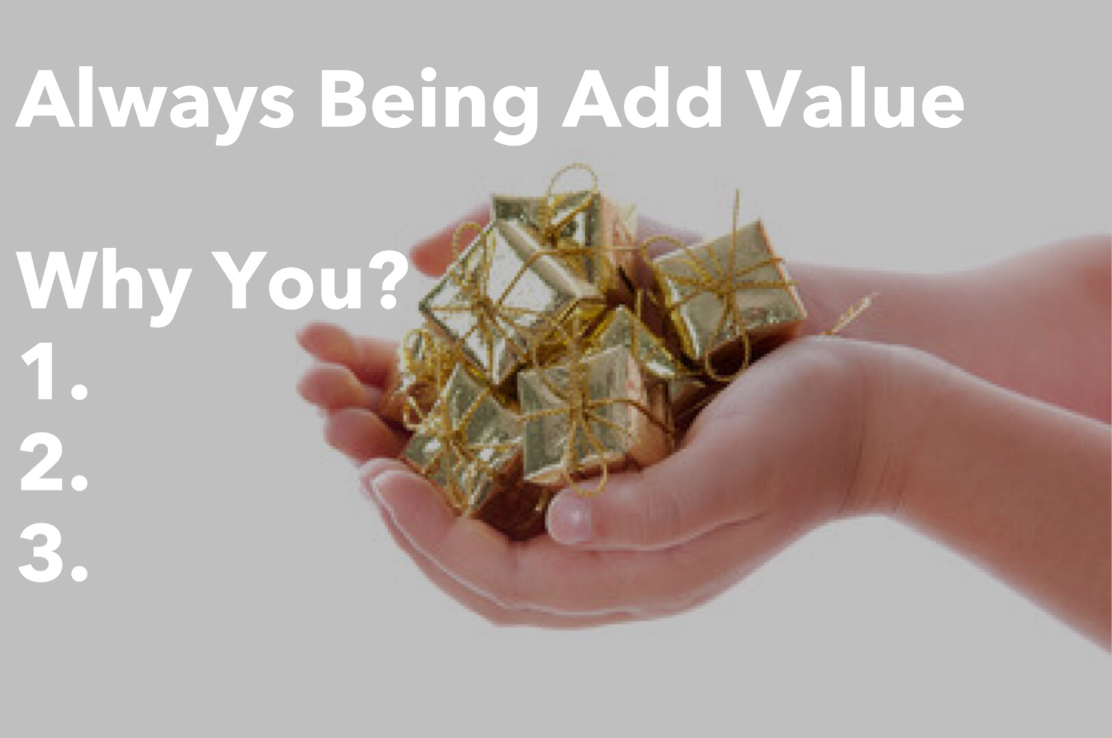
TF
#TomFerry
Notes:
1. 60 units from SOI = 322,031 GCI Team
Personal production 41 units SOI $176,573 GCI SOI
2. 17 units closed YTD SOI Team = $91,759
Personal production 17 units closed YTD SOI = $85,561
94 units just under 21 million 481,883 GCI in 2017

Slide 25

TF
#TomFerry
Notes:
1. 60 units from SOI = 322,031 GCI Team
Personal production 41 units SOI $176,573 GCI SOI
2. 17 units closed YTD SOI Team = $91,759
Personal production 17 units closed YTD SOI = $85,561
94 units just under 21 million 481,883 GCI in 2017

Slide 26
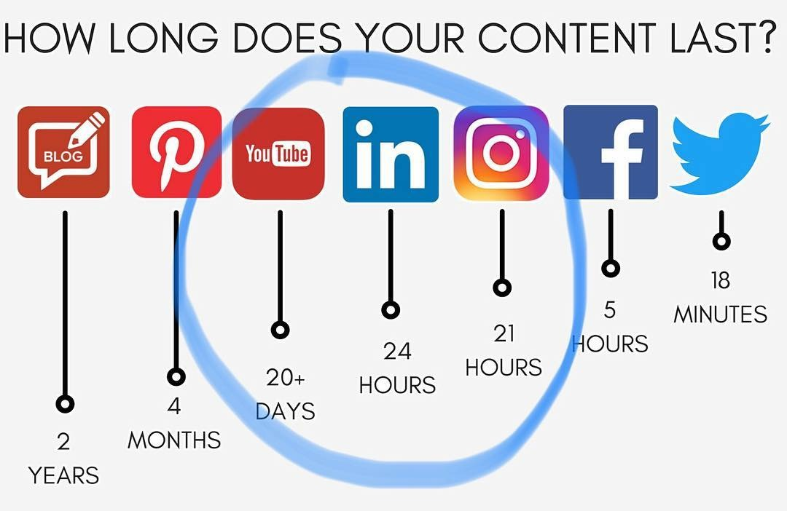
TF
#TomFerry
Notes:
1. 60 units from SOI = 322,031 GCI Team
Personal production 41 units SOI $176,573 GCI SOI
2. 17 units closed YTD SOI Team = $91,759
Personal production 17 units closed YTD SOI = $85,561
94 units just under 21 million 481,883 GCI in 2017

Slide 27

















TF
#TomFerry
Notes:
1. 60 units from SOI = 322,031 GCI Team
Personal production 41 units SOI $176,573 GCI SOI
2. 17 units closed YTD SOI Team = $91,759
Personal production 17 units closed YTD SOI = $85,561
94 units just under 21 million 481,883 GCI in 2017

Slide 28

TF
#TomFerry
Notes:
1. 60 units from SOI = 322,031 GCI Team
Personal production 41 units SOI $176,573 GCI SOI
2. 17 units closed YTD SOI Team = $91,759
Personal production 17 units closed YTD SOI = $85,561
94 units just under 21 million 481,883 GCI in 2017

Slide 29

TF
#TomFerry
Notes:
1. 60 units from SOI = 322,031 GCI Team
Personal production 41 units SOI $176,573 GCI SOI
2. 17 units closed YTD SOI Team = $91,759
Personal production 17 units closed YTD SOI = $85,561
94 units just under 21 million 481,883 GCI in 2017

Slide 30
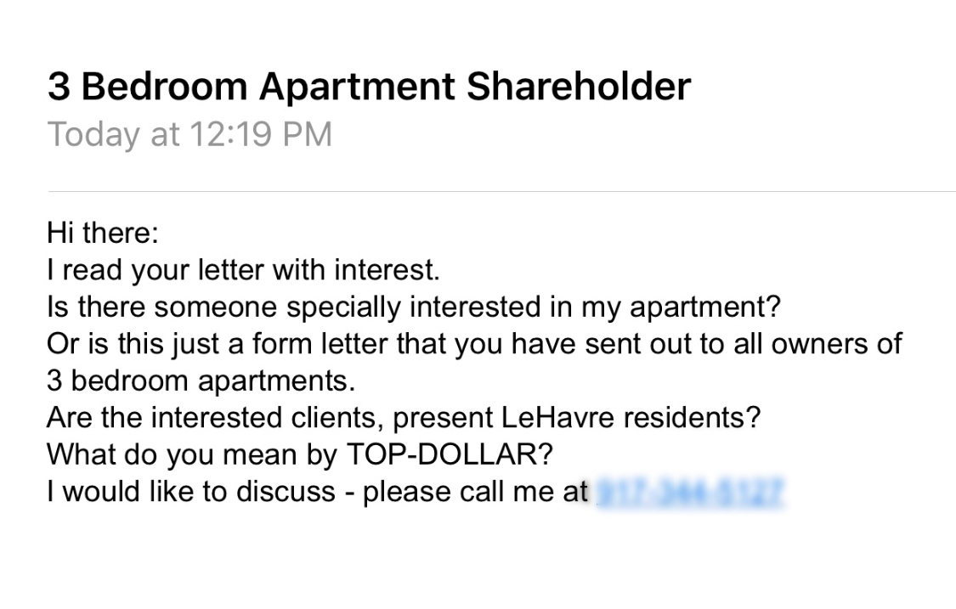
TF
#TomFerry
Notes:
1. 60 units from SOI = 322,031 GCI Team
Personal production 41 units SOI $176,573 GCI SOI
2. 17 units closed YTD SOI Team = $91,759
Personal production 17 units closed YTD SOI = $85,561
94 units just under 21 million 481,883 GCI in 2017

Slide 31

TF
#TomFerry
Notes:
1. 60 units from SOI = 322,031 GCI Team
Personal production 41 units SOI $176,573 GCI SOI
2. 17 units closed YTD SOI Team = $91,759
Personal production 17 units closed YTD SOI = $85,561
94 units just under 21 million 481,883 GCI in 2017

Slide 32
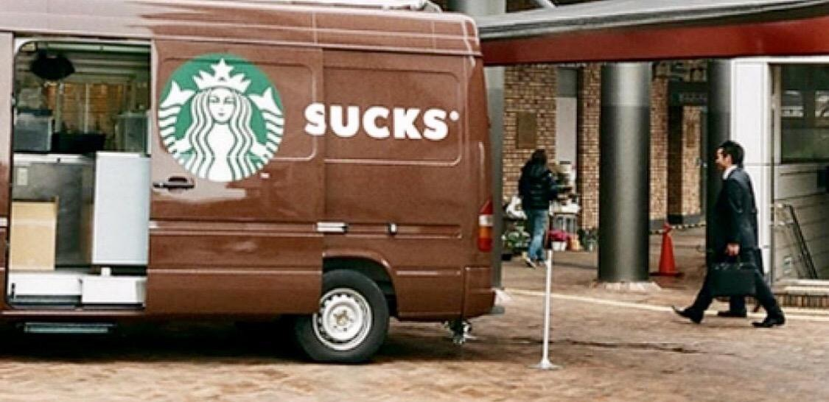
TF
#TomFerry
Notes:
1. 60 units from SOI = 322,031 GCI Team
Personal production 41 units SOI $176,573 GCI SOI
2. 17 units closed YTD SOI Team = $91,759
Personal production 17 units closed YTD SOI = $85,561
94 units just under 21 million 481,883 GCI in 2017

Slide 33

TF
#TomFerry
Notes:
1. 60 units from SOI = 322,031 GCI Team
Personal production 41 units SOI $176,573 GCI SOI
2. 17 units closed YTD SOI Team = $91,759
Personal production 17 units closed YTD SOI = $85,561
94 units just under 21 million 481,883 GCI in 2017

Slide 34

TF
#TomFerry
Notes:
1. 60 units from SOI = 322,031 GCI Team
Personal production 41 units SOI $176,573 GCI SOI
2. 17 units closed YTD SOI Team = $91,759
Personal production 17 units closed YTD SOI = $85,561
94 units just under 21 million 481,883 GCI in 2017

Slide 35

TF
#TomFerry
Notes:
1. 60 units from SOI = 322,031 GCI Team
Personal production 41 units SOI $176,573 GCI SOI
2. 17 units closed YTD SOI Team = $91,759
Personal production 17 units closed YTD SOI = $85,561
94 units just under 21 million 481,883 GCI in 2017

Slide 36

TF
#TomFerry
Notes:
1. 60 units from SOI = 322,031 GCI Team
Personal production 41 units SOI $176,573 GCI SOI
2. 17 units closed YTD SOI Team = $91,759
Personal production 17 units closed YTD SOI = $85,561
94 units just under 21 million 481,883 GCI in 2017

Slide 37

TF
#TomFerry
Notes:
1. 60 units from SOI = 322,031 GCI Team
Personal production 41 units SOI $176,573 GCI SOI
2. 17 units closed YTD SOI Team = $91,759
Personal production 17 units closed YTD SOI = $85,561
94 units just under 21 million 481,883 GCI in 2017

Slide 38

TF
#TomFerry
Notes:
1. 60 units from SOI = 322,031 GCI Team
Personal production 41 units SOI $176,573 GCI SOI
2. 17 units closed YTD SOI Team = $91,759
Personal production 17 units closed YTD SOI = $85,561
94 units just under 21 million 481,883 GCI in 2017

Slide 39

TF
#TomFerry
Notes:
1. 60 units from SOI = 322,031 GCI Team
Personal production 41 units SOI $176,573 GCI SOI
2. 17 units closed YTD SOI Team = $91,759
Personal production 17 units closed YTD SOI = $85,561
94 units just under 21 million 481,883 GCI in 2017

Slide 40

TF
#TomFerry
Notes:
1. 60 units from SOI = 322,031 GCI Team
Personal production 41 units SOI $176,573 GCI SOI
2. 17 units closed YTD SOI Team = $91,759
Personal production 17 units closed YTD SOI = $85,561
94 units just under 21 million 481,883 GCI in 2017

Slide 41

TF
#TomFerry
Notes:
1. 60 units from SOI = 322,031 GCI Team
Personal production 41 units SOI $176,573 GCI SOI
2. 17 units closed YTD SOI Team = $91,759
Personal production 17 units closed YTD SOI = $85,561
94 units just under 21 million 481,883 GCI in 2017

Slide 42

TF
#TomFerry
Notes:
1. 60 units from SOI = 322,031 GCI Team
Personal production 41 units SOI $176,573 GCI SOI
2. 17 units closed YTD SOI Team = $91,759
Personal production 17 units closed YTD SOI = $85,561
94 units just under 21 million 481,883 GCI in 2017

Slide 43

TF
#TomFerry
Notes:
1. 60 units from SOI = 322,031 GCI Team
Personal production 41 units SOI $176,573 GCI SOI
2. 17 units closed YTD SOI Team = $91,759
Personal production 17 units closed YTD SOI = $85,561
94 units just under 21 million 481,883 GCI in 2017

Slide 44

TF
#TomFerry
Notes:
1. 60 units from SOI = 322,031 GCI Team
Personal production 41 units SOI $176,573 GCI SOI
2. 17 units closed YTD SOI Team = $91,759
Personal production 17 units closed YTD SOI = $85,561
94 units just under 21 million 481,883 GCI in 2017

Slide 45

TF
#TomFerry
Notes:
1. 60 units from SOI = 322,031 GCI Team
Personal production 41 units SOI $176,573 GCI SOI
2. 17 units closed YTD SOI Team = $91,759
Personal production 17 units closed YTD SOI = $85,561
94 units just under 21 million 481,883 GCI in 2017

Slide 46
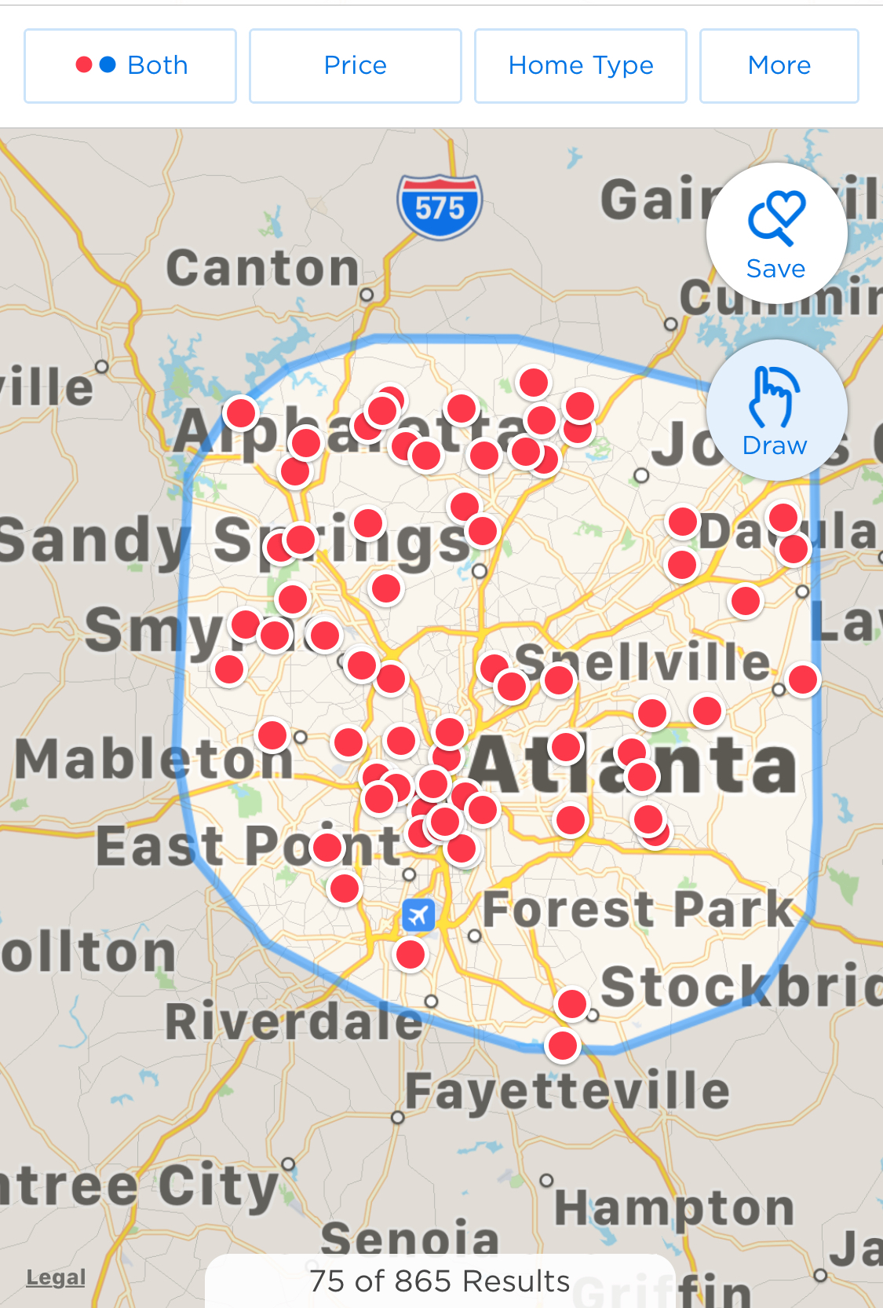
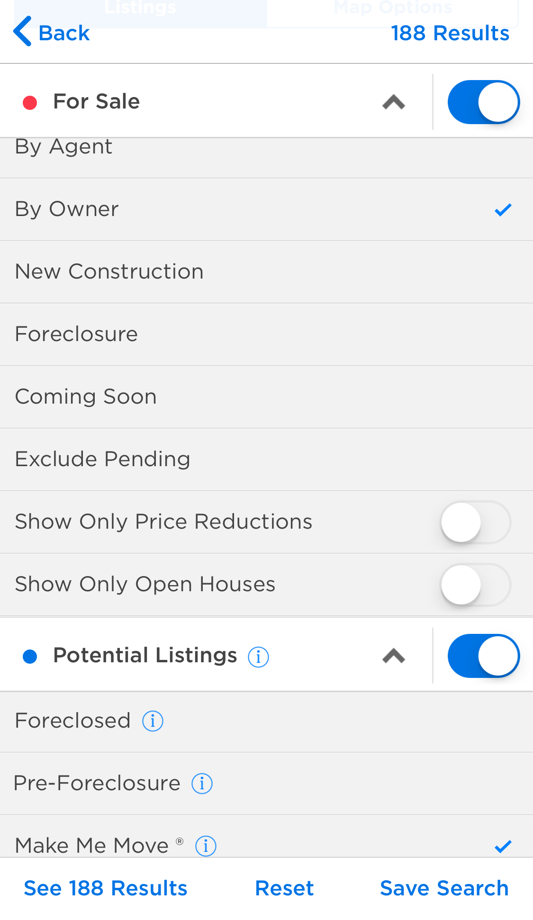
TF
#TomFerry
Notes:
1. 60 units from SOI = 322,031 GCI Team
Personal production 41 units SOI $176,573 GCI SOI
2. 17 units closed YTD SOI Team = $91,759
Personal production 17 units closed YTD SOI = $85,561
94 units just under 21 million 481,883 GCI in 2017

Slide 47
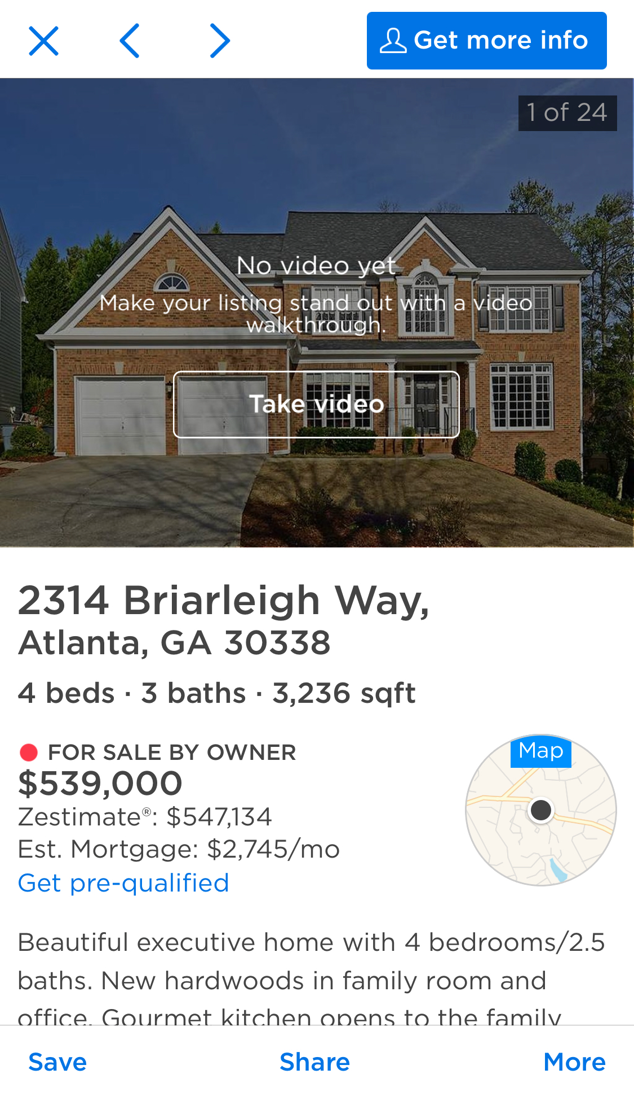

TF
#TomFerry
Notes:
1. 60 units from SOI = 322,031 GCI Team
Personal production 41 units SOI $176,573 GCI SOI
2. 17 units closed YTD SOI Team = $91,759
Personal production 17 units closed YTD SOI = $85,561
94 units just under 21 million 481,883 GCI in 2017

Slide 48
TF
#TomFerry
Notes:
1. 60 units from SOI = 322,031 GCI Team
Personal production 41 units SOI $176,573 GCI SOI
2. 17 units closed YTD SOI Team = $91,759
Personal production 17 units closed YTD SOI = $85,561
94 units just under 21 million 481,883 GCI in 2017

Slide 49

Center of Influence
TF
#TomFerry
Notes:
1. 60 units from SOI = 322,031 GCI Team
Personal production 41 units SOI $176,573 GCI SOI
2. 17 units closed YTD SOI Team = $91,759
Personal production 17 units closed YTD SOI = $85,561
94 units just under 21 million 481,883 GCI in 2017

Slide 50

TF
#TomFerry
Notes:
1. 60 units from SOI = 322,031 GCI Team
Personal production 41 units SOI $176,573 GCI SOI
2. 17 units closed YTD SOI Team = $91,759
Personal production 17 units closed YTD SOI = $85,561
94 units just under 21 million 481,883 GCI in 2017

Slide 51

TF
#TomFerry
Notes:
1. 60 units from SOI = 322,031 GCI Team
Personal production 41 units SOI $176,573 GCI SOI
2. 17 units closed YTD SOI Team = $91,759
Personal production 17 units closed YTD SOI = $85,561
94 units just under 21 million 481,883 GCI in 2017

Slide 52

TF
#TomFerry
Notes:
1. 60 units from SOI = 322,031 GCI Team
Personal production 41 units SOI $176,573 GCI SOI
2. 17 units closed YTD SOI Team = $91,759
Personal production 17 units closed YTD SOI = $85,561
94 units just under 21 million 481,883 GCI in 2017

Slide 53






TF
#TomFerry
Notes:
1. 60 units from SOI = 322,031 GCI Team
Personal production 41 units SOI $176,573 GCI SOI
2. 17 units closed YTD SOI Team = $91,759
Personal production 17 units closed YTD SOI = $85,561
94 units just under 21 million 481,883 GCI in 2017

Slide 54

TF
#TomFerry
Notes:
1. 60 units from SOI = 322,031 GCI Team
Personal production 41 units SOI $176,573 GCI SOI
2. 17 units closed YTD SOI Team = $91,759
Personal production 17 units closed YTD SOI = $85,561
94 units just under 21 million 481,883 GCI in 2017

Slide 55

TF
#TomFerry
Notes:
1. 60 units from SOI = 322,031 GCI Team
Personal production 41 units SOI $176,573 GCI SOI
2. 17 units closed YTD SOI Team = $91,759
Personal production 17 units closed YTD SOI = $85,561
94 units just under 21 million 481,883 GCI in 2017

Slide 56

TF
#TomFerry
Notes:
1. 60 units from SOI = 322,031 GCI Team
Personal production 41 units SOI $176,573 GCI SOI
2. 17 units closed YTD SOI Team = $91,759
Personal production 17 units closed YTD SOI = $85,561
94 units just under 21 million 481,883 GCI in 2017

Slide 57
TF
#TomFerry
Notes:
1. 60 units from SOI = 322,031 GCI Team
Personal production 41 units SOI $176,573 GCI SOI
2. 17 units closed YTD SOI Team = $91,759
Personal production 17 units closed YTD SOI = $85,561
94 units just under 21 million 481,883 GCI in 2017

Slide 58
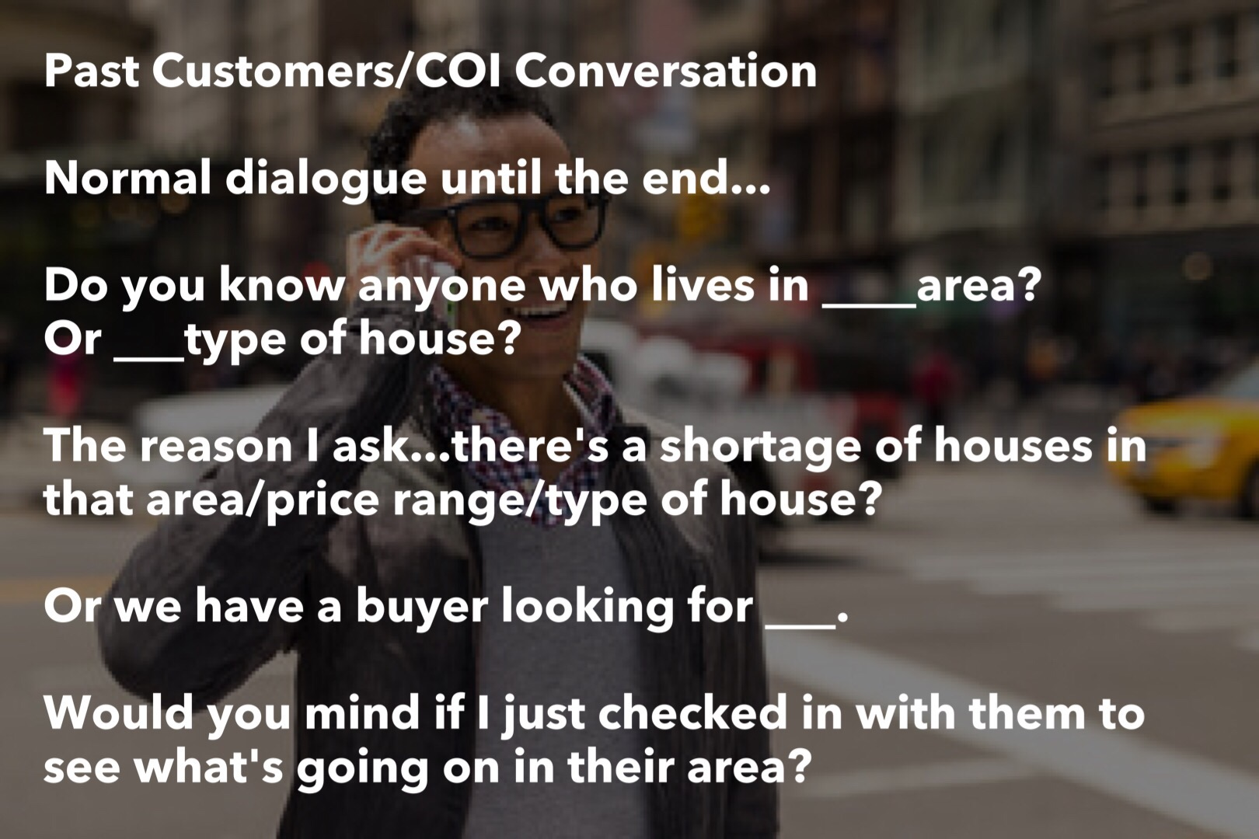
TF
#TomFerry
Notes:
1. 60 units from SOI = 322,031 GCI Team
Personal production 41 units SOI $176,573 GCI SOI
2. 17 units closed YTD SOI Team = $91,759
Personal production 17 units closed YTD SOI = $85,561
94 units just under 21 million 481,883 GCI in 2017

Slide 59
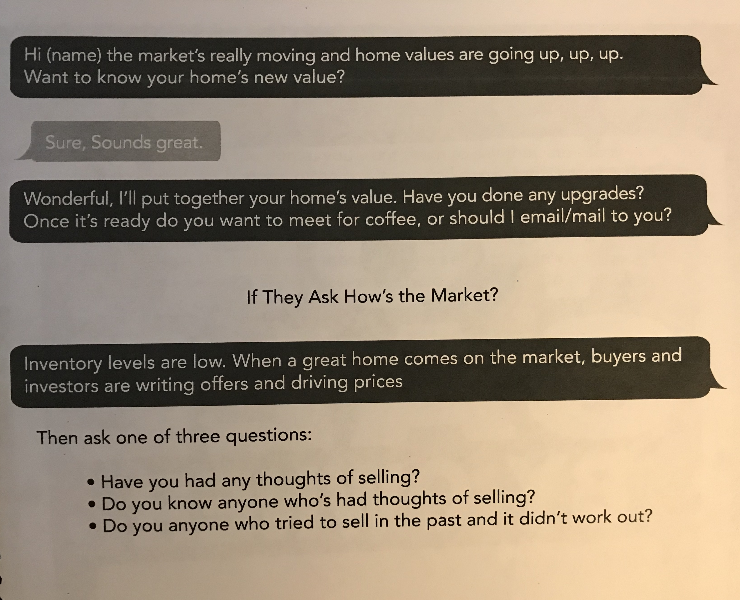
TF
#TomFerry
Notes:
1. 60 units from SOI = 322,031 GCI Team
Personal production 41 units SOI $176,573 GCI SOI
2. 17 units closed YTD SOI Team = $91,759
Personal production 17 units closed YTD SOI = $85,561
94 units just under 21 million 481,883 GCI in 2017

Slide 60

TF
#TomFerry
Notes:
1. 60 units from SOI = 322,031 GCI Team
Personal production 41 units SOI $176,573 GCI SOI
2. 17 units closed YTD SOI Team = $91,759
Personal production 17 units closed YTD SOI = $85,561
94 units just under 21 million 481,883 GCI in 2017

Slide 61

TF
#TomFerry
Notes:
1. 60 units from SOI = 322,031 GCI Team
Personal production 41 units SOI $176,573 GCI SOI
2. 17 units closed YTD SOI Team = $91,759
Personal production 17 units closed YTD SOI = $85,561
94 units just under 21 million 481,883 GCI in 2017

Slide 62

TF
#TomFerry
Notes:
1. 60 units from SOI = 322,031 GCI Team
Personal production 41 units SOI $176,573 GCI SOI
2. 17 units closed YTD SOI Team = $91,759
Personal production 17 units closed YTD SOI = $85,561
94 units just under 21 million 481,883 GCI in 2017

Slide 63

TF
#TomFerry
Notes:
1. 60 units from SOI = 322,031 GCI Team
Personal production 41 units SOI $176,573 GCI SOI
2. 17 units closed YTD SOI Team = $91,759
Personal production 17 units closed YTD SOI = $85,561
94 units just under 21 million 481,883 GCI in 2017

Slide 64
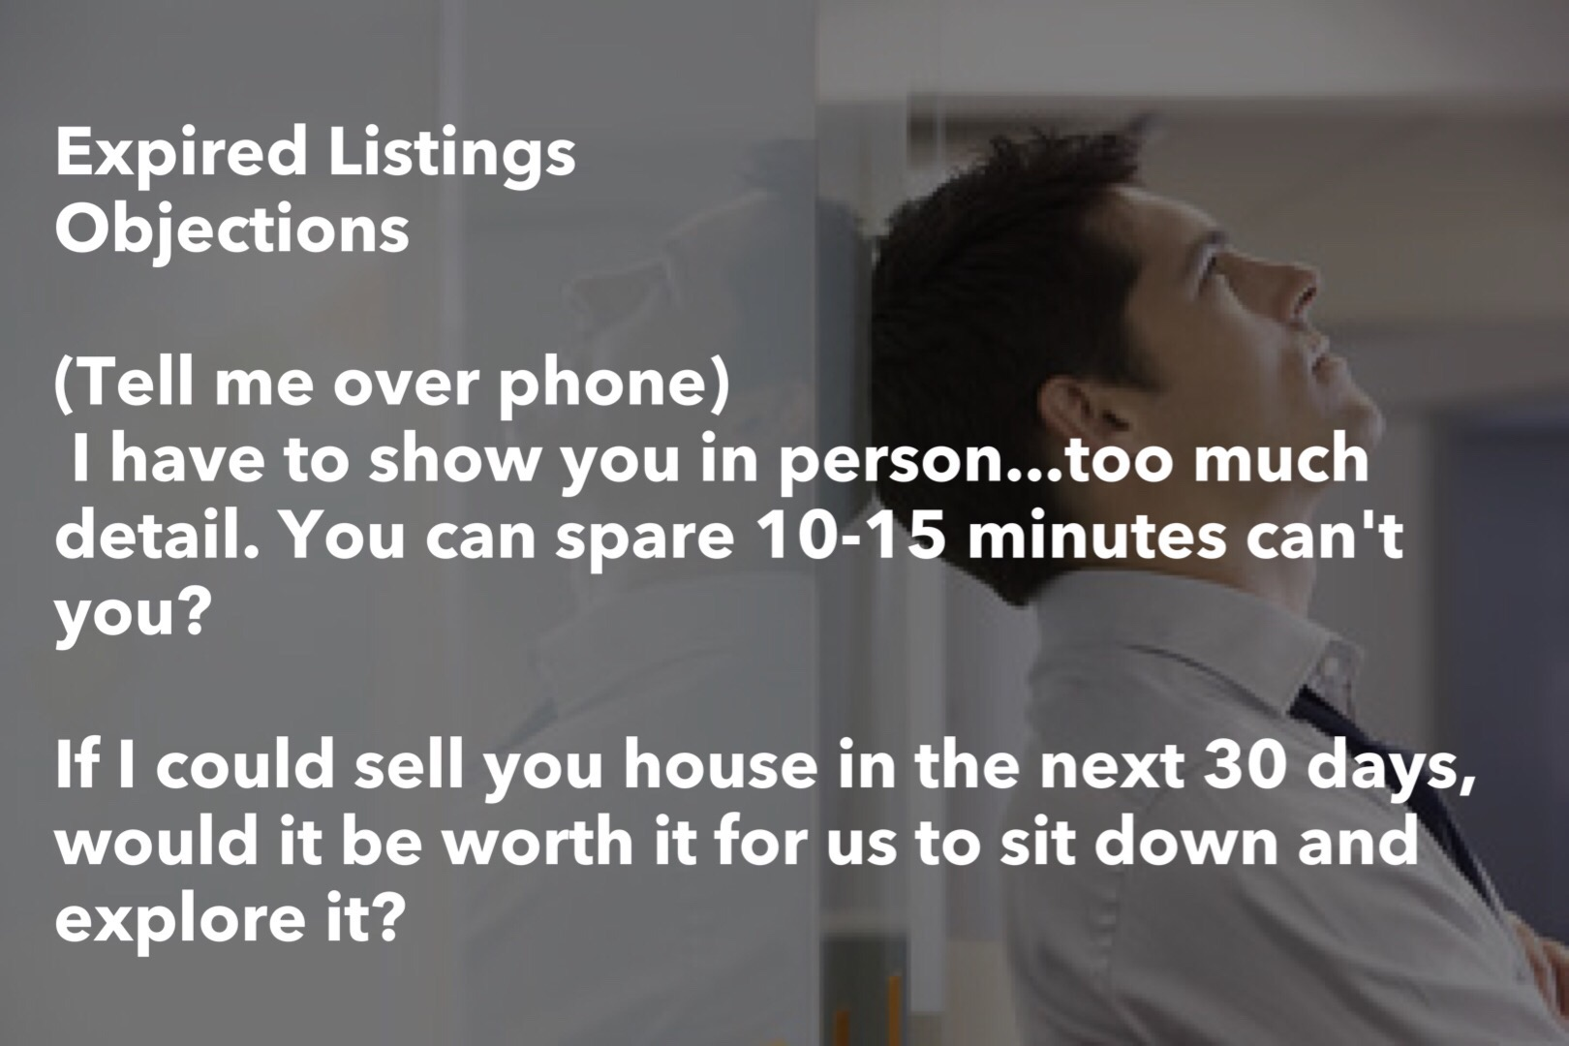
TF
#TomFerry
Notes:
1. 60 units from SOI = 322,031 GCI Team
Personal production 41 units SOI $176,573 GCI SOI
2. 17 units closed YTD SOI Team = $91,759
Personal production 17 units closed YTD SOI = $85,561
94 units just under 21 million 481,883 GCI in 2017

Slide 65

TF
#TomFerry
Notes:
1. 60 units from SOI = 322,031 GCI Team
Personal production 41 units SOI $176,573 GCI SOI
2. 17 units closed YTD SOI Team = $91,759
Personal production 17 units closed YTD SOI = $85,561
94 units just under 21 million 481,883 GCI in 2017

Slide 66

TF
#TomFerry
Notes:
1. 60 units from SOI = 322,031 GCI Team
Personal production 41 units SOI $176,573 GCI SOI
2. 17 units closed YTD SOI Team = $91,759
Personal production 17 units closed YTD SOI = $85,561
94 units just under 21 million 481,883 GCI in 2017

Slide 67
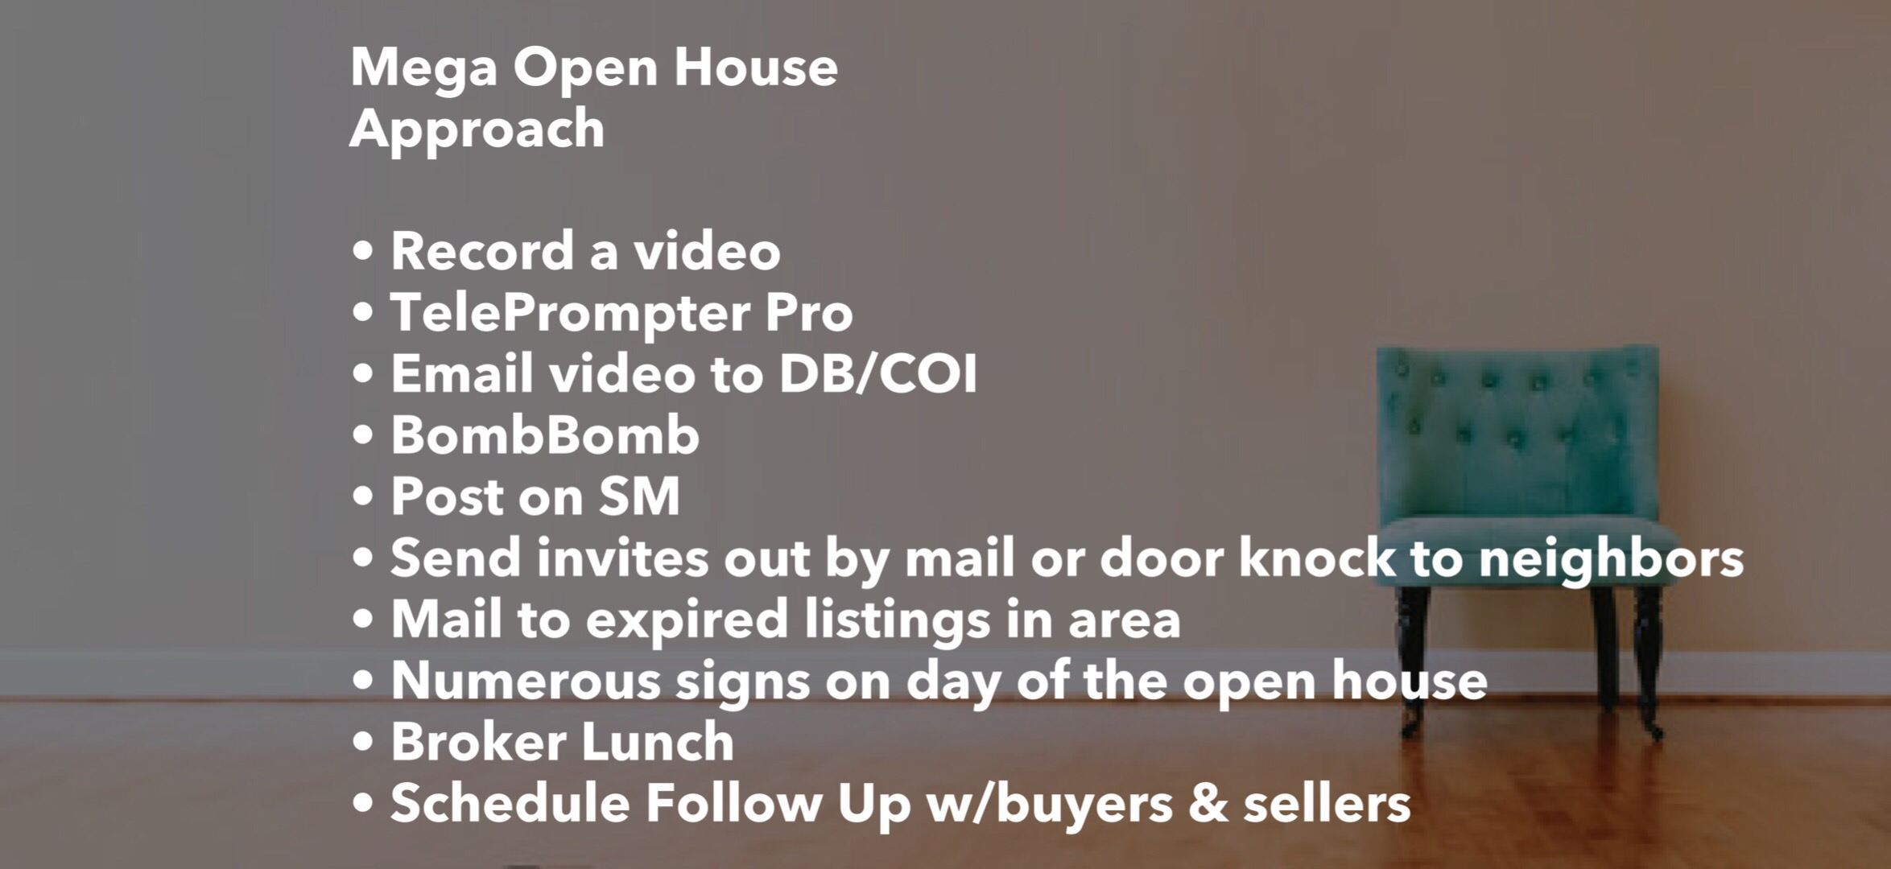
TF
#TomFerry
Notes:
1. 60 units from SOI = 322,031 GCI Team
Personal production 41 units SOI $176,573 GCI SOI
2. 17 units closed YTD SOI Team = $91,759
Personal production 17 units closed YTD SOI = $85,561
94 units just under 21 million 481,883 GCI in 2017

Slide 68

TF
#TomFerry
Notes:
1. 60 units from SOI = 322,031 GCI Team
Personal production 41 units SOI $176,573 GCI SOI
2. 17 units closed YTD SOI Team = $91,759
Personal production 17 units closed YTD SOI = $85,561
94 units just under 21 million 481,883 GCI in 2017

Slide 69

TF
#TomFerry
Notes:
1. 60 units from SOI = 322,031 GCI Team
Personal production 41 units SOI $176,573 GCI SOI
2. 17 units closed YTD SOI Team = $91,759
Personal production 17 units closed YTD SOI = $85,561
94 units just under 21 million 481,883 GCI in 2017

Slide 70

TF
#TomFerry
Notes:
1. 60 units from SOI = 322,031 GCI Team
Personal production 41 units SOI $176,573 GCI SOI
2. 17 units closed YTD SOI Team = $91,759
Personal production 17 units closed YTD SOI = $85,561
94 units just under 21 million 481,883 GCI in 2017

Slide 71

TF
#TomFerry
Notes:
1. 60 units from SOI = 322,031 GCI Team
Personal production 41 units SOI $176,573 GCI SOI
2. 17 units closed YTD SOI Team = $91,759
Personal production 17 units closed YTD SOI = $85,561
94 units just under 21 million 481,883 GCI in 2017

Slide 72

TF
#TomFerry
Notes:
1. 60 units from SOI = 322,031 GCI Team
Personal production 41 units SOI $176,573 GCI SOI
2. 17 units closed YTD SOI Team = $91,759
Personal production 17 units closed YTD SOI = $85,561
94 units just under 21 million 481,883 GCI in 2017

Slide 73
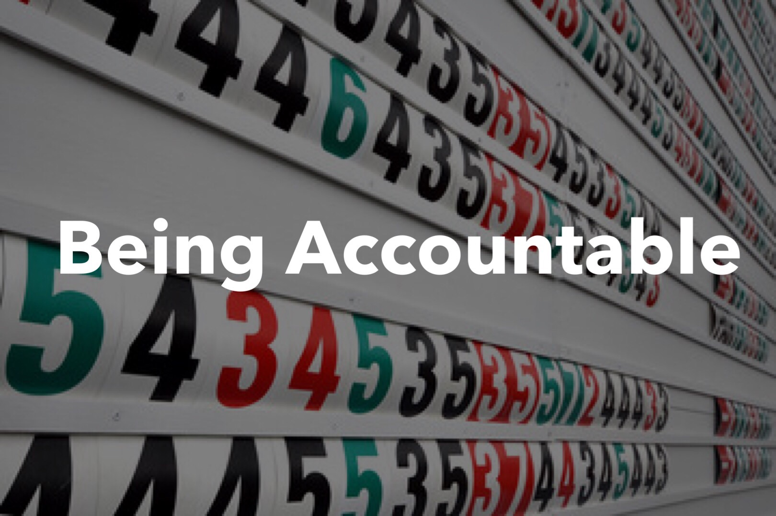
TF
#TomFerry
Notes:
1. 60 units from SOI = 322,031 GCI Team
Personal production 41 units SOI $176,573 GCI SOI
2. 17 units closed YTD SOI Team = $91,759
Personal production 17 units closed YTD SOI = $85,561
94 units just under 21 million 481,883 GCI in 2017

Slide 74

TF
#TomFerry
Notes:
1. 60 units from SOI = 322,031 GCI Team
Personal production 41 units SOI $176,573 GCI SOI
2. 17 units closed YTD SOI Team = $91,759
Personal production 17 units closed YTD SOI = $85,561
94 units just under 21 million 481,883 GCI in 2017

Slide 75

TF
#TomFerry
Notes:
1. 60 units from SOI = 322,031 GCI Team
Personal production 41 units SOI $176,573 GCI SOI
2. 17 units closed YTD SOI Team = $91,759
Personal production 17 units closed YTD SOI = $85,561
94 units just under 21 million 481,883 GCI in 2017

Slide 76


Jeff Mays
jmays@tomferry.com
TF
#TomFerry
Notes:
1. 60 units from SOI = 322,031 GCI Team
Personal production 41 units SOI $176,573 GCI SOI
2. 17 units closed YTD SOI Team = $91,759
Personal production 17 units closed YTD SOI = $85,561
94 units just under 21 million 481,883 GCI in 2017

Slide 77

TF
#TomFerry
Notes:
1. 60 units from SOI = 322,031 GCI Team
Personal production 41 units SOI $176,573 GCI SOI
2. 17 units closed YTD SOI Team = $91,759
Personal production 17 units closed YTD SOI = $85,561
94 units just under 21 million 481,883 GCI in 2017

