Slide 1
Facing Today’s Biggest Challenges Head On
TF
#TomFerry
Notes:
Scenario: goal of $450K, 60% of business, historically, is listings. Average listing commission is $7.5K. Requires 36 transactions.

Slide 2
The Real Estate Industry Loves Some Fear...
don’t we?
TF
#TomFerry
Notes:
Scenario: goal of $450K, 60% of business, historically, is listings. Average listing commission is $7.5K. Requires 36 transactions.

Slide 3
IBuyers
TF
#TomFerry
Notes:
Scenario: goal of $450K, 60% of business, historically, is listings. Average listing commission is $7.5K. Requires 36 transactions.

Slide 4
They aren’t DISRUPTORS...
They are DISTRACTORS...
TF
#TomFerry
Notes:
Scenario: goal of $450K, 60% of business, historically, is listings. Average listing commission is $7.5K. Requires 36 transactions.

Slide 5
This Is NOT a Sound Business Model
TF
#TomFerry
Notes:
Scenario: goal of $450K, 60% of business, historically, is listings. Average listing commission is $7.5K. Requires 36 transactions.

Slide 6
Commission Compression
TF
#TomFerry
Notes:
Scenario: goal of $450K, 60% of business, historically, is listings. Average listing commission is $7.5K. Requires 36 transactions.

Slide 7
Stand Out-Market Differently Than Everyone Else
What do YOU do that’s unique for clients?
How do they know that?
Is it packaged/marketed?
What’s your value add?
TF
#TomFerry
Notes:
Scenario: goal of $450K, 60% of business, historically, is listings. Average listing commission is $7.5K. Requires 36 transactions.

Slide 8
Someone Will Do It For Less-
“Really. List with anyone but THAT agent. If they can’t negotiate their own value already..what will they do with you equity, negotiating behind closed doors when it’s not their money? Is that who you want working to get you top dollar?
TF
#TomFerry
Notes:
Scenario: goal of $450K, 60% of business, historically, is listings. Average listing commission is $7.5K. Requires 36 transactions.

Slide 9
You’re mainly attracted to that agent/company because they’re offering a discount right? (YES)
Not because they’re the best or has an amazing marketing program..it’s the discount correct? (YES)
So..their business is solely built around attracting people with a discount..agreed? (YES)
Then that means they’ll be selling your property at a... what?
(A DISCOUNT)
Is that how you want your biggest asset positioned... at a discount? (NO)
TF
#TomFerry
Notes:
Scenario: goal of $450K, 60% of business, historically, is listings. Average listing commission is $7.5K. Requires 36 transactions.

Slide 10
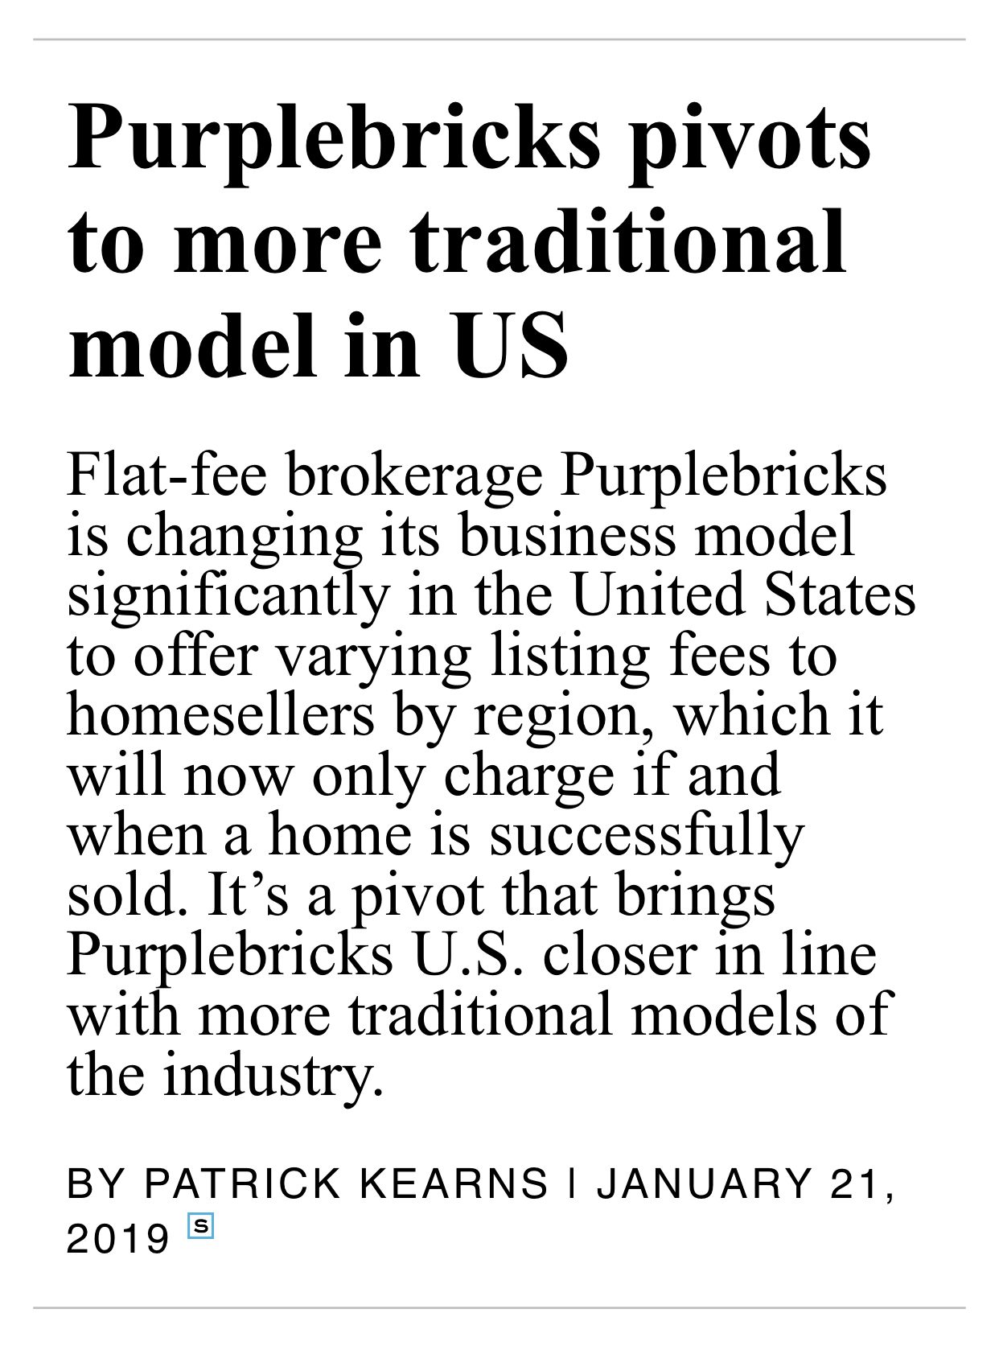
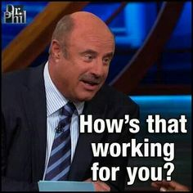
TF
#TomFerry
Notes:
Scenario: goal of $450K, 60% of business, historically, is listings. Average listing commission is $7.5K. Requires 36 transactions.

Slide 11
The Market is Slowing Down
TF
#TomFerry
Notes:
Scenario: goal of $450K, 60% of business, historically, is listings. Average listing commission is $7.5K. Requires 36 transactions.

Slide 12
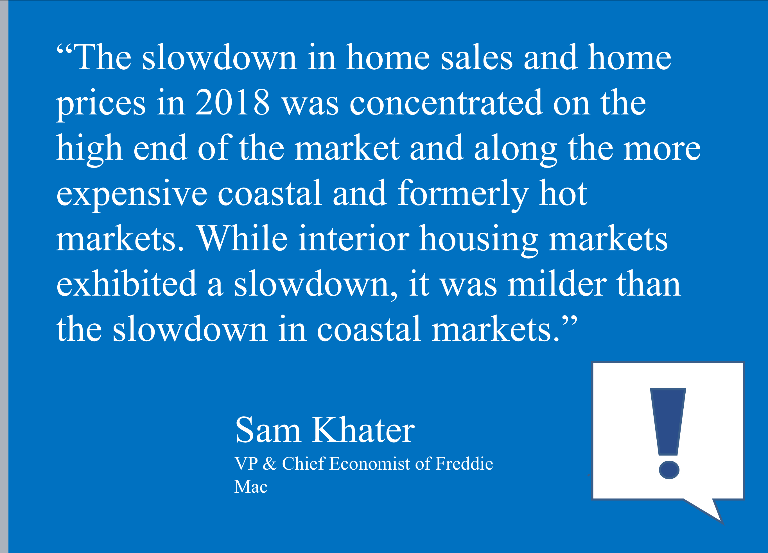
TF
#TomFerry
Notes:
Scenario: goal of $450K, 60% of business, historically, is listings. Average listing commission is $7.5K. Requires 36 transactions.

Slide 13
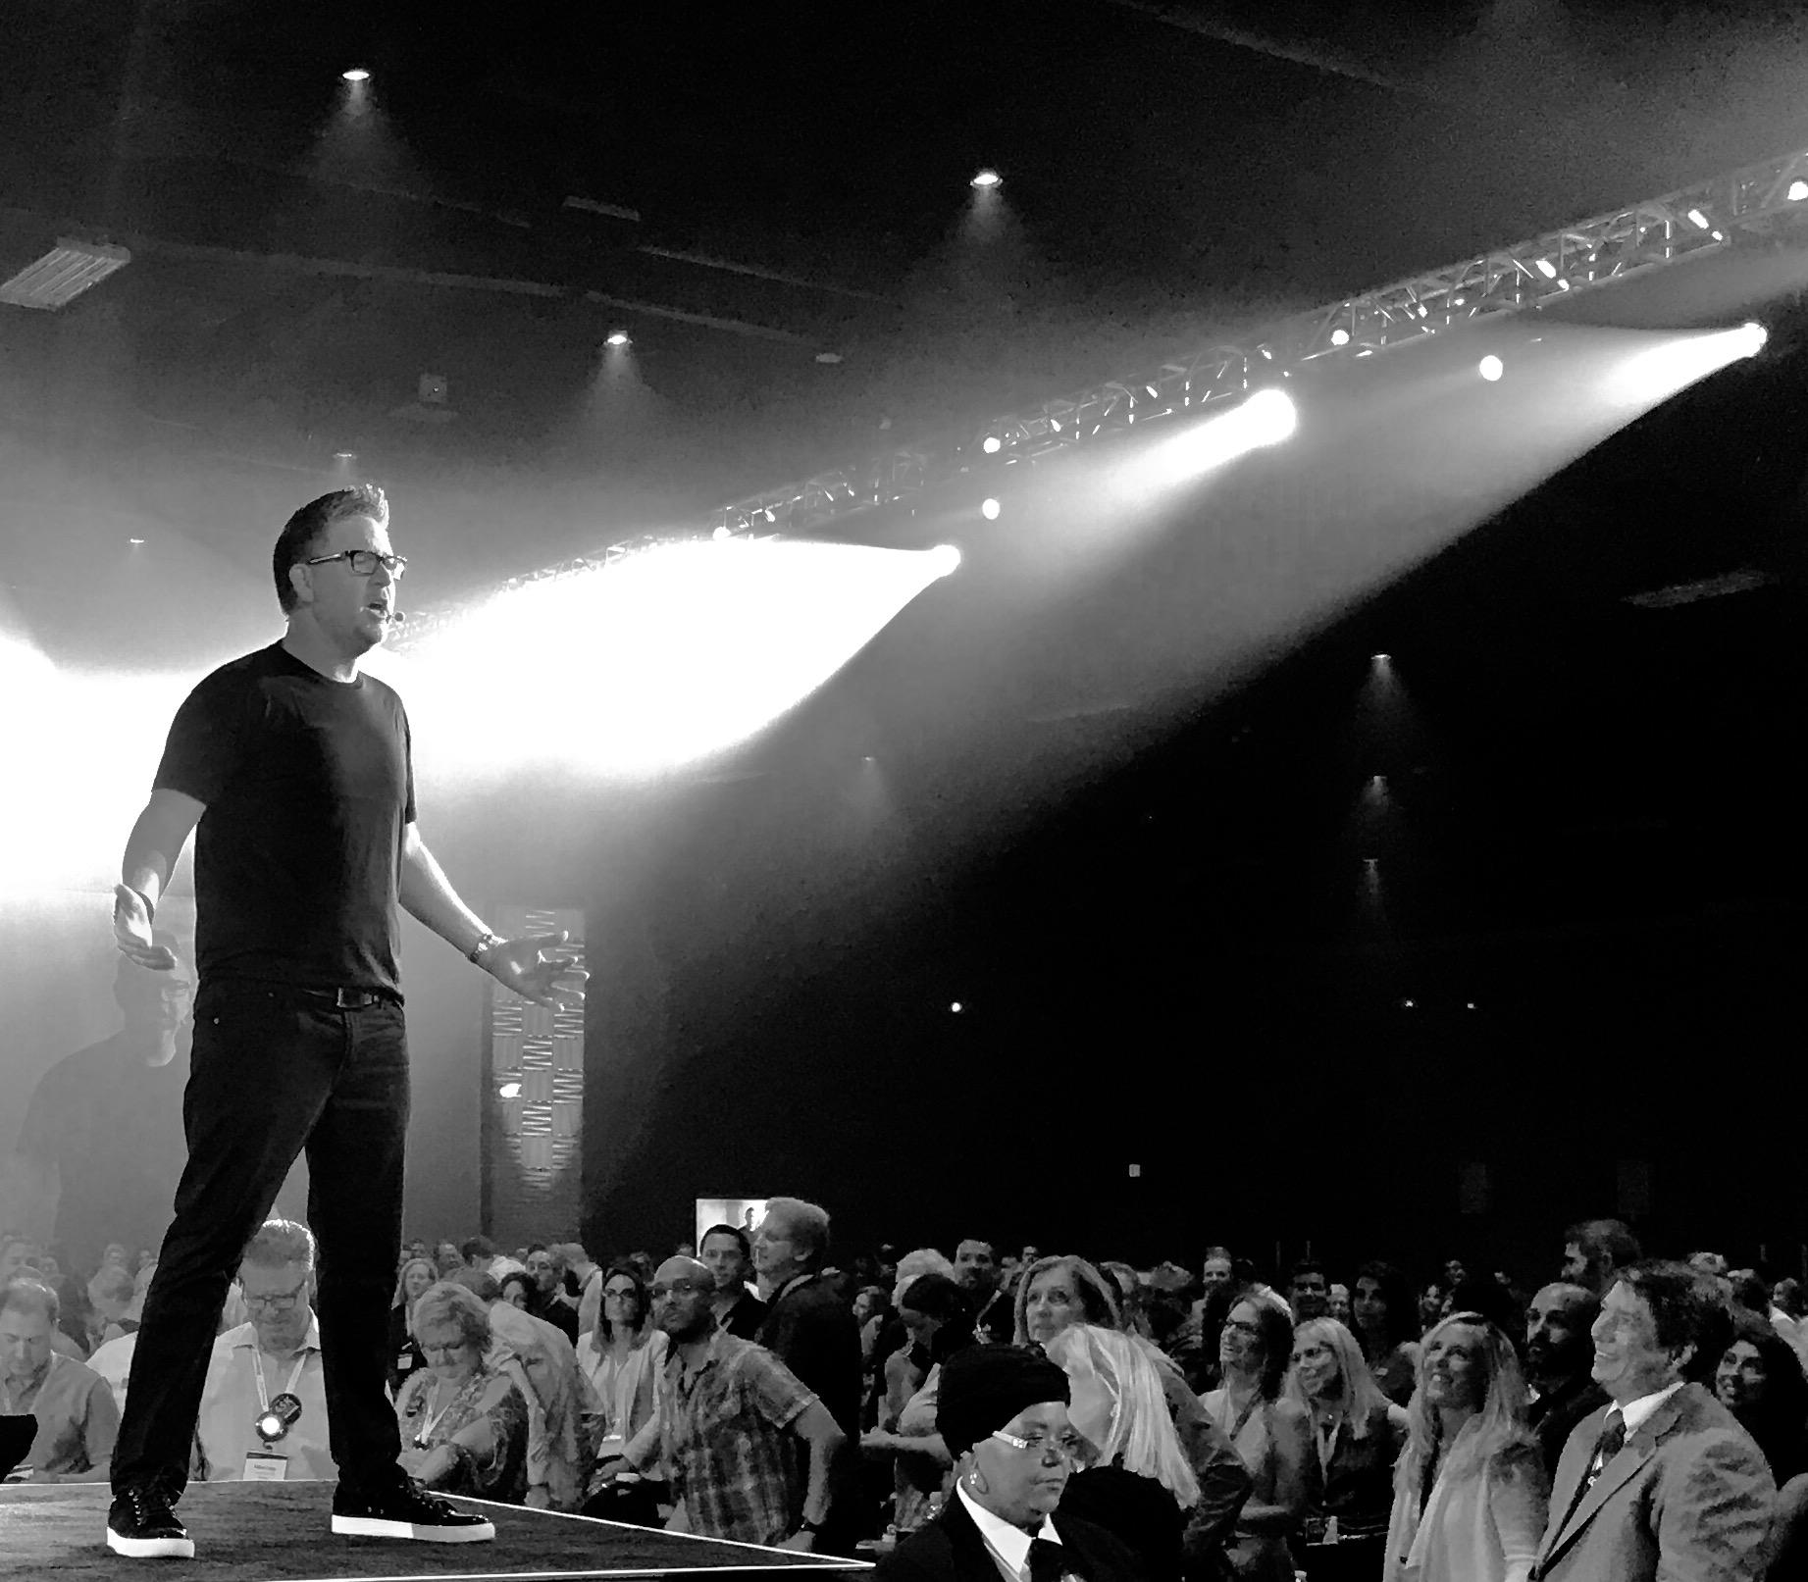
The ONLY people who should be worried about the market, are those who don’t have a strategy, a plan, are inconsistent with marketing, not analyzing their business intelligence, aren’t focused on conversion, don’t have systems in place, and lack accountability. They should be fearful”- Tom Ferry
TF
#TomFerry
Notes:
Scenario: goal of $450K, 60% of business, historically, is listings. Average listing commission is $7.5K. Requires 36 transactions.

Slide 14
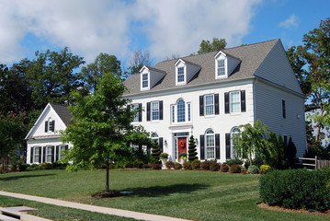
Values Are Going Down
Values Are
Going Down
TF
#TomFerry
Notes:
Scenario: goal of $450K, 60% of business, historically, is listings. Average listing commission is $7.5K. Requires 36 transactions.

Slide 15
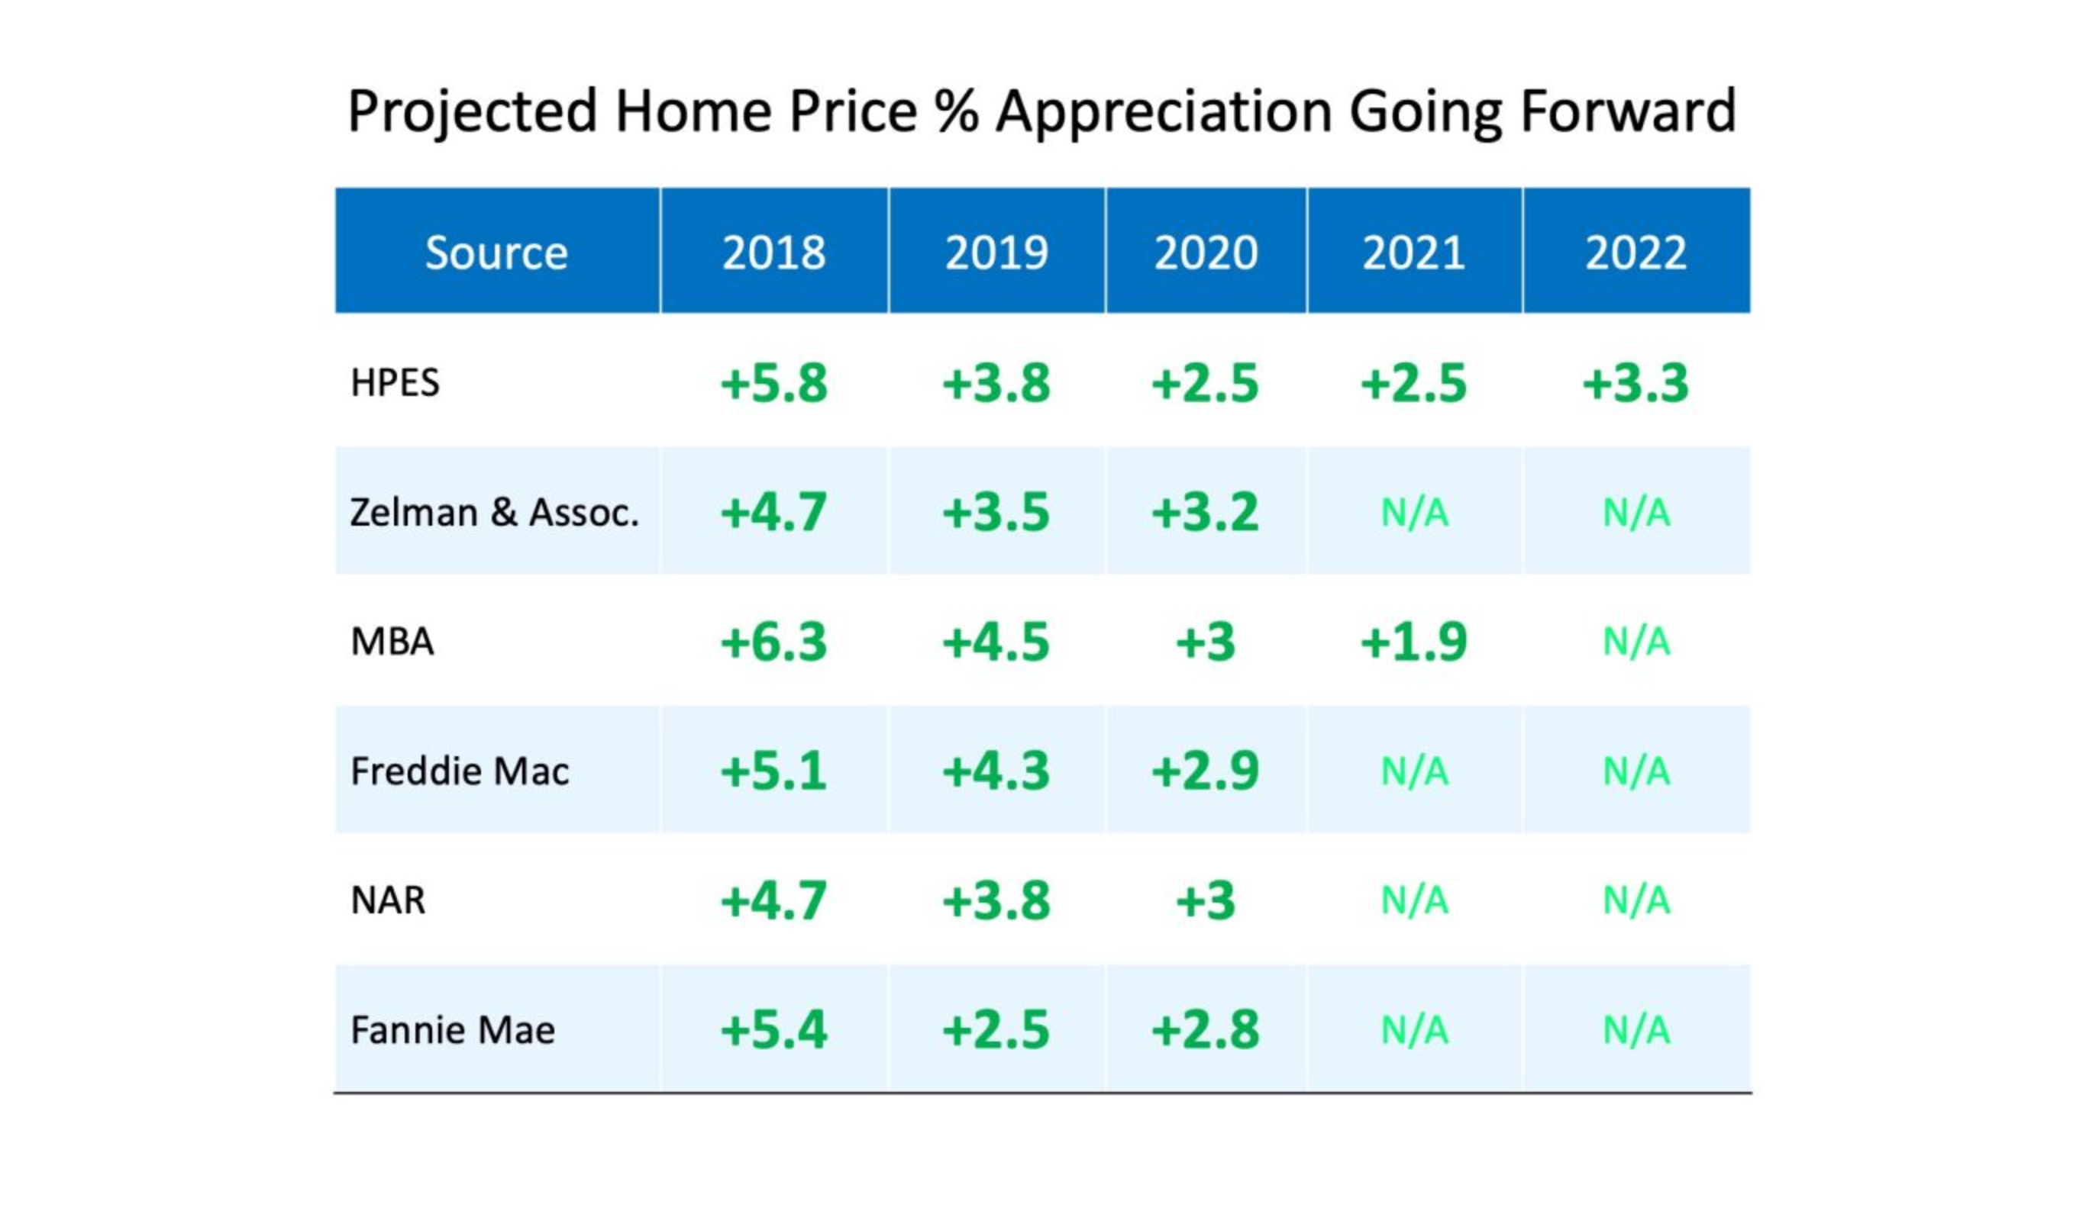
TF
#TomFerry
Notes:
Scenario: goal of $450K, 60% of business, historically, is listings. Average listing commission is $7.5K. Requires 36 transactions.

Slide 16
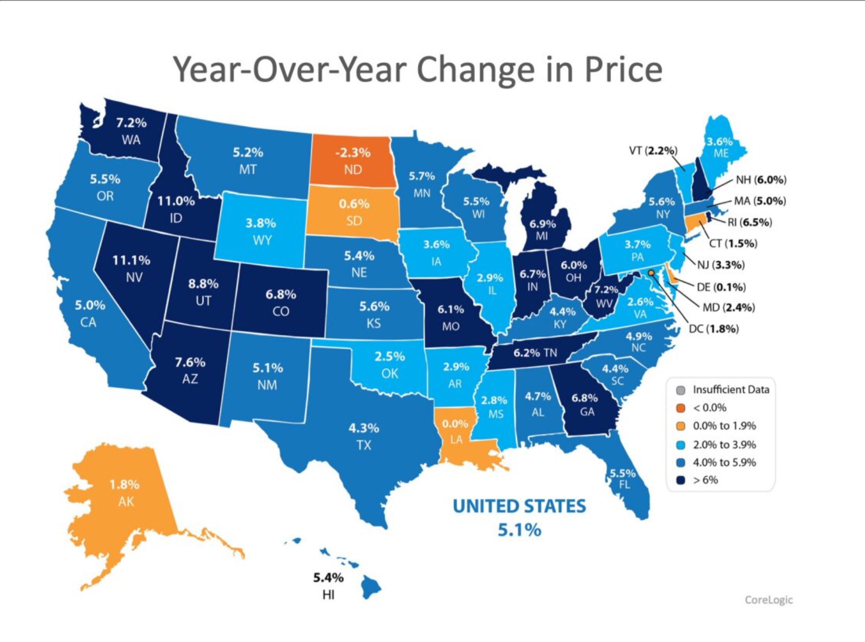
TF
#TomFerry
Notes:
Scenario: goal of $450K, 60% of business, historically, is listings. Average listing commission is $7.5K. Requires 36 transactions.

Slide 17
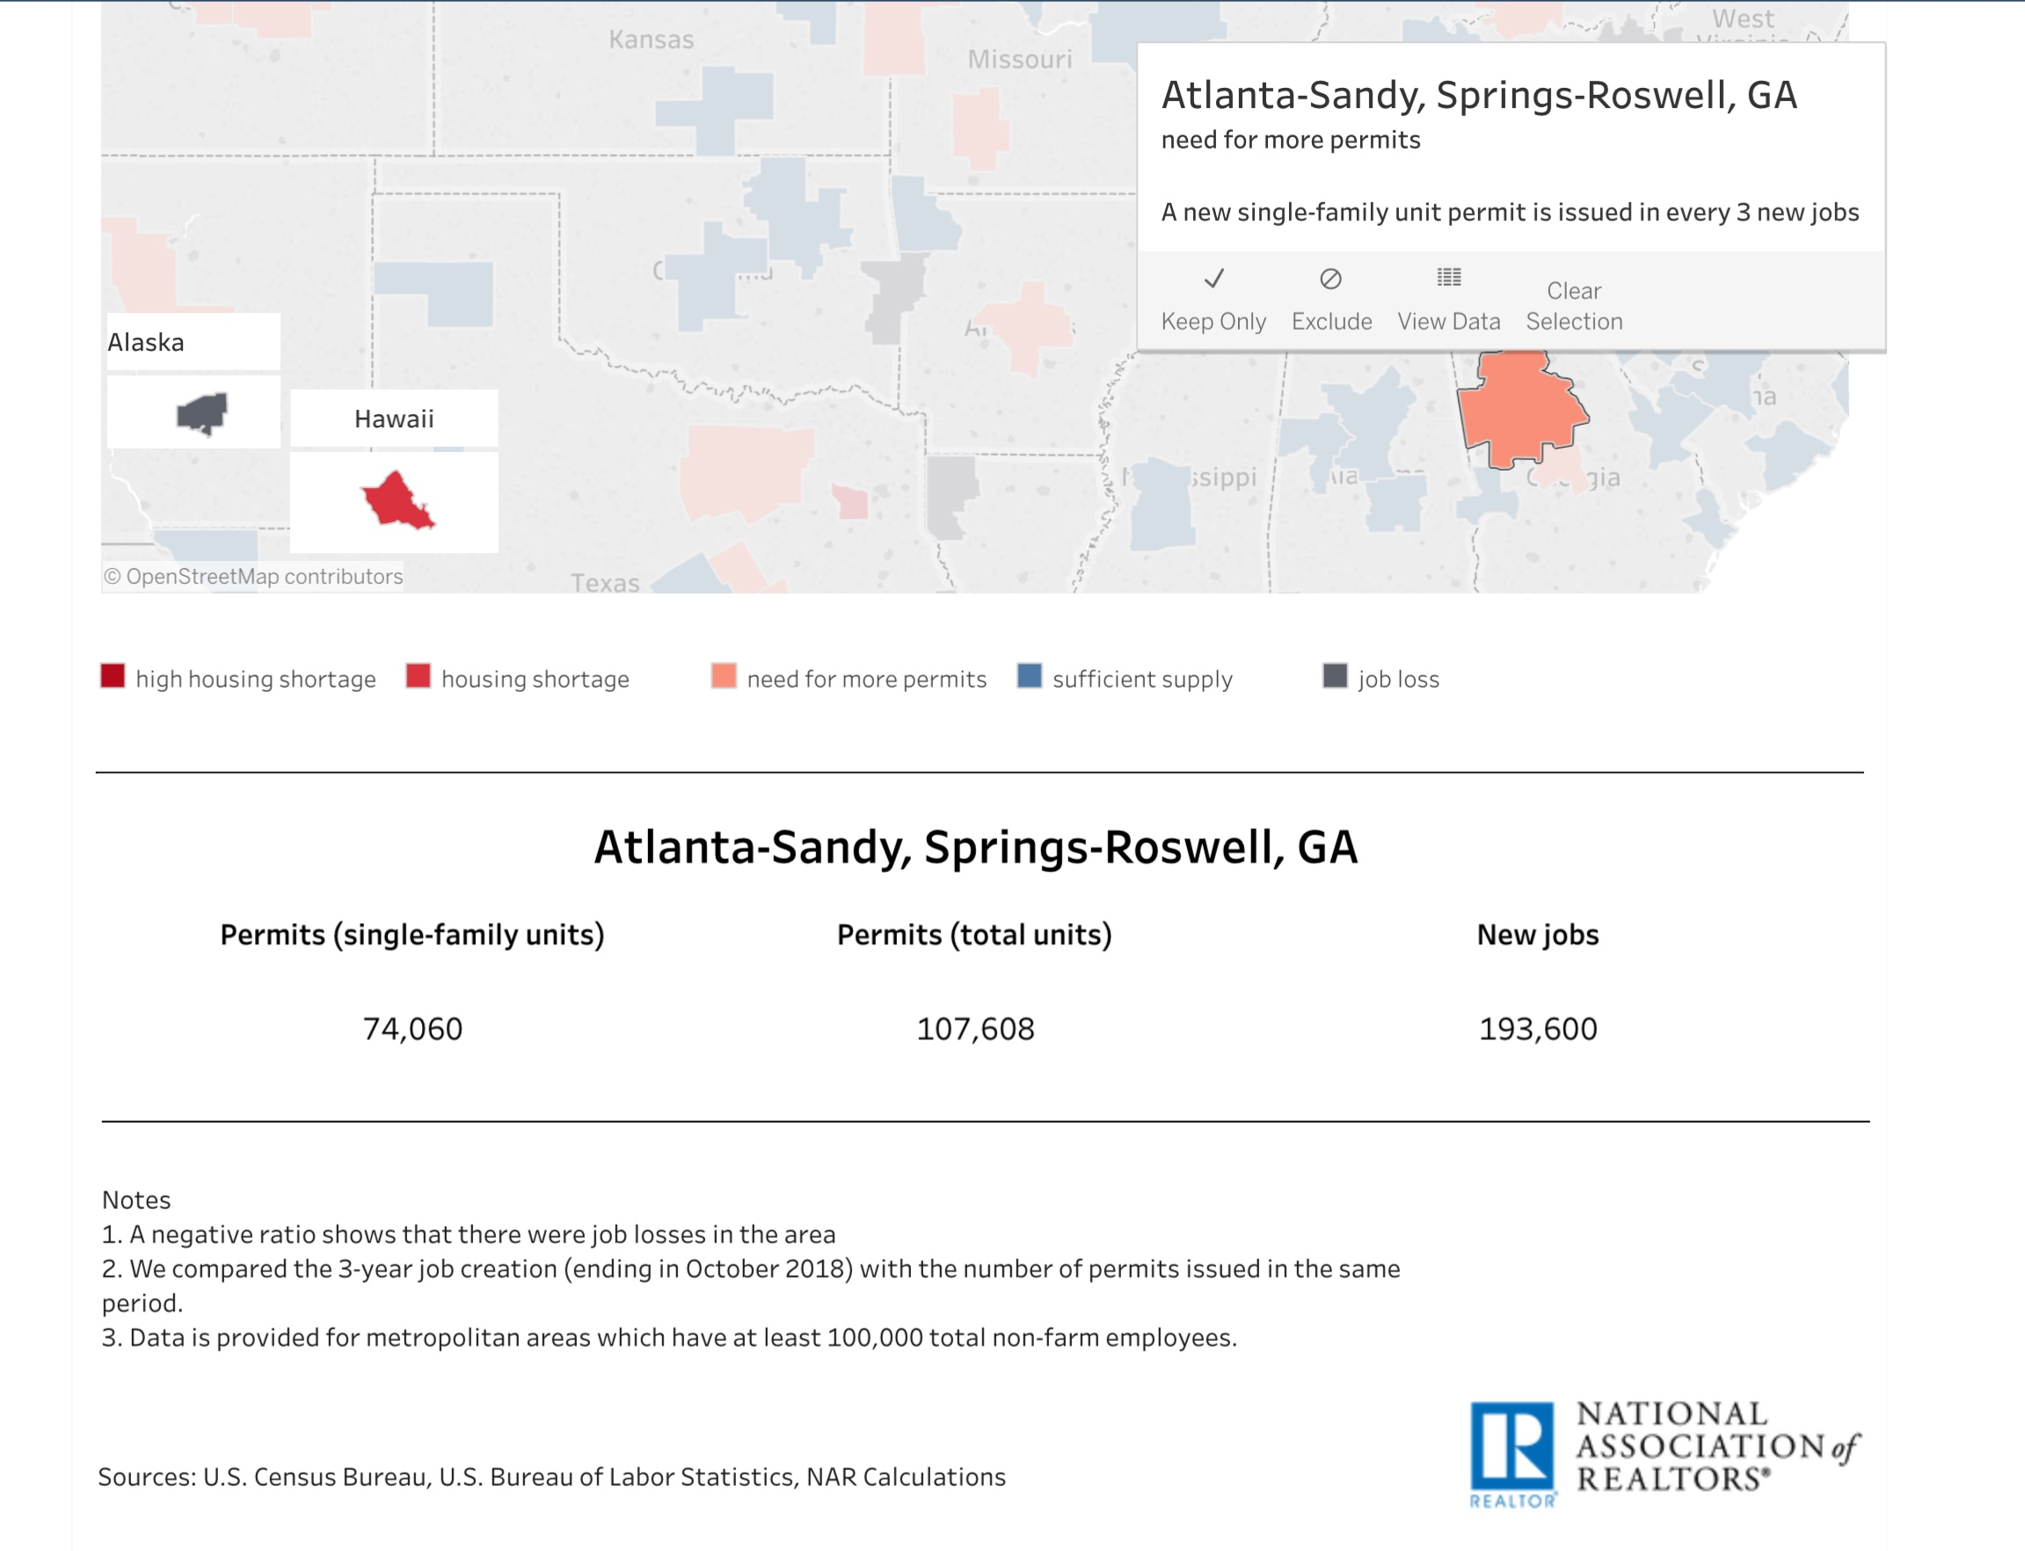
TF
#TomFerry
Notes:
Scenario: goal of $450K, 60% of business, historically, is listings. Average listing commission is $7.5K. Requires 36 transactions.

Slide 18
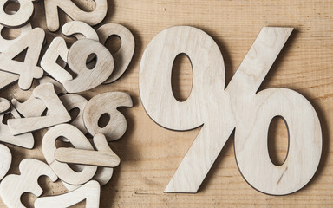
Interest Rate Uncertainty
TF
#TomFerry
Notes:
Scenario: goal of $450K, 60% of business, historically, is listings. Average listing commission is $7.5K. Requires 36 transactions.

Slide 19
TF
#TomFerry
Notes:
Scenario: goal of $450K, 60% of business, historically, is listings. Average listing commission is $7.5K. Requires 36 transactions.

Slide 20
TF
#TomFerry
Notes:
Scenario: goal of $450K, 60% of business, historically, is listings. Average listing commission is $7.5K. Requires 36 transactions.

Slide 21
No Urgency
“Are you OK LOSING money by waiting?”
TF
#TomFerry
Notes:
Scenario: goal of $450K, 60% of business, historically, is listings. Average listing commission is $7.5K. Requires 36 transactions.

Slide 22
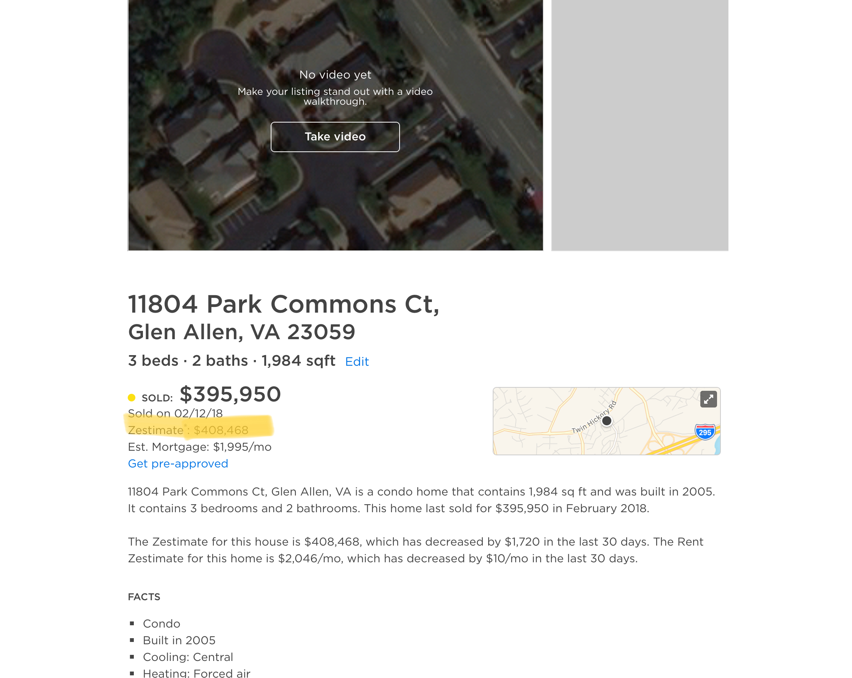
-Pull Zillow Reports on properties in your GEOFarm
-Highlight their Zestimate
-Handwrite on it-“Call me about why this isn’t correct.”
-Mail it to them
TF
#TomFerry
Notes:
Scenario: goal of $450K, 60% of business, historically, is listings. Average listing commission is $7.5K. Requires 36 transactions.

Slide 23
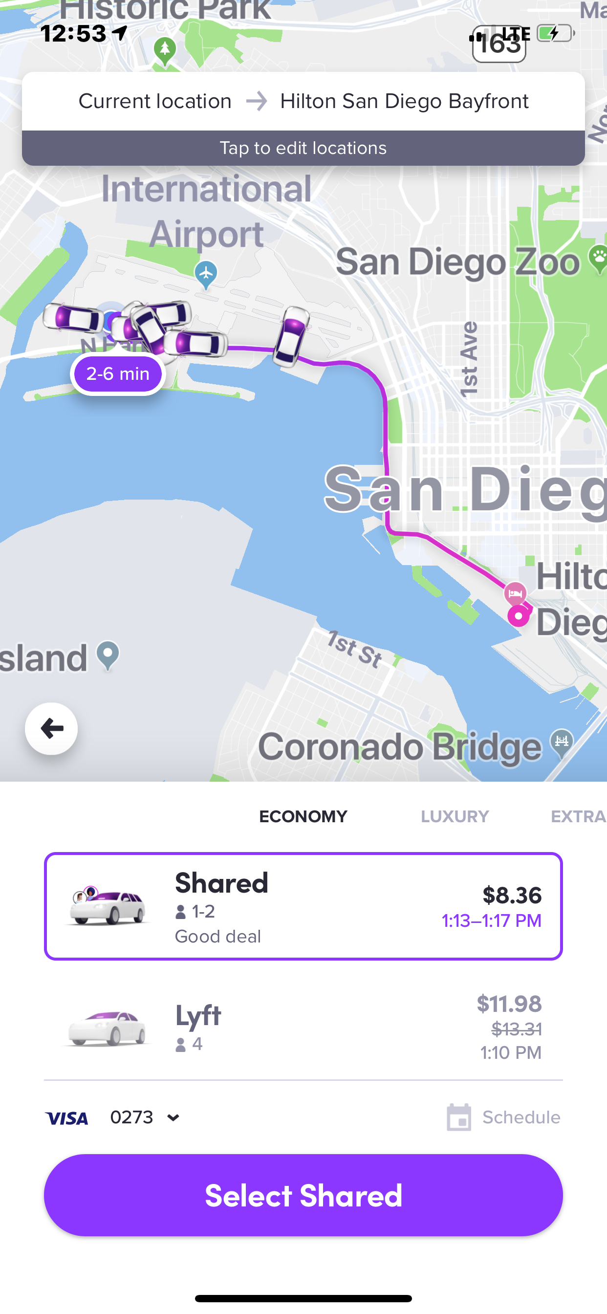
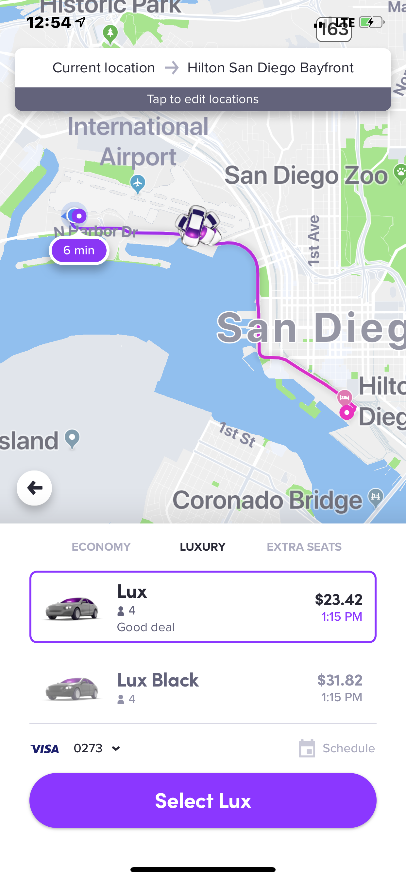
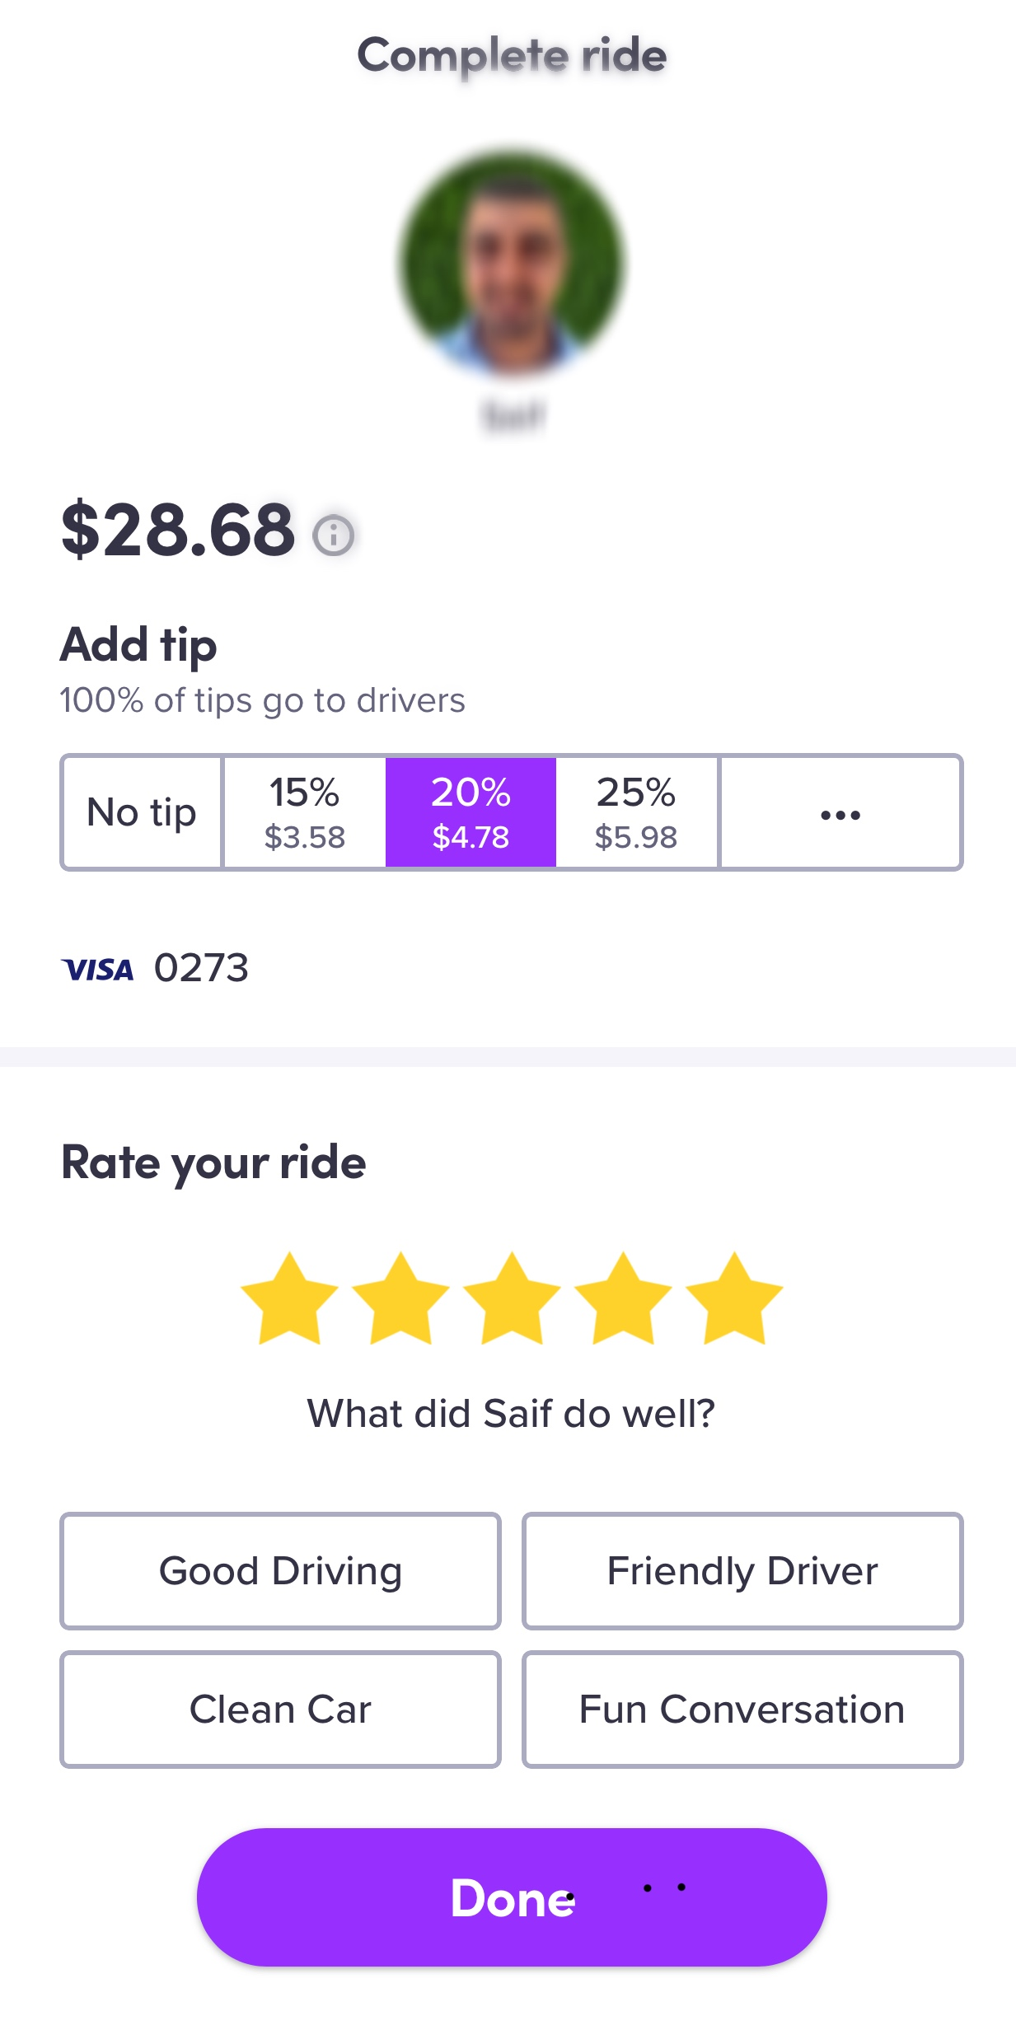
How’s the real estate market here?
Do you own a place?
How long ago did you buy it?
Where do you want to move next?
Would you sell your current place?
TF
#TomFerry
Notes:
Scenario: goal of $450K, 60% of business, historically, is listings. Average listing commission is $7.5K. Requires 36 transactions.

Slide 24
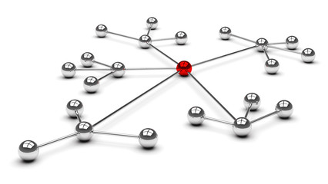
Leveraging A Sale
Tell a better story
Mail to neighbors
Call COI/PC
Do a Video-Post IG, FB and YouTube
Boast Post
Email COI/PC
TF
#TomFerry
Notes:
Scenario: goal of $450K, 60% of business, historically, is listings. Average listing commission is $7.5K. Requires 36 transactions.

Slide 25
Don’t have the Loser’s Limp mentality
TF
#TomFerry
Notes:
Scenario: goal of $450K, 60% of business, historically, is listings. Average listing commission is $7.5K. Requires 36 transactions.

Slide 26
The Biggest Challenge is
YOU!
TF
#TomFerry
Notes:
Scenario: goal of $450K, 60% of business, historically, is listings. Average listing commission is $7.5K. Requires 36 transactions.

Slide 27
Show You Care and Connect in Deeper Ways
TF
#TomFerry
Notes:
Scenario: goal of $450K, 60% of business, historically, is listings. Average listing commission is $7.5K. Requires 36 transactions.

Slide 28
Focus 100% on Your Clients
TF
#TomFerry
Notes:
Scenario: goal of $450K, 60% of business, historically, is listings. Average listing commission is $7.5K. Requires 36 transactions.

Slide 29
Get More Buyer Broker Agreements Signed
TF
#TomFerry
Notes:
Scenario: goal of $450K, 60% of business, historically, is listings. Average listing commission is $7.5K. Requires 36 transactions.

Slide 30
Have Massive Belief In Yourself & Your Company
TF
#TomFerry
Notes:
Scenario: goal of $450K, 60% of business, historically, is listings. Average listing commission is $7.5K. Requires 36 transactions.

Slide 31
Smile and Have Fun
TF
#TomFerry
Notes:
Scenario: goal of $450K, 60% of business, historically, is listings. Average listing commission is $7.5K. Requires 36 transactions.

Slide 32
Be Authentic and Genuine
TF
#TomFerry
Notes:
Scenario: goal of $450K, 60% of business, historically, is listings. Average listing commission is $7.5K. Requires 36 transactions.

Slide 33
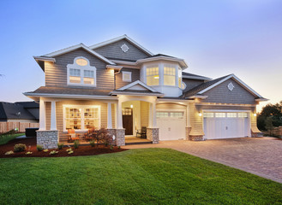
Focus on Listings
TF
#TomFerry
Notes:
Scenario: goal of $450K, 60% of business, historically, is listings. Average listing commission is $7.5K. Requires 36 transactions.

Slide 34
Get Better Everyday
TF
#TomFerry
Notes:
Scenario: goal of $450K, 60% of business, historically, is listings. Average listing commission is $7.5K. Requires 36 transactions.

Slide 35
Constant & Never Ending Practice and Learning
TF
#TomFerry
Notes:
Scenario: goal of $450K, 60% of business, historically, is listings. Average listing commission is $7.5K. Requires 36 transactions.

Slide 36
Get in Action
Don’t Wait
Do Something to Get Something
TF
#TomFerry
Notes:
Scenario: goal of $450K, 60% of business, historically, is listings. Average listing commission is $7.5K. Requires 36 transactions.

Slide 37
Focus on 1 Appointment a Day
TF
#TomFerry
Notes:
Scenario: goal of $450K, 60% of business, historically, is listings. Average listing commission is $7.5K. Requires 36 transactions.

Slide 38
Stand Out & Don’t Follow The Crowd
TF
#TomFerry
Notes:
Scenario: goal of $450K, 60% of business, historically, is listings. Average listing commission is $7.5K. Requires 36 transactions.

Slide 39
Be Excited About The Possibilities
TF
#TomFerry
Notes:
Scenario: goal of $450K, 60% of business, historically, is listings. Average listing commission is $7.5K. Requires 36 transactions.

Slide 40
Courage Over Comfort?
Take the Path of Resistance
TF
#TomFerry
Notes:
Scenario: goal of $450K, 60% of business, historically, is listings. Average listing commission is $7.5K. Requires 36 transactions.

Slide 41
My Challenge To You the Next 90 Days
How do you get 1 sale from every sale this year?
2. How do you get 1 referral from each client?
3. How do you get 1 referral from your each vendor partner?
TF
#TomFerry
Notes:
Scenario: goal of $450K, 60% of business, historically, is listings. Average listing commission is $7.5K. Requires 36 transactions.

Slide 42
THANK YOU!
@jeffmays_RE
TF
#TomFerry
Notes:
Scenario: goal of $450K, 60% of business, historically, is listings. Average listing commission is $7.5K. Requires 36 transactions.

