Slide 1


Slide 2

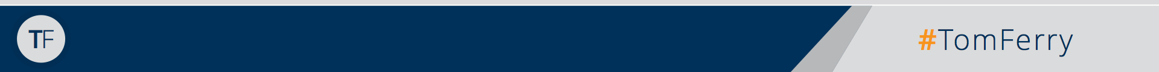
Facing Today’s Biggest Challenges Head On
TF
#TomFerry
Notes:
Scenario: goal of $450K, 60% of business, historically, is listings. Average listing commission is $7.5K. Requires 36 transactions.

Slide 3

The Real Estate Industry Loves Some Fear...
don’t we?
TF
#TomFerry
Notes:
Scenario: goal of $450K, 60% of business, historically, is listings. Average listing commission is $7.5K. Requires 36 transactions.

Slide 4

IBuyers
TF
#TomFerry
Notes:
Scenario: goal of $450K, 60% of business, historically, is listings. Average listing commission is $7.5K. Requires 36 transactions.

Slide 5


Slide 6
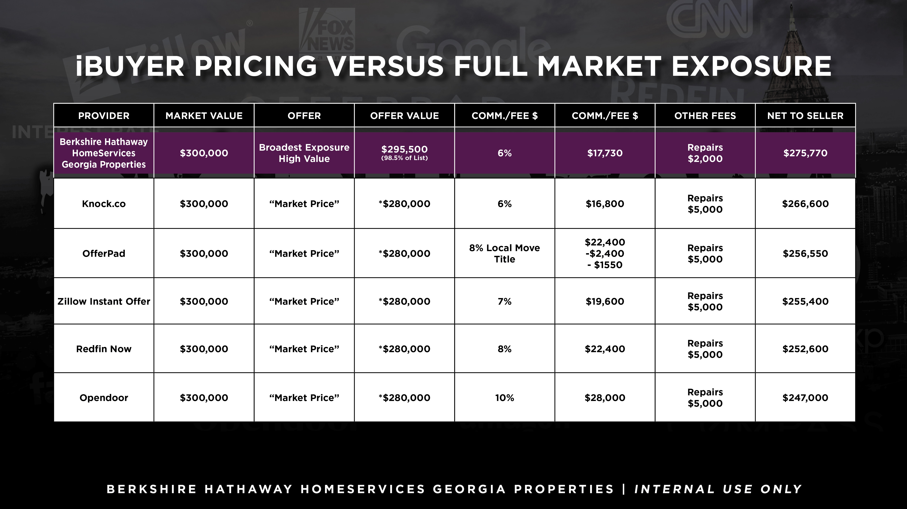

Slide 7
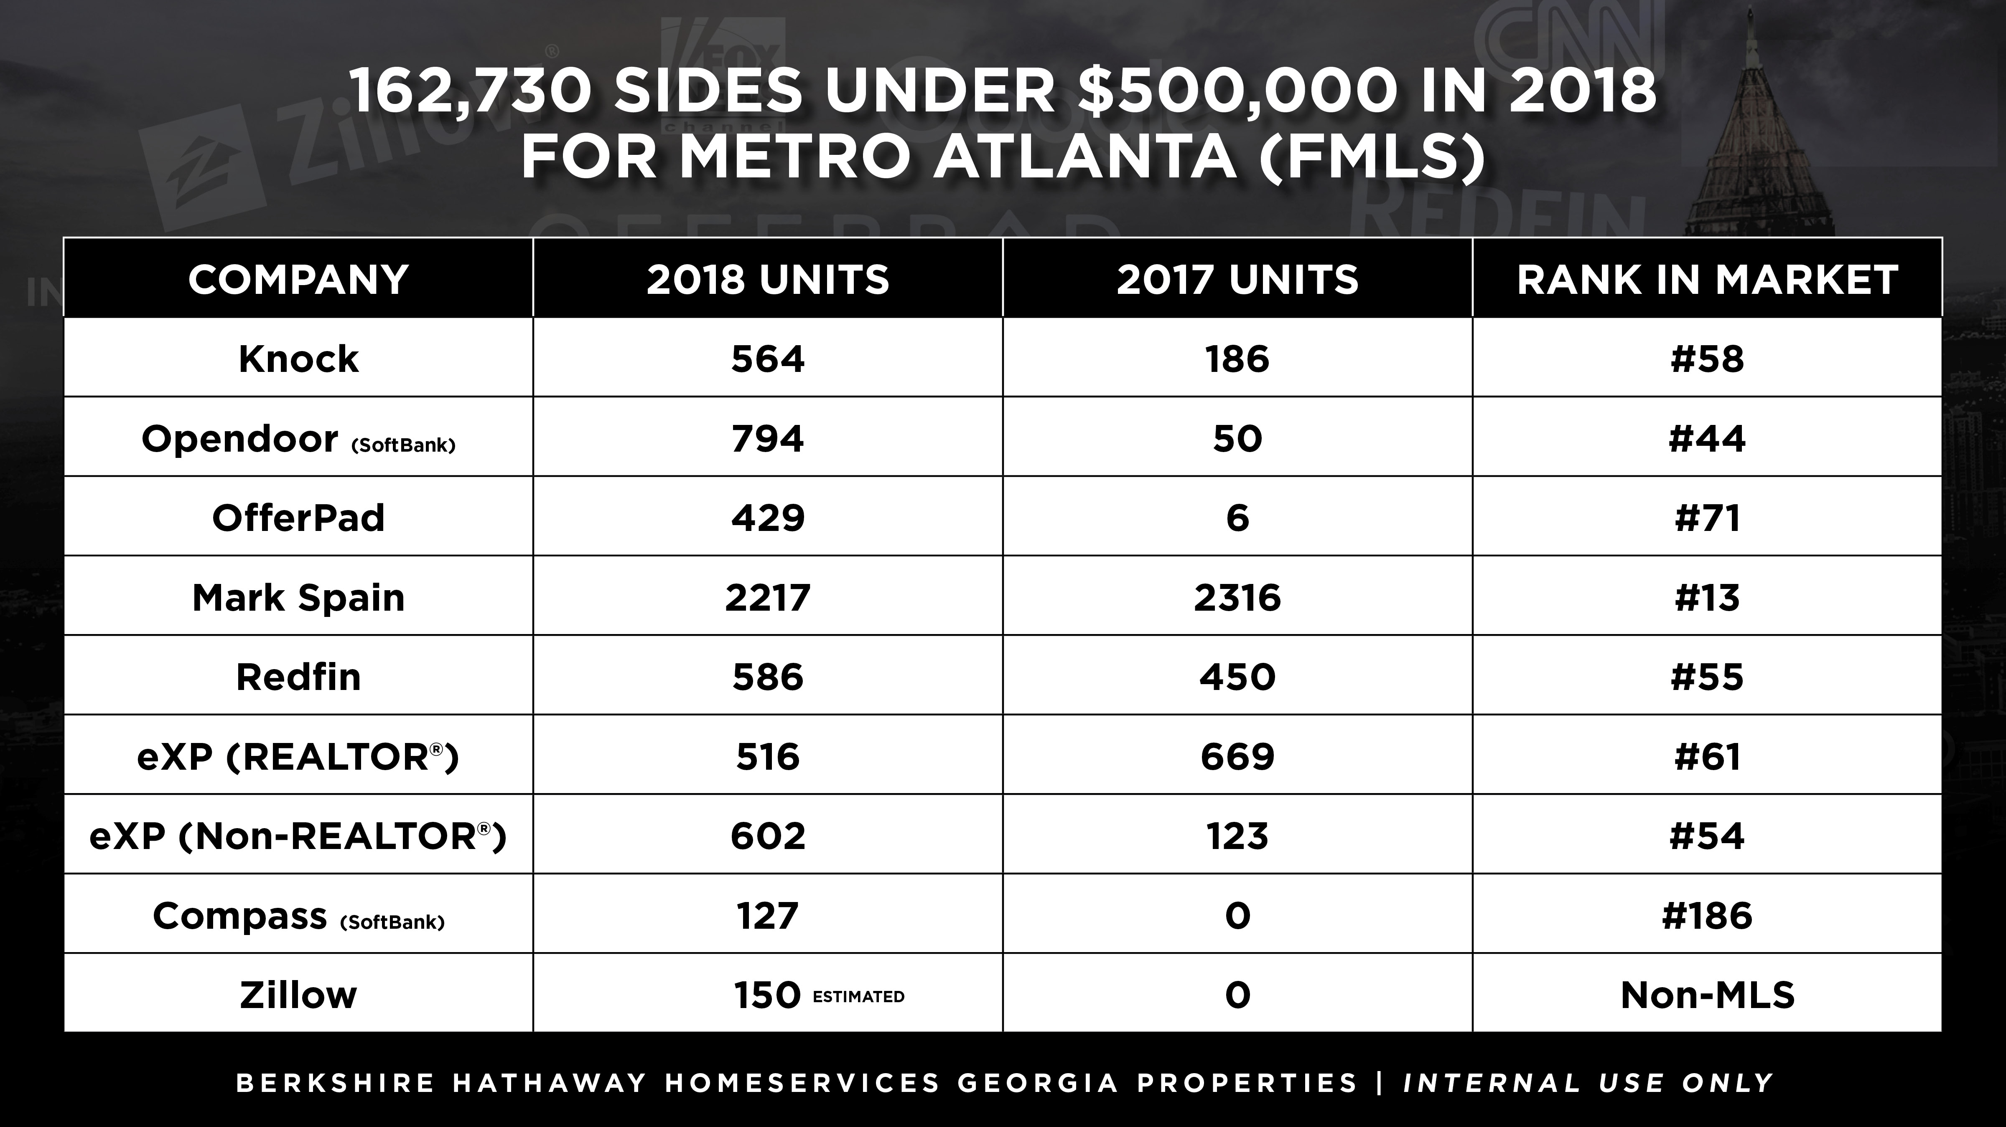

Slide 8
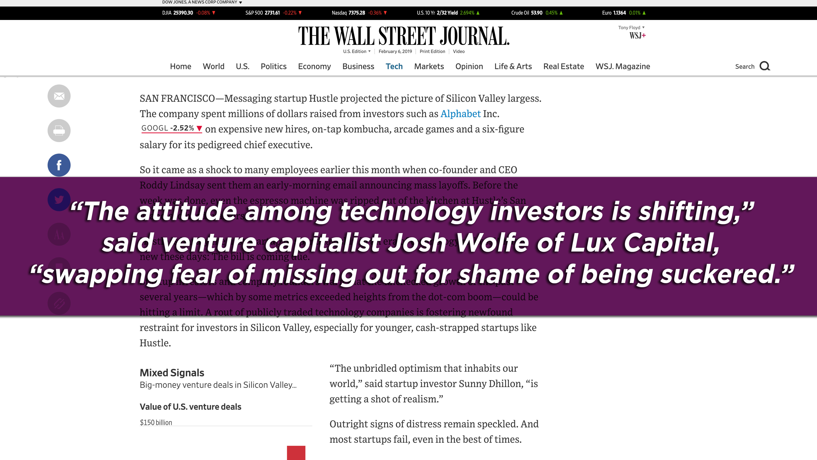

Slide 9
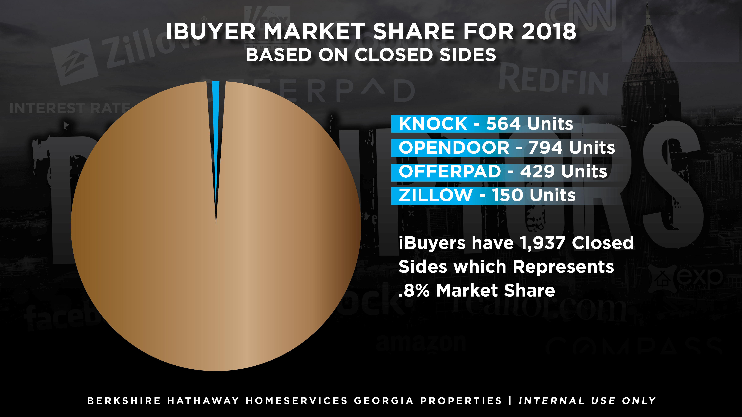

Slide 10
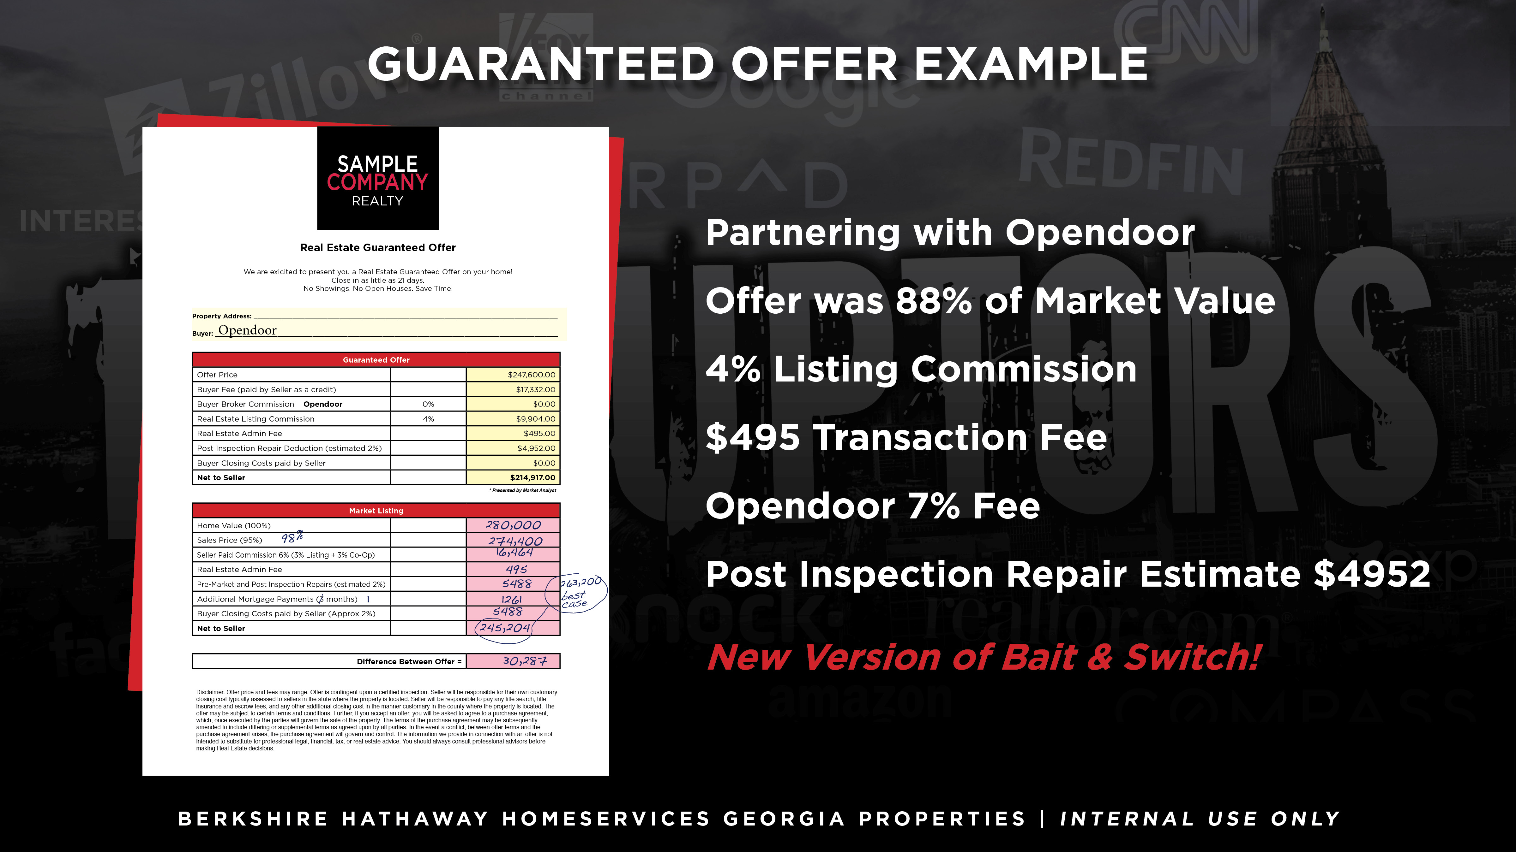

Slide 11
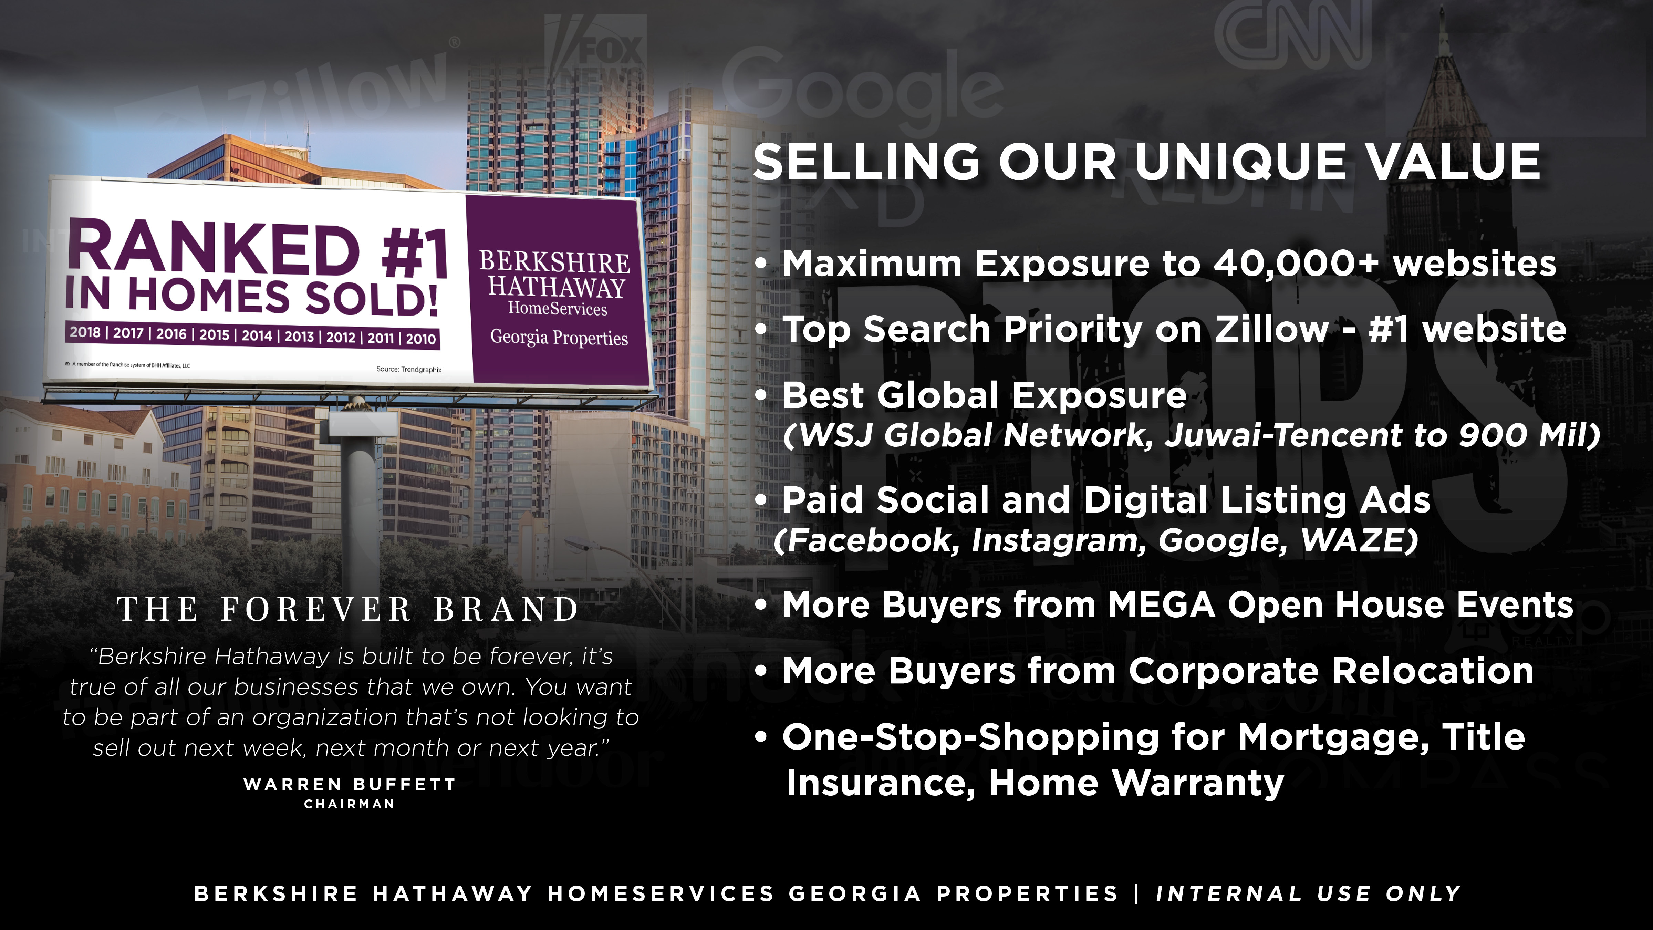

Slide 12


Slide 13
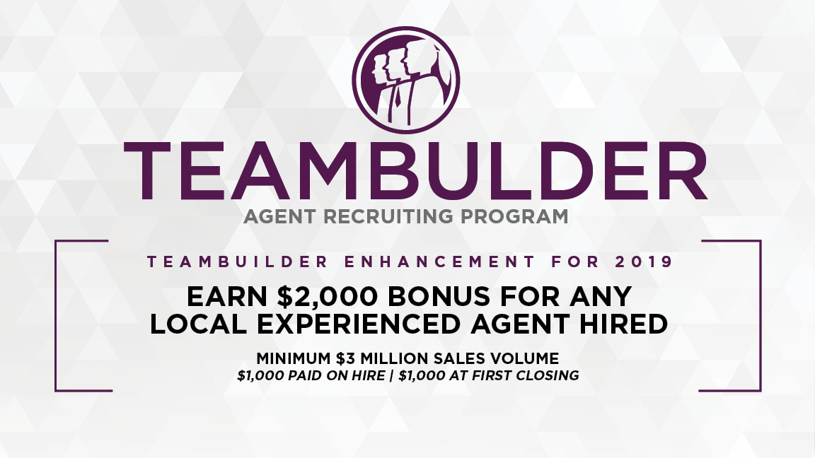

Slide 14

They aren’t DISRUPTORS...
They are DISTRACTORS...
TF
#TomFerry
Notes:
Scenario: goal of $450K, 60% of business, historically, is listings. Average listing commission is $7.5K. Requires 36 transactions.

Slide 15

This Is NOT a Sound Business Model
TF
#TomFerry
Notes:
Scenario: goal of $450K, 60% of business, historically, is listings. Average listing commission is $7.5K. Requires 36 transactions.

Slide 16

Commission Compression
TF
#TomFerry
Notes:
Scenario: goal of $450K, 60% of business, historically, is listings. Average listing commission is $7.5K. Requires 36 transactions.

Slide 17
Stand Out-Market Differently Than Everyone Else
What do YOU do that’s unique for clients?
How do they know that?
Is it packaged/marketed?
What’s your value add?
TF
#TomFerry
Notes:
Scenario: goal of $450K, 60% of business, historically, is listings. Average listing commission is $7.5K. Requires 36 transactions.

Slide 18

Someone Will Do It For Less-
“Really. List with anyone but THAT agent. If they can’t negotiate their own value already..what will they do with you equity, negotiating behind closed doors when it’s not their money? Is that who you want working to get you top dollar?
TF
#TomFerry
Notes:
Scenario: goal of $450K, 60% of business, historically, is listings. Average listing commission is $7.5K. Requires 36 transactions.

Slide 19
You’re mainly attracted to that agent/company because they’re offering a discount right? (YES)
Not because they’re the best or has an amazing marketing program..it’s the discount correct? (YES)
So..their business is solely built around attracting people with a discount..agreed? (YES)
Then that means they’ll be selling your property at a... what?
(A DISCOUNT)
Is that how you want your biggest asset positioned... at a discount? (NO)
TF
#TomFerry
Notes:
Scenario: goal of $450K, 60% of business, historically, is listings. Average listing commission is $7.5K. Requires 36 transactions.

Slide 20
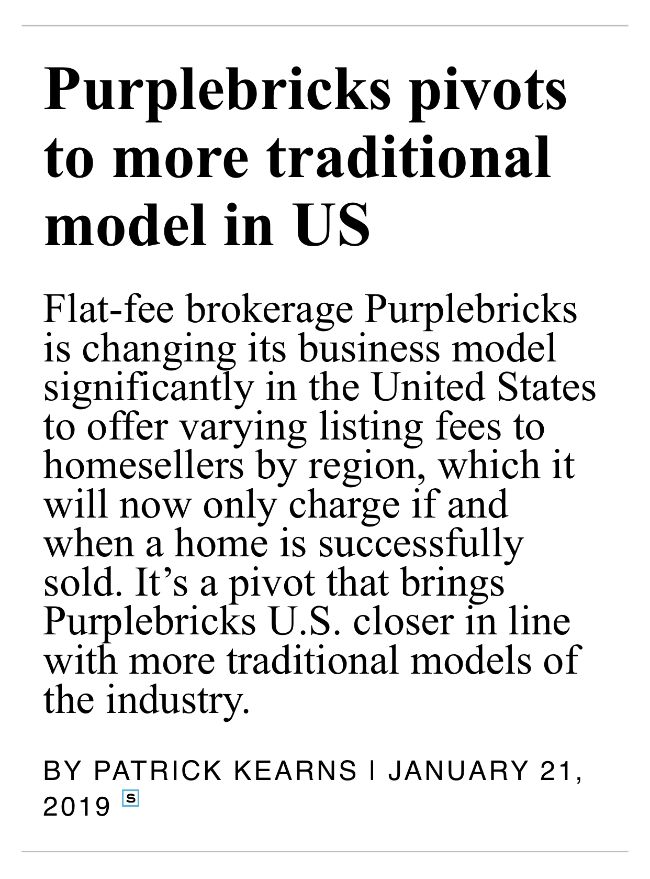
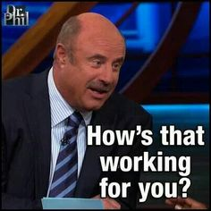
TF
#TomFerry
Notes:
Scenario: goal of $450K, 60% of business, historically, is listings. Average listing commission is $7.5K. Requires 36 transactions.

Slide 21

The Market is Slowing Down
TF
#TomFerry
Notes:
Scenario: goal of $450K, 60% of business, historically, is listings. Average listing commission is $7.5K. Requires 36 transactions.

Slide 22
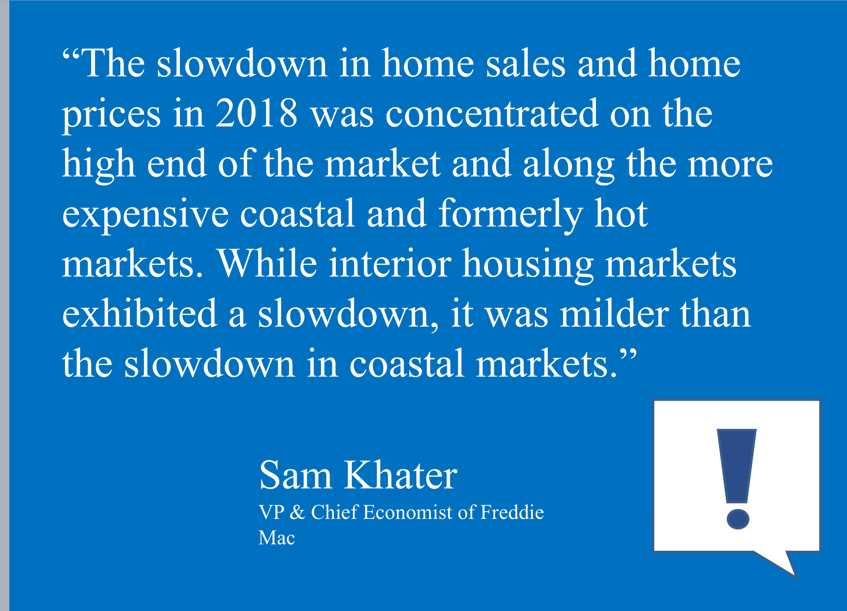
TF
#TomFerry
Notes:
Scenario: goal of $450K, 60% of business, historically, is listings. Average listing commission is $7.5K. Requires 36 transactions.

Slide 23
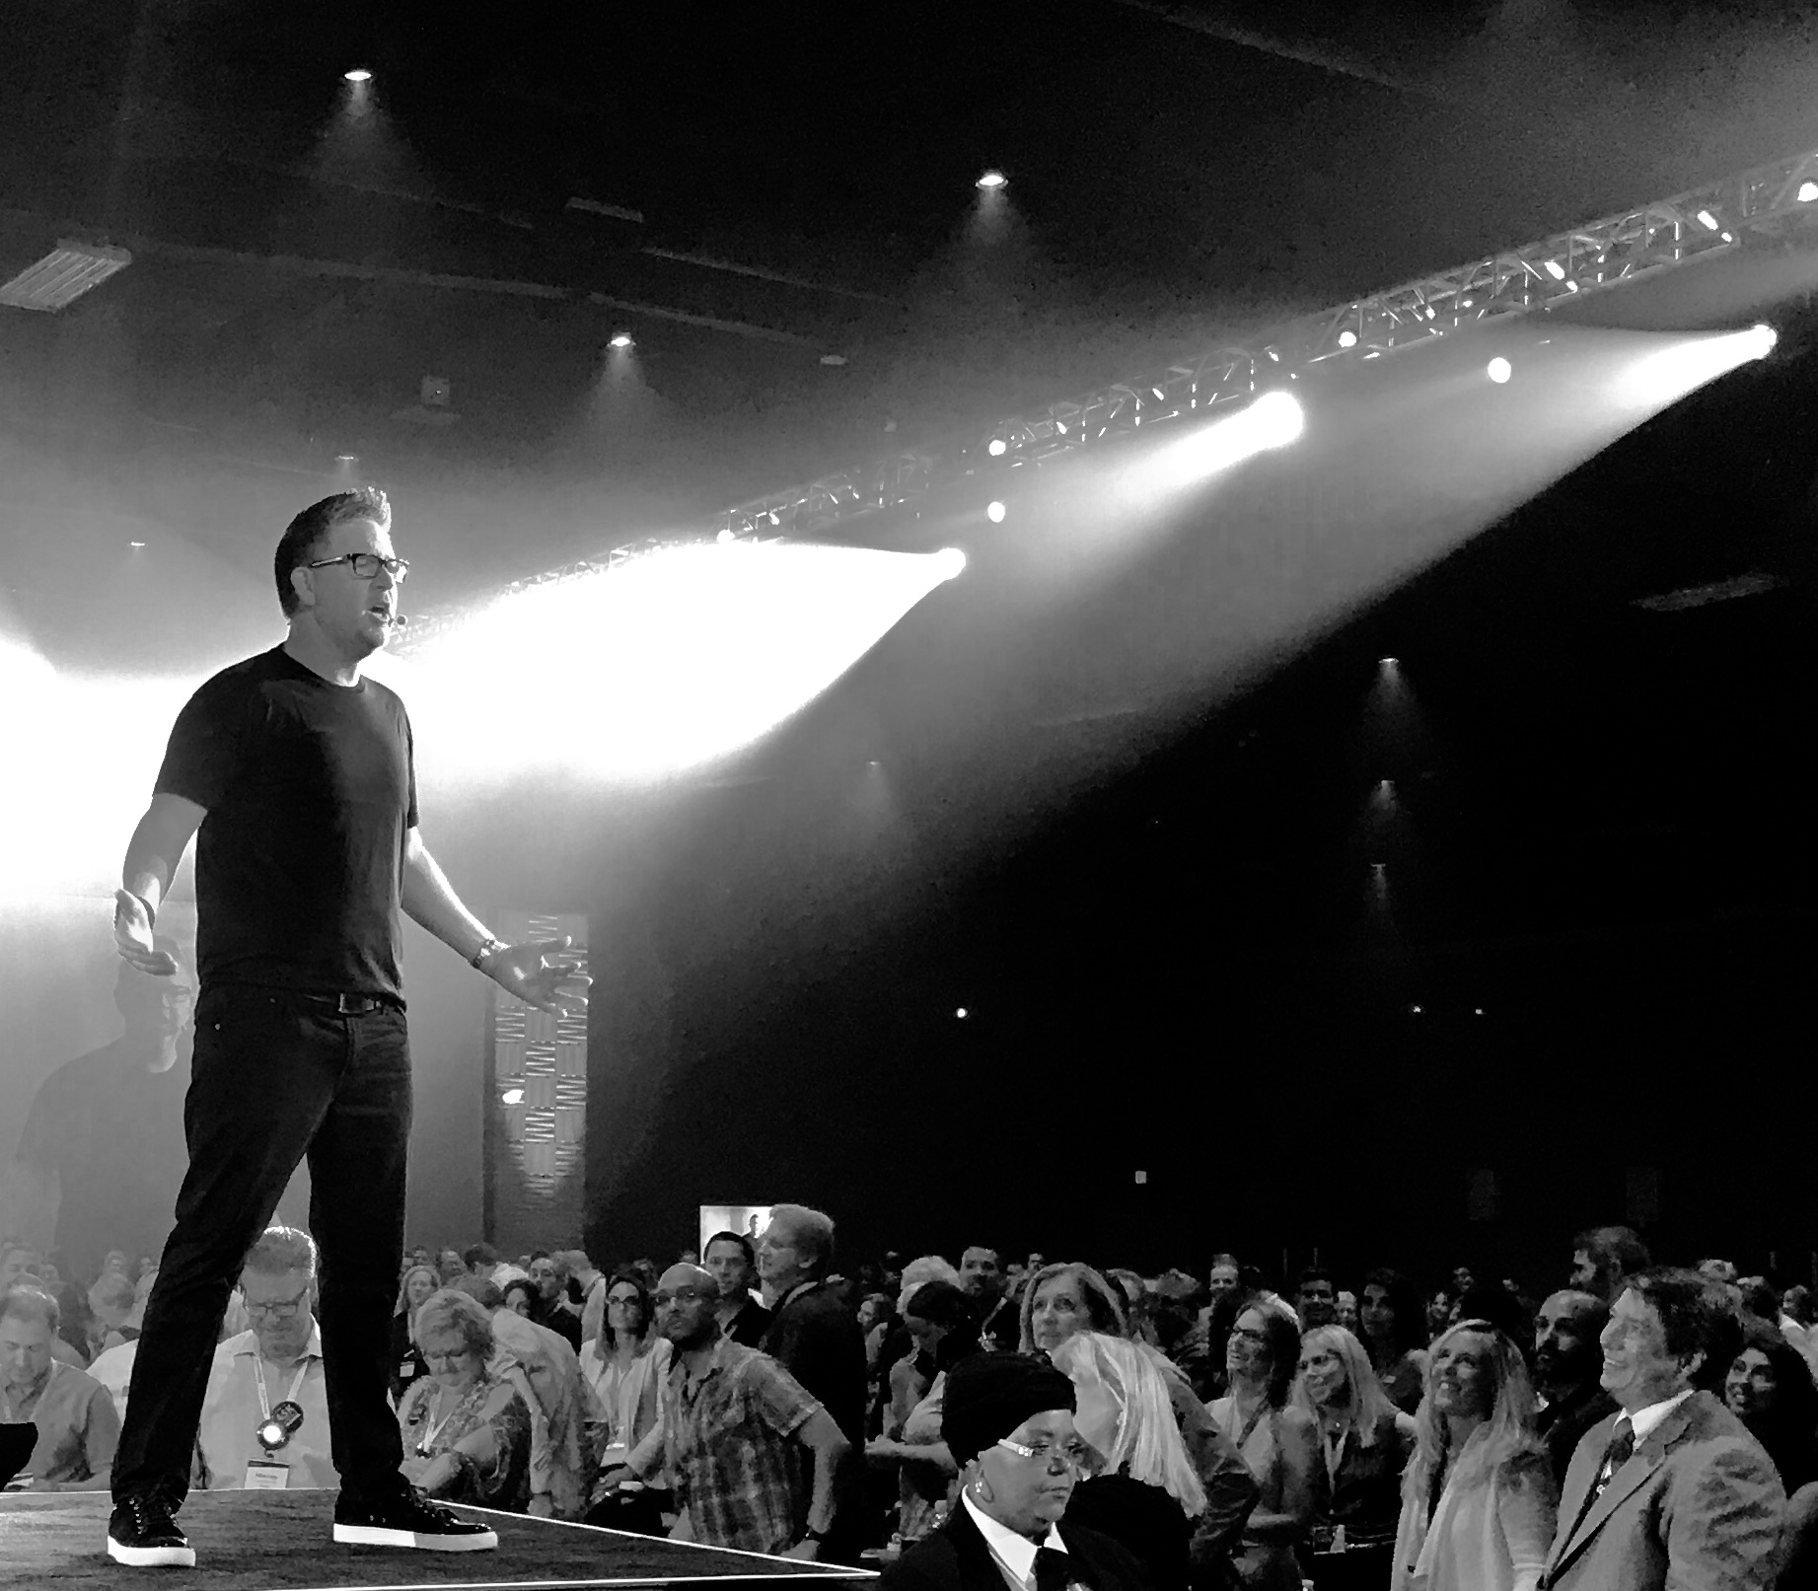
The ONLY people who should be worried about the market, are those who don’t have a strategy, a plan, are inconsistent with marketing, not analyzing their business intelligence, aren’t focused on conversion, don’t have systems in place, and lack accountability. They should be fearful”- Tom Ferry
TF
#TomFerry
Notes:
Scenario: goal of $450K, 60% of business, historically, is listings. Average listing commission is $7.5K. Requires 36 transactions.

Slide 24
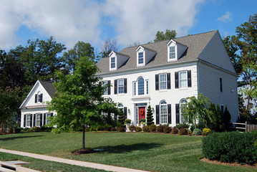
Values Are Going Down
Values Are
Going Down
TF
#TomFerry
Notes:
Scenario: goal of $450K, 60% of business, historically, is listings. Average listing commission is $7.5K. Requires 36 transactions.

Slide 25
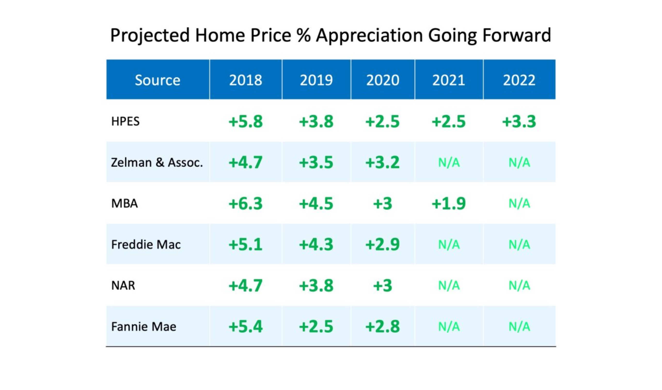
TF
#TomFerry
Notes:
Scenario: goal of $450K, 60% of business, historically, is listings. Average listing commission is $7.5K. Requires 36 transactions.

Slide 26
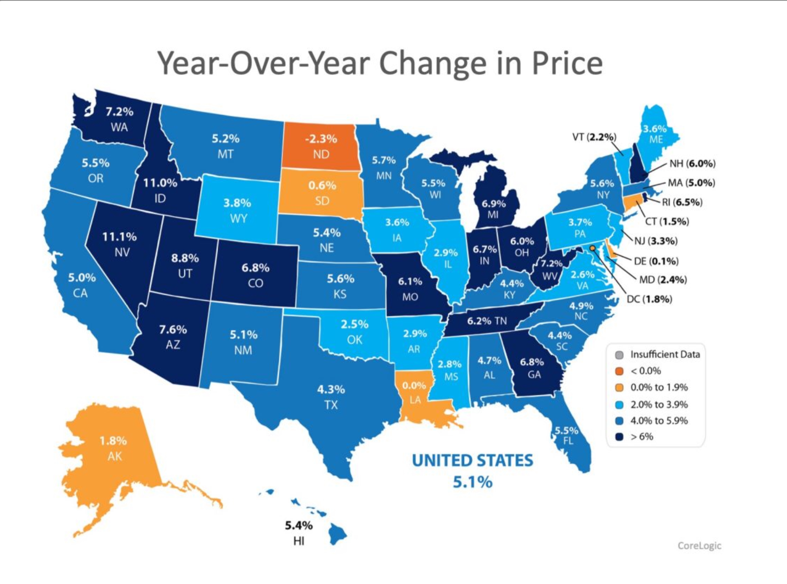
TF
#TomFerry
Notes:
Scenario: goal of $450K, 60% of business, historically, is listings. Average listing commission is $7.5K. Requires 36 transactions.

Slide 27
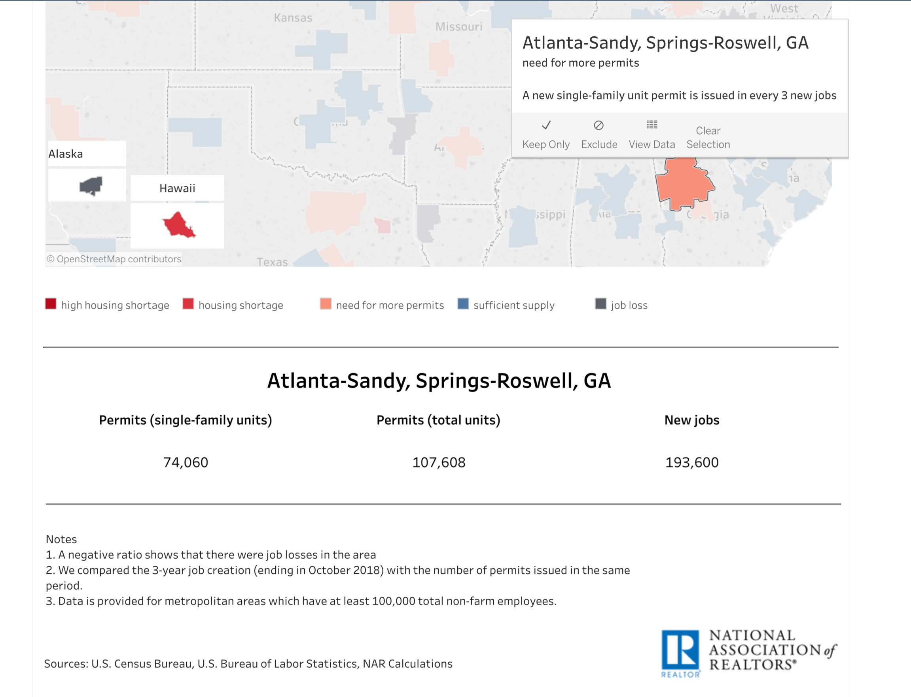
TF
#TomFerry
Notes:
Scenario: goal of $450K, 60% of business, historically, is listings. Average listing commission is $7.5K. Requires 36 transactions.

Slide 28
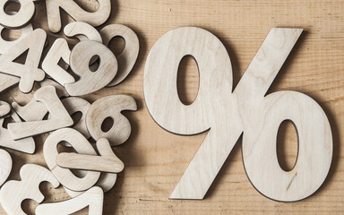
Interest Rate Uncertainty
TF
#TomFerry
Notes:
Scenario: goal of $450K, 60% of business, historically, is listings. Average listing commission is $7.5K. Requires 36 transactions.

Slide 29
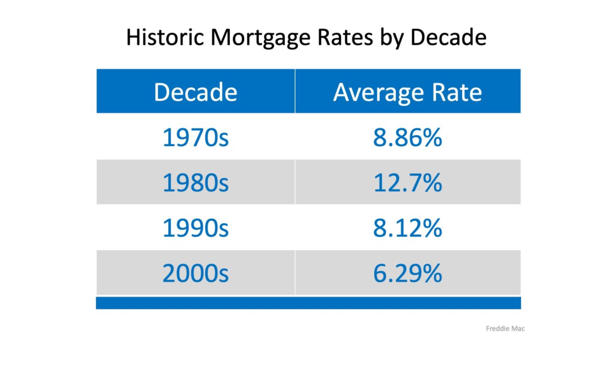
TF
#TomFerry
Notes:
Scenario: goal of $450K, 60% of business, historically, is listings. Average listing commission is $7.5K. Requires 36 transactions.

Slide 30
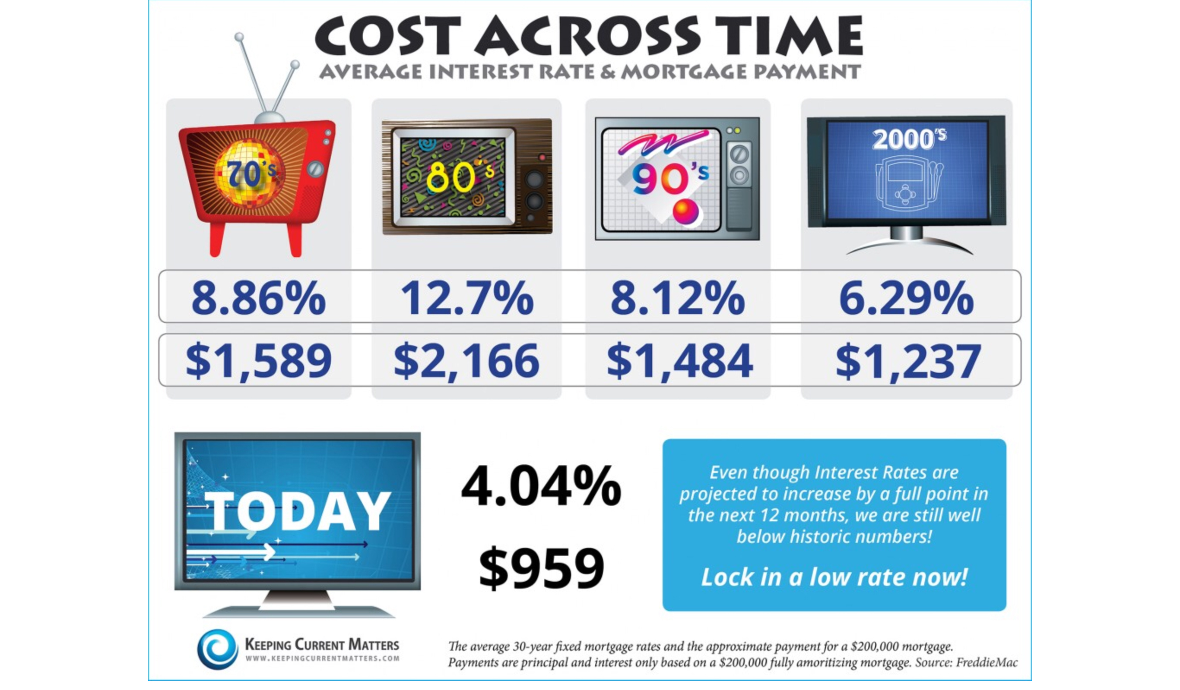
TF
#TomFerry
Notes:
Scenario: goal of $450K, 60% of business, historically, is listings. Average listing commission is $7.5K. Requires 36 transactions.

Slide 31

No Urgency
“Are you OK LOSING money by waiting?”
TF
#TomFerry
Notes:
Scenario: goal of $450K, 60% of business, historically, is listings. Average listing commission is $7.5K. Requires 36 transactions.

Slide 32
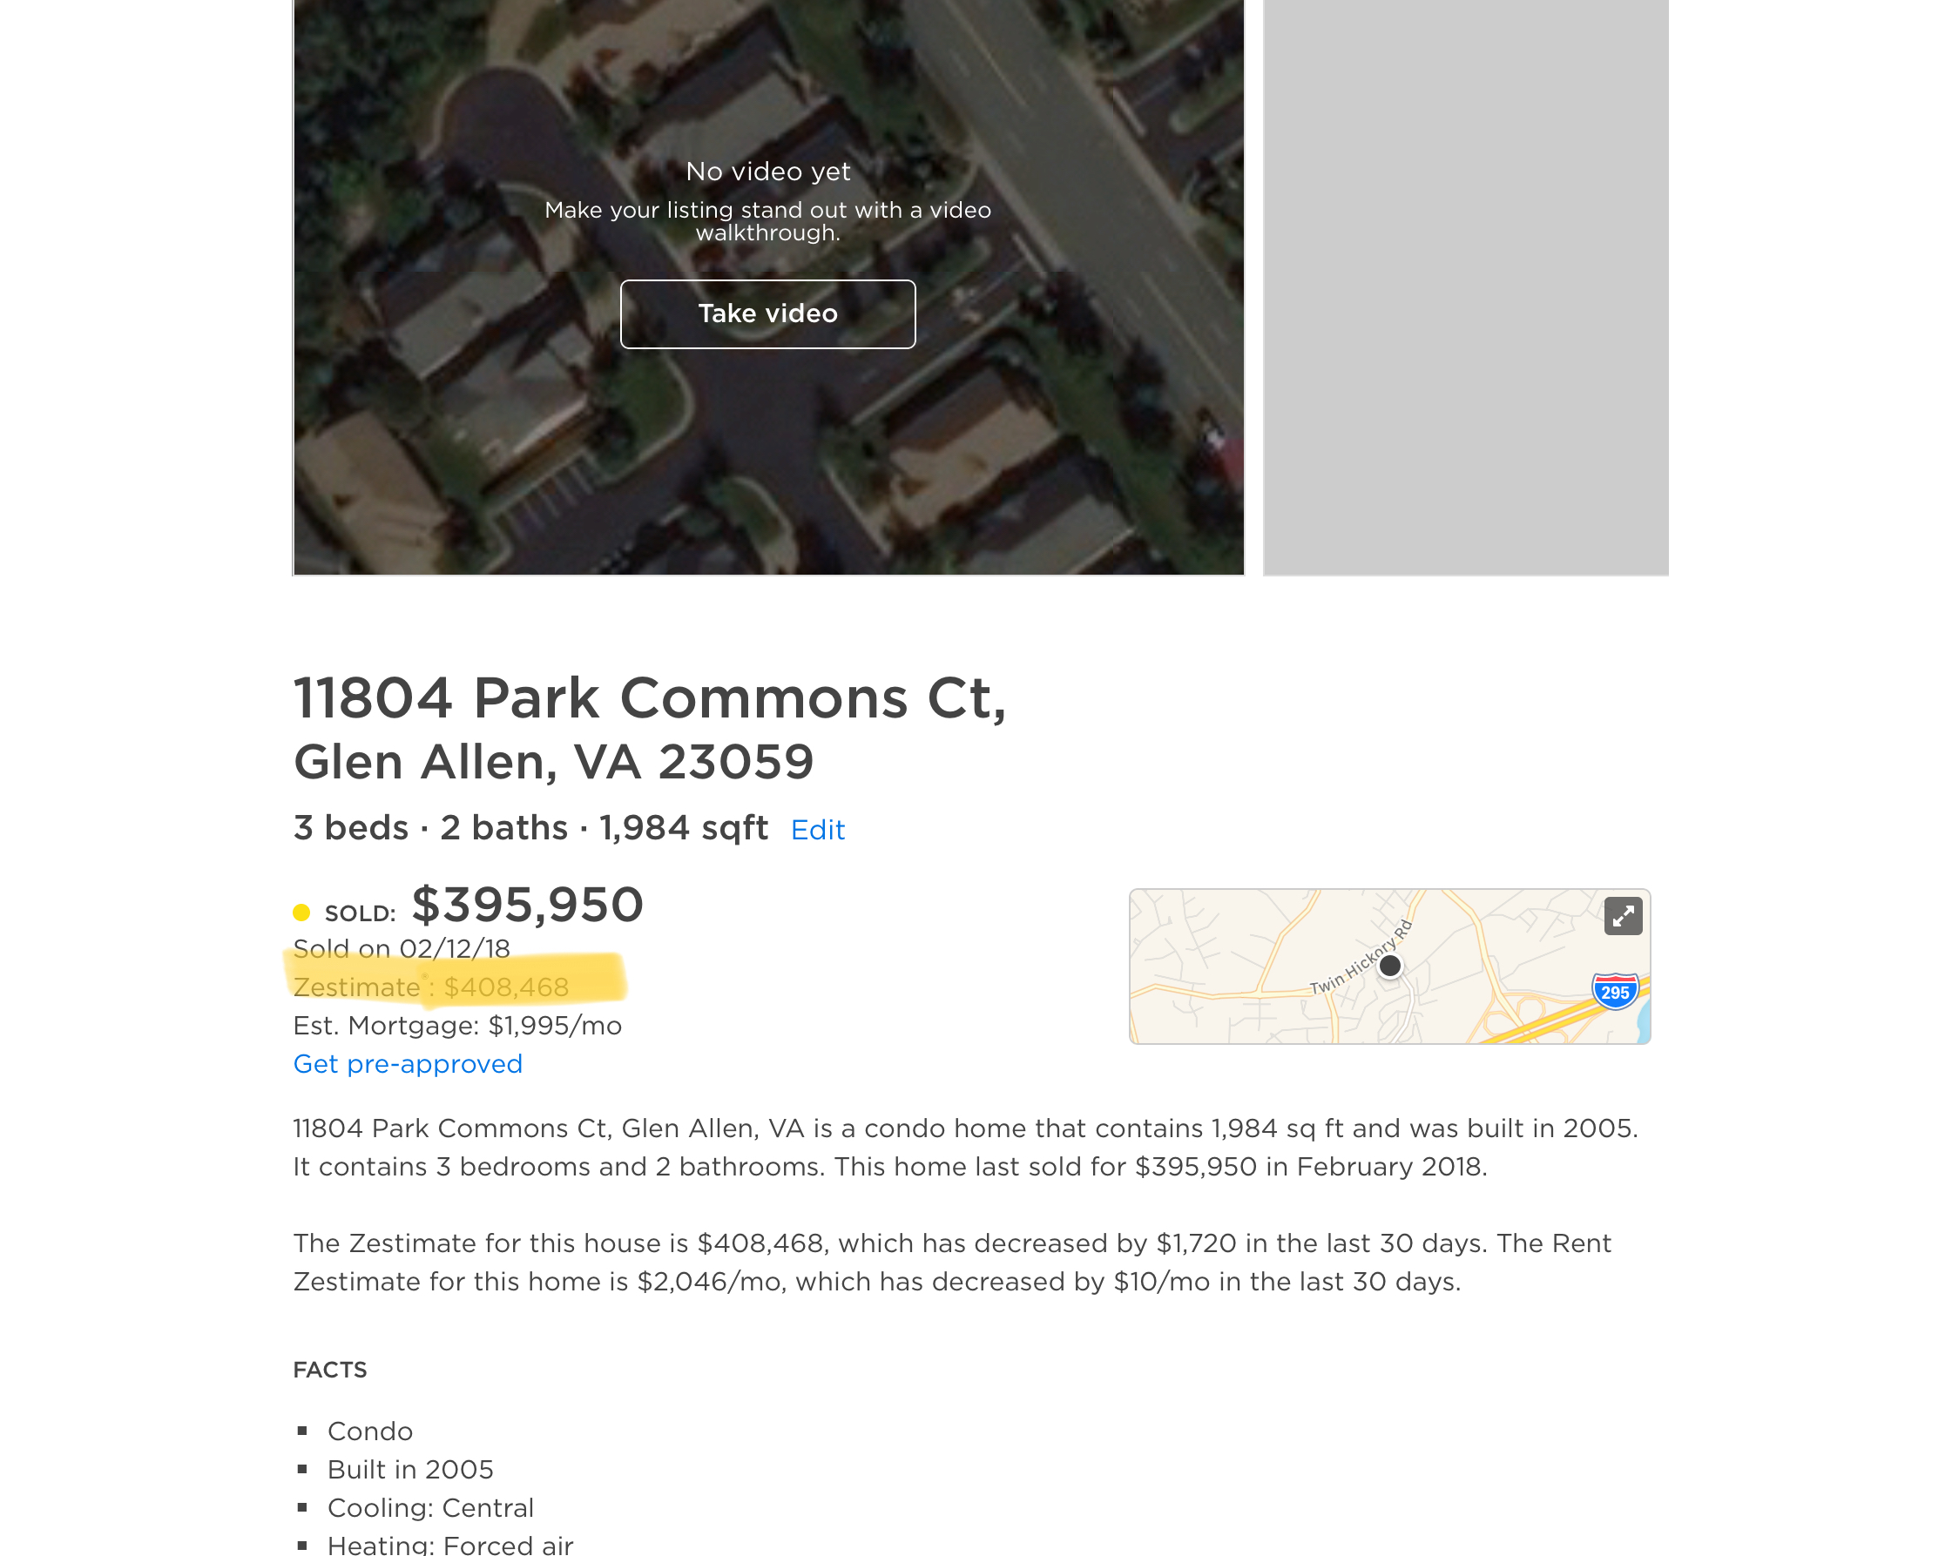
-Pull Zillow Reports on properties in your GEOFarm
-Highlight their Zestimate
-Handwrite on it-“Call me about why this isn’t correct.”
-Mail it to them
TF
#TomFerry
Notes:
Scenario: goal of $450K, 60% of business, historically, is listings. Average listing commission is $7.5K. Requires 36 transactions.

Slide 33
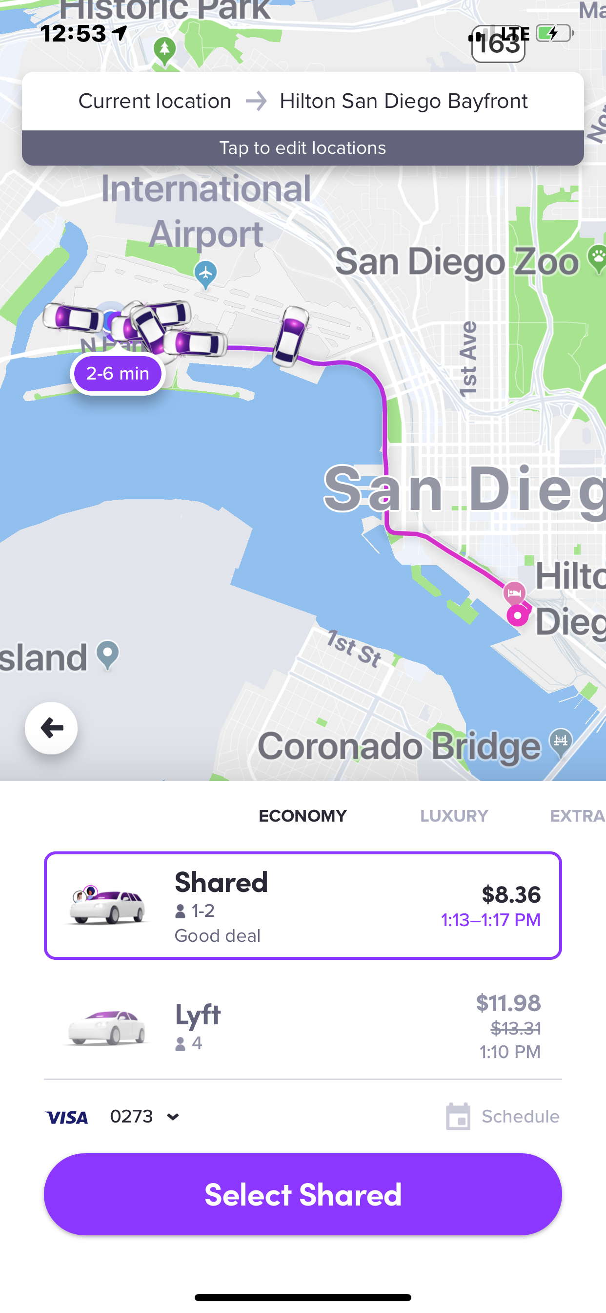
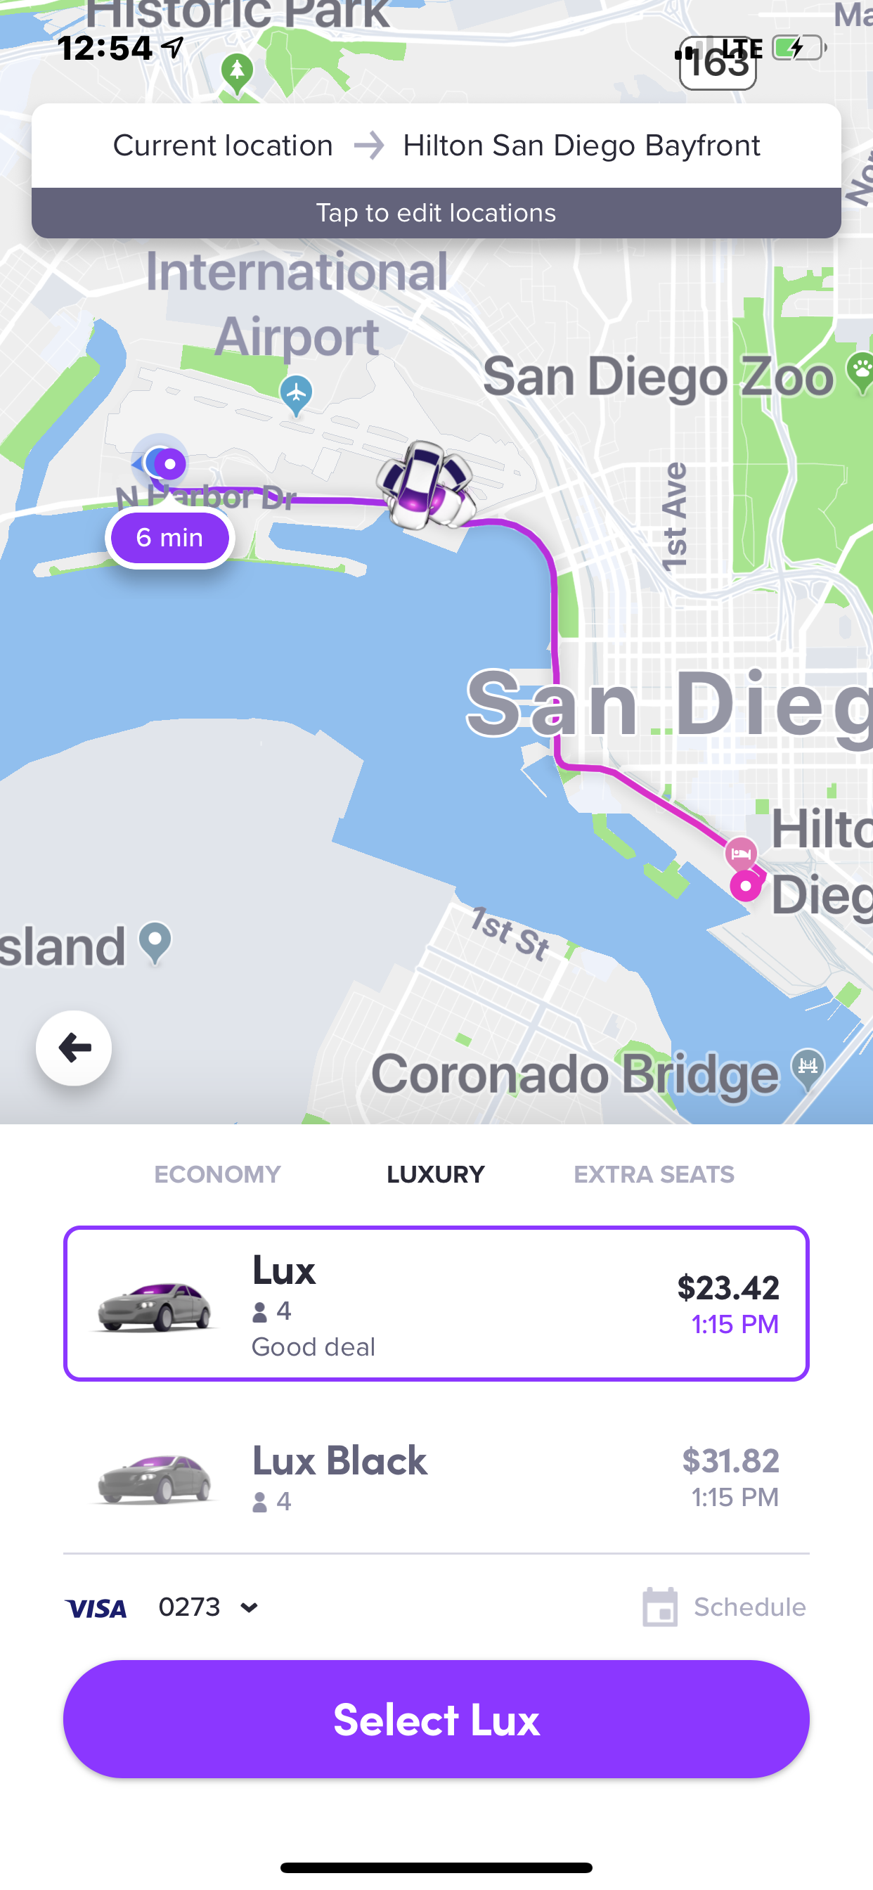
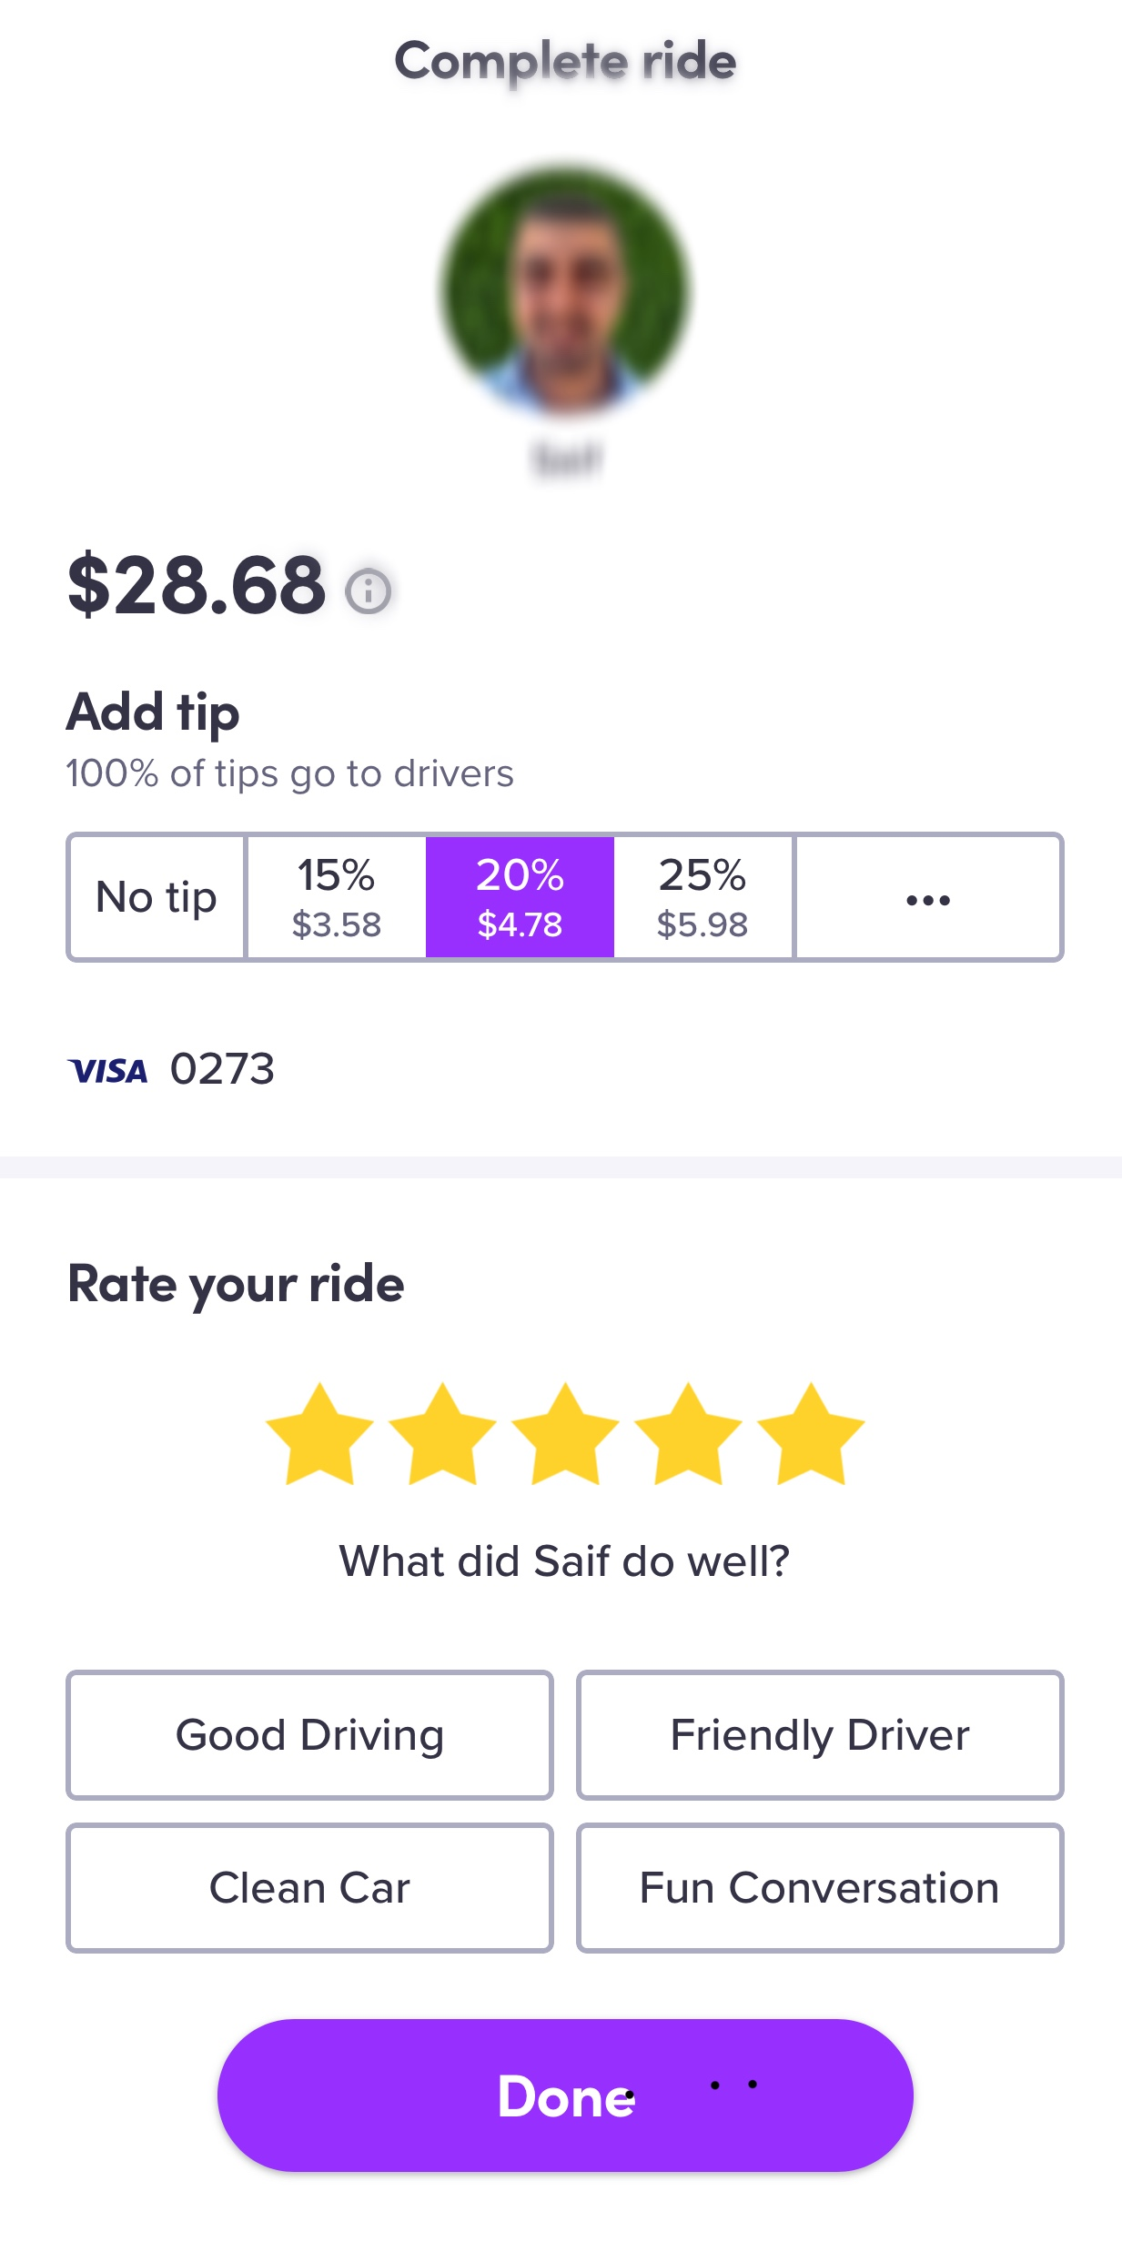
How’s the real estate market here?
Do you own a place?
How long ago did you buy it?
Where do you want to move next?
Would you sell your current place?
TF
#TomFerry
Notes:
Scenario: goal of $450K, 60% of business, historically, is listings. Average listing commission is $7.5K. Requires 36 transactions.

Slide 34
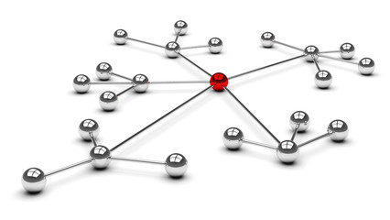
Leveraging A Sale
Tell a better story
Mail to neighbors
Call COI/PC
Do a Video-Post IG, FB and YouTube
Boast Post
Email COI/PC
TF
#TomFerry
Notes:
Scenario: goal of $450K, 60% of business, historically, is listings. Average listing commission is $7.5K. Requires 36 transactions.

Slide 35

Don’t have the Loser’s Limp mentality
TF
#TomFerry
Notes:
Scenario: goal of $450K, 60% of business, historically, is listings. Average listing commission is $7.5K. Requires 36 transactions.

Slide 36

The Biggest Challenge is
YOU!
TF
#TomFerry
Notes:
Scenario: goal of $450K, 60% of business, historically, is listings. Average listing commission is $7.5K. Requires 36 transactions.

Slide 37

Show You Care and Connect in Deeper Ways
TF
#TomFerry
Notes:
Scenario: goal of $450K, 60% of business, historically, is listings. Average listing commission is $7.5K. Requires 36 transactions.

Slide 38

Focus 100% on Your Clients
TF
#TomFerry
Notes:
Scenario: goal of $450K, 60% of business, historically, is listings. Average listing commission is $7.5K. Requires 36 transactions.

Slide 39

Get More Buyer Broker Agreements Signed
TF
#TomFerry
Notes:
Scenario: goal of $450K, 60% of business, historically, is listings. Average listing commission is $7.5K. Requires 36 transactions.

Slide 40

Have Massive Belief In Yourself & Your Company
TF
#TomFerry
Notes:
Scenario: goal of $450K, 60% of business, historically, is listings. Average listing commission is $7.5K. Requires 36 transactions.

Slide 41

Smile and Have Fun
TF
#TomFerry
Notes:
Scenario: goal of $450K, 60% of business, historically, is listings. Average listing commission is $7.5K. Requires 36 transactions.

Slide 42

Be Authentic and Genuine
TF
#TomFerry
Notes:
Scenario: goal of $450K, 60% of business, historically, is listings. Average listing commission is $7.5K. Requires 36 transactions.

Slide 43
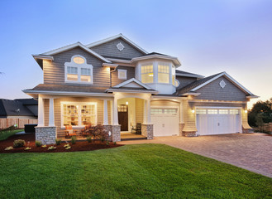
Focus on Listings
TF
#TomFerry
Notes:
Scenario: goal of $450K, 60% of business, historically, is listings. Average listing commission is $7.5K. Requires 36 transactions.

Slide 44

Get Better Everyday
TF
#TomFerry
Notes:
Scenario: goal of $450K, 60% of business, historically, is listings. Average listing commission is $7.5K. Requires 36 transactions.

Slide 45

Constant & Never Ending Practice and Learning
TF
#TomFerry
Notes:
Scenario: goal of $450K, 60% of business, historically, is listings. Average listing commission is $7.5K. Requires 36 transactions.

Slide 46

Get in Action
Don’t Wait
Do Something to Get Something
TF
#TomFerry
Notes:
Scenario: goal of $450K, 60% of business, historically, is listings. Average listing commission is $7.5K. Requires 36 transactions.

Slide 47

Focus on 1 Appointment a Day
TF
#TomFerry
Notes:
Scenario: goal of $450K, 60% of business, historically, is listings. Average listing commission is $7.5K. Requires 36 transactions.

Slide 48

Stand Out & Don’t Follow The Crowd
TF
#TomFerry
Notes:
Scenario: goal of $450K, 60% of business, historically, is listings. Average listing commission is $7.5K. Requires 36 transactions.

Slide 49

Be Excited About The Possibilities
TF
#TomFerry
Notes:
Scenario: goal of $450K, 60% of business, historically, is listings. Average listing commission is $7.5K. Requires 36 transactions.

Slide 50

Courage Over Comfort?
Take the Path of Resistance
TF
#TomFerry
Notes:
Scenario: goal of $450K, 60% of business, historically, is listings. Average listing commission is $7.5K. Requires 36 transactions.

Slide 51
My Challenge To You the Next 90 Days
How do you get 1 sale from every sale this year?
2. How do you get 1 referral from each client?
3. How do you get 1 referral from your each vendor partner?
TF
#TomFerry
Notes:
Scenario: goal of $450K, 60% of business, historically, is listings. Average listing commission is $7.5K. Requires 36 transactions.

Slide 52

THANK YOU!
@jeffmays_RE
TF
#TomFerry
Notes:
Scenario: goal of $450K, 60% of business, historically, is listings. Average listing commission is $7.5K. Requires 36 transactions.

