Slide 1

April 2019

Slide 2
Awareness Is The First ISM

Slide 3
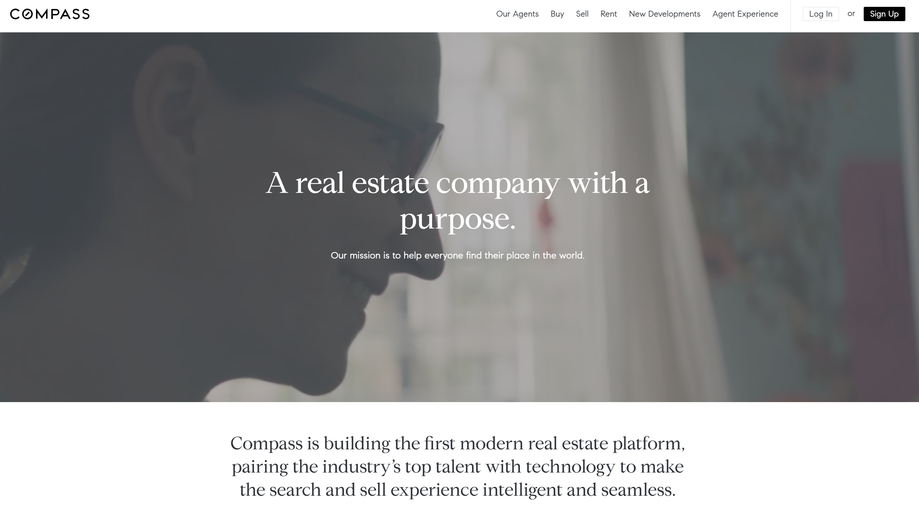

Slide 4
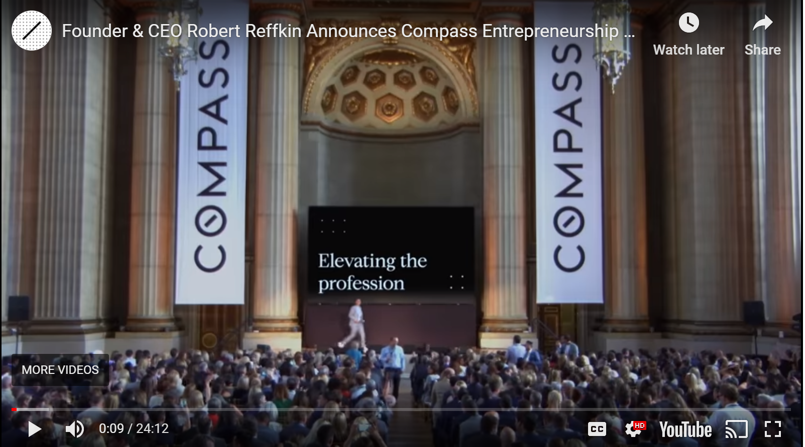
Compass 8 Core Principles
Dream Big
Move Fast
Learn From Reality
Be Solutions-Driven
Obsess About Opportunity
Collaborate Without Ego
Maximize Your Strengths
Bounce Back With Passion
Robert Reffkin announces Entrepreneurship Principles – May 2018
https://www.youtube.com/watch?time_continue=9&v=yDYQoe18ec4

Slide 5
The Stated Goal:
20 20
by
20 20
20% Market Share in 20 Top Cities by 2020

Slide 6
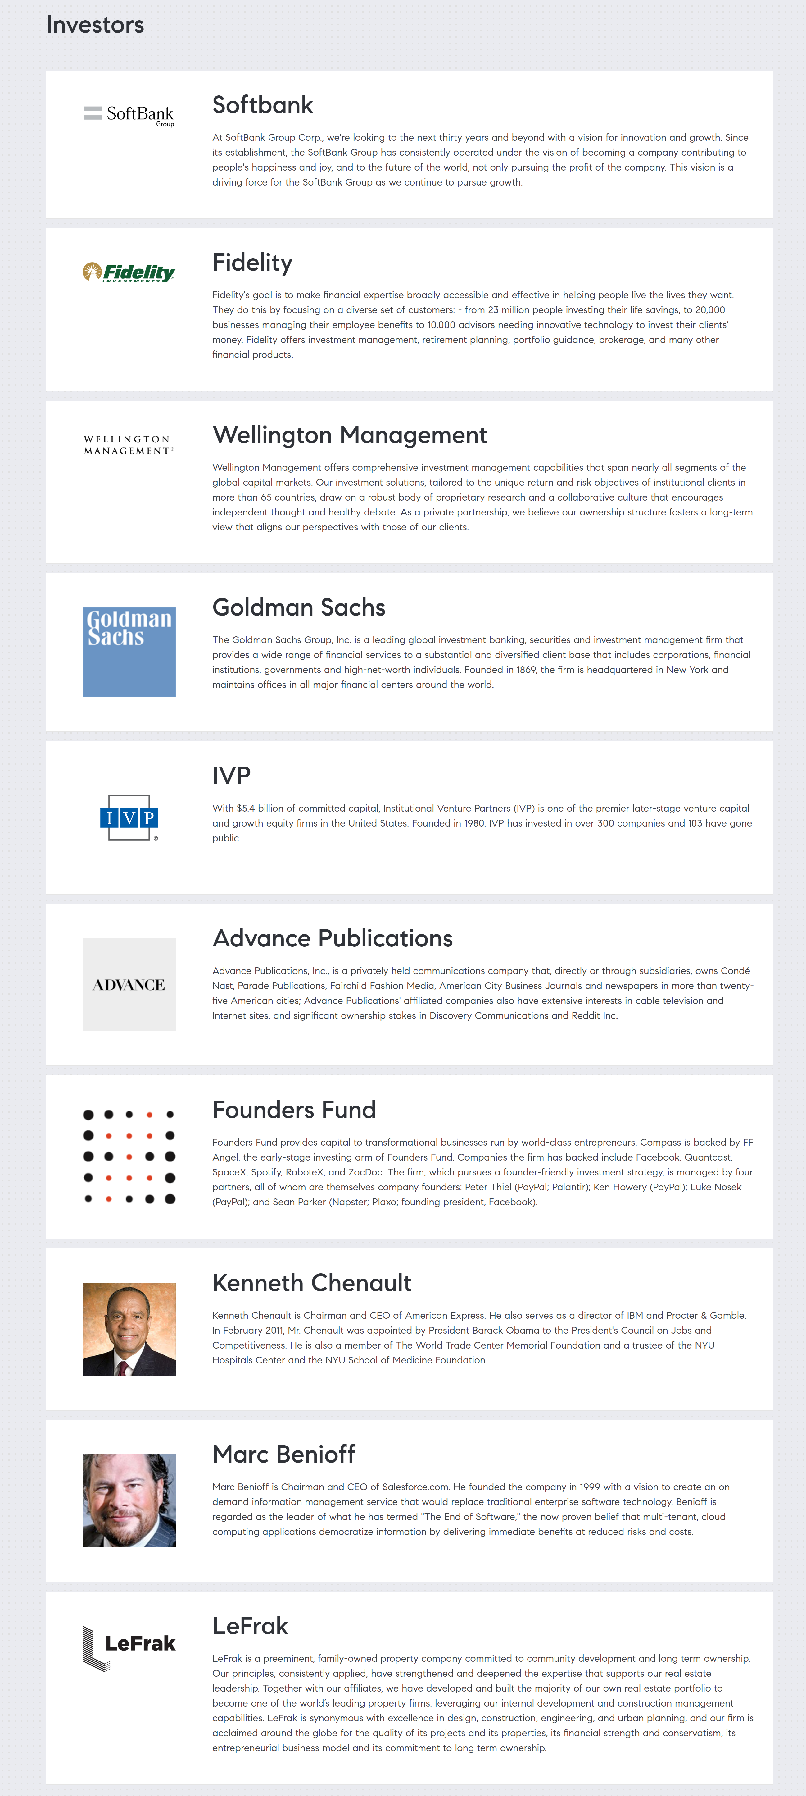


Compass Snapshot
6 years old
Raised $1.2 Bil in Financing, Valuation $4.4 Billion
Expect #3 on RealTrends 2019 Ranking (Acquired Pacific Union, Alain Pinel)
  https://www.realtrends.com/rankings/real-trends-500-by-volume-2019
$14 Bil Volume in 2017. $45 Bil Volume in 2018
1500 employees/ 8,000 Agents in 238 Offices
Forecasting 300 Offices by end of 2019
Ori Allon
Founder & Exec. Chairman
Google, Twitter
Robert Reffkin
Founder & CEO
Goldman Sachs, McKinsey

Slide 7
Compass Financial Comparison
 | Total Revenue | GCI Revenue | Valuation
Compass | $35 Billion | (1) $900 Million | $4.4 Billion
HomeServices of America | $135 Billion | (2) $4 Billion | $19.5 Billion
BHHS Georgia Properties | $4 Billion | $120 Million | $586 Million
Data from Inman News quote from Robert Reffkin
Assumes 3% of Revenue
WSJ Article: SoftBank Group Corp. was forced this month to slash a planned $16 billion investment in co-working startup WeWork Cos. by 88% after SoftBank’s backers objected and the Japanese company’s stock had fallen. The attitude among technology investors is shifting, said venture capitalist Josh Wolfe of Lux Capital, “swapping fear of missing out for shame of being suckered.”

Slide 8
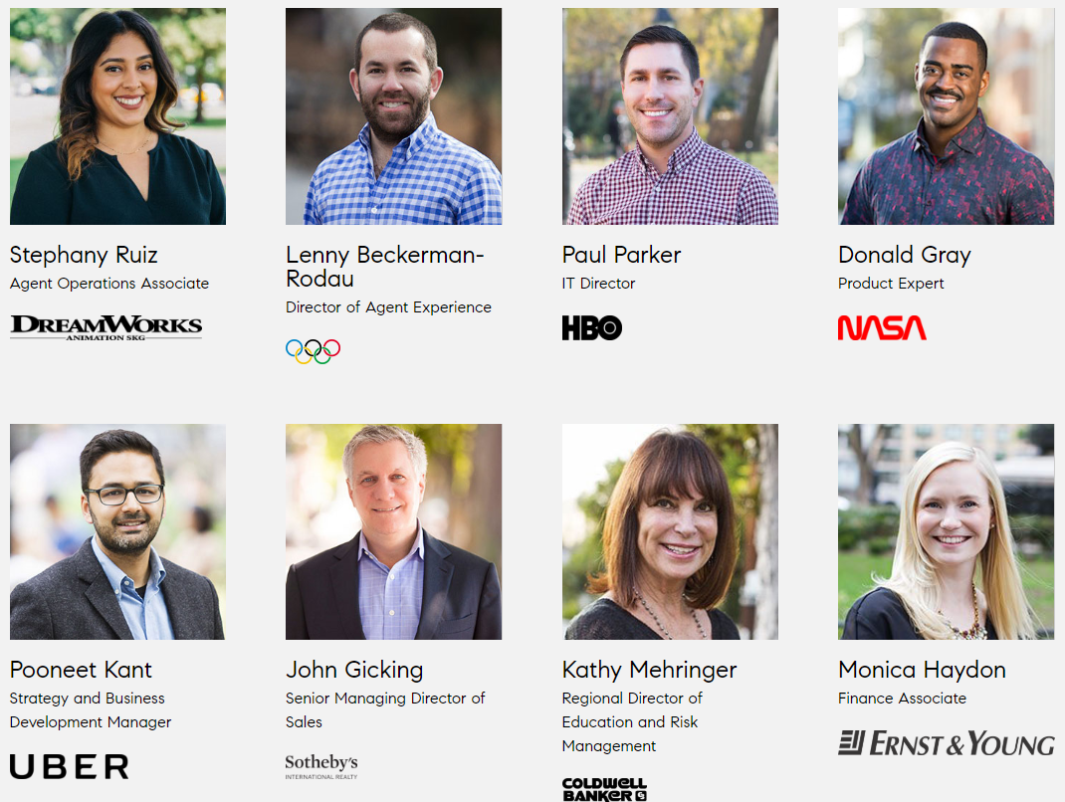

Slide 9
Compass Agent Value Proposition
Compass Technology Platform (One Single Platform)
Three Agent Revenue Streams
  Gross Commission Income
  Marketplace Revenue (Partners)
  Stock Dividend (Retirement Plan)
Attractive Splits, No Franchise Fee, No Monthly Technology Fees
Large Signing Bonuses with Stock Options
Large Marketing Budgets and Agency Resources
Compass Agent Betterment Fund (Interest-Free business loans)
Compass Black Card (Credit card that helps fund/ track business expenses)
Compass Listing Concierge Services (Funds listing renovations and upgrades)
Compass Bridge Loan Program (Allows Seller to buy before selling current property)
Compass Agent Healthcare (PEO from IdilusHR - CIGNA)
Compass Agent as CEO (Agents focus on driving revenue)
Compass COO (Business consulting services to help agents run business operations)
Compass Agent Data Pledge (Agent policy for protection of agent provided data)
Agent-Centric Culture (Agent feedback program to shape future initiatives)
Compass Cares (Locally controlled charities, Goal - $10 Billion in 10 years)

Slide 10
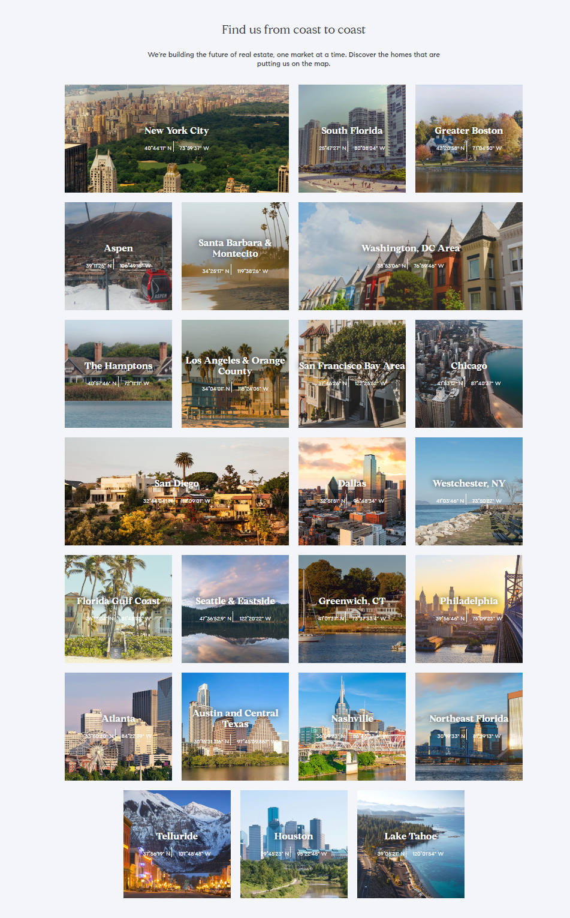
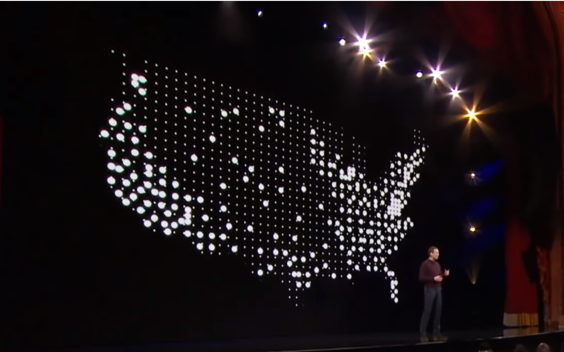
Compass Locations
300 Offices by end of 2019

Slide 11
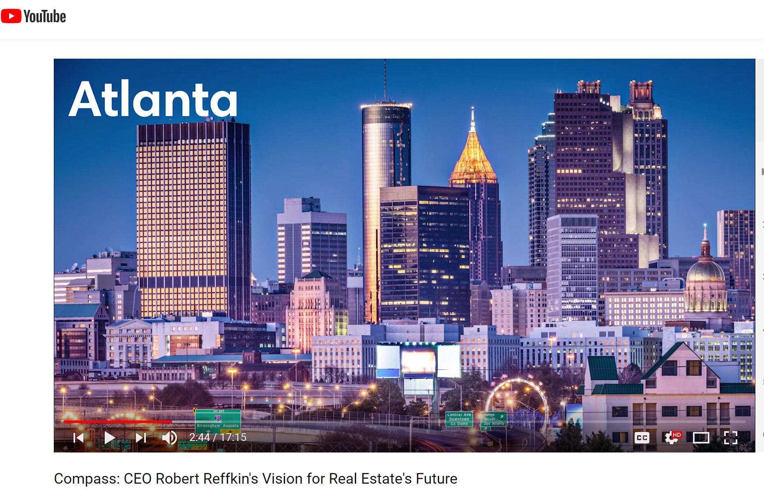
Compass Is In Atlanta
https://www.youtube.com/watch?v=K_yD6itgX9U&list=LLOJzEialegEtLZJTLPRJVng

Slide 12
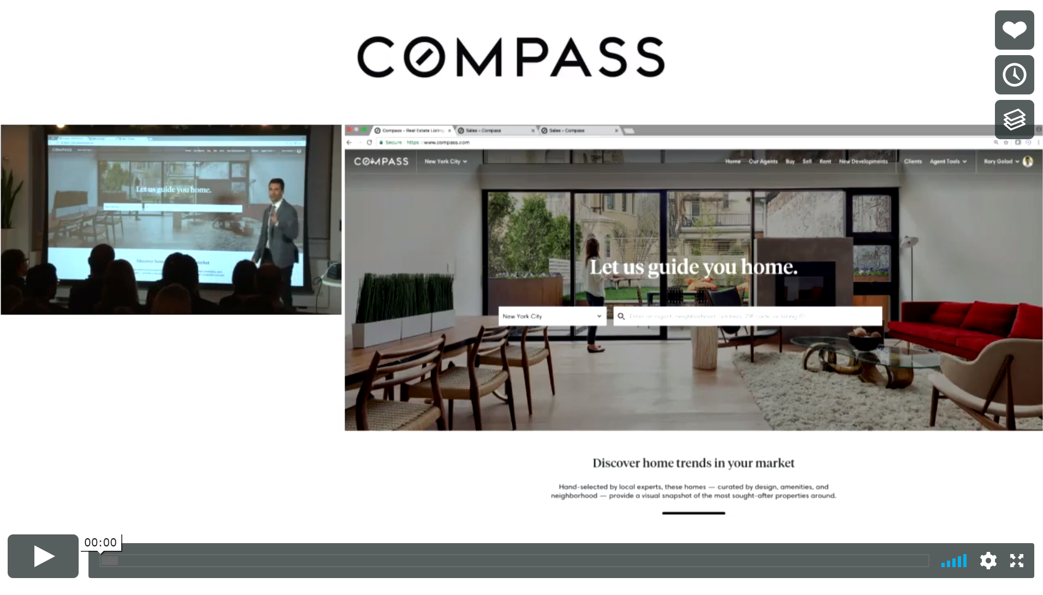
https://vimeo.com/250298441 Password: compasstech

Slide 13

Compass Los Angeles Event
Video: https://www.youtube.com/watch?v=0gutV9Zsk94&feature=youtu.be
Video Notes: http://atlantarealestatescoop.com/wp-content/uploads/2018/12/Compass-Video-Highlights-Los-Angeles-Event-2018.docx

Slide 14
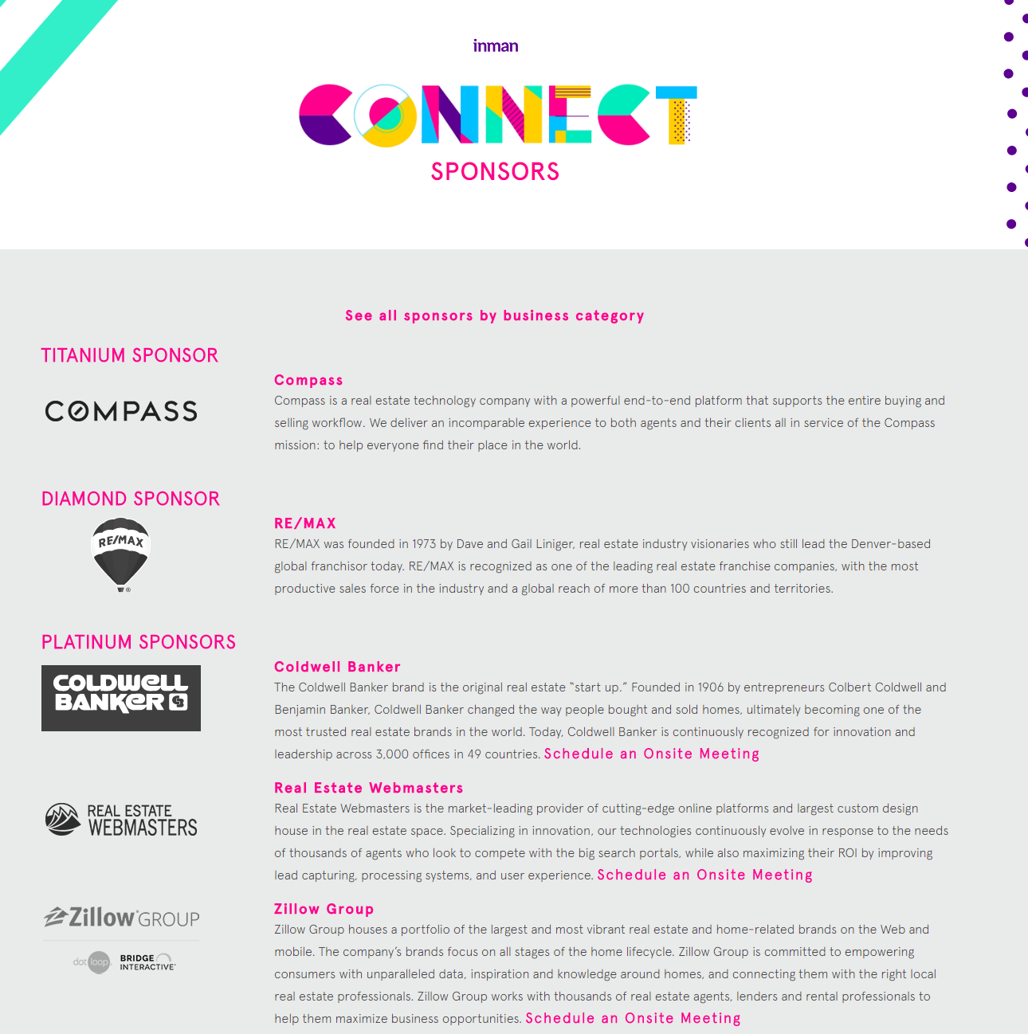
Spending Heavily with Inman News and Many Local Outlets to Influence Perception

Slide 15

How We Built the Compass Tech Suite
Presented by Rory Golod, Chief of Staff
Single most important thing Compass has created? Agent feedback system.
“We’d hate for our competitors to get their hands on this.”
Agents can add suggestions, up-vote other suggestions, and leave comments
Topics: Tech, Marketing, Office Space, Community/Culture, Support

Slide 16
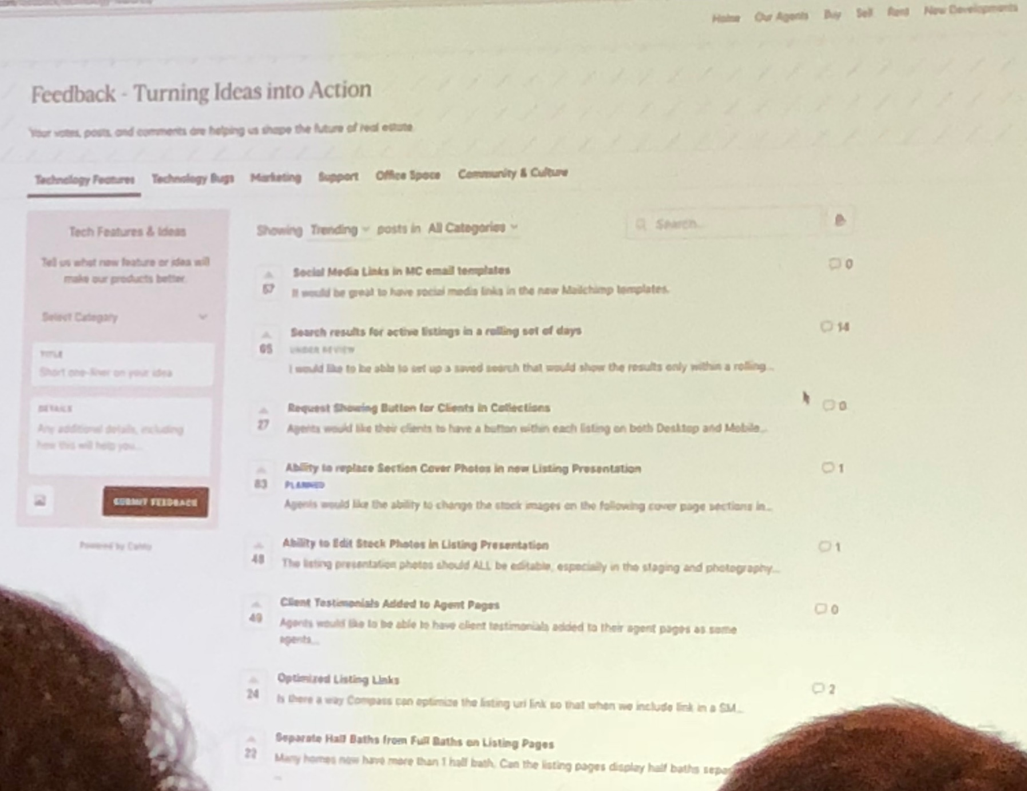

Slide 17
Marketing Platform
Goal: Allow agents to do everything from one platform
Content management system allows agents to create all marketing collateral easily
Postcards, brochures, social media posts, e-newsletters
Print at desk or 3rd party print shop
“The power of Photoshop in the hands of a novice”
One Marketing Services Resource for every 7 agents
Generous Marketing Budgets to fund

Slide 18
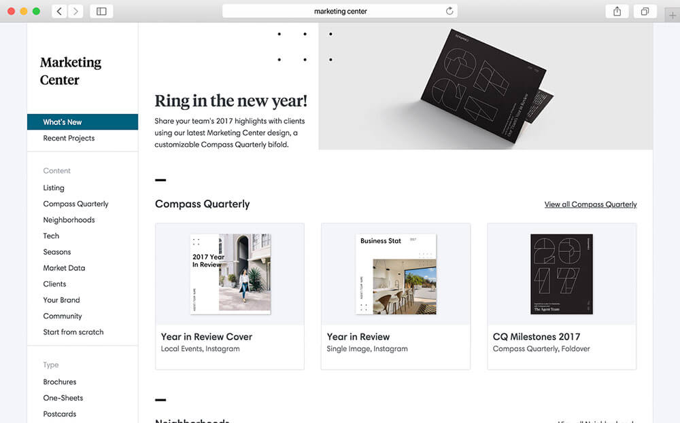

Slide 19



Agent Logos

Slide 20
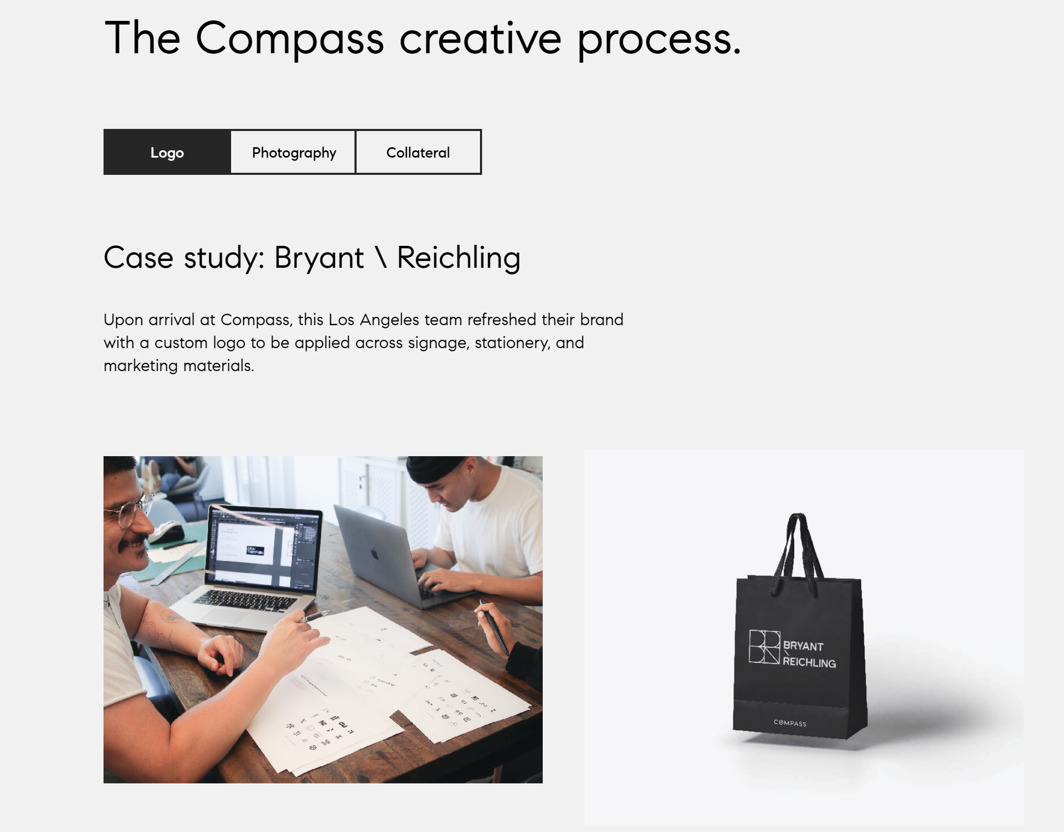

Slide 21
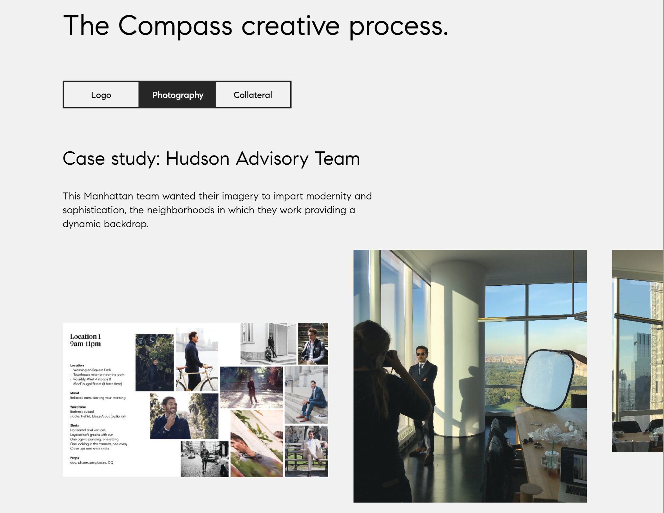

Slide 22
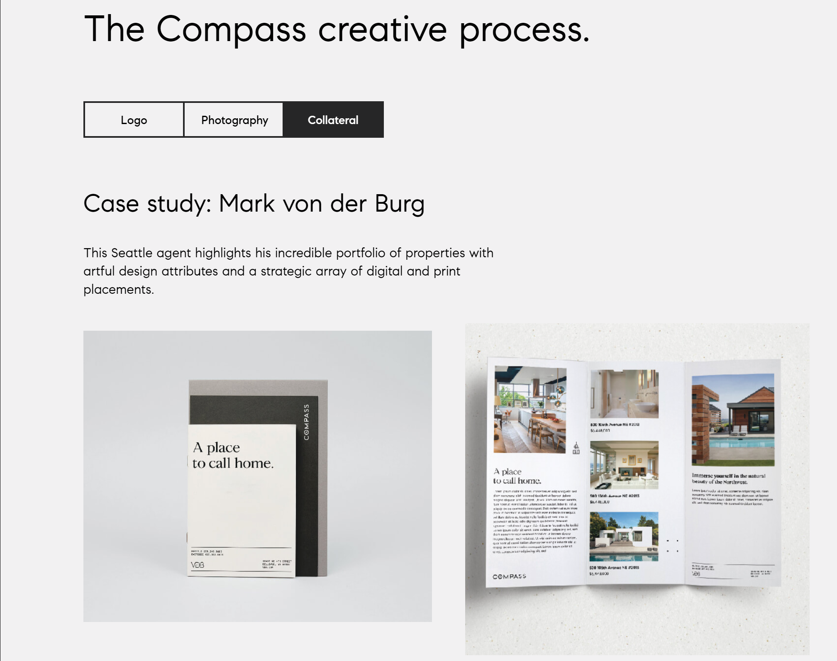

Slide 23
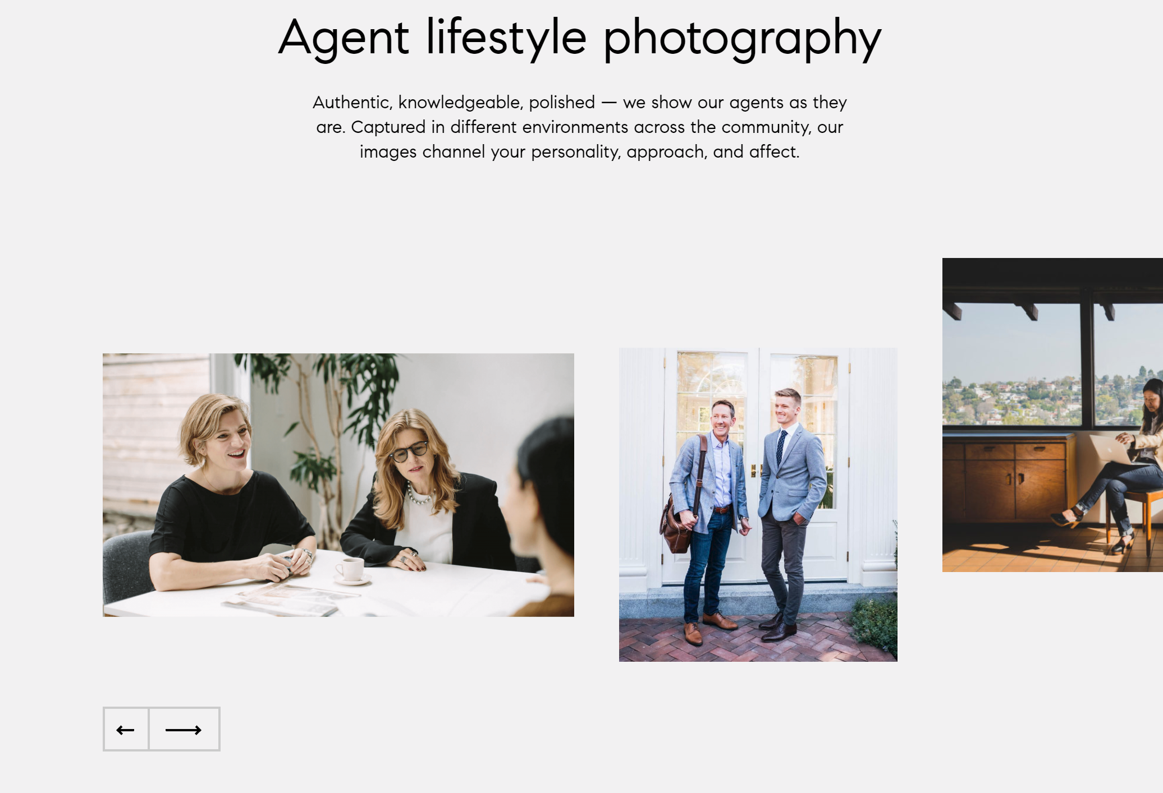

Slide 24
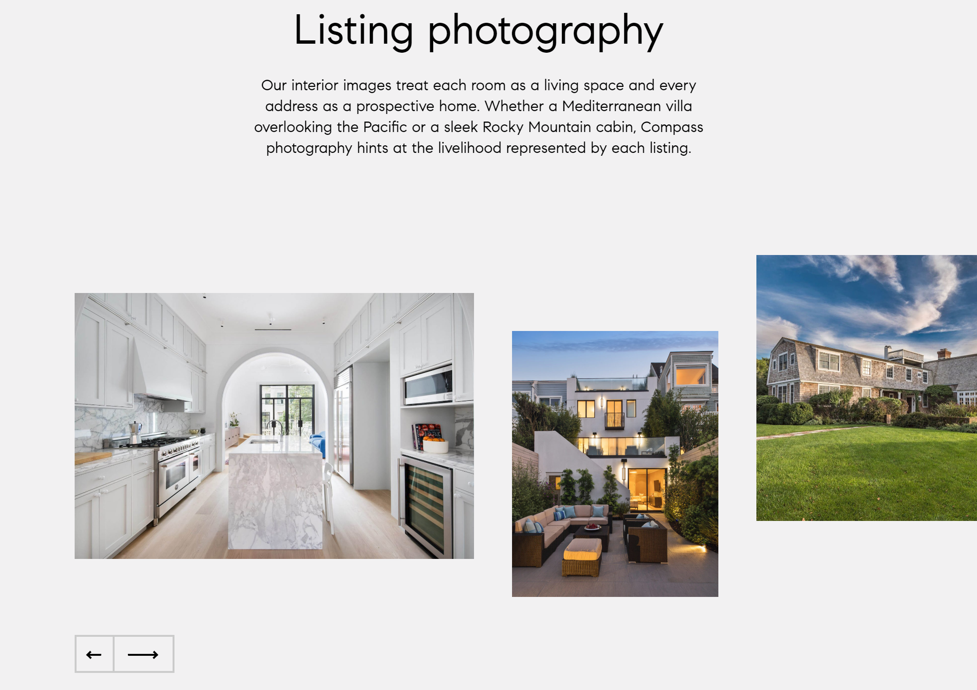

Slide 25
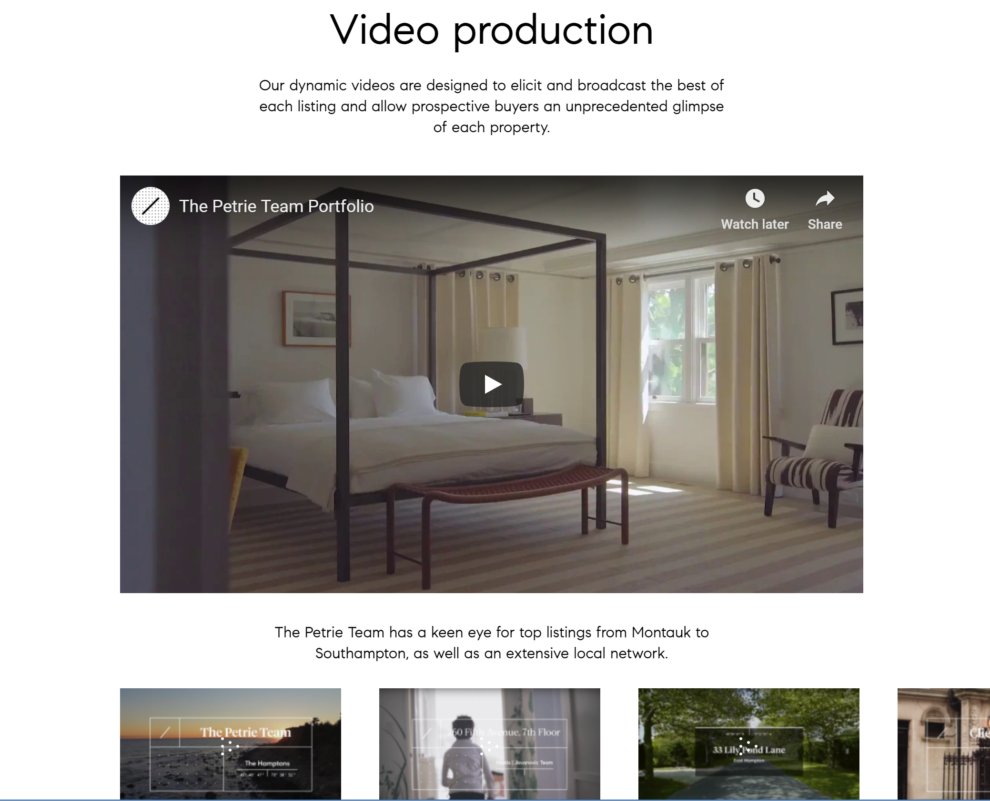

Slide 26
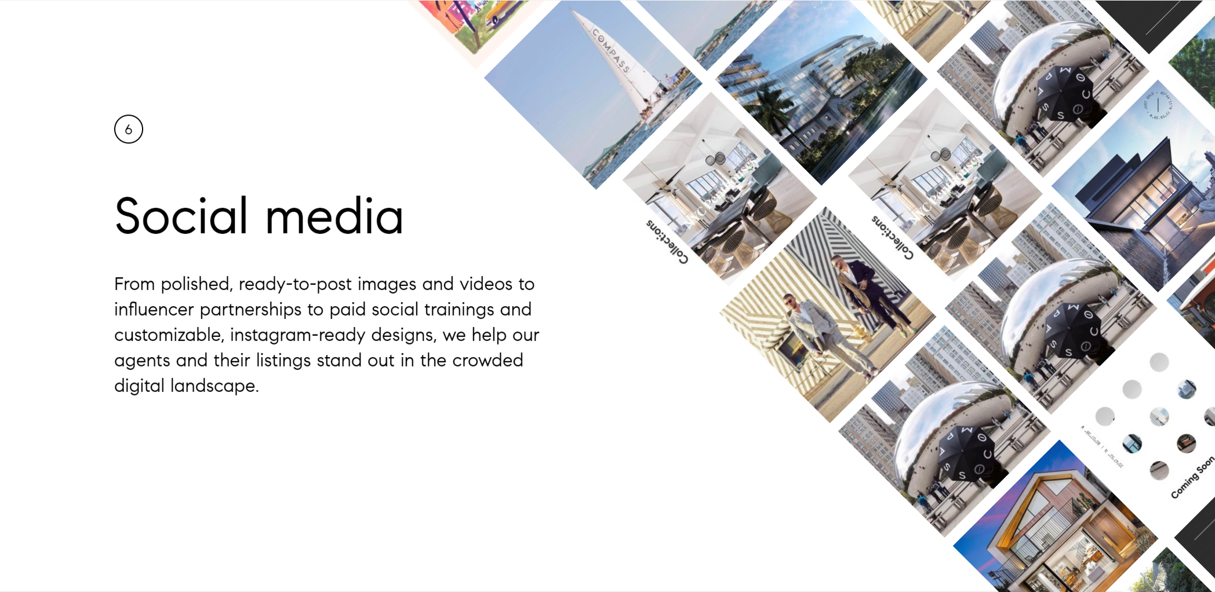

Slide 27
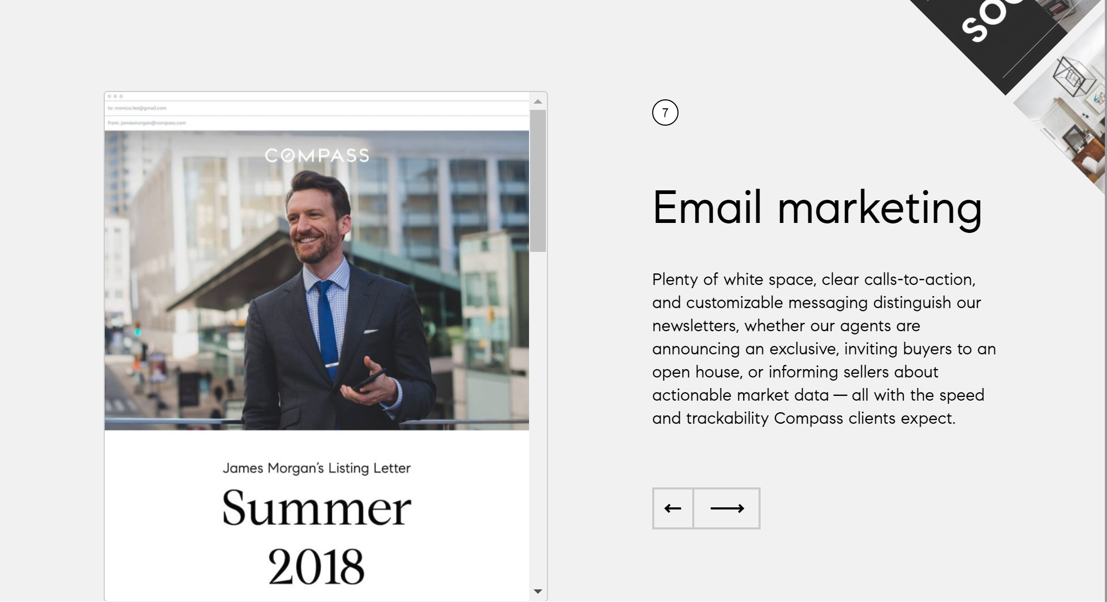

Slide 29
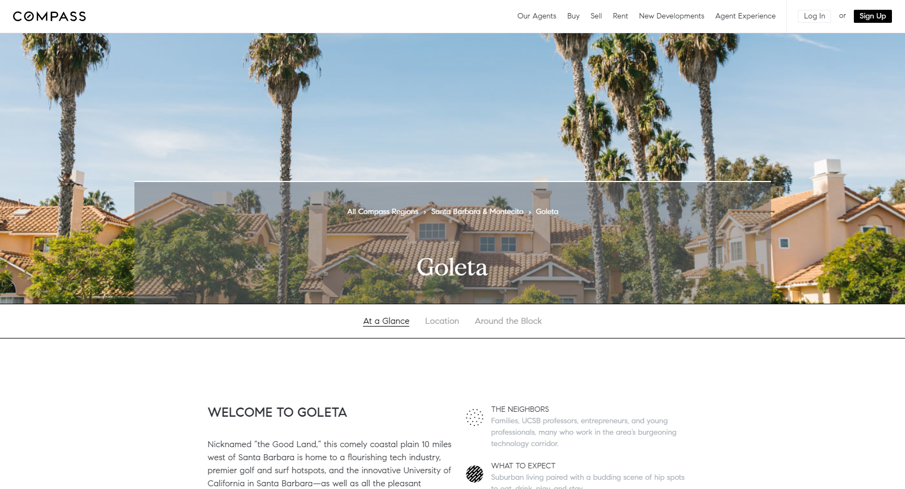
Compass Neighborhood Guides
Example: https://www.compass.com/neighborhood-guides/santa_barbara_montecito/goleta/

Slide 30
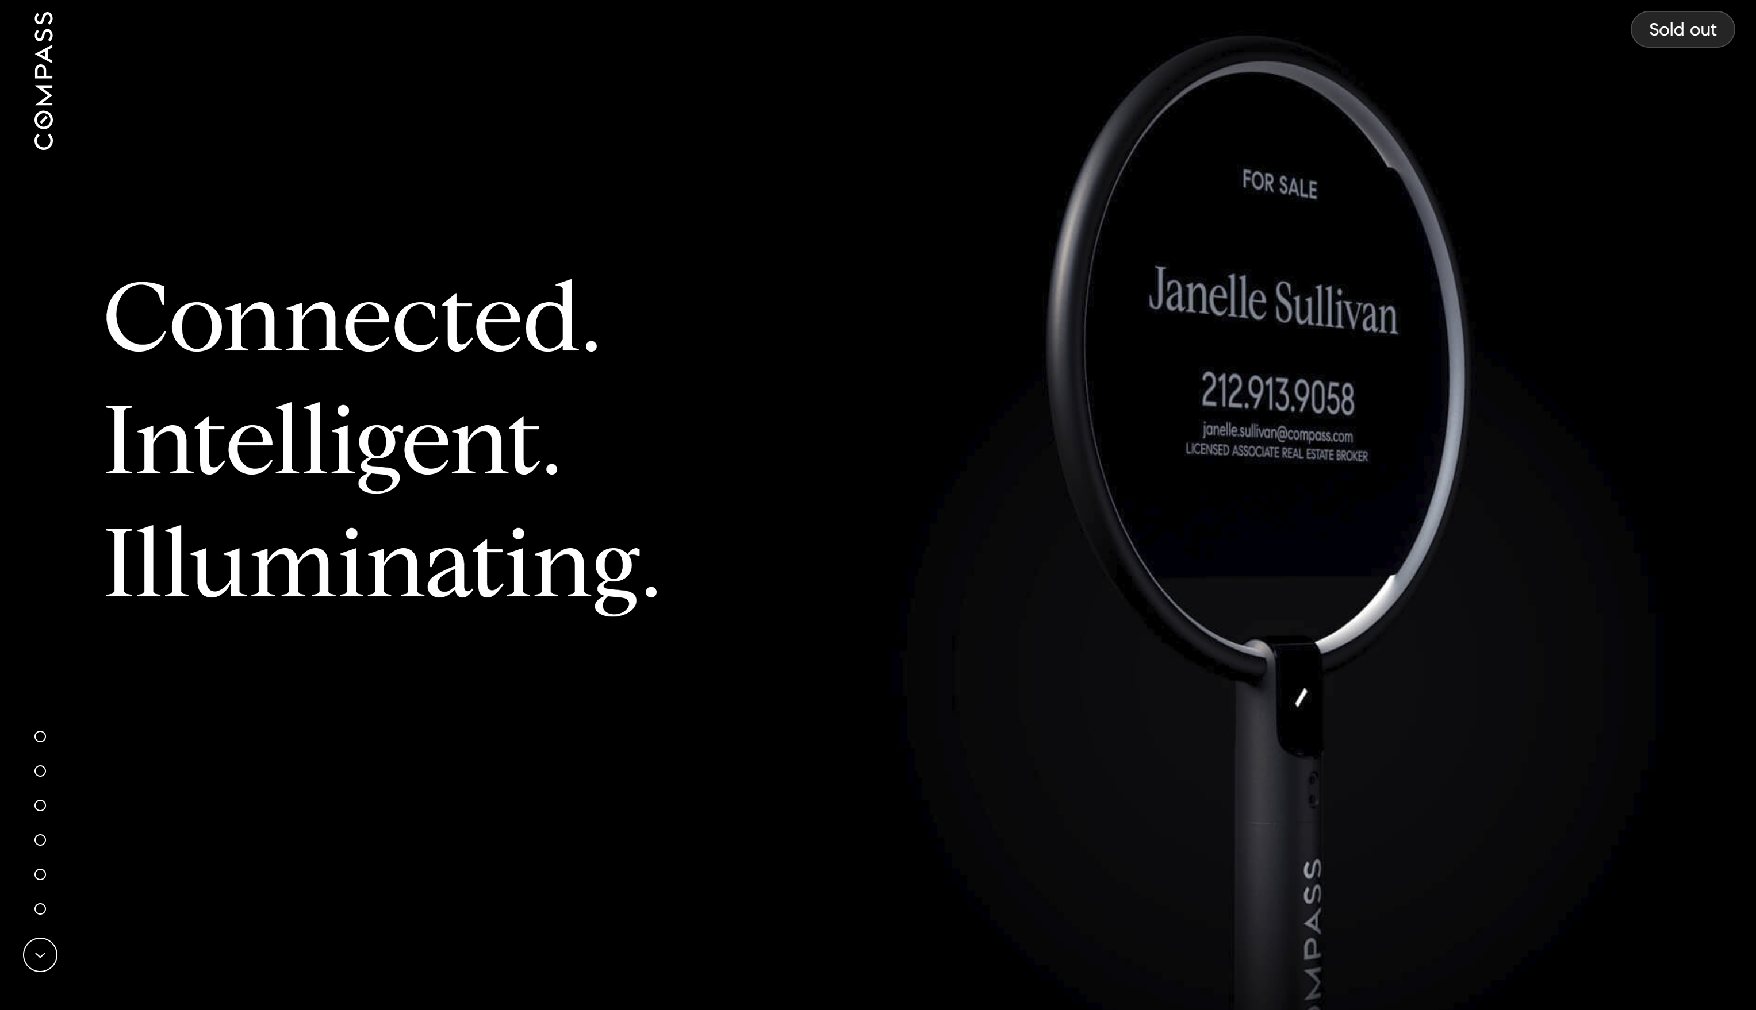
More Info Available: sign.compass.com

Slide 31
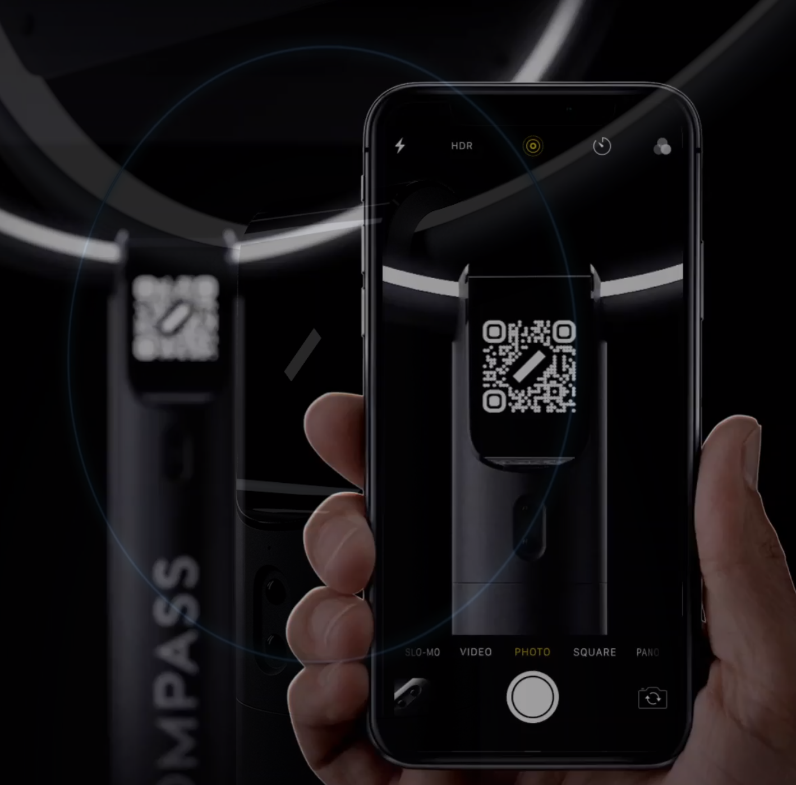
Compass Sign
Motion-sensor illumination when consumer comes within 20 feet
QR Code
Bluetooth
Beacon Technology
Allows consumer to connect and view listing info from the Compass App
Agent can customize listing info with 3D tour, floor plans, video, photos
Includes WAZE ads for the listing
Modular assembly for easy transport
Customizable with agent riders, illumination settings
Battery recharges in 3 hours and lasts 2 weeks
Initial cost $1000. Expect substantial reduction in cost over time.

Slide 32
Workspace for Buyers
Toursheet to view multiple properties
  Routes pre-calculated and easily edited in real-time
  Email listing agent with pre-populated message to schedule showing
  Add appointments to calendar
  Send link and calendar appointment to client

Slide 33
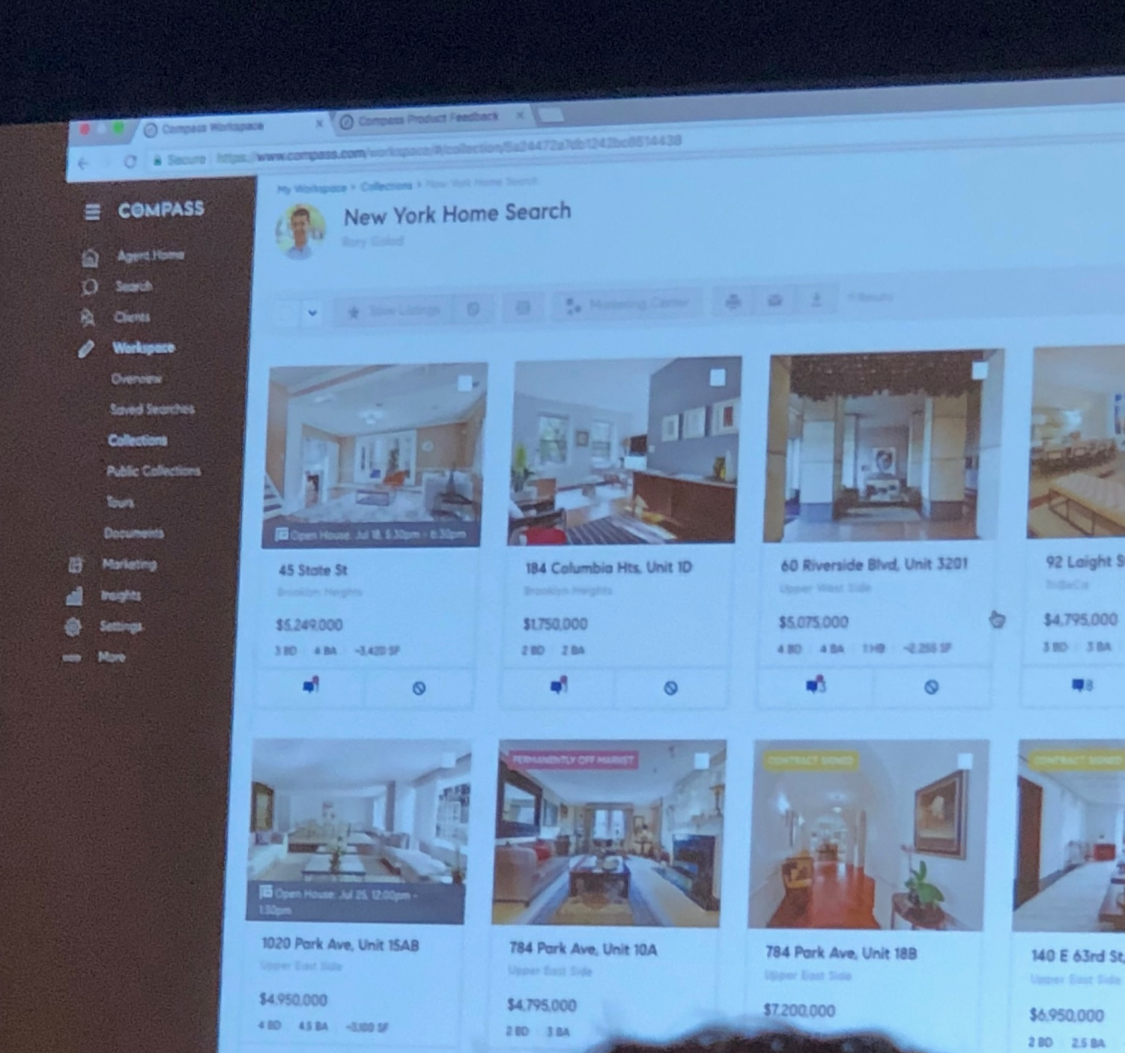

Slide 34
Collections
Organize
Collaborate (Chat with Clients)
Discuss
Monitor
Built in Pinterest style user interface

Slide 35
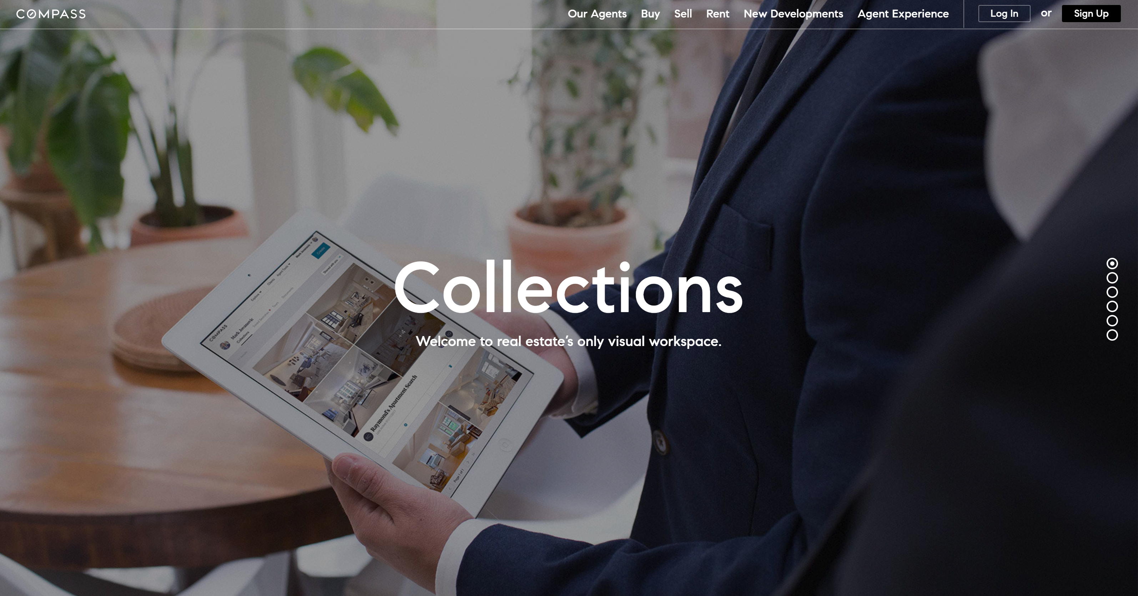

Slide 36
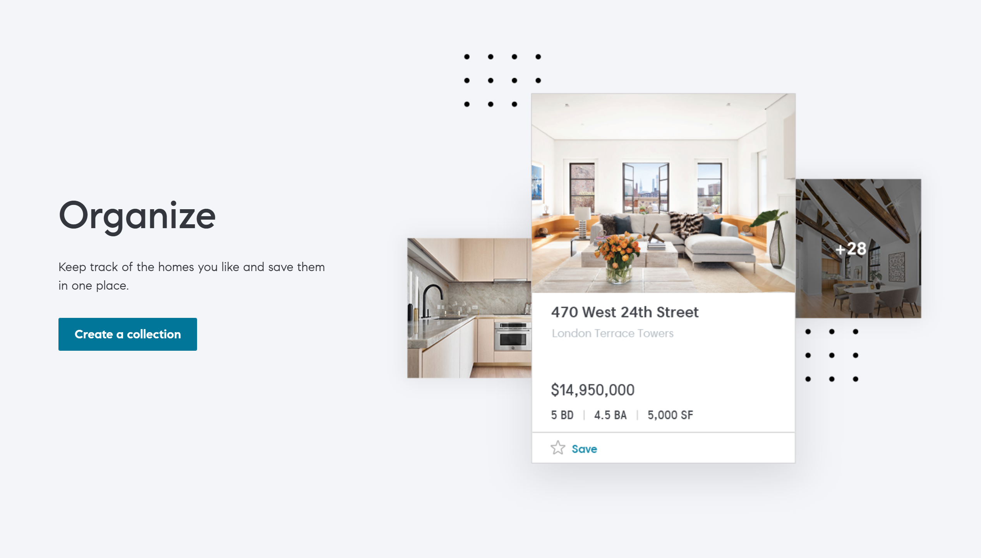

Slide 37
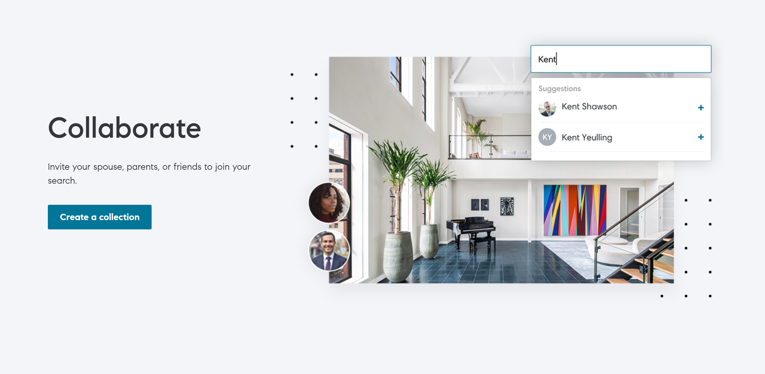

Slide 38
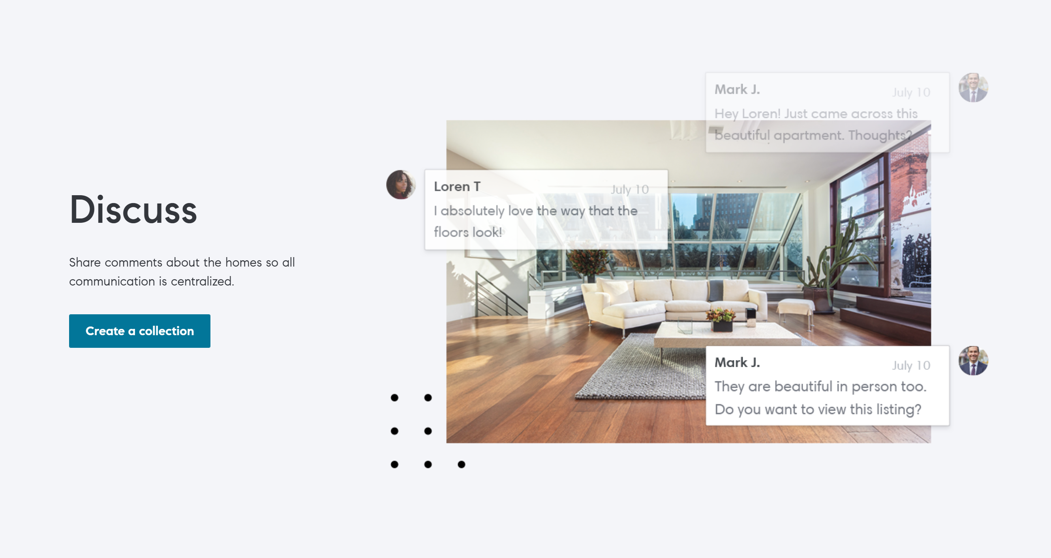

Slide 39
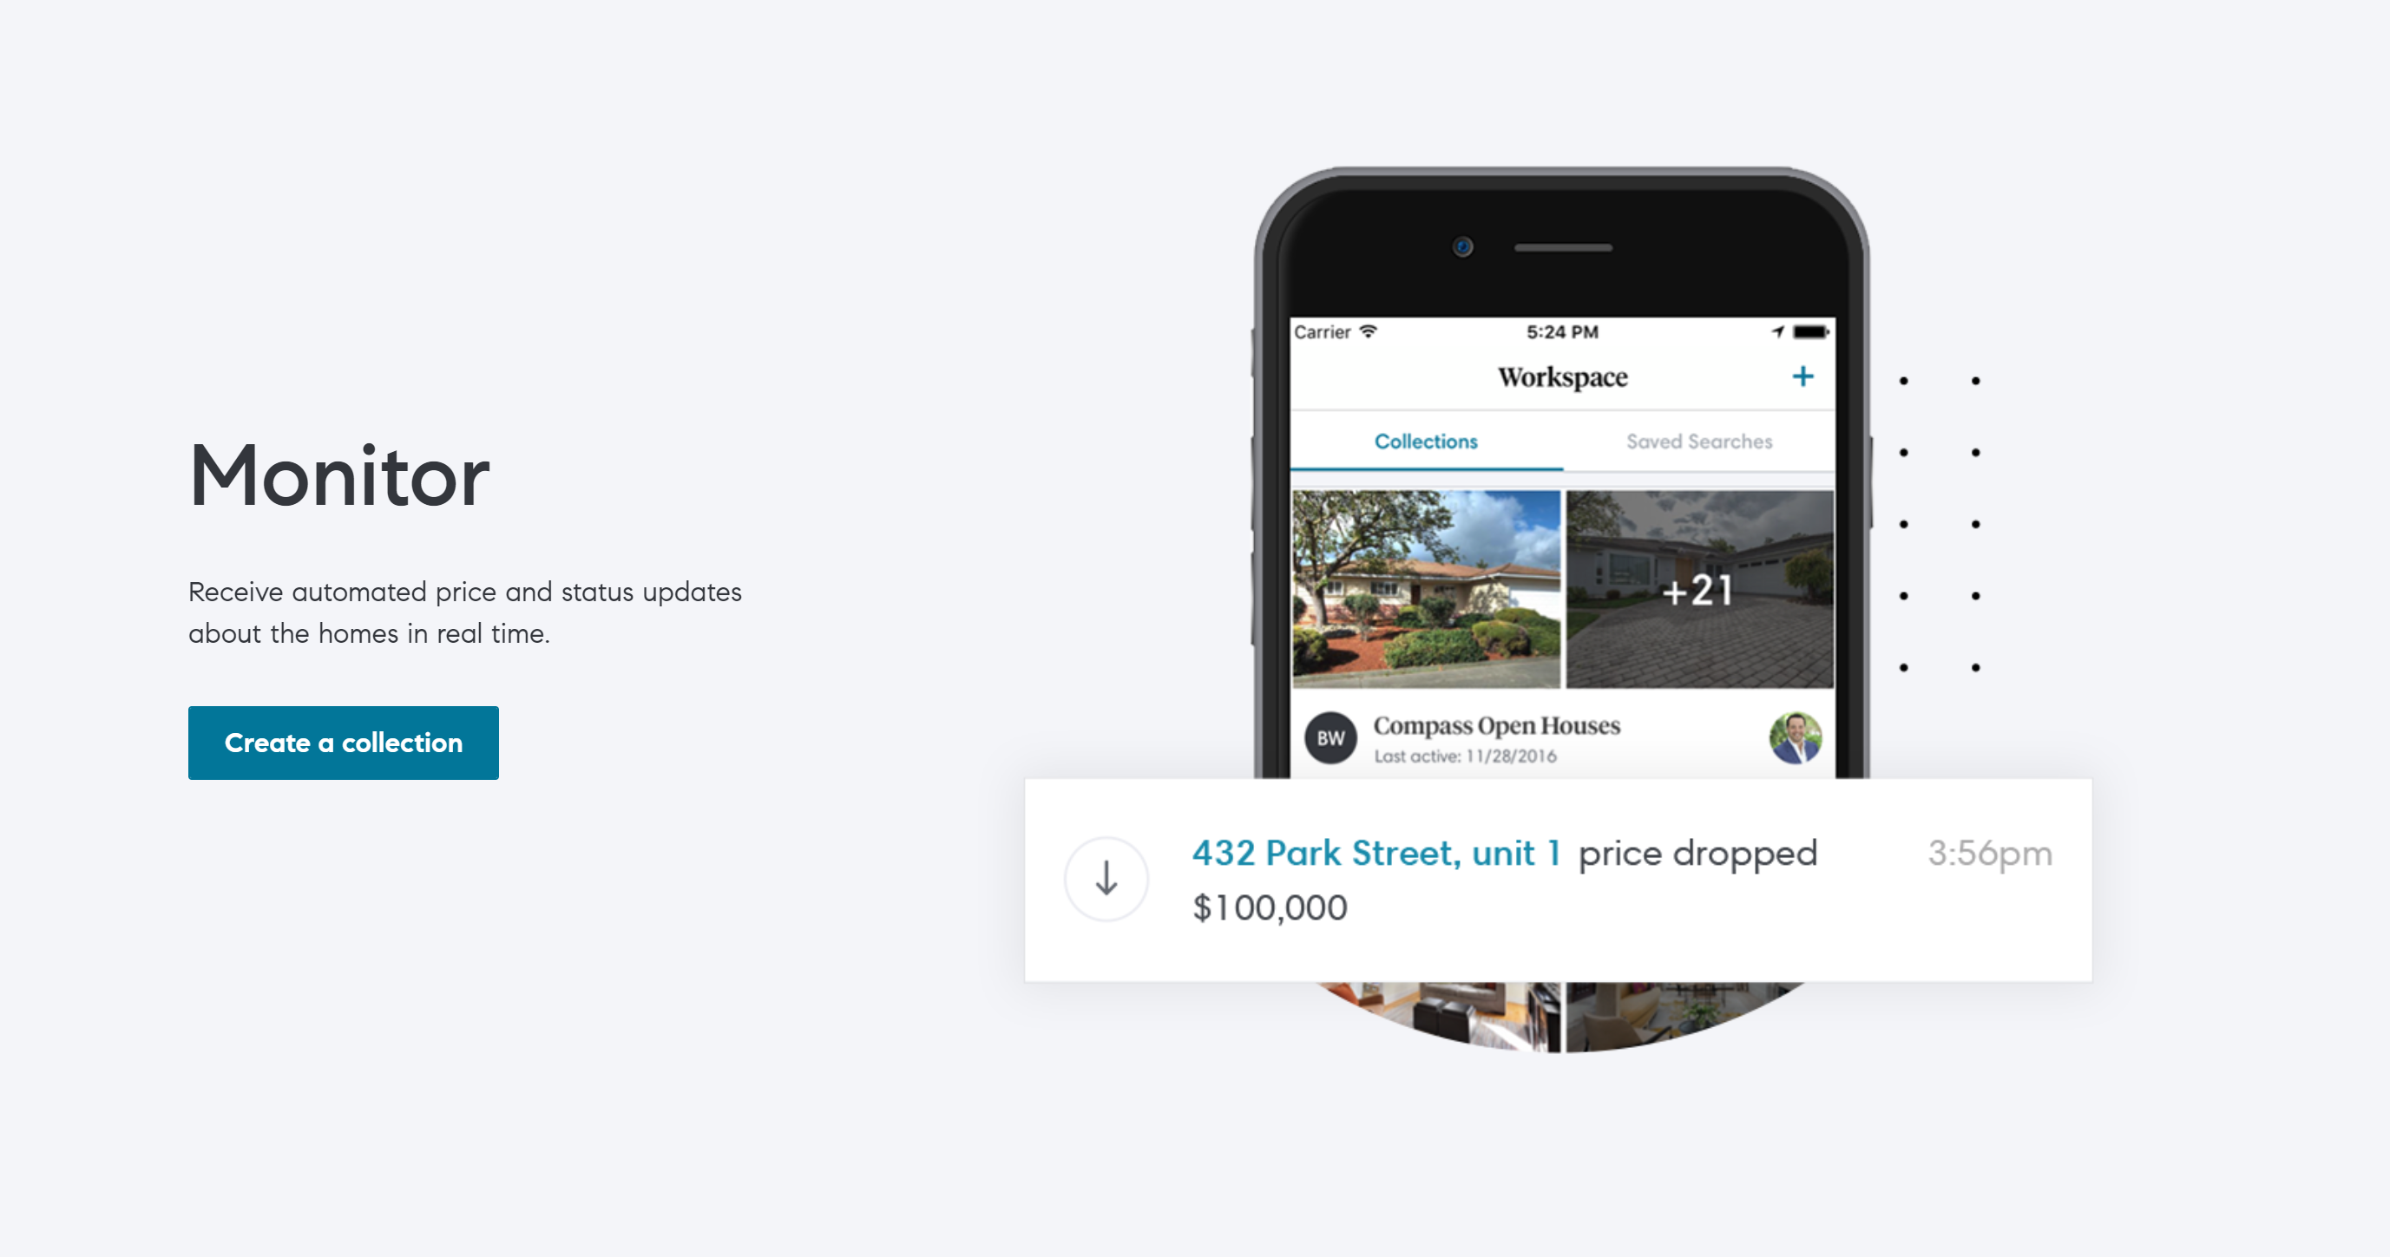

Slide 40
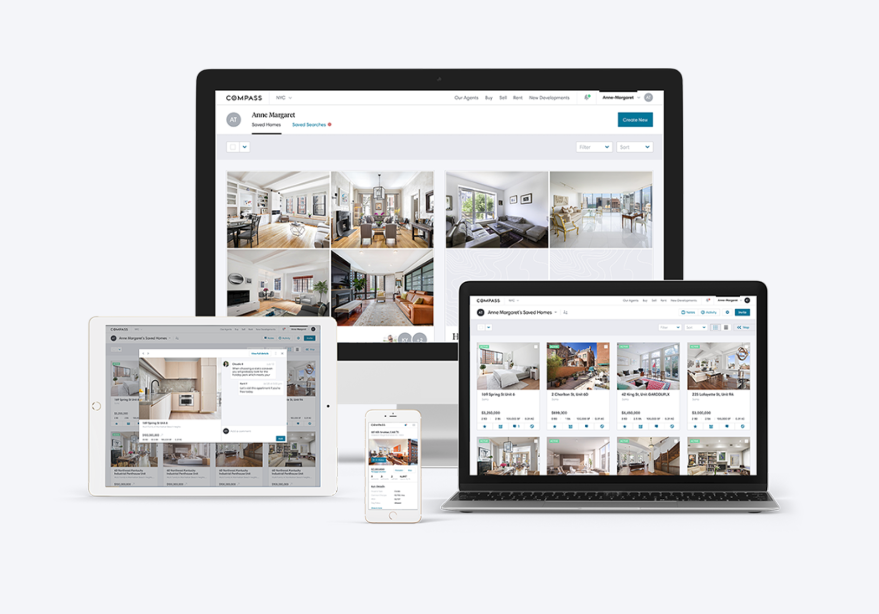

Slide 41
Insights
Views, time spent, new/returning, traffic source
Listings, agent profile, collections
Key insights
Available for Compass website and selected aggregators
Social targeting for viewers of competing listings

Slide 42
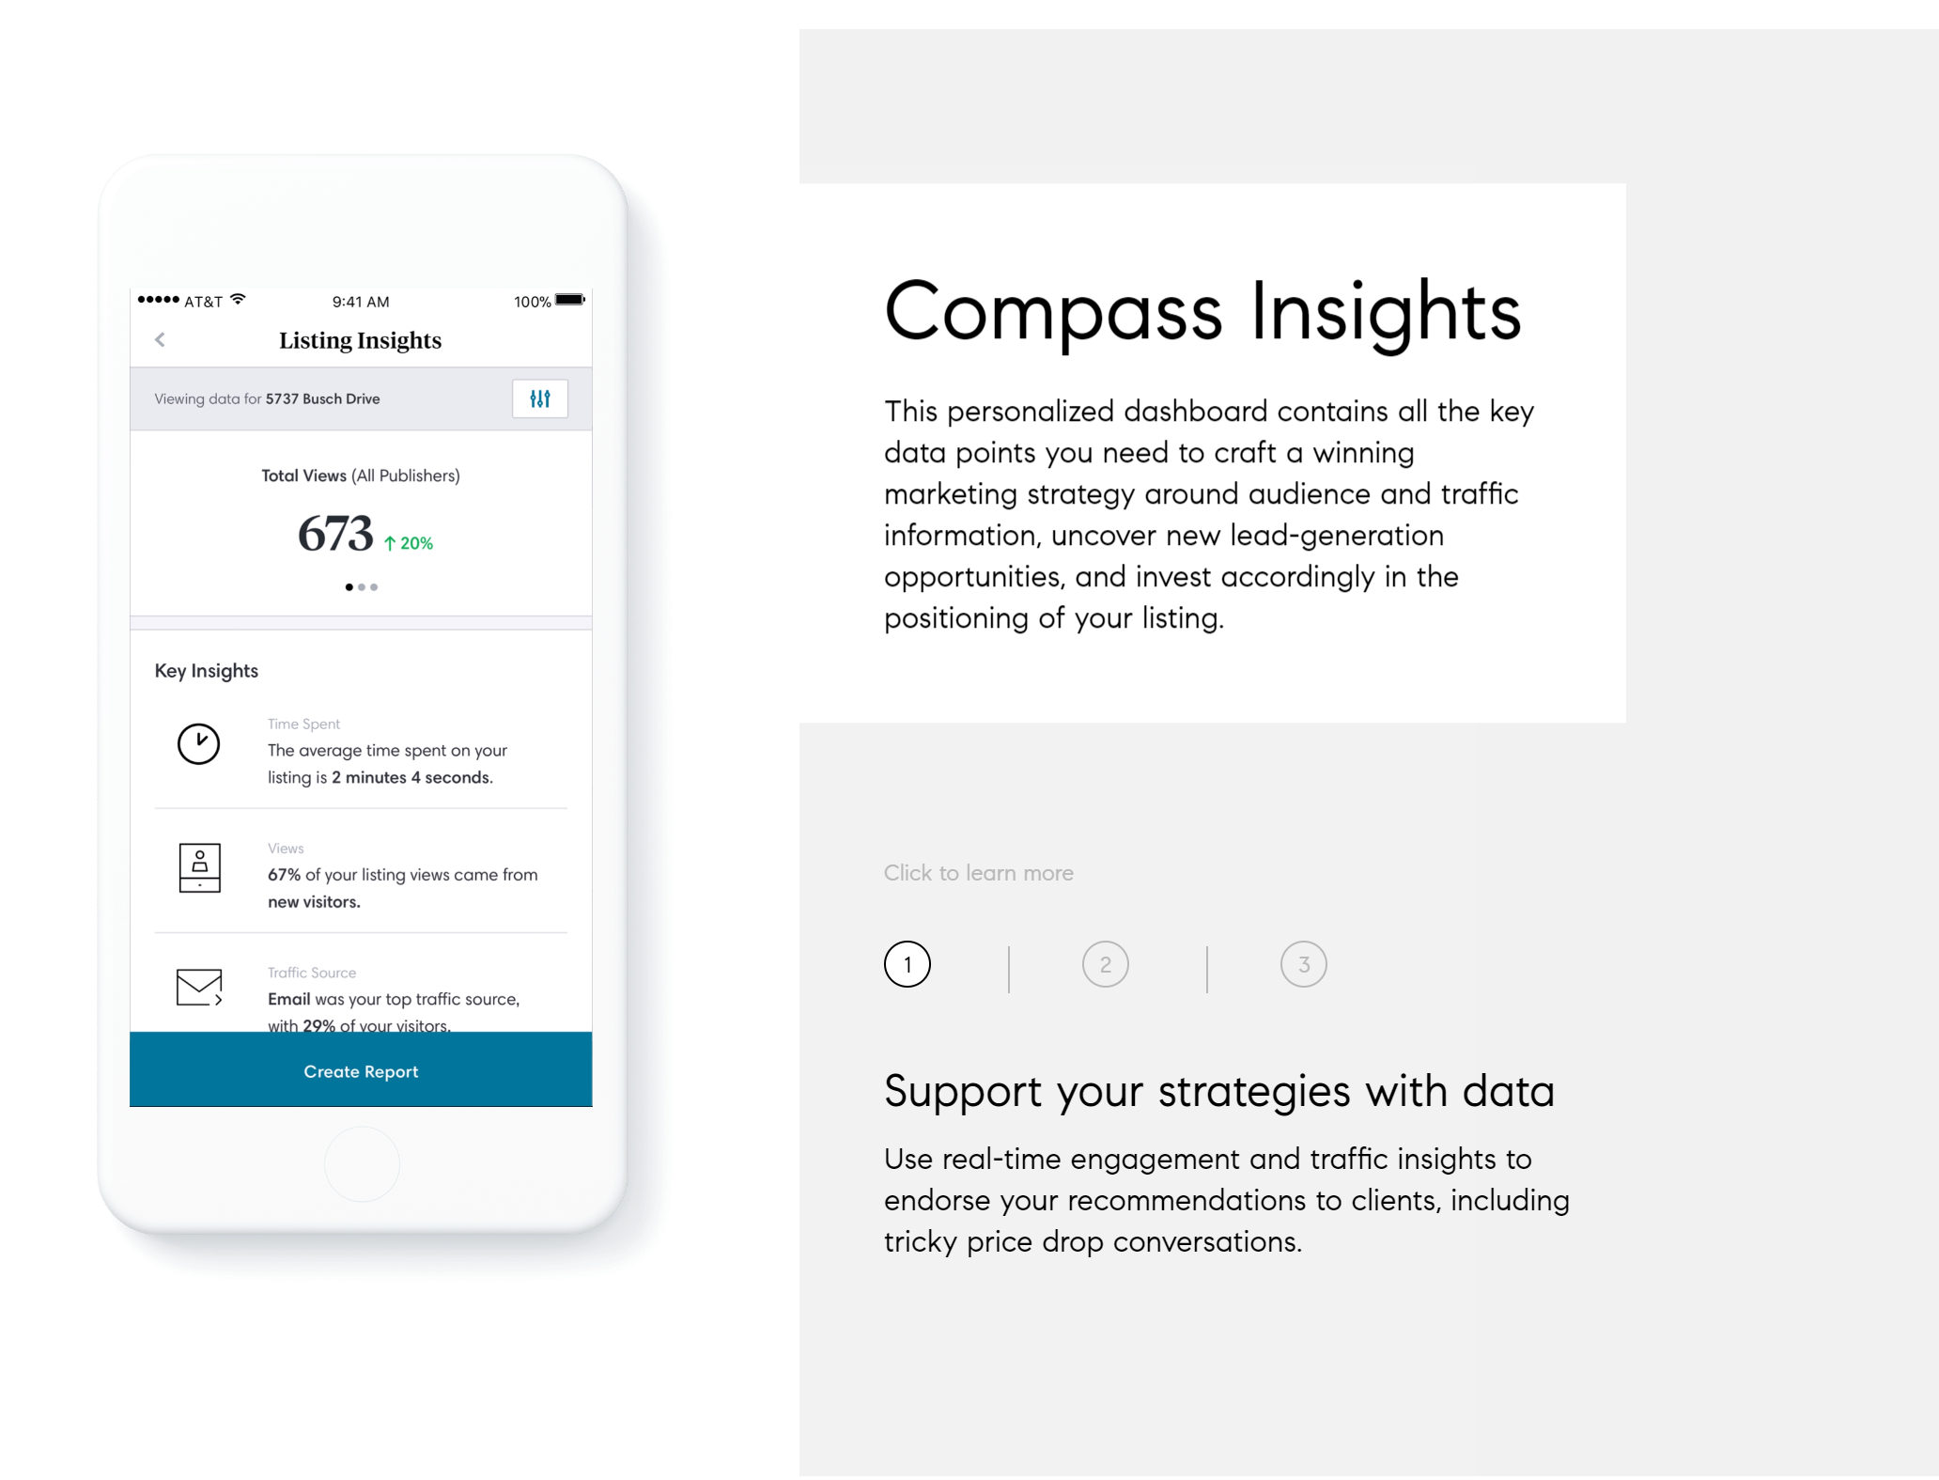

Slide 43
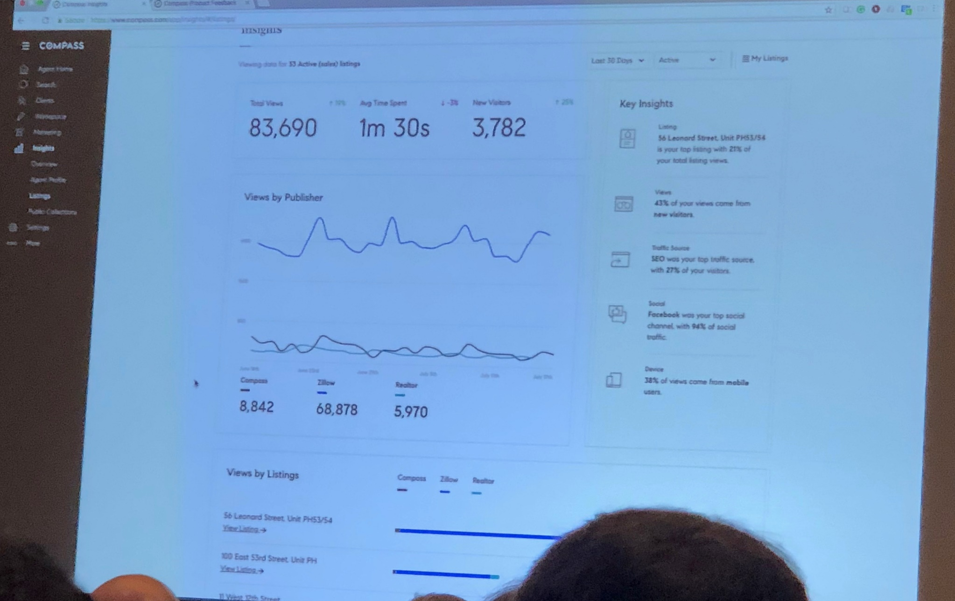

Slide 44
Network Tool
Show active agents with similar listings/buyer transactions
Contact top agents in other markets (at Compass or other brokerages)
Network with agents likely to bring a buyer for your property
Find international buyers

Slide 45
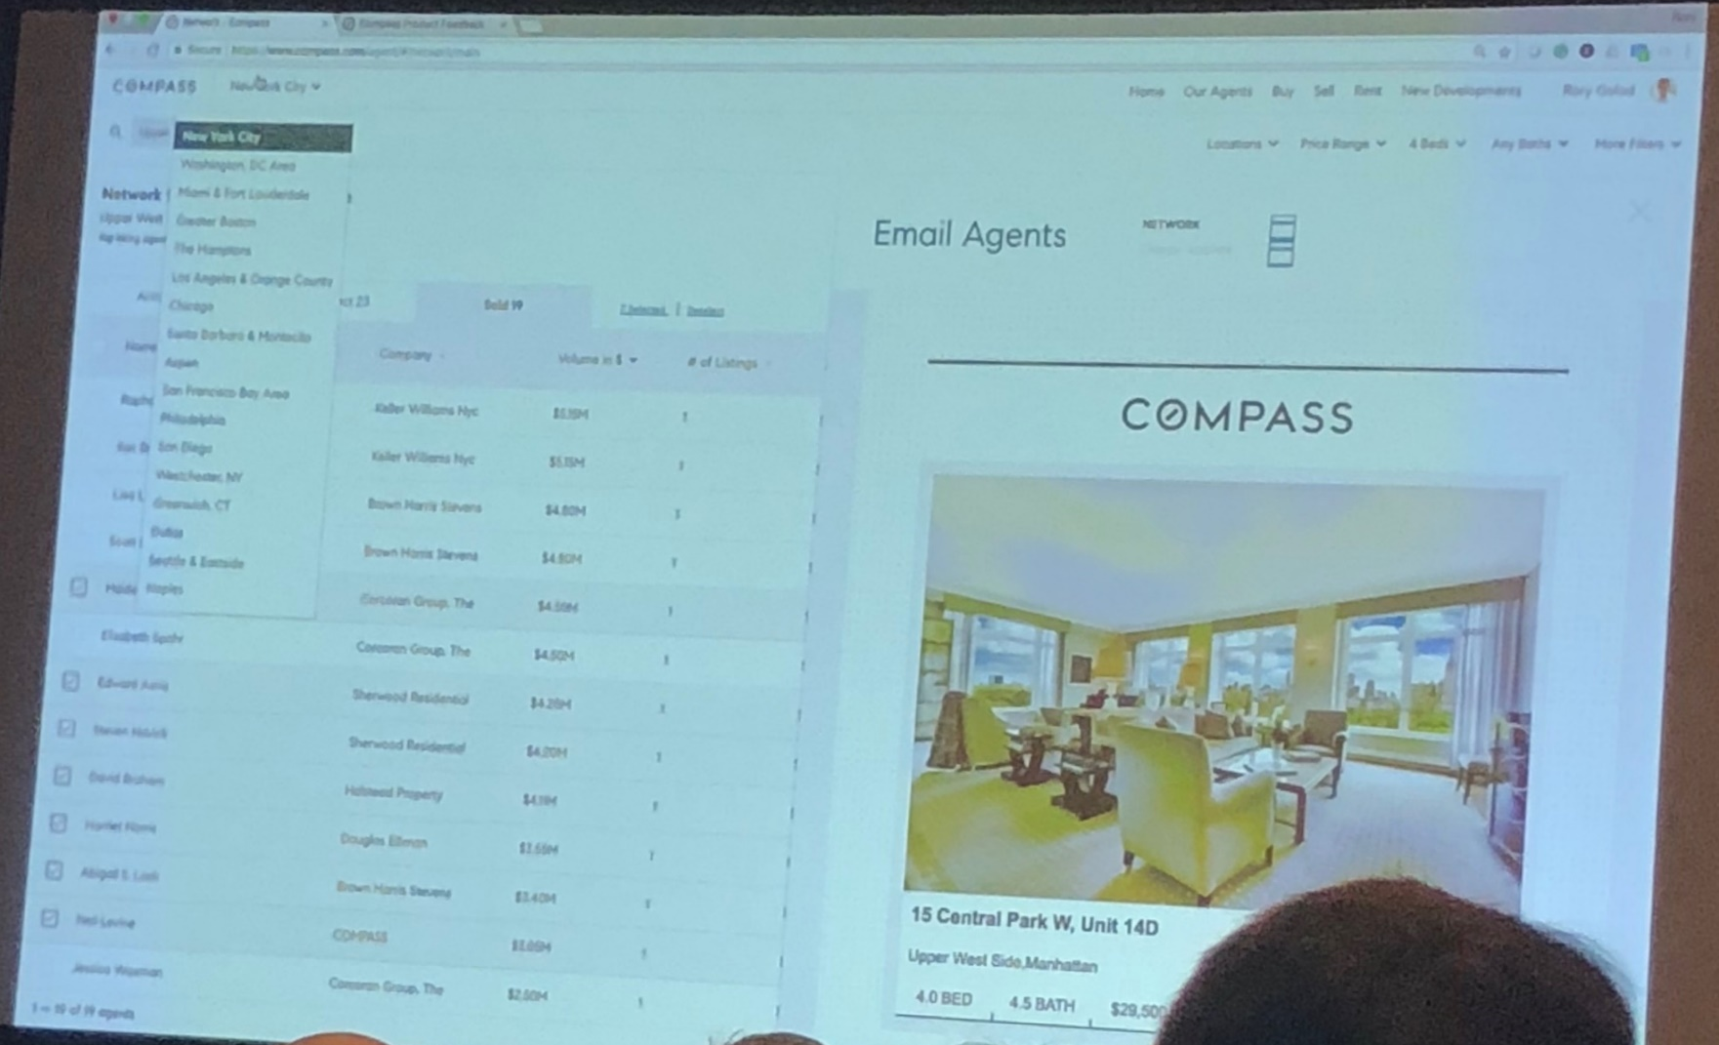

Slide 46
Mobile Platforms
All tools are available on mobile app
Including market data

Slide 47
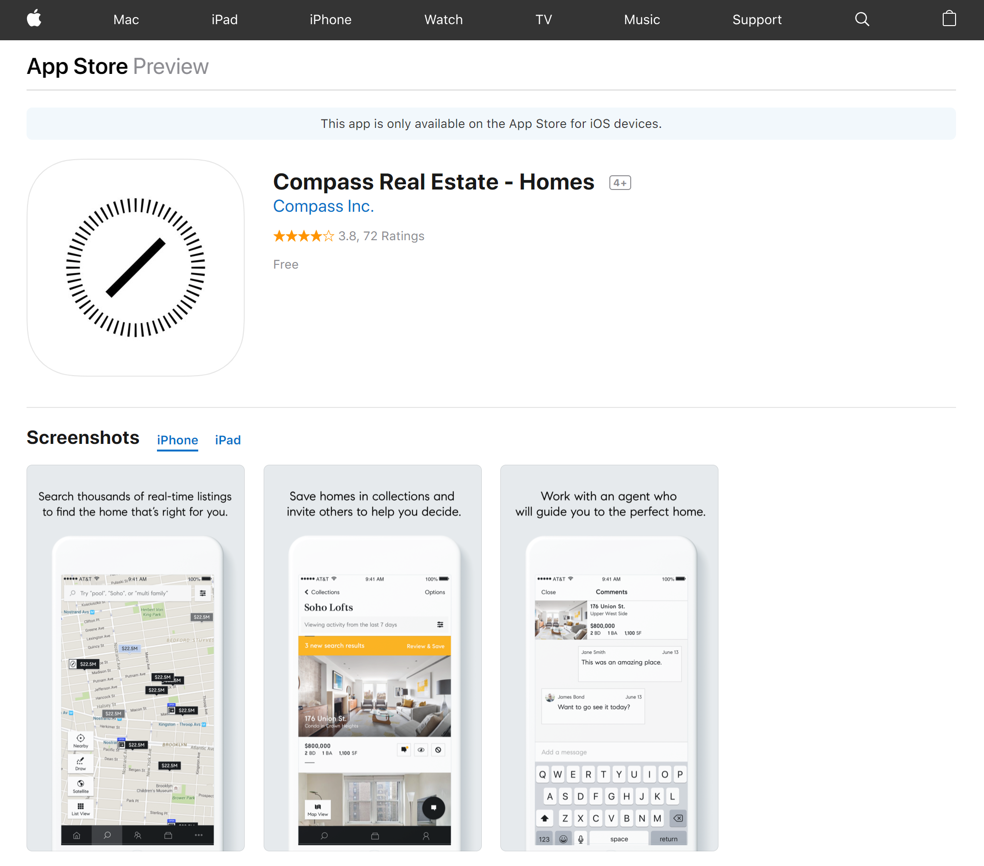
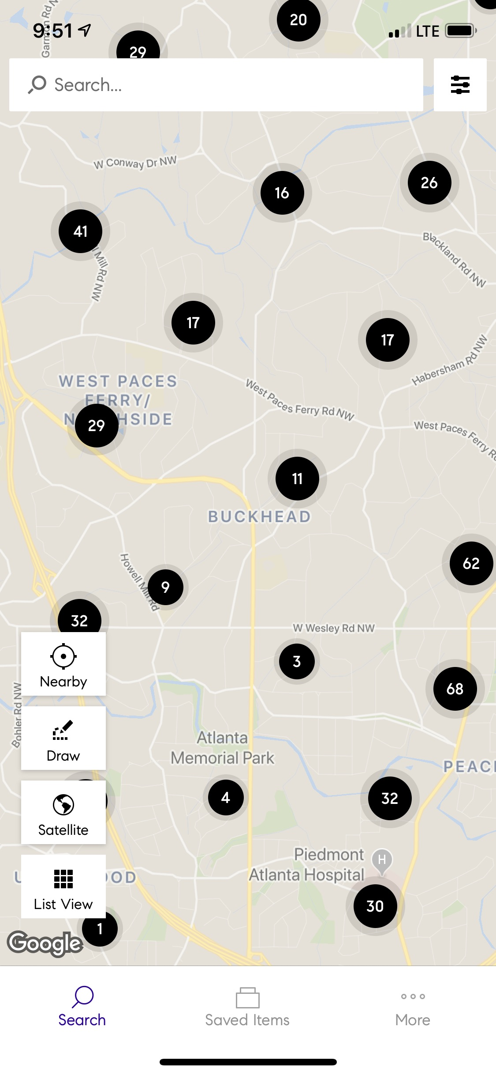

Slide 48
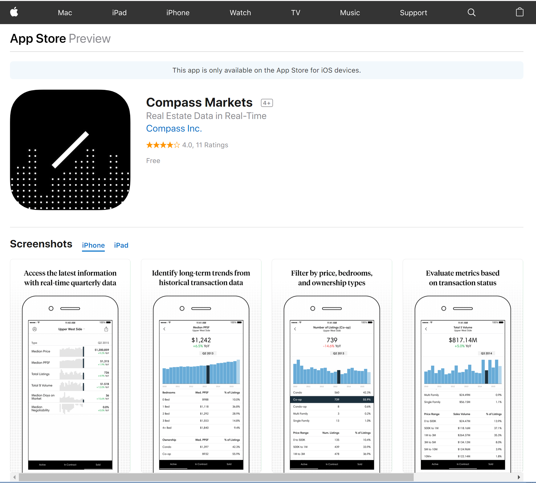
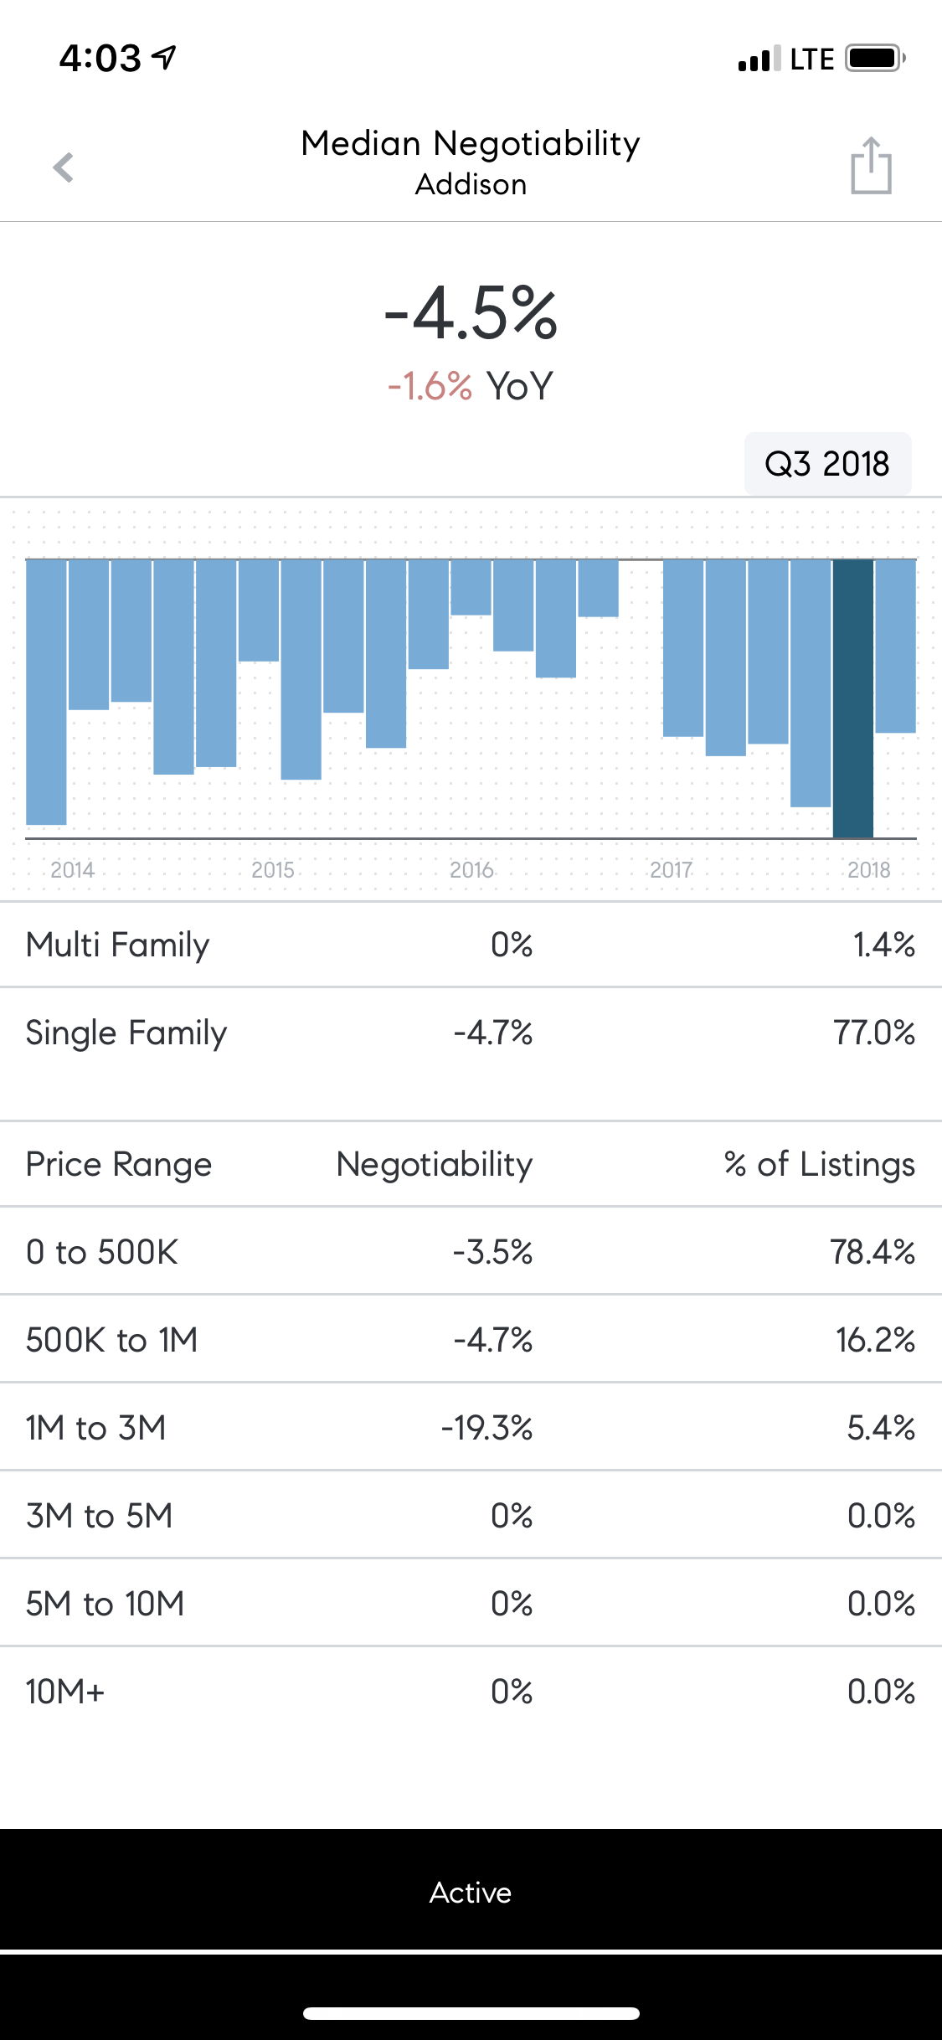

Slide 49
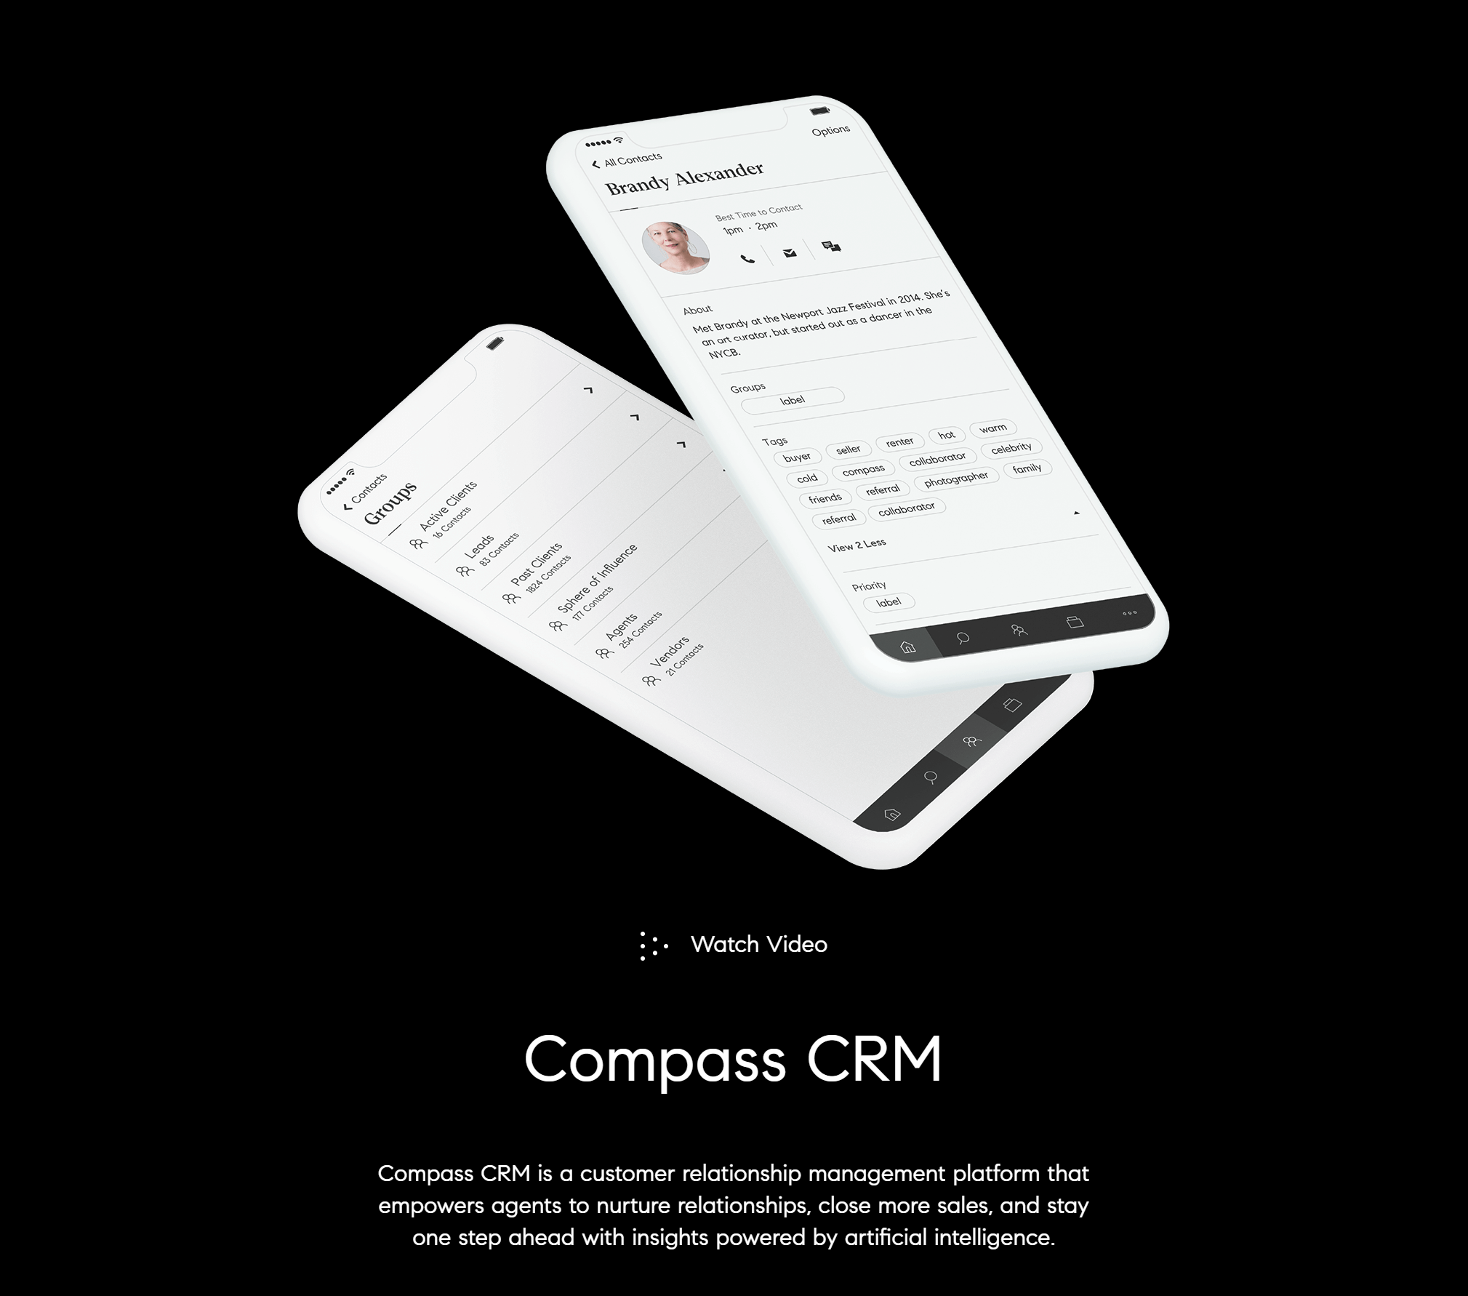
CRM Overview
Powered by Artificial Intelligence
Contacts
Deals
Keeps contacts updated
Predictive insights
Sales pipeline
Commission modeling
Track activities
Transforming data into actionable insights
Compass Data Pledge
We believe Agent's data is their own and we will always allow agents to take their client database with them.
We will never contact Agent's clients without their explicit permission.

Slide 50
NEW and IMPROVED CRM
Internally developed CRM scheduled for launch on 9/17/18. Official launch did not happen.
Acquired Contactually in February 2019.
Questions their initial strategy to develop solutions in-house. Now Robert Reffkin says they will have a mix of in-house and acquired technology.

Slide 51
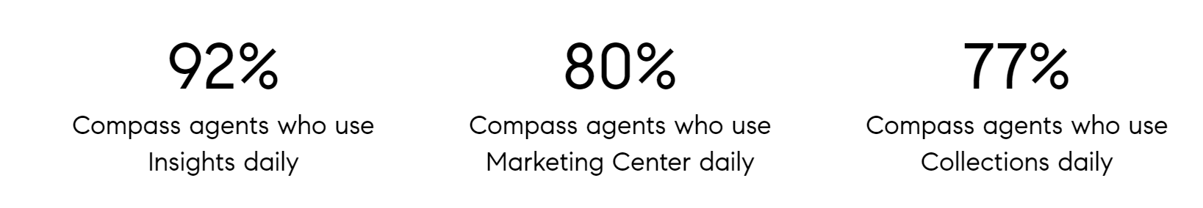
Coming Next:
Digital Marketing Platform for social media and Google AdWords advertising
Transaction management (within 12-18 months)
Compass Marketplace - Platform to allow agents to earn referral money on ancillary services (moving companies, interior design, furniture, lawn care, insurance, etc.)

Slide 52
Specialty Markets
New Developments
Sports & Entertainment
Commercial

Slide 53
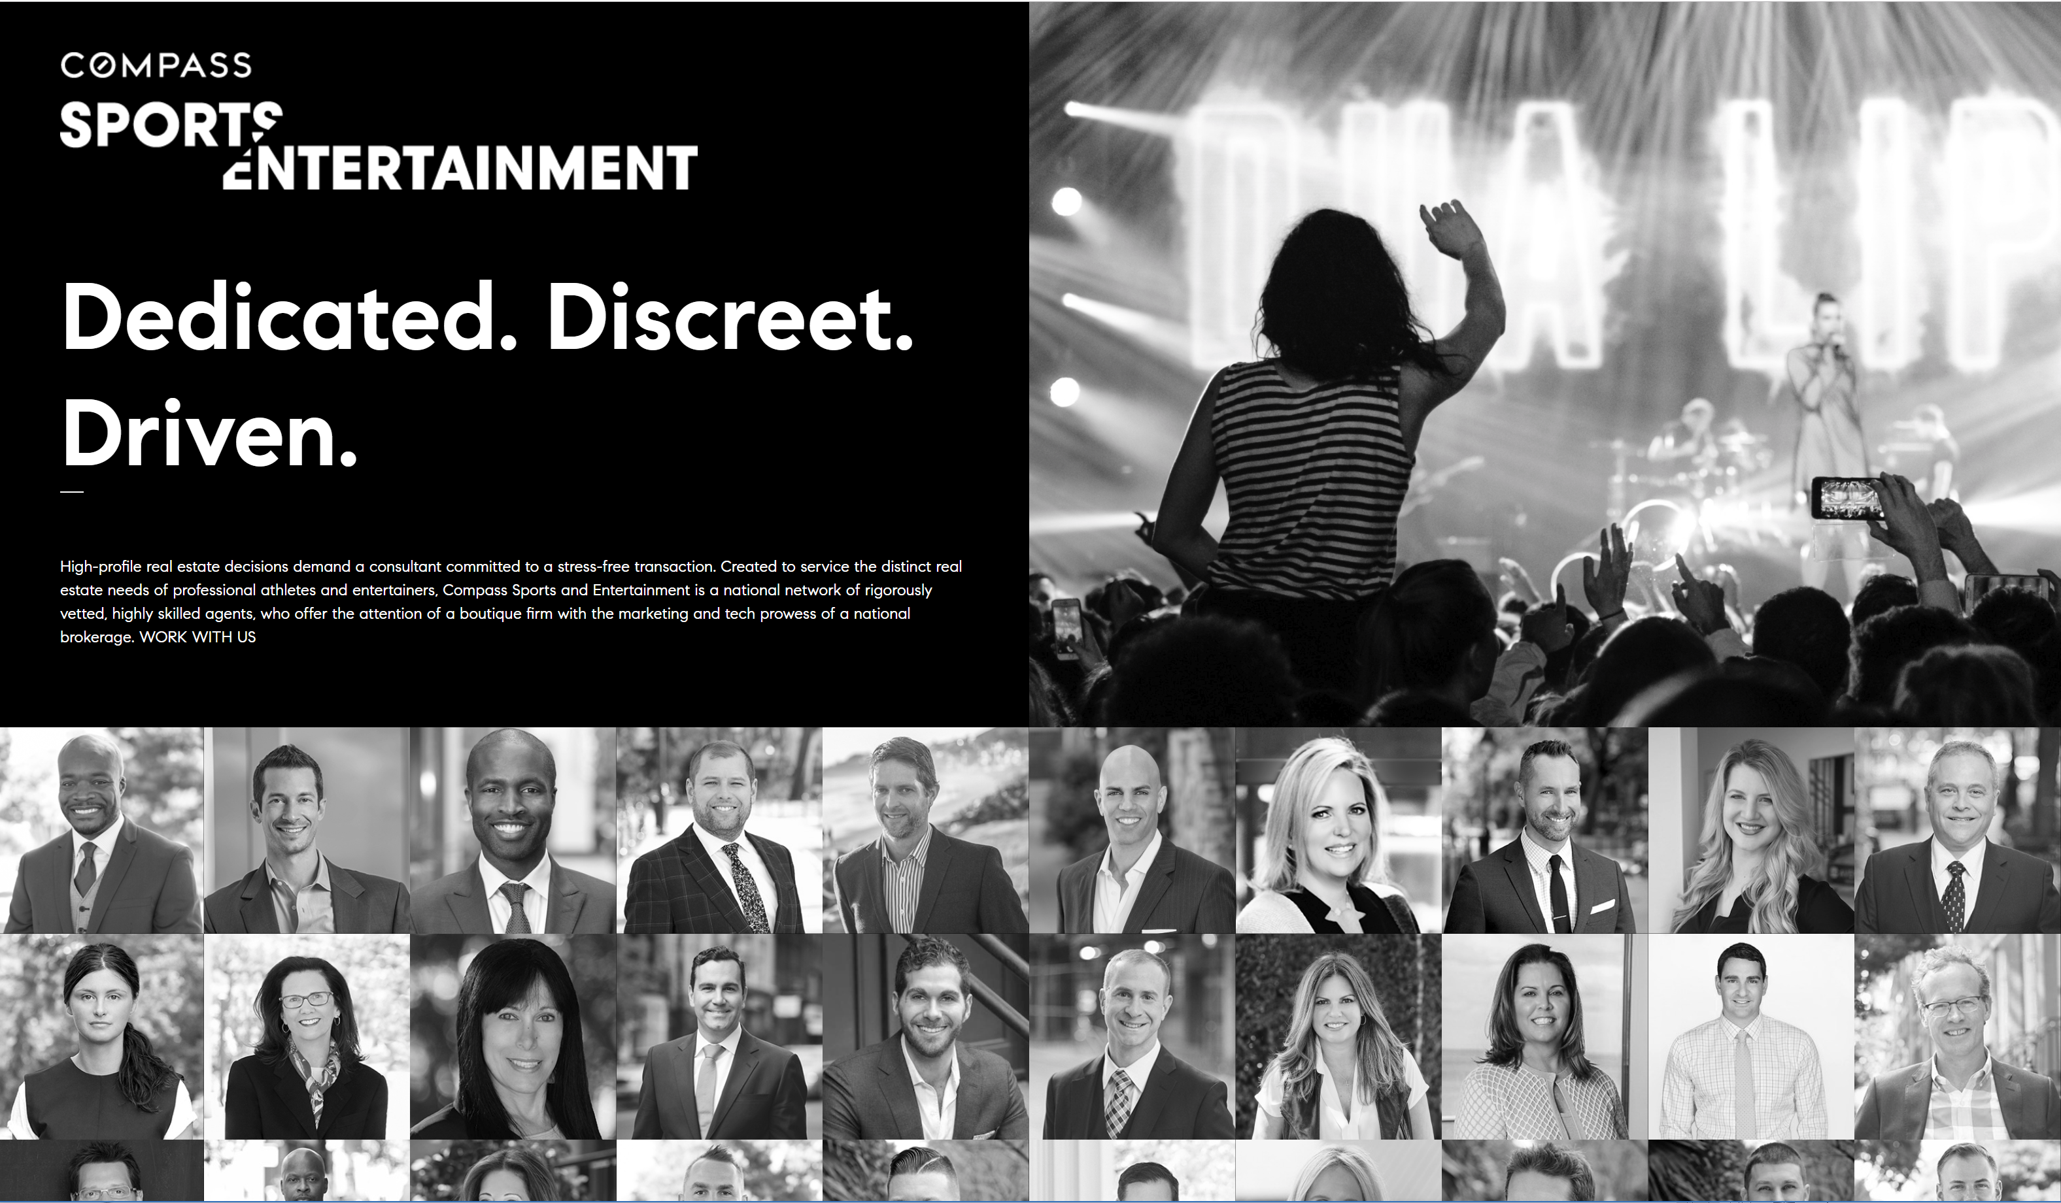

Slide 54
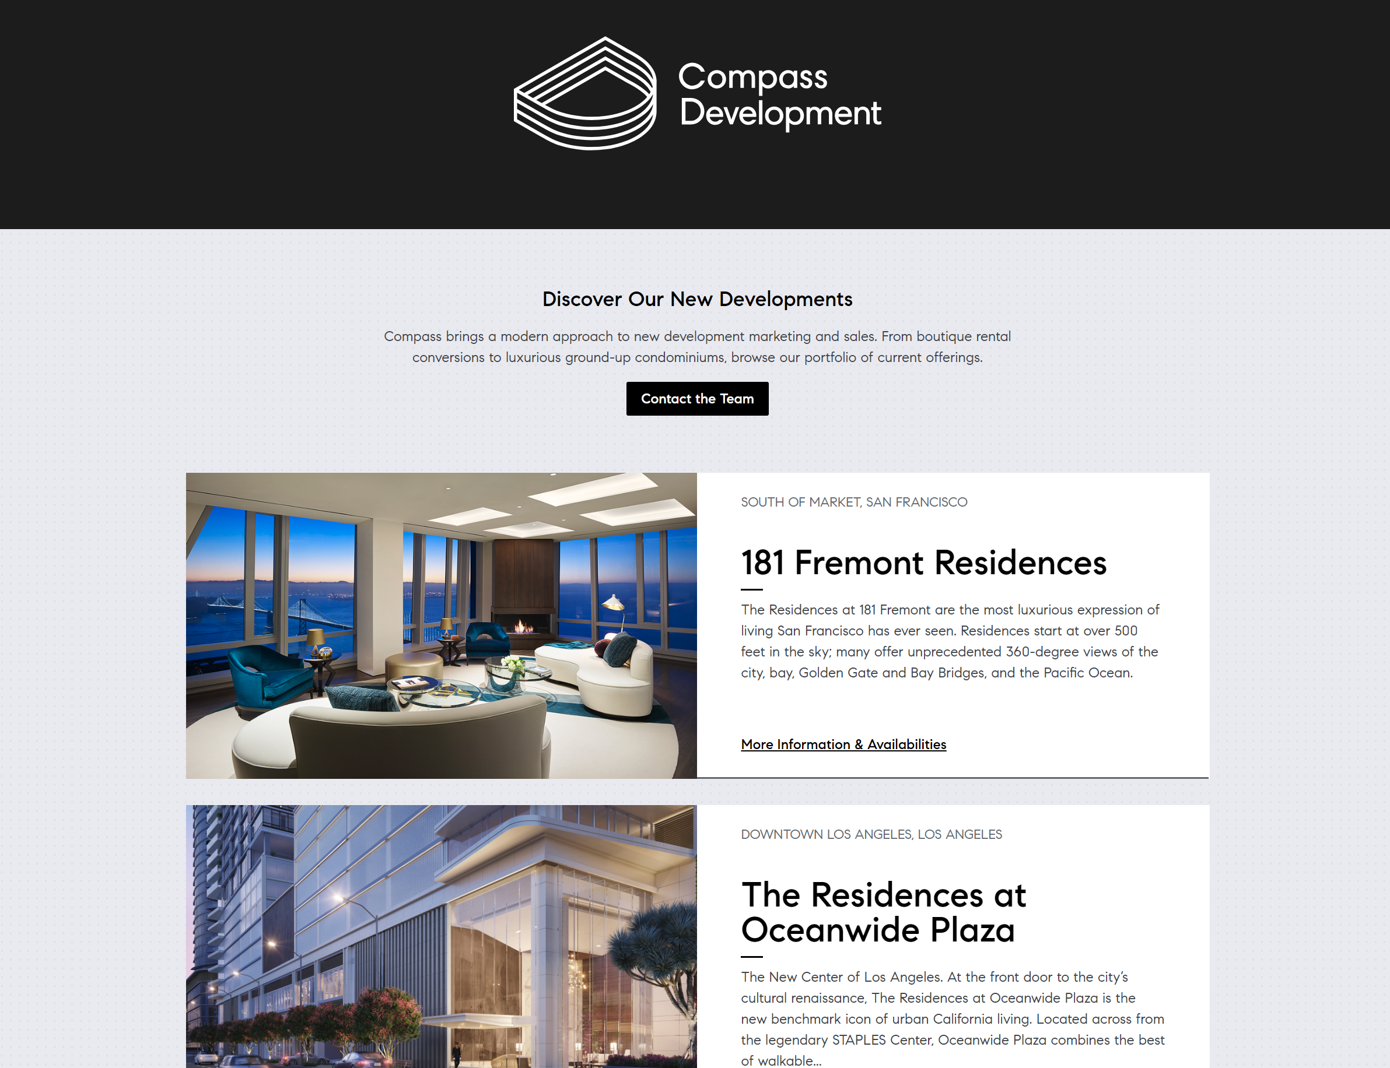

Slide 55
