Slide 6
MASTER MINDS BREAKOUTS
1 – How many MEGA Open Houses will you hold before July 4th?
2 – What is the state of your database, and how are you going to maximize it to drive more business?
3 – Open Master Mind.

Slide 9
Reasons to be
OPTIMISTIC
about this Summer
Strong Economy
Unemployment Rate is low
Wages are increasing
Mortgage Rates still
at historical low
Inventory is increasing

Slide 10
Strong Economic Growth
“The economy is doing well. It has steady growth, low unemployment, and little inflation. That's called the Goldilocks economy because it's neither too hot nor too cold.”
– The Balance
Notes:
https://www.thebalance.com/how-is-the-economy-doing-3306046

Slide 11
Wages Are Increasing
“Real average hourly earnings increased 1.2 percent from 2018 to 2019.
The change in real average hourly earnings combined with a 0.3%
decrease in the average work
week resulted in a 0.9% increase
in real average weekly earnings
over this 12-month period.”
- The Bureau of Labor Statistics
Notes:
https://www.bls.gov/opub/ted/2019/real-average-hourly-earnings-increased-1-point-2-percent-over-the-12-months-ending-april-2019.htm

Slide 12
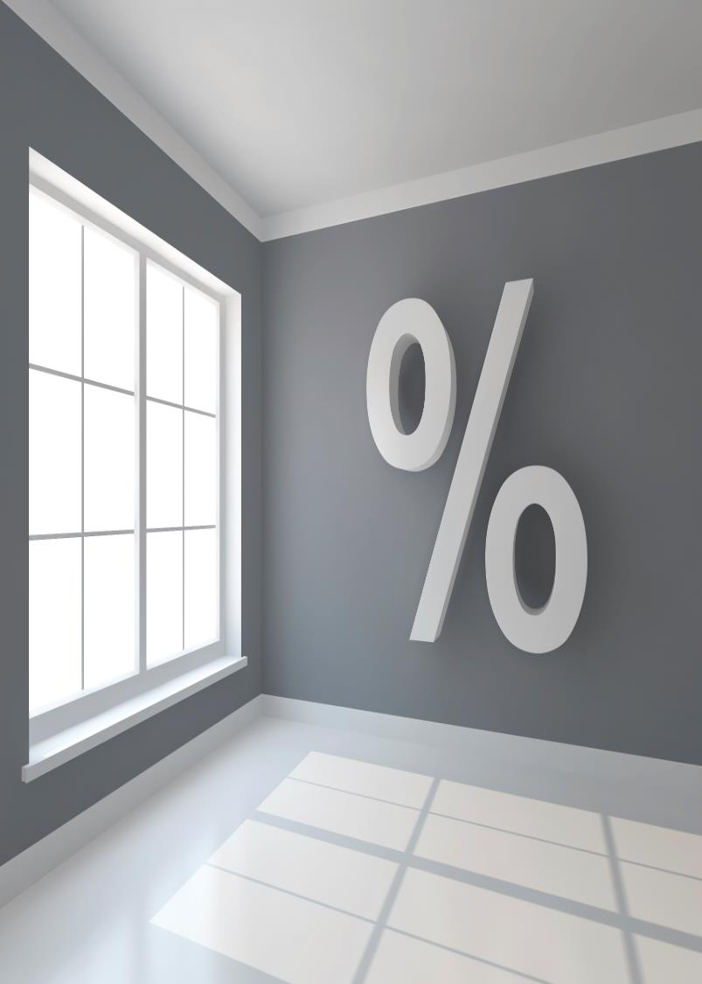
Mortgage Rates still at historical lows
“Modestly weaker consumer spending and manufacturing data…caused interest rates
to decline... While signals from the financial markets are flashing caution signs, the real economy remains on solid ground with steady job growth and five-decade low unemployment rates, which
will drive up home sales
this summer.”
- Freddie Mac
Notes:
http://www.freddiemac.com/pmms/

Slide 13
Inventory Is Increasing!
“Total housing inventory increased to 1.83 million, up from 1.67 million existing homes available for sale last month and a 1.7% increase from 1.80 million a year ago.
Unsold inventory is at a 4.2-month supply at the current sales pace, up from 3.8 months last month and up from 4.0 months last year.”
- NAR
Notes:
https://www.nar.realtor/newsroom/existing-home-sales-inch-back-0-4-in-april

Slide 14
Months Inventory of HOMES FOR SALE
Last 6 Months
NAR 5/2019
Notes:
nar.realtor
https://www.nar.realtor/topics/existing-home-sales

Slide 15
“We see that the inventory totals have steadily improved, and will provide more choices for those looking to buy a home…
…When placing their home on the market, home sellers need to be very realistic and aware of the current conditions.”
Lawrence Yun
Chief Economist at NAR
Notes:
https://www.nar.realtor/newsroom/existing-home-sales-inch-back-0-4-in-april

Slide 16
“Homeowners can see that we’re moving away from a strong seller’s market in many areas. So their feelings and motivations are shifting, too.”
Holden Lewis
NerdWallet home expert
Notes:
https://www.nerdwallet.com/blog/mortgages/home-seller-survey/

Slide 17
“2.1 million homeowners - 16% of them - plan to sell their primary residence within the next 18 months, according to a survey of over 1,400 homeowners.”
Harris Poll
Notes:
https://www.nerdwallet.com/blog/mortgages/home-seller-survey/

Slide 18
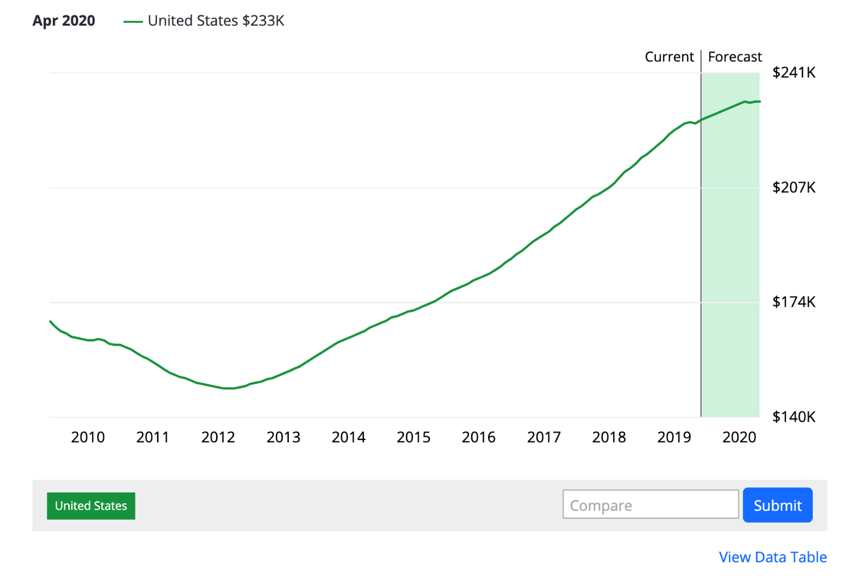

Slide 19
Motivations For Moving
More than 2 in 5
of those planning to sell in the next 18 months say recent shifts in the housing market have them selling sooner than initially planned.
44%
NerdWallet
Notes:
https://www.nerdwallet.com/blog/mortgages/home-seller-survey/

