Slide 1
National Housing Trends

Slide 2
America’s Choice of Best Long Term Investment
Gallup 2019
Notes:
https://news.gallup.com/poll/251696/real-estate-leads-stocks-best-investment.aspx

Slide 3
America’s Choice for Best Long-Term Investment
Real Estate 35%
Stocks 27%
Savings Accounts
15%
Gold 14%
Gallup 2019
Notes:
https://news.gallup.com/poll/251696/real-estate-leads-stocks-best-investment.aspx

Slide 4
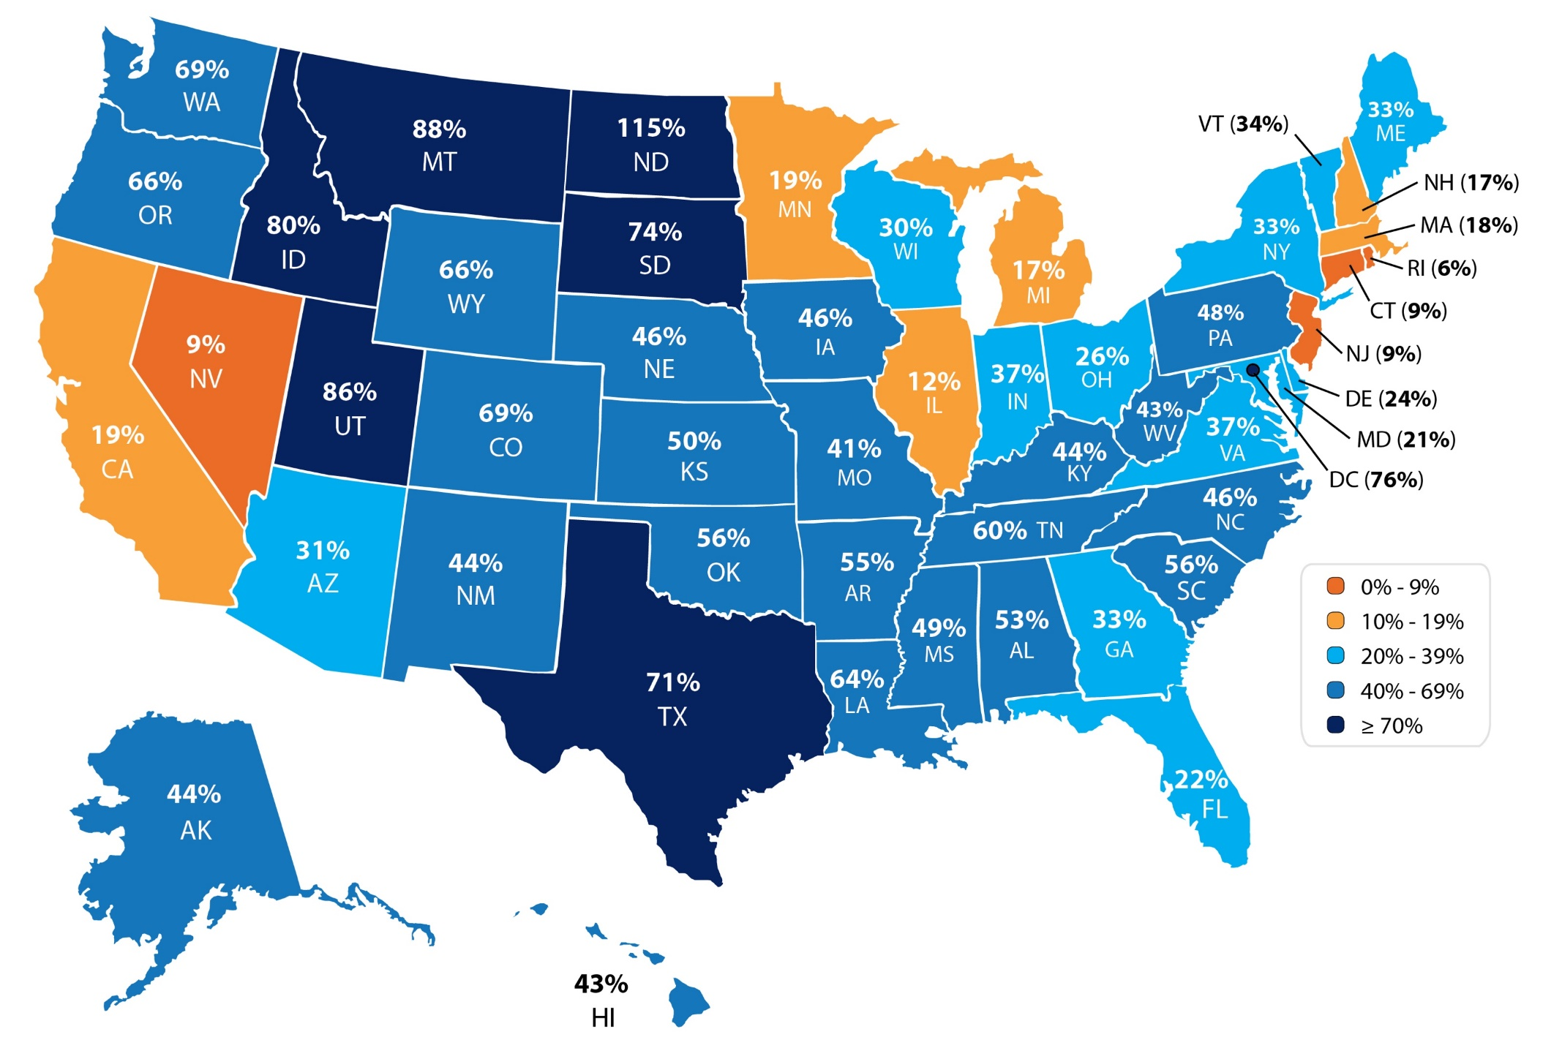
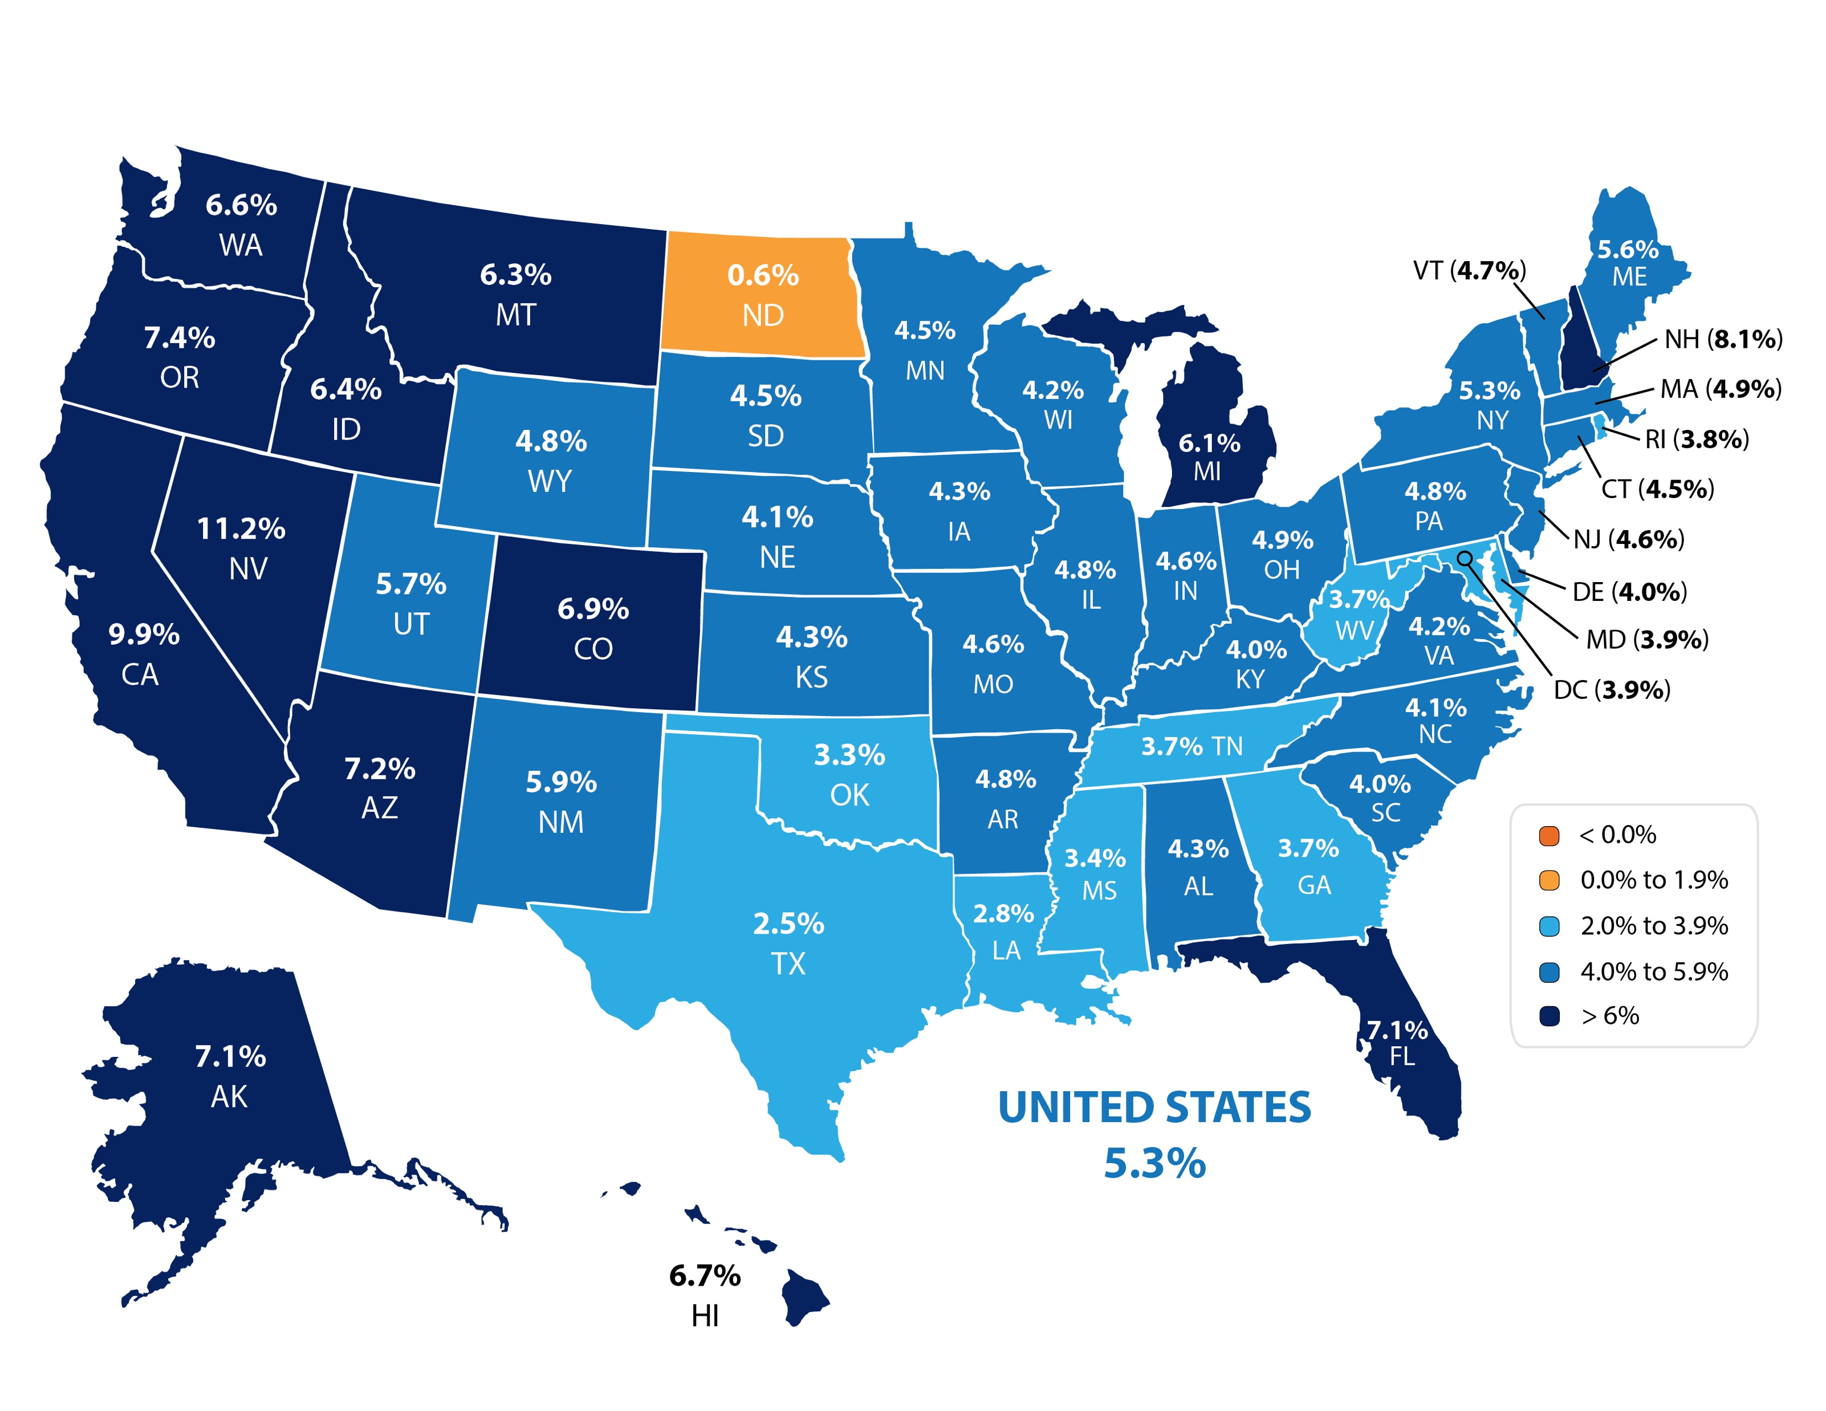
Increase in Home Values 2005-2018
Realtor.org
Notes:
https://www.nar.realtor/economists-outlook/property-values-by-state-from-2005-2018

Slide 5
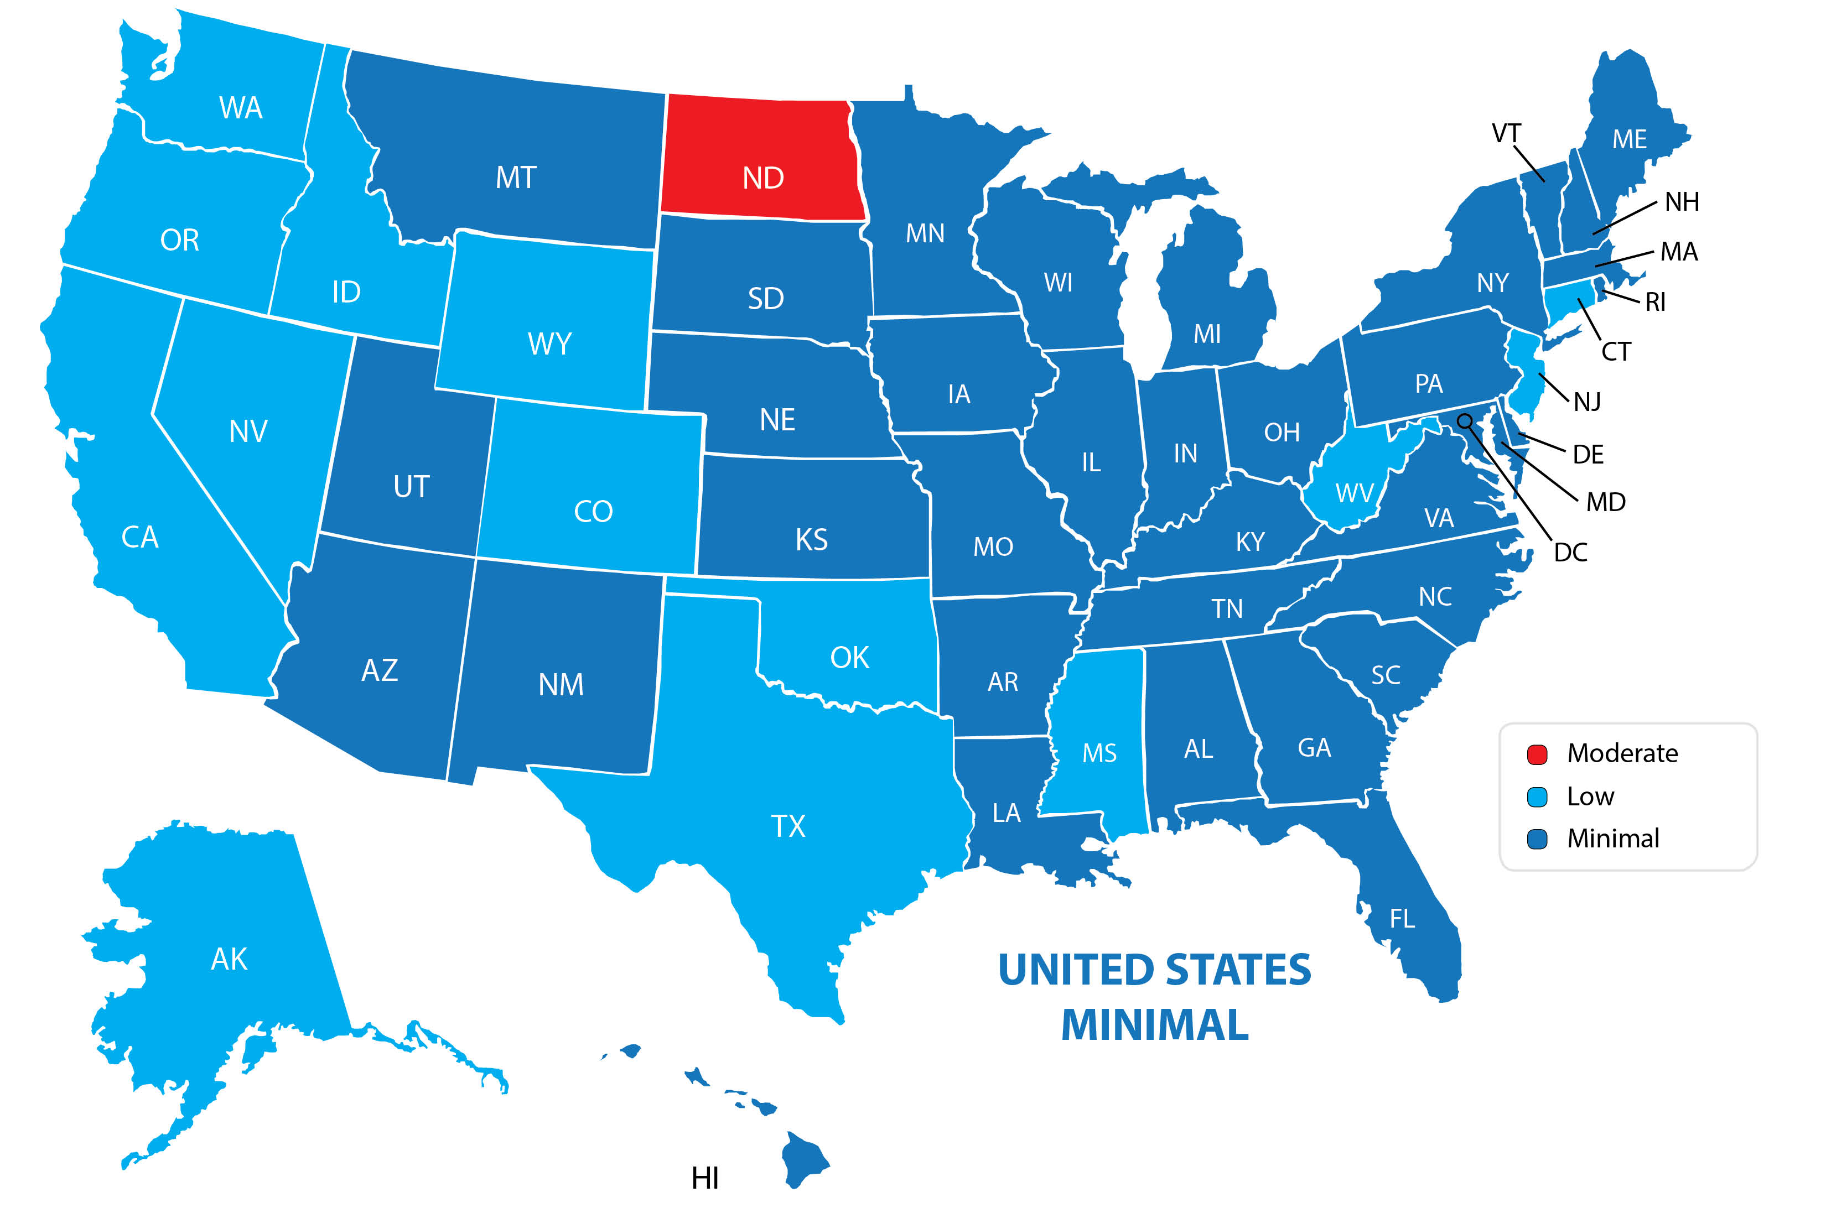
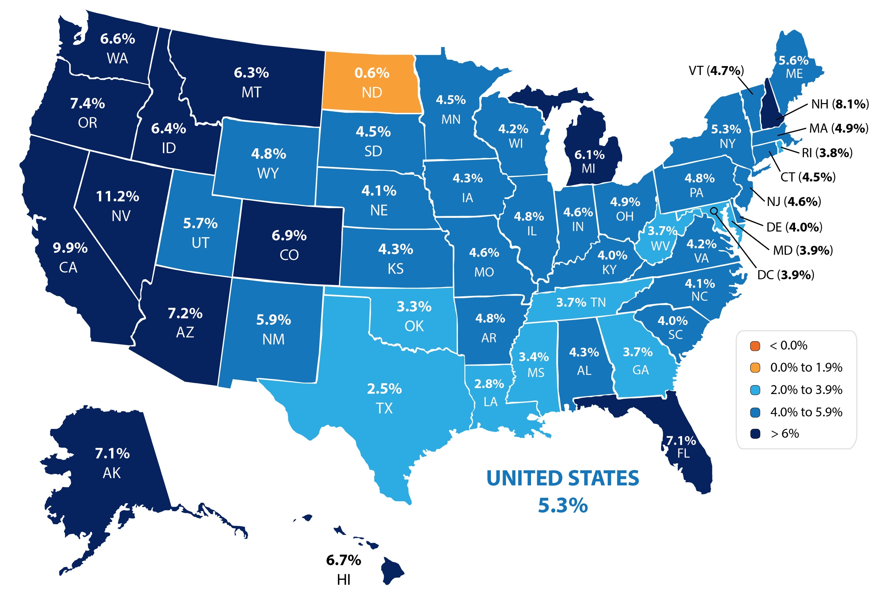
The Probability of Home Prices Being Lower in 2 Years
07/2019 Housing & Mortgage Market Review
Notes:
https://mi.archcapgroup.com/hammr
Source: Spring 2019 Housing & Mortgage Market Review

Slide 6
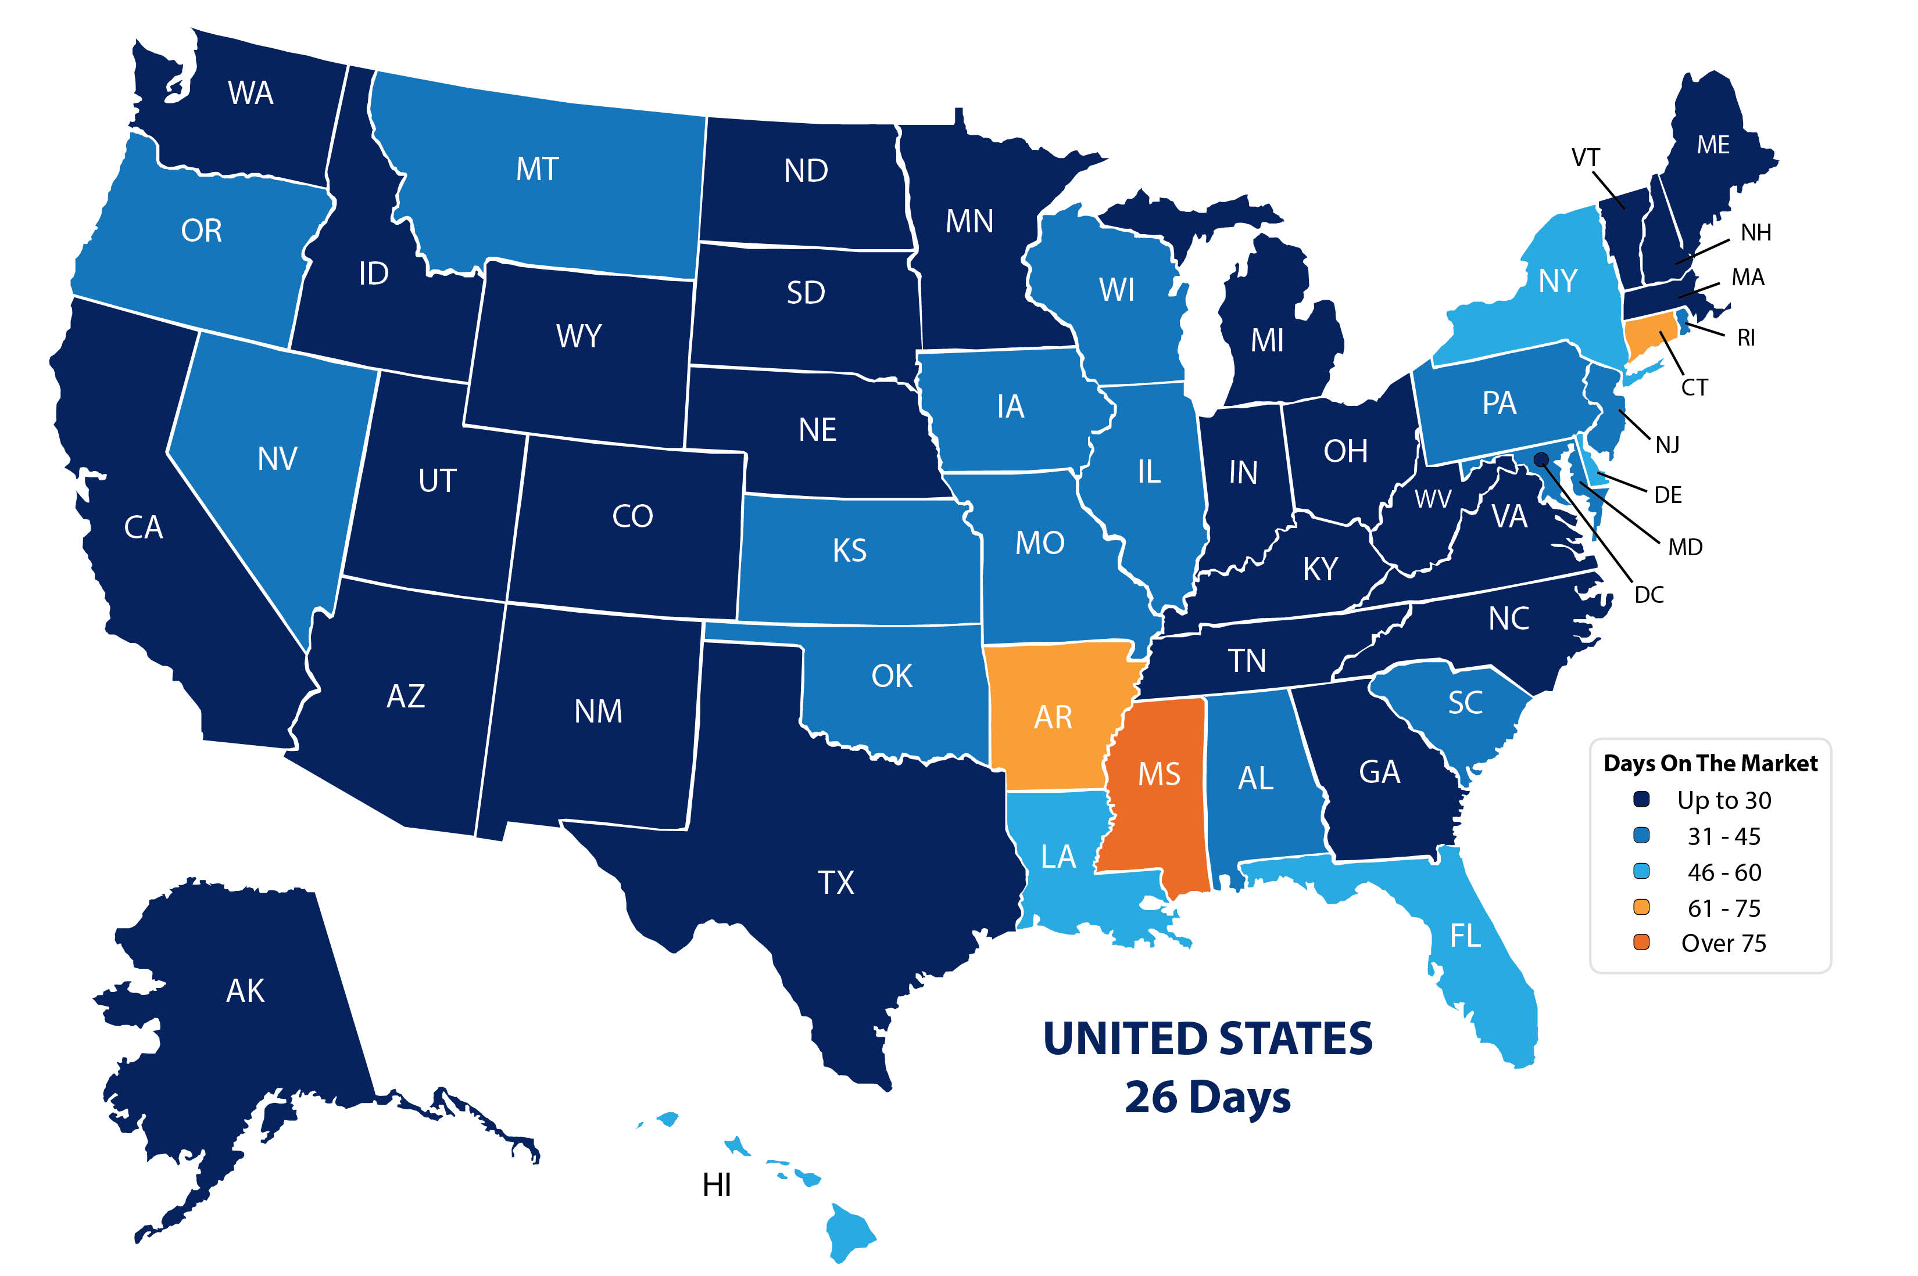
Average Days on the Market
07/2019 NAR
Notes:
https://www.nar.realtor/reports/realtors-confidence-index
https://www.nar.realtor/sites/default/files/documents/2019-05-realtors-confidence-index-06-21-2019.pdf

Slide 7
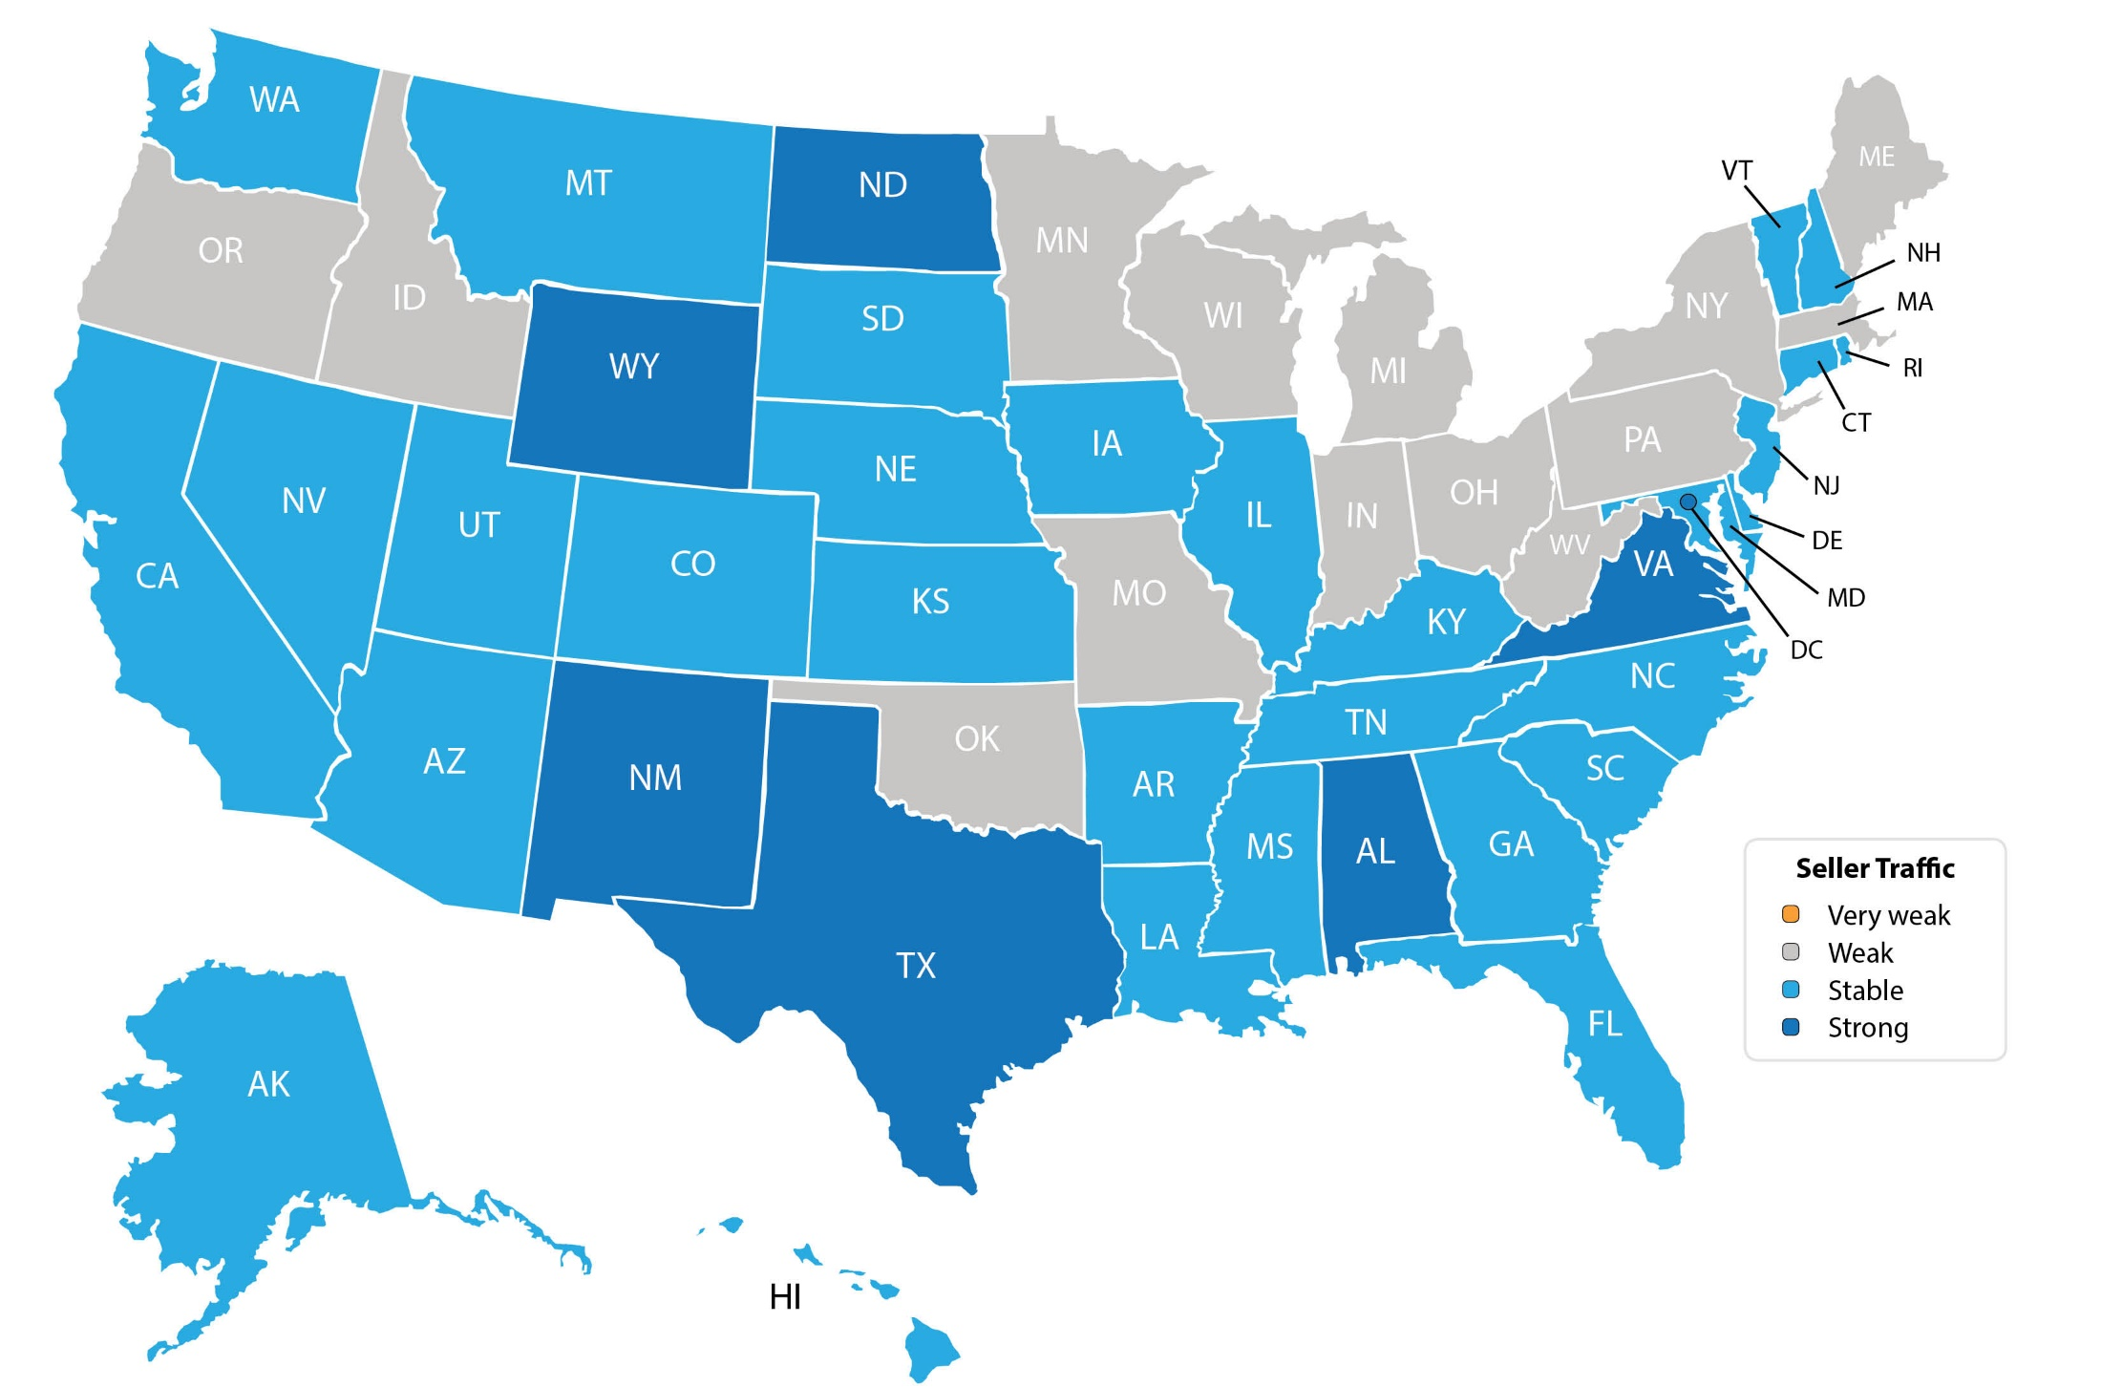
Seller Traffic
07/2019 NAR
Notes:
https://www.nar.realtor/reports/realtors-confidence-index
https://www.nar.realtor/sites/default/files/documents/2019-05-realtors-confidence-index-06-21-2019.pdf

Slide 8
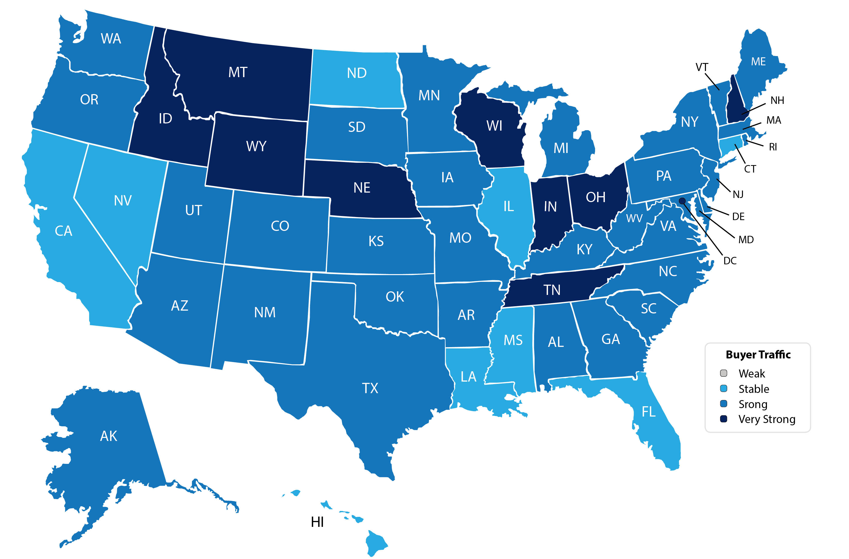
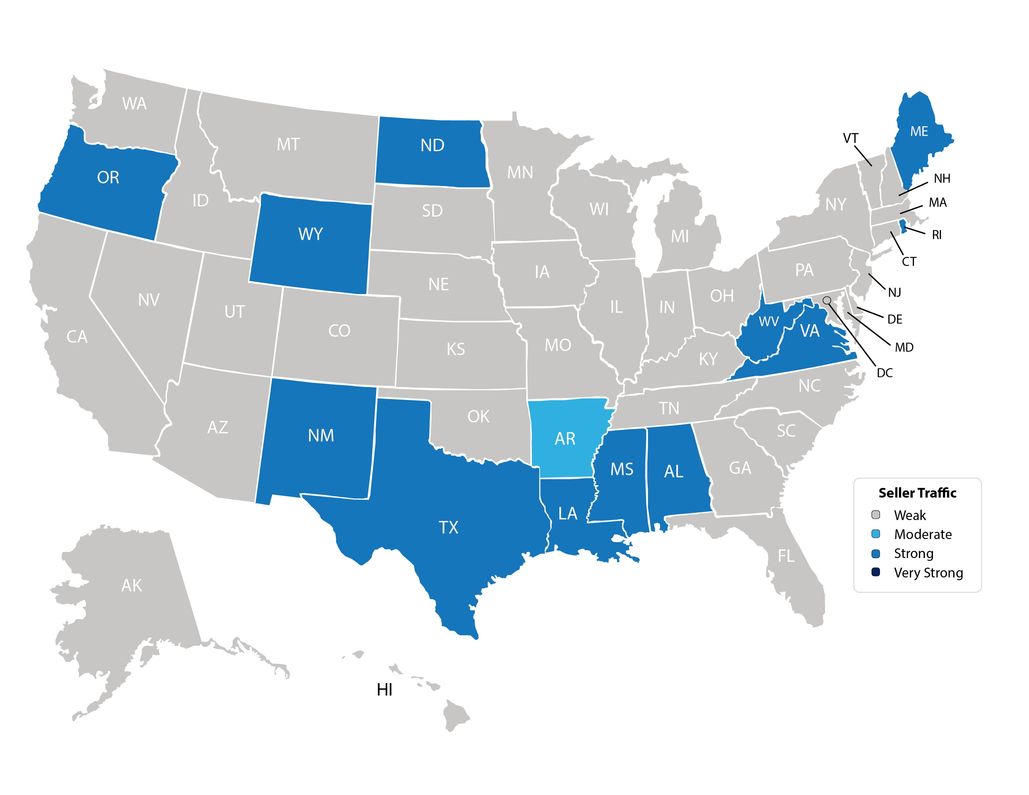
Buyer Traffic
07/2019 NAR
Notes:
https://www.nar.realtor/reports/realtors-confidence-index
https://www.nar.realtor/sites/default/files/documents/2019-05-realtors-confidence-index-06-21-2019.pdf

Slide 9
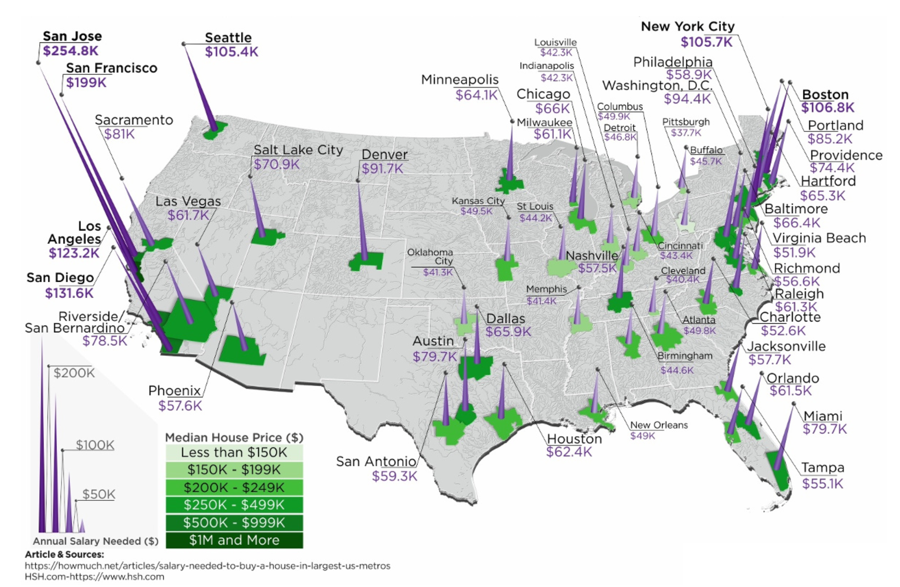
Annual Salary To Buy A Home

Slide 10
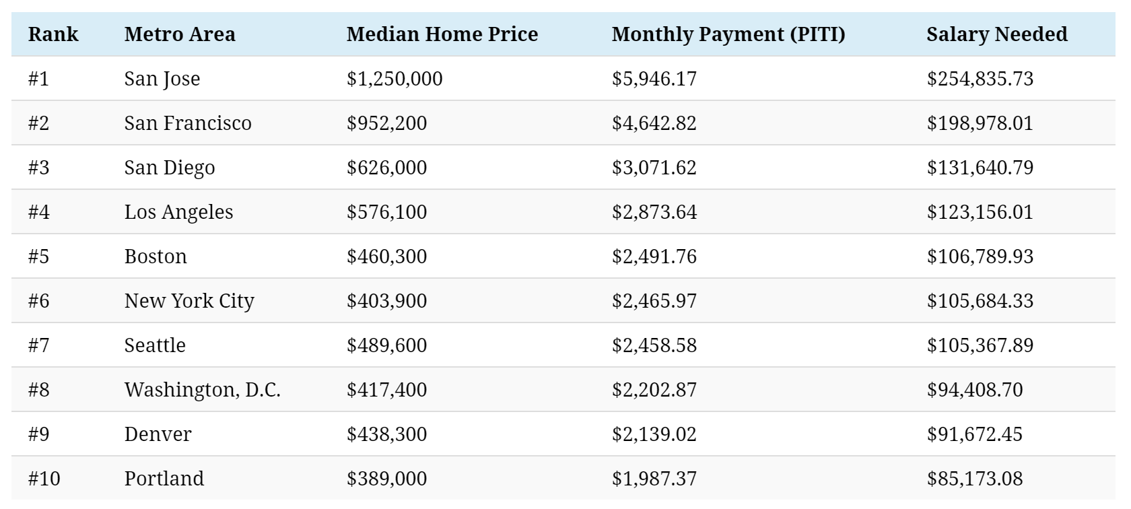
Most Expensive Metros To Buy A Home
Source: HSH.com

Slide 11
Historic Mortgage Rates by Decade
Decade | Average Rate
1970s | 8.86%
1980s | 12.7%
1990s | 8.12%
2000s | 6.29%
Freddie Mac
Notes:
http://www.freddiemac.com/blog/research_and_analysis/20140324_dirt_cheap_to_cheap.html

Slide 12
Mortgage Rate Projections
Quarter | Freddie Mac | Fannie Mae | MBA | NAR | Average of All Four
2019 3Q | 4.0 | 3.9 | 3.9 | 3.9 | 3.92%
2019 4Q | 4.0 | 3.9 | 4.0 | 3.9 | 3.95%
2020 1Q | 4.1 | 3.8 | 4.0 | 4.0 | 3.97%
2020 2Q | 4.1 | 3.8 | 4.0 | 4.1 | 4.0%
7/2019
Notes:
http://www.freddiemac.com/research/forecast/
http://www.fanniemae.com/portal/research-insights/forecast.html
https://www.mba.org/news-research-and-resources/research-and-economics/forecasts-and-commentary https://www.nar.realtor/sites/default/files/documents/forecast-07-2019-us-economic-outlook-06-27-2019.pdf

Slide 13
Mortgage Rates
Freddie Mac
30-Year Fixed Rate
- Actual
- Projected
2017
2018
2020
2016
2019
Freddie Mac 7/2019
Notes:
http://www.freddiemac.com/fmac-resources/research/pdf/201906-Forecast-02.pdf

Slide 14
Greater Metro Atlanta
Market
July 2019 Report With Results Through June 2019

Slide 15
Metro Atlanta 2018-2019 Closings
June Closings Down 8.6% Compared To May Closings
June 2019 Closings Down 7.1% Compared To June 2018
YTD Closings Down 2.2% Compared To Last Year
Notes:
PGR continues to grow our listing inventory market share. Our Advanced Property Marketing methodology and focused prospecting is making a difference.

Slide 16
Metro Atlanta Under Contract Trend
June Under Contract Down 2.3% Compared To May
June 2019 Under Contract Up 10% Compared To June 2018
Notes:
PGR continues to grow our listing inventory market share. Our Advanced Property Marketing methodology and focused prospecting is making a difference.

Slide 17
Metro Atlanta New Listings Trend
June New Listings Down 11.5% Compared To May
June 2019 New Listings Down 2.1% Compared To June 2018
Notes:
PGR continues to grow our listing inventory market share. Our Advanced Property Marketing methodology and focused prospecting is making a difference.

Slide 18
Metro Atlanta Closings – June 2019 (Number Of Transactions By Price)
83% Of Transactions In $100K-$500K Price Range
Notes:
Months of supply is well below normal in many of our markets. We expect this to continue in 2013.

Slide 19
Metro Atlanta Closed Units By Price Point June 2019 Compared To June 2018
Notes:
Months of supply is well below normal in many of our markets. We expect this to continue in 2013.

Slide 20
Listed Inventory January 2018 – June 2019
All Residential, Metro Atlanta
Inventory Up 3.2% From Last Month Up 11.8% Compared To Last Year
Notes:
PGR continues to grow our listing inventory market share. Our Advanced Property Marketing methodology and focused prospecting is making a difference.

Slide 21
Months of Inventory Change The Market Strategy
GREATER THAN
7 MONTHS
BETWEEN
6-7 MONTHS
LESS THAN
6 MONTHS
SELLERS
MARKET
Home prices
will appreciate
NEUTRAL
MARKET
Home prices
will only appreciate with inflation
BUYERS
MARKET
Home prices
will depreciate
Notes:
Realtor.org

Slide 22
Metro Atlanta Months of Inventory (June 2019, Based On Closed Sales)
6 Months Supply Is Considered Normal Market
Total Metro Atlanta “Months Of Inventory” Is 3 Months
Notes:
Months of supply is well below normal in many of our markets. We expect this to continue in 2013.

Slide 23
Metro Atlanta Monthly Average Sale Prices
ASP $332,000 In June. Up 1% From Last Month.
Up 4% From Last June.
Notes:
PGR continues to grow our listing inventory market share. Our Advanced Property Marketing methodology and focused prospecting is making a difference.

Slide 24
Metro Atlanta Annual Average Sale Prices
Annual ASP Up 77% From Bottom Of 2011
Notes:
PGR continues to grow our listing inventory market share. Our Advanced Property Marketing methodology and focused prospecting is making a difference.

Slide 25
Case-Shiller Index For Metro Atlanta
Jan 2010 Through April 2019 (Reported June 25, 2019)
Home Values Up 83% From Bottom Of March 2012.
Notes:
PGR continues to grow our listing inventory market share. Our Advanced Property Marketing methodology and focused prospecting is making a difference.

Slide 26
Case-Shiller Gain/ Loss For Metro Atlanta
Comparisons Based On The Latest Case Shiller Index Compared
To The Average Index For The Year Property Was Purchased.
Year Property Bought | Gain/ Loss
2001 | 38.93%
2002 | 33.77%
2003 | 29.56%
2004 | 25.15%
2005 | 19.15%
2006 | 13.71%
2007 | 12.98%
2008 | 23.49%
2009 | 39.71%
Year Property Bought | Gain/ Loss
2010 | 43.19%
2011 | 53.98%
2012 | 66.95%
2013 | 41.06%
2014 | 29.32%
2015 | 22.56%
2016 | 15.77%
2017 | 9.79%
2018 | 1.18%
Case Shiller Index For Metro Atlanta - April 2019 As Reported June 25, 2019. Micro Local Markets And Price Points May Have Significantly Different Outcomes.
Notes:
PGR continues to grow our listing inventory market share. Our Advanced Property Marketing methodology and focused prospecting is making a difference.

Slide 27
Case-Shiller Home Values For Metro Atlanta
Recent Bottom Was March 2012. Metro Average Home Values Back To Normal Trend Line.
Notes:
PGR continues to grow our listing inventory market share. Our Advanced Property Marketing methodology and focused prospecting is making a difference.

Slide 28
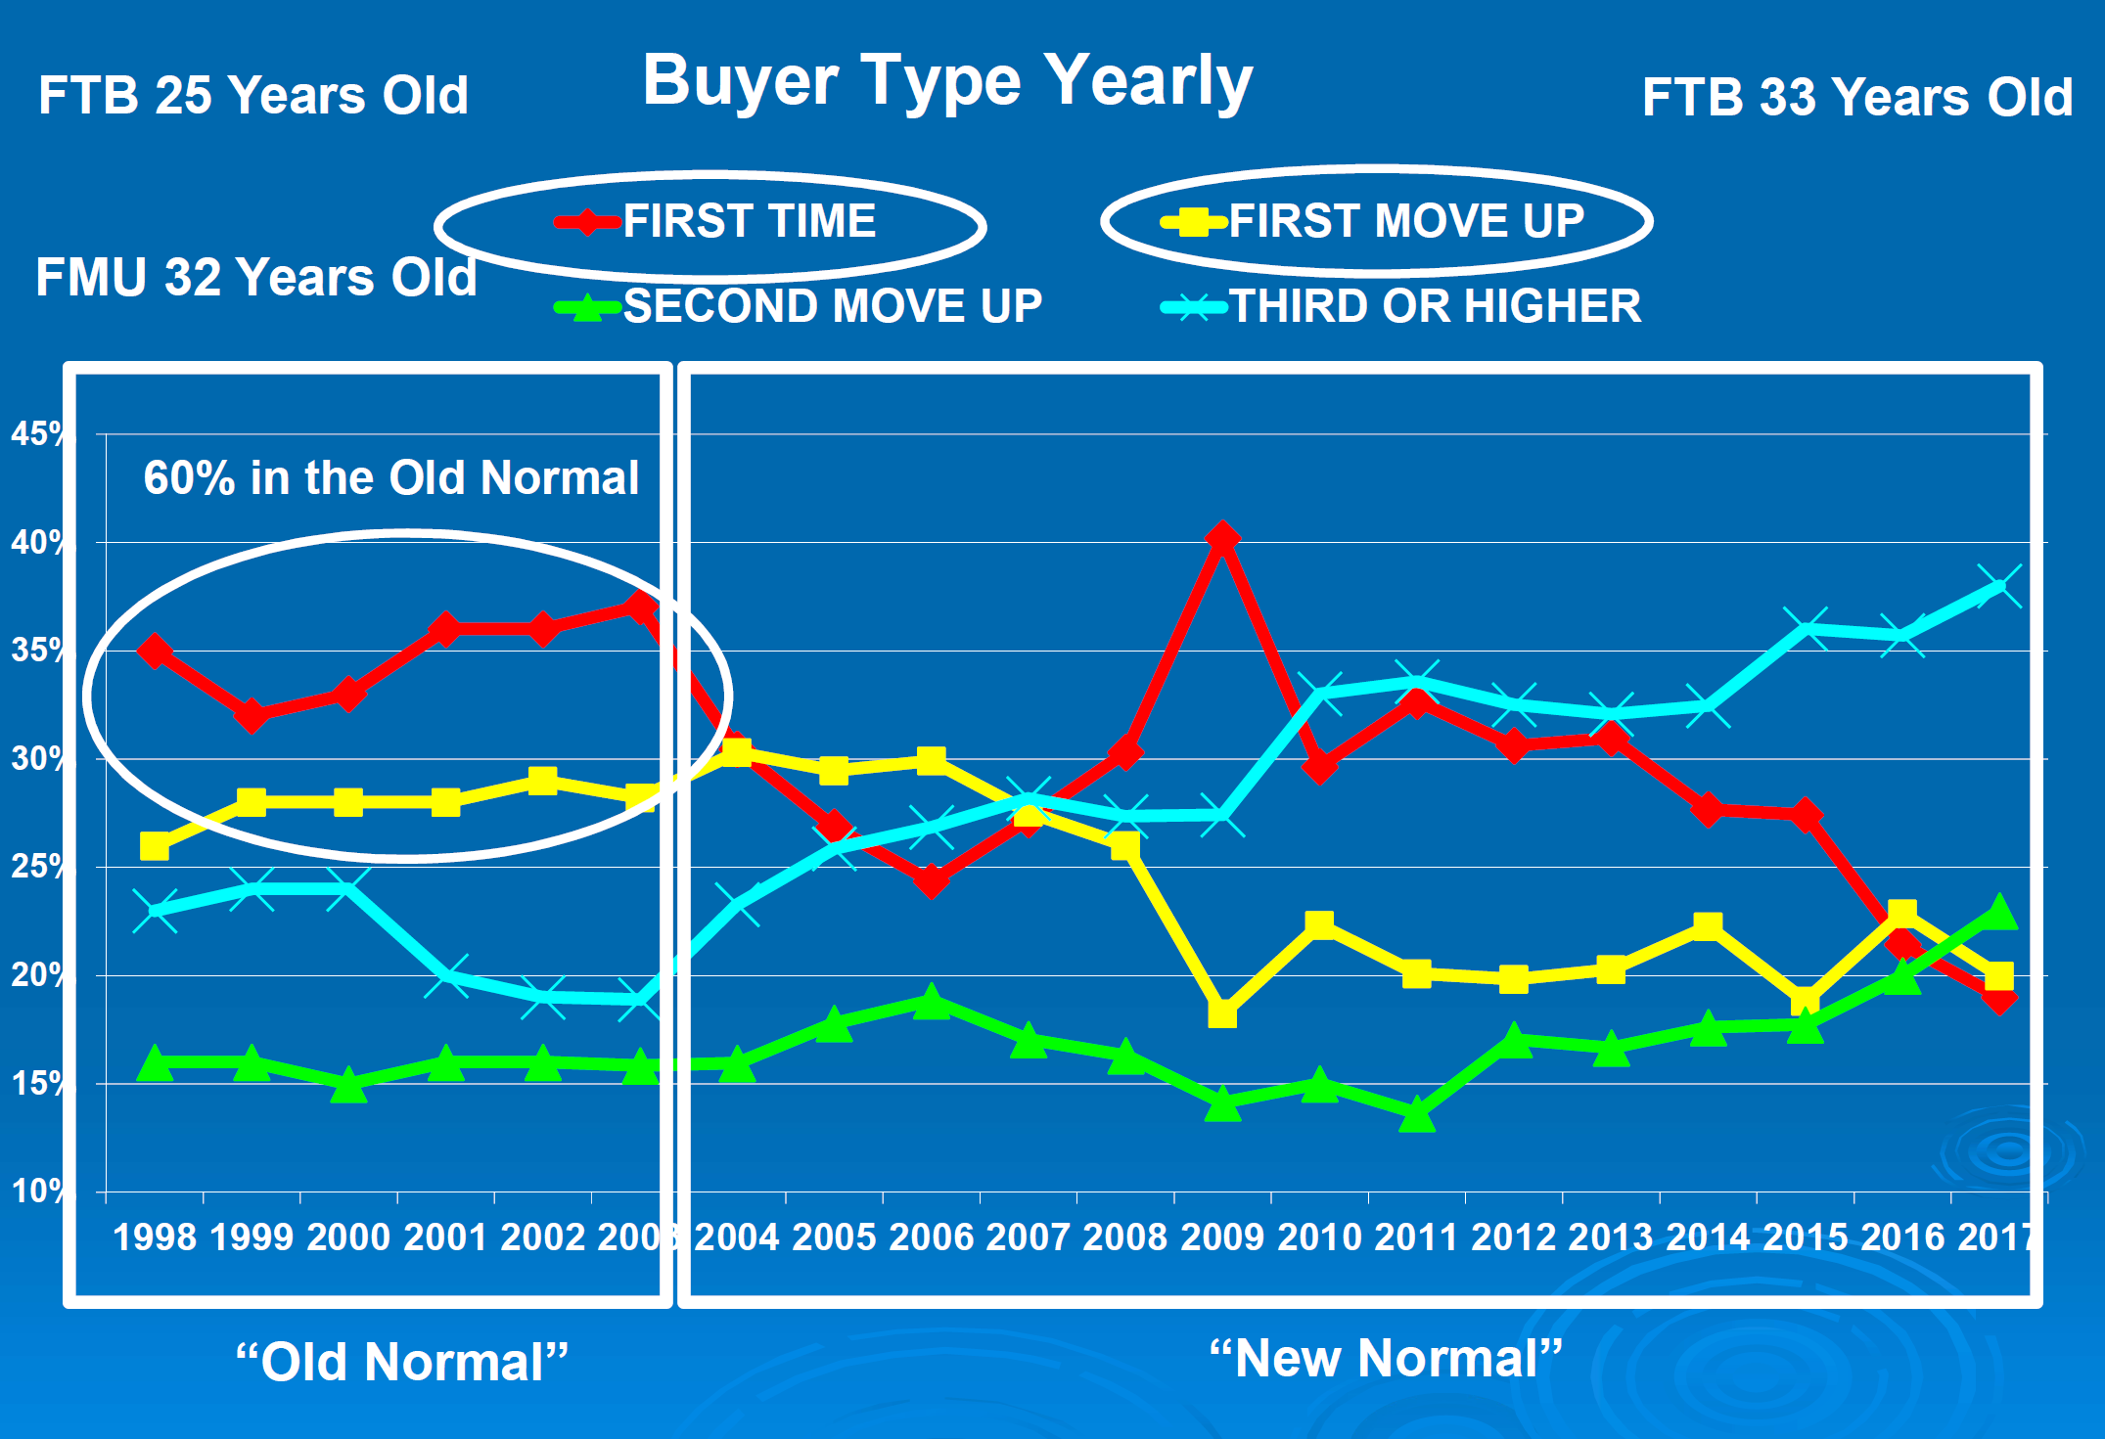

Slide 29
Metro Atlanta Brokerage Rankings

Slide 30
Annual Closed Volume – June 2019 FMLS Counties + Southern Crescent
($ Volume in Billions)
Information Provided By Trendgraphix and BHHS GP Internal Reports.
Notes:
In the past three years, our company has consistently grown our market share in both listing inventory and the sales of that inventory. Today, we are Ranked #1 in both categories.

Slide 31
Georgia Economic & Housing Trends

Slide 32
Top State For Business Site Selection Magazine
6 Years in a Row!
2018
2017
2016
2015
2014
2013

Slide 33
Buyers Moving To Atlanta!
Here is the Top 10 List including previous rank:
Atlanta (1)
Phoenix (4)
Tampa/Sarasota (2)
Dallas/Fort Worth (3)
Orlando (5)
Denver (7)
Houston (8)
Seattle (6)
Las Vegas (10)
Chicago (9)
Penske Truck Rental published their latest moving destination list and Atlanta was ranked #1 for the 6th year in a row. The trend of moving to the sunbelt has returned. Desirable attributes that help Metro Atlanta include a business friendly environment, low cost of living for a metro area, airport, moderate weather with 4 seasons and a high quality of life.

Slide 34
Baby Boomers Are Coming To Be Close To Their Children & Grandchildren.
 | Total Population | Rank of Share
 |  | Under 20 | 20-64 | 65+ | 25-39 | 45-59
Dallas | 6,144,489 | 3 | 9 | 25 | 1 | 24
Atlanta | 5,271,550 | 5 | 6 | 27 | 2 | 19
Phoenix | 4,179,427 | 4 | 24 | 15 | 3 | 26
Denver | 2,466,591 | 11 | 5 | 24 | 4 | 12
Riverside | 4,081,371 | 1 | 27 | 22 | 5 | 27
Houston | 5,629,127 | 2 | 10 | 26 | 6 | 21
Portland | 2,174,631 | 19 | 4 | 19 | 7 | 7
Seattle | 3,309,347 | 22 | 1 | 20 | 8 | 3
Sacramento | 2,091,120 | 12 | 13 | 14 | 9 | 20
Washington | 5,306,125 | 14 | 3 | 23 | 10 | 11
Los Angeles | 12,875,587 | 6 | 17 | 18 | 11 | 23
San Diego | 2,974,859 | 8 | 14 | 16 | 12 | 25
San Francisco | 4,203,898 | 26 | 2 | 10 | 13 | 4
Orlando | 2,032,496 | 18 | 15 | 8 | 14 | 22
Minneapolis | 3,208,212 | 10 | 7 | 21 | 15 | 6
Chicago | 9,522,879 | 7 | 16 | 17 | 16 | 18
New York | 18,815,988 | 21 | 12 | 6 | 17 | 15
Boston | 4,482,857 | 23 | 8 | 9 | 18 | 10
Cincinnati | 2,134,864 | 9 | 19 | 13 | 19 | 14
Baltimore | 2,668,056 | 17 | 11 | 11 | 20 | 9
Detroit | 4,467,592 | 13 | 18 | 12 | 21 | 5
Philadelphia | 5,827,962 | 16 | 21 | 5 | 22 | 13
St. Louis | 2,802,282 | 15 | 20 | 7 | 23 | 8
Miami | 5,413,212 | 24 | 26 | 3 | 24 | 17
Tampa | 2,723,949 | 25 | 25 | 1 | 25 | 16
Cleveland | 2,096,471 | 20 | 23 | 4 | 26 | 2
Pittsburgh | 2,355,712 | 27 | 22 | 2 | 27 | 1
Metro Atlanta Has The:
#2 Population Age 25-39
#5 Population Under 20
Source :Census Bureau

Slide 35
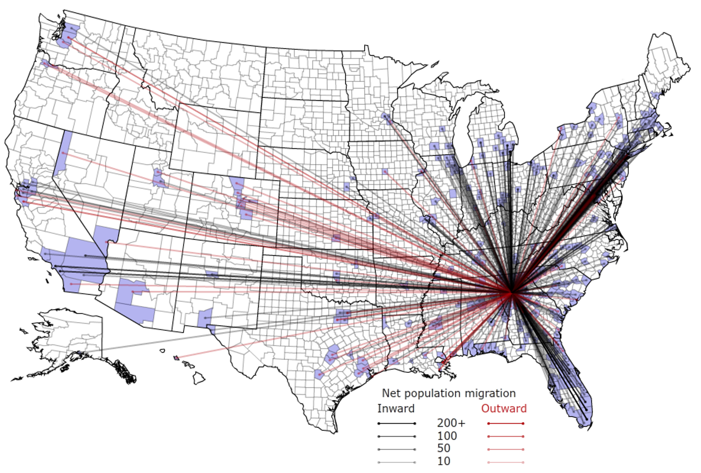
People Are Moving To Atlanta!

Slide 36
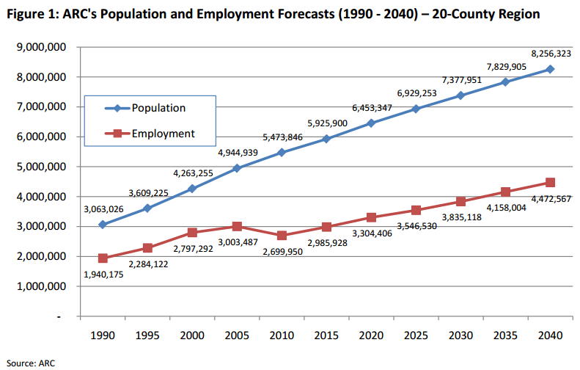
Population & Employment Growth Trends

Slide 37
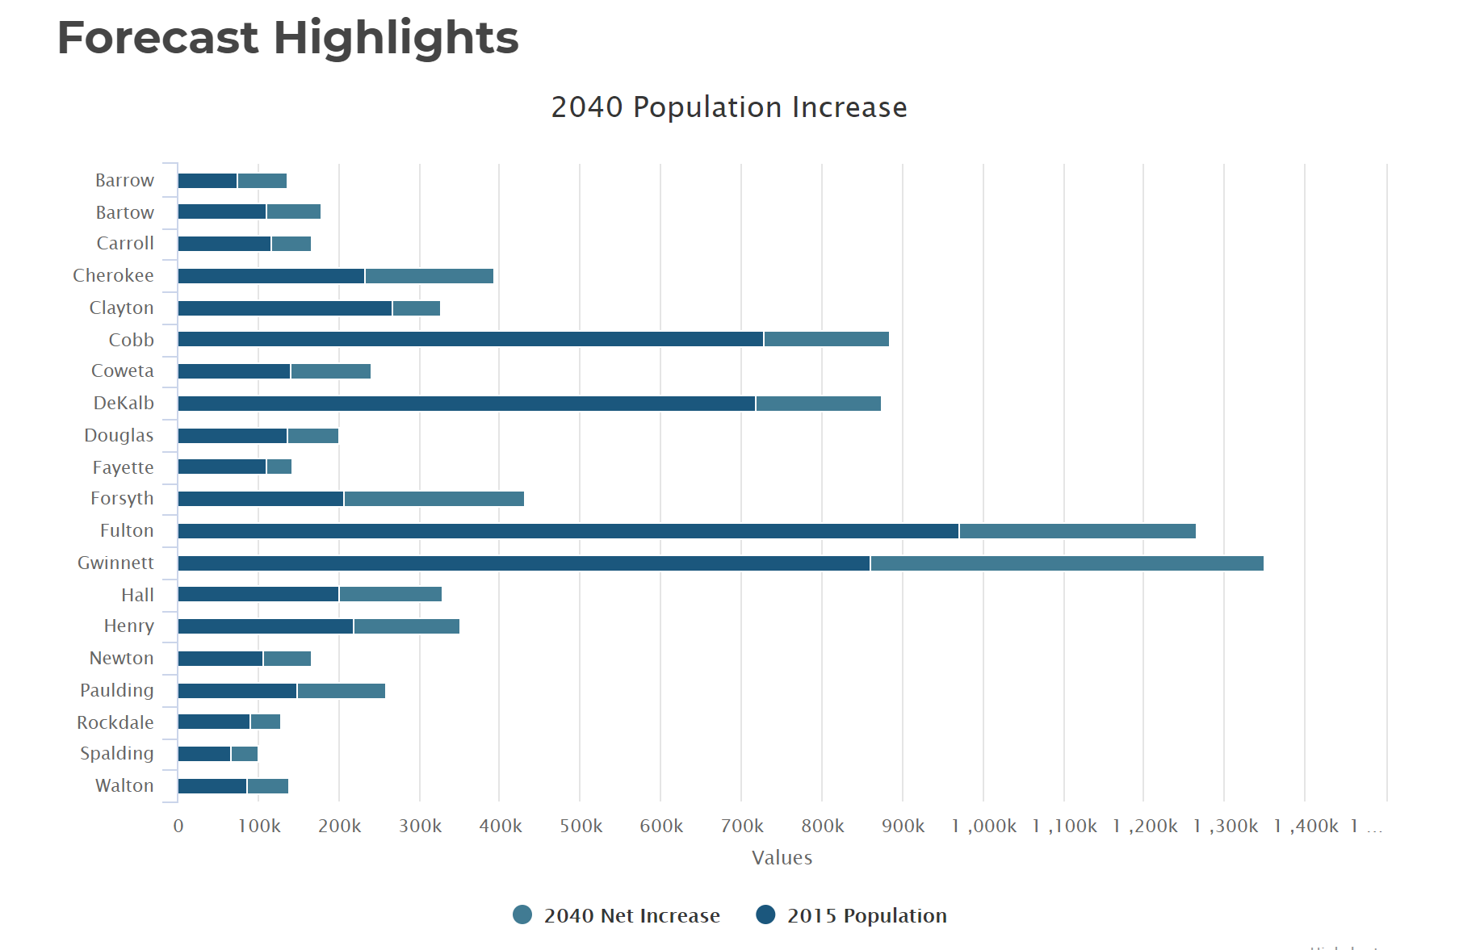
Population By County
Atlanta Regional Commission

Slide 38
Population & Employment Growth Trends
U.S. Conference of Mayors Report predicts that Metro Atlanta will be the 6th largest city in the nation by 2046.
Metro Atlanta will grow from 5.8 million residents to 8.6 million residents.
That means 2.8 million people will move to our area!
This is great news for our long-term real estate values!

