Slide 1
October 2019

Slide 3
When Will Next U.S. Recession Begin?
Pulsenomics, Duke, NABE, WSJ
Notes:
https://pulsenomics.com/surveys/#home-price-expectations
https://www.wsj.com/articles/ (subscription required)
https://www.cfosurvey.org/wp-content/uploads/2019/09/2019-Q3-US-Banners.pdf
https://files.constantcontact.com/668faa28001/2f0b98b4-3c7e-47e3-ade5-9887542aa300.pdf

Slide 4
When Will Next U.S. Recession Begin?
Pulsenomics, Duke, NABE, WSJ
Notes:
https://pulsenomics.com/Q3_2018_HPE_Survey.php
https://www.wsj.com/articles/economists-see-u-s-recession-risk-rising-11547132401 (subscription required)
https://www.cfosurvey.org/wp-content/uploads/2018/12/Q4-18-US-Toplines.pdf#page14
https://files.constantcontact.com/668faa28001/286fb75e-4f63-46ac-b351-7f6e78c57f67.pdf

Slide 5
1991
2008
HOME PRICE CHANGE
During Last 5 Recessions
CoreLogic National Home Price Index
Notes:
https://www.corelogic.com/blog/2019/03/housing-recessions-and-recoveries.aspx

Slide 6
Projected Home Price % Appreciation Going Forward
Source | 2019 | 2020 | 2021 | 2022
Home Price Expectation Survey | +3.6 | +2.5 | +2.2 | +2.7
Mortgage Bankers Association | +4.3 | +3.1 | +2.2 | N/A
Zelman & Assoc. | +3.4 | +3.2 | +3 | N/A
Freddie Mac | +3.4 | +2.6 | N/A | N/A
National Association of Realtors | +4.1 | +3.3 | N/A | N/A
Fannie Mae | +5.4 | +3.7 | N/A | N/A
Notes:
www.freddiemac.com
www.fanniemae.com
www.nar.realtor/
www.pulsenomics.com
www.mba.org
www.zelmanassociates.com (subscription required)
wsj.com (subscription required)

Slide 7
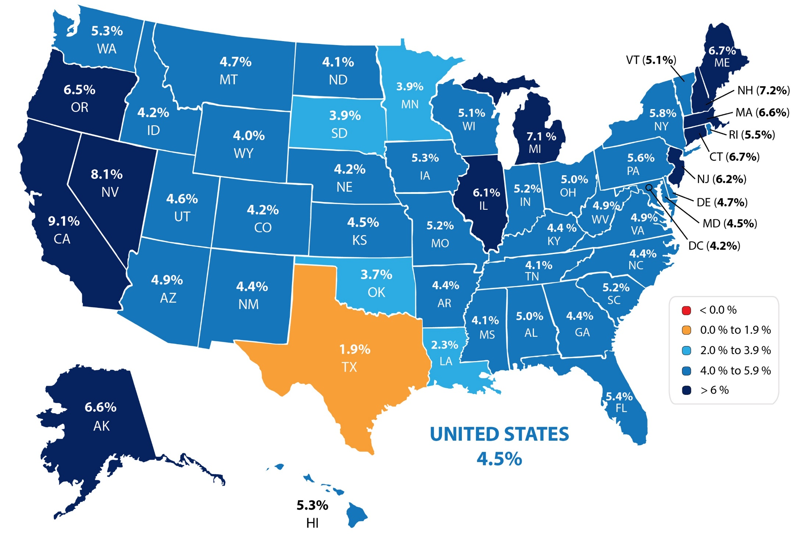
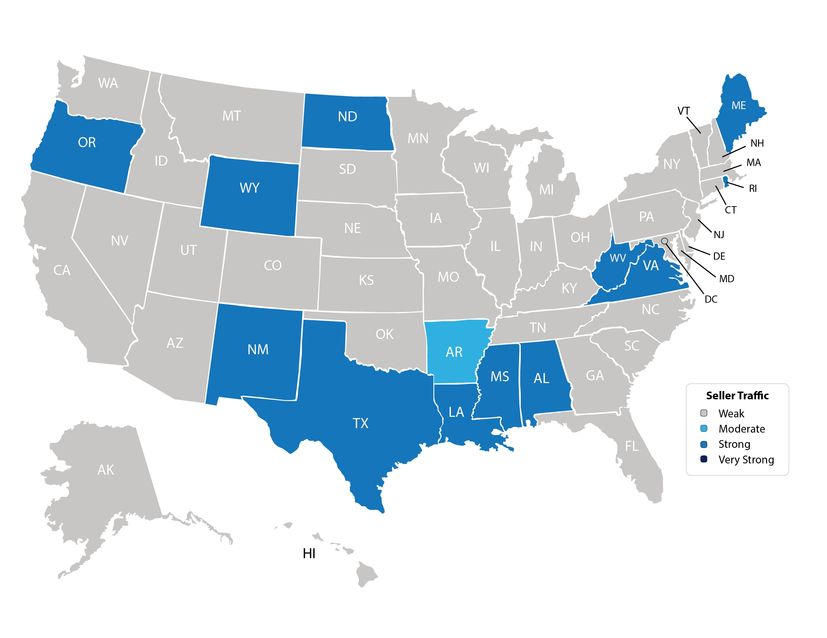
Forecasted Y-O-Y % Change in Price
CoreLogic
Notes:
https://www.corelogic.com/insights-download/homeowner-equity-report.aspx

Slide 8
30 Year Fixed Mortgage Rate
Freddie Mac
Notes:
freddiemac.com

Slide 9
Historic Norm
21.2%
Payment as a
% of Income
National Association of Realtors
Notes:
https://www.nar.realtor/blogs/economists-outlook/july-2019-housing-affordability-index

Slide 10
National Homebuyers’ “TYPICAL MORTGAGE PAYMENT”
Inflation-Adjusted Monthly Mortgage Payment That Buyers Commit To
*The typical mortgage payment used for this chart represents the inflation-adjusted monthly payment based on U.S. median sales price and assumes a 20% down payment, a fixed-rate 30-year mortgage and Freddie Mac’s average monthly rate. It does not include taxes or insurance.
CoreLogic
Notes:
https://www.corelogic.com/blog/2019/09/typical-mortgage-payment-us-homebuyers-committing-to-continues-to-dip-below-year-ago-levels.aspx

Slide 11
“Borrower equity rose to an all-time high in the first half of 2019 and has more than doubled since the housing recovery started. Combined with low mortgage rates, this rise in home equity supports spending on home improvements and may help improve balance sheets of households who could take out home equity loans to consolidate their debt.”
Frank Nothaft
Chief Economist for CoreLogic
Notes:
https://www.corelogic.com/insights/homeowner-equity-report.aspx

Slide 12
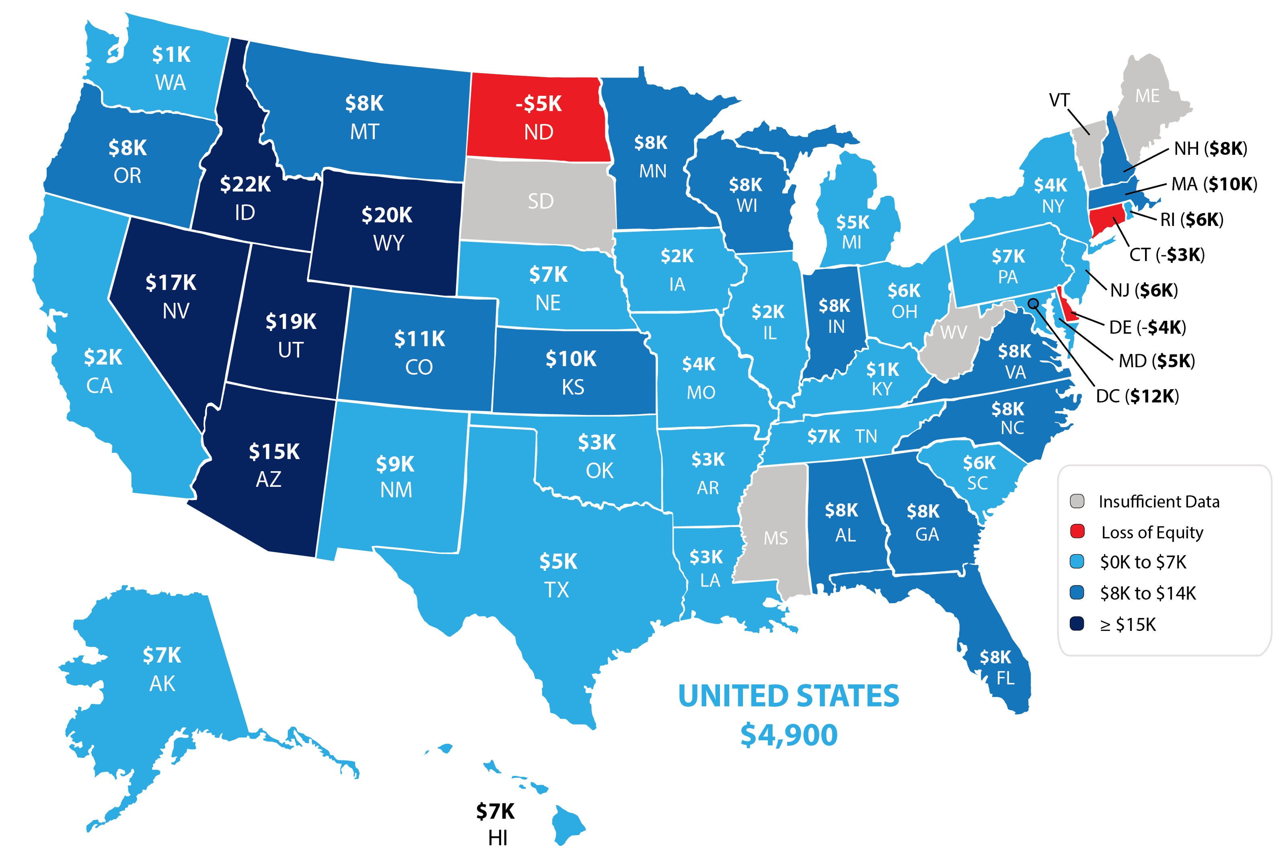
Home Equity Gain
CoreLogic
Notes:
https://www.corelogic.com/insights-download/homeowner-equity-report.aspx
**Replace with updated map

Slide 13
Projected Mean Home Price
% Appreciation Going Forward
Home Price Expectation Survey 2019 3Q
Notes:
https://pulsenomics.com/surveys/#home-price-expectations

Slide 14
$37,750
potential growth in family wealth over the next five years based solely on increased home equity
Increased home equity based on price appreciation projected by the Home Price Expectation Survey
Home Price Expectation Survey 2019 3Q
Notes:
https://pulsenomics.com/surveys/#home-price-expectations

Slide 15
Median Asking Rent
Since 2010
Census
Notes:
http://www.census.gov/housing/hvs/files/currenthvspress.pdf

Slide 16
The Non-Financial BENEFITS
of Homeownership
93%
said owning a home made them happier
Concentrix Analytics Survey
88%
agreed that buying a home is the “best decision they have ever made”
79%
believed owning a
home has changed
them for the better
Notes:
https://info.bankofamerica.com/homebuyers-report/

Slide 17
26%
of millennials expressed an
interest in buying a home
in the next 12 months.
Notes:
https://www.corelogic.com/insights/home-price-index.aspx

Slide 18
“New household formation is expected to grow as more millennials enter their prime home-buying years, and baby boomers are living longer and more independently than ever. For more than a decade, home building has not kept up with the demand for shelter, creating a housing supply deficit that will prove difficult to reduce significantly.”
Odeta Kushi Deputy Chief Economist, First American
Notes:
https://dsnews.com/daily-dose/08-21-2019/ask-the-economist-millennial-demand-and-affordability-issues

Slide 19
Months Inventory of HOMES FOR SALE
Last 12 Months
NAR
Notes:
nar.realtor
https://www.nar.realtor/topics/existing-home-sales
**Aug instead of Ago
So, we have more people looking for homes to buy, especially in the entry-level and mid-range markets.
We’ve also established over the past year in so many of our Monthly Market Reports that inventory of current homes is below the desired 6-month supply for a normal market, checking in at about 4.1 months right now.

Slide 20
Resources
Slide | Slide Title | Link
3-4 | When Will Next U.S. Recession Begin? | https://pulsenomics.com/surveys/#home-price-expectations https://www.wsj.com/articles/ (subscription required) https://www.cfosurvey.org/wp-content/uploads/2019/09/2019-Q3-US-Banners.pdf https://files.constantcontact.com/668faa28001/2f0b98b4-3c7e-47e3-ade5-9887542aa300.pdf
5 | Home Price Change during Last 5 Recessions | https://www.corelogic.com/blog/2019/03/housing-recessions-and-recoveries.aspx
6 | Projected Home Price % Appreciation Going Forward | www.freddiemac.com www.fanniemae.com www.nar.realtor/ www.pulsenomics.com www.mba.org www.zelmanassociates.com (subscription required) wsj.com (subscription required)
7 | Forecasted Y-O-Y % Change in Price | https://www.corelogic.com/insights-download/homeowner-equity-report.aspx
8 | 30 Year Fixed Mortgage Rate | freddiemac.com
9 | Payment as a % of Income | https://www.nar.realtor/blogs/economists-outlook/july-2019-housing-affordability-index
10 | Typical Mortgage Payment | https://www.corelogic.com/blog/2019/09/typical-mortgage-payment-us-homebuyers-committing-to-continues-to-dip-below-year-ago-levels.aspx
11 | Frank Nothaft Quote | https://www.corelogic.com/insights/homeowner-equity-report.asp
12 | Home Equity Gain | https://www.corelogic.com/insights-download/homeowner-equity-report.aspx
13-14 | Home Price Expectations | https://pulsenomics.com/surveys/#home-price-expectations
KEEPINGCURRENTMATTERS.COM

Slide 21
Resources
Slide | Slide Title | Link
15 | Median Asking Rent | http://www.census.gov/housing/hvs/files/currenthvspress.pdf
16 | Non-Financial Benefits of Homeownership | https://info.bankofamerica.com/homebuyers-report/
17 | Home Price Index | https://www.corelogic.com/insights/home-price-index.aspx
18 | Odeta Kushi Quote | https://dsnews.com/daily-dose/08-21-2019/ask-the-economist-millennial-demand-and-affordability-issues
19 | Existing Home Sales | https://www.nar.realtor/topics/existing-home-sales
KEEPINGCURRENTMATTERS.COM

Slide 23
3 Keys to a Great Brand:
Worldview, Point of Clarity, and Pledge
Worldview
A brand’s worldview is the problem they see in the world and that by them attending to it, the world becomes a better place.
Point of Clarity
It defines the specific niche which they reside in within the wider category of their industry. If you see a brand name you implicitly trust, you grab it and go. When you don't, you're stuck checking features and prices. This is why consumers subconsciously love brands. They make purchase shopping easy.
Pledge
In a fast-paced world where trust is hard to come by – promises matter. They’re how people learn whether they can truly believe in you.
Anyone can make promises. Brands keep them. Promises kept over time creates a sense of certainty with the customer base. Certainty creates trust. People trust brands.

Slide 24
YOUR WORLDVIEW is shaped by the problems created when consumers are misinformed about the real estate market. Your better world is one where everyone has all the facts to make sound, life-altering financial decisions.
YOUR POINT OF CLARITY is Intelligence. You are the source. You have the facts created by a balanced and unbiased knowledge of the facts.
YOUR PLEDGE is to offer the most researched, balanced reporting backed by empirical data that people can count on.

Slide 26
Resources
Slide | Slide Title | Link
28, 49, 61 | Confidence Index | https://www.nar.realtor/sites/default/files/documents/2019-08-realtors-confidence-index-09-19-2019.pdf
29-31, 41-42, 50-54 | Existing Home Sales | https://www.nar.realtor/topics/existing-home-sales http://www.census.gov/construction/nrs/pdf/newressales.pdf https://www.nar.realtor/topics/existing-home-salesealtor
32-35 | New Home Sales | http://www.census.gov/construction/nrs/pdf/newressales.pdf http://www.census.gov/newhomesales
36 | Total Home Sales | http://www.census.gov/construction/nrs/pdf/newressales.pdf
37-38 | Pending Home Sales | https://www.nar.realtor/research-and-statistics/housing-statistics/pending-home-sales
39 | Distressed Property Sales | https://www.nar.realtor/topics/existing-home-sales
43-45 | Case Shiller | http://us.spindices.com/indices/real-estate/sp-case-shiller-20-city-composite-home-price-index https://www.spindices.com/documents/indexnews/announcements/20190924-1000959/1000959_cshomeprice-release-0924.pdf
46 | Forecasted Y-O-Y % Change in Price | https://www.corelogic.com/downloadable-docs/marketpulse/the-marketpulse-vol-8-issue-9-september-2019-screen-092519.pdf
47 | Quicken Loans | https://www.quickenloans.com/press-room/2019/09/10/quicken-loans-study-shows-appraisal-values-lag-half-a-percent-behind-homeowner-estimates/
55-56 | New Home Inventory | http://www.census.gov/newhomesales http://www.census.gov/construction/nrs/pdf/newressales.pdf
58-60 | Foot Traffic | http://nar.realtor/infographics/foot-traffic
63-64 | Mortgage Rates | http://www.freddiemac.com/pmms/pmms_archives.html
KEEPINGCURRENTMATTERS.COM

Slide 27
Resources
Slide | Slide Title | Link
65 | Mortgage Rate Projections | http://www.freddiemac.com/research/forecast/ http://www.freddiemac.com/research/forecast/20190930_housing_strong_heading_into_fall.page? http://www.fanniemae.com/portal/research-insights/forecast.html https://www.mba.org/news-research-and-resources/research-and-economics/forecasts-and-commentary https://www.nar.realtor/sites/default/files/documents/forecast-10-2019-us-economic-outlook-09-26-2019.pdf
66-67 | Mortgage Rates Freddie Mac | http://www.freddiemac.com/fmac-resources/research/pdf/20190730-Forecast-02.pdf
69-70 | Mortgage Credit Availability | https://www.mba.org/news-research-and-resources/newsroom https://www.mba.org/news-research-and-resources/research-and-economics/single-family-research/mortgage-credit-availability-index
71 | Average Days to Close a Loan | http://www.elliemae.com/resources/origination-insight-reports https://static.elliemae.com/pdf/origination-insight-reports/EM_OIR_AUGUST2019.pdf
72-75 | FICO Score | http://www.elliemae.com/resources/origination-insight-reports https://static.elliemae.com/pdf/origination-insight-reports/EM_OIR_AUGUST2019.pdf
KEEPINGCURRENTMATTERS.COM

Slide 29
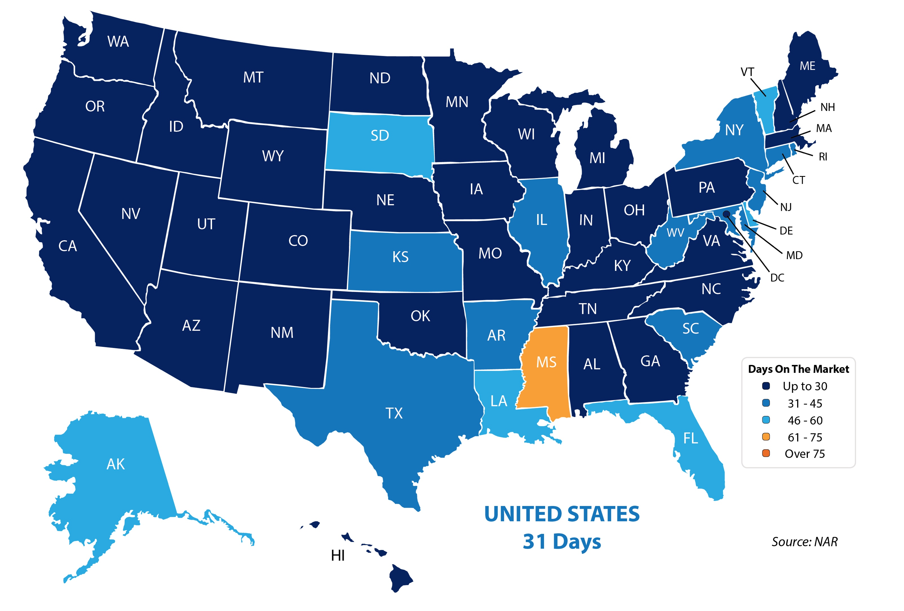
Average Days on the Market
Notes:
https://www.nar.realtor/reports/realtors-confidence-index
https://www.nar.realtor/sites/default/files/documents/2019-08-realtors-confidence-index-09-19-2019.pdf

Slide 30
EXISTING
Home Sales
Since January 2014
NAR
Notes:
nar.realtor
https://www.nar.realtor/topics/existing-home-sales

Slide 31
EXISTING Home Sales
Y-O-Y by region
South
NAR
Notes:
nar.realtor
https://www.nar.realtor/topics/existing-home-sales

Slide 32
Existing Home Sales
in thousands
Census & NAR
Notes:
http://www.census.gov/construction/nrs/pdf/newressales.pdf
http://nar.realtor

Slide 33
New Home Sales in thousands
Census & NAR
Notes:
http://www.census.gov/construction/nrs/pdf/newressales.pdf
http://nar.realtor

Slide 34
New Home Sales
annualized in thousands
Census
Notes:
http://www.census.gov/newhomesales
http://www.census.gov/construction/nrs/pdf/newressales.pdf

Slide 35
New Home Sales
% of sales by price range
Census
Notes:
http://www.census.gov/newhomesales
http://www.census.gov/construction/nrs/pdf/newressales.pdf

Slide 36
New Homes Selling Fast (median months from completion to sold)
Census
Notes:
http://www.census.gov/newhomesales
http://www.census.gov/construction/nrs/pdf/newressales.pdf

Slide 37
Total Home Sales in thousands
Census & NAR
Notes:
http://www.census.gov/construction/nrs/pdf/newressales.pdf
http://nar.realtor

Slide 38
PENDING Home Sales
since 2014
100 = Historically Healthy Level
NAR
Notes:
https://www.nar.realtor/research-and-statistics/housing-statistics/pending-home-sales

Slide 39
Pending Home Sales
Year-Over-Year By Region
South
Northeast
NAR
Notes:
https://www.nar.realtor/research-and-statistics/housing-statistics/pending-home-sales

Slide 40
35%
Percentage of
Distressed Property Sales
4%
January 2012 - Today
2%
NAR
Notes:
nar.realtor
https://www.nar.realtor/topics/existing-home-sales

Slide 41
Home Prices

Slide 42
EXISTING Home Prices
Y-O-Y by region
Northeast
NAR
Notes:
nar.realtor
https://www.nar.realtor/topics/existing-home-sales

Slide 43
% Change in Sales
from last year by Price Range
NAR
Notes:
nar.realtor
https://www.nar.realtor/topics/existing-home-sales

Slide 44
Case Shiller
Year-Over-Year
PRICE CHANGES
S&P Case Shiller
Notes:
http://us.spindices.com/indices/real-estate/sp-case-shiller-20-city-composite-home-price-index
https://www.spindices.com/documents/indexnews/announcements/20190924-1000959/1000959_cshomeprice-release-0924.pdf

Slide 45
Case Shiller
Year-Over-Year PRICE CHANGES
20 City Composite
S&P Case Shiller
Notes:
http://us.spindices.com/indices/real-estate/sp-case-shiller-20-city-composite-home-price-index
https://www.spindices.com/documents/indexnews/announcements/20190924-1000959/1000959_cshomeprice-release-0924.pdf

Slide 46
Case Shiller
Year-Over-Year PRICE CHANGES
20 City Composite
S&P Case Shiller
Notes:
http://us.spindices.com/indices/real-estate/sp-case-shiller-20-city-composite-home-price-index
https://www.spindices.com/documents/indexnews/announcements/20190924-1000959/1000959_cshomeprice-release-0924.pdf

Slide 47
Forecasted Year-Over-Year % Change in Price
CoreLogic
Notes:
https://www.corelogic.com/downloadable-docs/marketpulse/the-marketpulse-vol-8-issue-9-september-2019-screen-092519.pdf

Slide 48
Appraiser Home Value Opinions Compared to Homeowner Estimates
Last 12 Months
Quicken Loans
Notes:
https://www.quickenloans.com/press-room/2019/09/10/quicken-loans-study-shows-appraisal-values-lag-half-a-percent-behind-homeowner-estimates/

Slide 49
HOUSING
INVENTORY

Slide 50
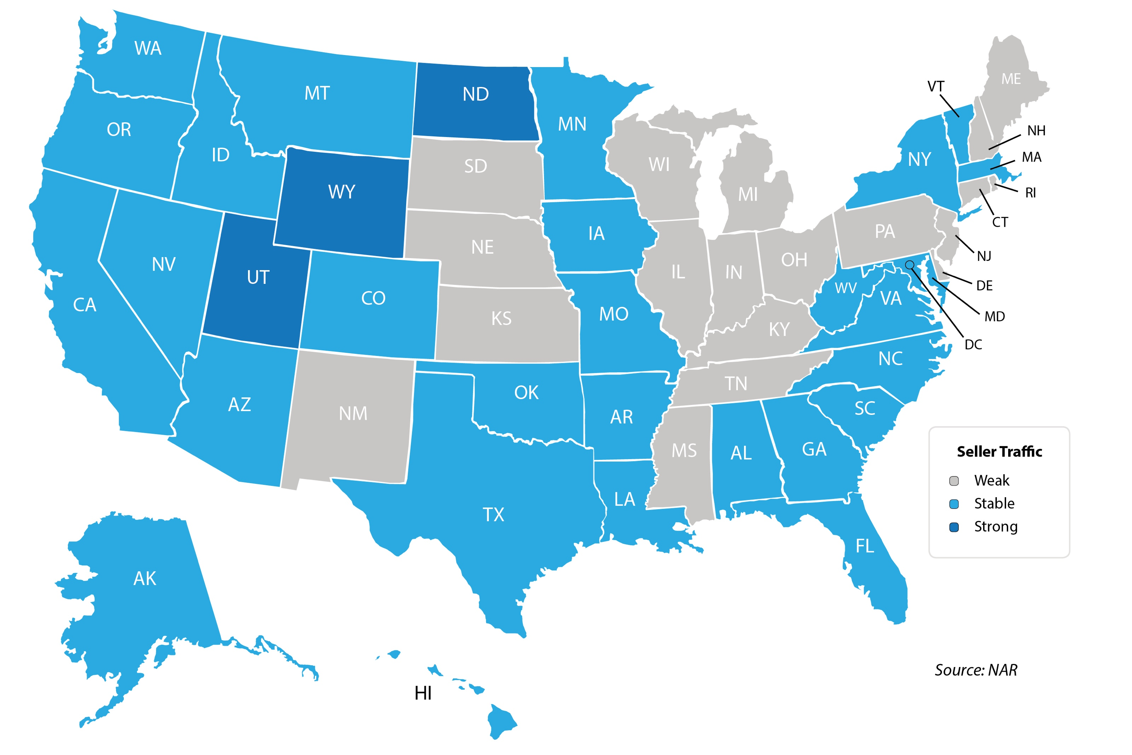
Seller Traffic
Notes:
https://www.nar.realtor/reports/realtors-confidence-index
https://www.nar.realtor/sites/default/files/documents/2019-08-realtors-confidence-index-09-19-2019.pdf

Slide 51
Months Inventory of
HOMES FOR SALE
2011 - Today
NAR
Notes:
nar.realtor
https://www.nar.realtor/topics/existing-home-sales

Slide 52
Months Inventory of HOMES FOR SALE
last 2 years
NAR
Notes:
nar.realtor
https://www.nar.realtor/topics/existing-home-salesealtor

Slide 53
Months Inventory of HOMES FOR SALE
Last 12 Months
NAR
Notes:
nar.realtor
https://www.nar.realtor/topics/existing-home-sales

Slide 54
Year-over-Year
Inventory Levels
NAR
Notes:
nar.realtor
https://www.nar.realtor/topics/existing-home-sales

Slide 55
HOUSING SUPPLY Year-Over-Year
Sep
Oct
Nov
Dec
Jan
Feb
Mar
Apr
May
Jun
Last 12 Months
NAR
Notes:
nar.realtor
https://www.nar.realtor/topics/existing-home-sales

Slide 56
New Home Inventory
months supply
Census
Notes:
http://www.census.gov/newhomesales
http://www.census.gov/construction/nrs/pdf/newressales.pdf

Slide 57
New Home Inventory
months supply
Last 12 Months
Census
Notes:
http://www.census.gov/newhomesales
http://www.census.gov/construction/nrs/pdf/newressales.pdf

Slide 58
BUYER DEMAND

Slide 59
Foot Traffic
indicator of future sales
NAR
Notes:
nar.realtor
http://nar.realtor/infographics/foot-traffic
"Every month SentriLock, LLC. provides NAR Research with data on the number of properties shown by a REALTOR®. Lockboxes made by SentriLock, LLC. are used in roughly a third of home showings across the nation. Foot traffic has a strong correlation with future contracts and home sales, so it can be viewed as a peek ahead at sales trends two to three months into the future."

Slide 60
Foot Traffic
Last 12 Months
indicator of future sales
NAR
Notes:
nar.realtor
http://nar.realtor/infographics/foot-traffic
"Every month SentriLock, LLC. provides NAR Research with data on the number of properties shown by a REALTOR®. Lockboxes made by SentriLock, LLC. are used in roughly a third of home showings across the nation. Foot traffic has a strong correlation with future contracts and home sales, so it can be viewed as a peek ahead at sales trends two to three months into the future."

Slide 61
Foot Traffic
indicator of future sales
NAR
Notes:
nar.realtor
http://nar.realtor/infographics/foot-traffic
"Every month SentriLock, LLC. provides NAR Research with data on the number of properties shown by a REALTOR®. Lockboxes made by SentriLock, LLC. are used in roughly a third of home showings across the nation. Foot traffic has a strong correlation with future contracts and home sales, so it can be viewed as a peek ahead at sales trends two to three months into the future."

Slide 62
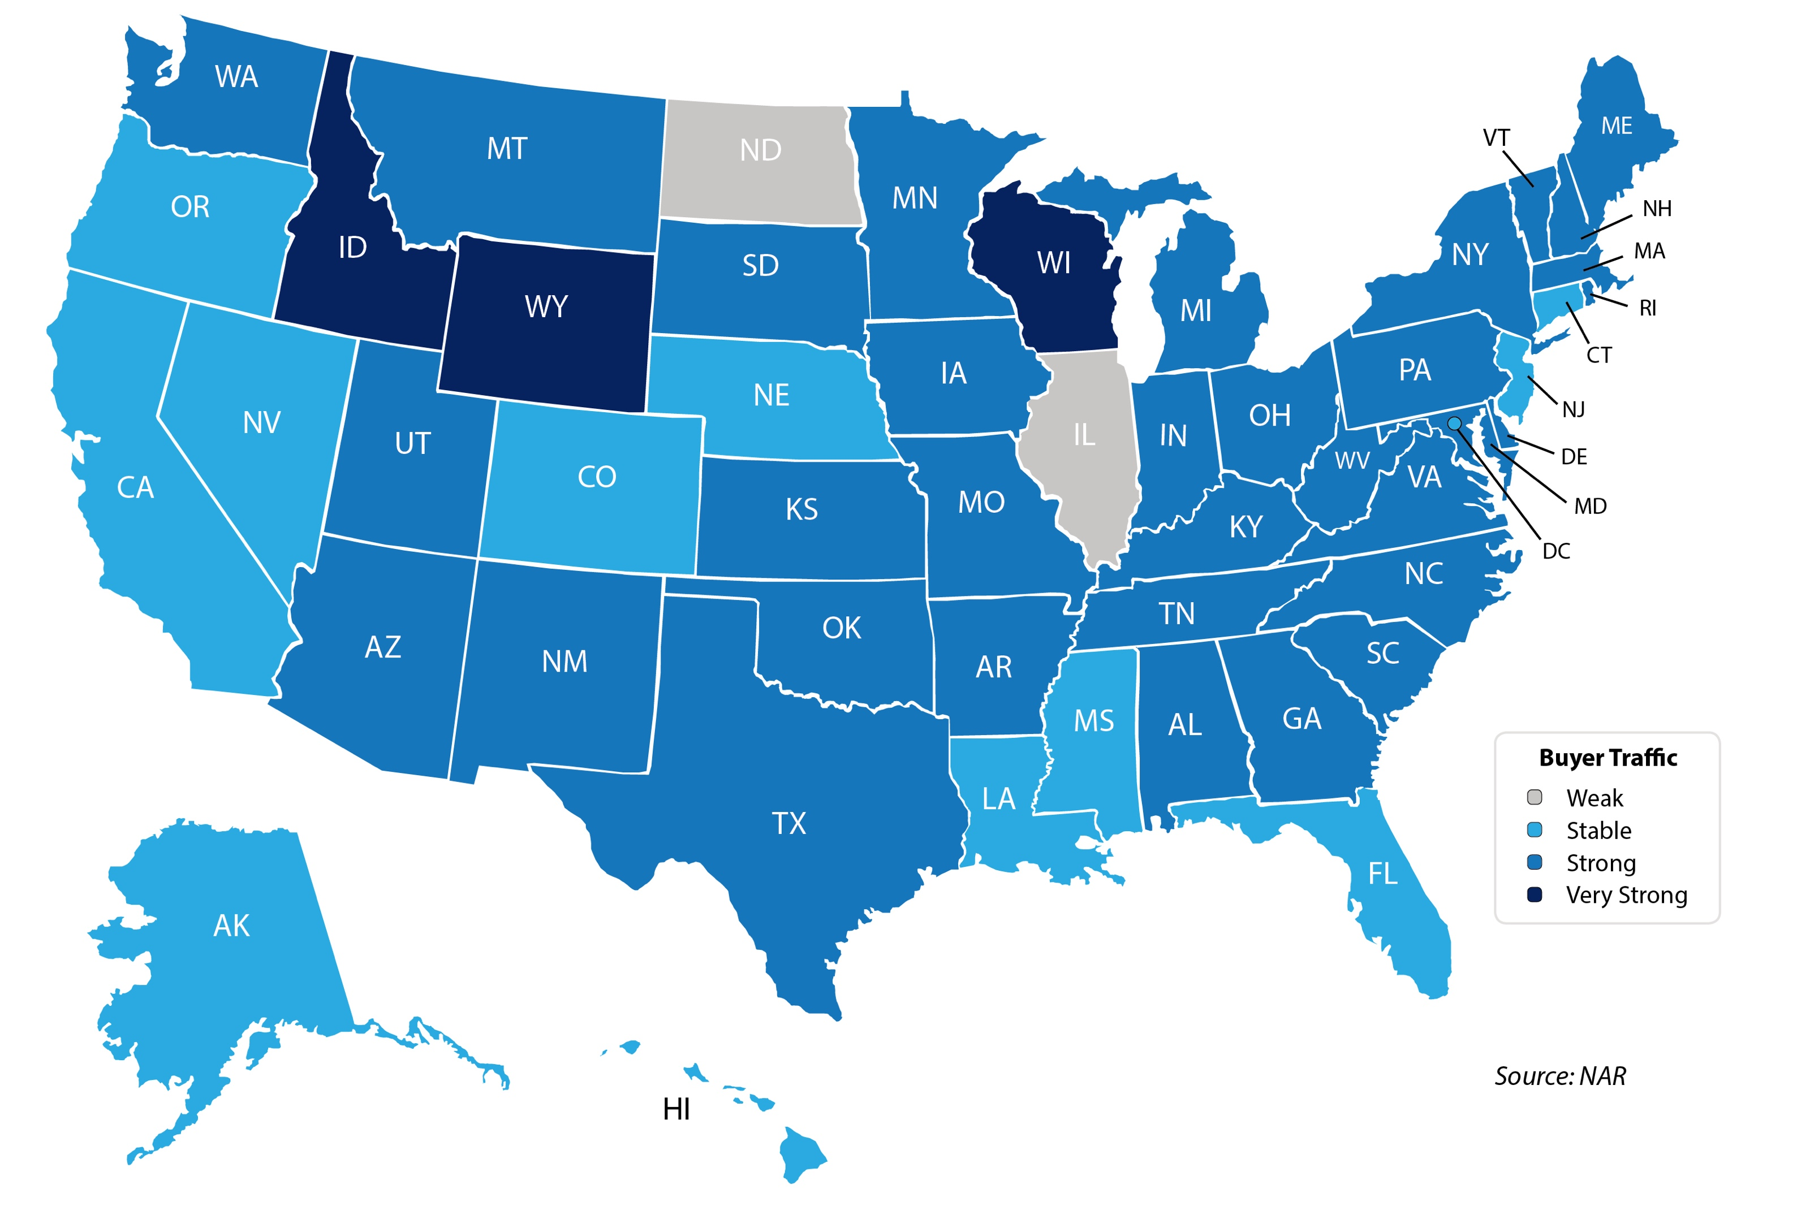
Buyer Traffic
Notes:
https://www.nar.realtor/reports/realtors-confidence-index
https://www.nar.realtor/sites/default/files/documents/2019-08-realtors-confidence-index-09-19-2019.pdf

Slide 63
INTEREST
RATES

Slide 64
Mortgage Rates
Freddie Mac 30-Year Fixed Rate
3.95%
3.64%
Freddie Mac
Notes:
http://www.freddiemac.com/pmms
http://www.freddiemac.com/pmms/pmms_archives.html

Slide 65
30-Year Fixed Rate Mortgages from Freddie Mac
3.97
3.64%
Freddie Mac
Notes:
http://www.freddiemac.com/pmms
http://www.freddiemac.com/pmms/pmms_archives.html

Slide 66
Mortgage Rate Projections
Quarter | Freddie Mac | Fannie Mae | MBA | NAR | Average of All Four
2019 4Q | 3.7 | 3.5 | 3.8 | 3.5 | 3.62%
2020 1Q | 3.7 | 3.4 | 3.8 | 3.5 | 3.60%
2020 2Q | 3.7 | 3.4 | 3.8 | 3.6 | 3.62%
2020 3Q | 3.8 | 3.4 | 3.9 | - | 3.70%
Notes:
http://www.freddiemac.com/research/forecast/
http://www.freddiemac.com/research/forecast/20190930_housing_strong_heading_into_fall.page?
http://www.fanniemae.com/portal/research-insights/forecast.html
https://www.mba.org/news-research-and-resources/research-and-economics/forecasts-and-commentary
https://www.nar.realtor/sites/default/files/documents/forecast-10-2019-us-economic-outlook-09-26-2019.pdf

Slide 67
Mortgage Rates
Freddie Mac
30-Year Fixed Rate
- Actual
- Projected
2017
2018
2019
2016
2020
Freddie Mac
Notes:
http://www.freddiemac.com/fmac-resources/research/pdf/20190730-Forecast-02.pdf

Slide 68
Mortgage Rates
Freddie Mac 30-Year Fixed Rate
Where Are They Going?
January 2018 – Today Actual Interest Rates
2019 Q4
Q1
Q2
Q3
2020
Freddie Mac
Notes:
http://www.freddiemac.com/fmac-resources/research/pdf/20190730-Forecast-02.pdf

Slide 69
Mortgage Credit Availability
YES
NO
MAYBE

Slide 70
Mortgage Credit
Availability
Mortgage Credit Availability Index (MCAI), a report from the Mortgage Bankers Association
MBA
Notes:
https://www.mba.org/news-research-and-resources/newsroom
https://www.mba.org/news-research-and-resources/research-and-economics/single-family-research/mortgage-credit-availability-index

Slide 71
Historic Data for the MORTGAGE CREDIT AVAILABILITY INDEX
(a report from the Mortgage Bankers Association)
MBA
Notes:
https://www.mba.org/news-research-and-resources/newsroom
https://www.mba.org/news-research-and-resources/research-and-economics/single-family-research/mortgage-credit-availability-index

Slide 72
Average Days To Close A Loan
Last 12 Months
All Closed Loans as per Ellie Mae
Notes:
http://www.elliemae.com/resources/origination-insight-reports
https://static.elliemae.com/pdf/origination-insight-reports/EM_OIR_AUGUST2019.pdf

Slide 73
FICO® Score Requirements
Last 12 months
All Closed Loans as per Ellie Mae
Notes:
http://www.elliemae.com/resources/origination-insight-reports
https://static.elliemae.com/pdf/origination-insight-reports/EM_OIR_AUGUST2019.pdf

Slide 74
FICO® Score
Distribution
50.27%
All Closed Loans as per Ellie Mae
Notes:
http://www.elliemae.com/resources/origination-insight-reports
https://static.elliemae.com/pdf/origination-insight-reports/EM_OIR_AUGUST2019.pdf

Slide 75
Average FICO® Score
for Closed Purchase Loans
by Loan Type
All Closed Loans as per Ellie Mae
Notes:
http://www.elliemae.com/resources/origination-insight-reports
https://static.elliemae.com/pdf/origination-insight-reports/EM_OIR_AUGUST2019.pdf

Slide 76
Average Back End DTI
for Closed Purchase Loans by Loan Type
All Closed Loans as per Ellie Mae
Notes:
http://www.elliemae.com/resources/origination-insight-reports
https://static.elliemae.com/pdf/origination-insight-reports/EM_OIR_AUGUST2019.pdf

