Slide 1
National Housing Trends

Slide 2
America’s Choice of Best Long Term Investment
Gallup 2019
Notes:
https://news.gallup.com/poll/251696/real-estate-leads-stocks-best-investment.aspx

Slide 3
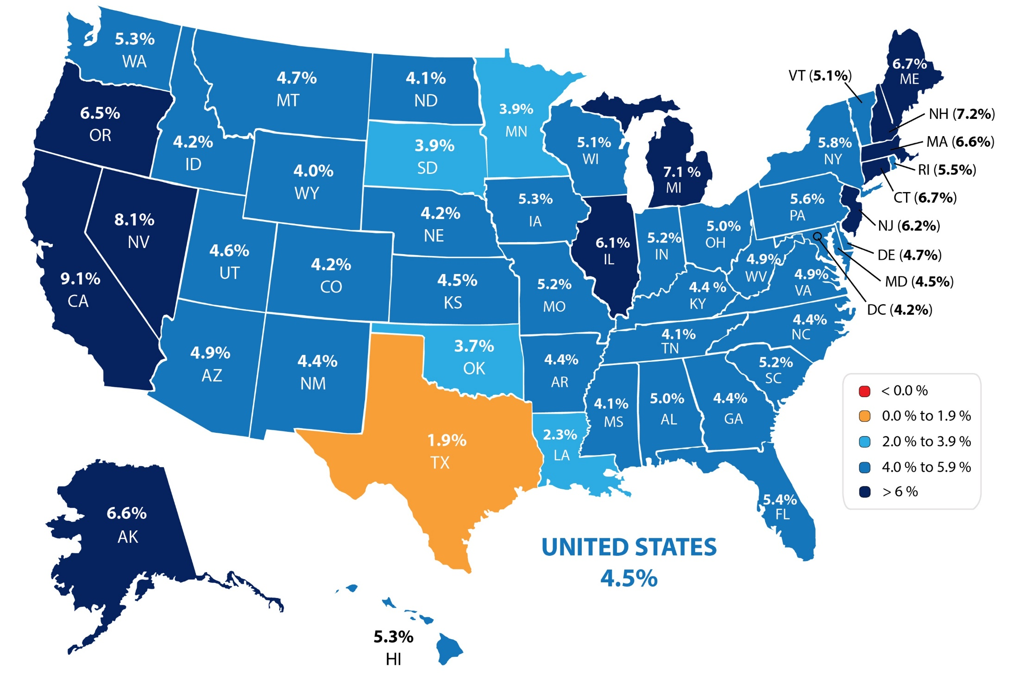
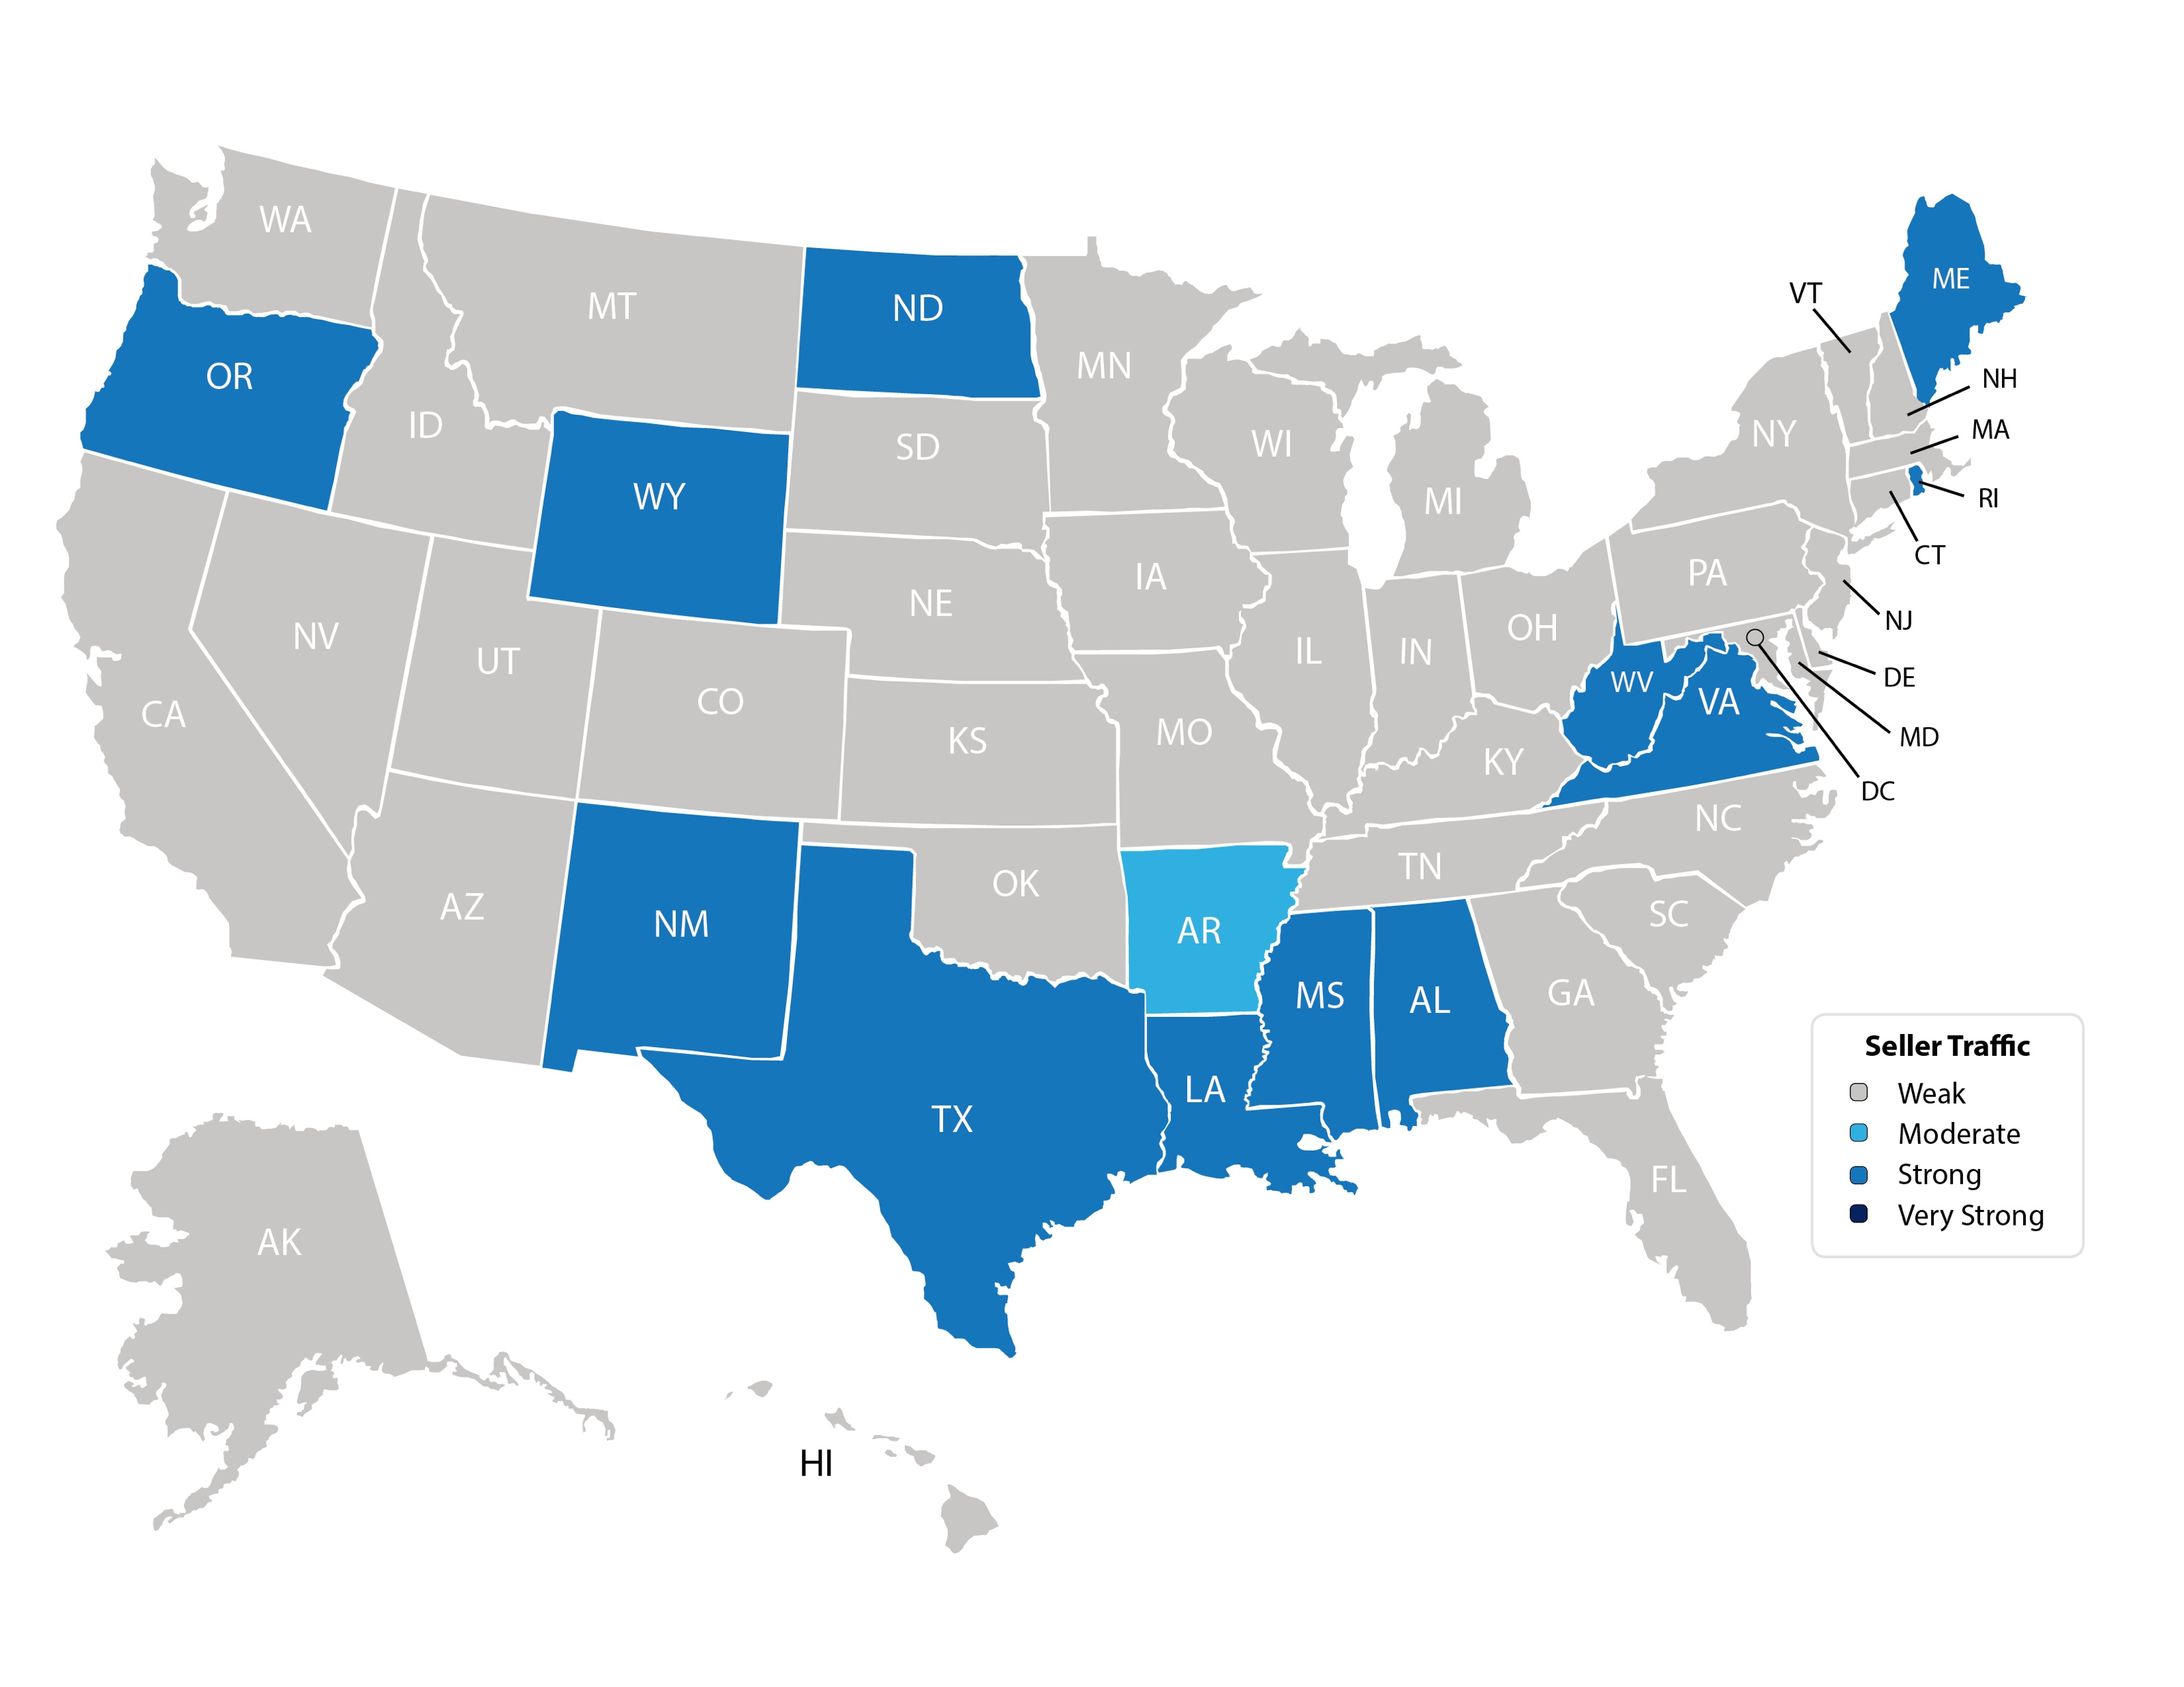
Forecasted Y-O-Y % Change in Price
CoreLogic
Notes:
https://www.corelogic.com/insights-download/homeowner-equity-report.aspx

Slide 4
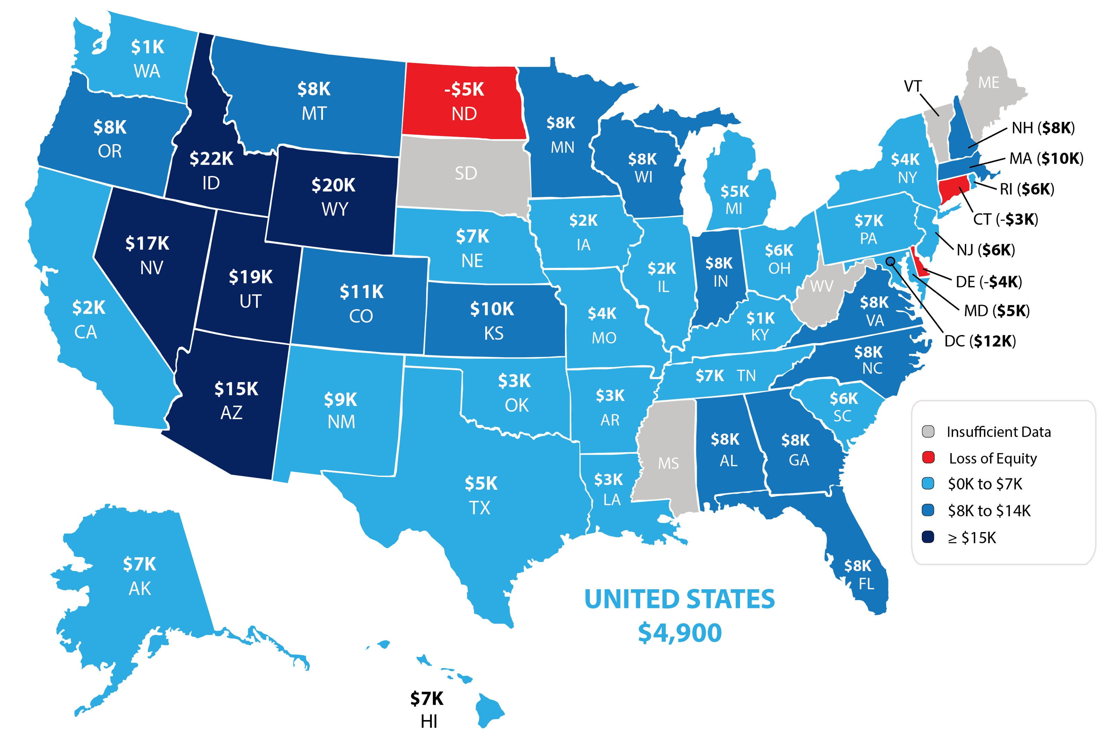
Home Equity Gain (Gain/ Loss in 2nd Quarter of 2019)
CoreLogic
Notes:
https://www.corelogic.com/insights-download/homeowner-equity-report.aspx
**Replace with updated map

Slide 5
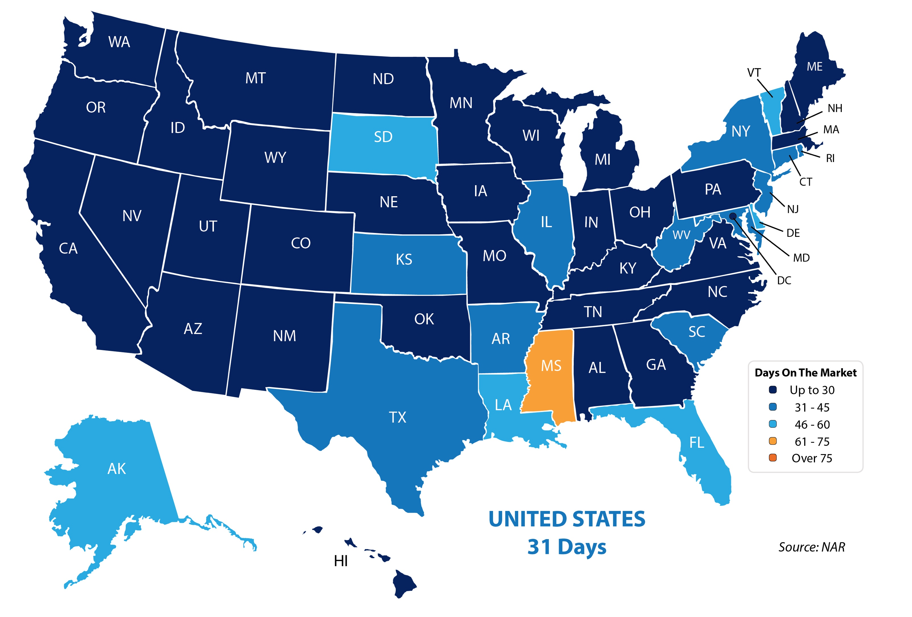
Average Days on the Market
Notes:
https://www.nar.realtor/reports/realtors-confidence-index
https://www.nar.realtor/sites/default/files/documents/2019-08-realtors-confidence-index-09-19-2019.pdf

Slide 6
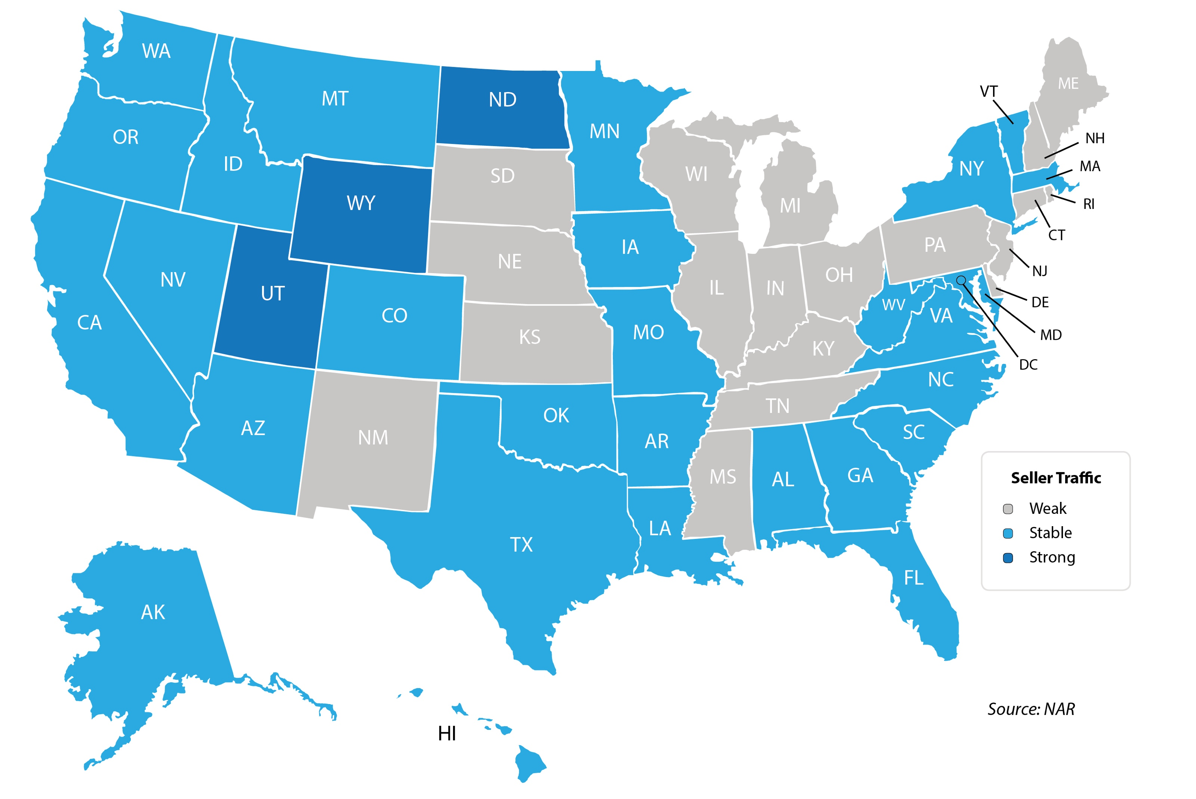
Seller Traffic
Notes:
https://www.nar.realtor/reports/realtors-confidence-index
https://www.nar.realtor/sites/default/files/documents/2019-08-realtors-confidence-index-09-19-2019.pdf

Slide 7
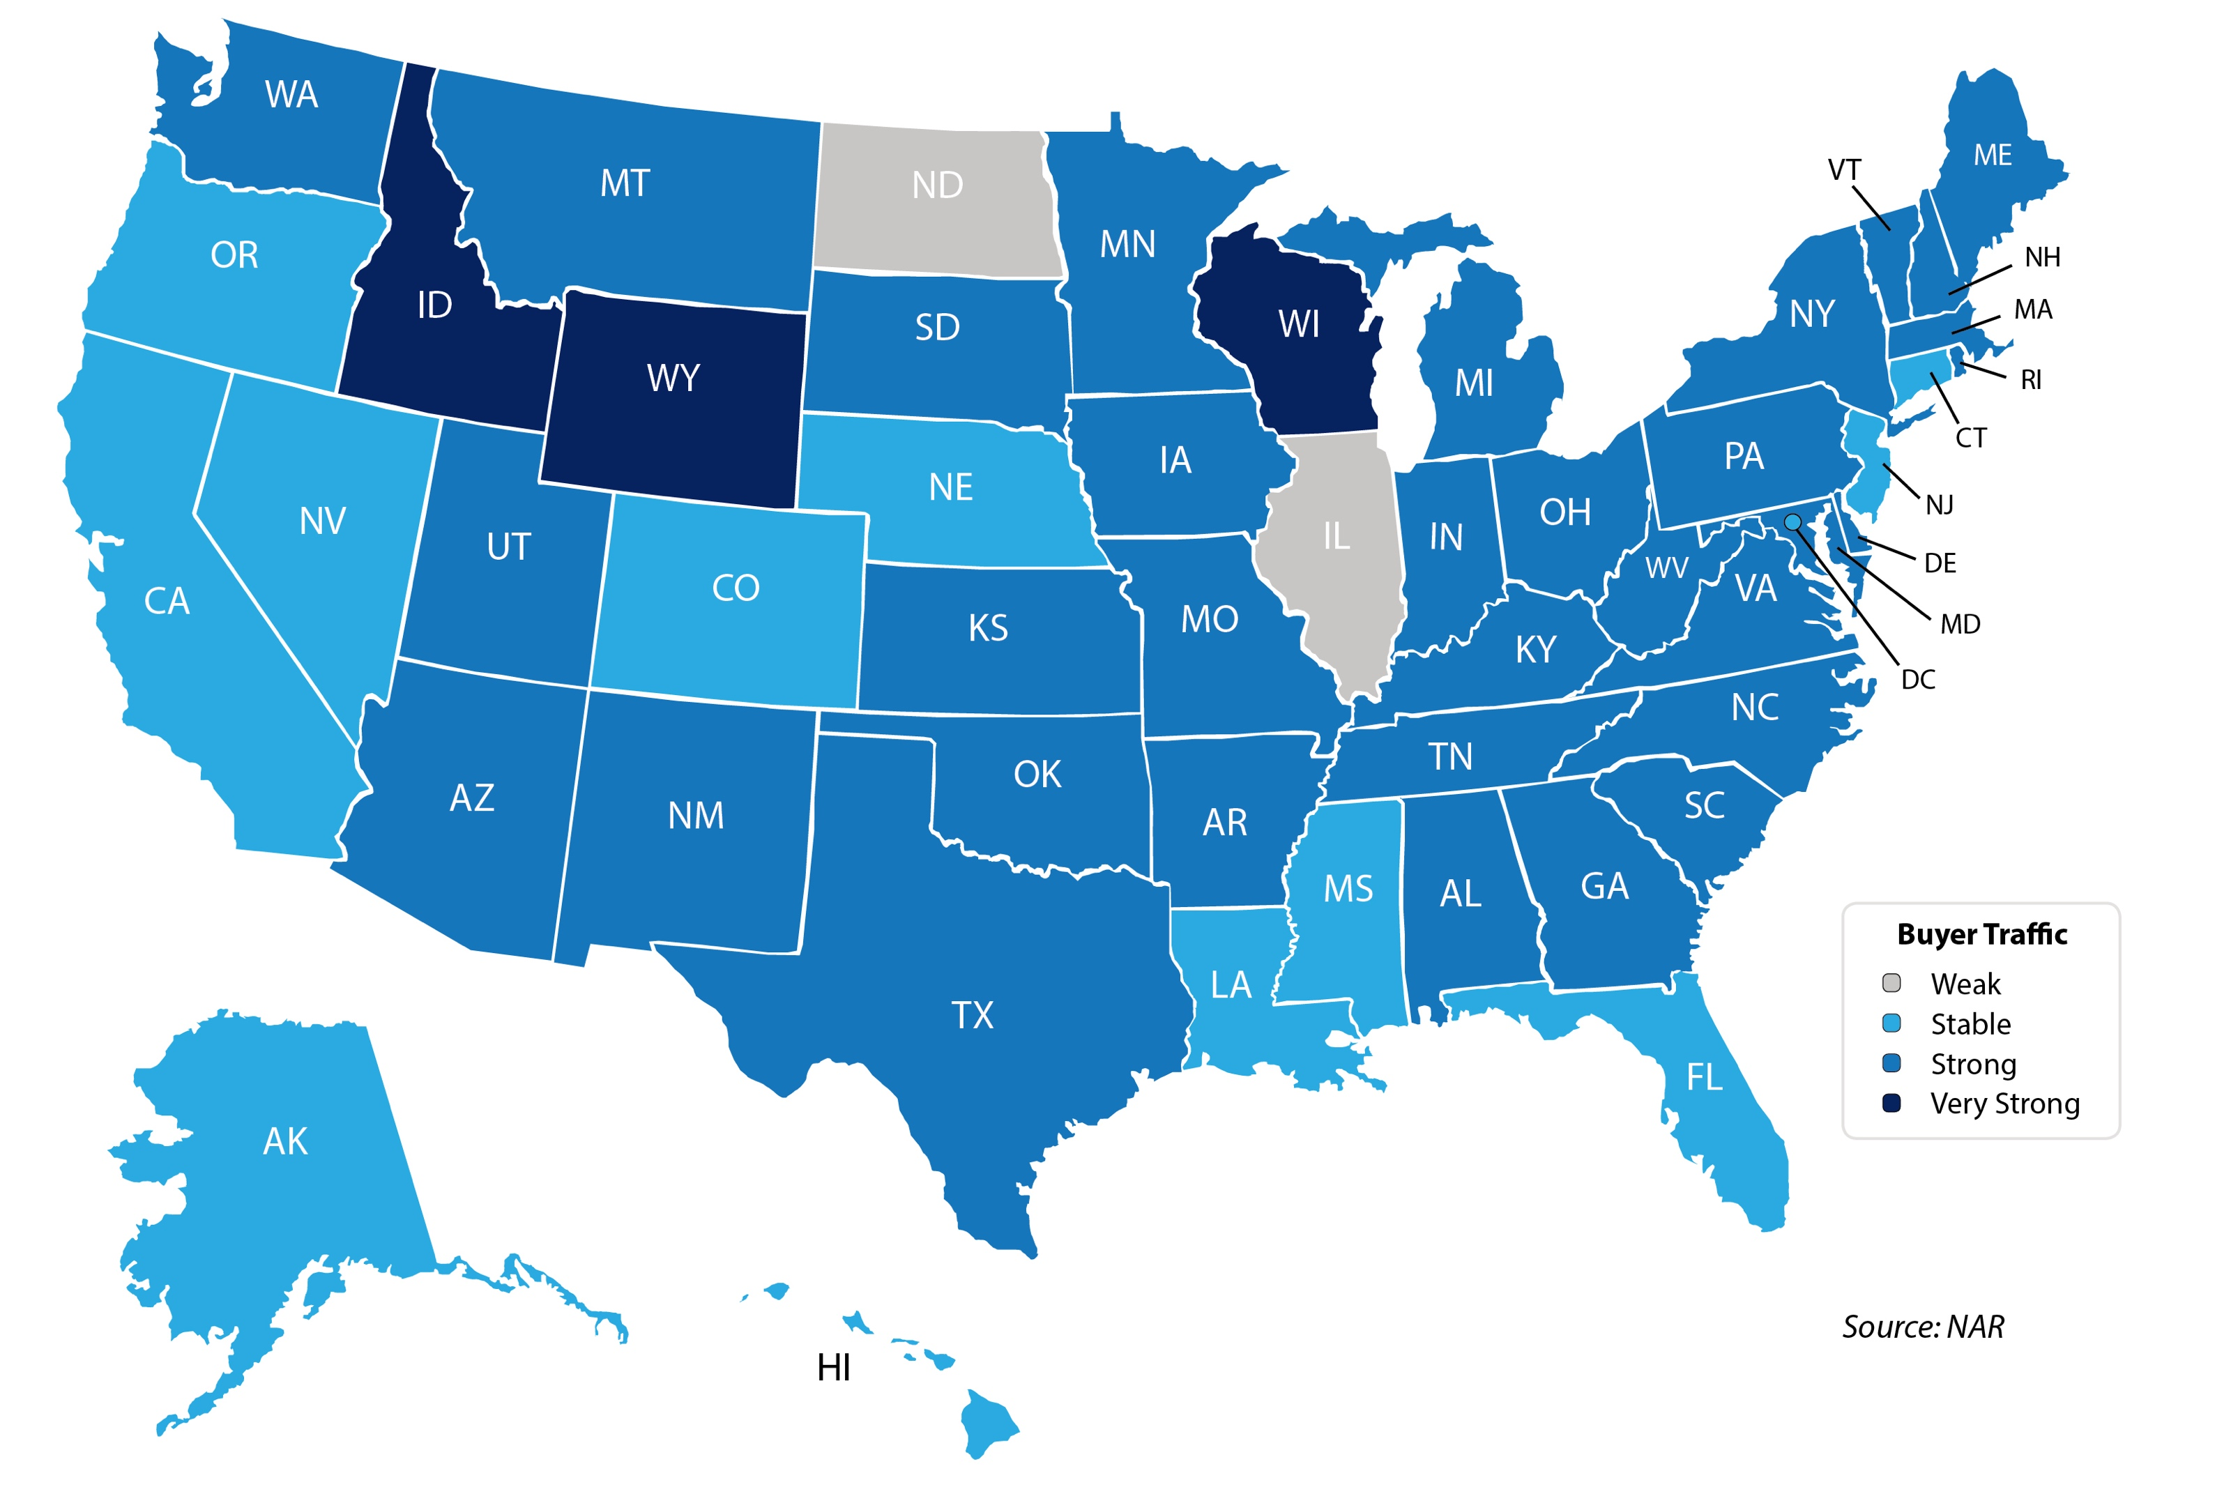
Buyer Traffic
Notes:
https://www.nar.realtor/reports/realtors-confidence-index
https://www.nar.realtor/sites/default/files/documents/2019-08-realtors-confidence-index-09-19-2019.pdf

Slide 8
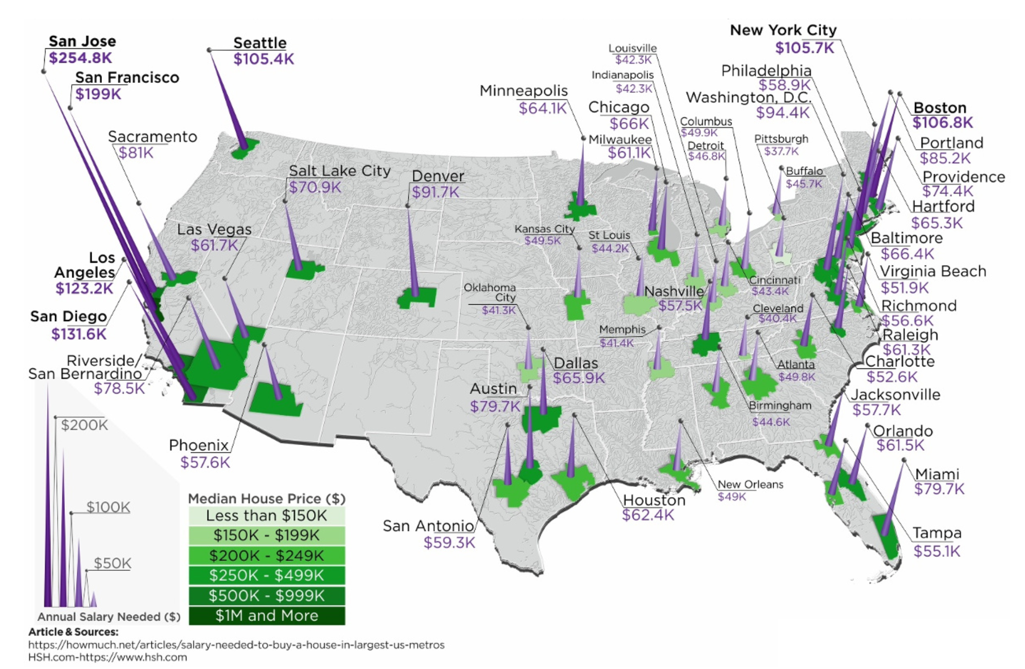
Annual Salary To Buy A Home

Slide 9
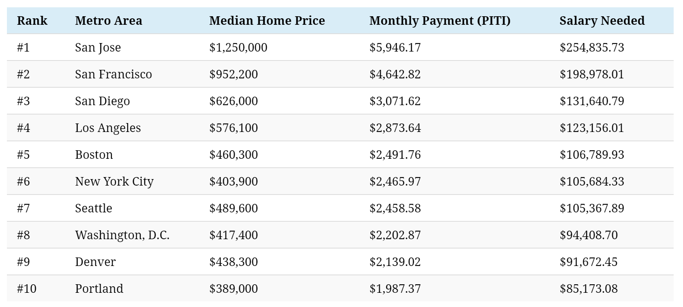
Most Expensive Metros To Buy A Home
Source: HSH.com

Slide 10
Historic Mortgage Rates by Decade
Decade | Average Rate
1970s | 8.86%
1980s | 12.7%
1990s | 8.12%
2000s | 6.29%
Freddie Mac
Notes:
http://www.freddiemac.com/blog/research_and_analysis/20140324_dirt_cheap_to_cheap.html

Slide 11
Mortgage Rate Projections
Quarter | Freddie Mac | Fannie Mae | MBA | NAR | Average of All Four
2019 4Q | 3.7 | 3.5 | 3.8 | 3.5 | 3.62%
2020 1Q | 3.7 | 3.4 | 3.8 | 3.5 | 3.60%
2020 2Q | 3.7 | 3.4 | 3.8 | 3.6 | 3.62%
2020 3Q | 3.8 | 3.4 | 3.9 | - | 3.70%
Notes:
http://www.freddiemac.com/research/forecast/
http://www.freddiemac.com/research/forecast/20190930_housing_strong_heading_into_fall.page?
http://www.fanniemae.com/portal/research-insights/forecast.html
https://www.mba.org/news-research-and-resources/research-and-economics/forecasts-and-commentary
https://www.nar.realtor/sites/default/files/documents/forecast-10-2019-us-economic-outlook-09-26-2019.pdf

Slide 12
Mortgage Rates
Freddie Mac
30-Year Fixed Rate
- Actual
- Projected
2017
2018
2019
2016
2020
Freddie Mac
Notes:
http://www.freddiemac.com/fmac-resources/research/pdf/20190730-Forecast-02.pdf

Slide 13
30 Year Fixed Mortgage Rate
Freddie Mac
Notes:
freddiemac.com

Slide 14
Historic Norm
21.2%
Payment as a
% of Income
National Association of Realtors
Notes:
https://www.nar.realtor/blogs/economists-outlook/july-2019-housing-affordability-index

Slide 15
Greater Metro Atlanta
Market
October 2019 Report With Results Through September 2019

Slide 16
Metro Atlanta 2018-2019 Closing Units
September Closings Down 16.7% Compared To August Closings
September 2019 Closings Up 1.6% Compared To September 2018
YTD Closings Units Up .5 (Statistically Flat) Compared To Last Year
YTD Closing Volume Up 4.6% Compared To Last Year
Notes:
PGR continues to grow our listing inventory market share. Our Advanced Property Marketing methodology and focused prospecting is making a difference.

Slide 17
Metro Atlanta Under Contract Trend
September Under Contract Down 8.7% Compared To August
Sept. 2019 Under Contract Up 15.7% Compared To Sept. 2018
Notes:
PGR continues to grow our listing inventory market share. Our Advanced Property Marketing methodology and focused prospecting is making a difference.

Slide 18
Metro Atlanta New Listings Trend
September New Listings Down 8.9% Compared To August
September 2019 New Listings Up 2.4% Compared To September 2018
Notes:
PGR continues to grow our listing inventory market share. Our Advanced Property Marketing methodology and focused prospecting is making a difference.

Slide 19
Metro Atlanta Closings – September 2019 (Number Of Transactions By Price)
85% Of Transactions In $100K-$500K Price Range
Notes:
Months of supply is well below normal in many of our markets. We expect this to continue in 2013.

Slide 20
Metro Atlanta Closed Units By Price Point September 2019 Compared To September 2018
Notes:
Months of supply is well below normal in many of our markets. We expect this to continue in 2013.

Slide 21
Listed Inventory January 2018 – Sept. 2019
All Residential, Metro Atlanta
Inventory Up 1.5% From Last Month Up 7.2% Compared To Last Year
Notes:
PGR continues to grow our listing inventory market share. Our Advanced Property Marketing methodology and focused prospecting is making a difference.

Slide 22
Months of Inventory Change The Market Strategy
GREATER THAN
7 MONTHS
BETWEEN
6-7 MONTHS
LESS THAN
6 MONTHS
SELLERS
MARKET
Home prices
will appreciate
NEUTRAL
MARKET
Home prices
will only appreciate with inflation
BUYERS
MARKET
Home prices
will depreciate
Notes:
Realtor.org

Slide 23
Metro Atlanta Months of Inventory (September 2019, Based On Closed Sales)
6 Months Supply Is Considered Normal Market
Total Metro Atlanta “Months Of Inventory” Is 3.6 Months
Notes:
Months of supply is well below normal in many of our markets. We expect this to continue in 2013.

Slide 24
Metro Atlanta Monthly Average Sale Prices
ASP $311,000 In August. Flat Compared To Last Month
Up 5.1% From Last September
Notes:
PGR continues to grow our listing inventory market share. Our Advanced Property Marketing methodology and focused prospecting is making a difference.

Slide 25
Metro Atlanta Annual Average Sale Prices
Annual ASP Up 78% From Bottom Of 2011
Notes:
PGR continues to grow our listing inventory market share. Our Advanced Property Marketing methodology and focused prospecting is making a difference.

Slide 26
Case-Shiller Index For Metro Atlanta
Jan 2010 Through July 2019 (Reported September 24, 2019)
Home Values Up 85% From Bottom Of March 2012.
Notes:
PGR continues to grow our listing inventory market share. Our Advanced Property Marketing methodology and focused prospecting is making a difference.

Slide 27
Case-Shiller Gain/ Loss For Metro Atlanta
Comparisons Based On The Latest Case Shiller Index Compared
To The Average Index For The Year Property Was Purchased.
Year Property Bought | Gain/ Loss
2001 | 40.26%
2002 | 35.16%
2003 | 30.96%
2004 | 26.35%
2005 | 20.19%
2006 | 15.21%
2007 | 14.47%
2008 | 25.12%
2009 | 41.56%
Year Property Bought | Gain/ Loss
2010 | 45.08%
2011 | 56.01%
2012 | 69.12%
2013 | 42.39%
2014 | 31.03%
2015 | 24.18%
2016 | 17.30%
2017 | 11.24%
2018 | 5.04%
Case Shiller Index For Metro Atlanta - July 2019 As Reported September 24, 2019. Micro-Local Markets And Price Points May Have Significantly Different Outcomes.
Notes:
PGR continues to grow our listing inventory market share. Our Advanced Property Marketing methodology and focused prospecting is making a difference.

Slide 28
Case-Shiller Home Values For Metro Atlanta
Recent Bottom Was March 2012. Metro Average Home Values Back To Normal Trend Line.
Notes:
PGR continues to grow our listing inventory market share. Our Advanced Property Marketing methodology and focused prospecting is making a difference.

Slide 29
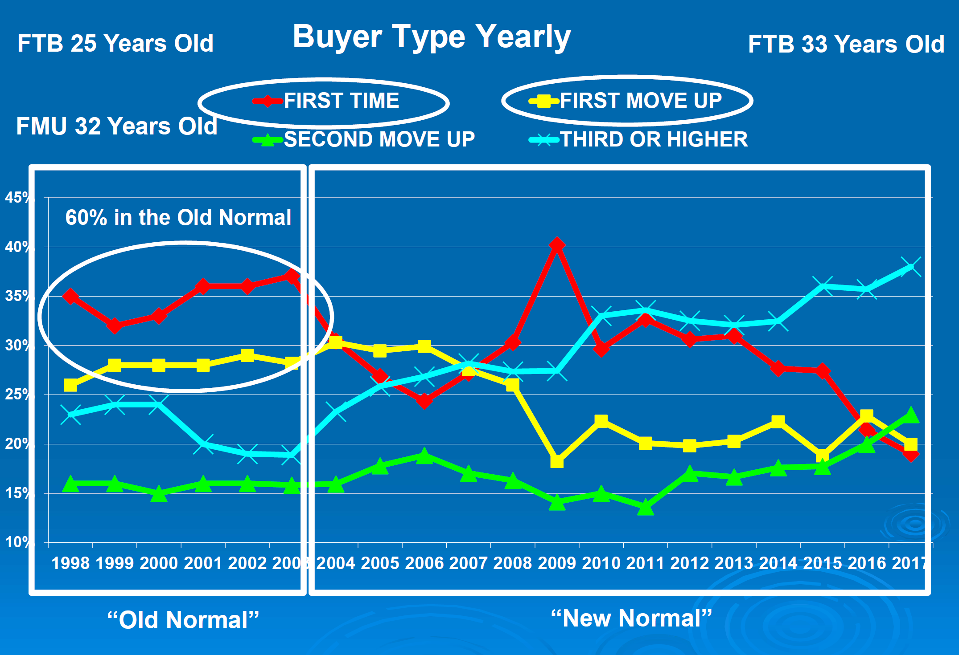

Slide 30
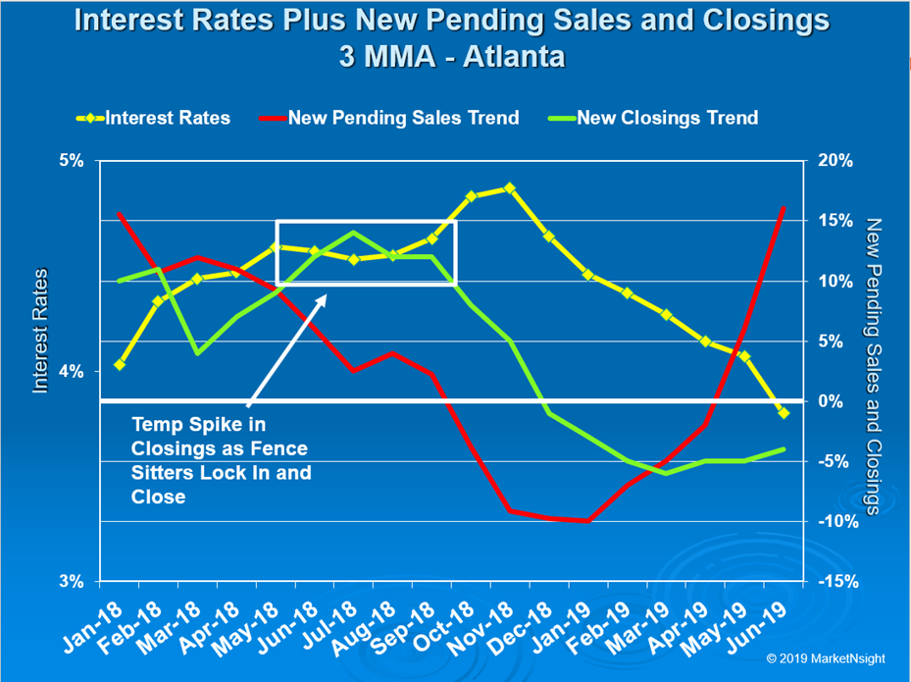

Slide 31
Metro Atlanta Brokerage Rankings

Slide 32
Annual Closed Volume – September 2019 FMLS Counties + Southern Crescent
($ Volume in Billions)
Information Provided By Trendgraphix and BHHS Georgia Properties Internal Reports.
Notes:
In the past three years, our company has consistently grown our market share in both listing inventory and the sales of that inventory. Today, we are Ranked #1 in both categories.

Slide 33
Georgia Economic & Housing Trends

Slide 34
Top State For Business Site Selection Magazine
6 Years in a Row!
2018
2017
2016
2015
2014
2013

Slide 35
Buyers Moving To Atlanta!
Here is the Top 10 List including previous rank:
Atlanta (1)
Phoenix (4)
Tampa/Sarasota (2)
Dallas/Fort Worth (3)
Orlando (5)
Denver (7)
Houston (8)
Seattle (6)
Las Vegas (10)
Chicago (9)
Penske Truck Rental published their latest moving destination list and Atlanta was ranked #1 for the 6th year in a row. The trend of moving to the sunbelt has returned. Desirable attributes that help Metro Atlanta include a business friendly environment, low cost of living for a metro area, airport, moderate weather with 4 seasons and a high quality of life.

Slide 36
Baby Boomers Are Coming To Be Close To Their Children & Grandchildren.
 | Total Population | Rank of Share
 |  | Under 20 | 20-64 | 65+ | 25-39 | 45-59
Dallas | 6,144,489 | 3 | 9 | 25 | 1 | 24
Atlanta | 5,271,550 | 5 | 6 | 27 | 2 | 19
Phoenix | 4,179,427 | 4 | 24 | 15 | 3 | 26
Denver | 2,466,591 | 11 | 5 | 24 | 4 | 12
Riverside | 4,081,371 | 1 | 27 | 22 | 5 | 27
Houston | 5,629,127 | 2 | 10 | 26 | 6 | 21
Portland | 2,174,631 | 19 | 4 | 19 | 7 | 7
Seattle | 3,309,347 | 22 | 1 | 20 | 8 | 3
Sacramento | 2,091,120 | 12 | 13 | 14 | 9 | 20
Washington | 5,306,125 | 14 | 3 | 23 | 10 | 11
Los Angeles | 12,875,587 | 6 | 17 | 18 | 11 | 23
San Diego | 2,974,859 | 8 | 14 | 16 | 12 | 25
San Francisco | 4,203,898 | 26 | 2 | 10 | 13 | 4
Orlando | 2,032,496 | 18 | 15 | 8 | 14 | 22
Minneapolis | 3,208,212 | 10 | 7 | 21 | 15 | 6
Chicago | 9,522,879 | 7 | 16 | 17 | 16 | 18
New York | 18,815,988 | 21 | 12 | 6 | 17 | 15
Boston | 4,482,857 | 23 | 8 | 9 | 18 | 10
Cincinnati | 2,134,864 | 9 | 19 | 13 | 19 | 14
Baltimore | 2,668,056 | 17 | 11 | 11 | 20 | 9
Detroit | 4,467,592 | 13 | 18 | 12 | 21 | 5
Philadelphia | 5,827,962 | 16 | 21 | 5 | 22 | 13
St. Louis | 2,802,282 | 15 | 20 | 7 | 23 | 8
Miami | 5,413,212 | 24 | 26 | 3 | 24 | 17
Tampa | 2,723,949 | 25 | 25 | 1 | 25 | 16
Cleveland | 2,096,471 | 20 | 23 | 4 | 26 | 2
Pittsburgh | 2,355,712 | 27 | 22 | 2 | 27 | 1
Metro Atlanta Has The:
#2 Population Age 25-39
#5 Population Under 20
Source :Census Bureau

Slide 37
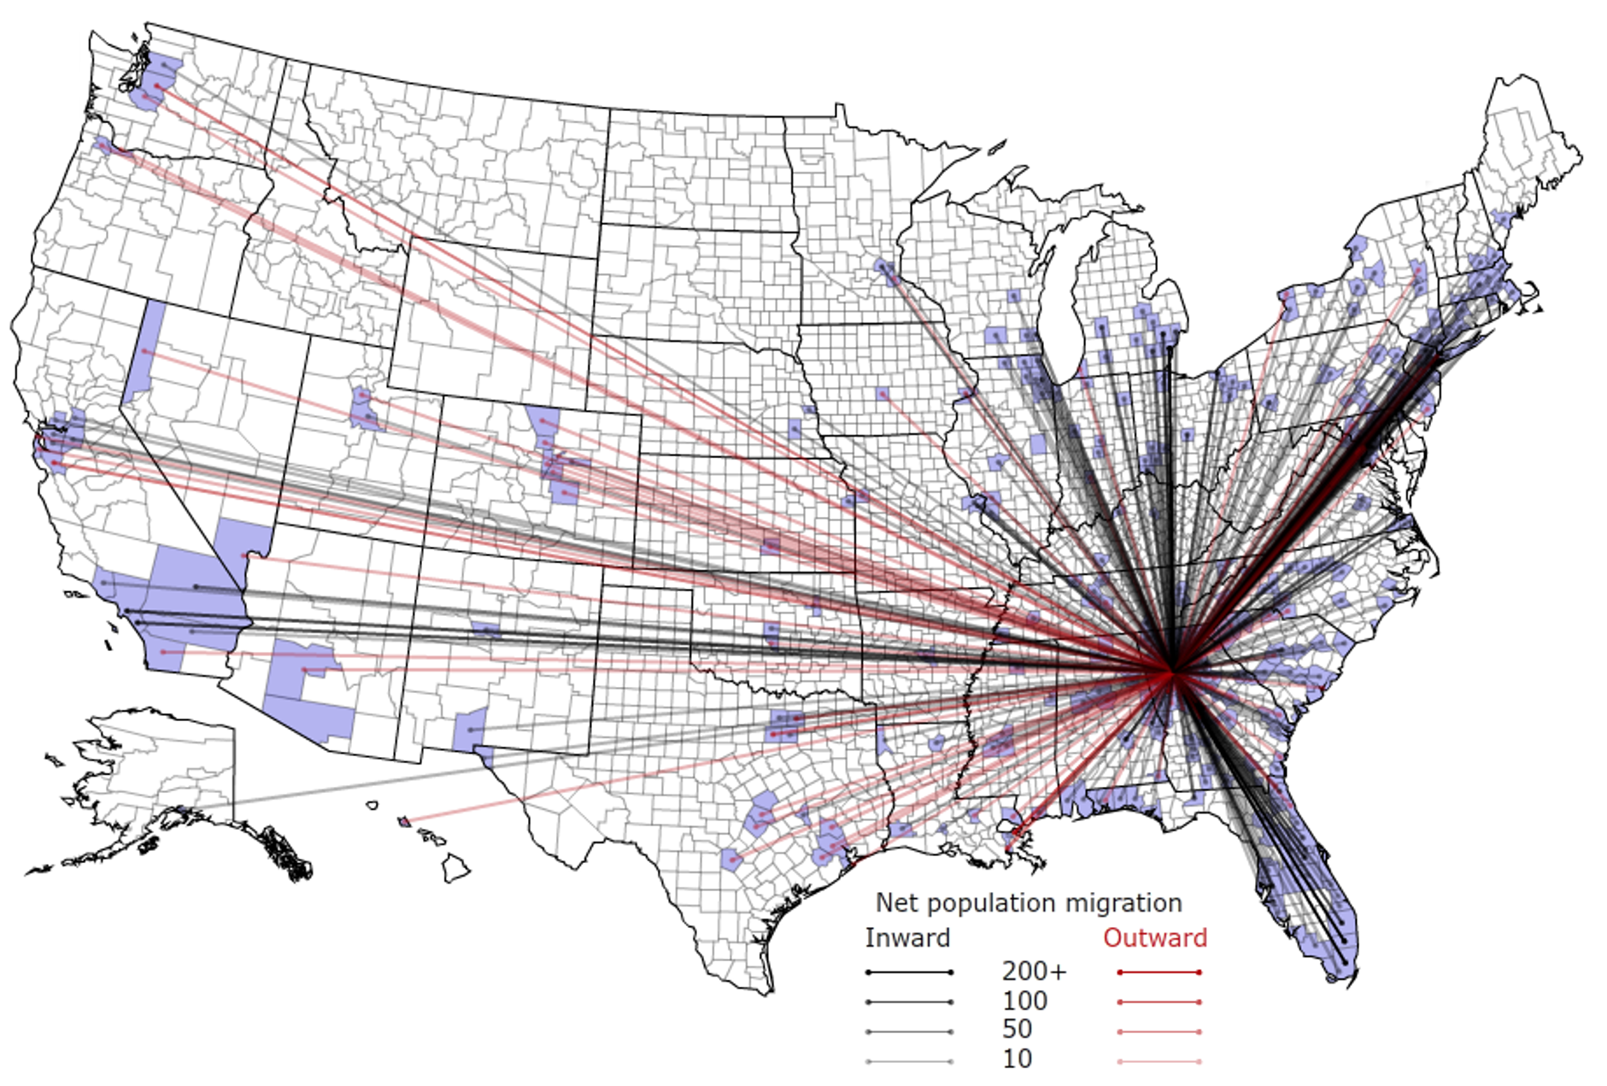
People Are Moving To Atlanta!

Slide 38
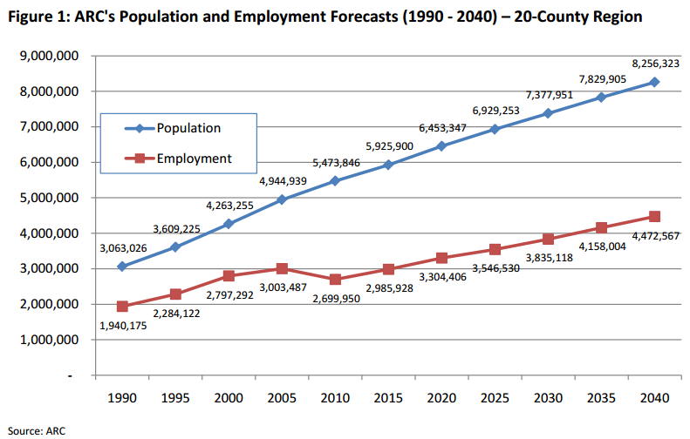
Population & Employment Growth Trends

Slide 39
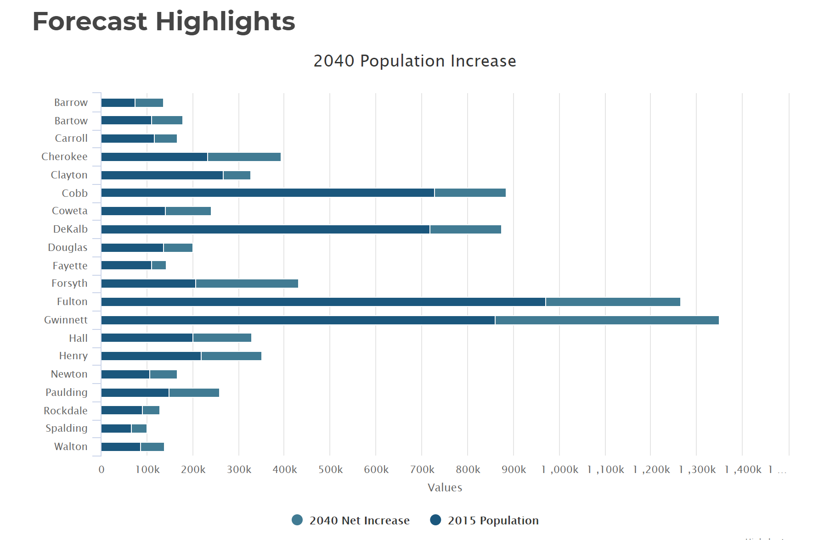
Population By County
Atlanta Regional Commission

Slide 40
Population & Employment Growth Trends
U.S. Conference of Mayors Report predicts that Metro Atlanta will be the 6th largest city in the nation by 2046.
Metro Atlanta will grow from 5.8 million residents to 8.6 million residents.
That means 2.8 million people will move to our area!
This is great news for our long-term real estate values!

