Slide 1
Create Your Break Through

Slide 2
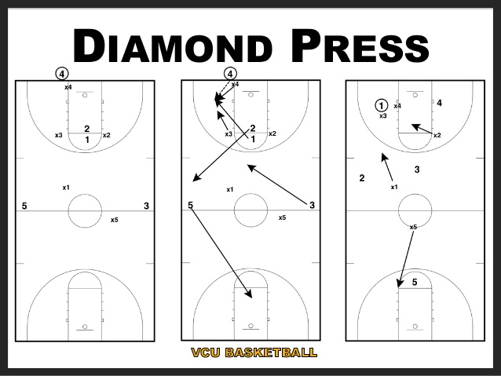

Slide 3
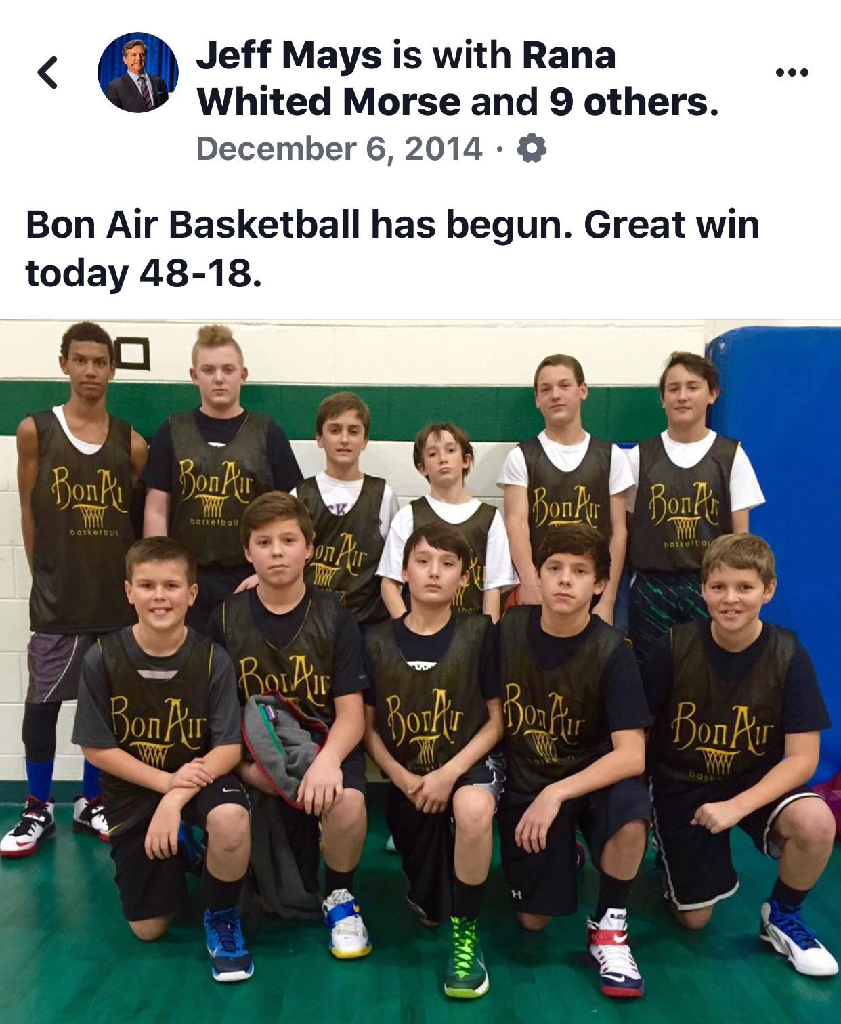
What Plays Do You Run That
WORK..
Every Time?

Slide 4
If your life depended on making a sale or taking a listing this week...
What Would You Do?

Slide 5
Intentions Today :
Take Advantage of the Unique Opportunties Right Now
2. Have a Break Through to Reach Your
Full Income Potential
3. Build Your 2020 Business Plan
4. Have Fun!

Slide 6
TO CHANGE YOUR LIFE
TF
#TomFerry

Slide 7
TF
#TomFerry

Slide 8
What do you WANT TO MAKE in 2020?
TF
#TomFerry

Slide 9
2020 Income Goal ________ 2020 Potential Income = ________
(X3)
TF
#TomFerry

Slide 10
Interested or Are You ALL IN?
TF
#TomFerry

Slide 11
HOW
COACHABLE
ARE YOU?

Slide 13
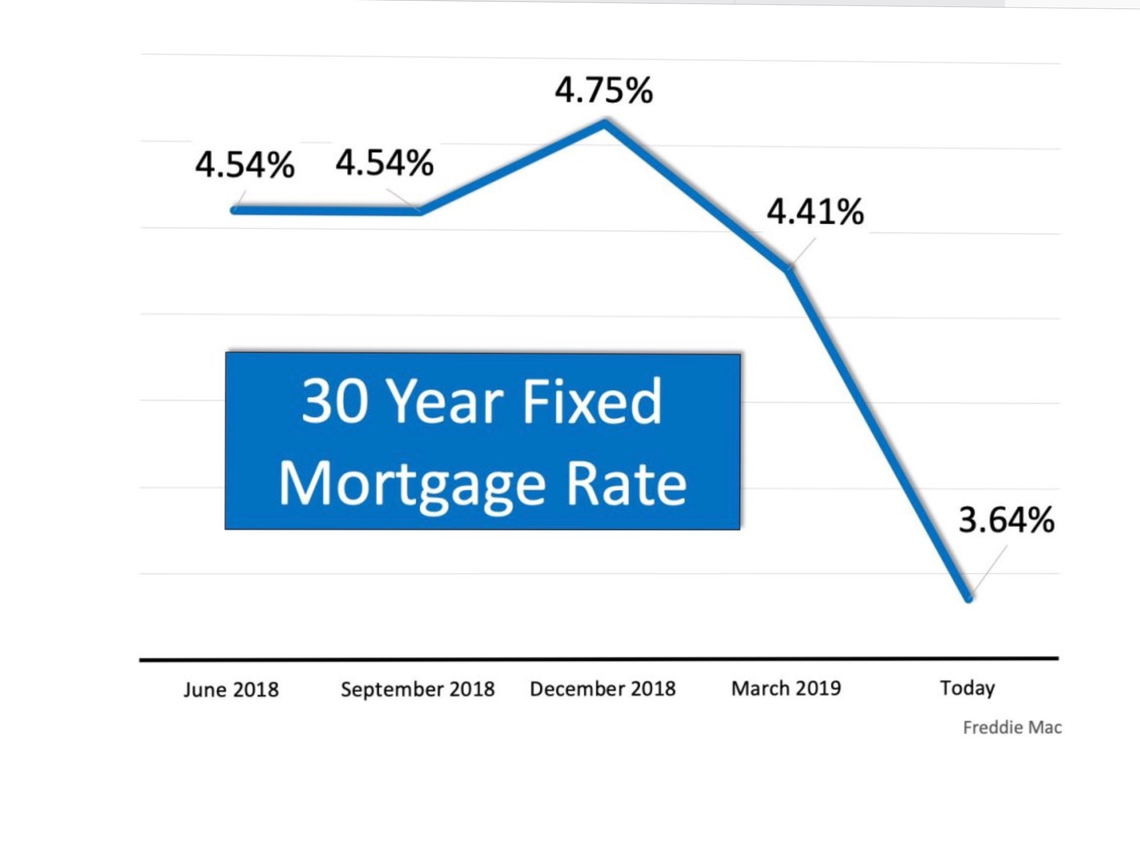

Slide 14
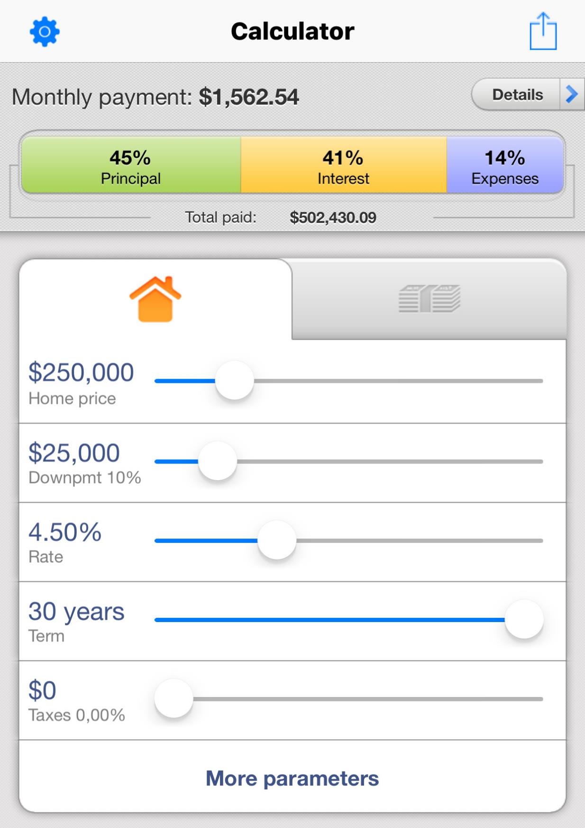
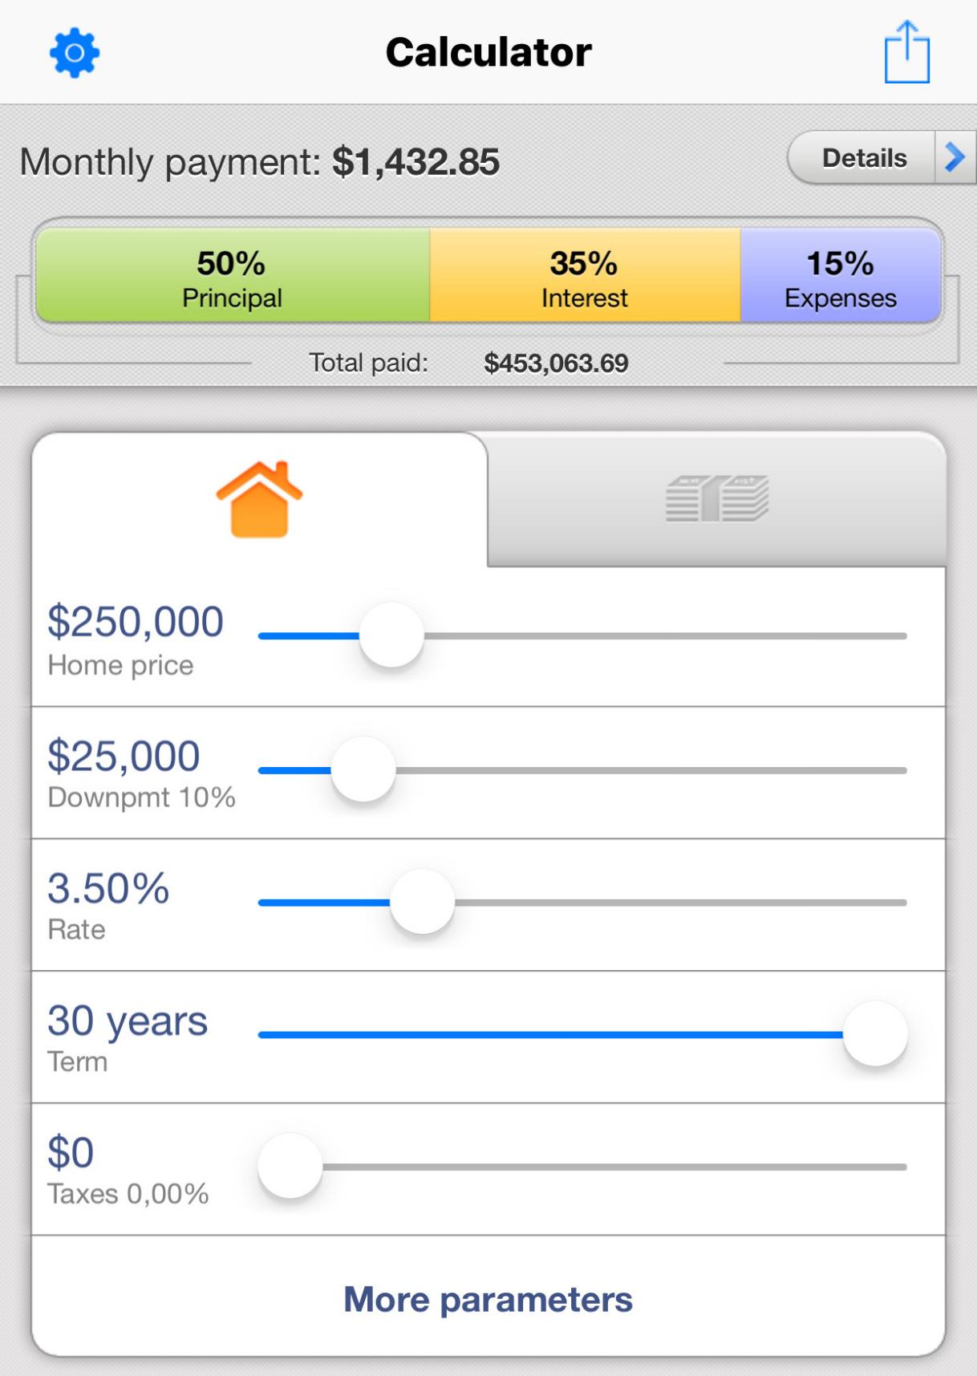
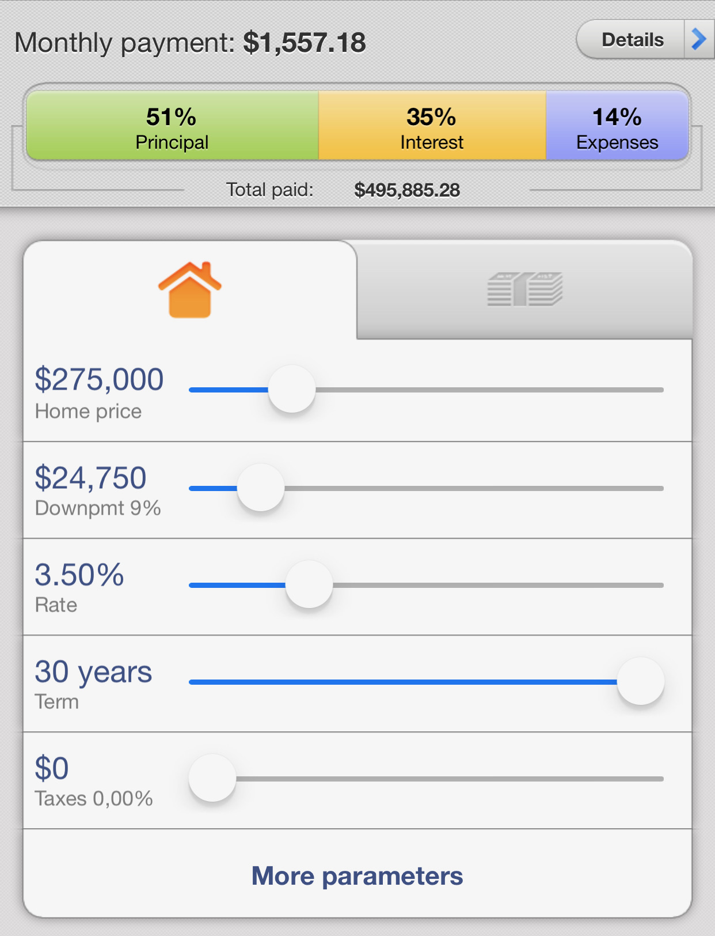
Purchaser’s Buying Power Increased by 10%
in 3 months
TF
#TomFerry

Slide 16
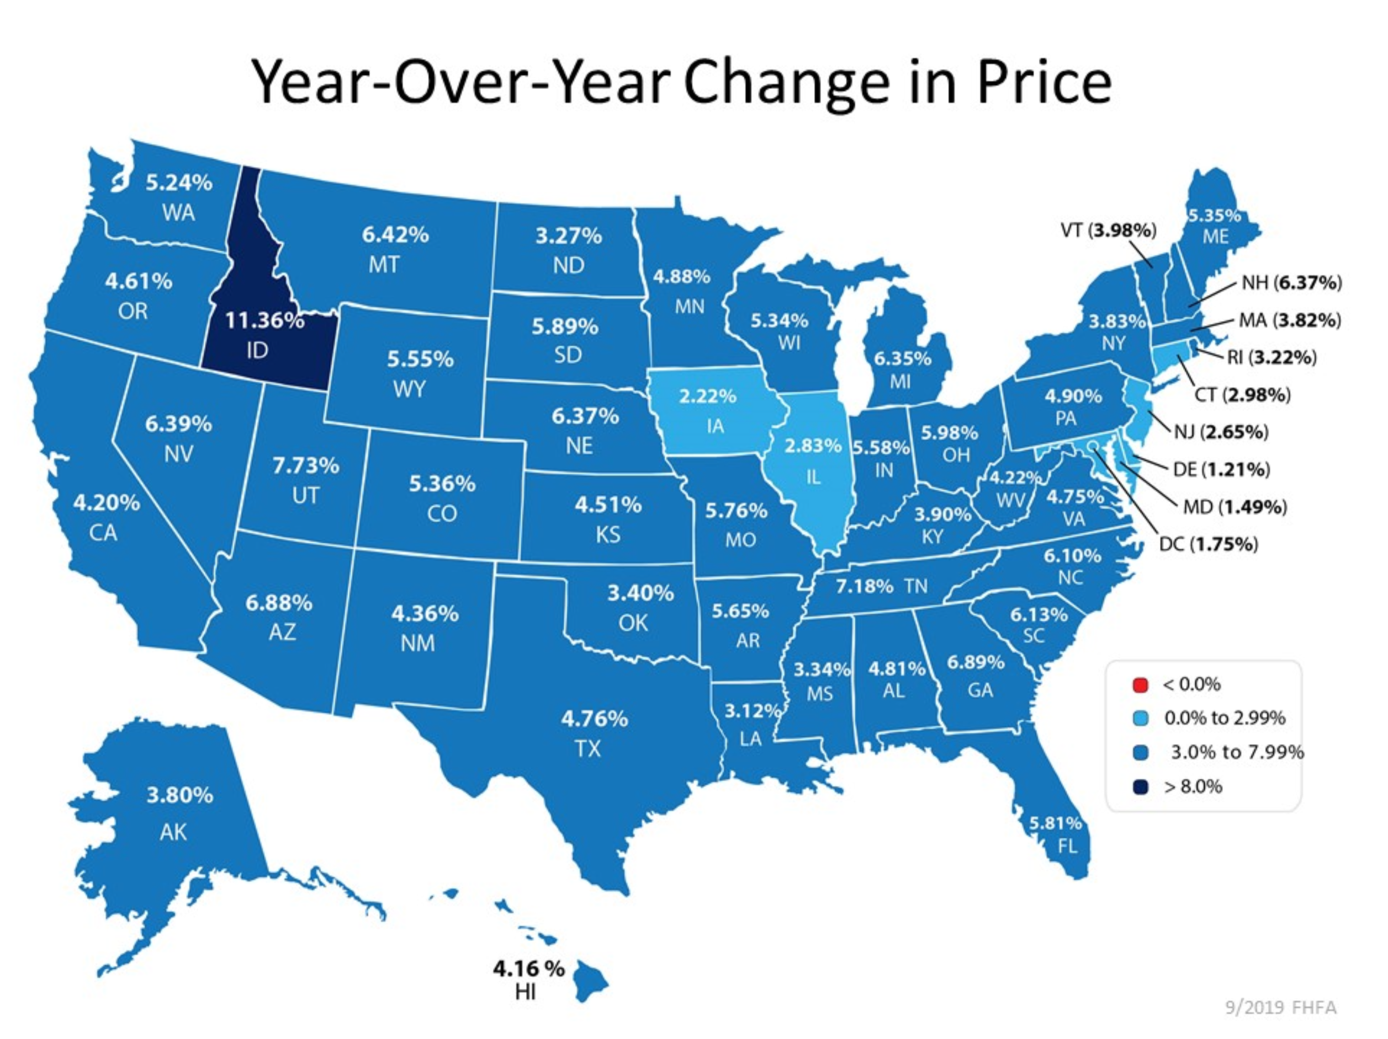

Slide 17
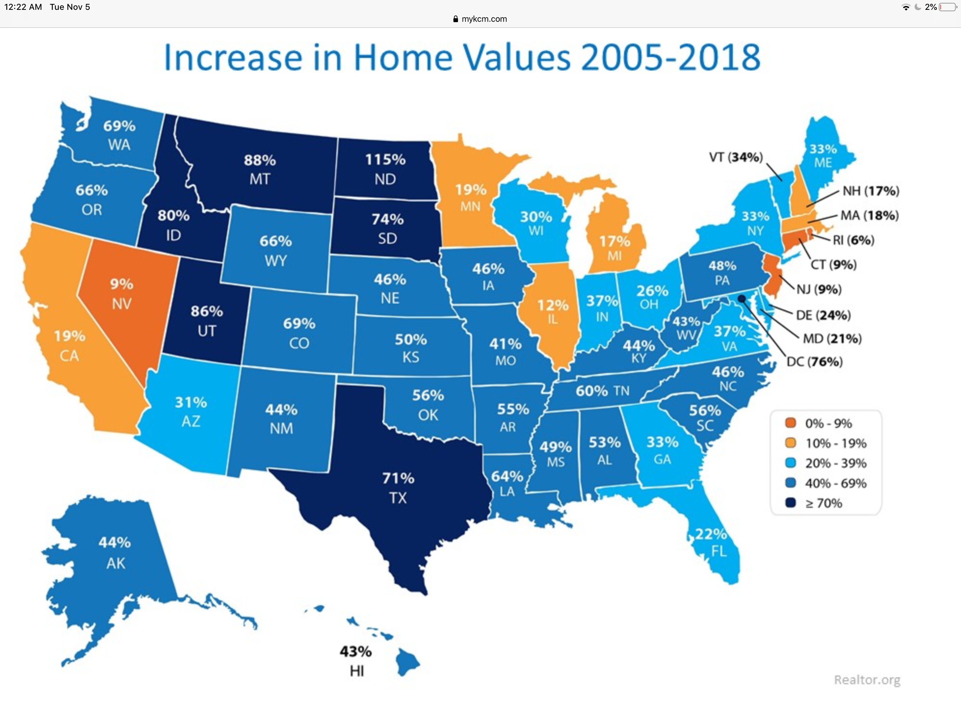

Slide 20
RENT v OWN
After 5 Years
RENT - $2,000x12x5yr=$120,000 Mortgage - $2,000x12x5yr=$120,000
Equity- $0 Equity-$75,000 ($300k x .05 x 5yrs)
Tax Deduction -$0 TaxDed.-$22k ($108k x .32 -$12k)
Down Payment -$0 Down Pay.-$15,000
Mortgage Paydown-$10,800
Net Worth -$124,000 (total loss) Net Worth + $122,800
mortagecalculator.org

Slide 22
WHAT DO WE ACTUALLY SELL?
TF
#TomFerry

Slide 23
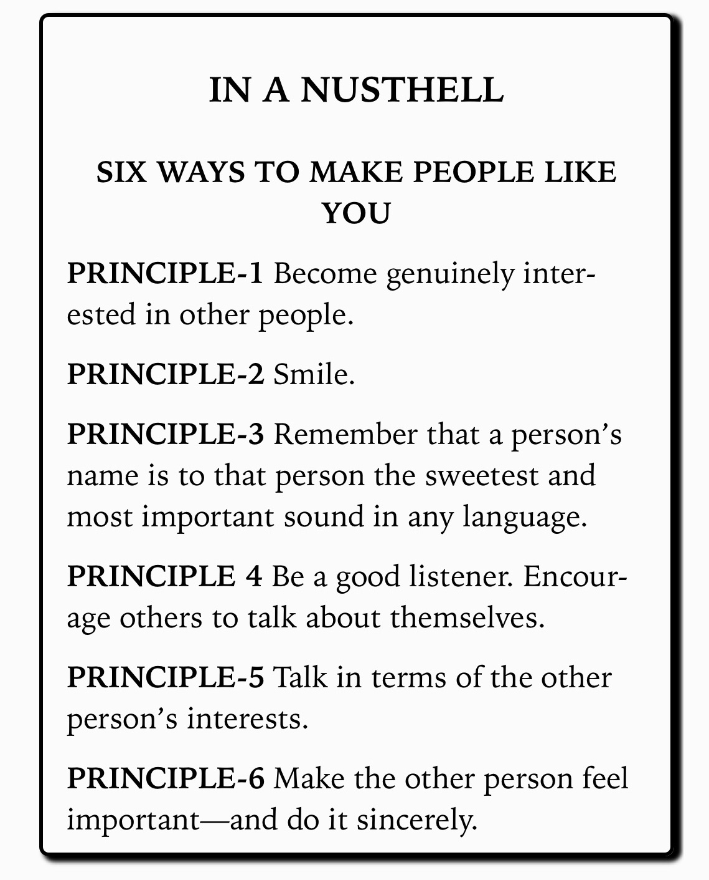

Slide 24
OPEN HOUSE DIALOGUE
Do you live in the neighborhood?
What brought you by today?
Are you renting or do you own?
(RENT) How long have you been renting?
(OWN) Do you have to sell to buy?
Is your house on the market?
What are you looking for in your next home?
How long have you been looking?
Is this the area you are looking in?
Will you be paying cash or getting a mortgage?
Have your seen what interest rates are doing?
What price range are you looking in?
Have you seen anything you like?
How have you been locating houses?

Slide 25
SETTING AN APPOINTMENT at OPEN HOUSES
If there was an advantage to working with me that saves you time and money,
would you want to know about it?
If I found the perfect property for you and it wasn’t on the market
would you want to know about it?
Has anyone explained the process of buying a home to you?
With our clients: we explain step by step what happens buying a home...
we go thru the paperwork so they feel comfortable knowing what they’re signing...
Talk about market conditions...find out exactly what your looking for so not to waste your time...
develop a negotiating strategy to save you money...partner with vendors who will give great service and make this an easy process.
Can you see the advantage of all this for you?

Slide 26
What’s the advantage
to working with you?
Why should they sit down
with you?
What are the OBJECTIONS at an Open House?
TF
#TomFerry

Slide 29
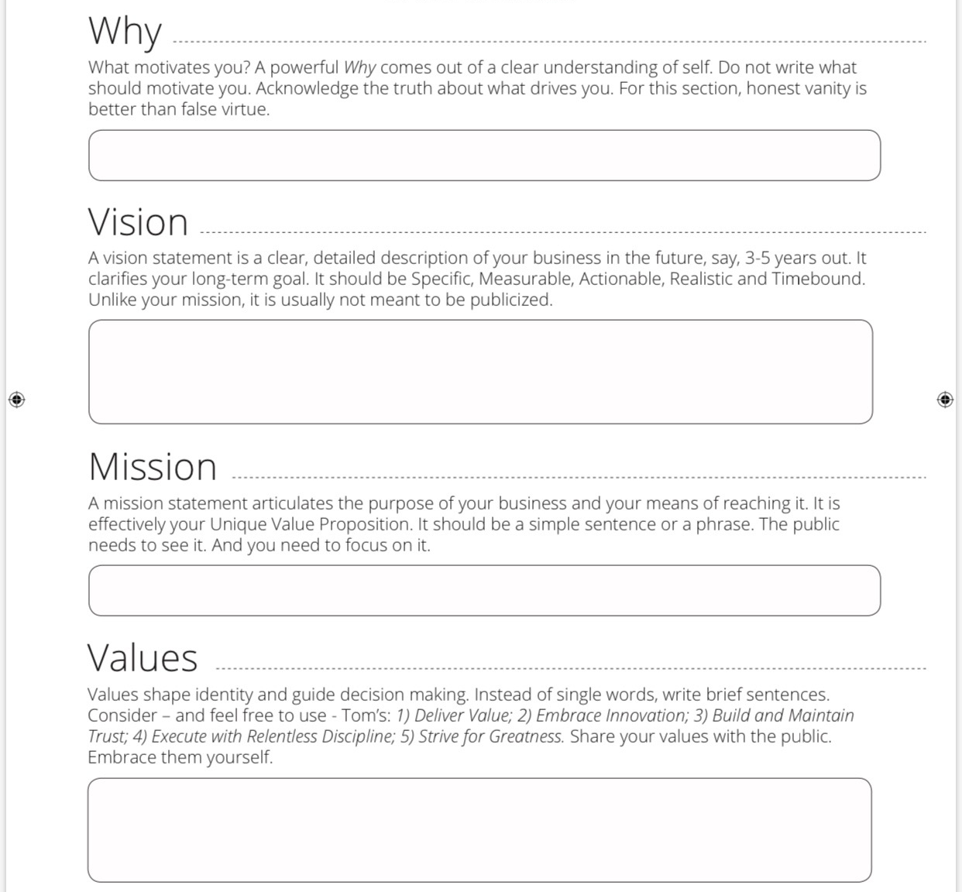

Slide 30
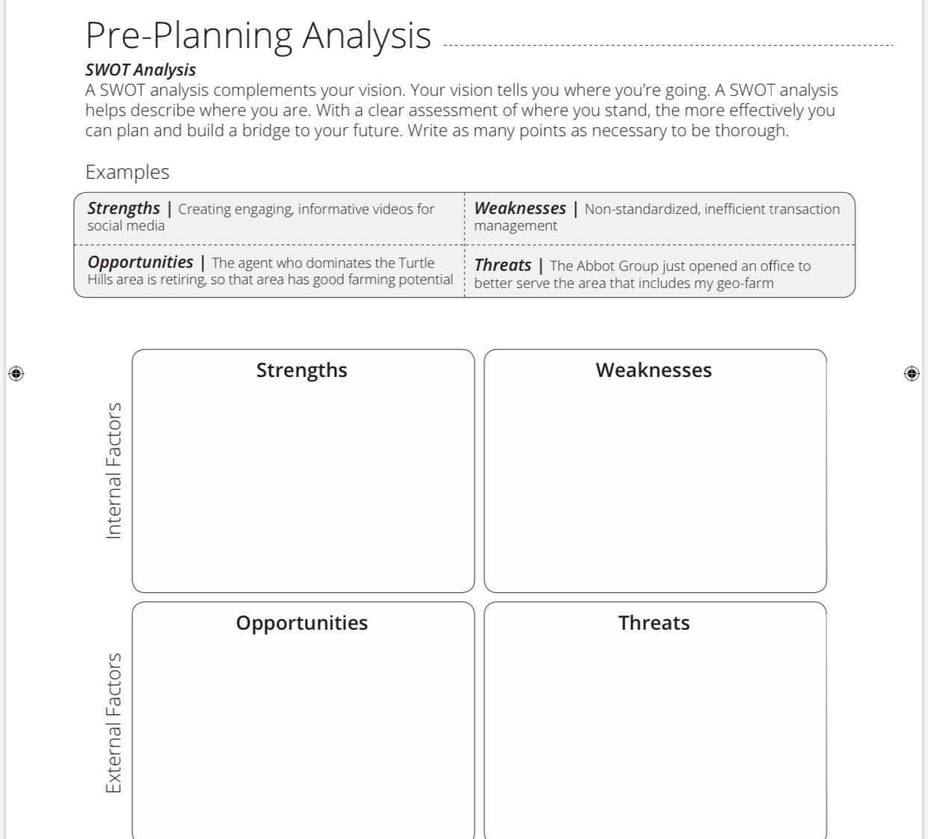

Slide 31
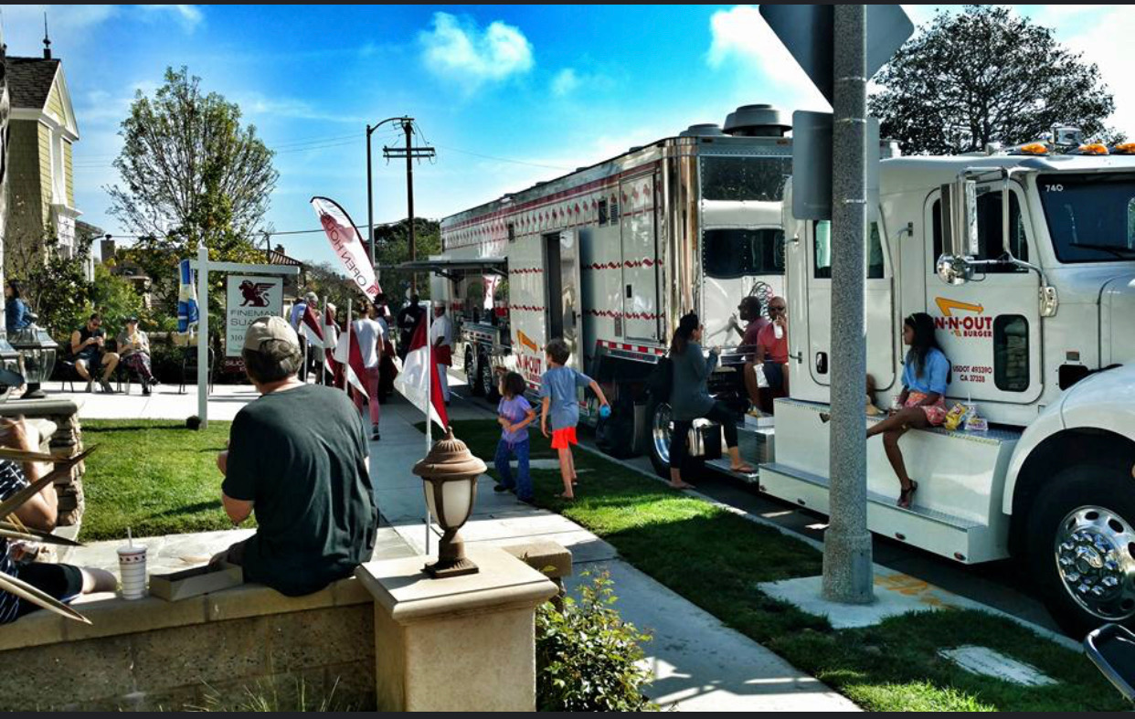
WHAT IS A MEGA OPEN HOUSE?

Slide 32
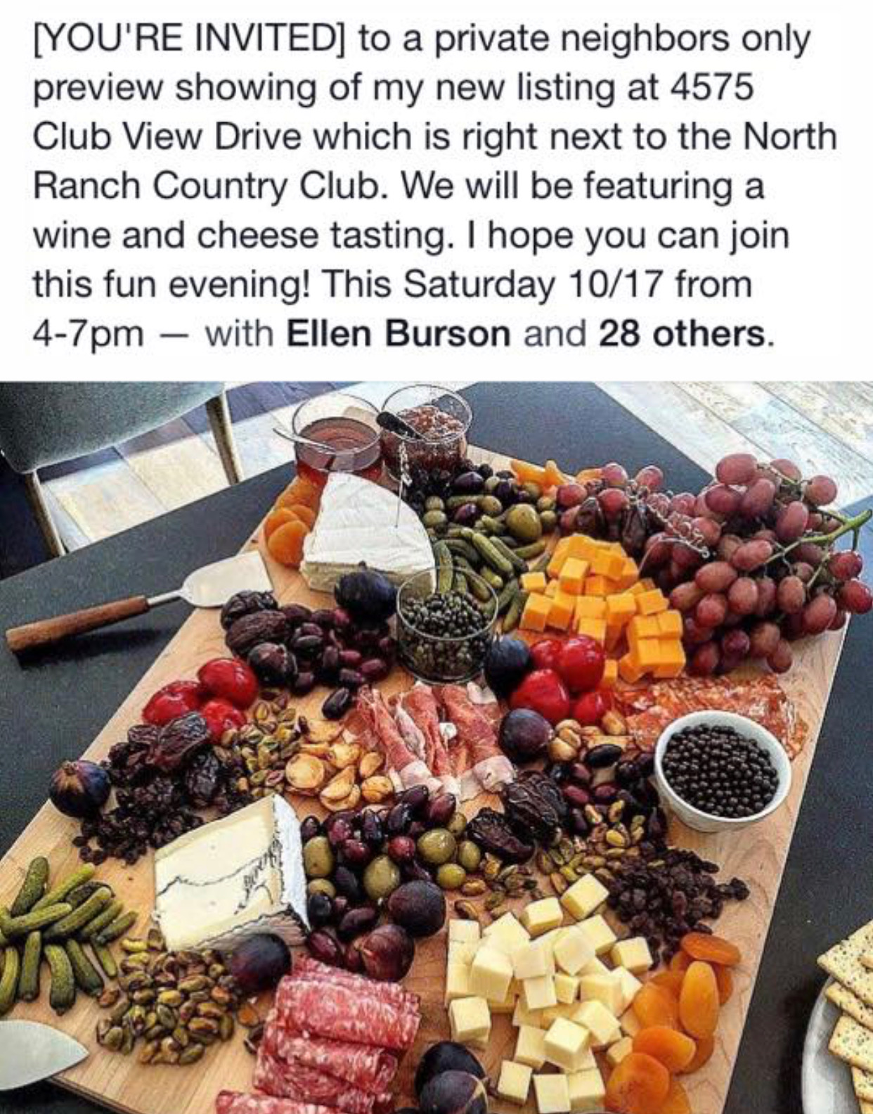

Slide 33
MEGA Open House Checklist
[ ] Schedule Mega Open House: ______________
[ ] Just Listed w/ Mega OH Details
[ ] Schedule Catering: ______________
[ ] Drinks/Refreshments/Snacks
[ ] Mega OH Social Media Blast
[ ] Mega OH Ad
[ ] Neighbor Invites
[ ] RSVP Landing Page
[ ] OH Sign Rider on Property
[ ] Live Video
[ ] Giveaways: _________
[ ] Bomb Bomb Sign-In & Program
[ ] Flyers w/flyer holder
[ ] Music
[ ] Mega OH Banner
[ ] Pop-up Tent
[ ] Trash Can
[ ] OH Street Signs w/map
[ ] Buyer Guides
[ ] Seller Guides
[ ] Live Video @ Mega OH
[ ] Photos/Video @ OH
TF
#TomFerry

Slide 34
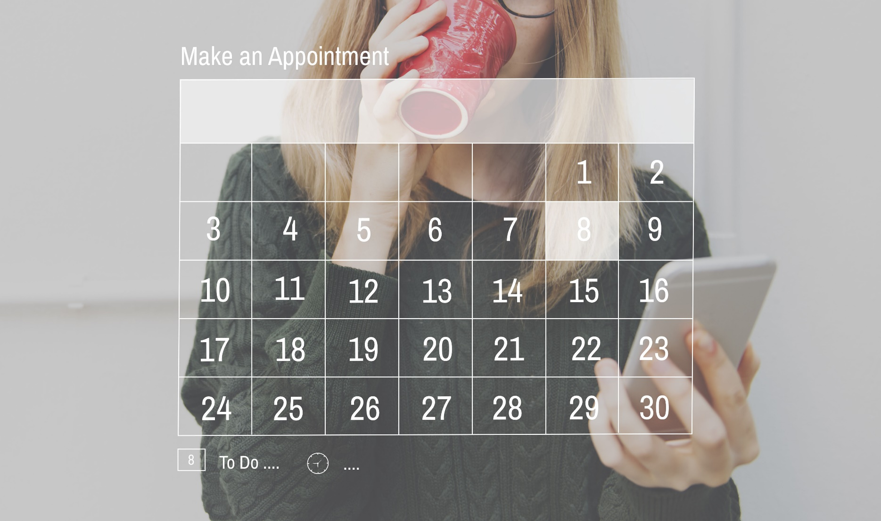
TOTAL focus on… APPOINTMENTS
TF
#TomFerry

Slide 35
Focus on 1 Appointment a Day

Slide 36
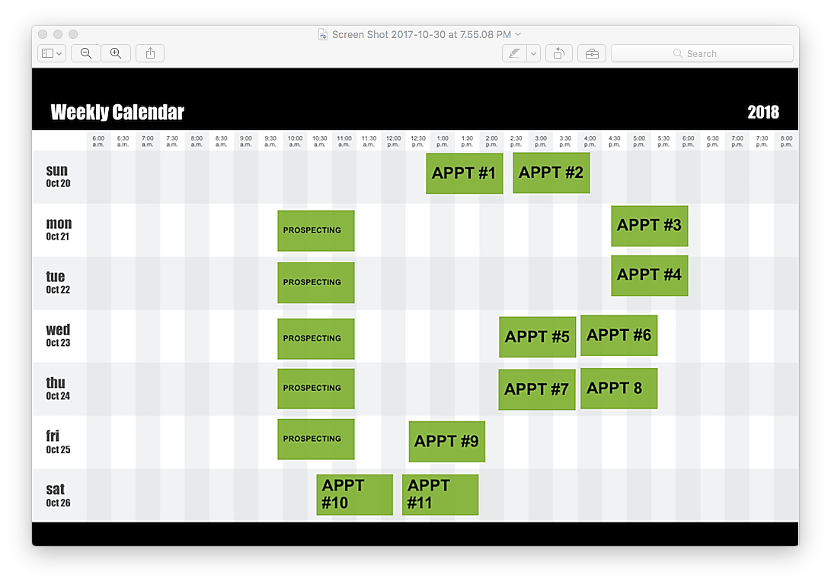
TF
#TomFerry

Slide 37
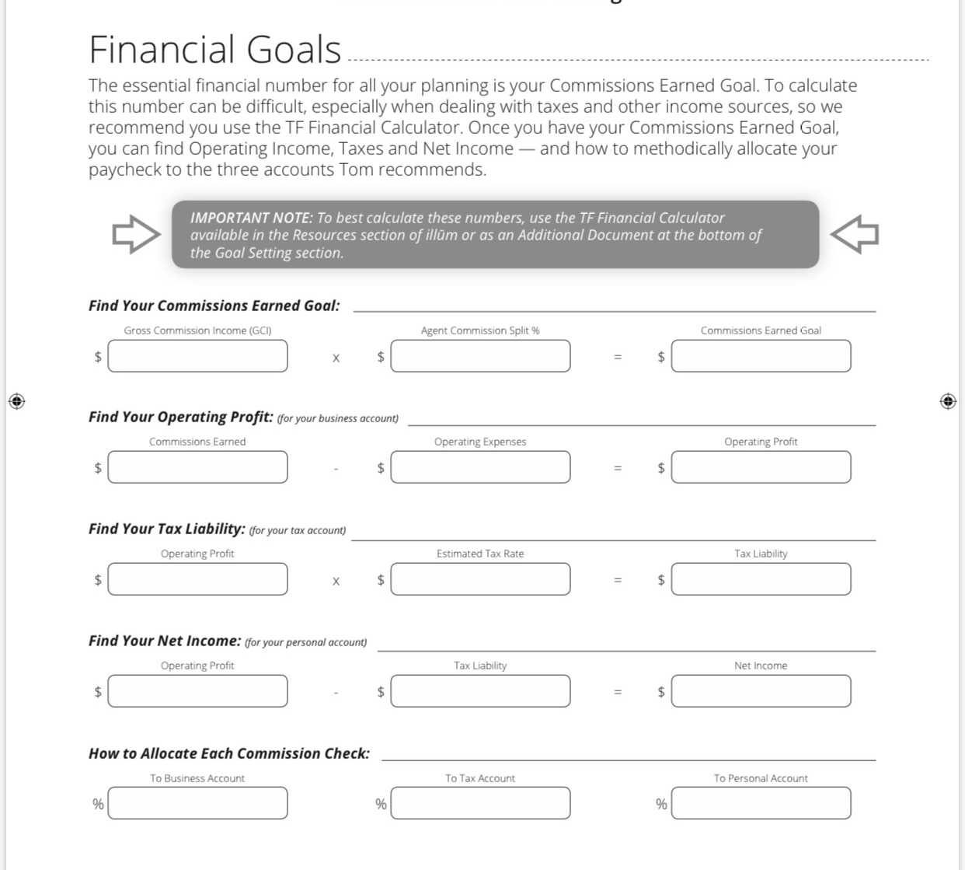

Slide 38
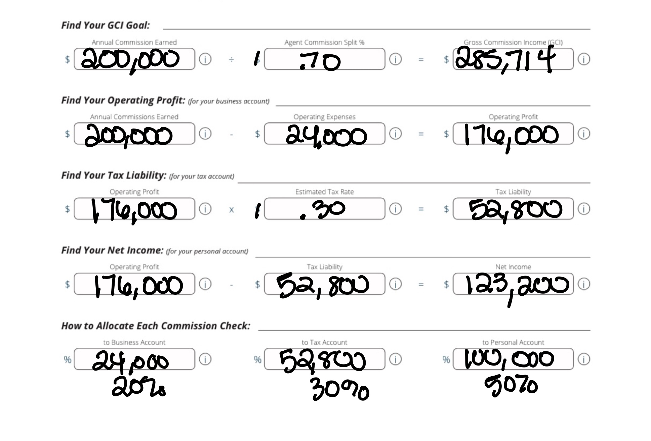

Slide 39
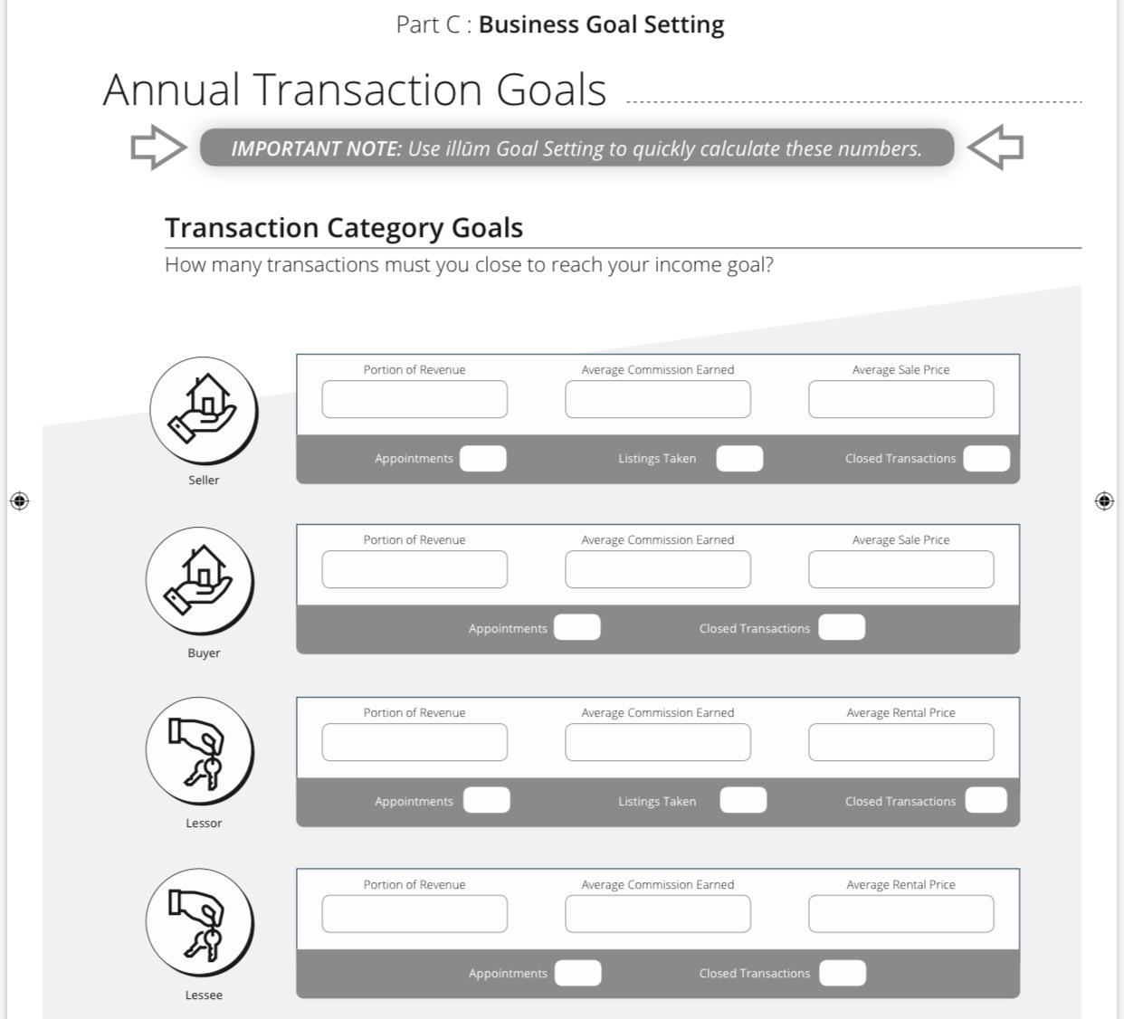

Slide 40
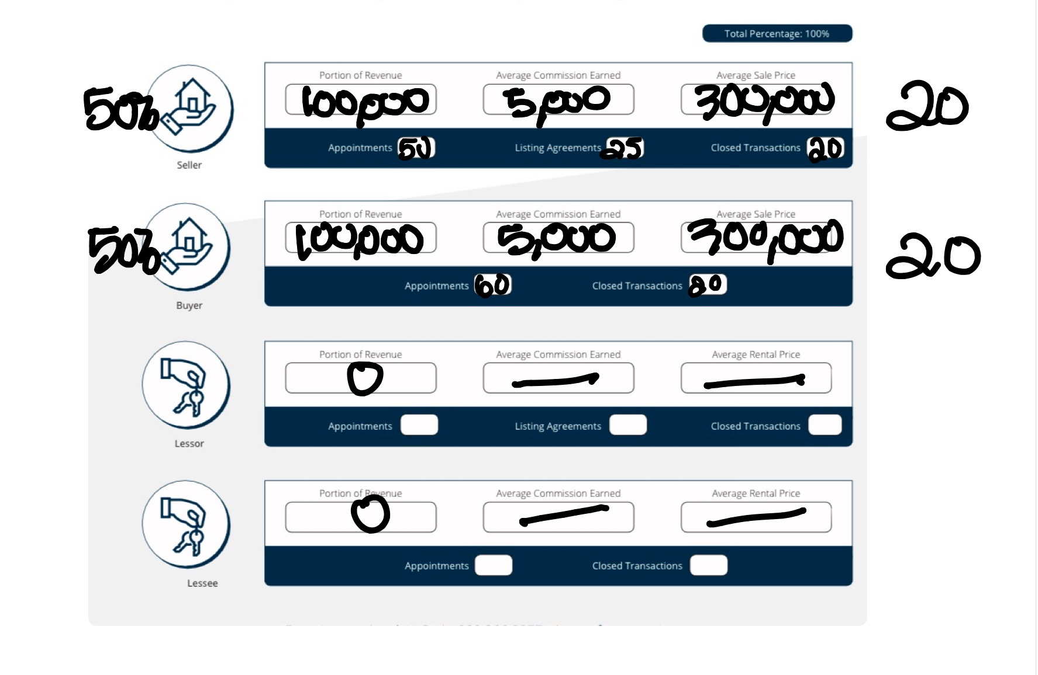

Slide 41
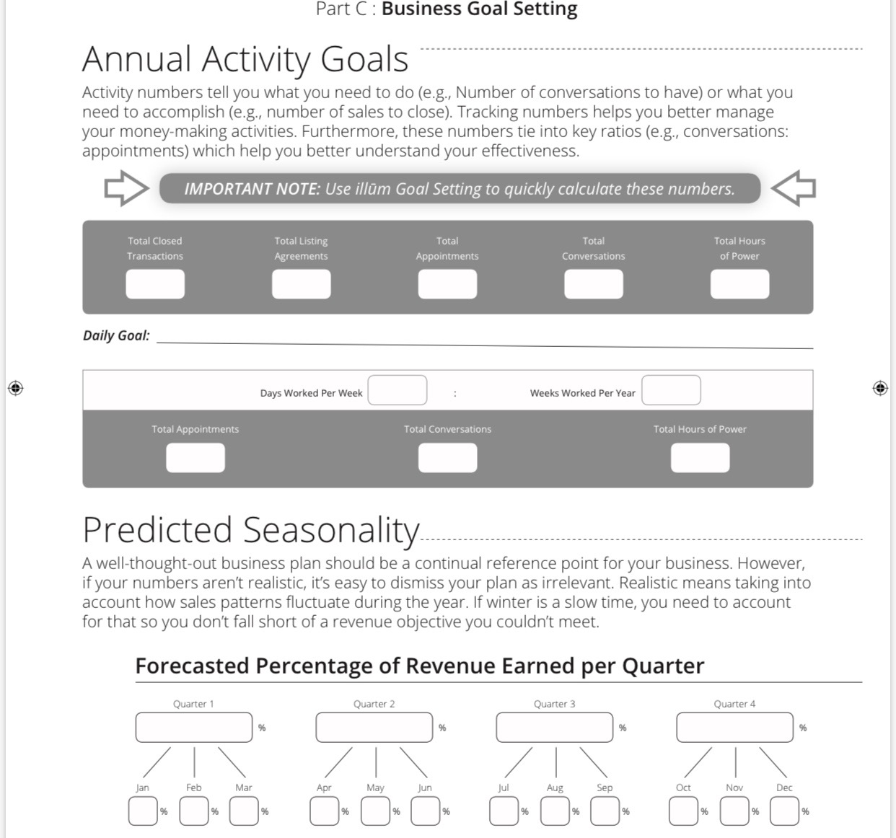

Slide 43
Refinance
Buy
Invest

Slide 44
RATE DIALOGUE w/COI
Hey ___. It’s __ w/BHHS GA Properties.
I was think about you recently.
What interest rate where you at when you purchased?
The reason I’m asking... mortgage rates have really dropped recently. And I thought you might be able to save some money.
Would you like my mortgage specialist to reach out to see if you could potentially lower your payment? (GREAT)

Slide 45
MOVE UP DIALOGUE
Have you considered taking advantage of these property values and your equity?
If you could live in your next dream home and have close to the same payment...would you consider moving?
Where would you move next?
Let me do some research on your property...what do you owe roughly?
Would you like me to email or drop this off to you?

Slide 46
INVESTMENT DIALOGUE
Have you ever considered owning income producing property?
Did you noticed mortgages rates recently?
They’ve really dropped. When that happens ...investment properties because even more lucrative because owners make more on their property.
When would be a good time to talk thru you real estate investment strategy?

Slide 47
Notes:
1. 60 units from SOI = 322,031 GCI Team
Personal production 41 units SOI $176,573 GCI SOI
2. 17 units closed YTD SOI Team = $91,759
Personal production 17 units closed YTD SOI = $85,561
94 units just under 21 million 481,883 GCI in 2017

Slide 49
Always set the next apppointment
when you’re together
if they don’t buy or list.

Slide 50
Is this a good ROI?
$15 Directional Signs=$24,000 GCI

Slide 51
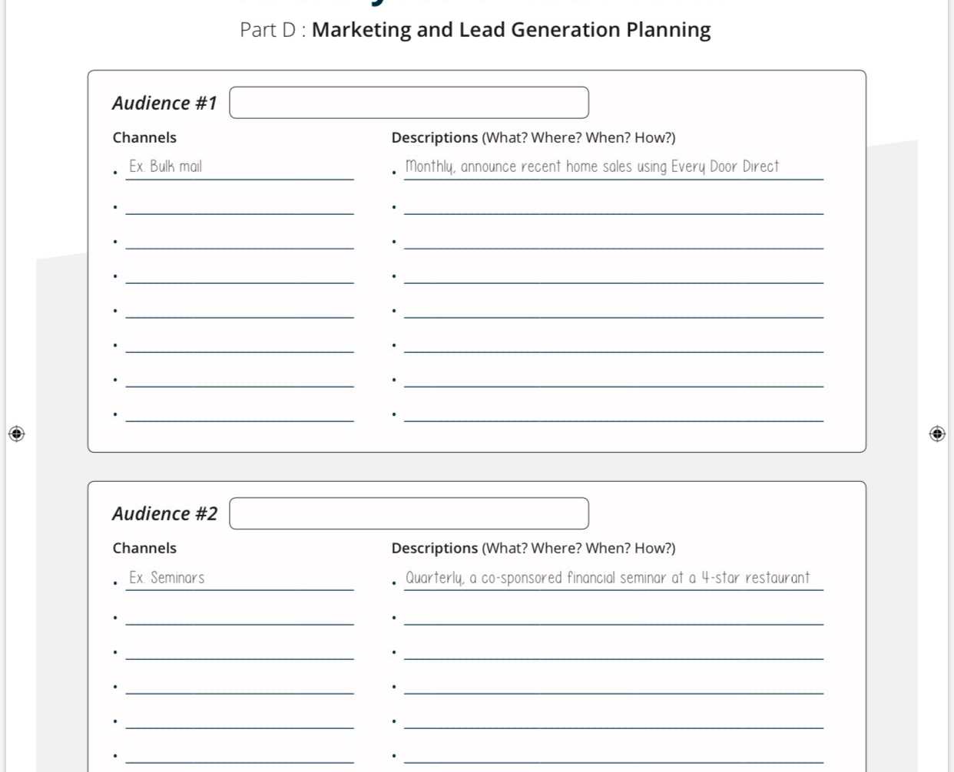

Slide 52
Your Vision Statement

Slide 53
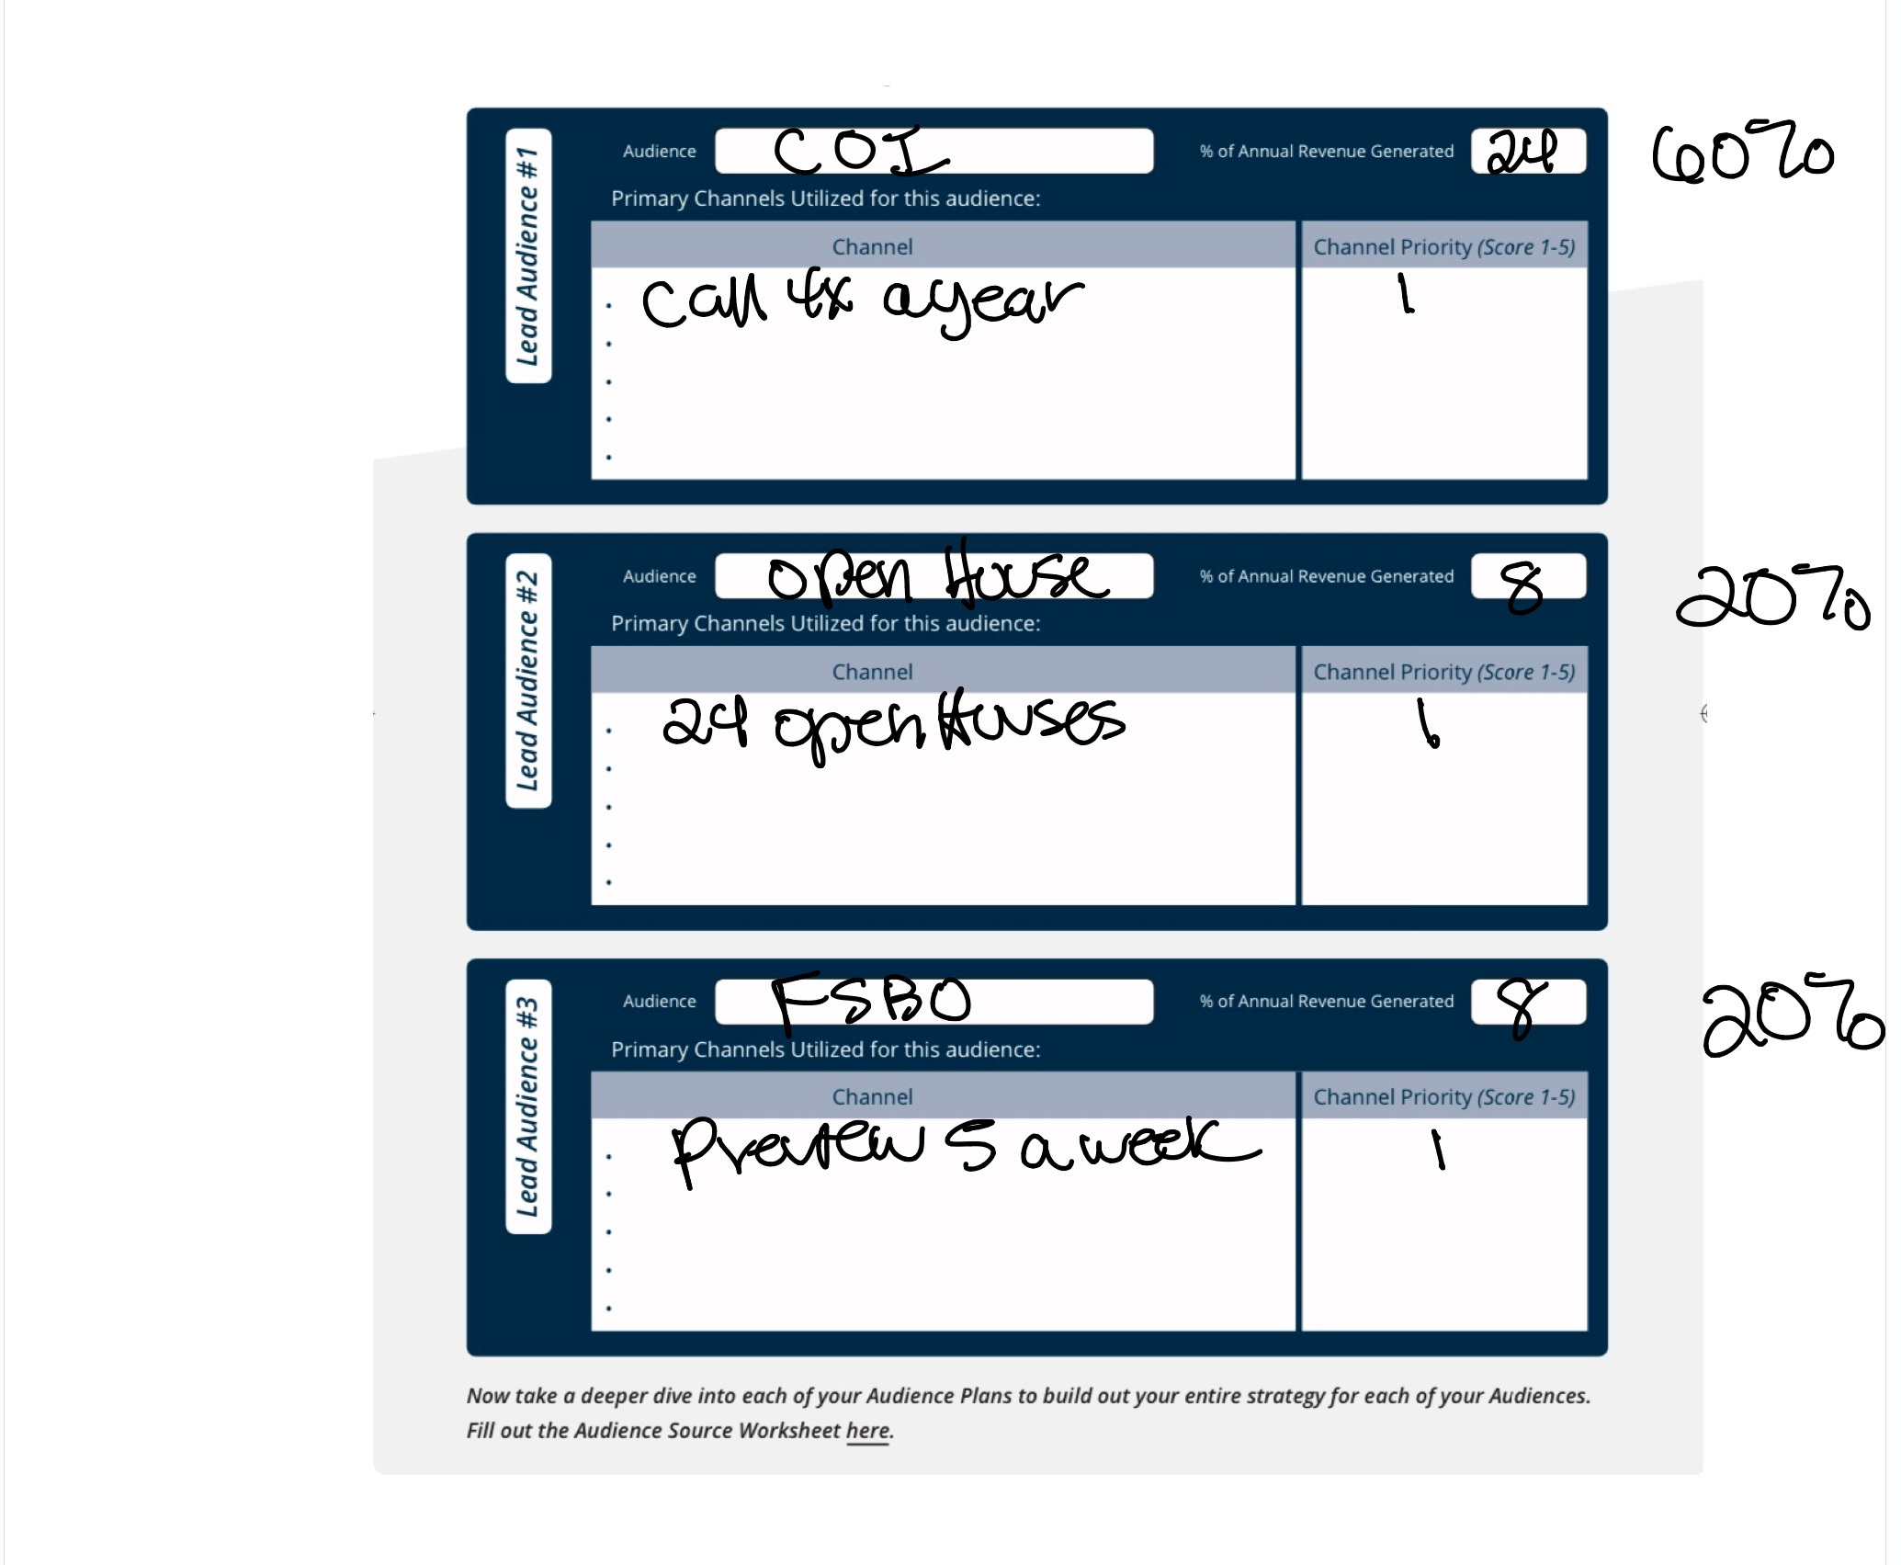

Slide 54
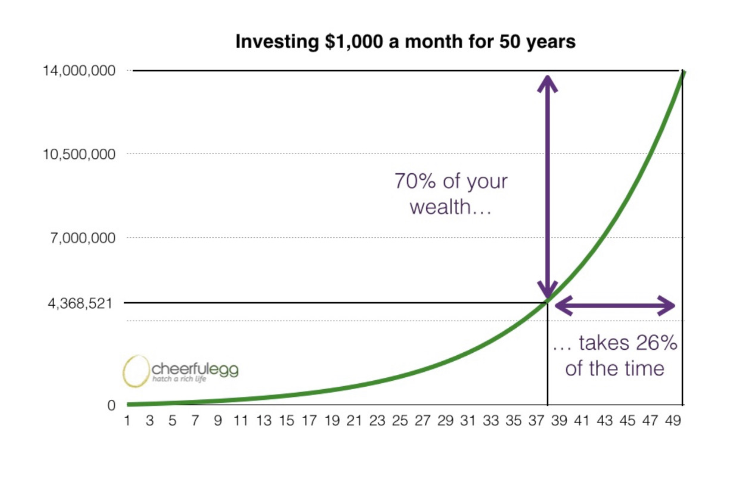

Slide 55
What Can You Commit to for a WHOLE Year?
5 conversations a day
25 in a week
100 a month
1,200 in a year
How much business would you have from 1,200 additional conversations?

Slide 58
APPROACH
Listen & Notice
Multiple Offers & Quick Sales Within Or Out Of Your Office
Recent Office Sales
Buyers Who Can’t Locate A Property
Your GEOFarm
Prior To An Open House

Slide 59
CASE STUDY
12doors-1Hr
12 doors-4 conv
4x3x4x12=576 conv
12 conv-2 leads
8 leads-3 LA
2LT-2LS
24 LS-$360k
$100k yr to $360k
That equals=
$2,500 HR

Slide 60
DOOR KNOCKING DIALOGUE-
“Sorry to bother you. We recently sold, 123 Main St.
There’s currently qualified buyers looking in your area. Have you heard of a neighbor looking to move?
Have you noticed anyone doing any extra work, painting or improvements recently?
Have you considered selling?
At what price would you be a seller?”

Slide 64
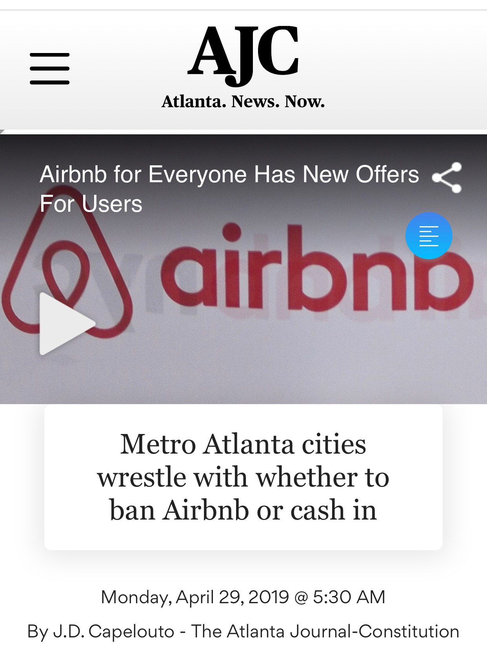

Slide 65
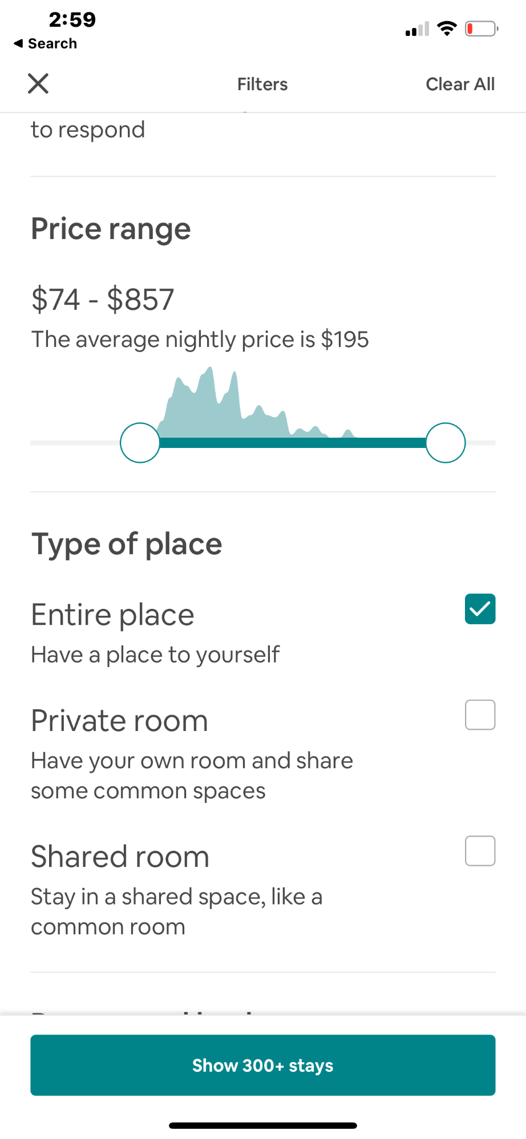
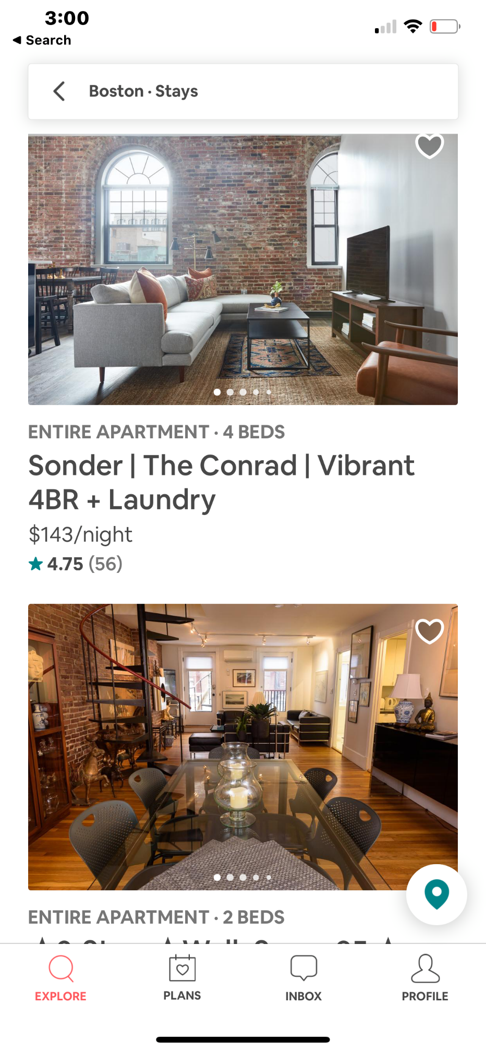
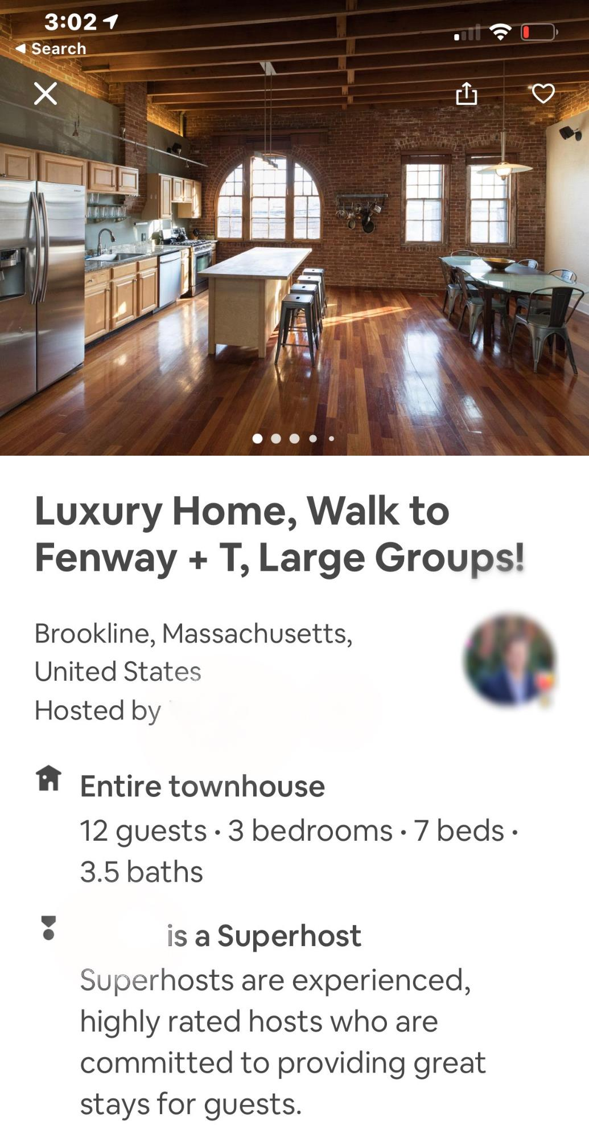
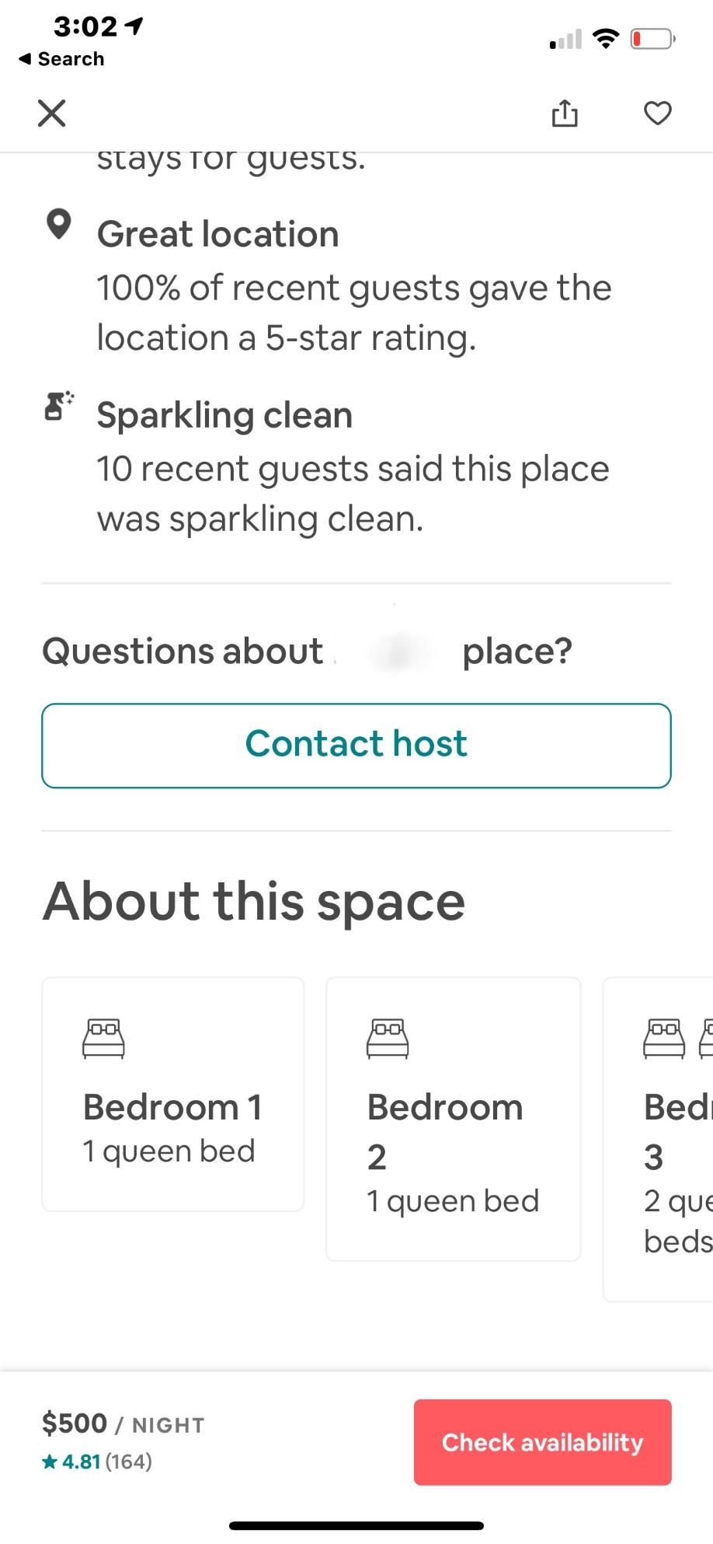

Slide 66
DIALOGUE-EMAIL-CALL-TEXT
With all the uncertainty around the changes in short term rental regulations, have you considered selling for top dollar now?

Slide 68
HOW DO YOU MAKE A SALE FROM EVERY SALE ?
HOW GET A REFERRAL FROM EVERY CLIENT?
HOW DO YOU GET A LEAD FROM EVERY VENDOR?

Slide 69
PRICE REDUCTION DIALOGUE
If you received an all cash contract closing in 30 days...
what would you take?
I think we should lower to that price.
The market has spoken.
Let me fight to get you that price.
I’d rather you turn down offers that not have any.
We’ve found when we’re having showings and no offers...
We’re 2-5% off.
When there’s no showings and no offers..we could be 5%+ off?

Slide 75
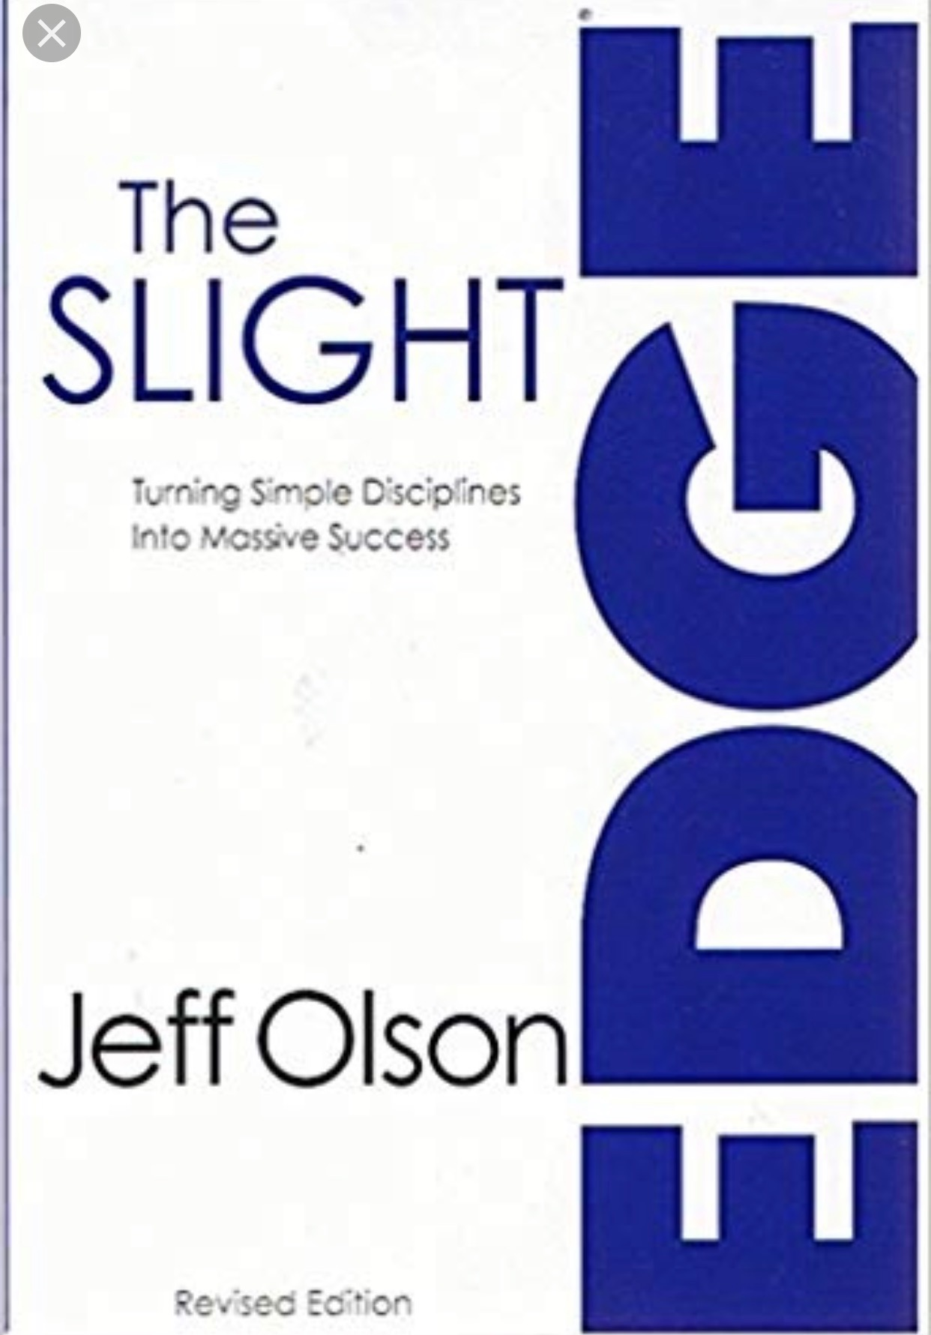
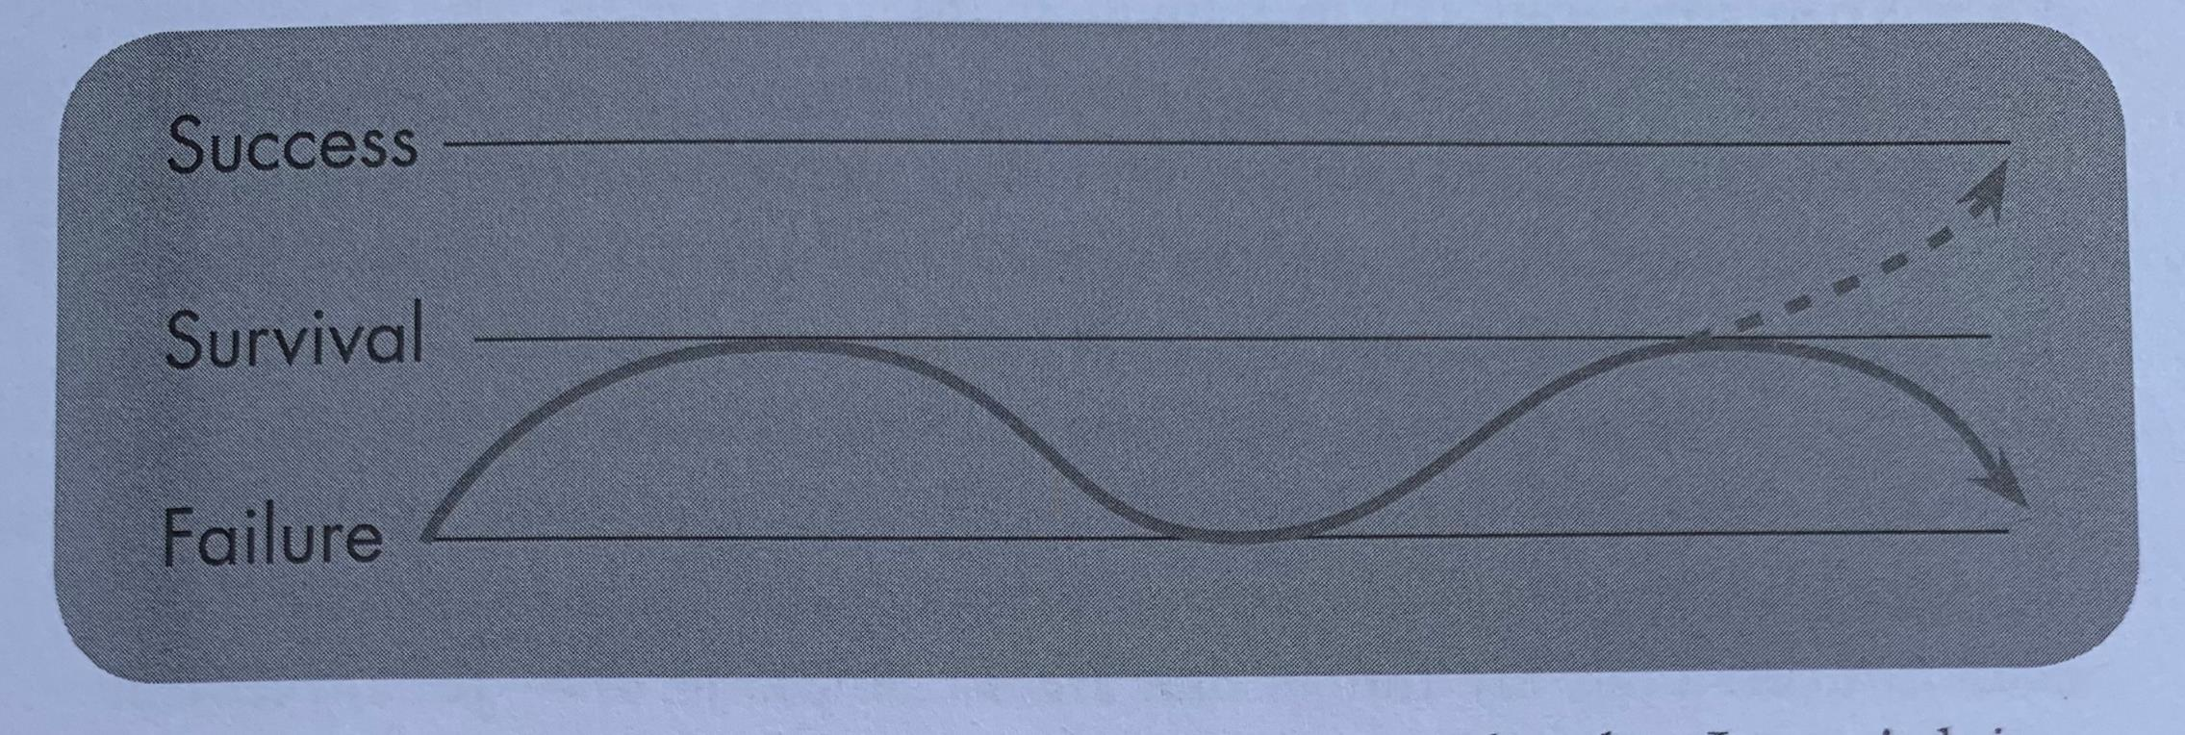
“Once I got a little way above survival
and was starting to head to warmer waters
of success, without realizing it, I would stop
doing the things that had gotten me there.
Naturally, I would start sinking back down again,
back down toward survival and beyond,
back down toward the failure line.
That’s the only reason our lives follow
that roller coaster.”

Slide 77
CAROLYN YOUNG
$400k- 10yrs+
$1.2m GCI -‘18
$1.8m GCI -‘19

Slide 78
IRINA SHER
$20k GCI -‘18
$500k+ GCI -‘19
“I took charge of my choices.
I let fear lead me instead of stopping me.
I put clients interest first, once I have their trust, I have their loyalty.”

Slide 79
TF
#TomFerry
Notes:
1. 60 units from SOI = 322,031 GCI Team
Personal production 41 units SOI $176,573 GCI SOI
2. 17 units closed YTD SOI Team = $91,759
Personal production 17 units closed YTD SOI = $85,561
94 units just under 21 million 481,883 GCI in 2017

Slide 80
What’s the
thing?

Slide 81
The Dream
TF
#TomFerry

Slide 82
NOTHING will change until….. YOU CHANGE

Slide 84
JEFF MAYS
IG- jmays_re
jmays@tomferry.com
804-651-6297
www.tomferry.com/BHHSGA

