Slide 1
National Housing Trends

Slide 2
Americans Choose Real Estate as Safest Investment
What do you believe is the safest
investment over the next 10 years?
(Top 5 Answers)
Porch.com
Notes:
https://porch.com/resource/generational-housing-outlooks

Slide 3
Housing Affordability
Index 1990 to Today
Years when distressed properties dominated the market
National Association of Realtors
Notes:
http://economistsoutlook.blogs.realtor.org/

Slide 4
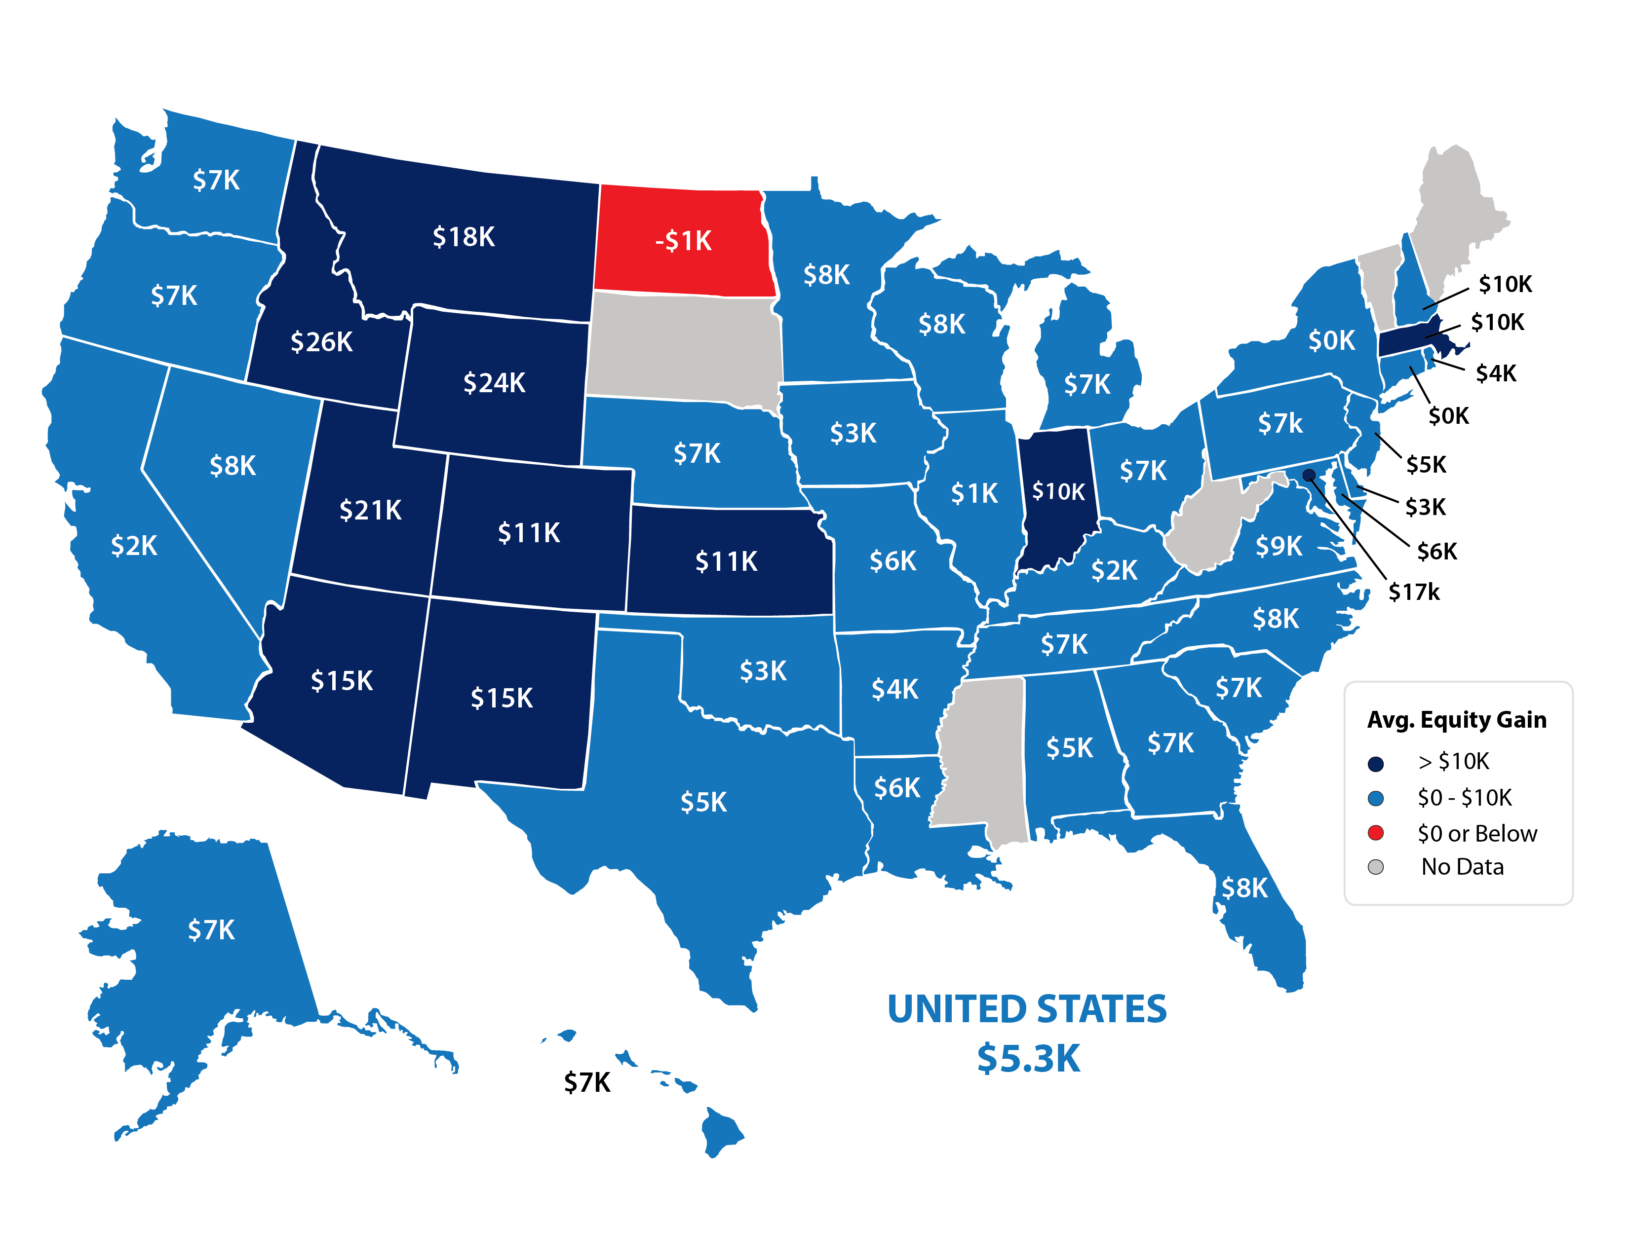
In the last 12 Months, 44 States had an increase in Home Equity.
Only one had a decrease.
CoreLogic
Notes:
https://www.corelogic.com/insights-download/homeowner-equity-report.aspx

Slide 5
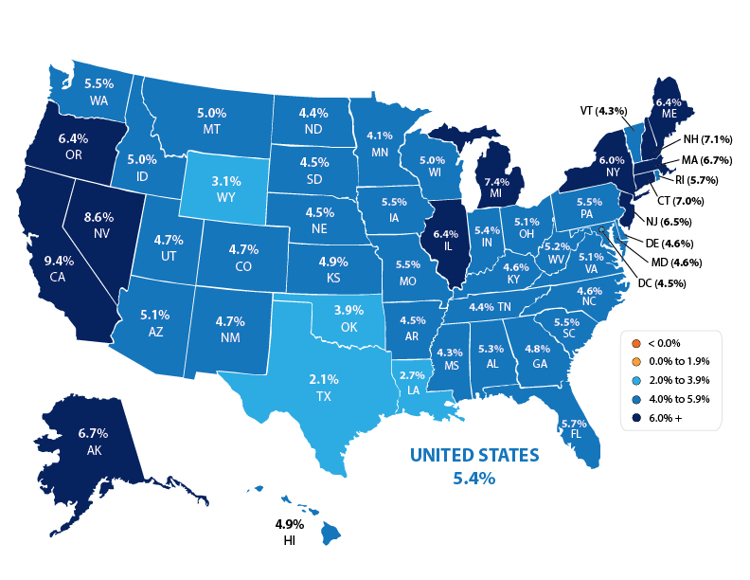
Forecasted Year-Over-Year % Change in Price
CoreLogic
Notes:
https://www.corelogic.com/downloadable-docs/marketpulse/the-marketpulse-vol-8-issue-11-november-2019-screen-112519.pdf

Slide 6
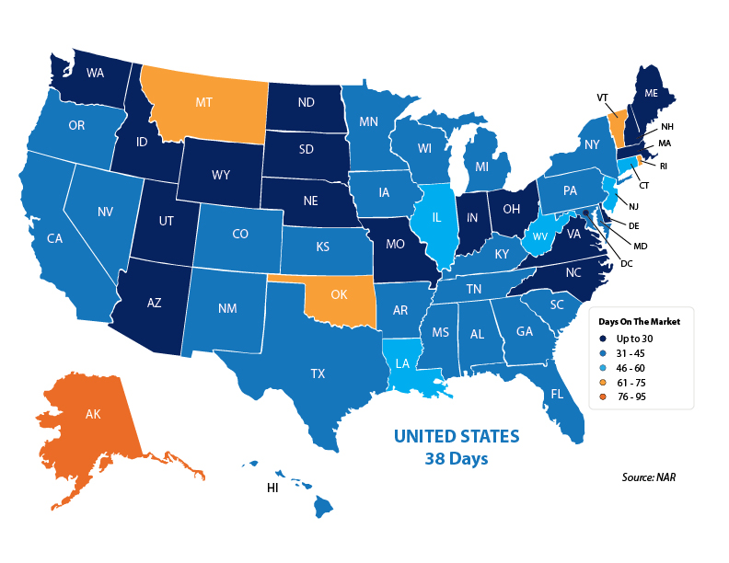
Average Days on the Market
Notes:
https://www.nar.realtor/research-and-statistics/research-reports/realtors-confidence-index
https://www.nar.realtor/sites/default/files/documents/2019-11-realtors-confidence-index-12-19-2019.pdf

Slide 7
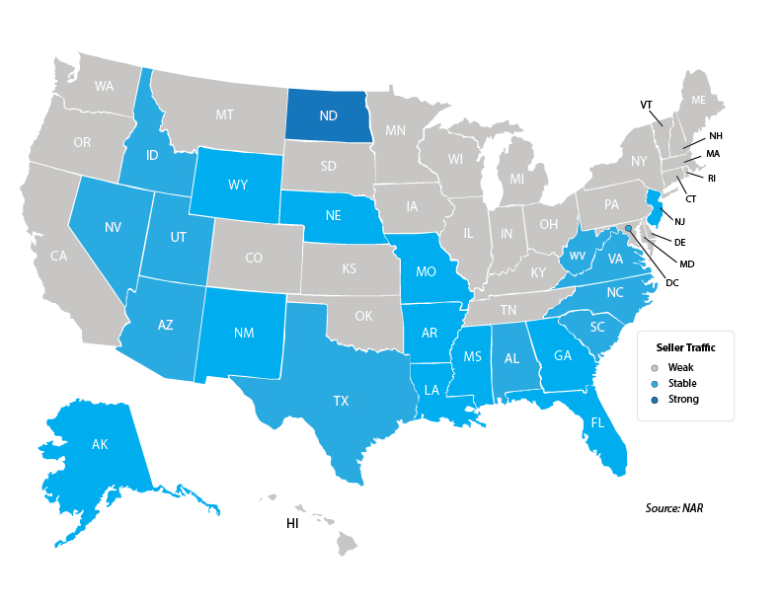
Seller Traffic
Notes:
https://www.nar.realtor/research-and-statistics/research-reports/realtors-confidence-index
https://www.nar.realtor/sites/default/files/documents/2019-11-realtors-confidence-index-12-19-2019.pdf

Slide 8
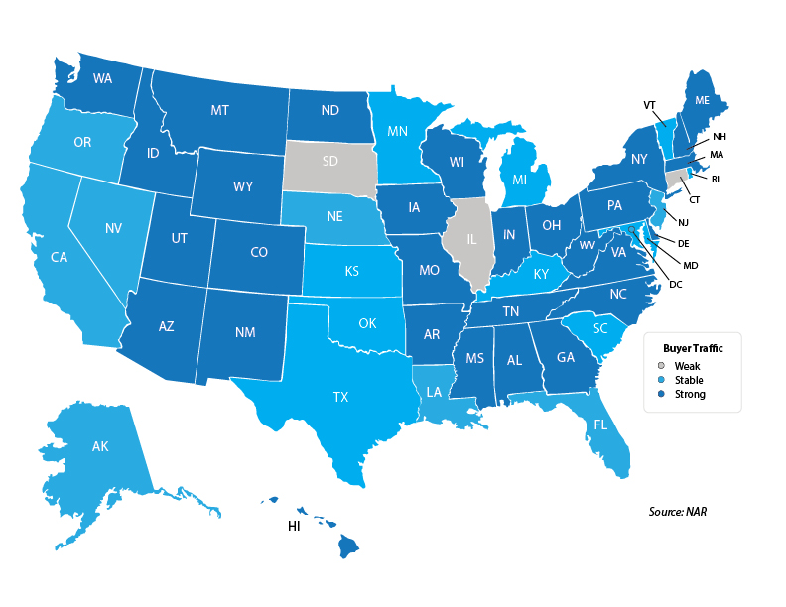
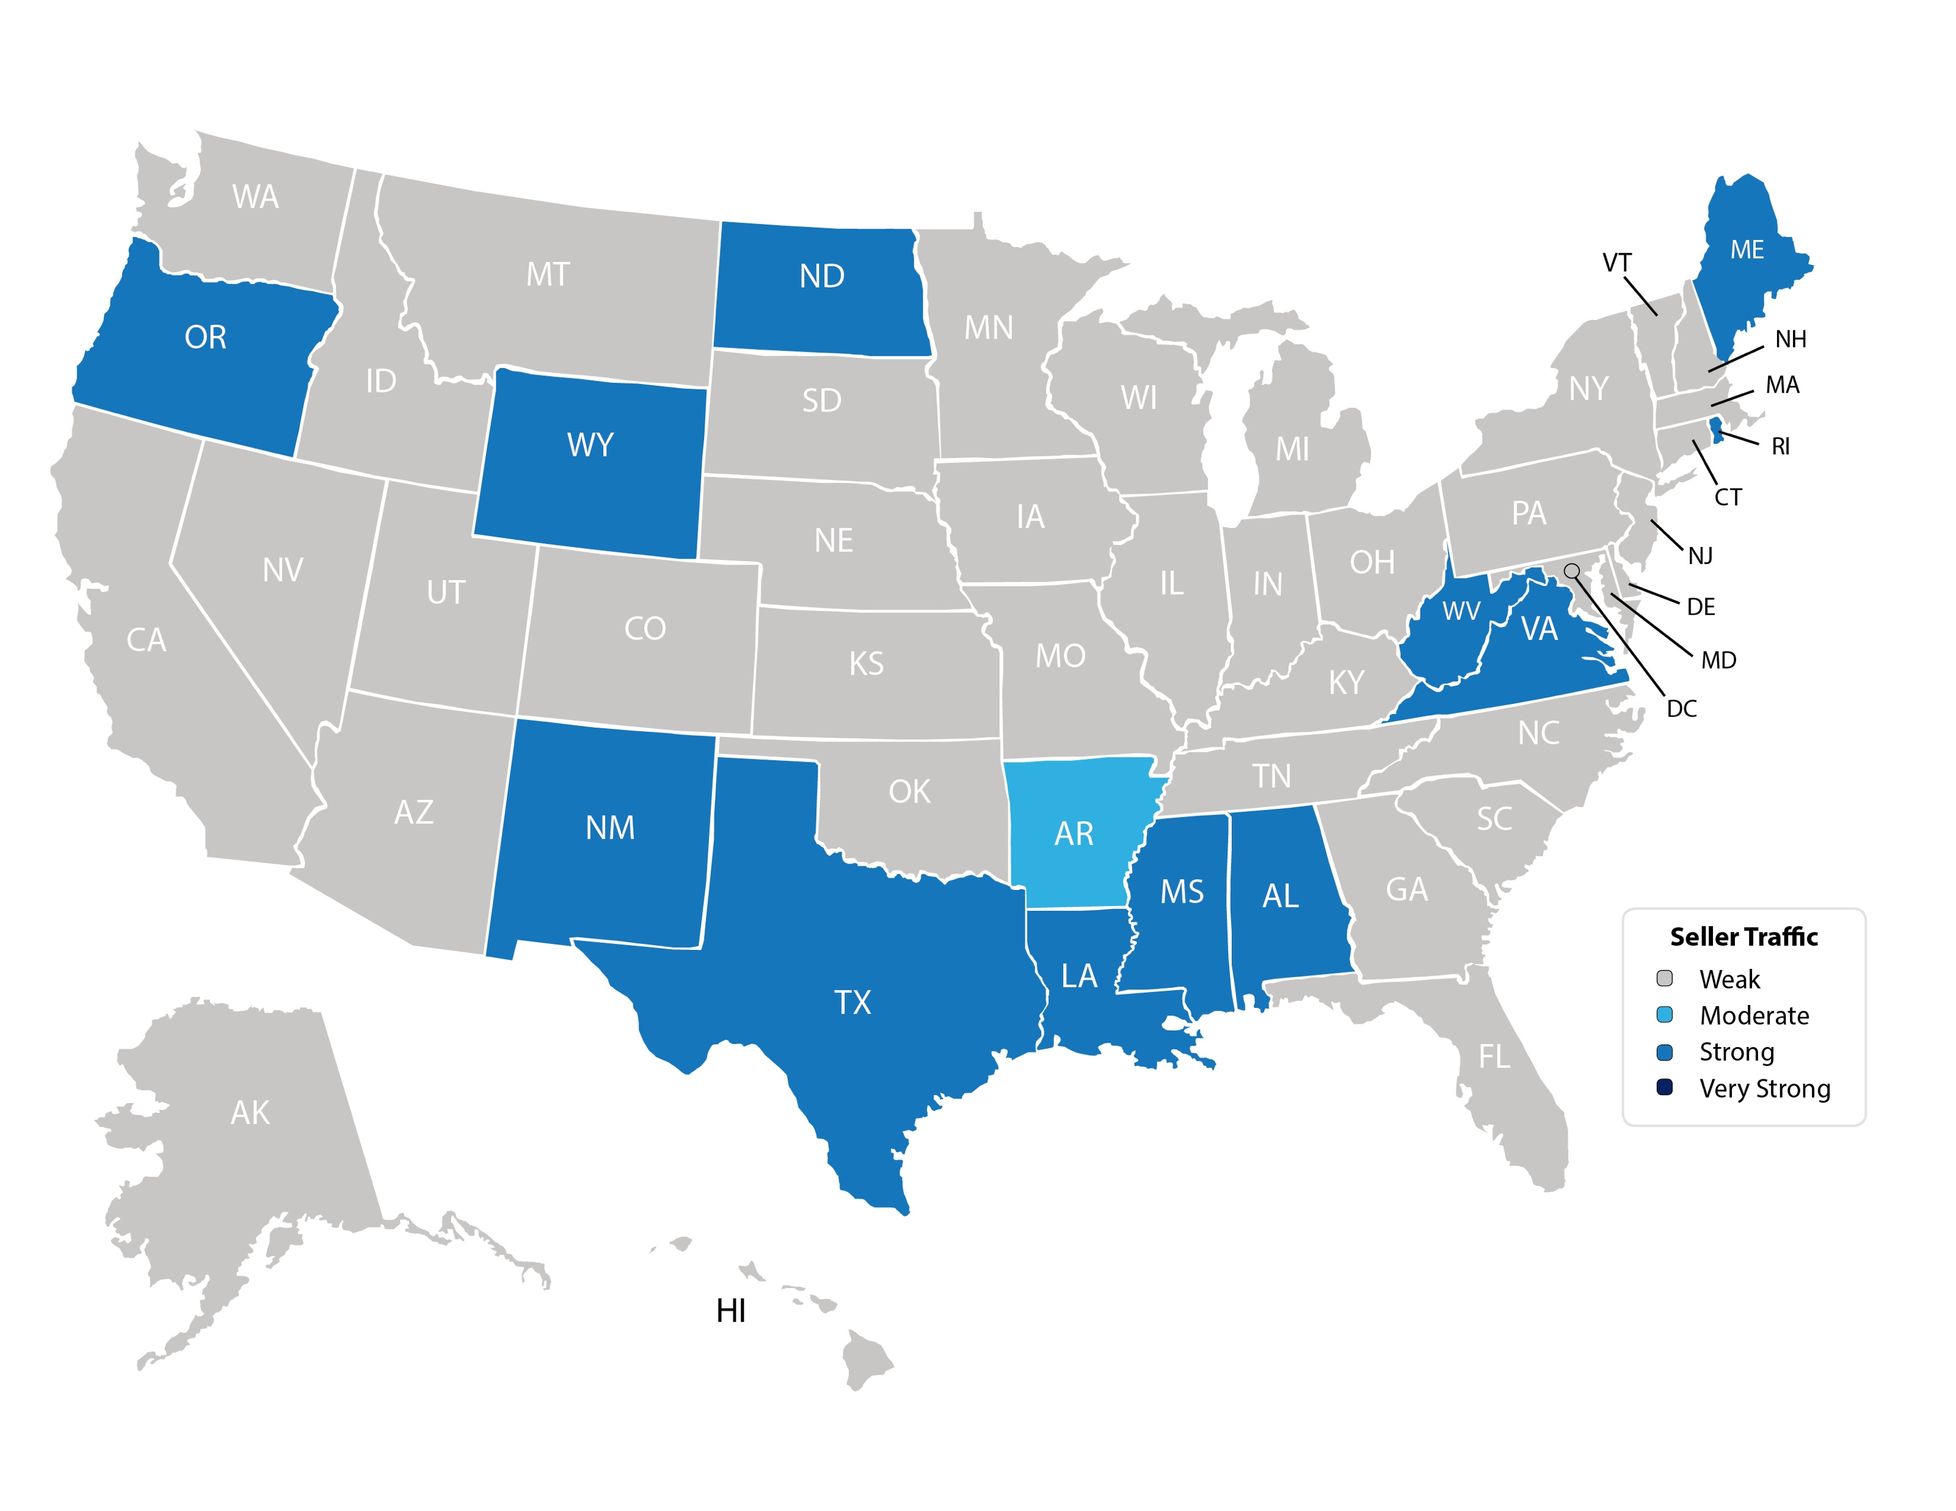
Buyer Traffic
Notes:
https://www.nar.realtor/research-and-statistics/research-reports/realtors-confidence-index
https://www.nar.realtor/sites/default/files/documents/2019-11-realtors-confidence-index-12-19-2019.pdf

Slide 9
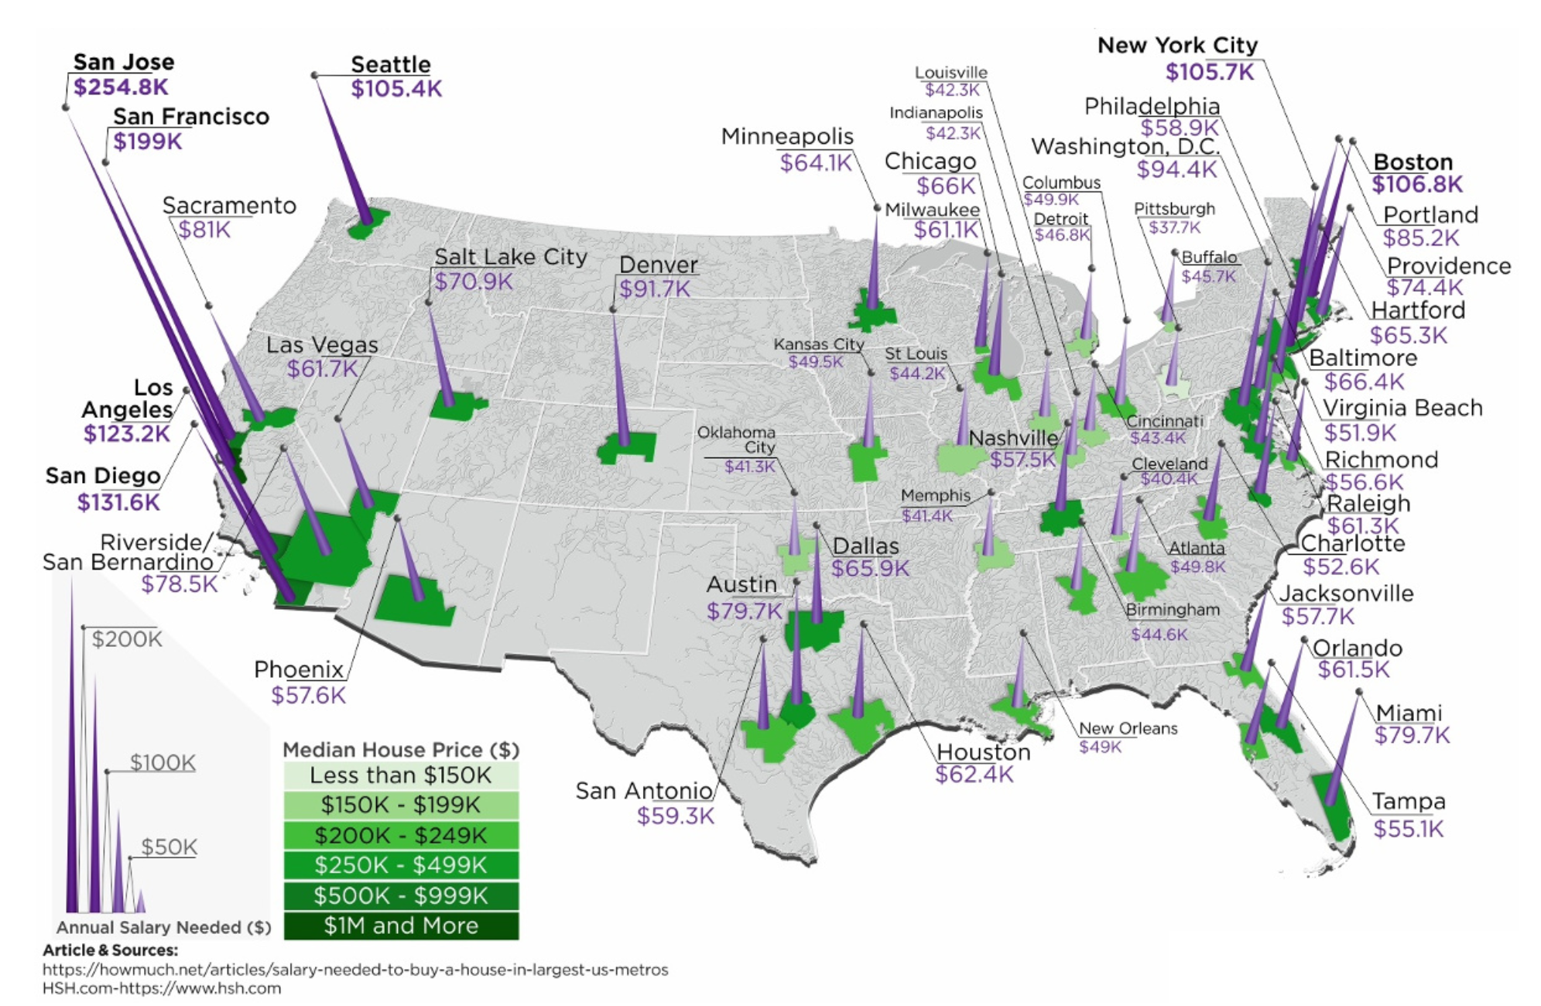
Annual Salary To Buy A Home

Slide 10
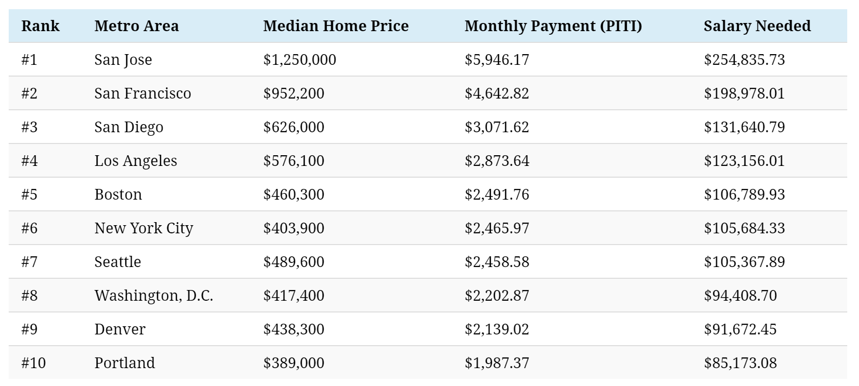
Most Expensive Metros To Buy A Home
Source: HSH.com

Slide 11
Historic Mortgage Rates by Decade
Decade | Average Rate
1970s | 8.86%
1980s | 12.7%
1990s | 8.12%
2000s | 6.29%
Freddie Mac
Notes:
http://www.freddiemac.com/blog/research_and_analysis/20140324_dirt_cheap_to_cheap.html

Slide 12
Mortgage Rate Projections
Quarter | Freddie Mac | Fannie Mae | MBA | NAR | Average of All Four
2020 1Q | 3.8 | 3.7 | 3.7 | 3.8 | 3.75%
2020 2Q | 3.8 | 3.6 | 3.7 | 3.8 | 3.72%
2020 3Q | 3.8 | 3.6 | 3.7 | 3.8 | 3.72%
2020 4Q | 3.8 | 3.6 | 3.7 | 3.8 | 3.72%
Notes:
http://www.freddiemac.com/research/forecast/
http://www.fanniemae.com/portal/research-insights/forecast.html
https://www.mba.org/news-research-and-resources/research-and-economics/forecasts-and-commentary
https://www.nar.realtor/research-and-statistics

Slide 13
Mortgage Rates
Freddie Mac
30-Year Fixed Rate
- Actual
- Projected
2017
2018
2019
2016
2020
Freddie Mac
Notes:
http://www.freddiemac.com/research/forecast/20191220_optimism_heading_into_2020.page?

Slide 14
Greater Metro Atlanta
Market
2019 Full Year Report With Results Through December 2019

Slide 15
Metro Atlanta 2018-2019 Closing Units
December Closings Up 16% Compared To November Closings
December 2019 Closings Up 24% Compared To December 2018
YTD Closings Units Up 2.7 Compared To Last Year
YTD Closing Volume Up 7.5% Compared To Last Year
Notes:
PGR continues to grow our listing inventory market share. Our Advanced Property Marketing methodology and focused prospecting is making a difference.

Slide 16
Metro Atlanta Under Contract Trend
December Under Contract Down 20.4% Compared To November
December 2019 Under Contract Up 12.1% Compared To December 2018
Notes:
PGR continues to grow our listing inventory market share. Our Advanced Property Marketing methodology and focused prospecting is making a difference.

Slide 17
Metro Atlanta New Listings Trend
December New Listings Down 23.6% Compared To November
December 2019 New Listings Up 1.5% Compared To December 2018
Notes:
PGR continues to grow our listing inventory market share. Our Advanced Property Marketing methodology and focused prospecting is making a difference.

Slide 18
Metro Atlanta Closings – December 2019 (Number Of Transactions By Price)
85% Of Transactions In $100K-$500K Price Range
Notes:
Months of supply is well below normal in many of our markets. We expect this to continue in 2013.

Slide 19
Metro Atlanta Closed Units By Price Point December 2019 Compared To December 2018
Notes:
Months of supply is well below normal in many of our markets. We expect this to continue in 2013.

Slide 20
Listed Inventory January 2018 – December 2019
All Residential, Metro Atlanta
Inventory Down 9.7% From Last Month Up .8% Compared To Last Year
Notes:
PGR continues to grow our listing inventory market share. Our Advanced Property Marketing methodology and focused prospecting is making a difference.

Slide 21
Months of Inventory Change The Market Strategy
GREATER THAN
7 MONTHS
BETWEEN
6-7 MONTHS
LESS THAN
6 MONTHS
SELLERS
MARKET
Home prices
will appreciate
NEUTRAL
MARKET
Home prices
will only appreciate with inflation
BUYERS
MARKET
Home prices
will depreciate
Notes:
Realtor.org

Slide 22
Metro Atlanta Months of Inventory (December 2019, Based On Closed Sales)
6 Months Supply Is Considered Normal Market
Total Metro Atlanta “Months Of Inventory” Is 2.9 Months
Notes:
Months of supply is well below normal in many of our markets. We expect this to continue in 2013.

Slide 23
Metro Atlanta Monthly Average Sale Prices
ASP $320,000 In December. Up 2.8% Compared To Last Month.
Up 7.3% From Last December
Notes:
PGR continues to grow our listing inventory market share. Our Advanced Property Marketing methodology and focused prospecting is making a difference.

Slide 24
Metro Atlanta Annual Average Sale Prices
Annual ASP Up 78% From Bottom Of 2011
Notes:
PGR continues to grow our listing inventory market share. Our Advanced Property Marketing methodology and focused prospecting is making a difference.

Slide 25
Case-Shiller Index For Metro Atlanta
Jan 2010 Through September 2019 (Reported December 31, 2019)
Home Values Up 87% From Bottom Of March 2012.
Notes:
PGR continues to grow our listing inventory market share. Our Advanced Property Marketing methodology and focused prospecting is making a difference.

Slide 26
Case-Shiller Gain/ Loss For Metro Atlanta
Comparisons Based On The Latest Case Shiller Index Compared
To The Average Index For The Year Property Was Purchased.
Year Property Bought | Gain/ Loss
2001 | 41.30%
2002 | 36.15%
2003 | 31.92%
2004 | 27.28%
2005 | 21.08%
2006 | 16.06%
2007 | 15.31%
2008 | 26.04%
2009 | 42.60%
Year Property Bought | Gain/ Loss
2010 | 46.15%
2011 | 57.16%
2012 | 70.40%
2013 | 43.98%
2014 | 31.99%
2015 | 25.09%
2016 | 18.16%
2017 | 12.05%
2018 | 5.81%
Case Shiller Index For Metro Atlanta - October 2019 As Reported December 31, 2019. Micro-Local Markets And Price Points May Have Significantly Different Outcomes.
Notes:
PGR continues to grow our listing inventory market share. Our Advanced Property Marketing methodology and focused prospecting is making a difference.

Slide 27
Case-Shiller Home Values For Metro Atlanta
Recent Bottom Was March 2012. Metro Average Home Values Back To Normal Trend Line.
Notes:
PGR continues to grow our listing inventory market share. Our Advanced Property Marketing methodology and focused prospecting is making a difference.

Slide 28
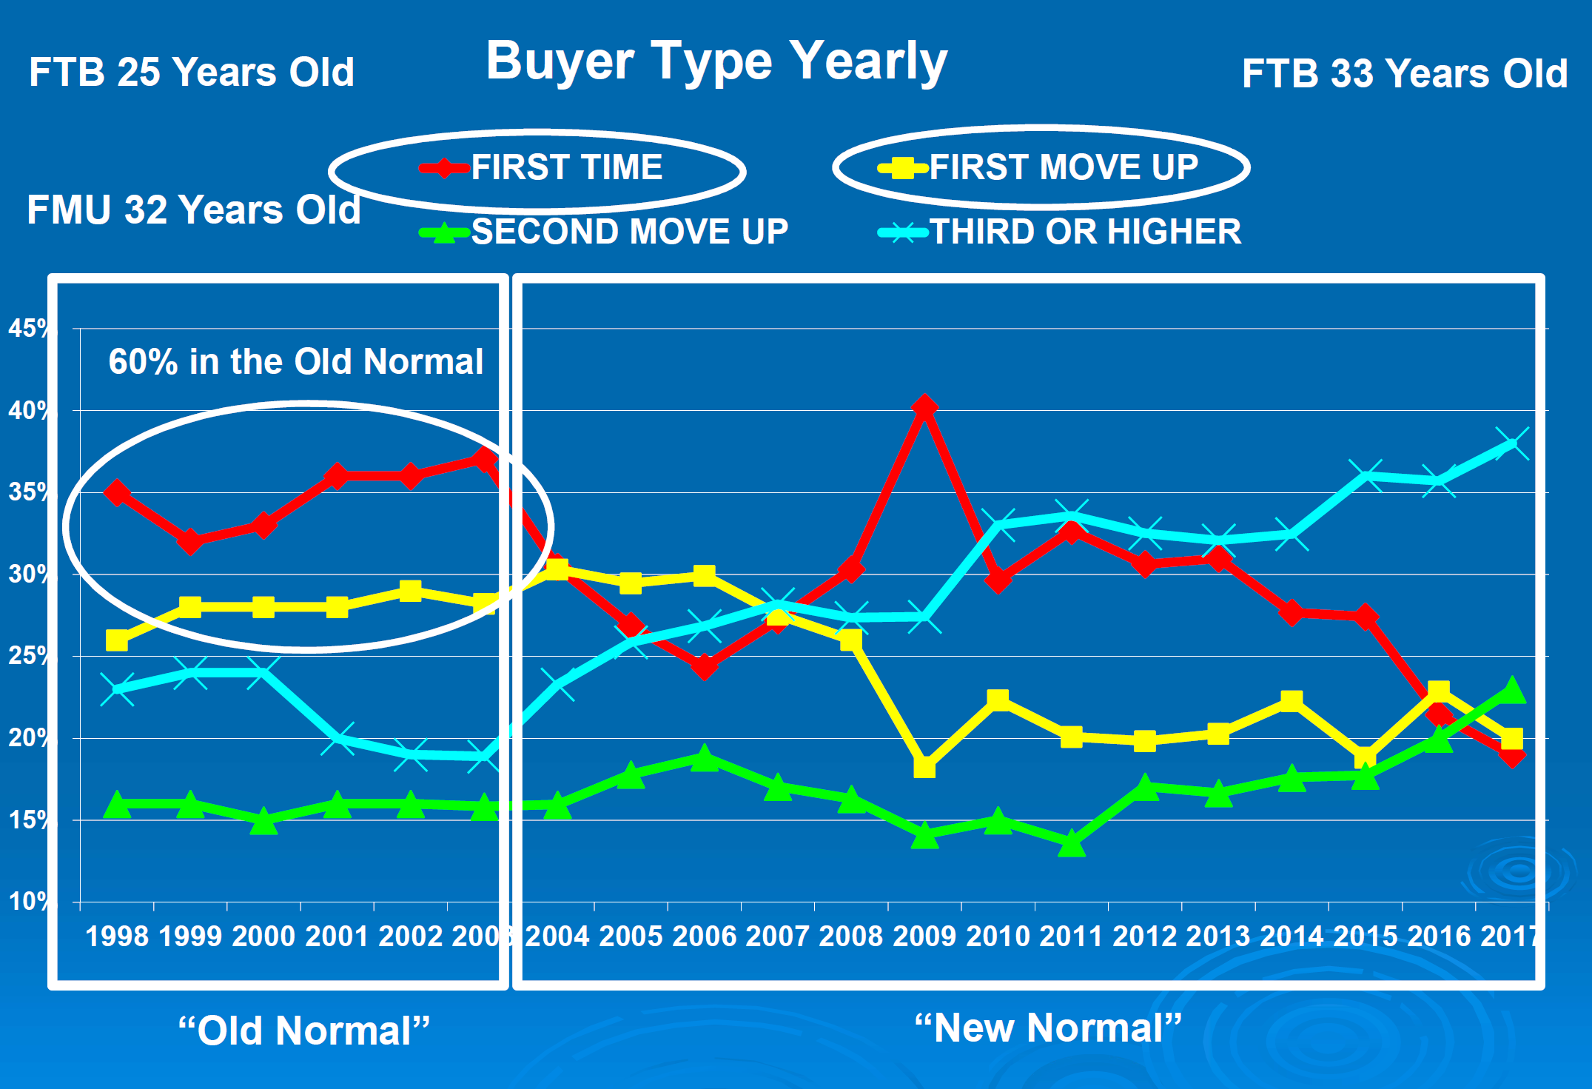

Slide 29
Metro Atlanta Brokerage Rankings

Slide 30
Annual Closed Volume – December 2019 FMLS Counties + Southern Crescent
($ Volume in Billions)
Information Provided By Trendgraphix and BHHS Georgia Properties Internal Reports.
Notes:
In the past three years, our company has consistently grown our market share in both listing inventory and the sales of that inventory. Today, we are Ranked #1 in both categories.

Slide 31
Georgia Economic & Housing Trends

Slide 32
Top State For Business Site Selection Magazine
6 Years in a Row!
2018
2017
2016
2015
2014
2013

Slide 33
Buyers Moving To Atlanta!
Here is the Top 10 List including previous rank:
Atlanta (1)
Phoenix (4)
Tampa/Sarasota (2)
Dallas/Fort Worth (3)
Orlando (5)
Denver (7)
Houston (8)
Seattle (6)
Las Vegas (10)
Chicago (9)
Penske Truck Rental published their latest moving destination list and Atlanta was ranked #1 for the 6th year in a row. The trend of moving to the sunbelt has returned. Desirable attributes that help Metro Atlanta include a business friendly environment, low cost of living for a metro area, airport, moderate weather with 4 seasons and a high quality of life.

Slide 34
Baby Boomers Are Coming To Be Close To Their Children & Grandchildren.
 | Total Population | Rank of Share
 |  | Under 20 | 20-64 | 65+ | 25-39 | 45-59
Dallas | 6,144,489 | 3 | 9 | 25 | 1 | 24
Atlanta | 5,271,550 | 5 | 6 | 27 | 2 | 19
Phoenix | 4,179,427 | 4 | 24 | 15 | 3 | 26
Denver | 2,466,591 | 11 | 5 | 24 | 4 | 12
Riverside | 4,081,371 | 1 | 27 | 22 | 5 | 27
Houston | 5,629,127 | 2 | 10 | 26 | 6 | 21
Portland | 2,174,631 | 19 | 4 | 19 | 7 | 7
Seattle | 3,309,347 | 22 | 1 | 20 | 8 | 3
Sacramento | 2,091,120 | 12 | 13 | 14 | 9 | 20
Washington | 5,306,125 | 14 | 3 | 23 | 10 | 11
Los Angeles | 12,875,587 | 6 | 17 | 18 | 11 | 23
San Diego | 2,974,859 | 8 | 14 | 16 | 12 | 25
San Francisco | 4,203,898 | 26 | 2 | 10 | 13 | 4
Orlando | 2,032,496 | 18 | 15 | 8 | 14 | 22
Minneapolis | 3,208,212 | 10 | 7 | 21 | 15 | 6
Chicago | 9,522,879 | 7 | 16 | 17 | 16 | 18
New York | 18,815,988 | 21 | 12 | 6 | 17 | 15
Boston | 4,482,857 | 23 | 8 | 9 | 18 | 10
Cincinnati | 2,134,864 | 9 | 19 | 13 | 19 | 14
Baltimore | 2,668,056 | 17 | 11 | 11 | 20 | 9
Detroit | 4,467,592 | 13 | 18 | 12 | 21 | 5
Philadelphia | 5,827,962 | 16 | 21 | 5 | 22 | 13
St. Louis | 2,802,282 | 15 | 20 | 7 | 23 | 8
Miami | 5,413,212 | 24 | 26 | 3 | 24 | 17
Tampa | 2,723,949 | 25 | 25 | 1 | 25 | 16
Cleveland | 2,096,471 | 20 | 23 | 4 | 26 | 2
Pittsburgh | 2,355,712 | 27 | 22 | 2 | 27 | 1
Metro Atlanta Has The:
#2 Population Age 25-39
#5 Population Under 20
Source :Census Bureau

Slide 35
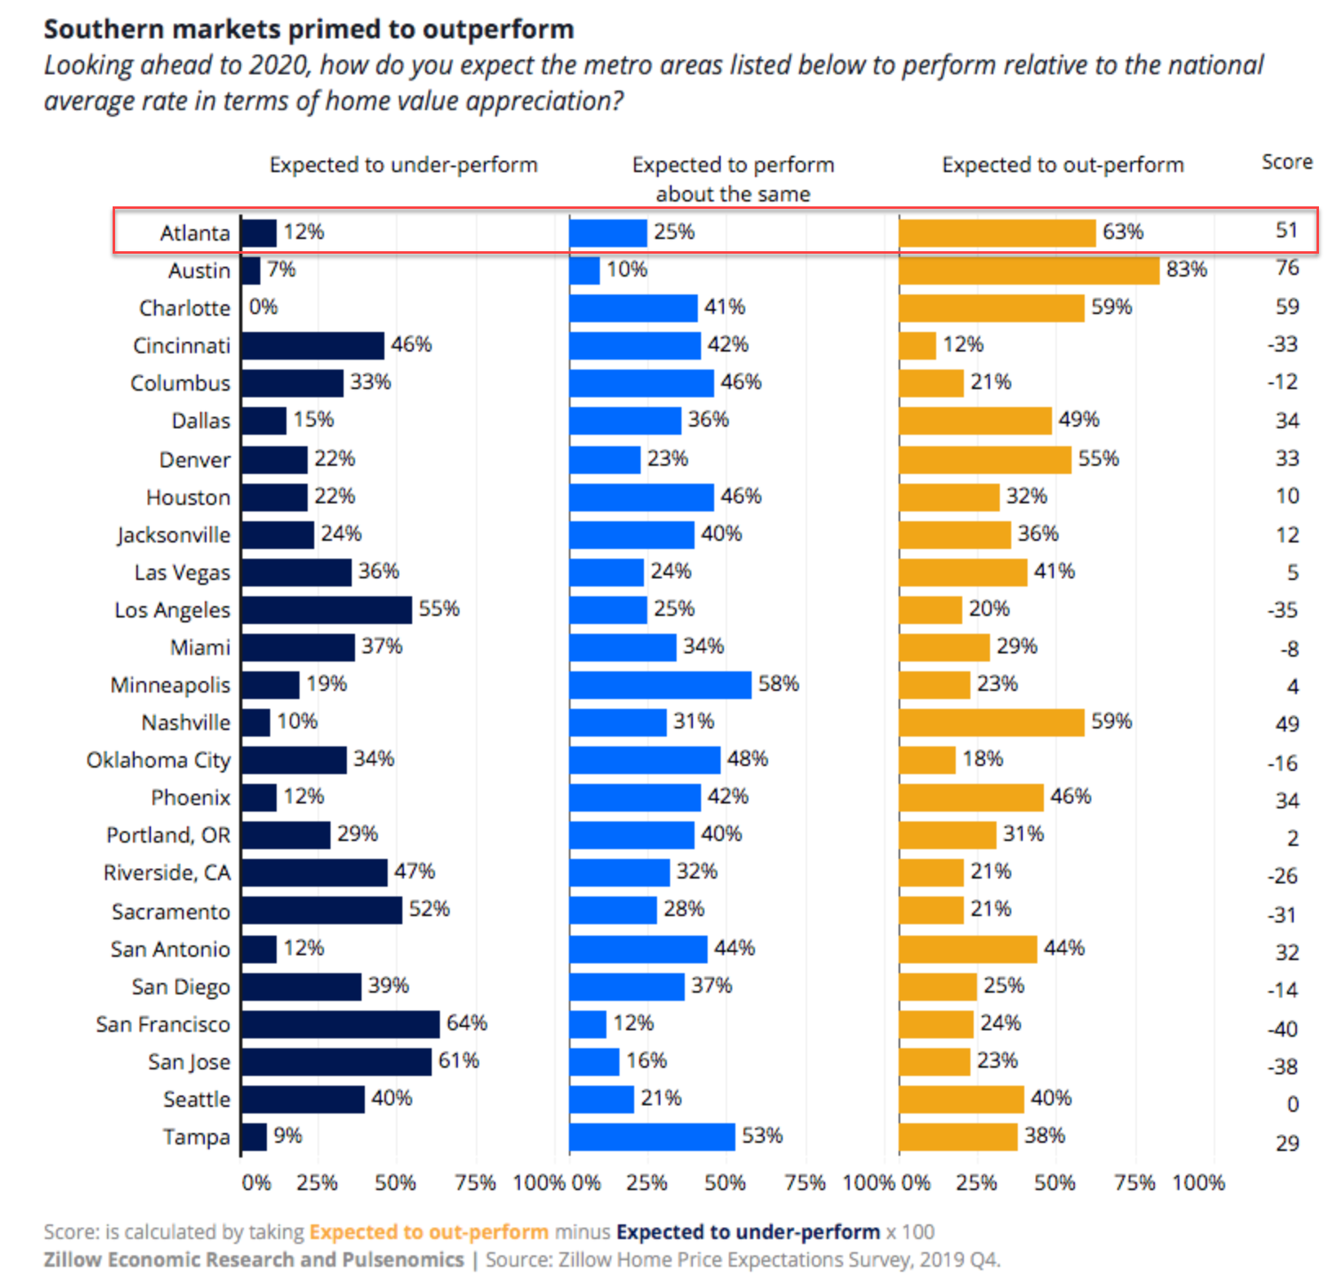
People Are Moving To Atlanta!

Slide 36
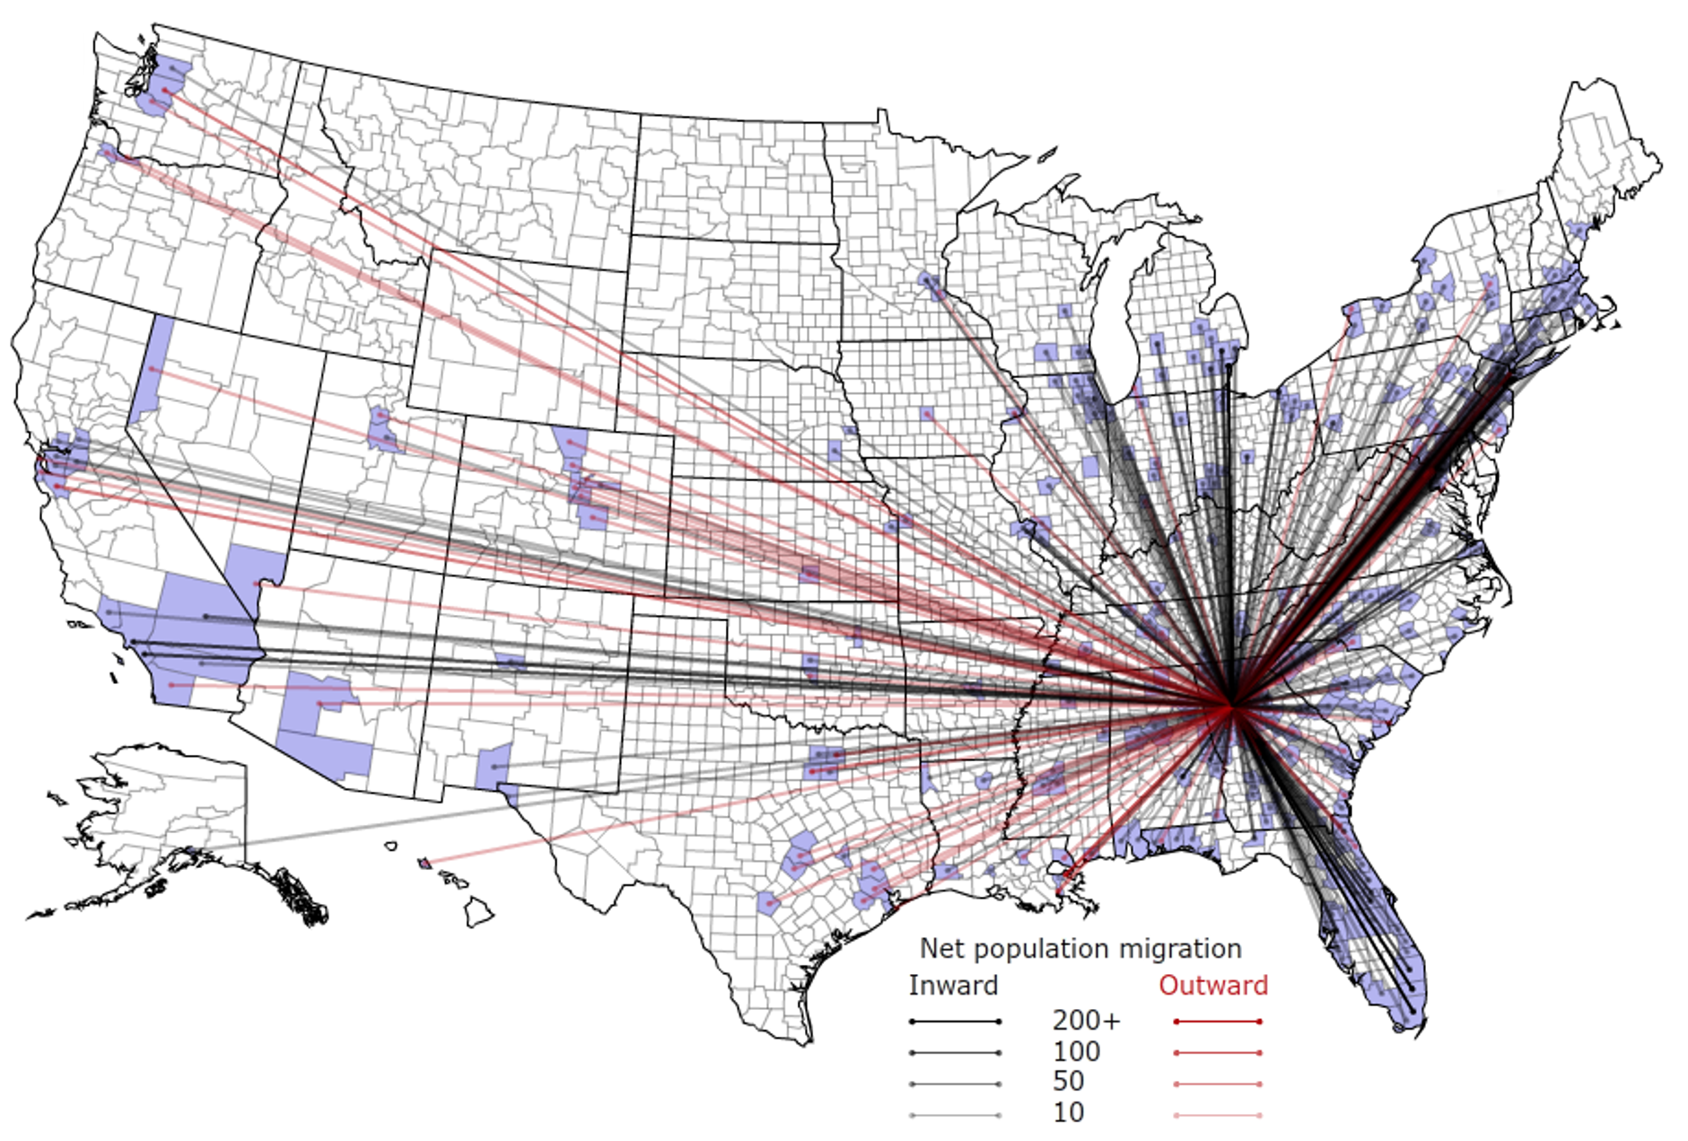
People Are Moving To Atlanta!

Slide 37
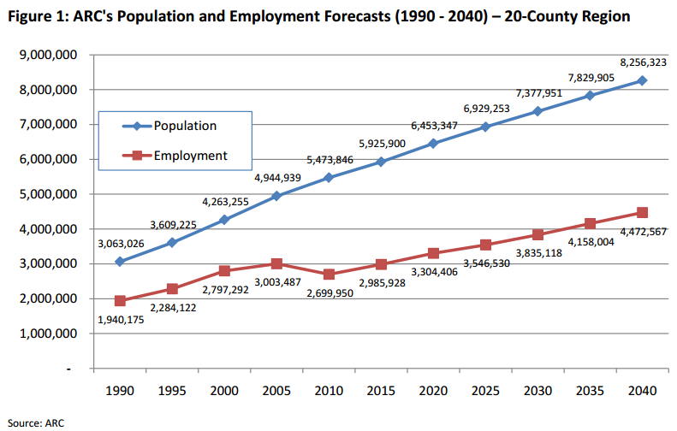
Population & Employment Growth Trends

Slide 38
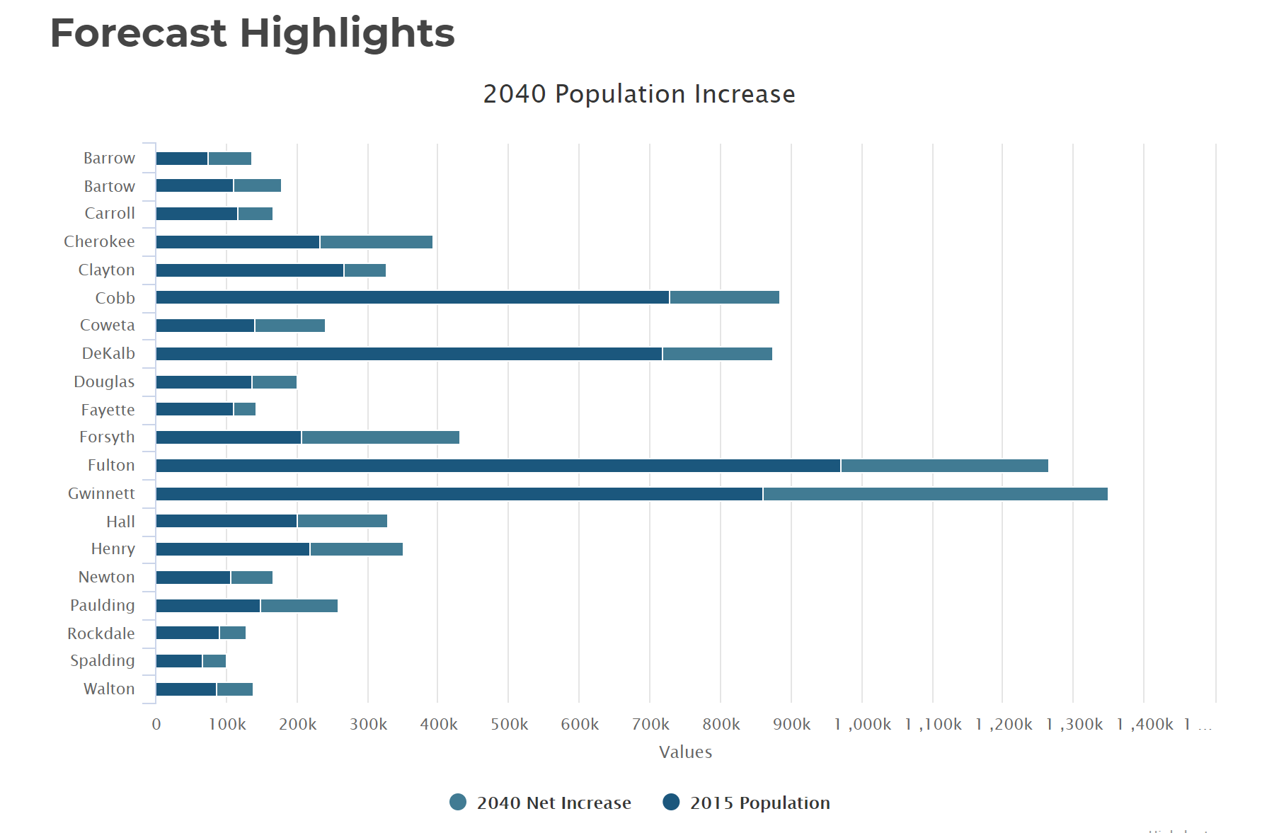
Population By County
Atlanta Regional Commission

Slide 39
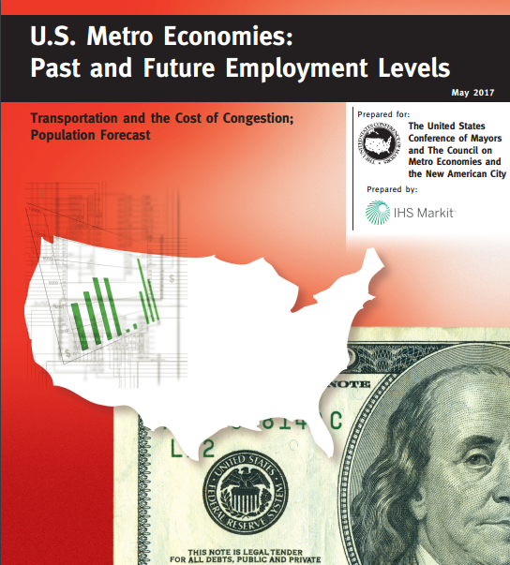
Population & Employment Growth Trends
U.S. Conference of Mayors Report predicts that Metro Atlanta will be the 6th largest city in the nation by 2046.
Metro Atlanta will grow from 5.8 million residents to 8.6 million residents.
That means 2.8 million people will move to our area!
This is great news for our long-term real estate values!

