Slide 1
National Housing Trends

Slide 2
Americans Choose Real Estate as Safest Investment
What do you believe is the safest
investment over the next 10 years?
(Top 5 Answers)
Porch.com

Slide 3
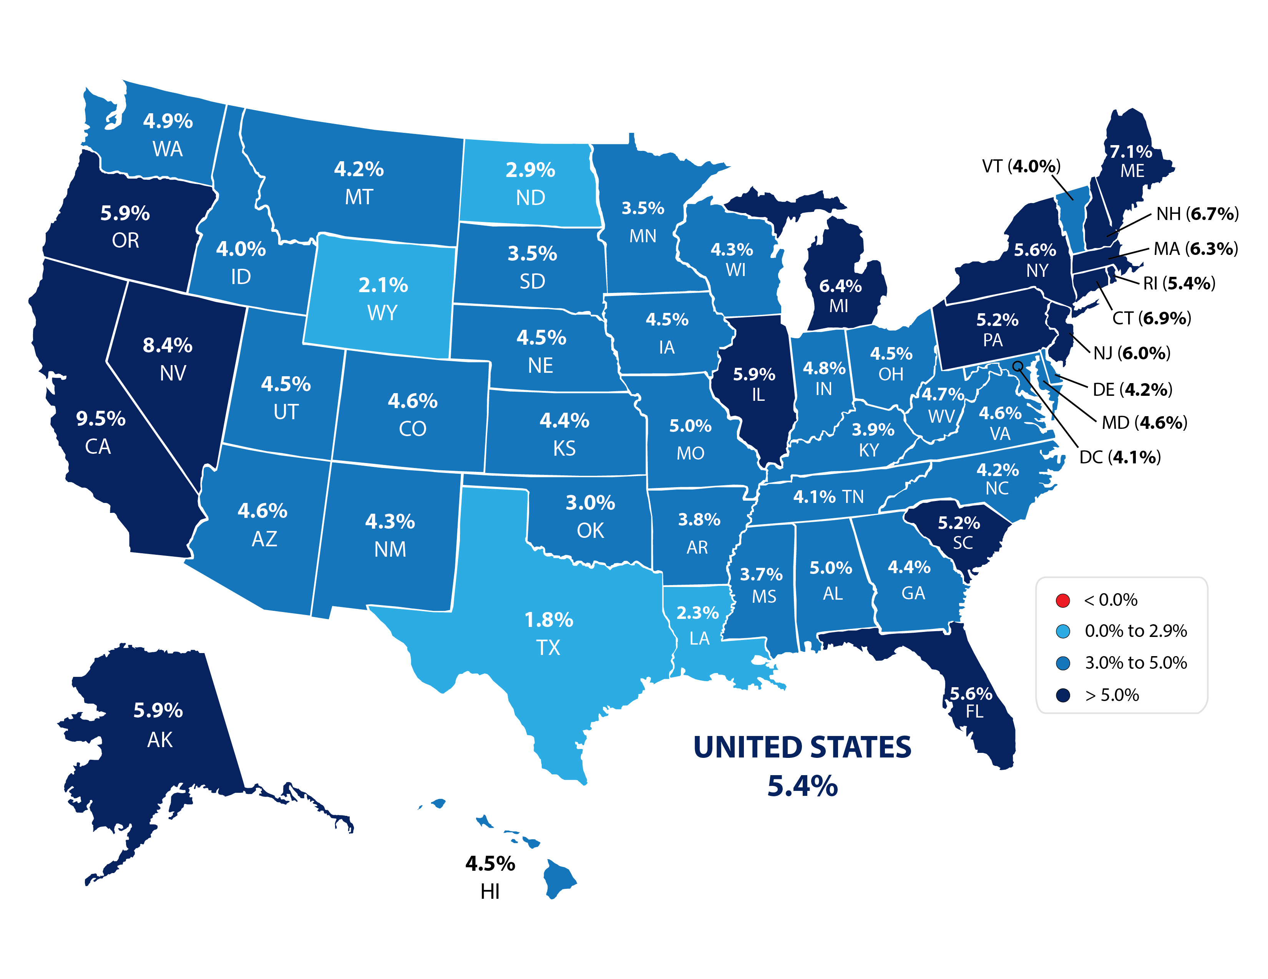
Forecasted Year-Over-Year % Change in Price
CoreLogic
Notes:
https://www.corelogic.com/downloadable-docs/marketpulse/17-mktplse-0220-01-the-marketpulse-vol-9-issue-2-february-2020-screen.pdf

Slide 4
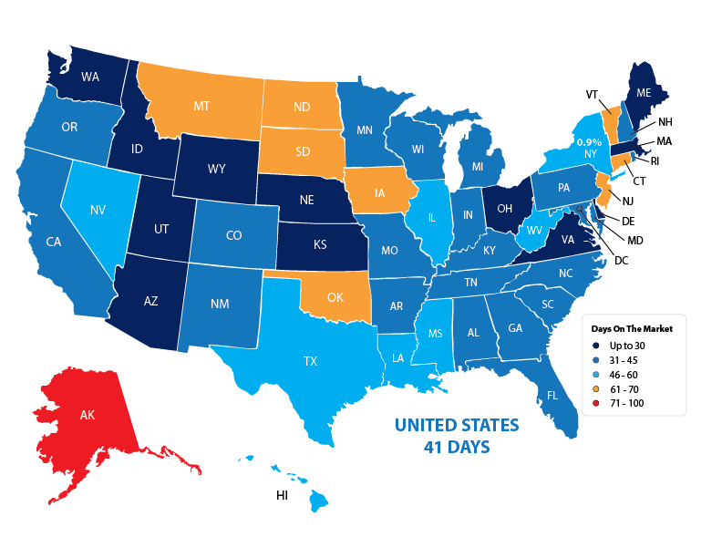
Average Days on the Market
NAR
Notes:
https://www.nar.realtor/sites/default/files/documents/2019-12-realtors-confidence-index-01-22-2020.pdf
December 2019

Slide 5
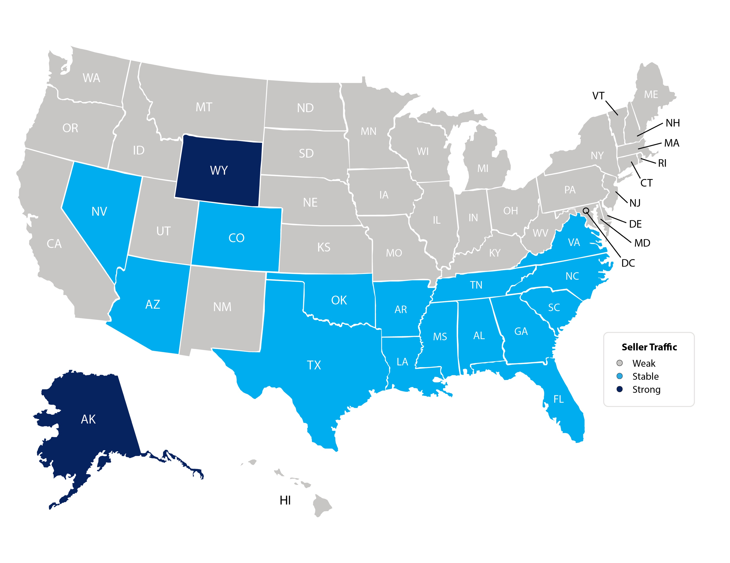
Seller Traffic Index
NAR
Notes:
https://www.nar.realtor/sites/default/files/documents/2019-12-realtors-confidence-index-01-22-2020.pdf
January 2020

Slide 6
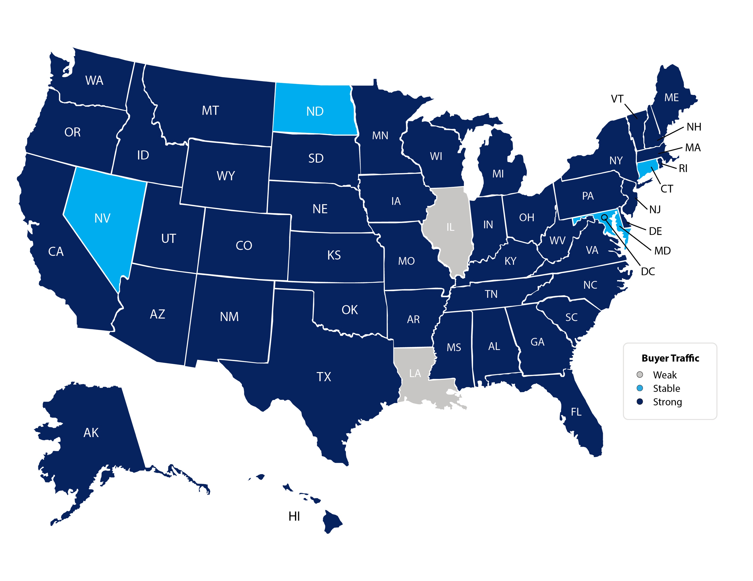
Buyer Traffic Index
NAR
Notes:
https://www.nar.realtor/sites/default/files/documents/2019-12-realtors-confidence-index-01-22-2020.pdf
January 2020

Slide 7
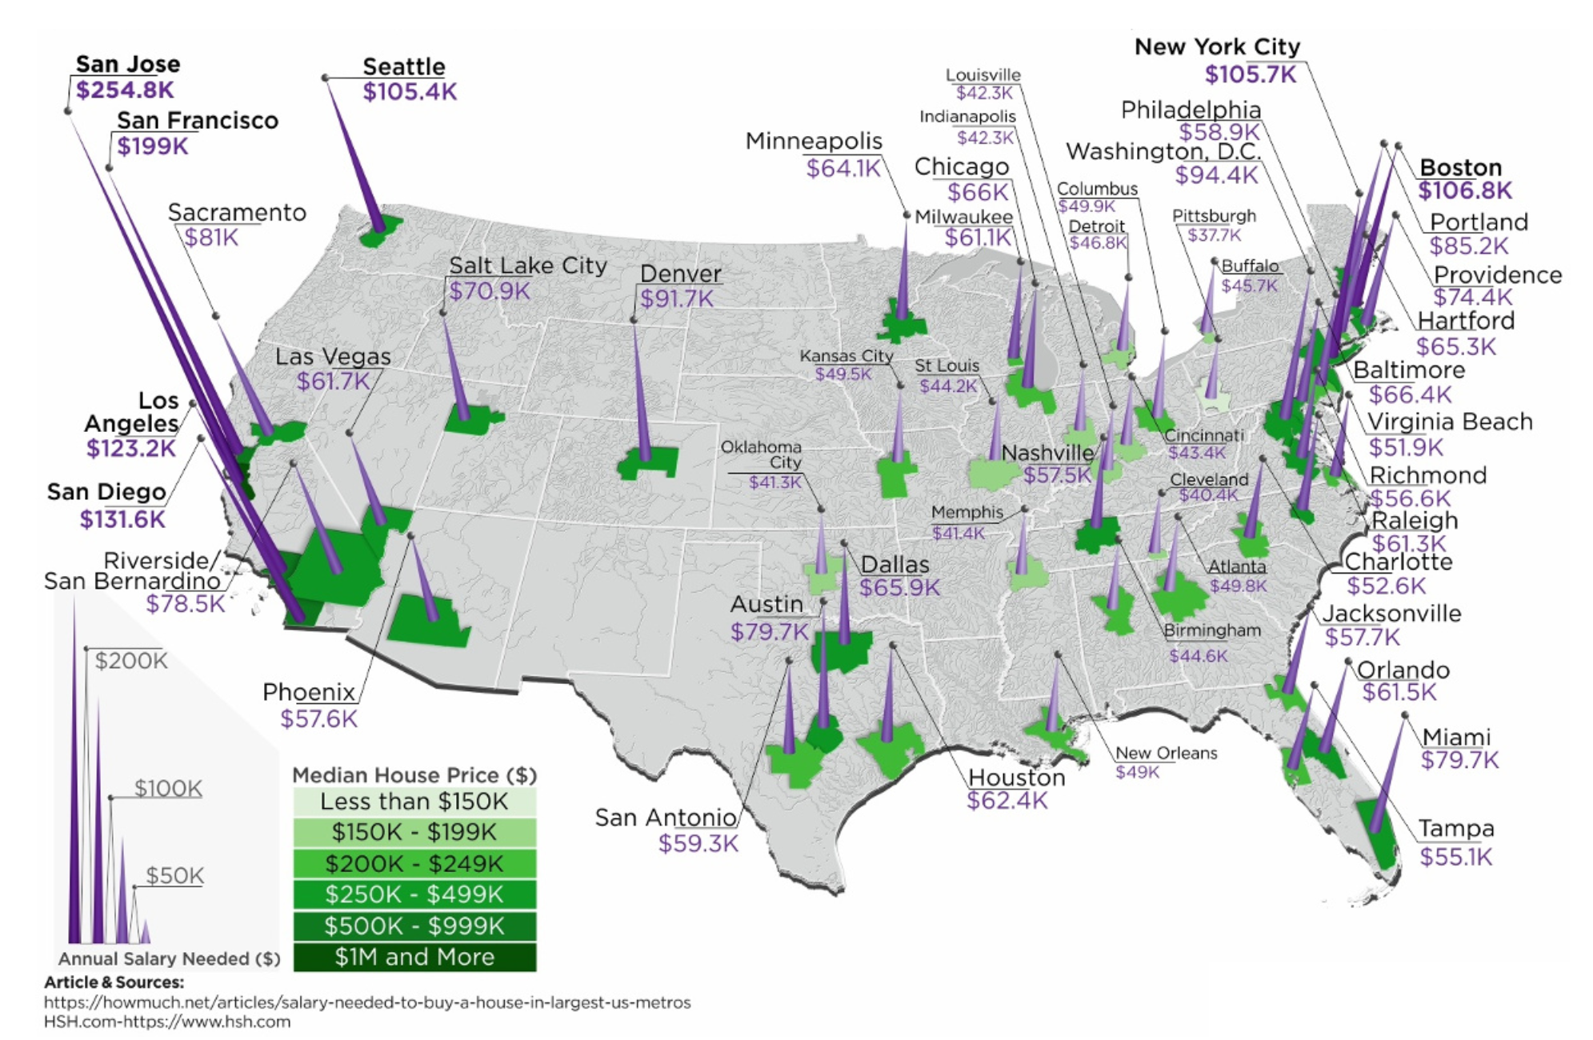
Annual Salary To Buy A Home

Slide 8
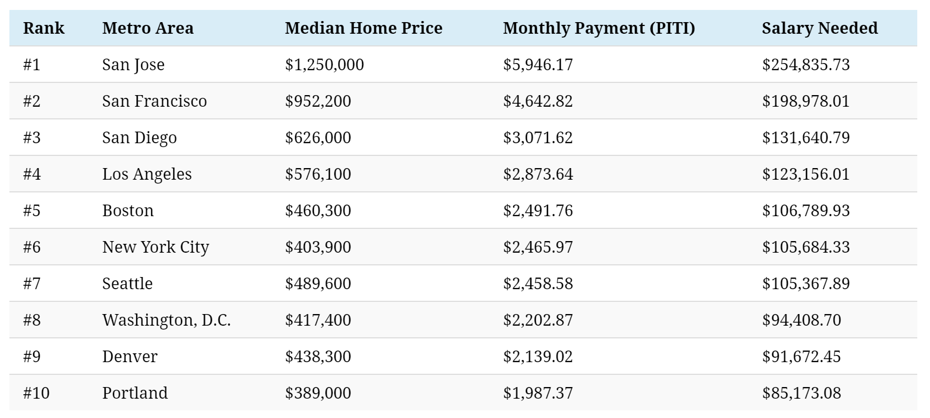
Most Expensive Metros To Buy A Home
Source: HSH.com

Slide 9
Historic Mortgage Rates by Decade
Decade | Average Rate
1970s | 8.86%
1980s | 12.7%
1990s | 8.12%
2000s | 6.29%
Freddie Mac

Slide 10
For almost 50 years, the
30-year mortgage rate
has moved in unison with the
10-year treasury rate
Freddie Mac, Macrotrends
Notes:
https://www.macrotrends.net/2016/10-year-treasury-bond-rate-yield-chart
www.freddiemac.com

Slide 11
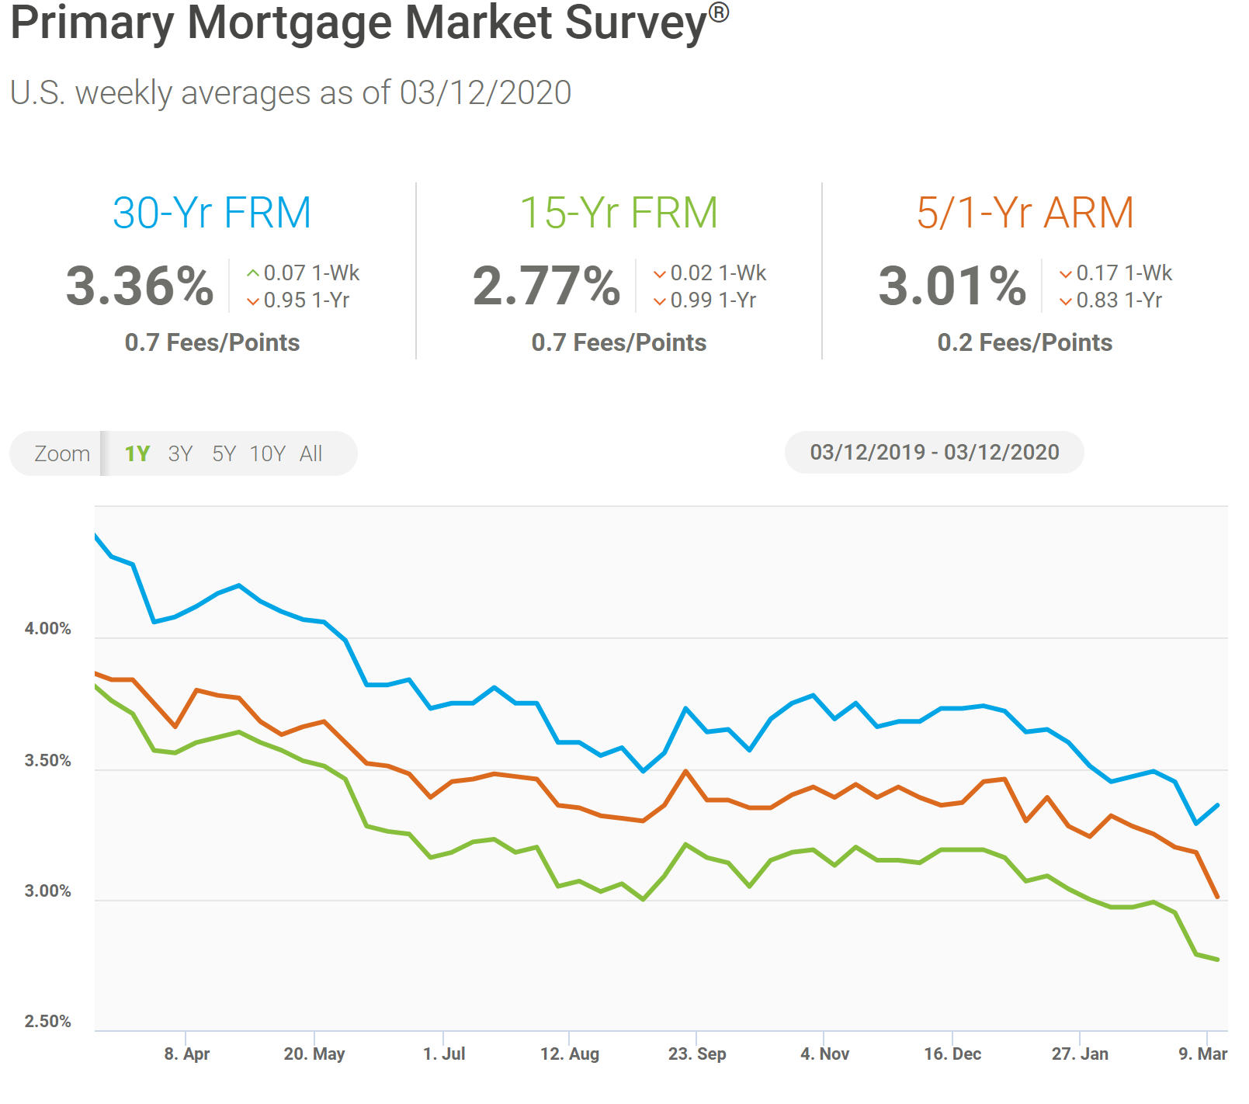

Slide 12
Greater Metro Atlanta
Market
March 2020 Report With Results Through February 2020

Slide 13
Metro Atlanta 2018-2020 Closing Units
February Closings Up 14.9% Compared To January Closings
February 2020 Closings Up 8.5% Compared To February 2019
Notes:
PGR continues to grow our listing inventory market share. Our Advanced Property Marketing methodology and focused prospecting is making a difference.

Slide 14
Metro Atlanta Under Contract Trend
February Under Contract Up 5.1% Compared To January
February 2020 Under Contract Up 8.5% Compared To February 2019
Notes:
PGR continues to grow our listing inventory market share. Our Advanced Property Marketing methodology and focused prospecting is making a difference.

Slide 15
Metro Atlanta New Listings Trend
February New Listings Down 11.2% Compared To January
February 2020 New Listings Down 12.2% Compared To February 2019
Notes:
PGR continues to grow our listing inventory market share. Our Advanced Property Marketing methodology and focused prospecting is making a difference.

Slide 16
Metro Atlanta Closings – February 2020 (Number Of Transactions By Price)
86% Of Transactions In $100K-$500K Price Range
Notes:
Months of supply is well below normal in many of our markets. We expect this to continue in 2013.

Slide 17
Metro Atlanta Closed Units By Price Point February 2020 Compared To February 2019
Notes:
Months of supply is well below normal in many of our markets. We expect this to continue in 2013.

Slide 18
Listed Inventory January 2018 – February 2020
All Residential, Metro Atlanta
Inventory Down 5.5% From Last Month Down 9.2% Compared To Last Year
Notes:
PGR continues to grow our listing inventory market share. Our Advanced Property Marketing methodology and focused prospecting is making a difference.

Slide 19
Months of Inventory Change The Market Strategy
GREATER THAN
7 MONTHS
BETWEEN
6-7 MONTHS
LESS THAN
6 MONTHS
SELLERS
MARKET
Home prices
will appreciate
NEUTRAL
MARKET
Home prices
will only appreciate with inflation
BUYERS
MARKET
Home prices
will depreciate
Notes:
Realtor.org

Slide 20
Metro Atlanta Months of Inventory (February 2020, Based On Closed Sales)
6 Months Supply Is Considered Normal Market
Total Metro Atlanta “Months Of Inventory” Is 3 Months
Notes:
Months of supply is well below normal in many of our markets. We expect this to continue in 2013.

Slide 21
Metro Atlanta Monthly Average Sale Prices
ASP $311,000 In February. Up 1.9% Compared To Last Month.
Up .6% From Last February
Notes:
PGR continues to grow our listing inventory market share. Our Advanced Property Marketing methodology and focused prospecting is making a difference.

Slide 22
Metro Atlanta Annual Average Sale Prices
Annual ASP Up 75% From Bottom Of 2011
Notes:
PGR continues to grow our listing inventory market share. Our Advanced Property Marketing methodology and focused prospecting is making a difference.

Slide 23
Case-Shiller Index For Metro Atlanta
Jan 2010 Through December 2019 (Reported February 25, 2020)
Home Values Up 87% From Bottom Of March 2012.
Notes:
PGR continues to grow our listing inventory market share. Our Advanced Property Marketing methodology and focused prospecting is making a difference.

Slide 24
Case-Shiller Gain/ Loss For Metro Atlanta
Comparisons Based On The Latest Case Shiller Index Compared
To The Average Index For The Year Property Was Purchased.
Year Property Bought | Gain/ Loss
2001 | 41.50%
2002 | 36.34%
2003 | 32.11%
2004 | 27.46%
2005 | 21.25%
2006 | 16.23%
2007 | 15.48%
2008 | 26.22%
2009 | 42.80%
Year Property Bought | Gain/ Loss
2010 | 46.36%
2011 | 57.39%
2012 | 70.64%
2013 | 44.19%
2014 | 32.18%
2015 | 25.27%
2016 | 18.33%
2017 | 12.21%
2018 | 5.96%
Case Shiller Index For Metro Atlanta - December 2019 As Reported February 25, 2020. Micro-Local Markets And Price Points May Have Significantly Different Outcomes.
Notes:
PGR continues to grow our listing inventory market share. Our Advanced Property Marketing methodology and focused prospecting is making a difference.

Slide 25
Case-Shiller Home Values For Metro Atlanta
Recent Bottom Was March 2012. Metro Average Home Values Back To Normal Trend Line.
Notes:
PGR continues to grow our listing inventory market share. Our Advanced Property Marketing methodology and focused prospecting is making a difference.

Slide 26
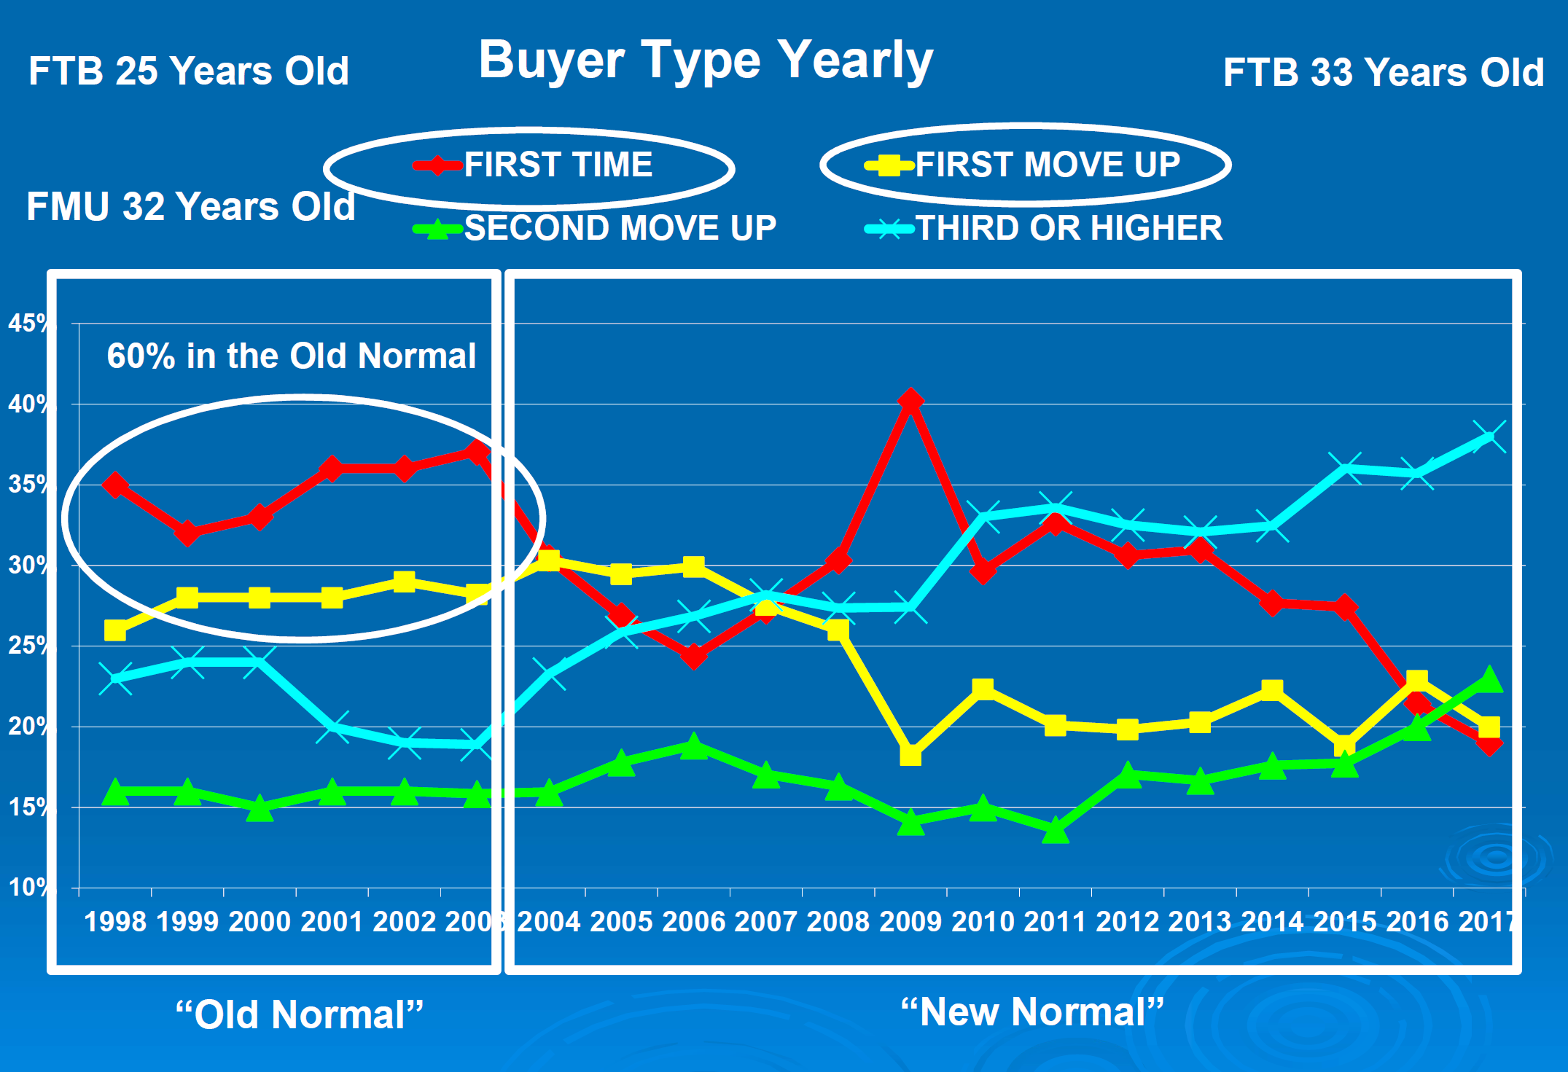

Slide 27
Metro Atlanta Brokerage Rankings

Slide 28
Annual Closed Volume – February 2020 FMLS Counties + Southern Crescent
($ Volume in Thousands)
Information Provided By Trendgraphix and BHHS Georgia Properties Internal Reports.
Notes:
In the past three years, our company has consistently grown our market share in both listing inventory and the sales of that inventory. Today, we are Ranked #1 in both categories.

Slide 29
Georgia Economic & Housing Trends

Slide 30
Top State For Business Site Selection Magazine
7 Years in a Row!
2019
2018
2017
2016
2015
2014
2013

Slide 31
Buyers Moving To Atlanta!
Here is the Top 10 List including previous rank:
Atlanta (1)
Phoenix (4)
Tampa/Sarasota (2)
Dallas/Fort Worth (3)
Orlando (5)
Denver (7)
Houston (8)
Seattle (6)
Las Vegas (10)
Chicago (9)
Penske Truck Rental published their latest moving destination list and Atlanta was ranked #1 for the 6th year in a row. The trend of moving to the sunbelt has returned. Desirable attributes that help Metro Atlanta include a business friendly environment, low cost of living for a metro area, airport, moderate weather with 4 seasons and a high quality of life.

Slide 32
Baby Boomers Are Coming To Be Close To Their Children & Grandchildren.
 | Total Population | Rank of Share
 |  | Under 20 | 20-64 | 65+ | 25-39 | 45-59
Dallas | 6,144,489 | 3 | 9 | 25 | 1 | 24
Atlanta | 5,271,550 | 5 | 6 | 27 | 2 | 19
Phoenix | 4,179,427 | 4 | 24 | 15 | 3 | 26
Denver | 2,466,591 | 11 | 5 | 24 | 4 | 12
Riverside | 4,081,371 | 1 | 27 | 22 | 5 | 27
Houston | 5,629,127 | 2 | 10 | 26 | 6 | 21
Portland | 2,174,631 | 19 | 4 | 19 | 7 | 7
Seattle | 3,309,347 | 22 | 1 | 20 | 8 | 3
Sacramento | 2,091,120 | 12 | 13 | 14 | 9 | 20
Washington | 5,306,125 | 14 | 3 | 23 | 10 | 11
Los Angeles | 12,875,587 | 6 | 17 | 18 | 11 | 23
San Diego | 2,974,859 | 8 | 14 | 16 | 12 | 25
San Francisco | 4,203,898 | 26 | 2 | 10 | 13 | 4
Orlando | 2,032,496 | 18 | 15 | 8 | 14 | 22
Minneapolis | 3,208,212 | 10 | 7 | 21 | 15 | 6
Chicago | 9,522,879 | 7 | 16 | 17 | 16 | 18
New York | 18,815,988 | 21 | 12 | 6 | 17 | 15
Boston | 4,482,857 | 23 | 8 | 9 | 18 | 10
Cincinnati | 2,134,864 | 9 | 19 | 13 | 19 | 14
Baltimore | 2,668,056 | 17 | 11 | 11 | 20 | 9
Detroit | 4,467,592 | 13 | 18 | 12 | 21 | 5
Philadelphia | 5,827,962 | 16 | 21 | 5 | 22 | 13
St. Louis | 2,802,282 | 15 | 20 | 7 | 23 | 8
Miami | 5,413,212 | 24 | 26 | 3 | 24 | 17
Tampa | 2,723,949 | 25 | 25 | 1 | 25 | 16
Cleveland | 2,096,471 | 20 | 23 | 4 | 26 | 2
Pittsburgh | 2,355,712 | 27 | 22 | 2 | 27 | 1
Metro Atlanta Has The:
#2 Population Age 25-39
#5 Population Under 20
Source :Census Bureau

Slide 33
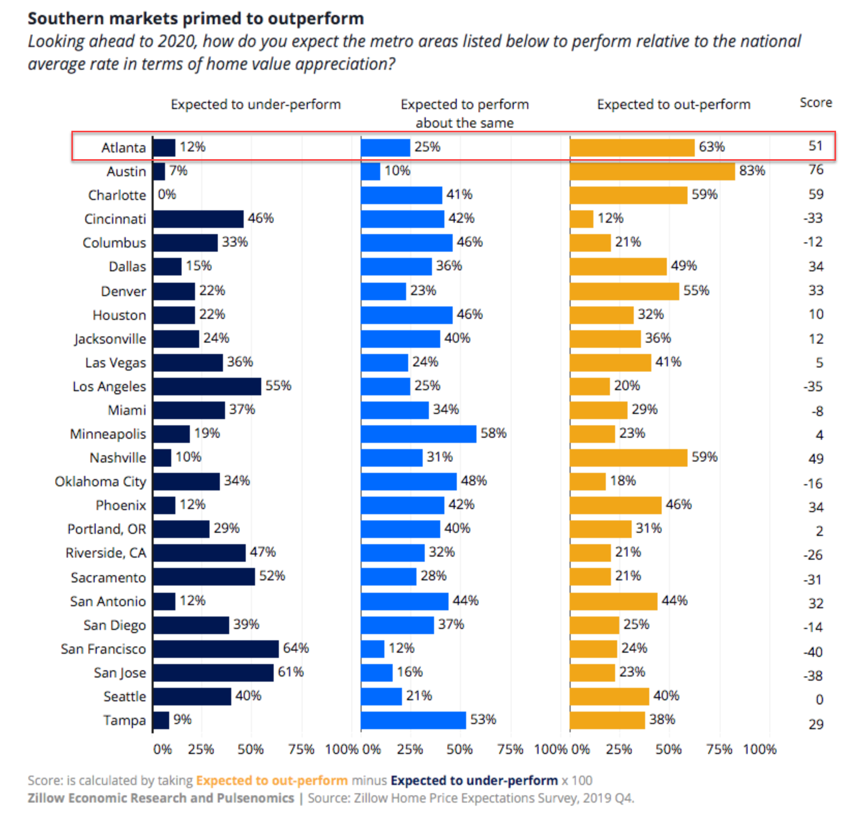
People Are Moving To Atlanta!

Slide 34
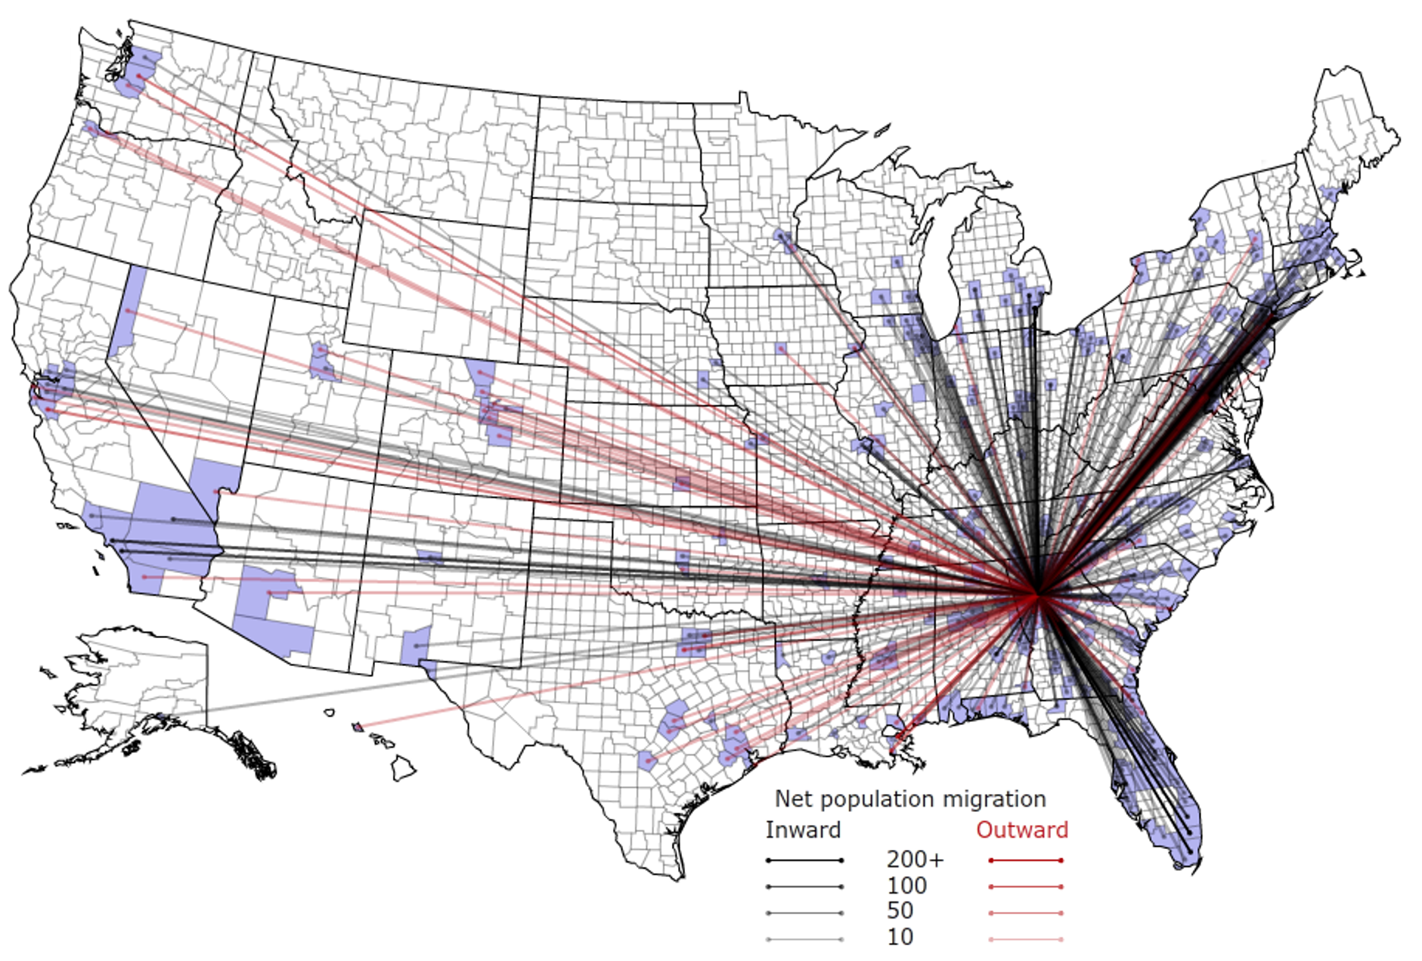
People Are Moving To Atlanta!

Slide 35
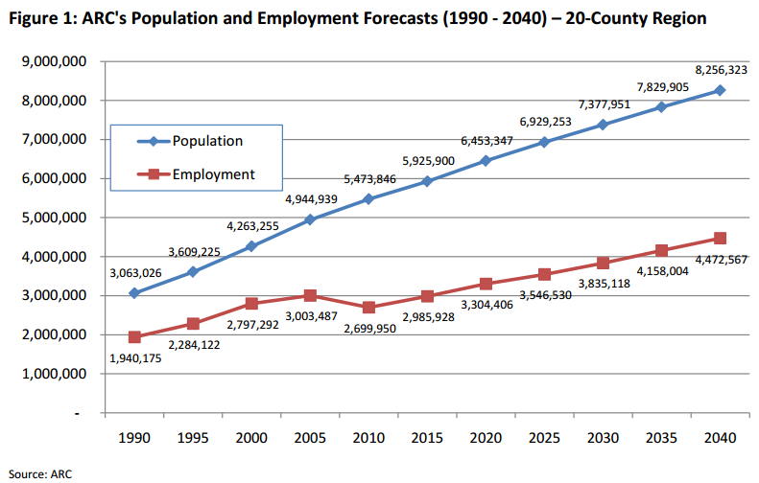
Population & Employment Growth Trends

Slide 36
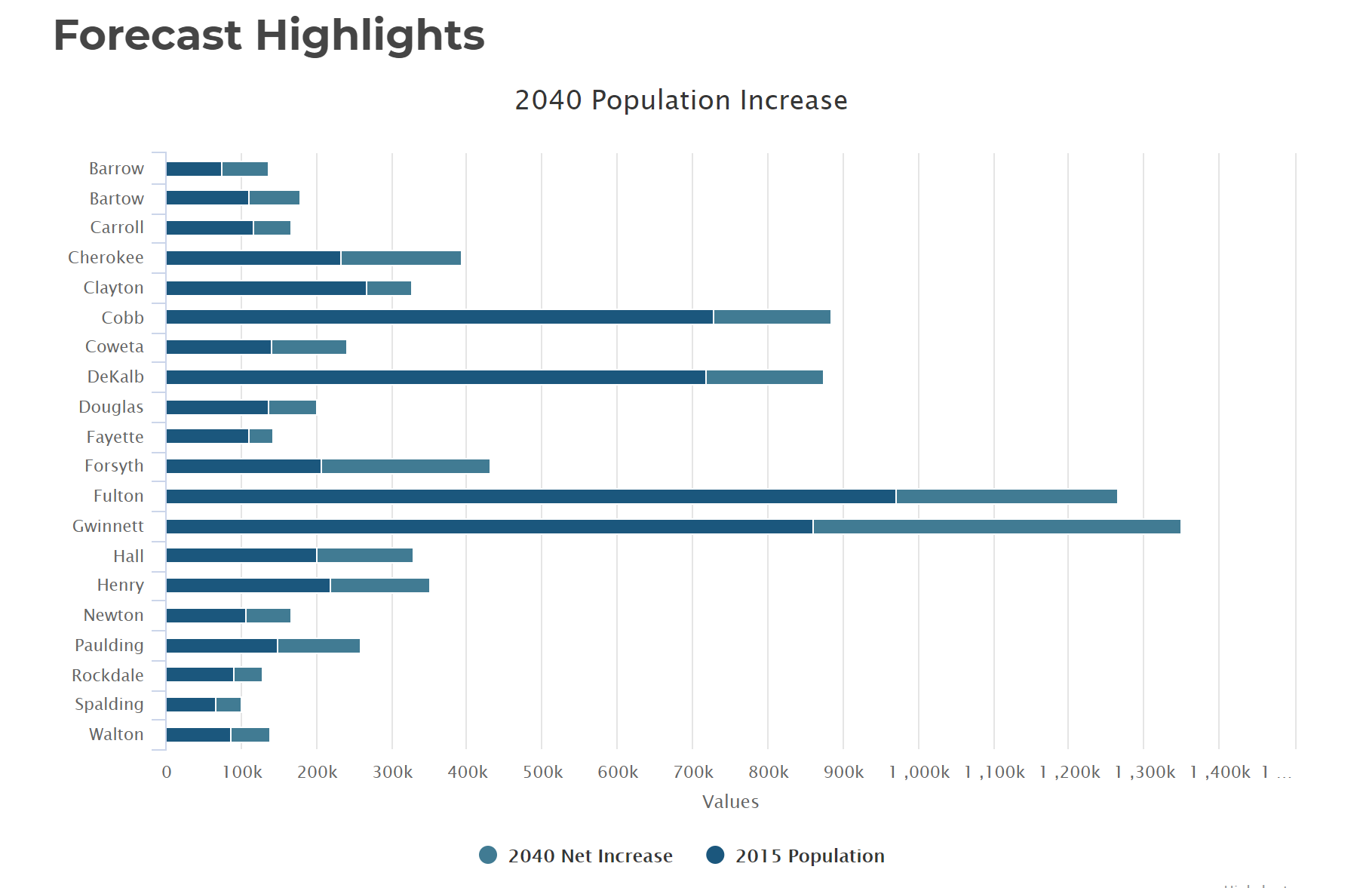
Population By County
Atlanta Regional Commission

Slide 37
Population & Employment Growth Trends
U.S. Conference of Mayors Report predicts that Metro Atlanta will be the 6th largest city in the nation by 2046.
Metro Atlanta will grow from 5.8 million residents to 8.6 million residents.
That means 2.8 million people will move to our area!
This is great news for our long-term real estate values!

