Slide 1
National Housing Trends

Slide 2
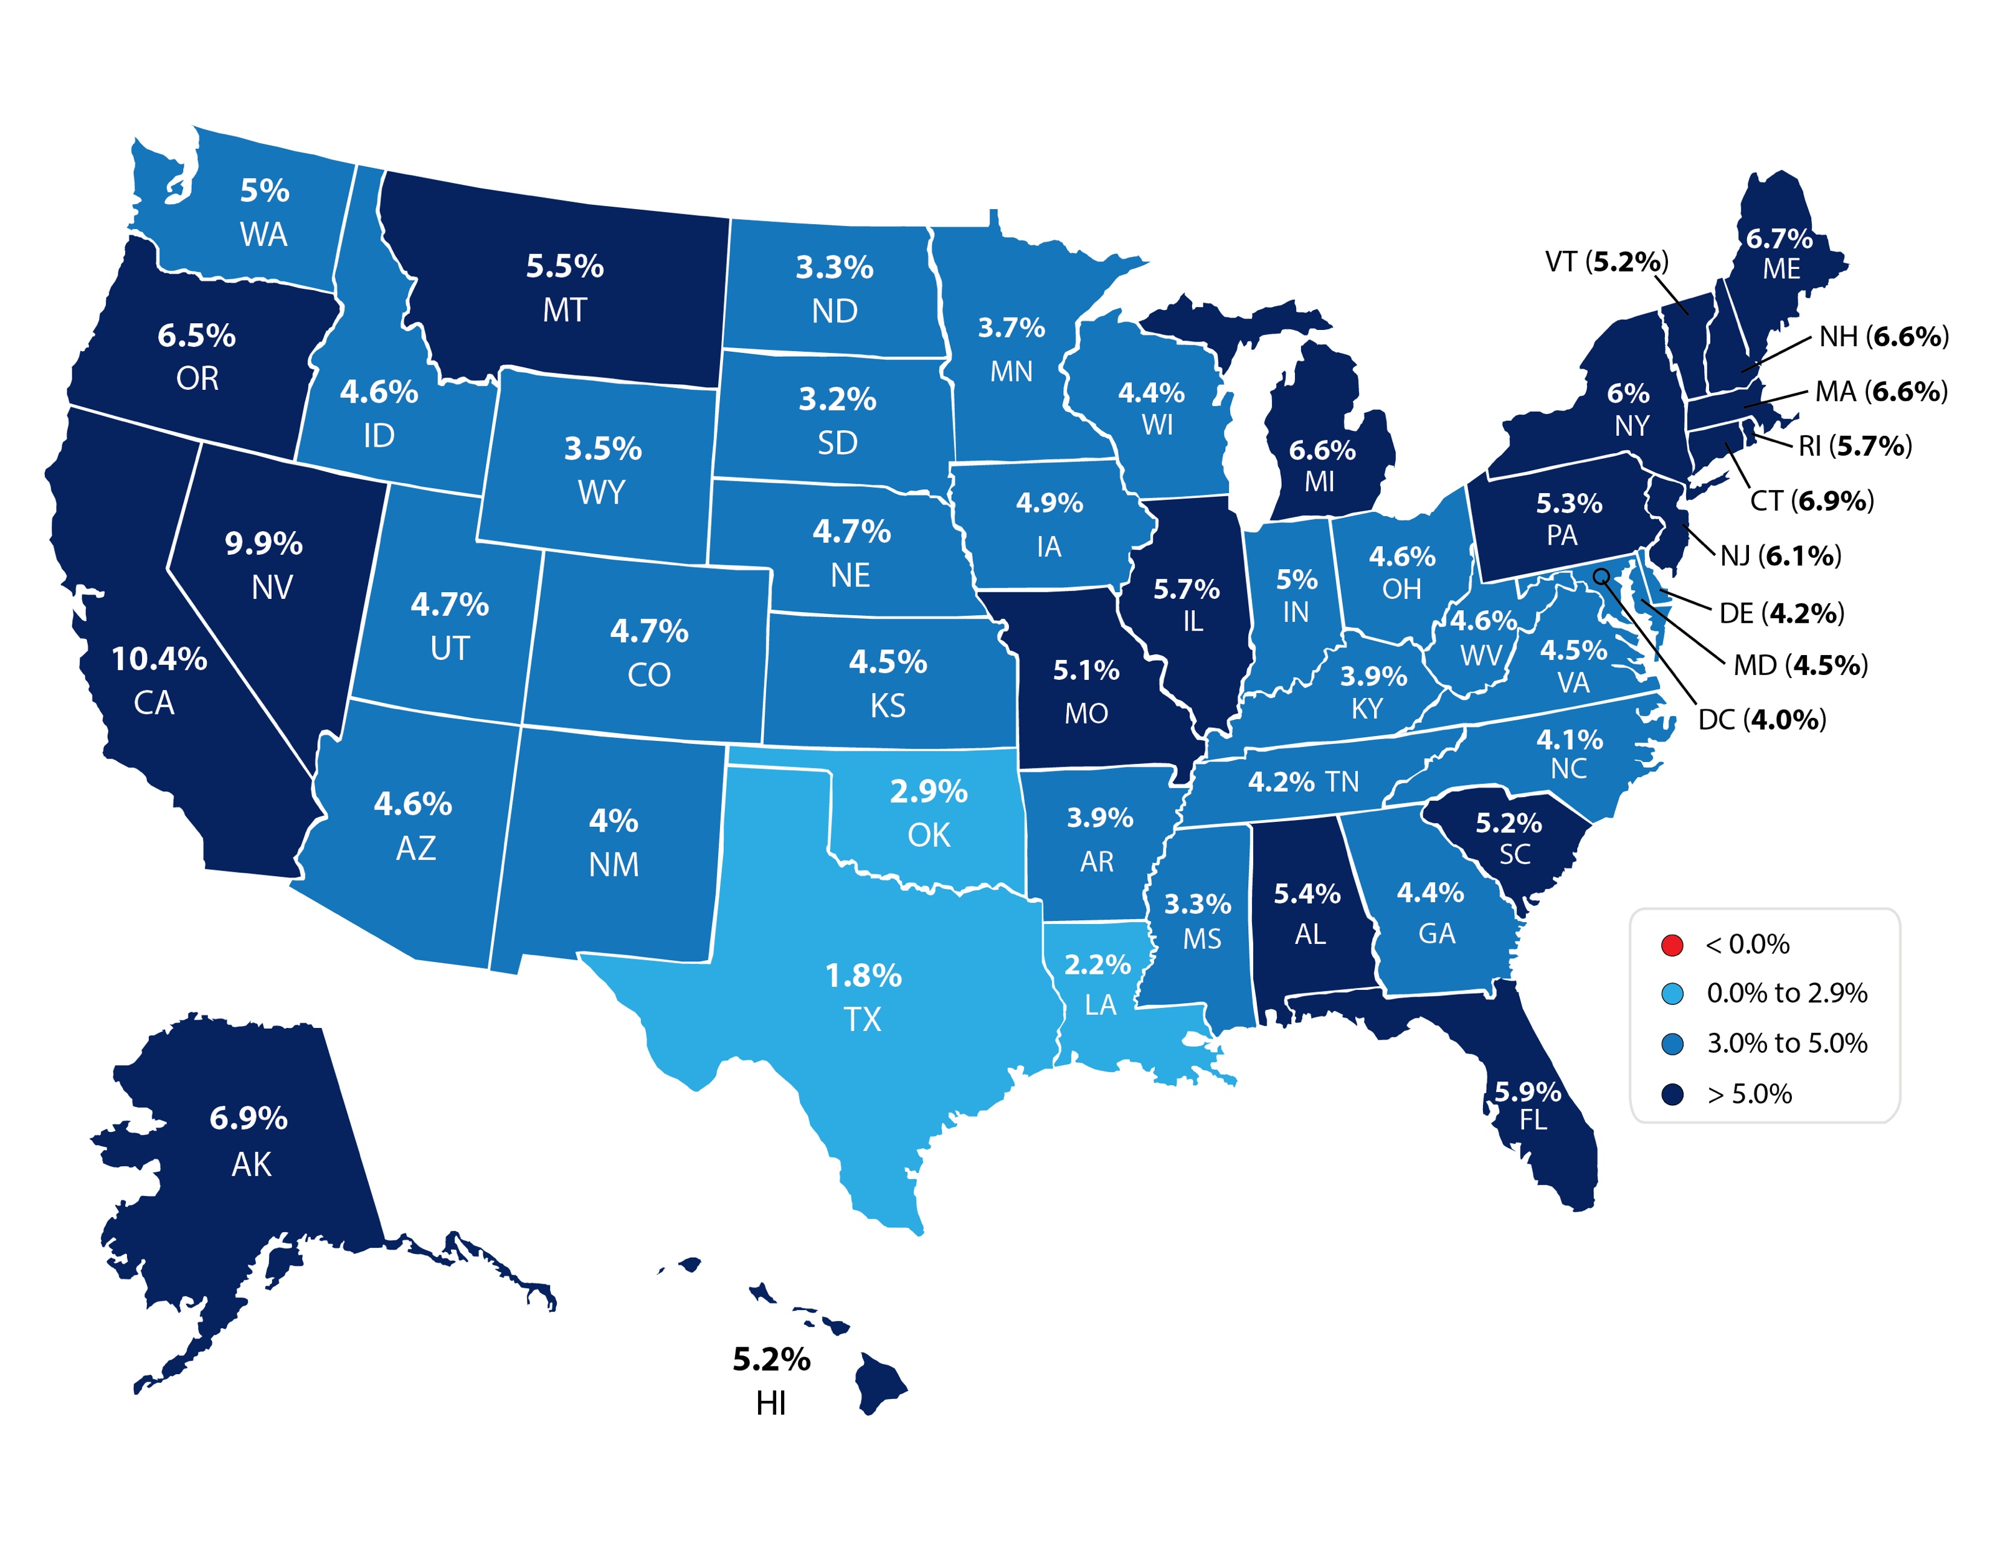
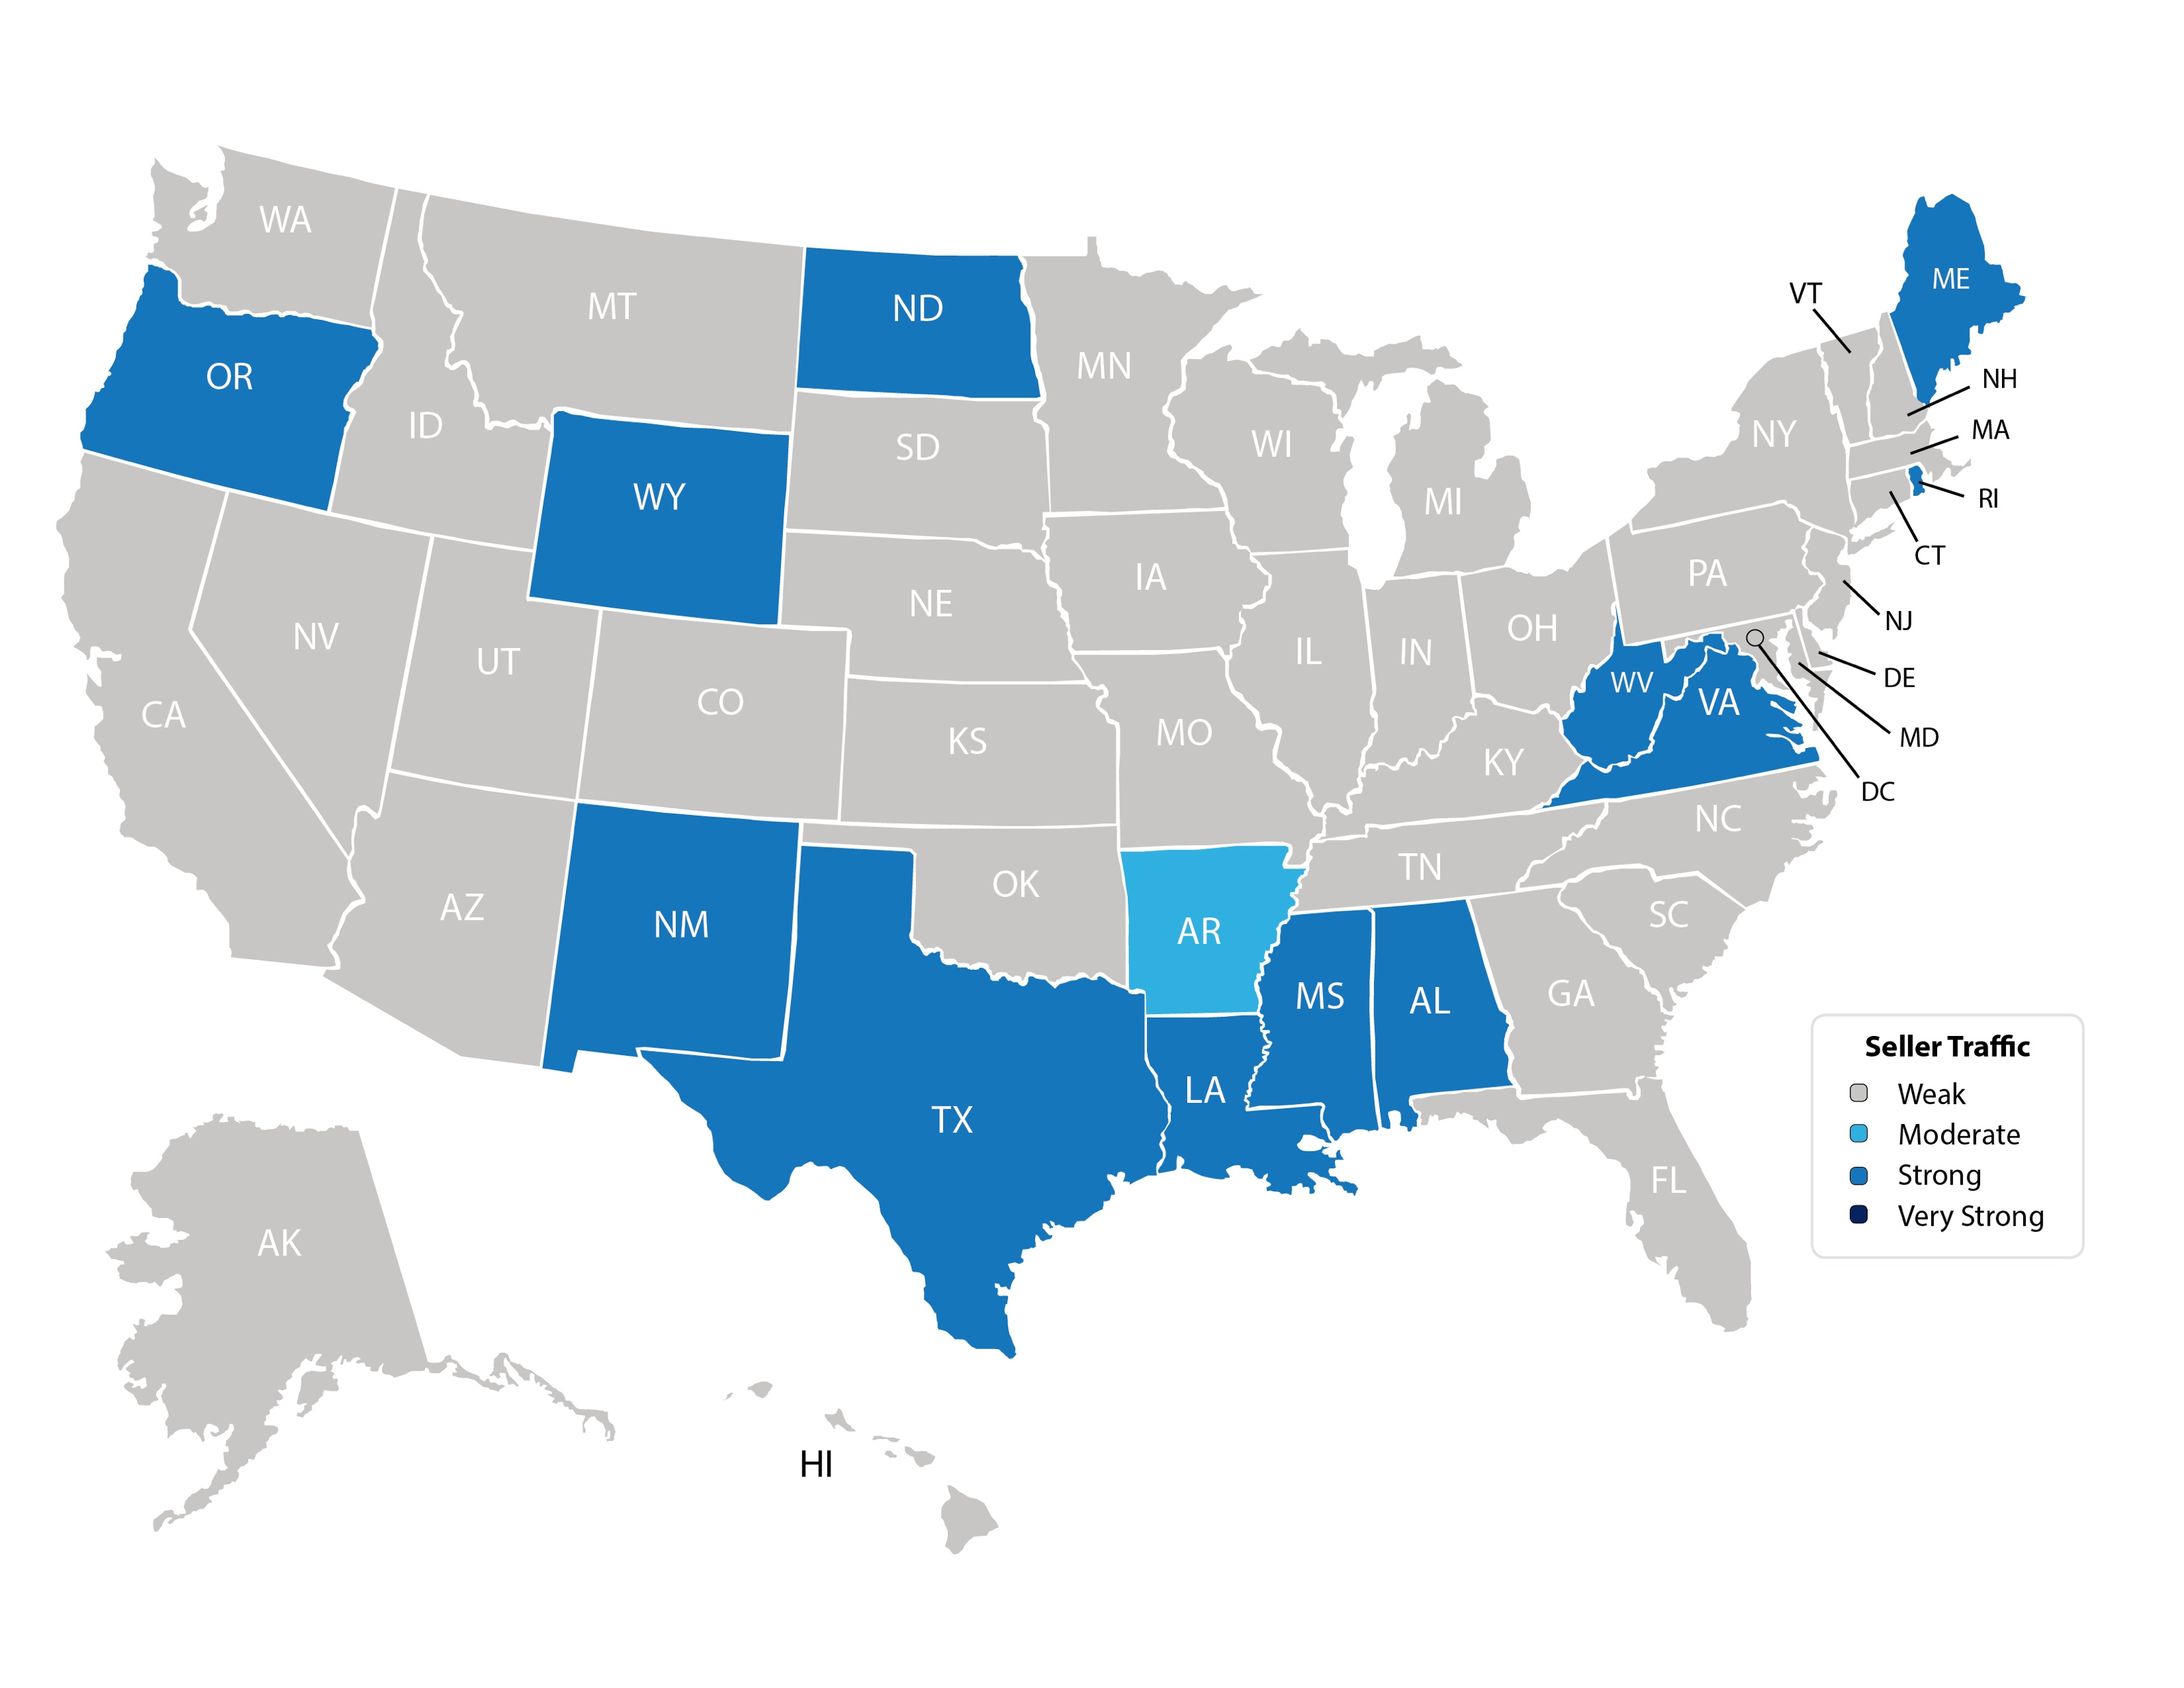
Forecasted Year-Over-Year % Change in Price
CoreLogic
Notes:
https://www.corelogic.com/downloadable-docs/marketpulse/17-mktplse-0320-00-the-marketpulse-vol-9-issue-3-march-2020-screen-032420.pdf

Slide 3
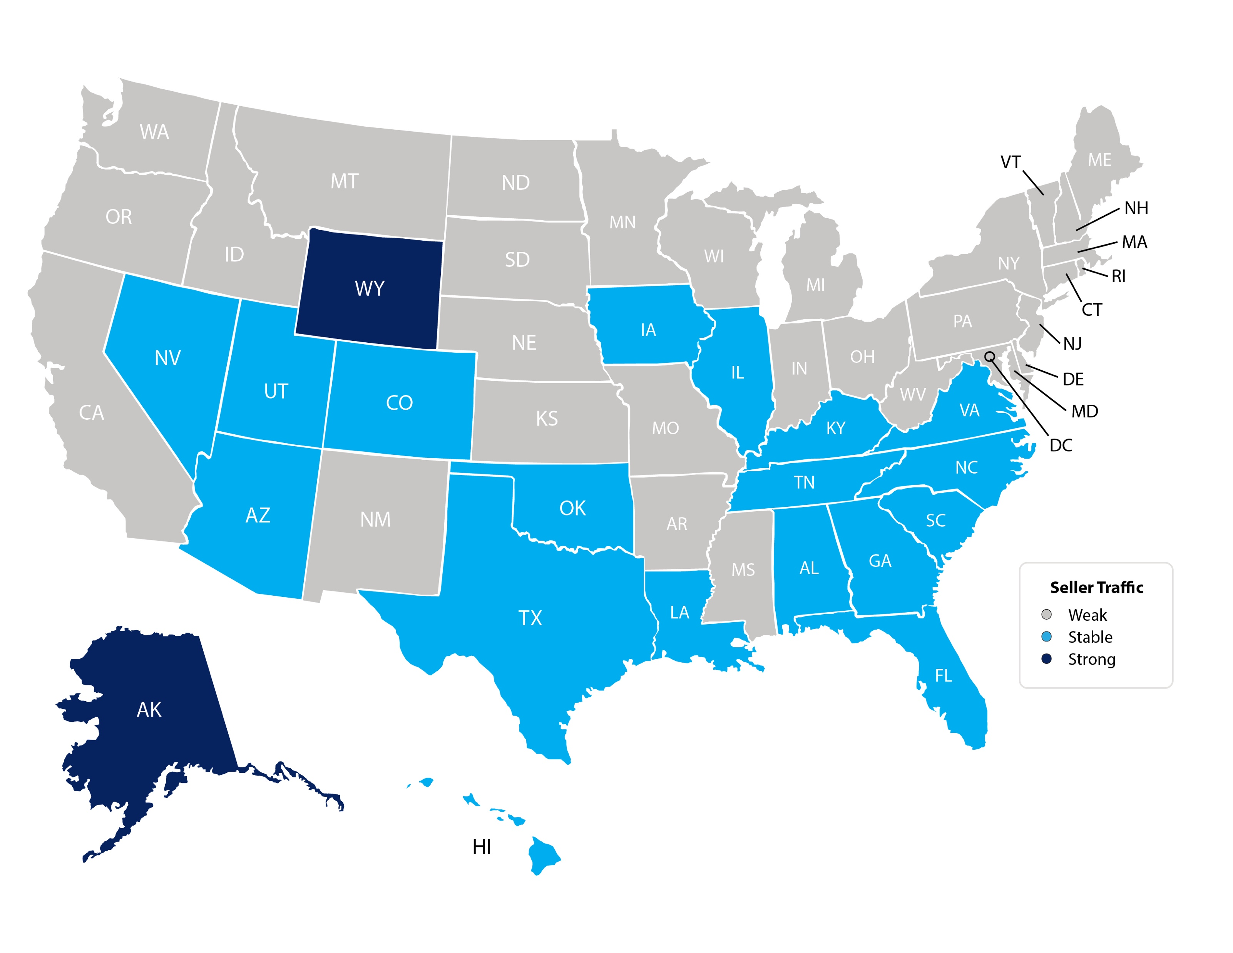
Seller Traffic Index
NAR
Notes:
https://www.nar.realtor/sites/default/files/documents/2020-02-realtors-confidence-index-03-20-2020.pdf

Slide 4
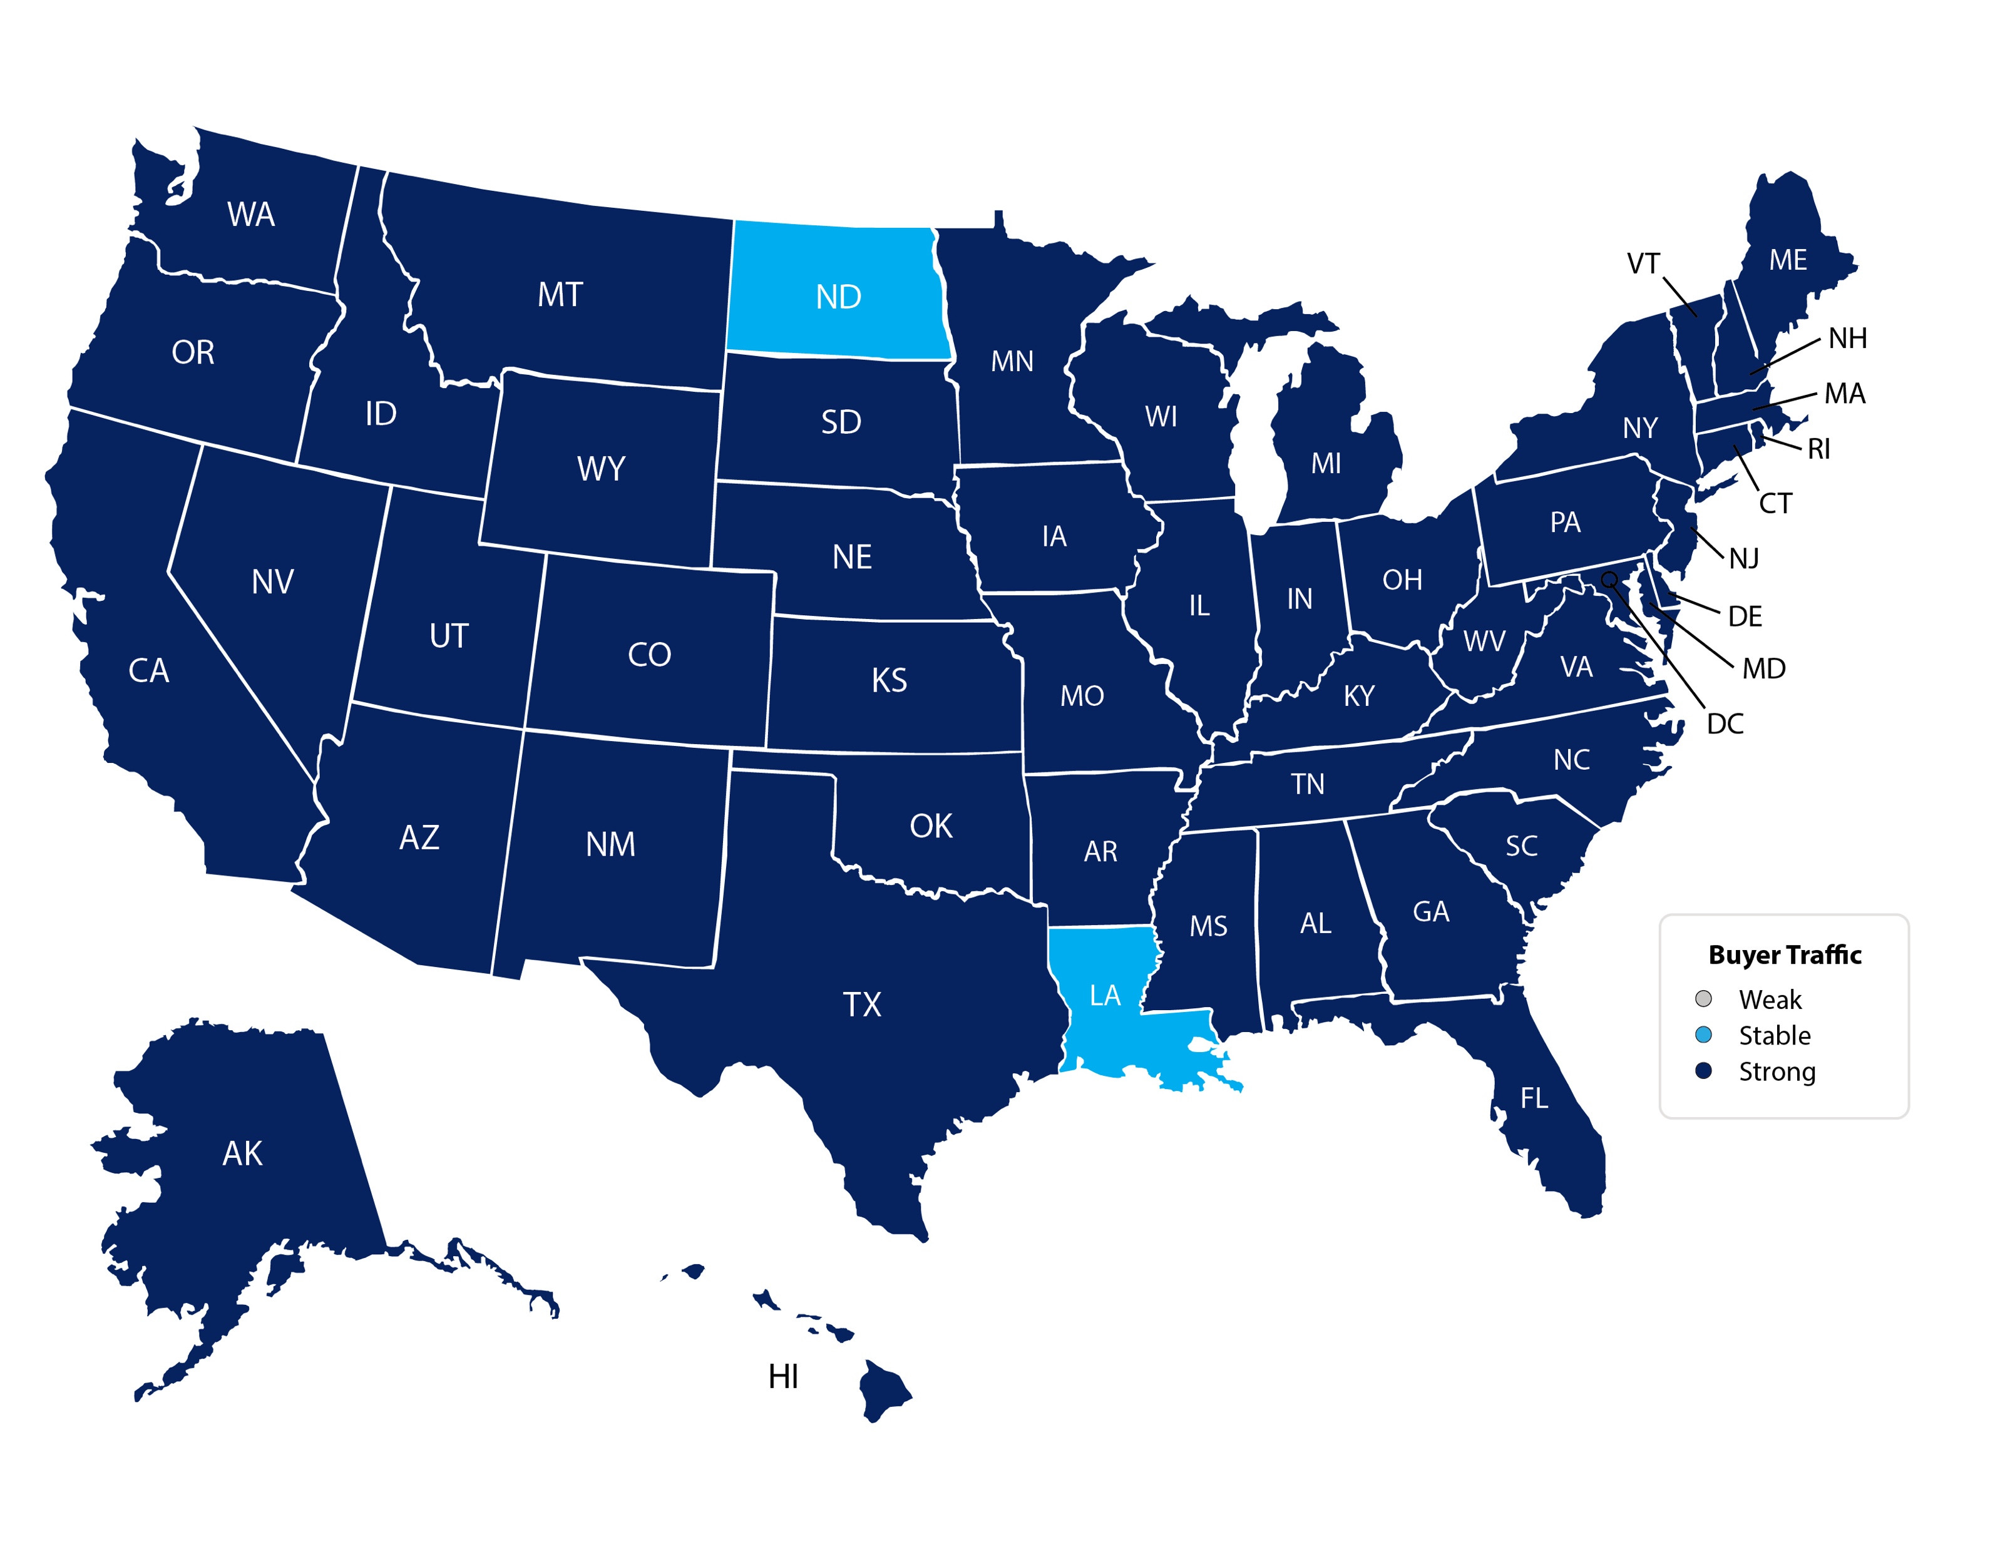
Buyer Traffic Index
NAR
Notes:
https://www.nar.realtor/sites/default/files/documents/2020-02-realtors-confidence-index-03-20-2020.pdf

Slide 5
Historic Mortgage Rates by Decade
Decade | Average Rate
1970s | 8.86%
1980s | 12.7%
1990s | 8.12%
2000s | 6.29%
Freddie Mac

Slide 6
For almost 50 years, the
30-year mortgage rate
has moved in unison with the
10-year treasury rate
Freddie Mac, Macrotrends
Notes:
https://www.macrotrends.net/2016/10-year-treasury-bond-rate-yield-chart
www.freddiemac.com

Slide 7
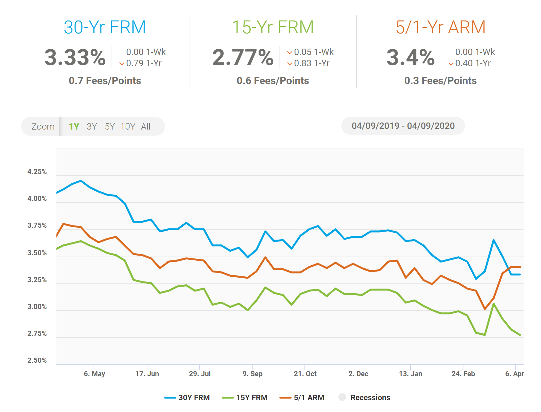

Slide 8
Mortgage Rate Projections
Quarter | Freddie Mac | Fannie Mae | MBA | NAR | Average of All Four
2020 2Q | 3.8 | 3.3 | 3.3 | 3.7 | 3.52%
2020 3Q | 3.8 | 3.2 | 3.3 | 3.8 | 3.52%
2020 4Q | 3.8 | 3.2 | 3.4 | 3.9 | 3.57%
2021 1Q | 3.8 | 3.1 | 3.6 | 4.0 | 3.47%
Notes:
http://www.freddiemac.com/research/forecast/
http://www.fanniemae.com/portal/research-insights/forecast.html
https://www.mba.org/news-research-and-resources/research-and-economics/forecasts-and-commentary
https://www.nar.realtor/research-and-statistics

Slide 9
Mortgage Rates Make A Significant Difference In Home Affordability
Amount Of Mortgage | 3.5% Mortgage | 30-Year Cost | 5% Mortgage | 30-Year Cost
$200,000 | $898 | $323,280 | $1,073 | $386,280
$300,000 | $1,347 | $484,920 | $1,610 | $579,600
$400,000 | $1,796 | $646,560 | $2,147 | $772,920
$500,000 | $2,245 | $808,200 | $2,684 | $966,240
$1 million | $4,490 | $1,616,400 | $5,368 | $1,932,480

Slide 10
Greater Metro Atlanta
Market
April 2020 Report With Results Through March 2020

Slide 11
Metro Atlanta 2018-2020 Closing Units
March Closings Up 19% Compared To February Closings
March 2020 Closings Up 2% Compared To March 2019
Notes:
PGR continues to grow our listing inventory market share. Our Advanced Property Marketing methodology and focused prospecting is making a difference.

Slide 12
Metro Atlanta Under Contract Trend
March Under Contract Down 9.6% Compared To February
March 2020 Under Contract Down 21.6% Compared To March 2019
Notes:
PGR continues to grow our listing inventory market share. Our Advanced Property Marketing methodology and focused prospecting is making a difference.

Slide 13
Metro Atlanta New Listings Trend
March New Listings Up 16.8% Compared To February
March 2020 New Listings Down 11.5% Compared To March 2019
Notes:
PGR continues to grow our listing inventory market share. Our Advanced Property Marketing methodology and focused prospecting is making a difference.

Slide 14
Metro Atlanta Closings – March 2020 (Number Of Transactions By Price)
85% Of Transactions In $100K-$500K Price Range
Notes:
Months of supply is well below normal in many of our markets. We expect this to continue in 2013.

Slide 15
Metro Atlanta Closed Units By Price Point March 2020 Compared To March 2019
Notes:
Months of supply is well below normal in many of our markets. We expect this to continue in 2013.

Slide 16
Listed Inventory January 2018 – March 2020
All Residential, Metro Atlanta
Inventory Up 8.9% From Last Month Down 9.5% Compared To Last Year
Notes:
PGR continues to grow our listing inventory market share. Our Advanced Property Marketing methodology and focused prospecting is making a difference.

Slide 17
Months of Inventory Change The Market Strategy
GREATER THAN
7 MONTHS
BETWEEN
6-7 MONTHS
LESS THAN
6 MONTHS
SELLERS
MARKET
Home prices
will appreciate
NEUTRAL
MARKET
Home prices
will only appreciate with inflation
BUYERS
MARKET
Home prices
will depreciate
Notes:
Realtor.org

Slide 18
Metro Atlanta Months of Inventory (March 2020, Based On Closed Sales)
6 Months Supply Is Considered Normal Market
Total Metro Atlanta “Months Of Inventory” Is 2.7 Months
Notes:
Months of supply is well below normal in many of our markets. We expect this to continue in 2013.

Slide 19
Metro Atlanta Monthly Average Sale Prices
ASP $324,000 In February. Up 4.1% Compared To Last Month.
Up 4.8% From Last March
Notes:
PGR continues to grow our listing inventory market share. Our Advanced Property Marketing methodology and focused prospecting is making a difference.

Slide 20
Metro Atlanta Annual Average Sale Prices
Annual ASP Up 77% From Bottom Of 2011
Notes:
PGR continues to grow our listing inventory market share. Our Advanced Property Marketing methodology and focused prospecting is making a difference.

Slide 21
Case-Shiller Index For Metro Atlanta
Jan 2010 Through December 2019 (Reported March 31, 2020)
Home Values Up 87% From Bottom Of March 2012.
Notes:
PGR continues to grow our listing inventory market share. Our Advanced Property Marketing methodology and focused prospecting is making a difference.

Slide 22
Case-Shiller Gain/ Loss For Metro Atlanta
Comparisons Based On The Latest Case Shiller Index Compared
To The Average Index For The Year Property Was Purchased.
Year Property Bought | Gain/ Loss
2001 | 41.71%
2002 | 36.55%
2003 | 32.31%
2004 | 27.65%
2005 | 21.43%
2006 | 16.40%
2007 | 15.65%
2008 | 26.41%
2009 | 43.02%
Year Property Bought | Gain/ Loss
2010 | 46.58%
2011 | 57.62%
2012 | 70.90%
2013 | 44.40%
2014 | 32.38%
2015 | 25.46%
2016 | 18.51%
2017 | 12.38%
2018 | 6.12%
Case Shiller Index For Metro Atlanta - December 2019 As Reported March 31, 2020. Micro-Local Markets And Price Points May Have Significantly Different Outcomes.
Notes:
PGR continues to grow our listing inventory market share. Our Advanced Property Marketing methodology and focused prospecting is making a difference.

Slide 23
Case-Shiller Home Values For Metro Atlanta
Recent Bottom Was March 2012. Metro Average Home Values Back To Normal Trend Line.
Notes:
PGR continues to grow our listing inventory market share. Our Advanced Property Marketing methodology and focused prospecting is making a difference.

Slide 24
April Month-To-Date Results

Slide 25
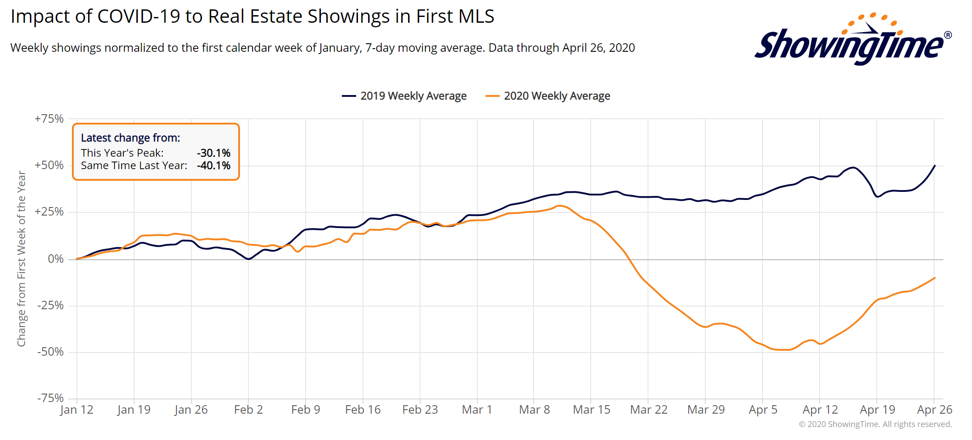
Notes:
PGR continues to grow our listing inventory market share. Our Advanced Property Marketing methodology and focused prospecting is making a difference.

Slide 26
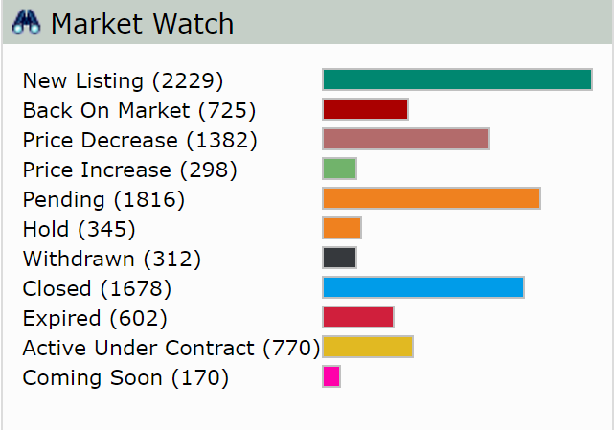
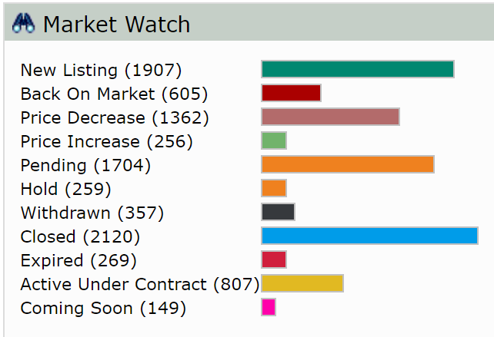
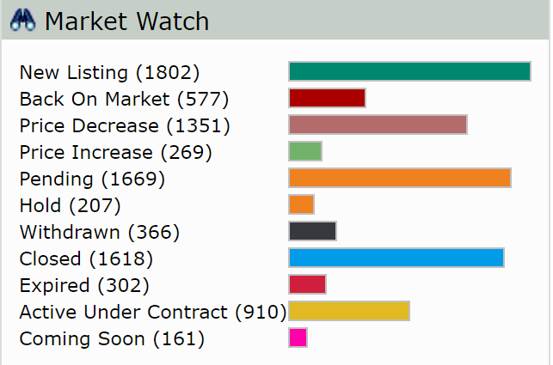
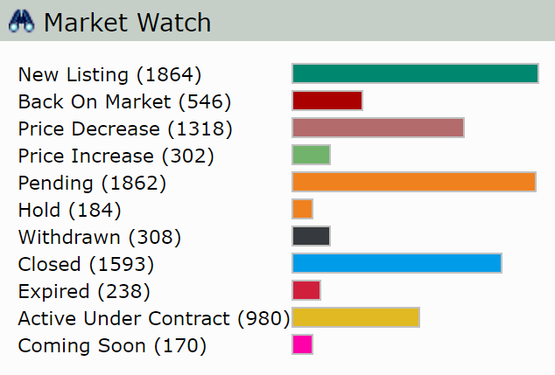
FMLS Summary – 1st 3 Weeks
Week of April 7
Week of April 14
Week of April 21
Last7 Days

Slide 27
Metro Atlanta – Through April 26th
 | Matrix | April Forecast | March Results | Variance | April 2019 Results | Variance
New Listings | 5,480 | 6,323 | 10,925 | -42.12% | 12,948 | -51.17%
Pending | 3,881 | 4,478 | 7,164 | -37.49% | 9,203 | -51.34%
Closed Summary | 3,941 | 4,547 | 7,741 | -41.26% | 8,052 | -43.53%
* April forecast assumes the last 4 days of the month perform at the average for the month.
Note: FMLS True-Ups For Prior Month Average 3-5% for Pendings and Closings.
Notes:
PGR continues to grow our listing inventory market share. Our Advanced Property Marketing methodology and focused prospecting is making a difference.

Slide 28
Metro Atlanta Brokerage Rankings

Slide 29
Annual Closed Volume – March 2020 FMLS Counties + Southern Crescent
($ Volume in Thousands)
Information Provided By Trendgraphix and BHHS Georgia Properties Internal Reports.
Notes:
In the past three years, our company has consistently grown our market share in both listing inventory and the sales of that inventory. Today, we are Ranked #1 in both categories.

Slide 30
Georgia Economic & Housing Trends

Slide 31
Top State For Business Site Selection Magazine
7 Years in a Row!
2019
2018
2017
2016
2015
2014
2013

Slide 32
Buyers Moving To Atlanta!
Here is the Top 10 List including previous rank:
Atlanta (1)
Phoenix (4)
Tampa/Sarasota (2)
Dallas/Fort Worth (3)
Orlando (5)
Denver (7)
Houston (8)
Seattle (6)
Las Vegas (10)
Chicago (9)
Penske Truck Rental published their latest moving destination list and Atlanta was ranked #1 for the 6th year in a row. The trend of moving to the sunbelt has returned. Desirable attributes that help Metro Atlanta include a business friendly environment, low cost of living for a metro area, airport, moderate weather with 4 seasons and a high quality of life.

Slide 33
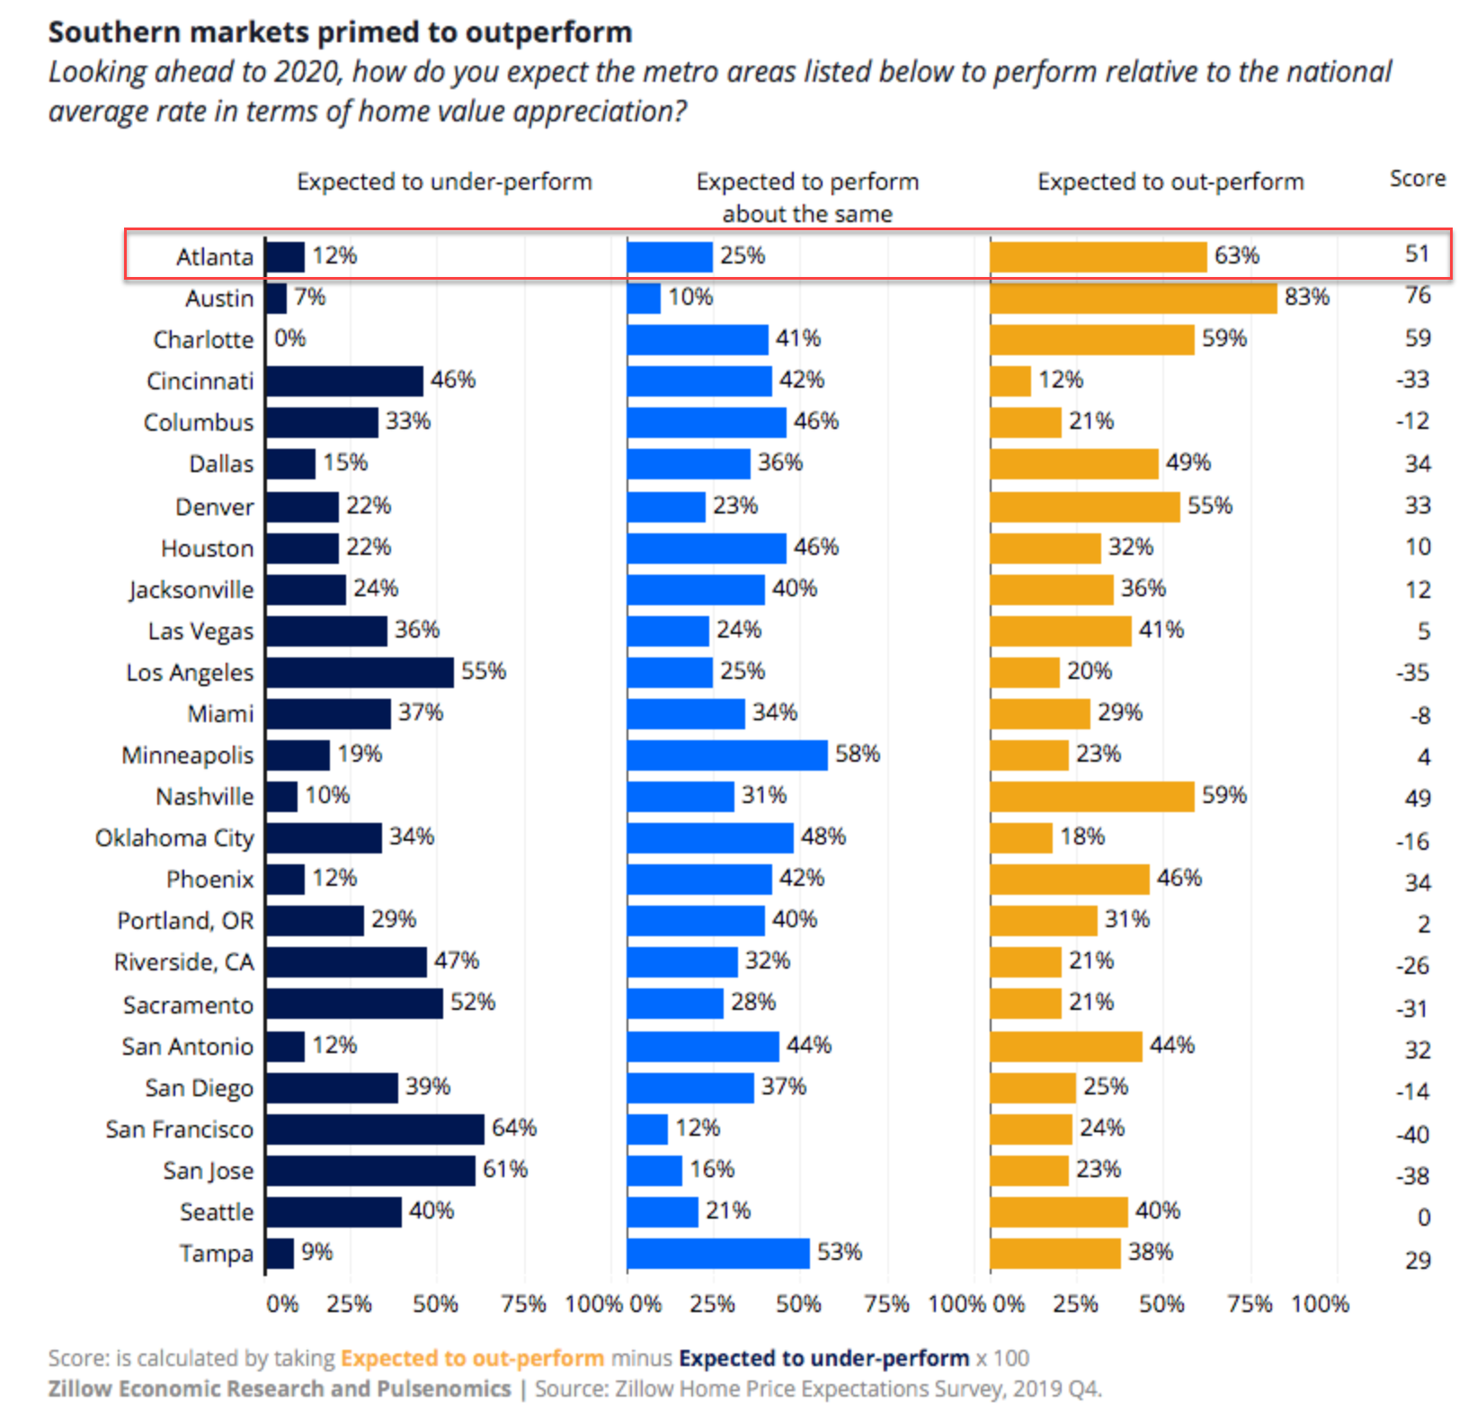
People Are Moving To Atlanta!

Slide 34
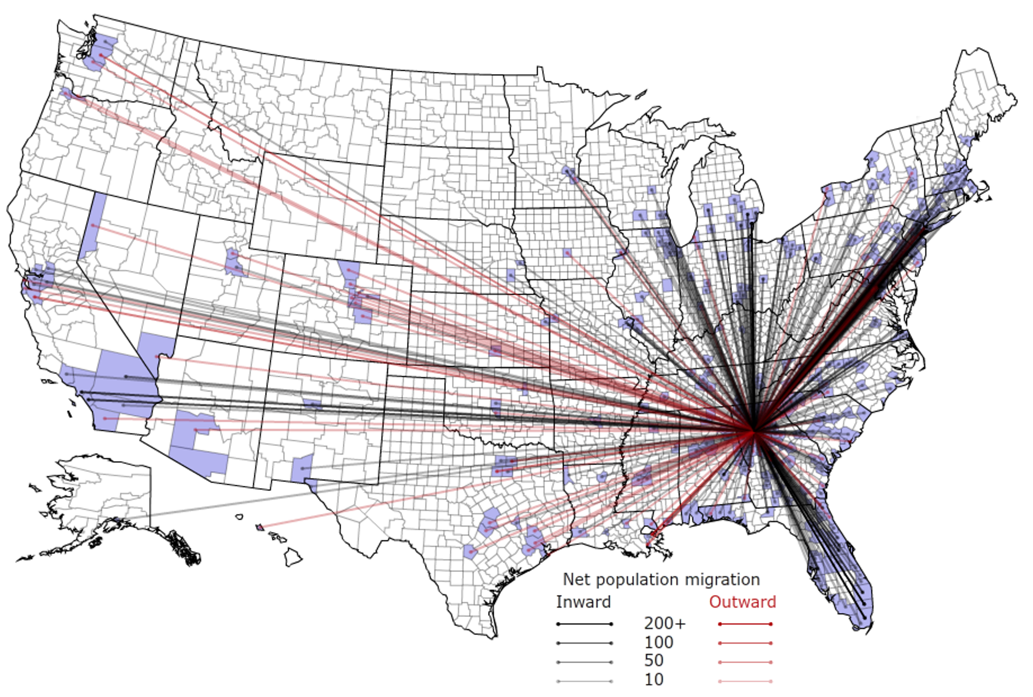
People Are Moving To Atlanta!

Slide 35
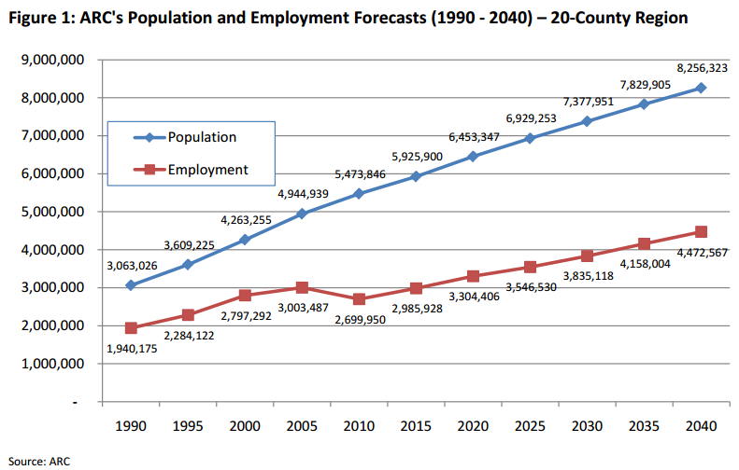
Population & Employment Growth Trends

Slide 36
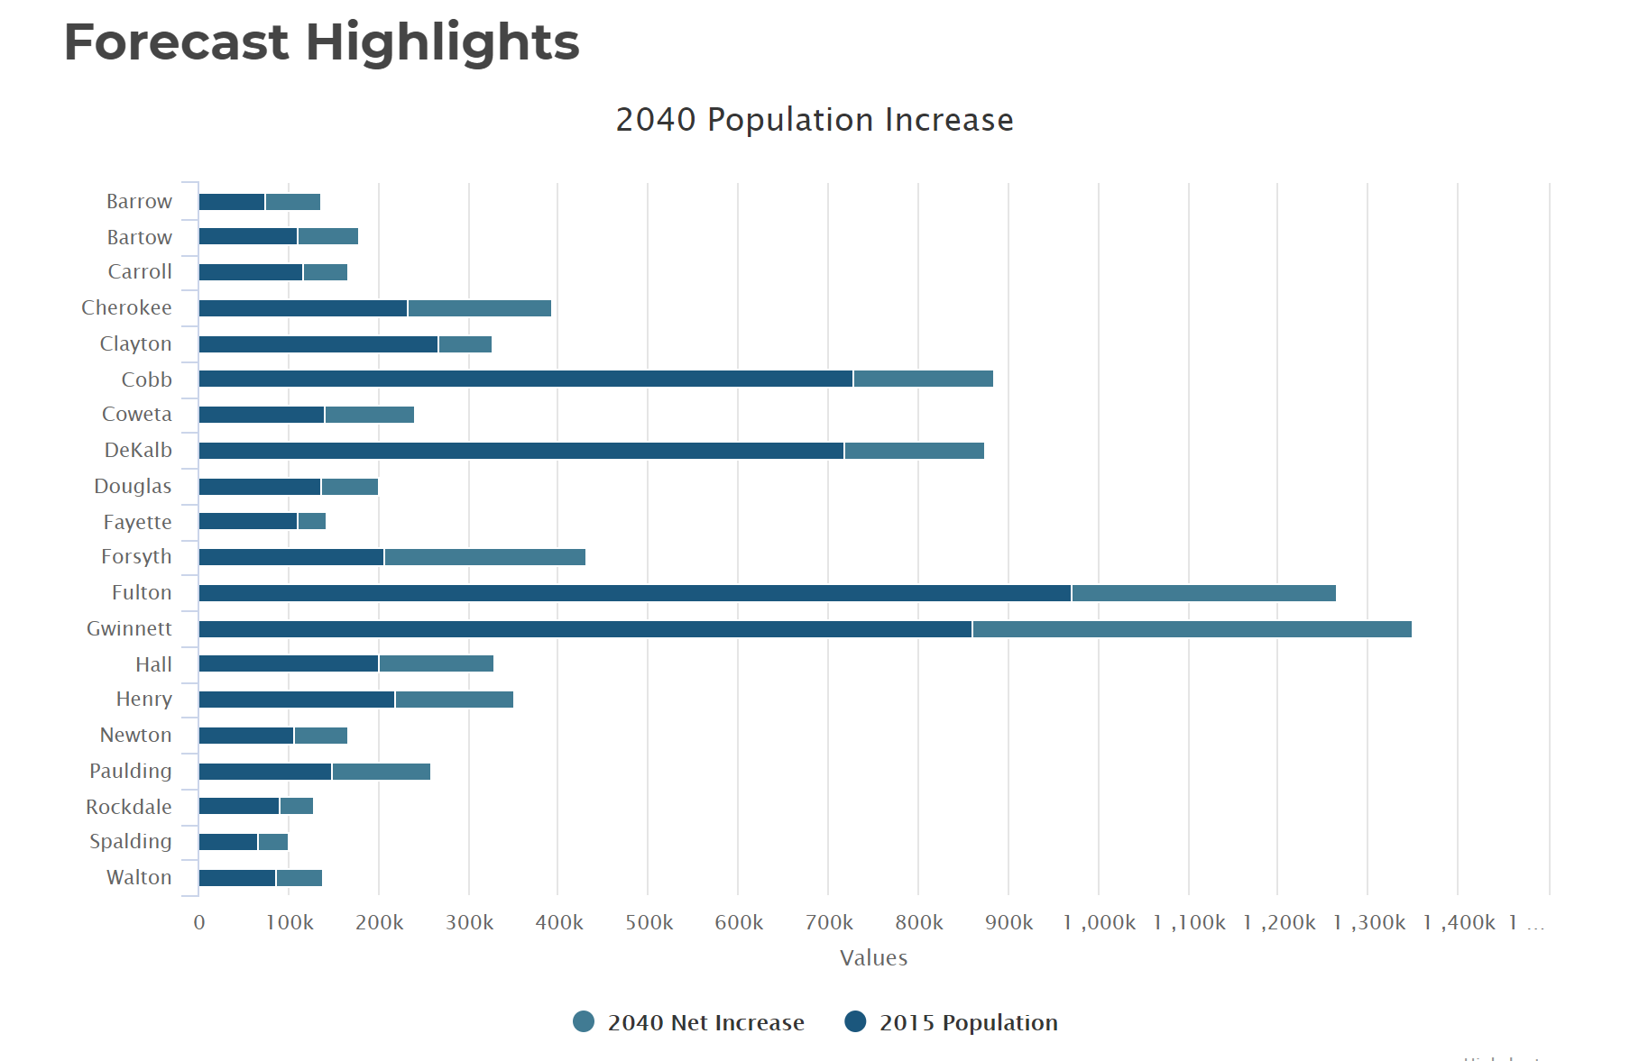
Population By County
Atlanta Regional Commission

Slide 37
Population & Employment Growth Trends
U.S. Conference of Mayors Report predicts that Metro Atlanta will be the 6th largest city in the nation by 2046.
Metro Atlanta will grow from 5.8 million residents to 8.6 million residents.
That means 2.8 million people will move to our area!
This is great news for our long-term real estate values!

