Slide 2
Agenda
Virtual Showings – Online
Virtual Showings – LIVE
Virtual Open Houses – LIVE
Virtual Caravans - LIVE
Socially Responsible and Innovative!

Slide 3
YouTube, Vimeo, Facebook, 3D Tours
Virtual Showing Links on Listing Detail Pages
New Virtual Showing Filtering Options

Slide 4
Best Practices for Virtual Online Showings
Plan ahead – Highlight the Story of the Property! Do not show things that “don’t matter or don’t flatter.”
Consider Video Length - Zillow WalkThrough (2 minutes), Zillow Video (up to 10 minutes)
Consider Branding – Branded Videos, Facebook Live, Zoom cannot be added as virtual tours in FMLS, MLS. Branded videos can be added to Reliance, Zillow, R.com, etc.

Slide 5
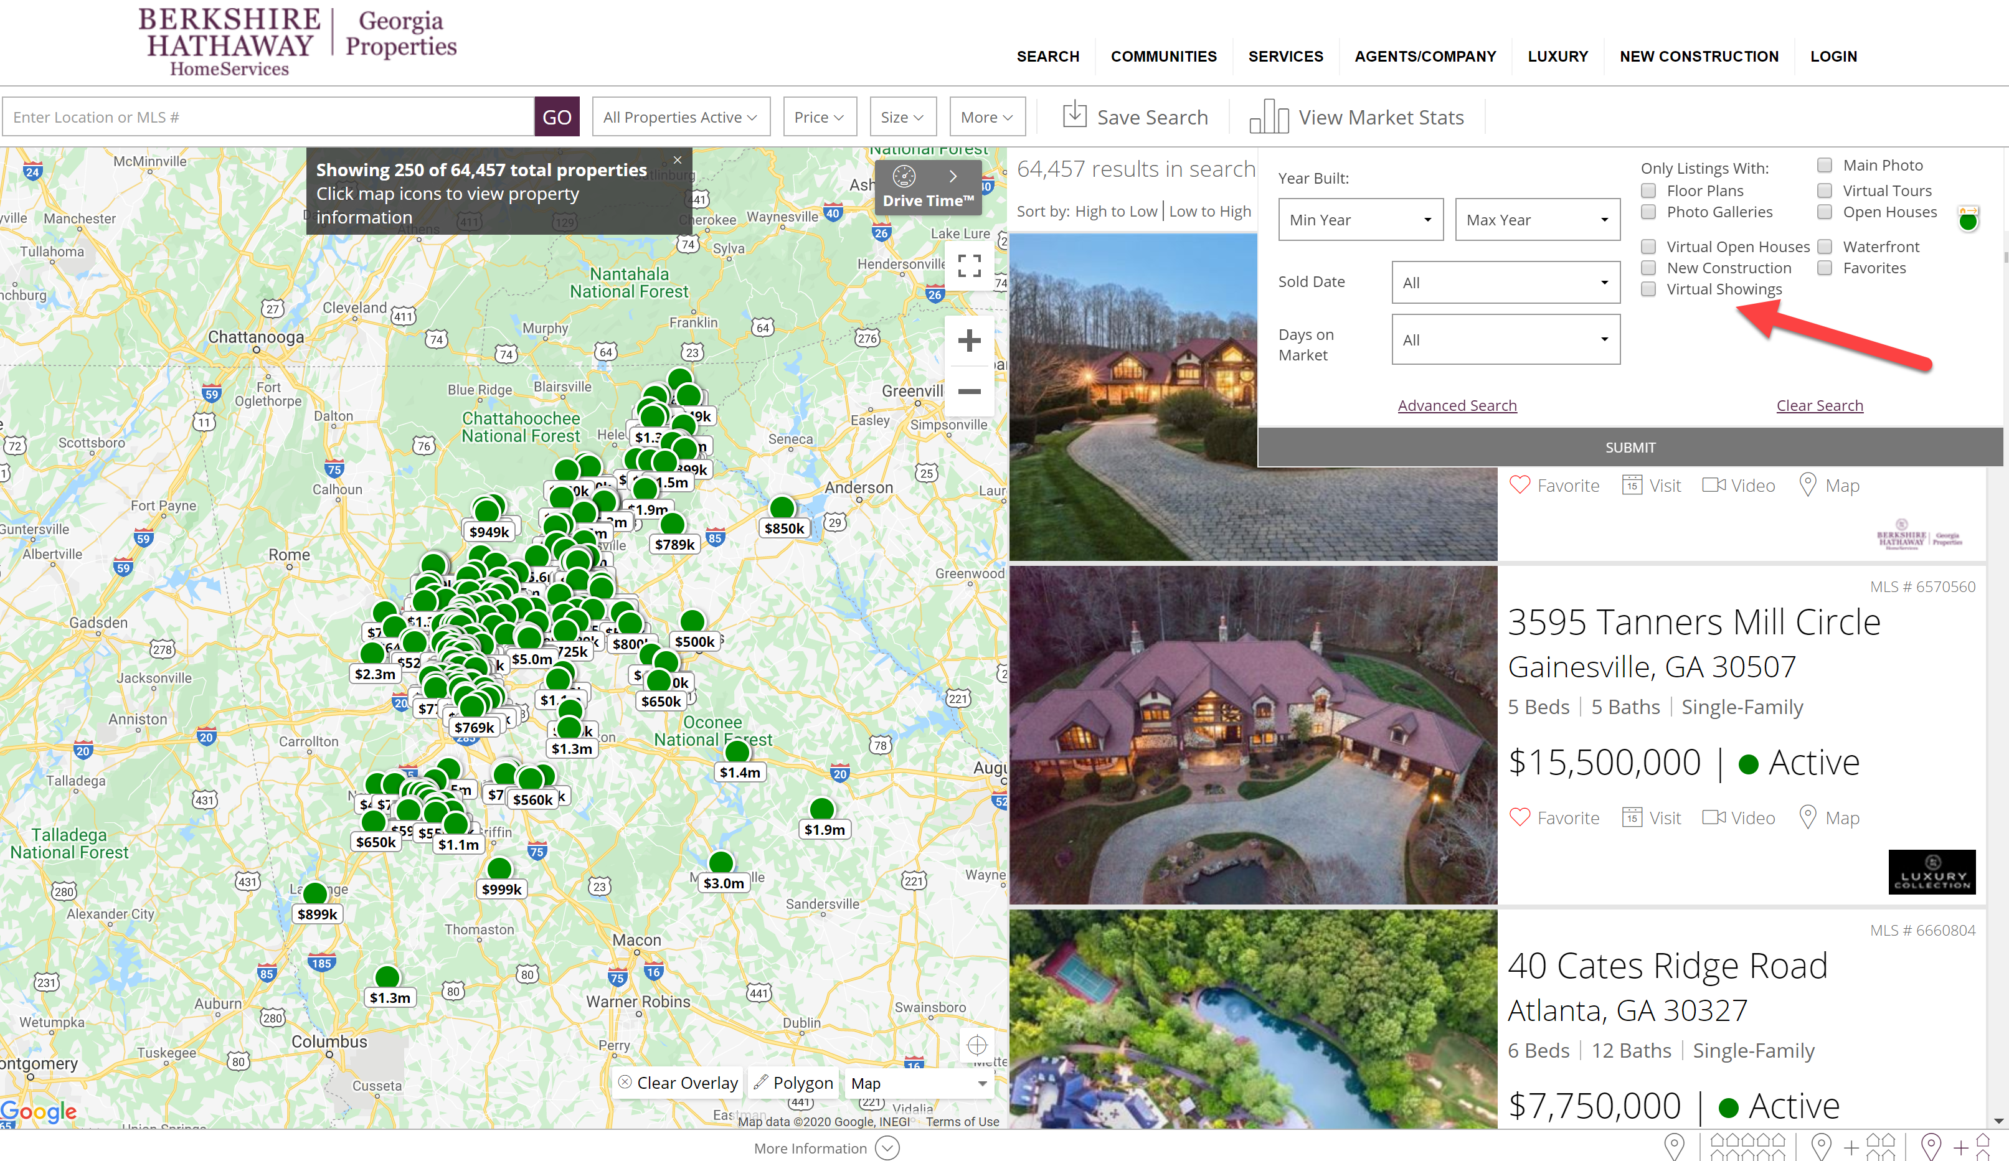

Slide 6
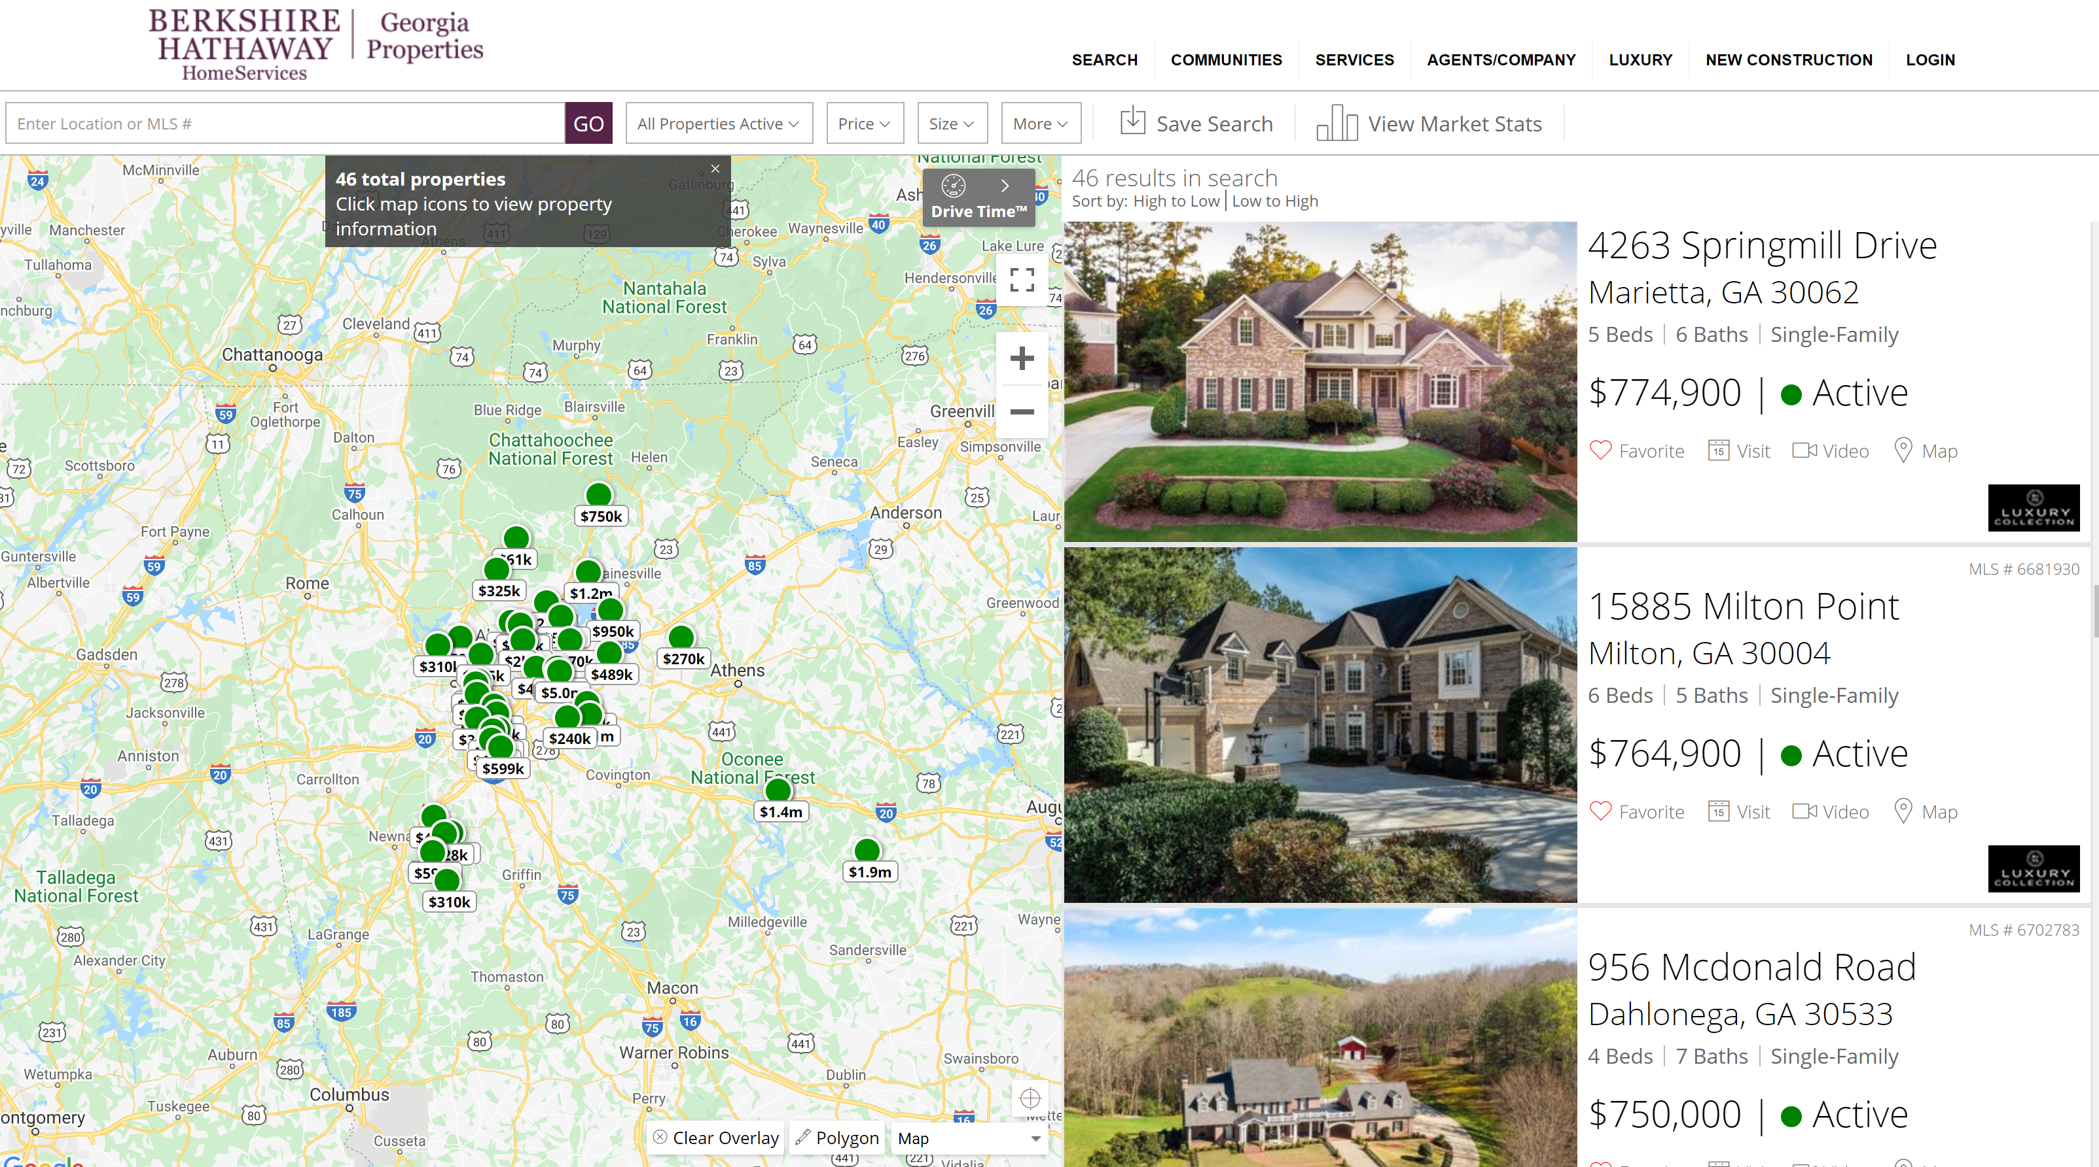

Slide 7
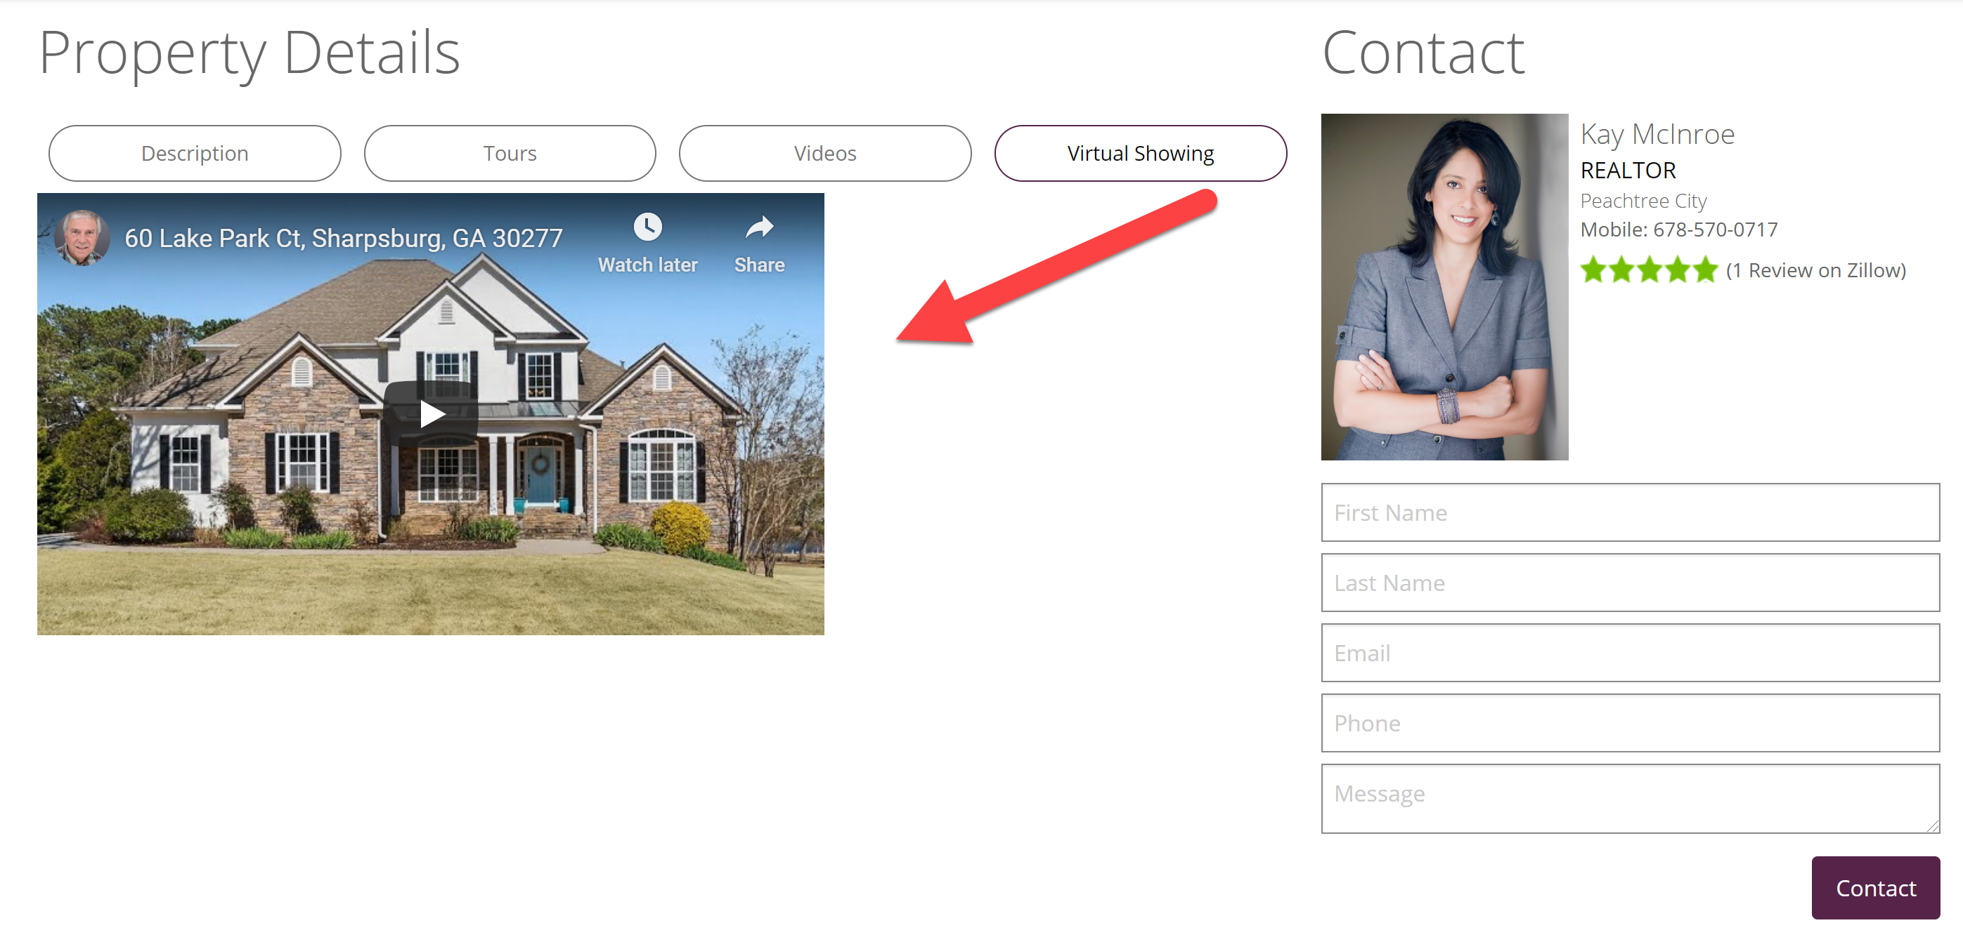

Slide 9
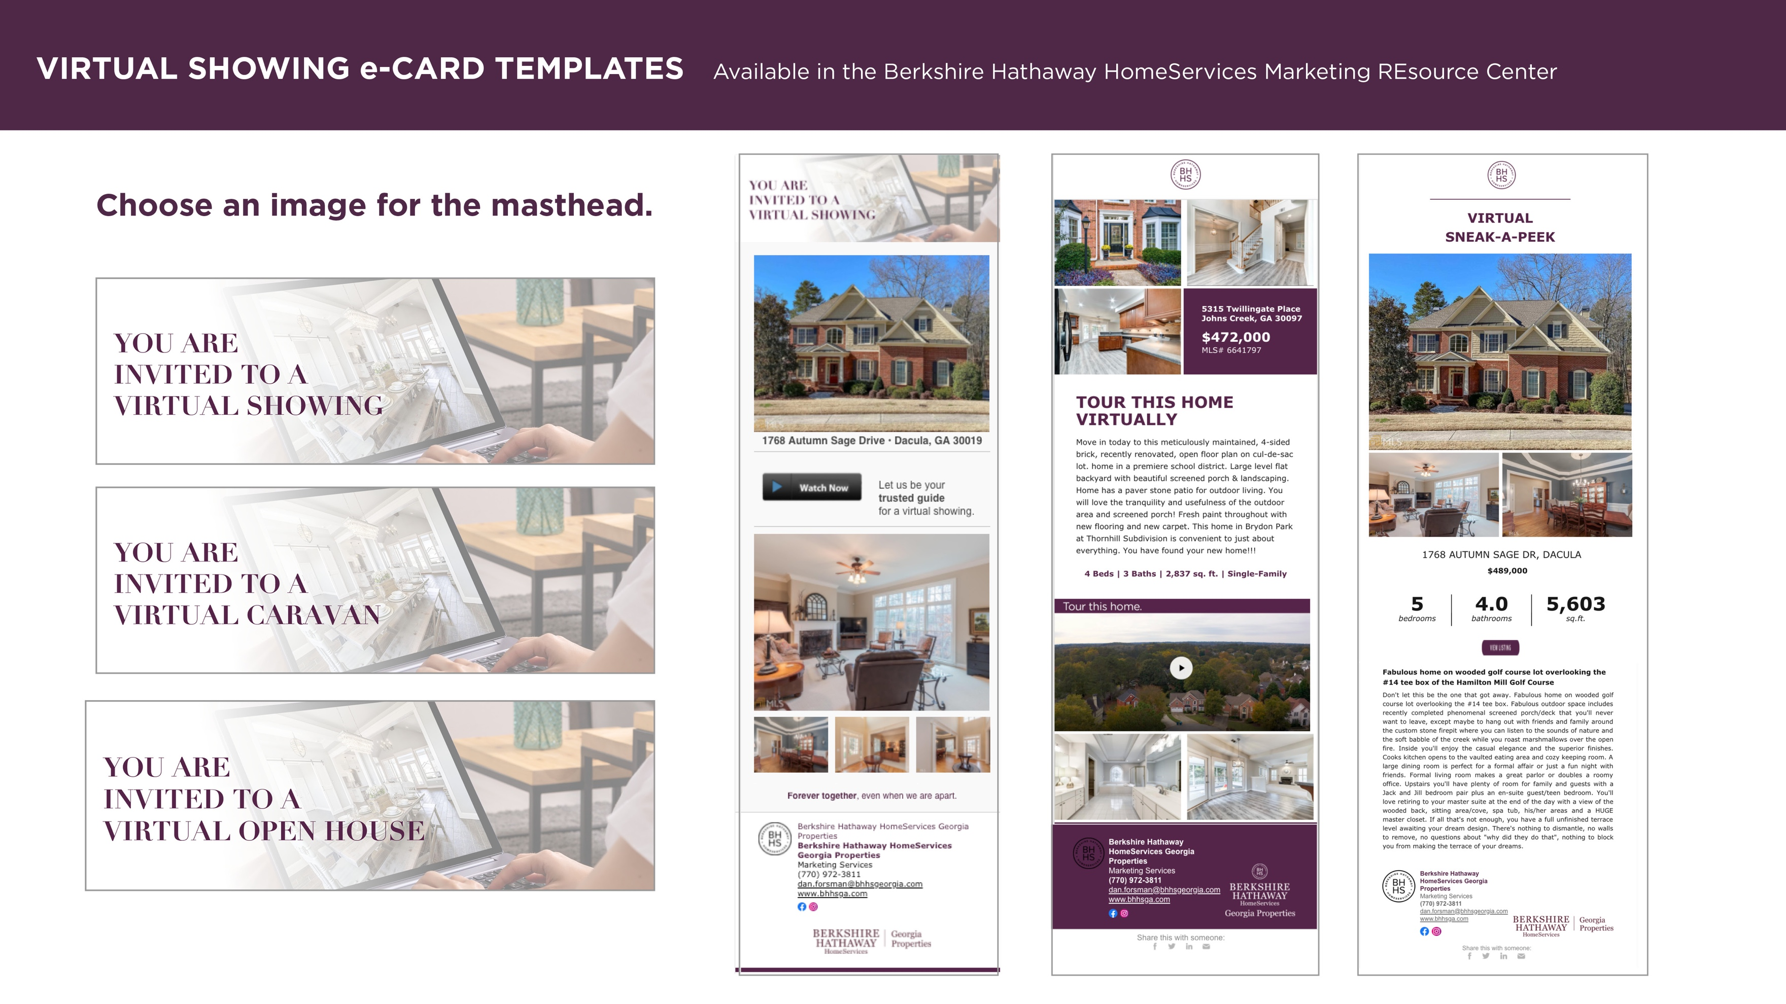

Slide 11
Best Practices for Virtual Open Houses
Plan ahead – Highlight the Story of the Property! Do not show things that “don’t matter or don’t flatter.”
Decide on Platform – Zoom, Facebook LIVE, Instagram LIVE, YouTube LIVE, Remine LIVE Streaming (Coming next week)
Consider Your Location/ Content – Your home and/ or seller’s home. PowerPoint Slides, MoxiPresent, MLS Listing Details, Website Listing Page/ Singe Property Website, Live Video at seller’s home. Caution: full motion video or 3D may not work well over Zoom (audio).

Slide 13
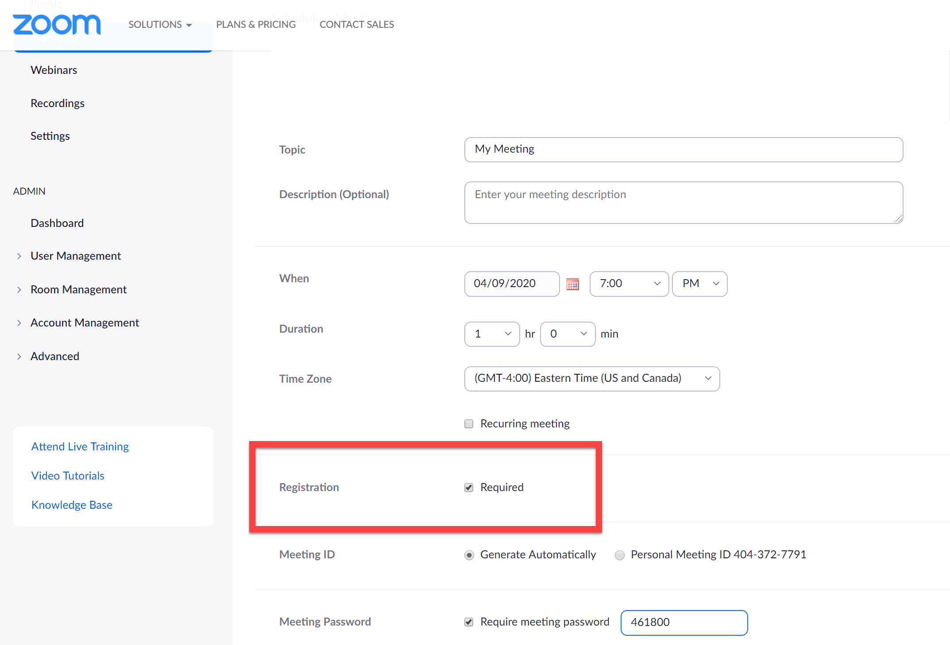
https://support.zoom.us/hc/en-us/articles/211579443-Registration-for-Meetings

Slide 14
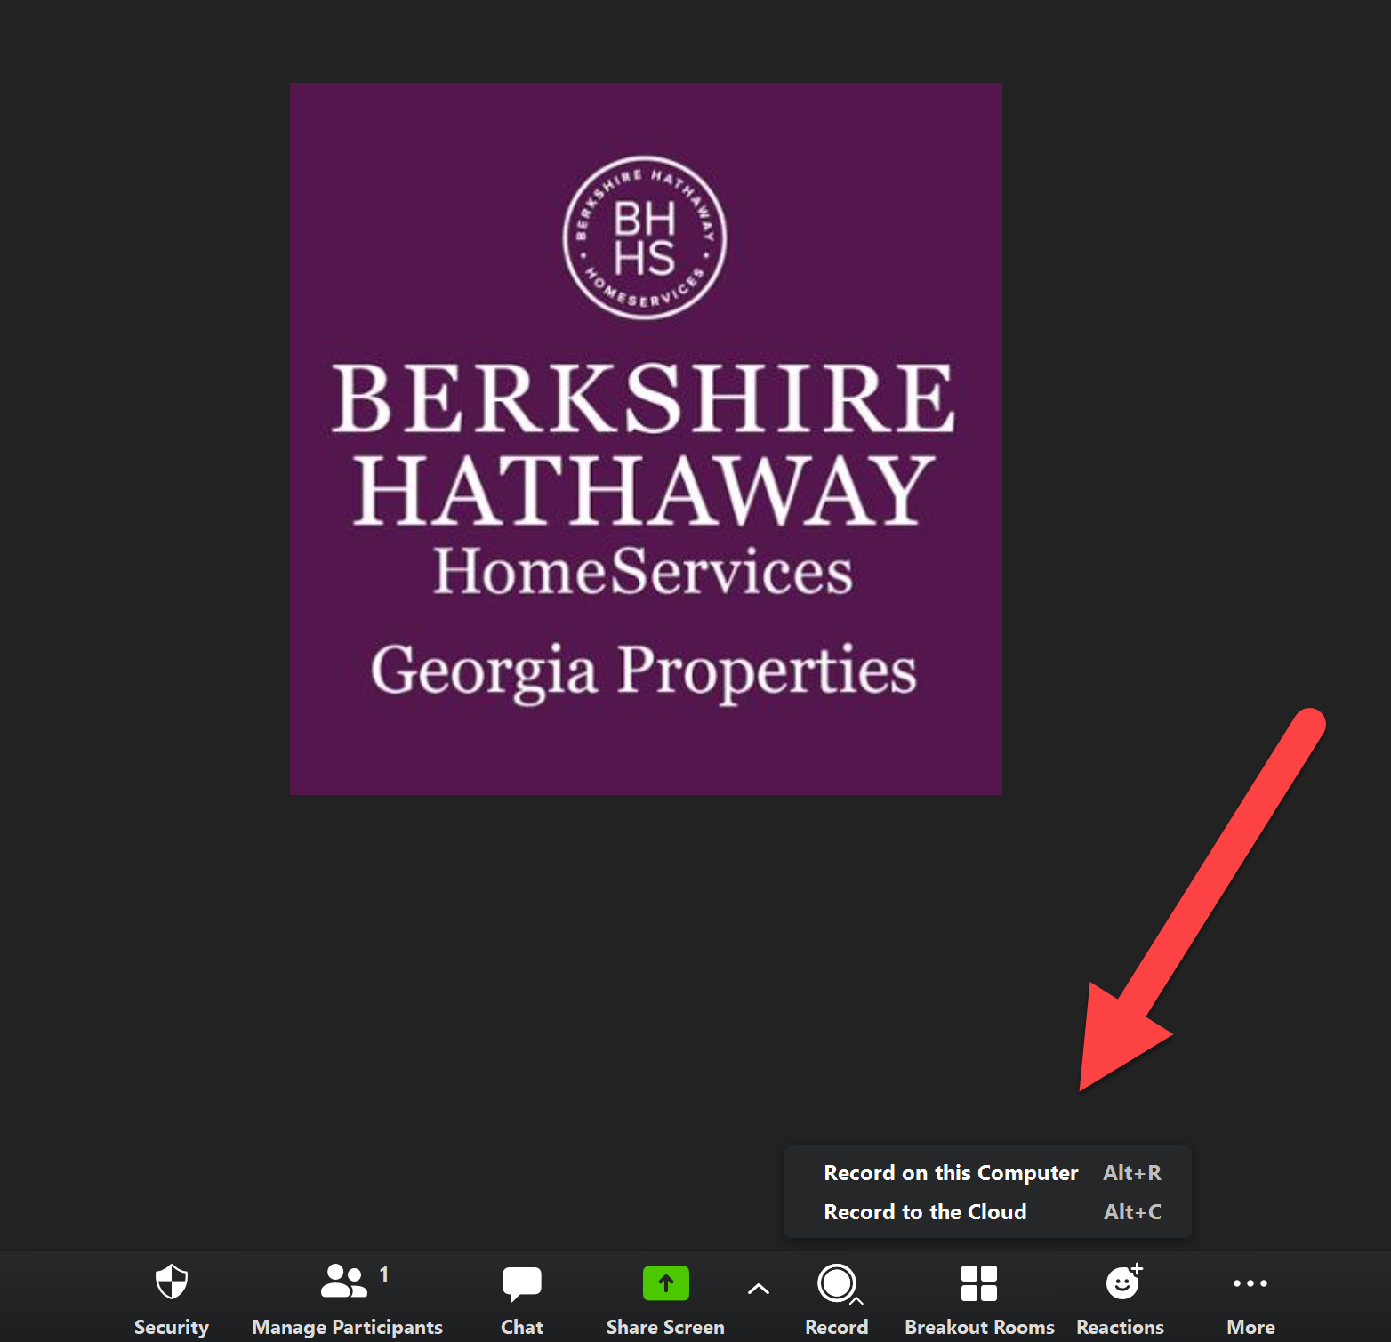

Slide 15
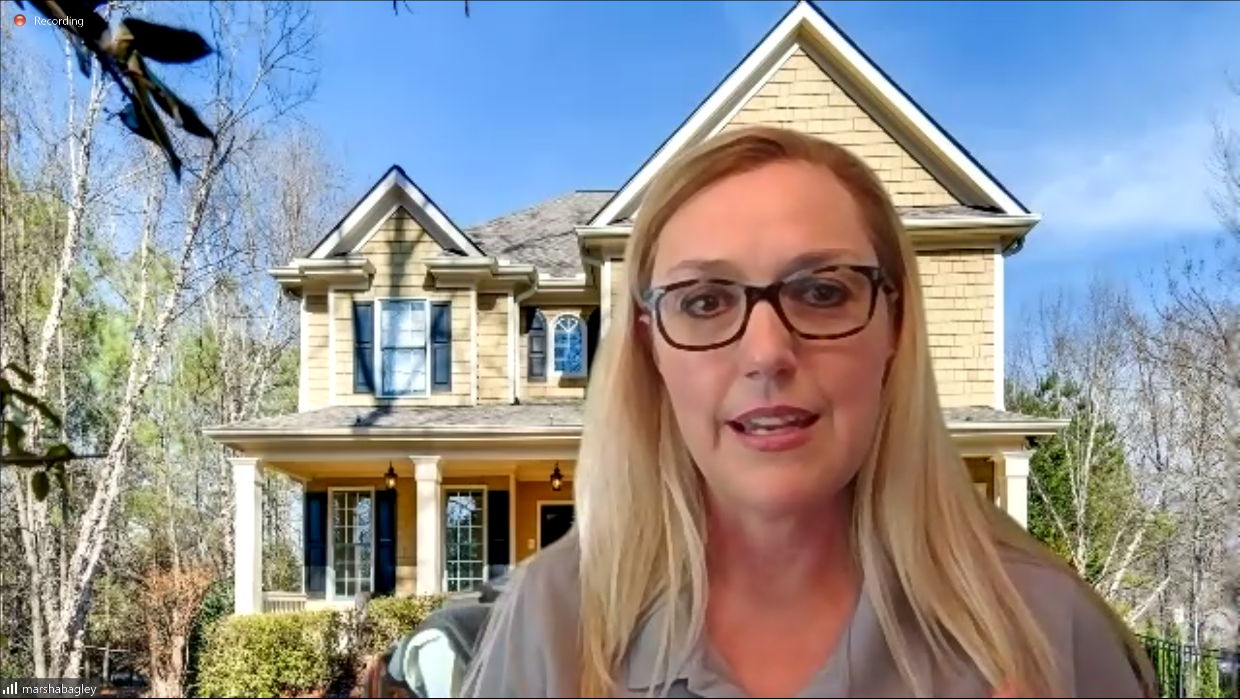
Great Job! Marsha Bagley and Lindsay Levin

Slide 17
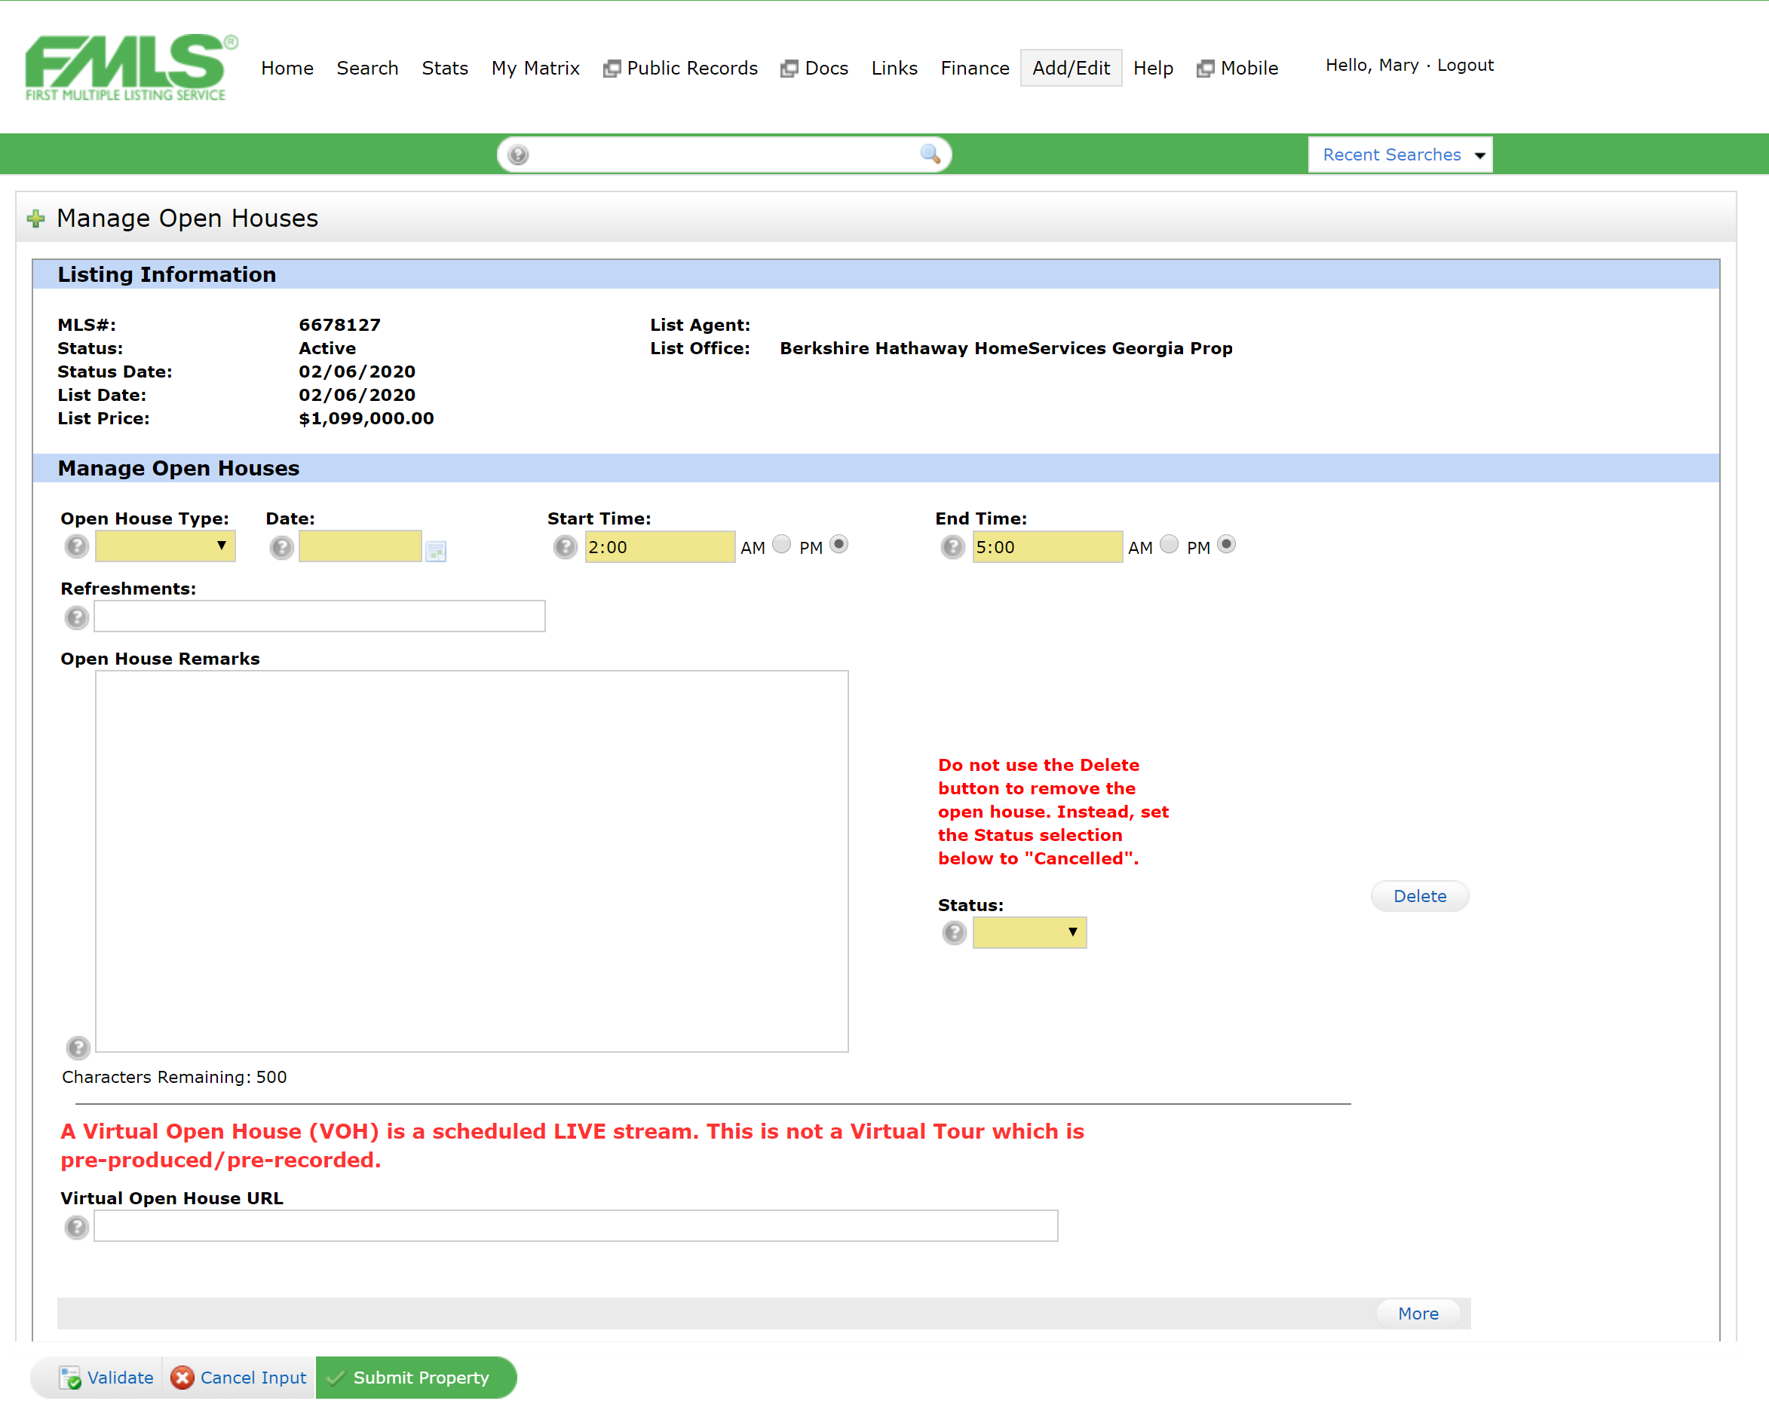
Virtual Open Houses/ Caravans Available In FMLS and Georgia MLS
Zoom, Facebook LIVE, IG LIVE, YouTube LIVE
VOH Syndication To Zillow, R.com, Reliance, HomeSpotter Mobile App

Slide 18
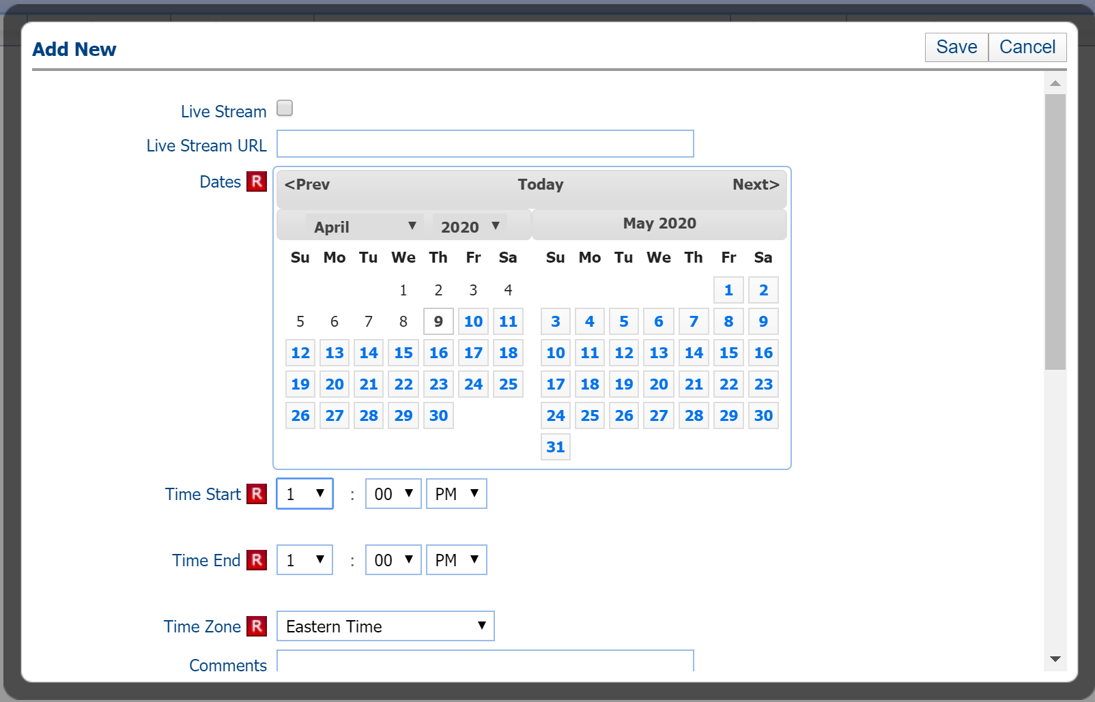

Slide 19
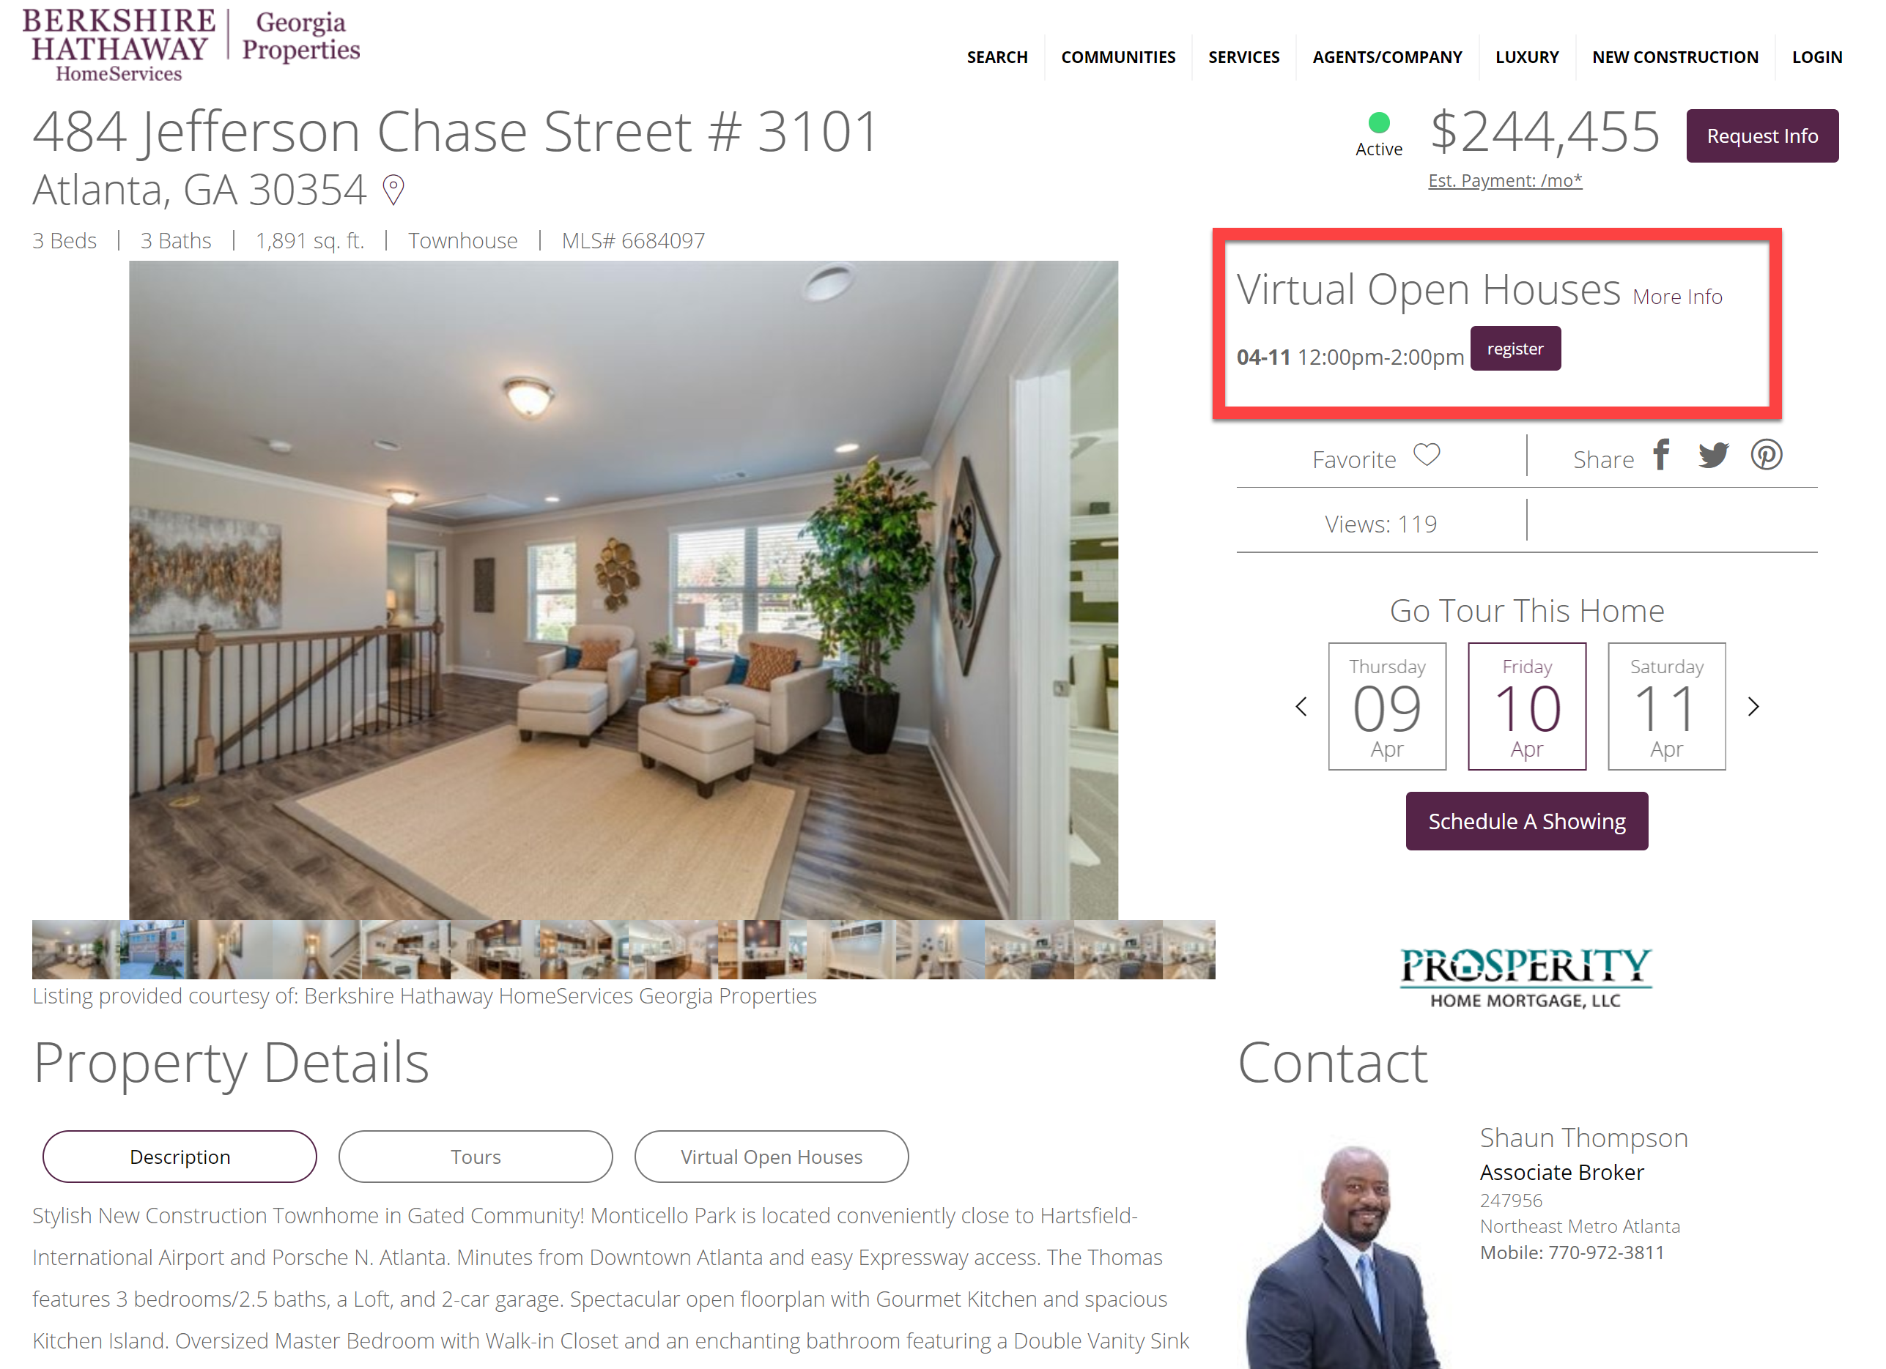

Slide 20
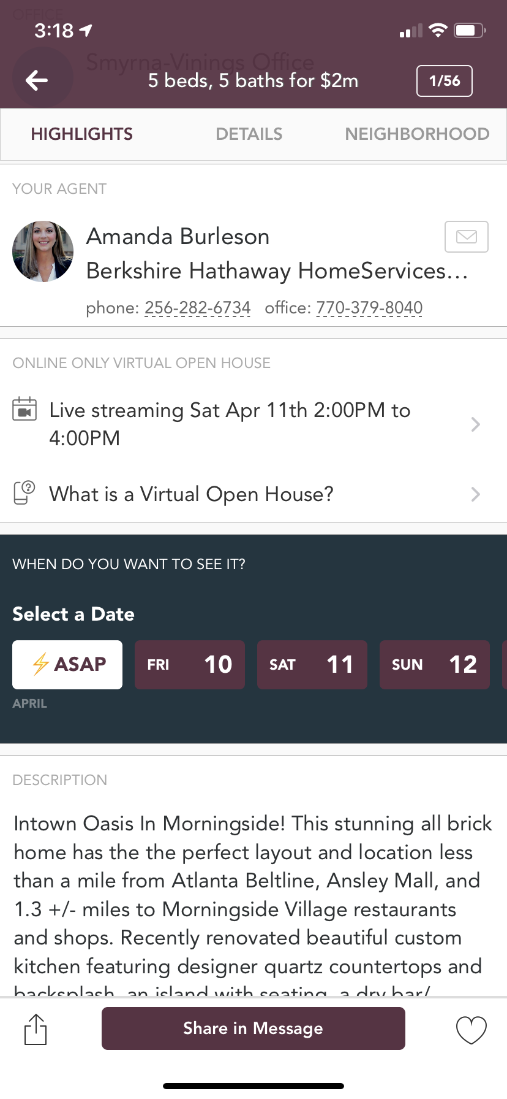
Virtual Open Houses Available on HomeSpotter Mobile App
Zoom, Facebook LIVE, IG LIVE, YouTube LIVE
New Filtering Option Next Week

Slide 21
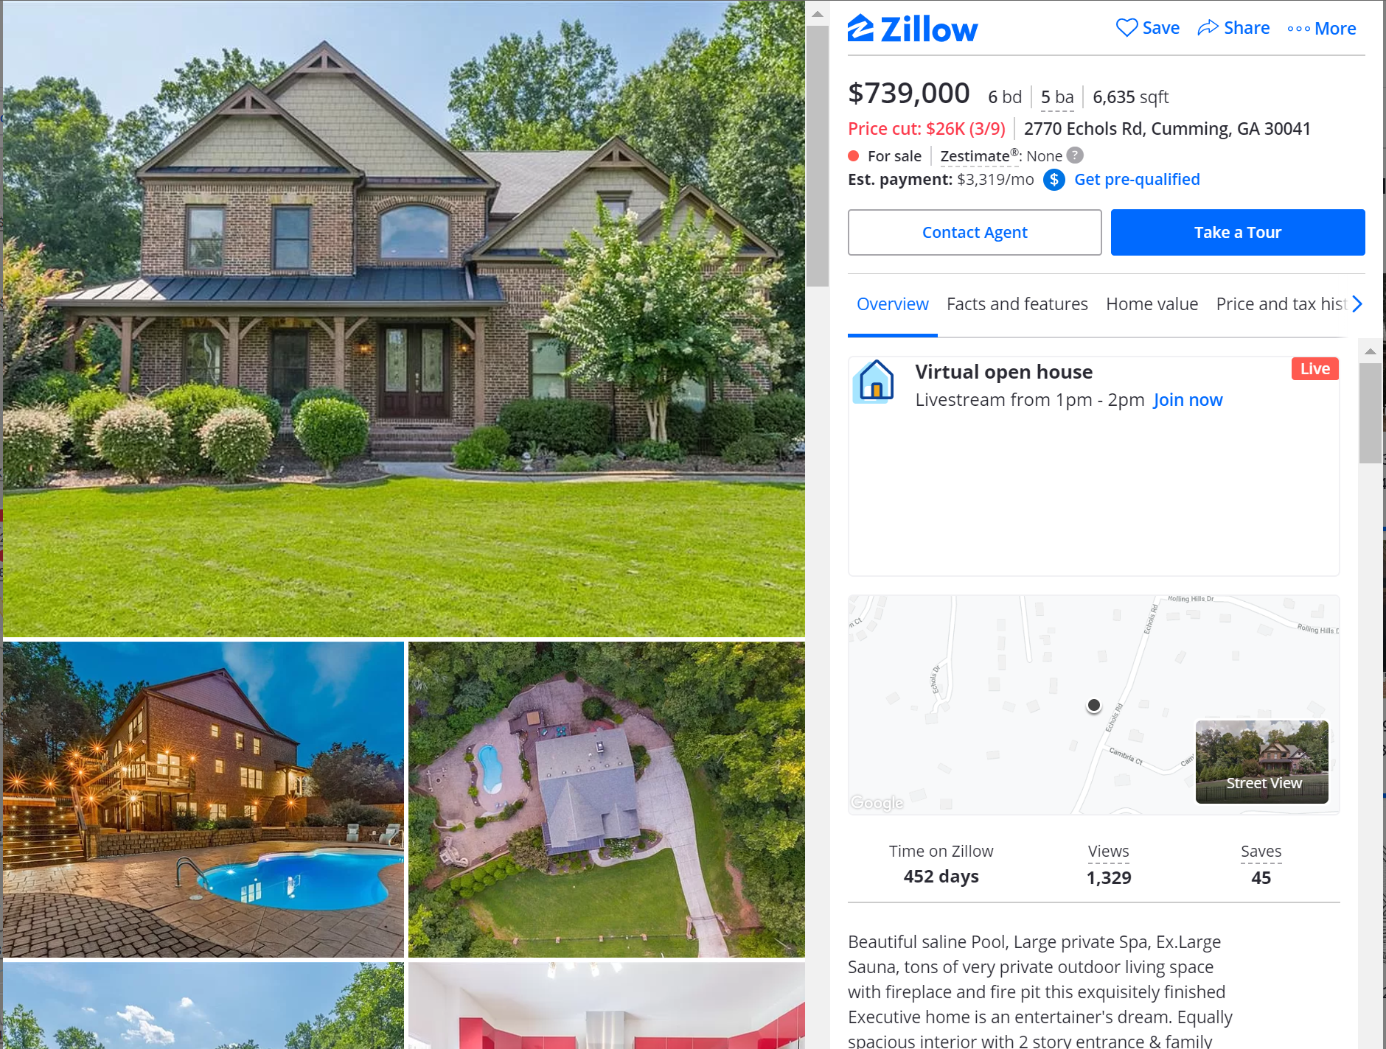

Slide 22
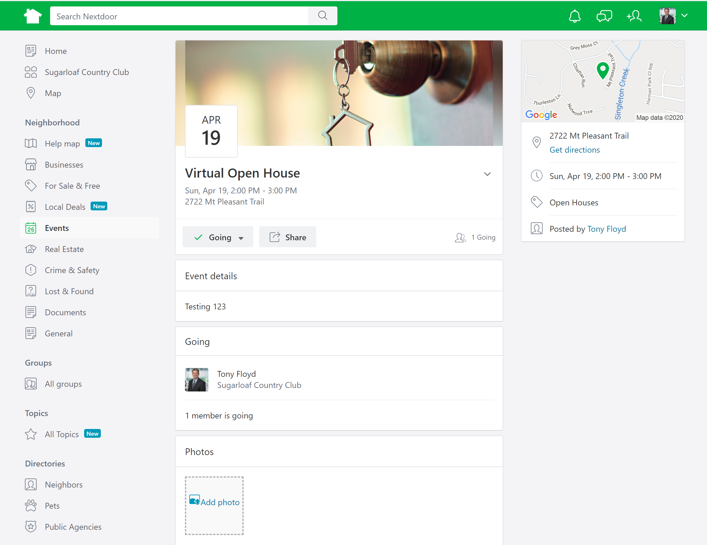
Nextdoor

Slide 23
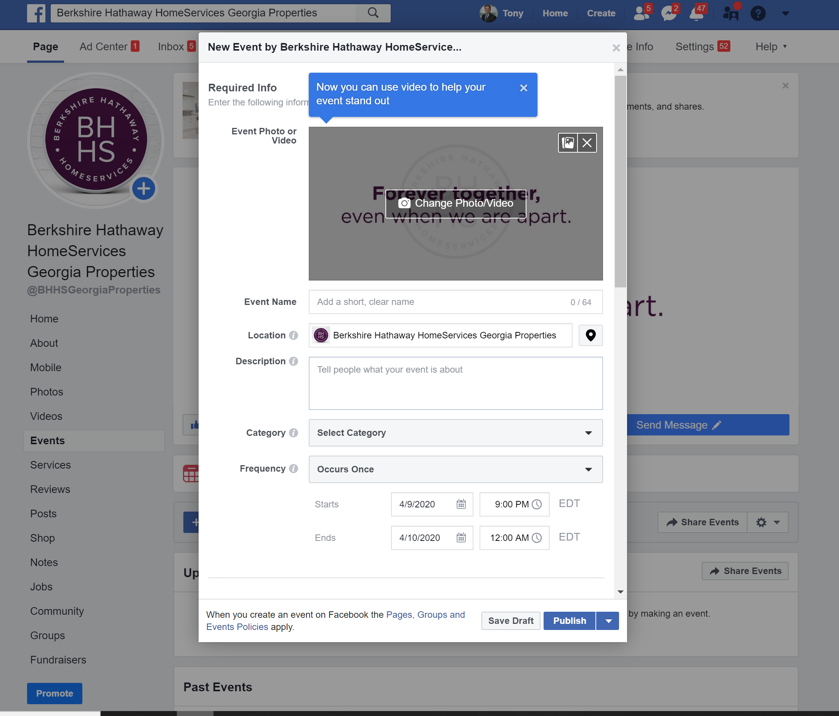

Slide 24
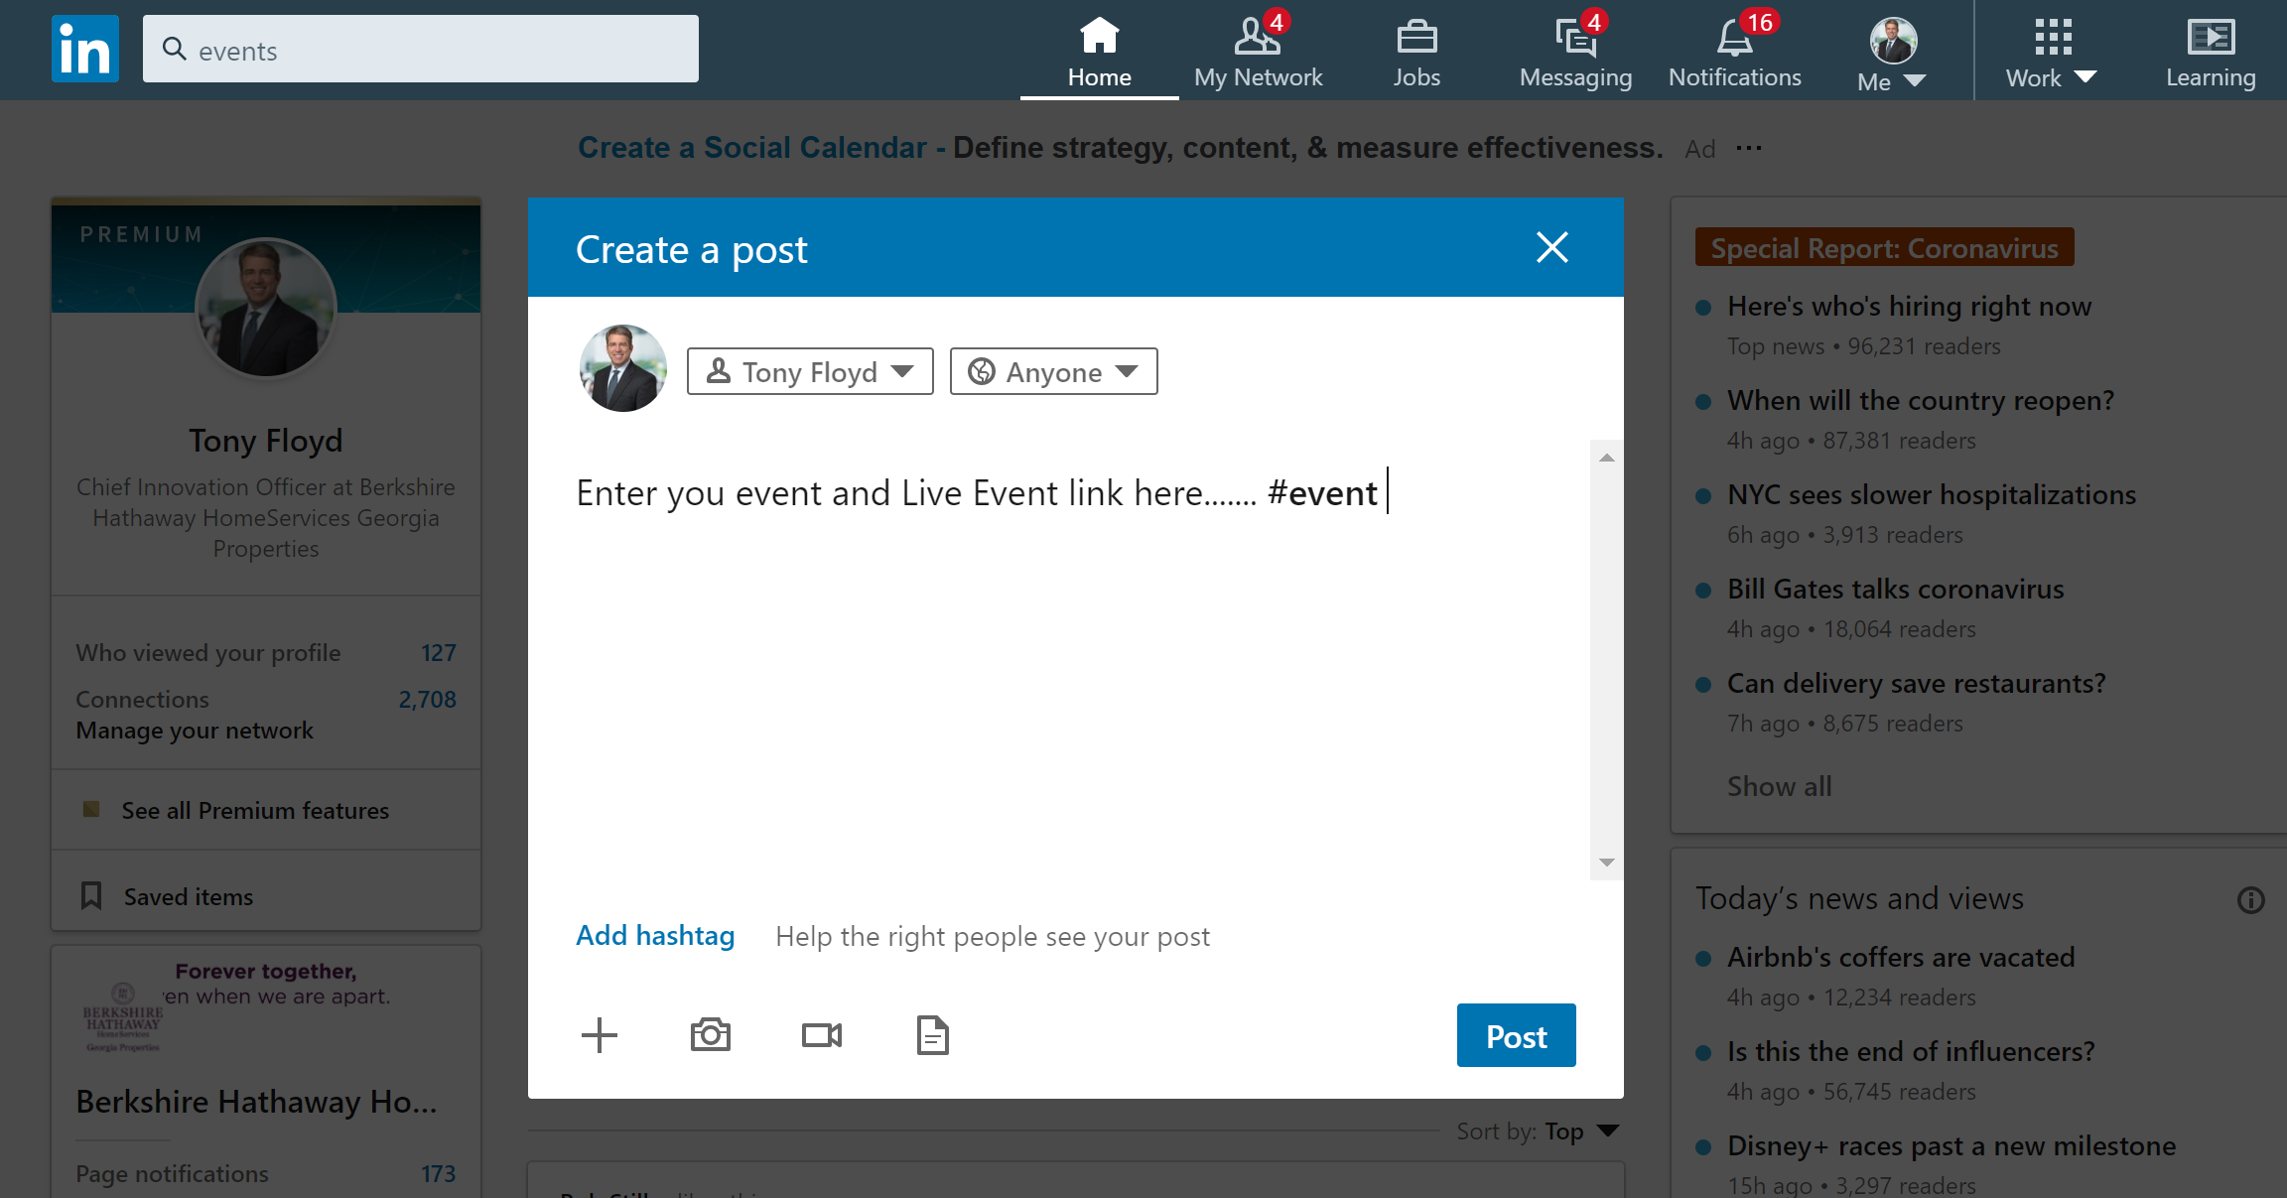

Slide 25
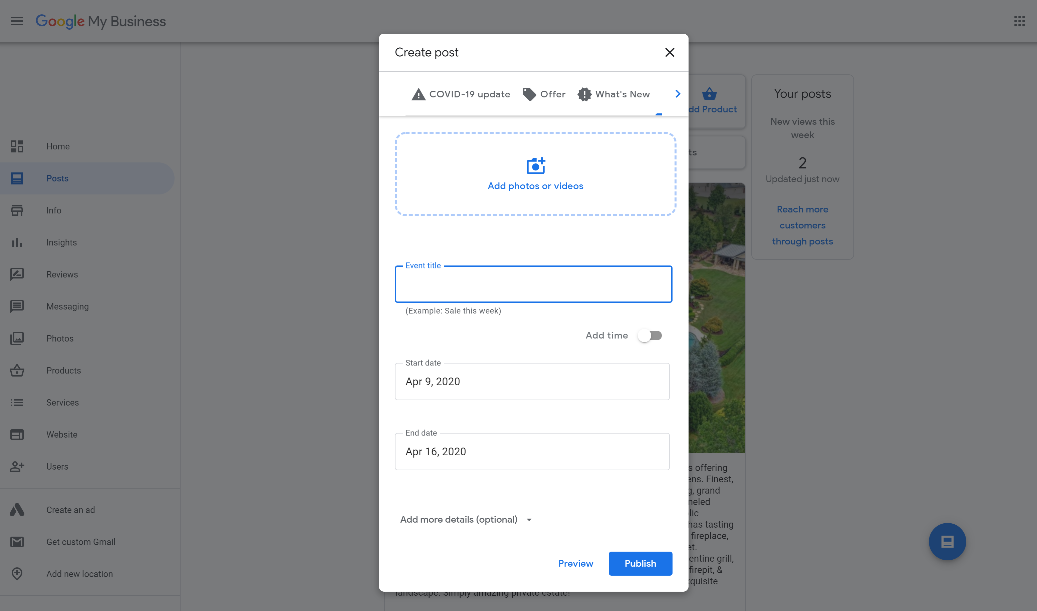

Slide 26
Best Practices for Virtual Caravans
Plan ahead – Highlight the Story of the Property! Do not show things that “don’t matter or don’t flatter.”
Consider Your Location/ Content – PowerPoint Slides, MoxiPresent, MLS Listing Details, Website Listing Detail Page, LIVE Zoom video on location.
Promotion – Enter in FMLS/ MLS, eFlyers, Text messages, Audio Messages with SlyBroadcast
Get Feedback After Each Property – Zoom Poll (requires paid version), Chat Responses, SurveyMonkey, ShowingSuite, other…

Slide 28
https://support.zoom.us/hc/en-us/categories/200101697
Training@BHHSGeorgia.com

