Slide 1
Comparisons To Prior Economic Downturns Or Recessions

Slide 2
Americans Choose Real Estate as Safest Investment
What do you believe is the safest
investment over the next 10 years?
(Top 5 Answers)
Porch.com

Slide 3
Average Economic Impact of
One Existing Home Sale in the U.S.
$43,099
Income generated from
real estate industries
Expenditures related to home purchase
Multiplier of housing related expenditures
$24,471
27.7%
of total impact
+
$4,650
5.3%
of total impact
+
$13,978
15.8%
of total impact
NAR calculated the total economic impact of real estate-related industries on the state economy, as well as the expenditures that result from a single home sale.
NAR
Notes:
https://www.nar.realtor/sites/default/files/documents/2019-state-economic-impact-of-real-estate-activity-us-04-14-2020.pdf
https://www.nar.realtor/reports/state-by-state-economic-impact-of-real-estate-activity

Slide 4
Average Economic Impact of
One New Home Sale in the U.S.
$88,416
Income generated from
real estate industries
Expenditures related to home purchase
Multiplier of housing related expenditures
New home construction
$24,471
27.7%
of total impact
+
$4,650
5.3%
of total impact
+
$13,978
15.8%
of total impact
+
$45,317
51.3%
of total impact
NAR calculated the total economic impact of real estate-related industries on the state economy, as well as the expenditures that result from a single home sale, including aspects like home construction costs, real estate brokerage, mortgage lending and title insurance.
NAR
Notes:
https://www.nar.realtor/sites/default/files/documents/2019-state-economic-impact-of-real-estate-activity-us-04-14-2020.pdf
https://www.nar.realtor/reports/state-by-state-economic-impact-of-real-estate-activity

Slide 5
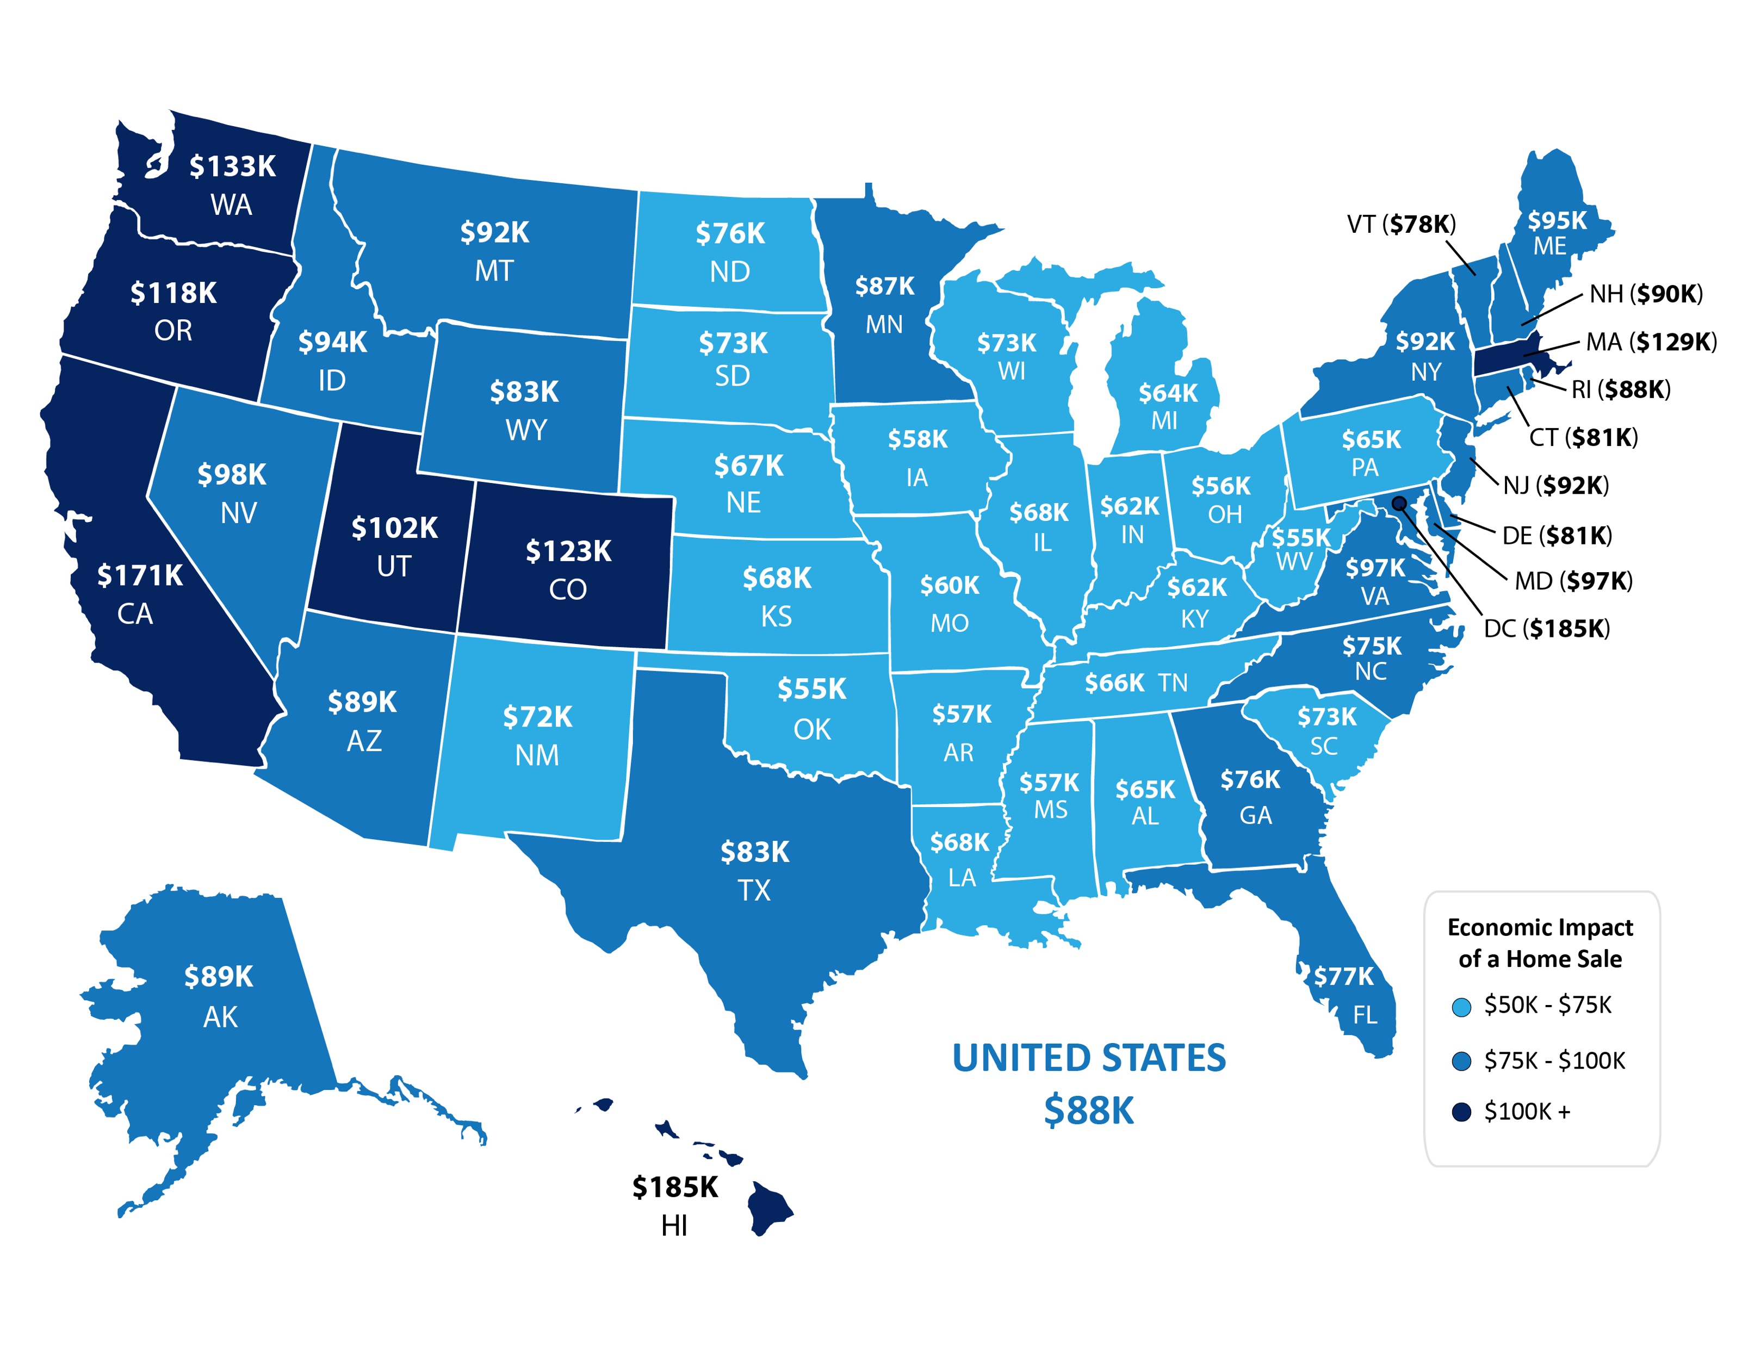
Average Economic Impact of One Home Sale by State
NAR
Notes:
https://www.nar.realtor/sites/default/files/documents/2019-state-economic-impact-of-real-estate-activity-us-04-14-2020.pdf
https://www.nar.realtor/reports/state-by-state-economic-impact-of-real-estate-activity

Slide 6
U.S. Homeownership % Rates
Q1 Results
Census
Notes:
https://www.census.gov/housing/hvs/files/currenthvspress.pdf

Slide 7
Homeownership Rates
U.S. Percentage Last 4 Quarters
Census
Notes:
https://www.census.gov/housing/hvs/files/currenthvspress.pdf

Slide 8
1.) When is the economy going to recover?
2.) Are we going into a recession?
3.) Is this going to be like 2008?
4.) What about all those job losses?
5.) What should I do right now?
Be smart…be patient…but most of all – Stay Safe

Slide 9
A Recession Is Coming.
Recession DOES NOT
Equal Housing Crisis.
This Is NOT Like The Last Time!

Slide 10
1991
2008
HOME PRICE CHANGE
During Last 5 Recessions
CoreLogic
Notes:
https://www.corelogic.com/blog/2019/03/housing-recessions-and-recoveries.aspx

Slide 11
Annual Home Price Appreciation
The 6 years leading up
to the housing crash
The last 6 years
Black Knight
Notes:
https://www.blackknightinc.com/black-knights-december-2019-mortgage-monitor-2/

Slide 12
Total Home Equity Cashed Out
by Refinance in Billions
Then…
Now…
Year | Dollars
2005 | $263B
2006 | $321B
2007 | $240B
Total | $824B
Year | Dollars
2017 | $71B
2018 | $87B
2019 | $74B*
Total | $232B
*Using the first 3 quarter estimates from Freddie Mac and estimating $20B for the 4th quarter
Freddie Mac
Notes:
http://www.freddiemac.com/research/datasets/refinance-stats/index.page

Slide 13
Percentage of
Homeowner
Equity 2020
John Burns Consulting
Notes:
https://www.realestateconsulting.com

Slide 14
of all homes in America have at least 60% equity
58.7%
Americans are sitting on tremendous equity
42%
of all homes are owned
‘free and clear’
$177,000
is the average equity of mortgaged homes
John Burns Consulting
CoreLogic
Notes:
https://www.realestateconsulting.com
https://www.corelogic.com/insights-download/loan-performance-insights-report.aspx

Slide 16
Housing Bubble 2006: 868.7
MORTGAGE CREDIT AVAILABILITY INDEX
The taller the graph, the
easier it is to get a loan
Today:
181.3
MBA
Notes:
https://www.mba.org/news-research-and-resources/newsroom
https://www.mba.org/news-research-and-resources/research-and-economics/single-family-research/mortgage-credit-availability-index

Slide 17
Months Inventory of Homes for Sale
NAR
Notes:
nar.realtor

Slide 18
What About The Impact of Unemployment?
Will Job Loss Have A Significant Impact On Real Estate?

Slide 19
Unemployment Rates and Home Sales
DO NOT Have a Direct Relationship
3
1
Existing Home Sales (Bars)
Unemployment Rate (Line)
2
4
U.S. Bureau of Labor Statistics, NAR
Notes:
https://www.nar.realtor/research-and-statistics/housing-statistics/existing-home-sales
https://data.bls.gov/timeseries/LNU04000000?years_option=all_years&periods_option=specific_periods&periods=Annual+Data
https://data.bls.gov/timeseries/LNS14000000

Slide 20
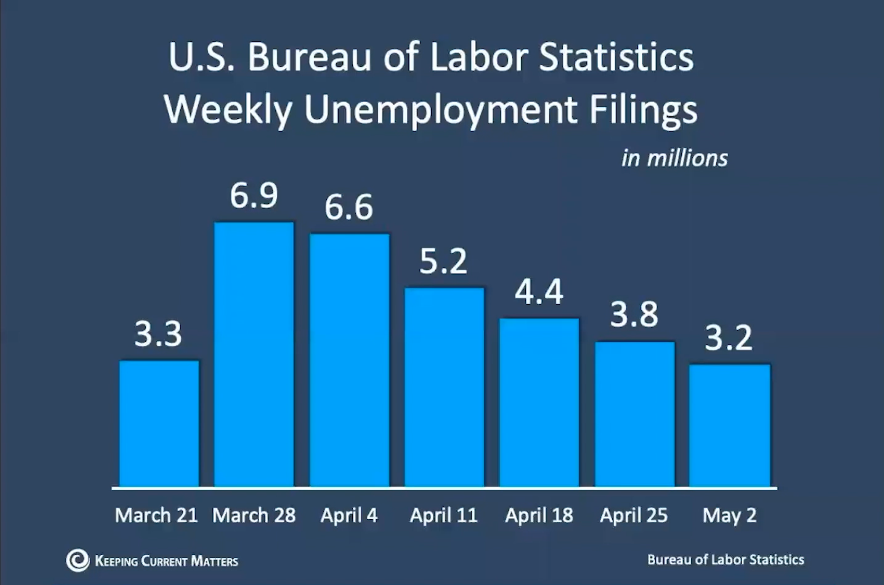
Estimated 33.5 Million Unemployment Filings

Slide 21
2020 Unemployment Rate Forecast
Bureau of Labor Statistics

Slide 22
When is the economy going to recover?

Slide 23
Breakdown of U.S. Bureau of Labor Statistics
April 3, 2020 Unemployment Report
Accommodation Industry
Other
Retail Trade (Stores)
Temporary Help Services
Food Services and Drinking Places
(Servers and Bartenders)
Child Day Care Workers
Health Care Office Workers
Construction Workers
Job loss will be significant but will not last as long. High % of workers can return to jobs quickly.
Notes:
https://www.bls.gov/news.release/empsit.nr0.htm

Slide 25
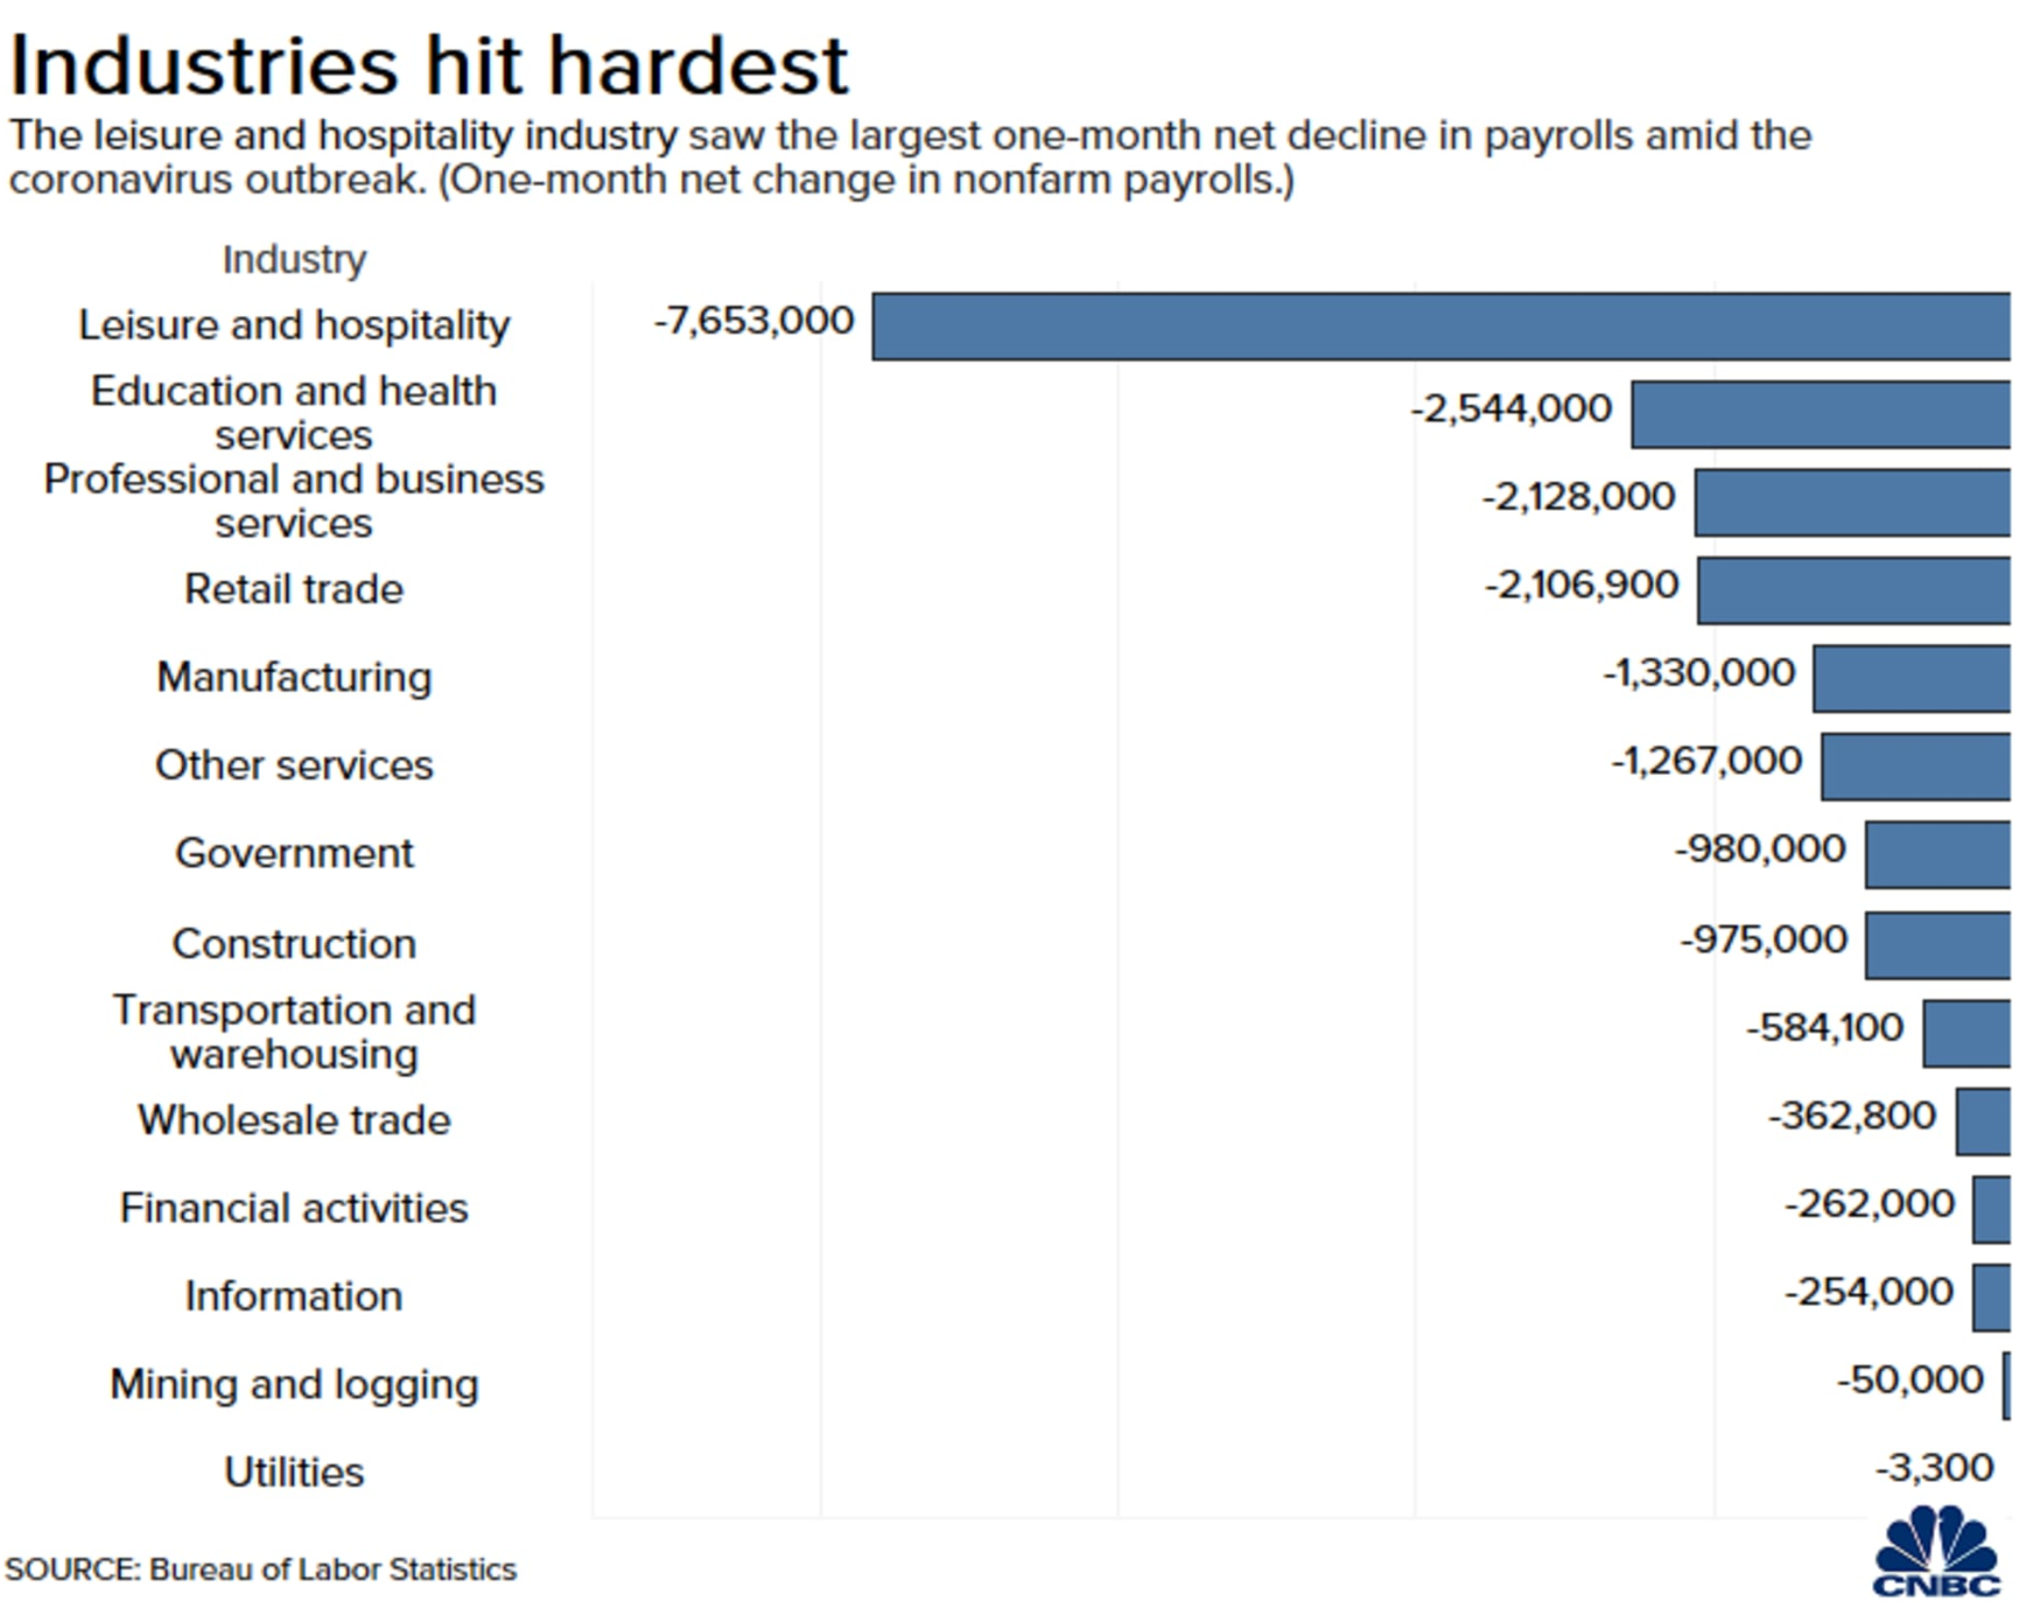

Slide 26
Unemployment Rates
Breakdown of U.S. Bureau
of Labor Statistics 5/8/2020
Unemployment Report Covering Up Until 4/12
78% Furloughed Versus Laid Off. Most Will Return To Jobs
Notes:
https://www.bls.gov/news.release/empsit.nr0.htm

Slide 27
More Depth, Less Length
2nd
Year
9th
Year
12th
Year
Years for unemployment rate to return to pre-crisis level
Notes:
www.thebalance.com/unemployment-rate-by-year-3305506
What about unemployment and the housing market

Slide 28
“V” Shaped Recovery
“U” Shaped Recovery
“L” Shaped Recovery

Slide 29
Notes:
https://www.calculatedriskblog.com/2020/03/the-economic-outlook.html
https://markets.businessinsider.com/news/stocks/us-recession-coronavirus-gdp-plunge-2q-forecast-economy-morgan-stanley-2020-3-1029023137
https://www.foxbusiness.com/markets/coronavirus-gdp-impact-bigger-than-financial-crisis-j-p-morgan

Slide 30
Notes:
https://www.goldmansachs.com/insights/pages/gs-research/us-daily-20-mar-2020/report.pdf
https://www.jpmorgan.com/global/research/fallout-from-covid19
https://www.marketwatch.com/story/morgan-stanley-releases-new-forecast-showing-us-economy-may-drop-as-much-as-38-2020-04-03
https://olui2.fs.ml.com/Publish/Content/application/pdf/GWMOL/ME-cio-weekly-letter.pdf
https://www08.wellsfargomedia.com/assets/pdf/commercial/insights/economics/monthly-outlook/forecast-update-20200325.pdf

Slide 31
“It’s worth looking back at history to place the potential impact path of Covid-19 empirically. In fact, V-shapes monopolize the empirical landscape of prior shocks, including epidemics such as SARS, the 1968 H3N2 (“Hong Kong”) flu, 1958 H2N2 (“Asian”) flu, and 1918 Spanish flu.”
Harvard Business Review
Notes:
https://hbr.org/2020/03/what-coronavirus-could-mean-for-the-global-economy

Slide 32
Historic Mortgage Rates by Decade
Decade | Average Rate
1970s | 8.86%
1980s | 12.7%
1990s | 8.12%
2000s | 6.29%
Freddie Mac

Slide 33
Mortgage Rates
Freddie Mac
30-Year Fixed Rate
- Actual
- Projected
2019
2018
2017
2020
2016
2021
Freddie Mac
Notes:
http://www.freddiemac.com/fmac-resources/research/pdf/202004-Forecast.pdf

Slide 34
Mortgage Rate Projections
Quarter | Freddie Mac | Fannie Mae | MBA | NAR | Average of All Four
2020 2Q | 3.3 | 3.3 | 3.6 | 3.7 | 3.47%
2020 3Q | 3.2 | 3.1 | 3.6 | 3.8 | 3.42%
2020 4Q | 3.2 | 3.0 | 3.5 | 3.9 | 3.40%
2021 1Q | 3.1 | 3.0 | 3.5 | 4.0 | 3.40%
Notes:
http://www.freddiemac.com/research/forecast/20200413_quarterly_forecast_housing_challenges.page?
http://www.fanniemae.com/portal/research-insights/forecast.html
https://www.mba.org/news-research-and-resources/research-and-economics/forecasts-and-commentary
https://www.nar.realtor/research-and-statistics

