Slide 1
National Housing Trends

Slide 2
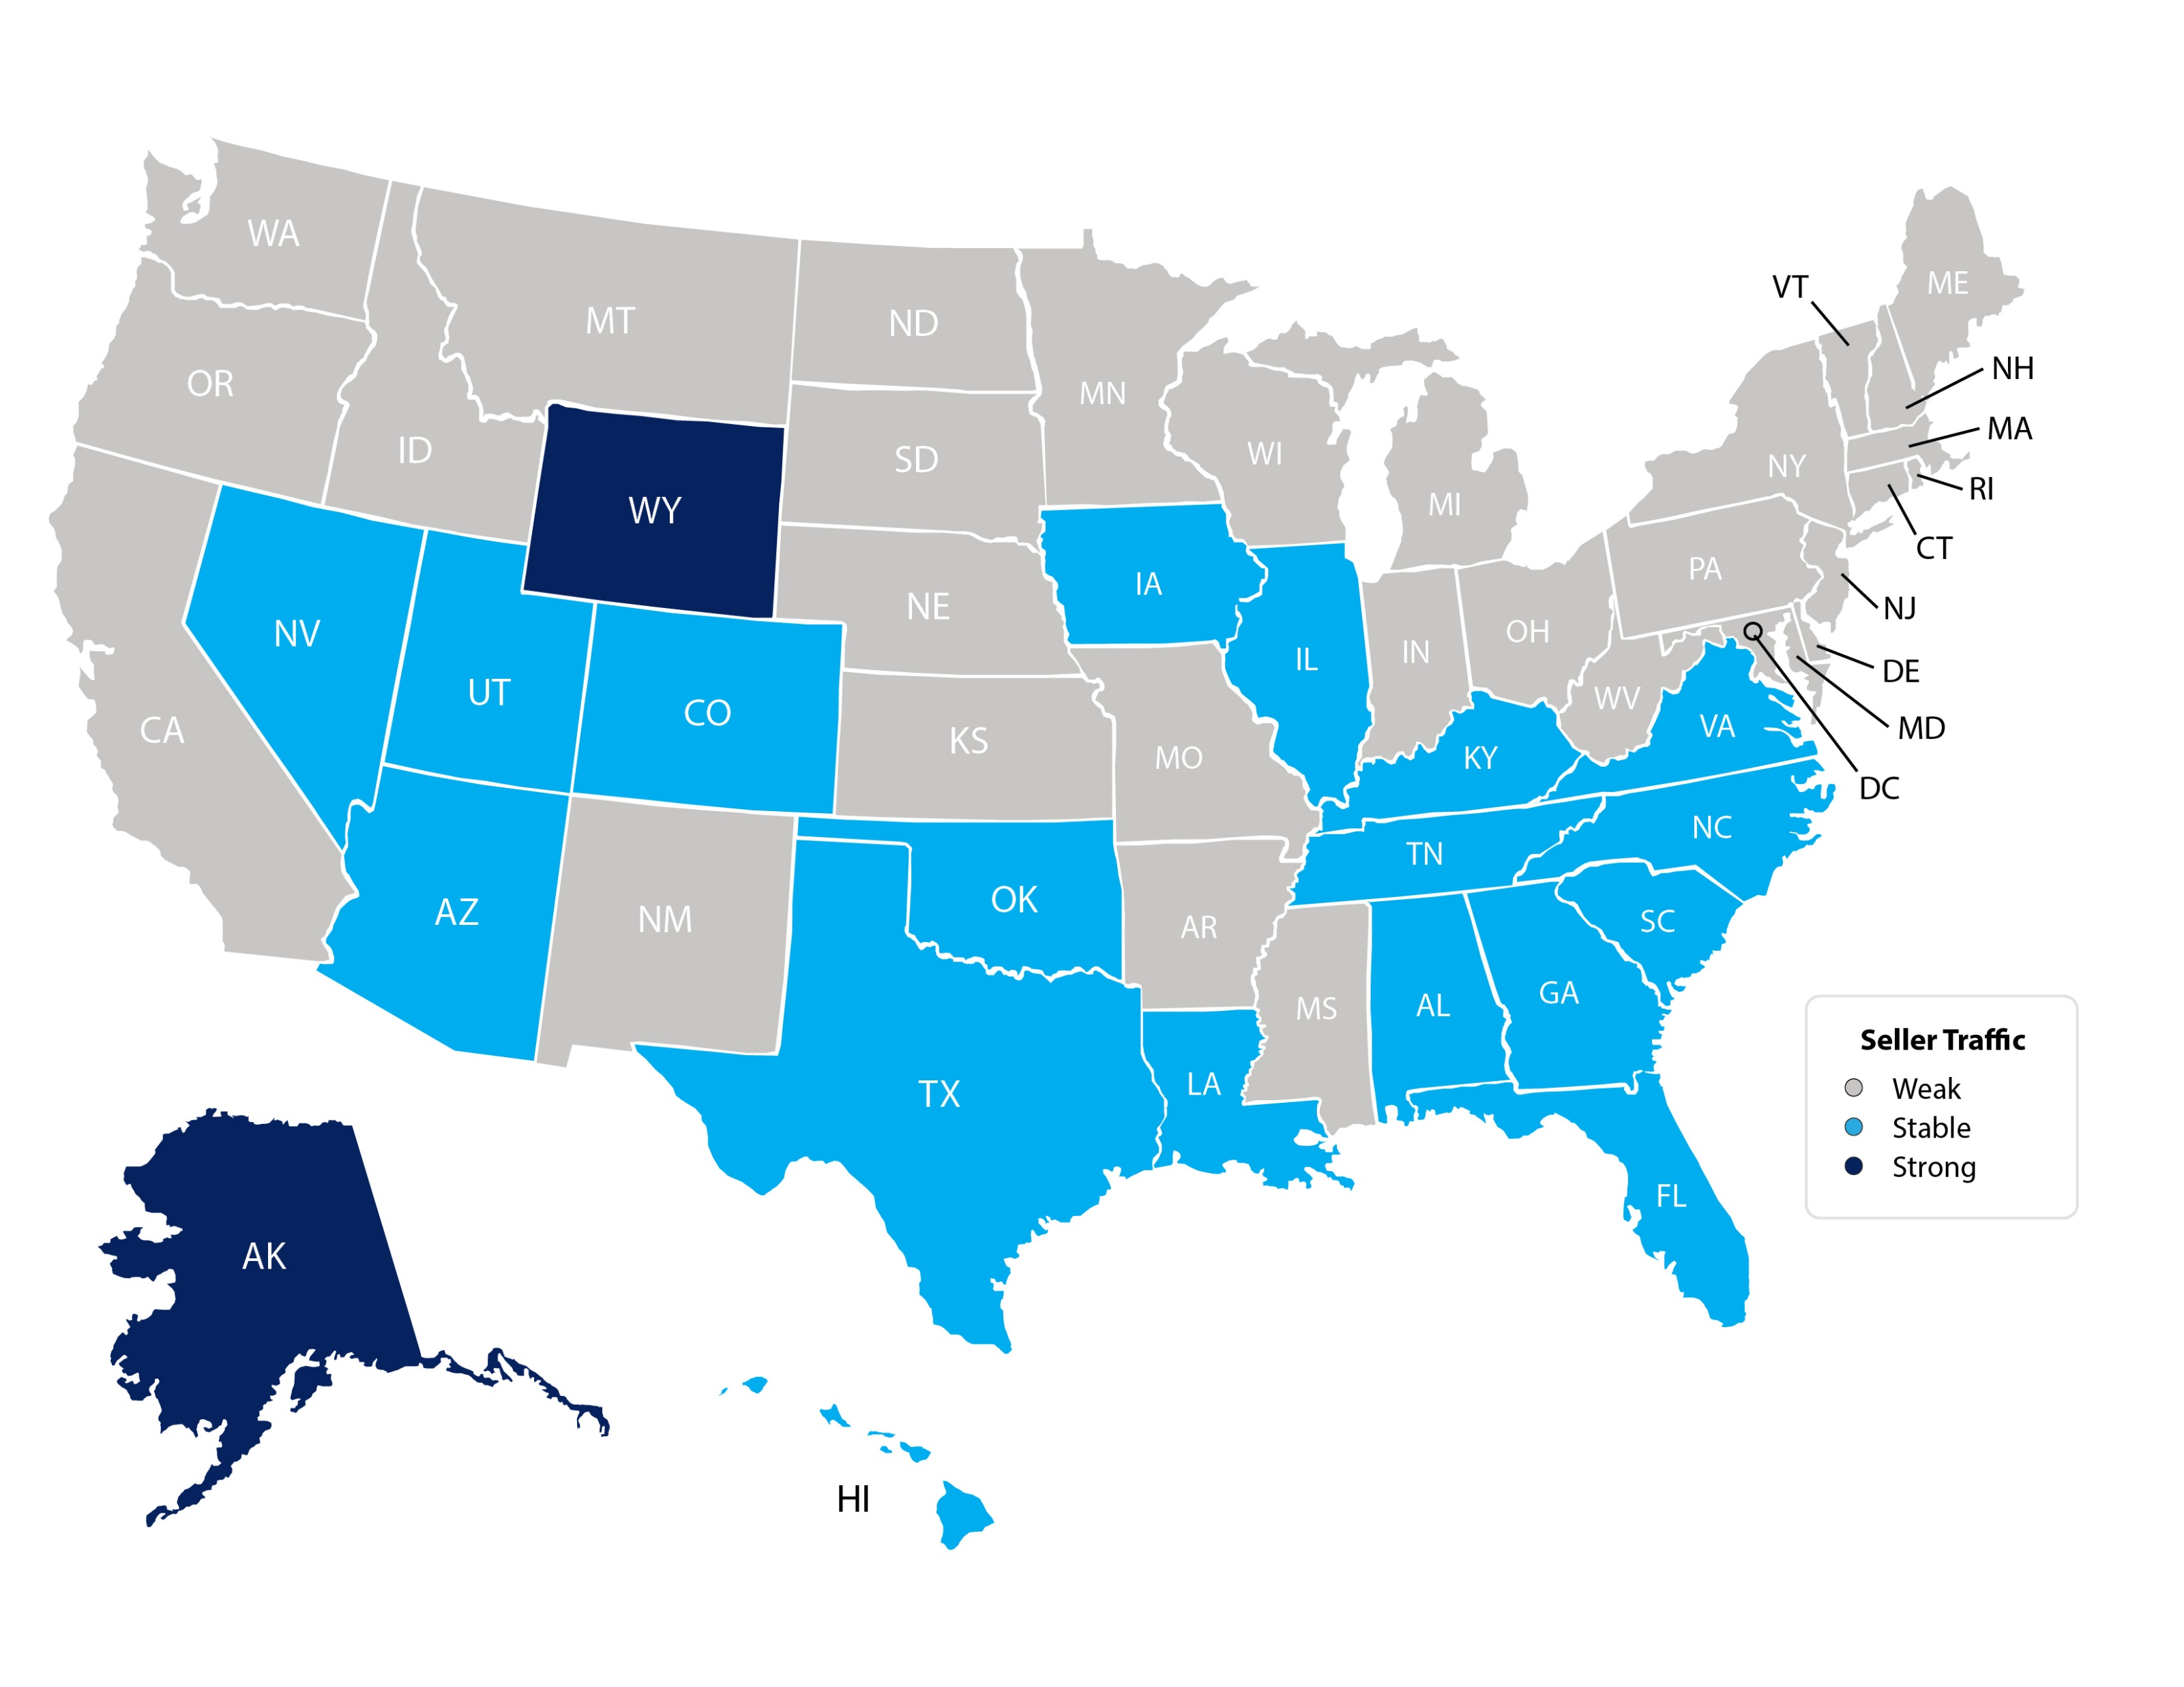
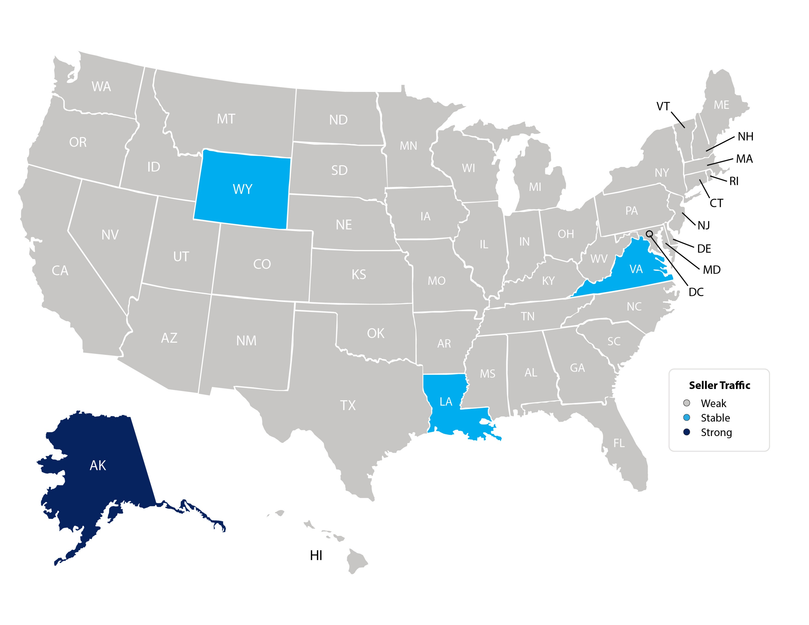
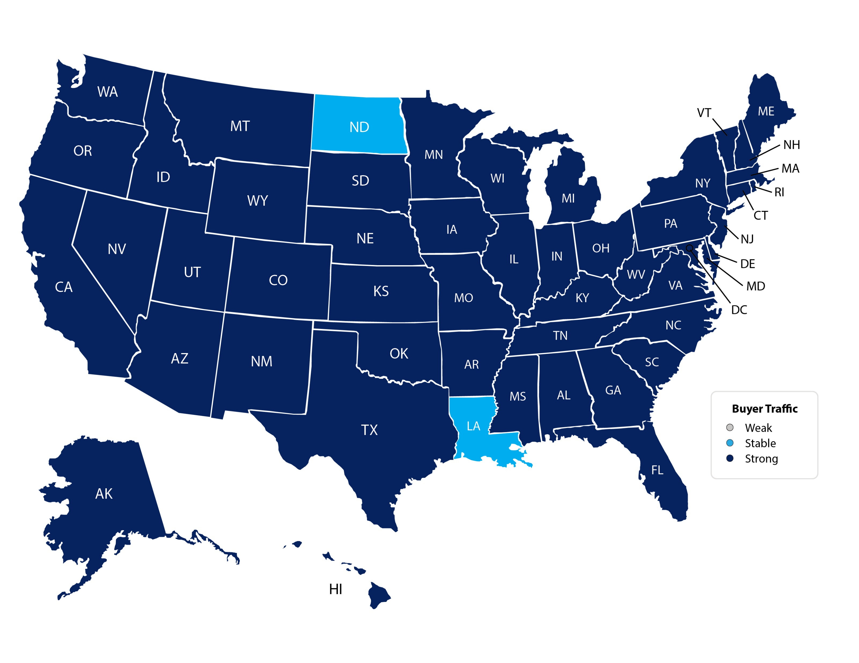
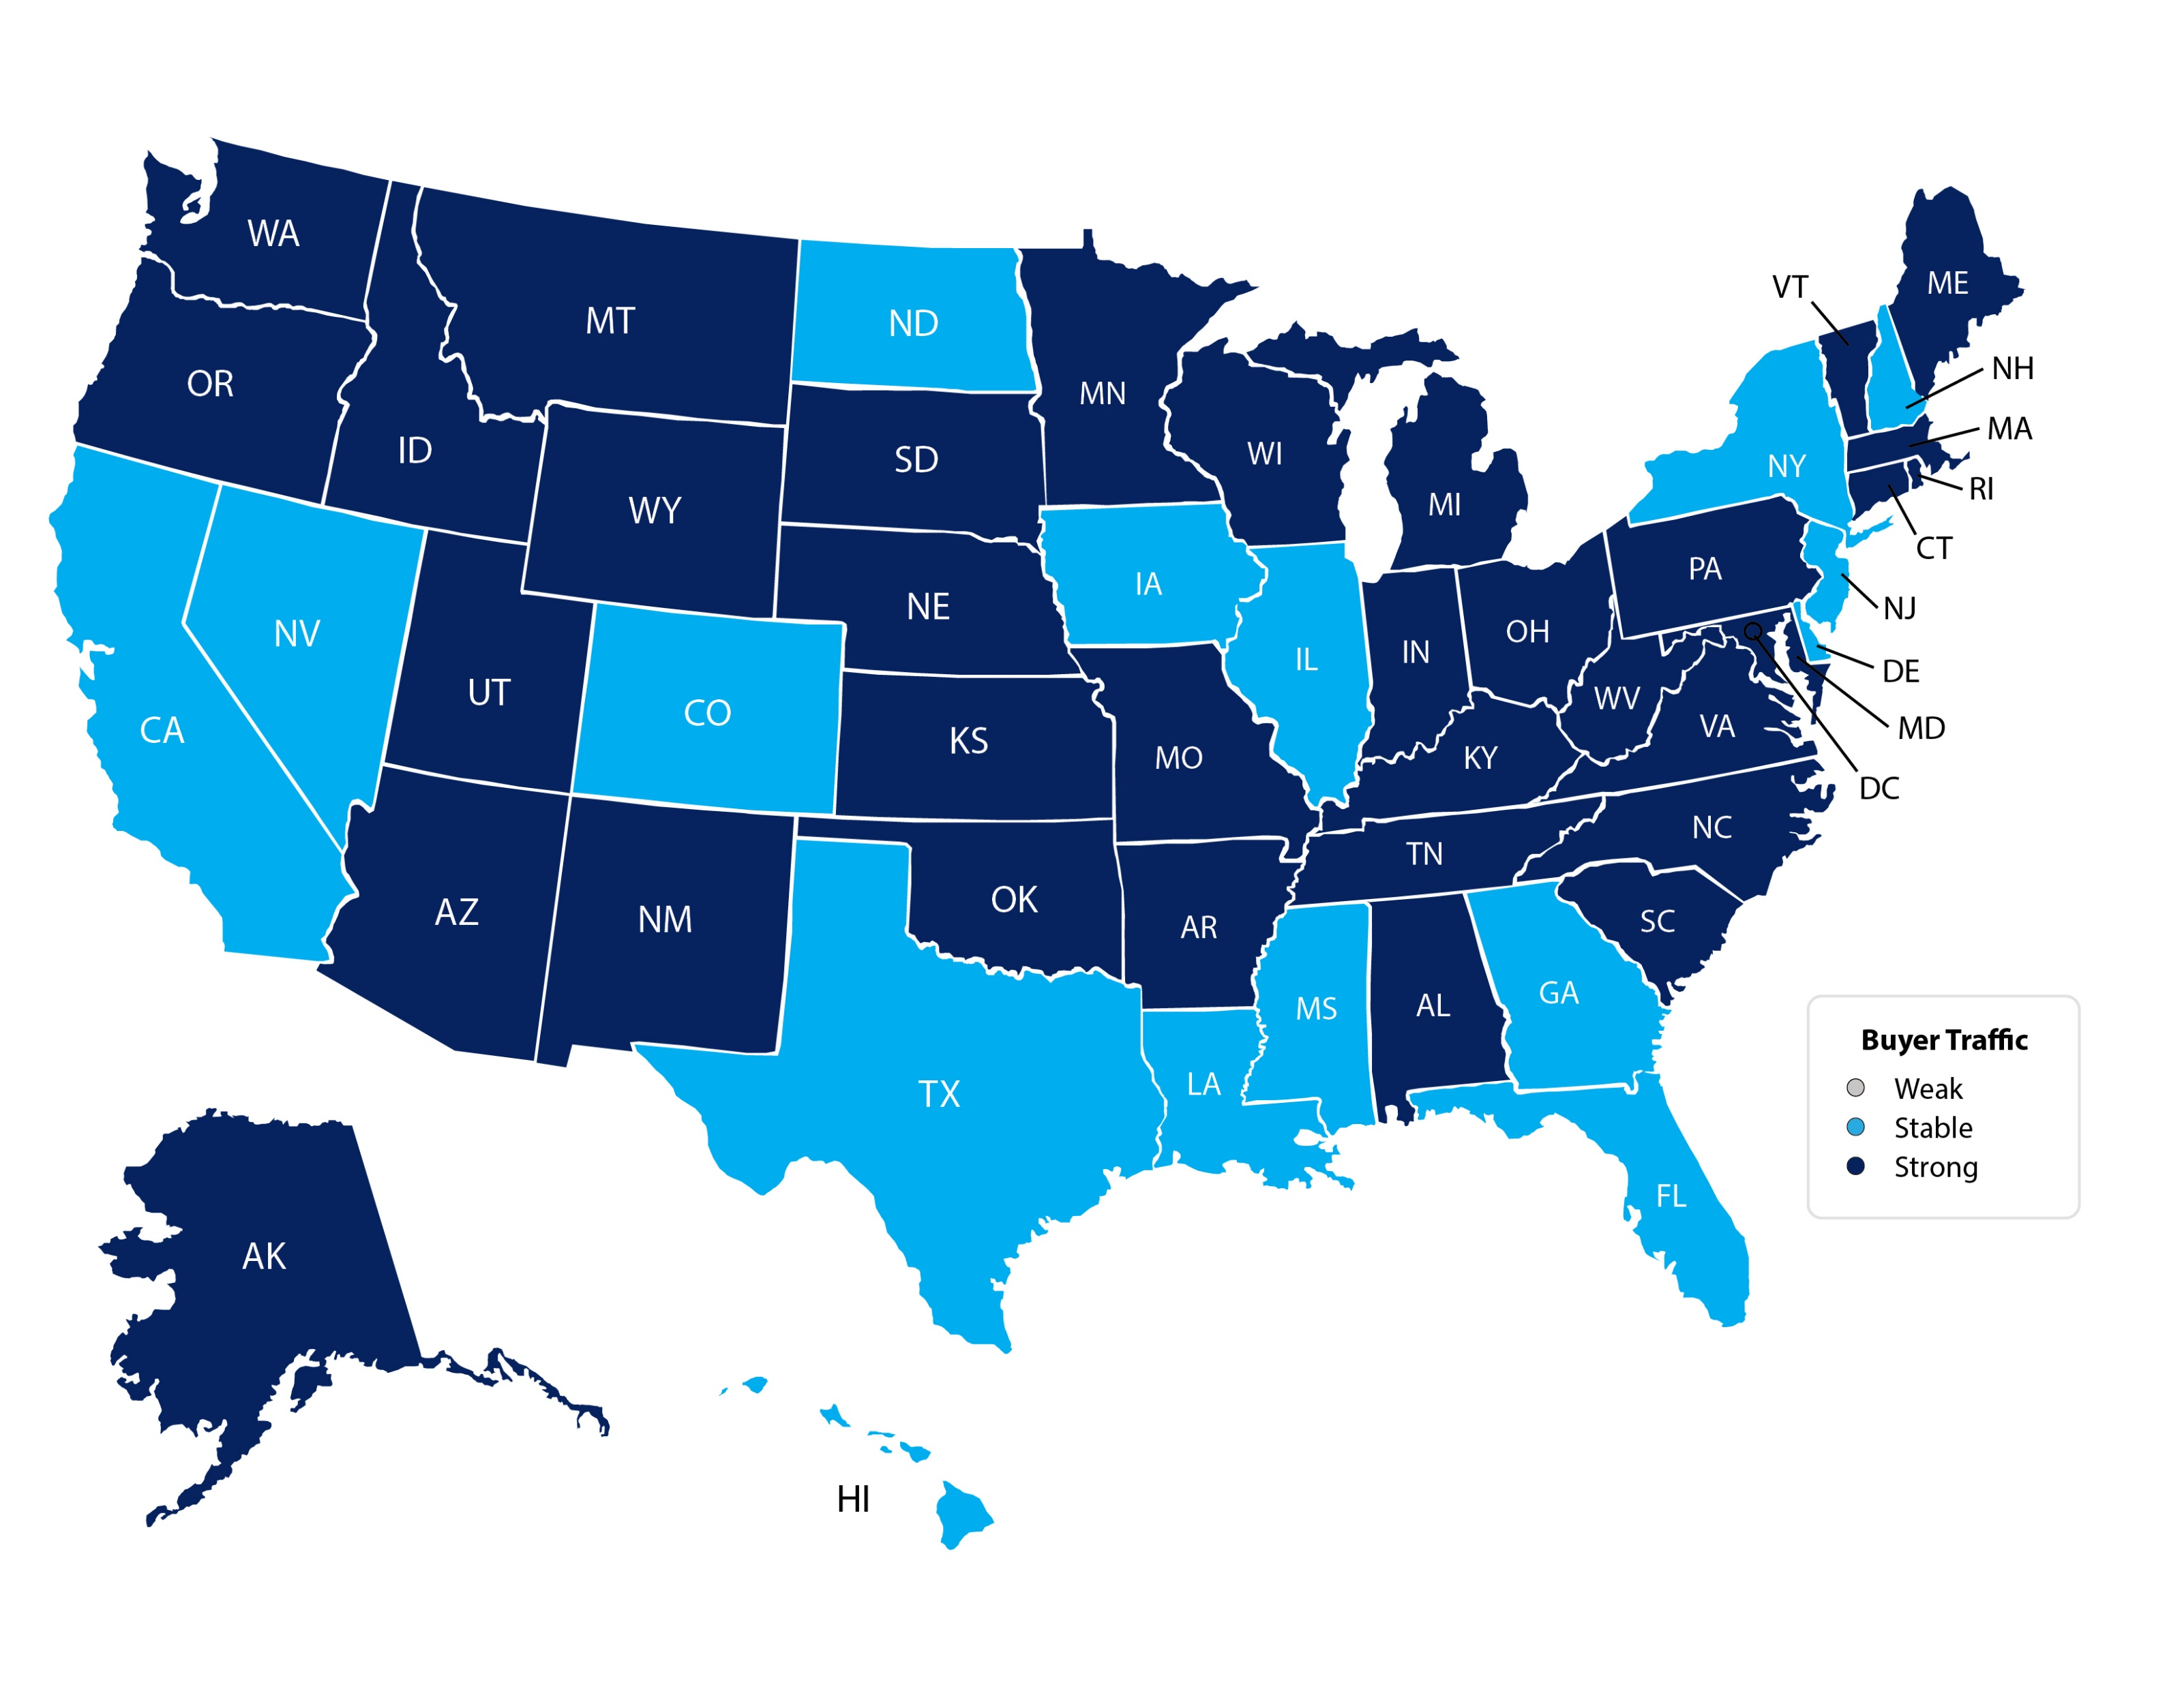
Seller’s Traffic
Feb 2020
Seller’s Traffic
Mar 2020
Buyer’s Traffic
Feb 2020
Buyer’s Traffic
Mar 2020
* Last numbers available
NAR
Notes:
https://www.nar.realtor/research-and-statistics/research-reports/realtors-confidence-index

Slide 3
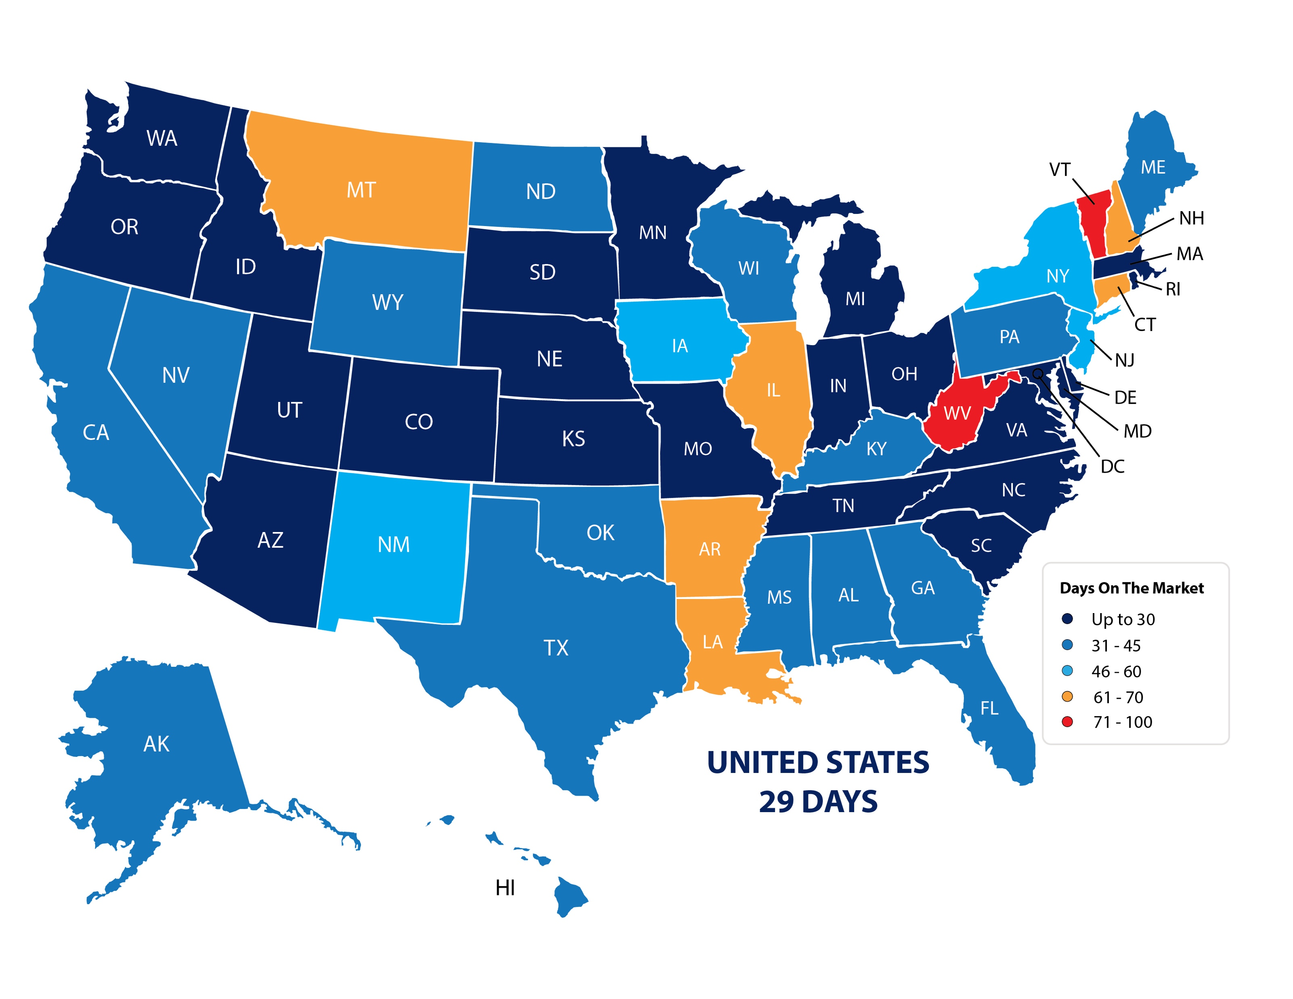
Average Days on the Market
NAR
Notes:
https://www.nar.realtor/research-and-statistics/research-reports/realtors-confidence-index

Slide 4
Historic Mortgage Rates by Decade
Decade | Average Rate
1970s | 8.86%
1980s | 12.7%
1990s | 8.12%
2000s | 6.29%
Freddie Mac

Slide 5
Mortgage Rates
Freddie Mac
30-Year Fixed Rate
- Actual
- Projected
2019
2018
2017
2020
2016
2021
Freddie Mac
Notes:
http://www.freddiemac.com/fmac-resources/research/pdf/202004-Forecast.pdf

Slide 6
Mortgage Rate Projections
Quarter | Freddie Mac | Fannie Mae | MBA | NAR | Average of All Four
2020 2Q | 3.3 | 3.3 | 3.6 | 3.7 | 3.47%
2020 3Q | 3.2 | 3.1 | 3.6 | 3.8 | 3.42%
2020 4Q | 3.2 | 3.0 | 3.5 | 3.9 | 3.40%
2021 1Q | 3.1 | 3.0 | 3.5 | 4.0 | 3.40%
Notes:
http://www.freddiemac.com/research/forecast/20200413_quarterly_forecast_housing_challenges.page?
http://www.fanniemae.com/portal/research-insights/forecast.html
https://www.mba.org/news-research-and-resources/research-and-economics/forecasts-and-commentary
https://www.nar.realtor/research-and-statistics

Slide 7
Mortgage Rates Make A Significant Difference In Home Affordability
Amount Of Mortgage | 3.5% Mortgage | 30-Year Cost | 5% Mortgage | 30-Year Cost
$200,000 | $898 | $323,280 | $1,073 | $386,280
$300,000 | $1,347 | $484,920 | $1,610 | $579,600
$400,000 | $1,796 | $646,560 | $2,147 | $772,920
$500,000 | $2,245 | $808,200 | $2,684 | $966,240
$1 million | $4,490 | $1,616,400 | $5,368 | $1,932,480

Slide 8
Greater Metro Atlanta
Market
May 2020 Report With Results Through April 2020

Slide 9
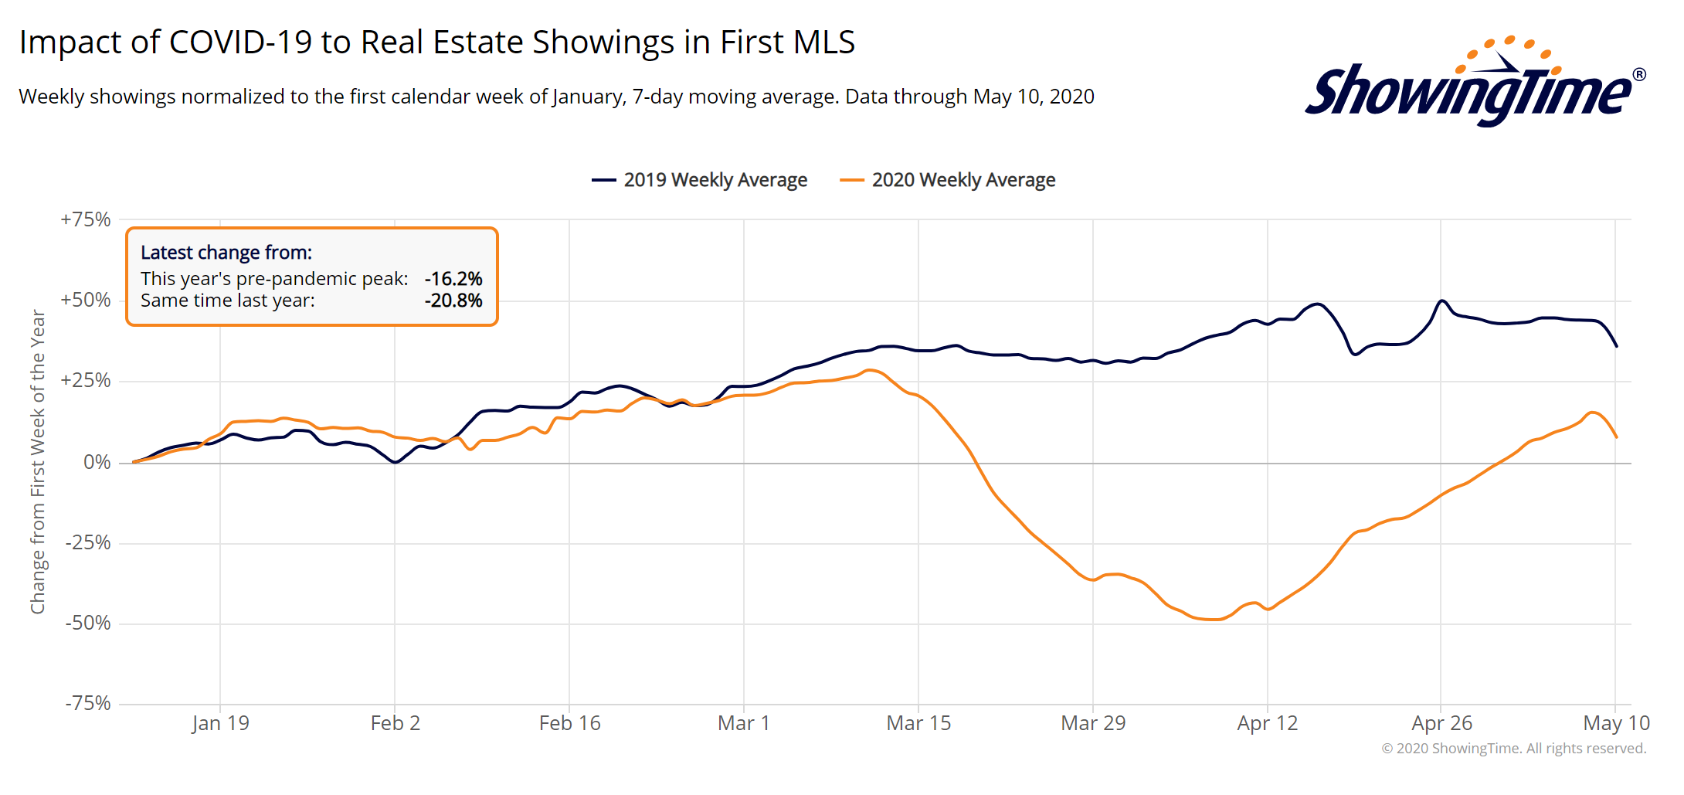
Metro Atlanta Showing Trend
* Showings may be higher than shown here due to Virtual Showings and Virtual Open House Showings
Notes:
PGR continues to grow our listing inventory market share. Our Advanced Property Marketing methodology and focused prospecting is making a difference.

Slide 10
Metro Atlanta 2018-2020 Closing Units
April Closings Down 16.7% Compared To March Closings
April 2020 Closings Down 17.8% Compared To April 2019
Notes:
PGR continues to grow our listing inventory market share. Our Advanced Property Marketing methodology and focused prospecting is making a difference.

Slide 11
Metro Atlanta Under Contract Trend
April Under Contract Down 10.8% Compared To March
April 2020 Under Contract Down 28.7% Compared To April 2019
Notes:
PGR continues to grow our listing inventory market share. Our Advanced Property Marketing methodology and focused prospecting is making a difference.

Slide 12
Metro Atlanta New Listings Trend
April New Listings Down 22.5% Compared To March
April 2020 New Listings Down 33.6% Compared To April 2019
Notes:
PGR continues to grow our listing inventory market share. Our Advanced Property Marketing methodology and focused prospecting is making a difference.

Slide 13
Metro Atlanta Closings – April 2020 (Number Of Transactions By Price)
85% Of Transactions In $100K-$500K Price Range
Notes:
Months of supply is well below normal in many of our markets. We expect this to continue in 2013.

Slide 14
Metro Atlanta Closed Units By Price Point April 2020 Compared To April 2019
Notes:
Months of supply is well below normal in many of our markets. We expect this to continue in 2013.

Slide 15
Listed Inventory January 2018 – April 2020
All Residential, Metro Atlanta
Inventory Up 2.1% From Last Month Down 7.2% Compared To Last Year
Notes:
PGR continues to grow our listing inventory market share. Our Advanced Property Marketing methodology and focused prospecting is making a difference.

Slide 16
Months of Inventory Change The Market Strategy
GREATER THAN
7 MONTHS
BETWEEN
6-7 MONTHS
LESS THAN
6 MONTHS
SELLERS
MARKET
Home prices
will appreciate
NEUTRAL
MARKET
Home prices
will only appreciate with inflation
BUYERS
MARKET
Home prices
will depreciate
Notes:
Realtor.org

Slide 17
Metro Atlanta Months of Inventory (April 2020, Based On Closed Sales)
6 Months Supply Is Considered Normal Market
Total Metro Atlanta “Months Of Inventory” Is 3.3 Months
Notes:
Months of supply is well below normal in many of our markets. We expect this to continue in 2013.

Slide 18
Metro Atlanta Monthly Average Sale Prices
ASP $330,000 In April. Up 1.9% Compared To Last Month.
Up 3.1% From Last April.
Notes:
PGR continues to grow our listing inventory market share. Our Advanced Property Marketing methodology and focused prospecting is making a difference.

Slide 19
Metro Atlanta Annual Average Sale Prices
Annual ASP Up 80% From Bottom Of 2011
Notes:
PGR continues to grow our listing inventory market share. Our Advanced Property Marketing methodology and focused prospecting is making a difference.

Slide 20
Case-Shiller Index For Metro Atlanta
Jan 2010 Through February 2020 (Reported April 28, 2020)
Home Values Up 87% From Bottom Of March 2012.
Notes:
PGR continues to grow our listing inventory market share. Our Advanced Property Marketing methodology and focused prospecting is making a difference.

Slide 21
Case-Shiller Gain/ Loss For Metro Atlanta
Comparisons Based On The Latest Case Shiller Index Compared
To The Average Index For The Year Property Was Purchased.
Year Property Bought | Gain/ Loss
2003 | 32.39%
2004 | 28.26%
2005 | 22.01%
2006 | 16.96%
2007 | 16.20%
2008 | 27.01%
2009 | 43.70%
2010 | 47.27%
2011 | 58.37%
Year Property Bought | Gain/ Loss
2012 | 71.71%
2013 | 45.09%
2014 | 33.01%
2015 | 26.05%
2016 | 19.07%
2017 | 12.92%
2018 | 6.63%
2019 | 2.13%
2020 | 1.89%
Case Shiller Index For Metro Atlanta - February 2020 As Reported April 28, 2020. Micro-Local Markets And Price Points May Have Significantly Different Outcomes.
Notes:
PGR continues to grow our listing inventory market share. Our Advanced Property Marketing methodology and focused prospecting is making a difference.

Slide 22
Case-Shiller Home Values For Metro Atlanta
Recent Bottom Was March 2012. Metro Average Home Values Back To Normal Trend Line.
Notes:
PGR continues to grow our listing inventory market share. Our Advanced Property Marketing methodology and focused prospecting is making a difference.

Slide 23
Metro Atlanta Brokerage Rankings

Slide 24
Annual Closed Volume – April 2020 FMLS Counties + Southern Crescent
($ Volume in Thousands)
Information Provided By Trendgraphix and BHHS Georgia Properties Internal Reports.
Notes:
In the past three years, our company has consistently grown our market share in both listing inventory and the sales of that inventory. Today, we are Ranked #1 in both categories.

Slide 25
Georgia Economic & Housing Trends

Slide 26
Top State For Business Site Selection Magazine
7 Years in a Row!
2019
2018
2017
2016
2015
2014
2013

Slide 27
Buyers Moving To Atlanta!
Here is the Top 10 List including previous rank:
Atlanta (1)
Phoenix (4)
Tampa/Sarasota (2)
Dallas/Fort Worth (3)
Orlando (5)
Denver (7)
Houston (8)
Seattle (6)
Las Vegas (10)
Chicago (9)
Penske Truck Rental published their 2019 moving destination list and Atlanta was ranked #1 for the 9th year in a row. The trend of moving to the sunbelt has returned. Desirable attributes that help Metro Atlanta include a business friendly environment, low cost of living for a metro area, airport, moderate weather with 4 seasons and a high quality of life.

Slide 28
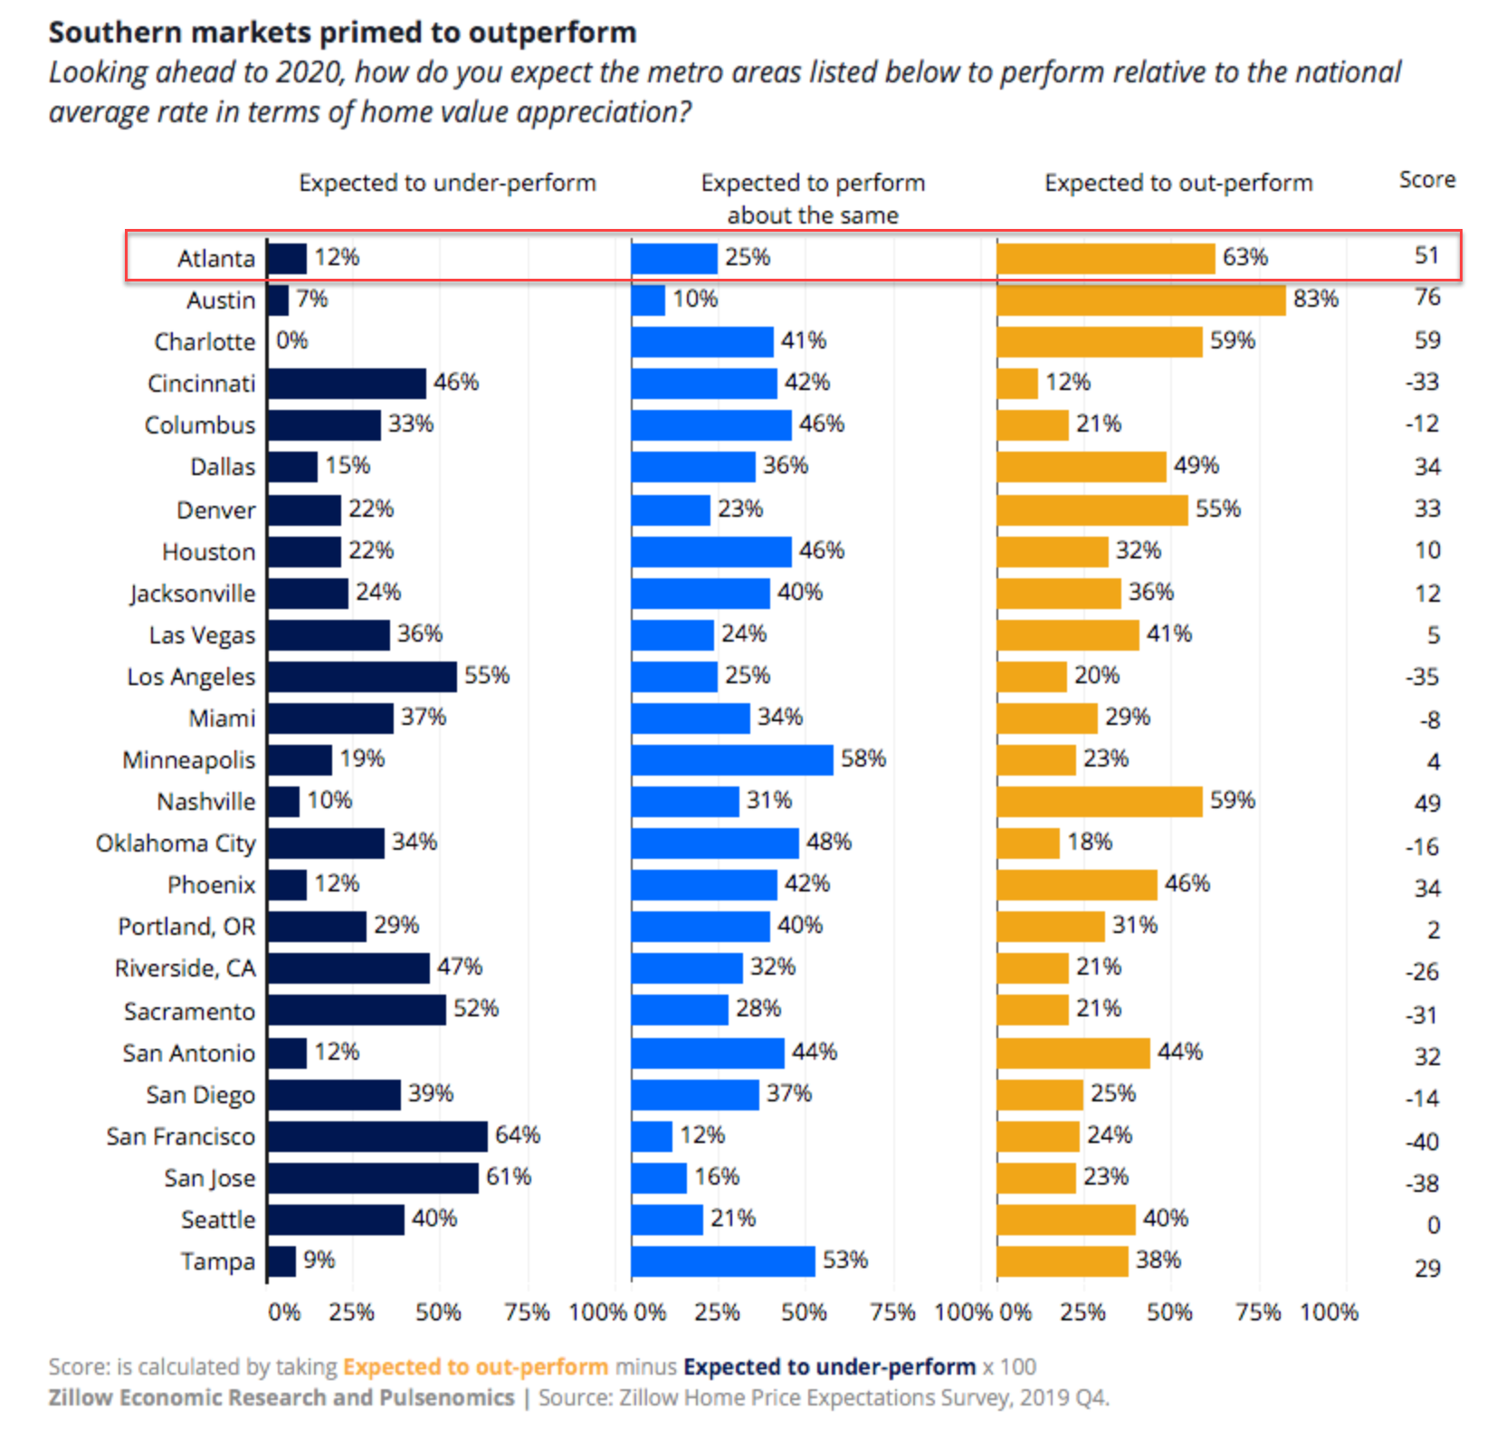
People Are Moving To Atlanta!

Slide 29
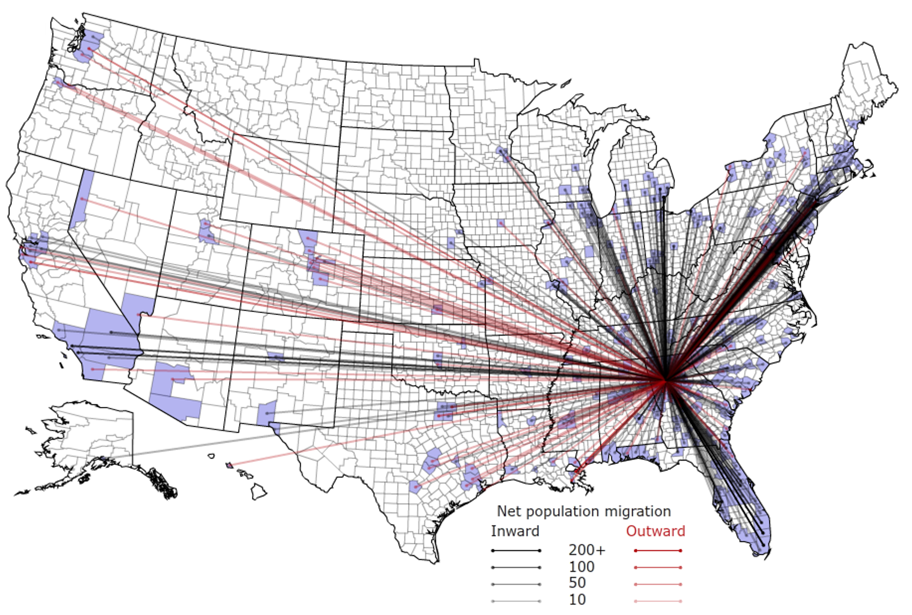
People Are Moving To Atlanta!

Slide 30
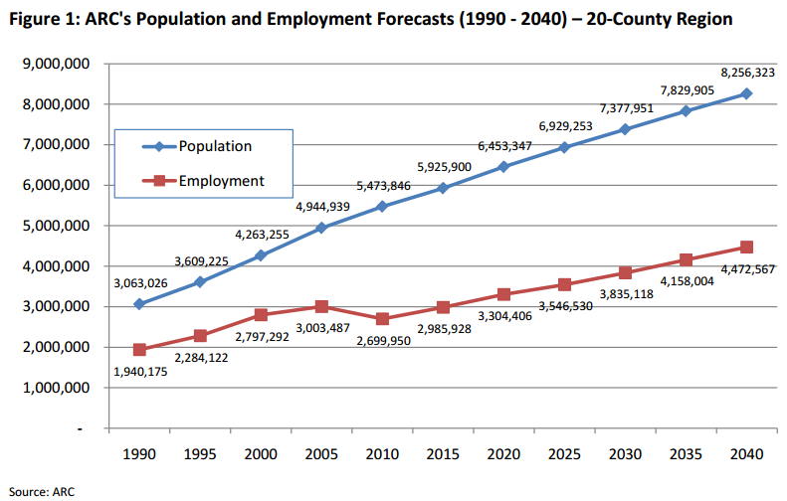
Population & Employment Growth Trends

Slide 31
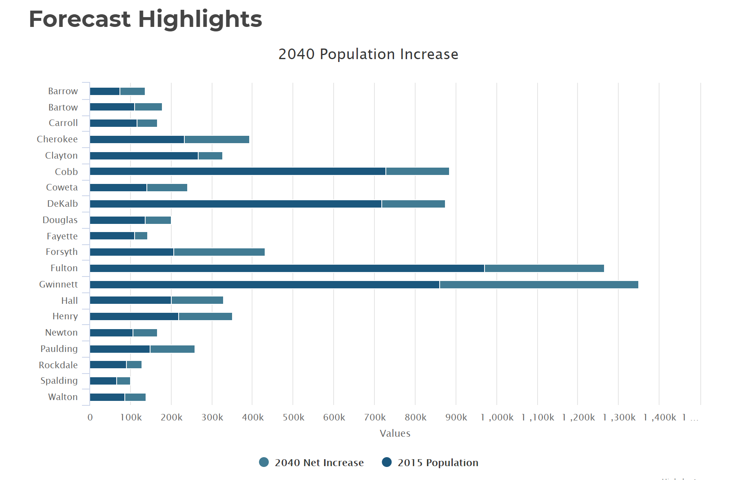
Population By County
Atlanta Regional Commission

Slide 32
Population & Employment Growth Trends
U.S. Conference of Mayors Report predicts that Metro Atlanta will be the 6th largest city in the nation by 2046.
Metro Atlanta will grow from 5.8 million residents to 8.6 million residents.
That means 2.8 million people will move to our area!
This is great news for our long-term real estate values!

