Slide 1
Comparisons To Prior Economic Downturns Or Recessions

Slide 2
Americans Choose Real Estate as Safest Investment
What do you believe is the safest
investment over the next 10 years?
(Top 5 Answers)
Porch.com

Slide 3
Average Economic Impact of
One Existing Home Sale in the U.S.
$43,099
Income generated from
real estate industries
Expenditures related to home purchase
Multiplier of housing related expenditures
$24,471
27.7%
of total impact
+
$4,650
5.3%
of total impact
+
$13,978
15.8%
of total impact
NAR calculated the total economic impact of real estate-related industries on the state economy, as well as the expenditures that result from a single home sale.
NAR
Notes:
https://www.nar.realtor/sites/default/files/documents/2019-state-economic-impact-of-real-estate-activity-us-04-14-2020.pdf
https://www.nar.realtor/reports/state-by-state-economic-impact-of-real-estate-activity

Slide 4
Average Economic Impact of
One New Home Sale in the U.S.
$88,416
Income generated from
real estate industries
Expenditures related to home purchase
Multiplier of housing related expenditures
New home construction
$24,471
27.7%
of total impact
+
$4,650
5.3%
of total impact
+
$13,978
15.8%
of total impact
+
$45,317
51.3%
of total impact
NAR calculated the total economic impact of real estate-related industries on the state economy, as well as the expenditures that result from a single home sale, including aspects like home construction costs, real estate brokerage, mortgage lending and title insurance.
NAR
Notes:
https://www.nar.realtor/sites/default/files/documents/2019-state-economic-impact-of-real-estate-activity-us-04-14-2020.pdf
https://www.nar.realtor/reports/state-by-state-economic-impact-of-real-estate-activity

Slide 5
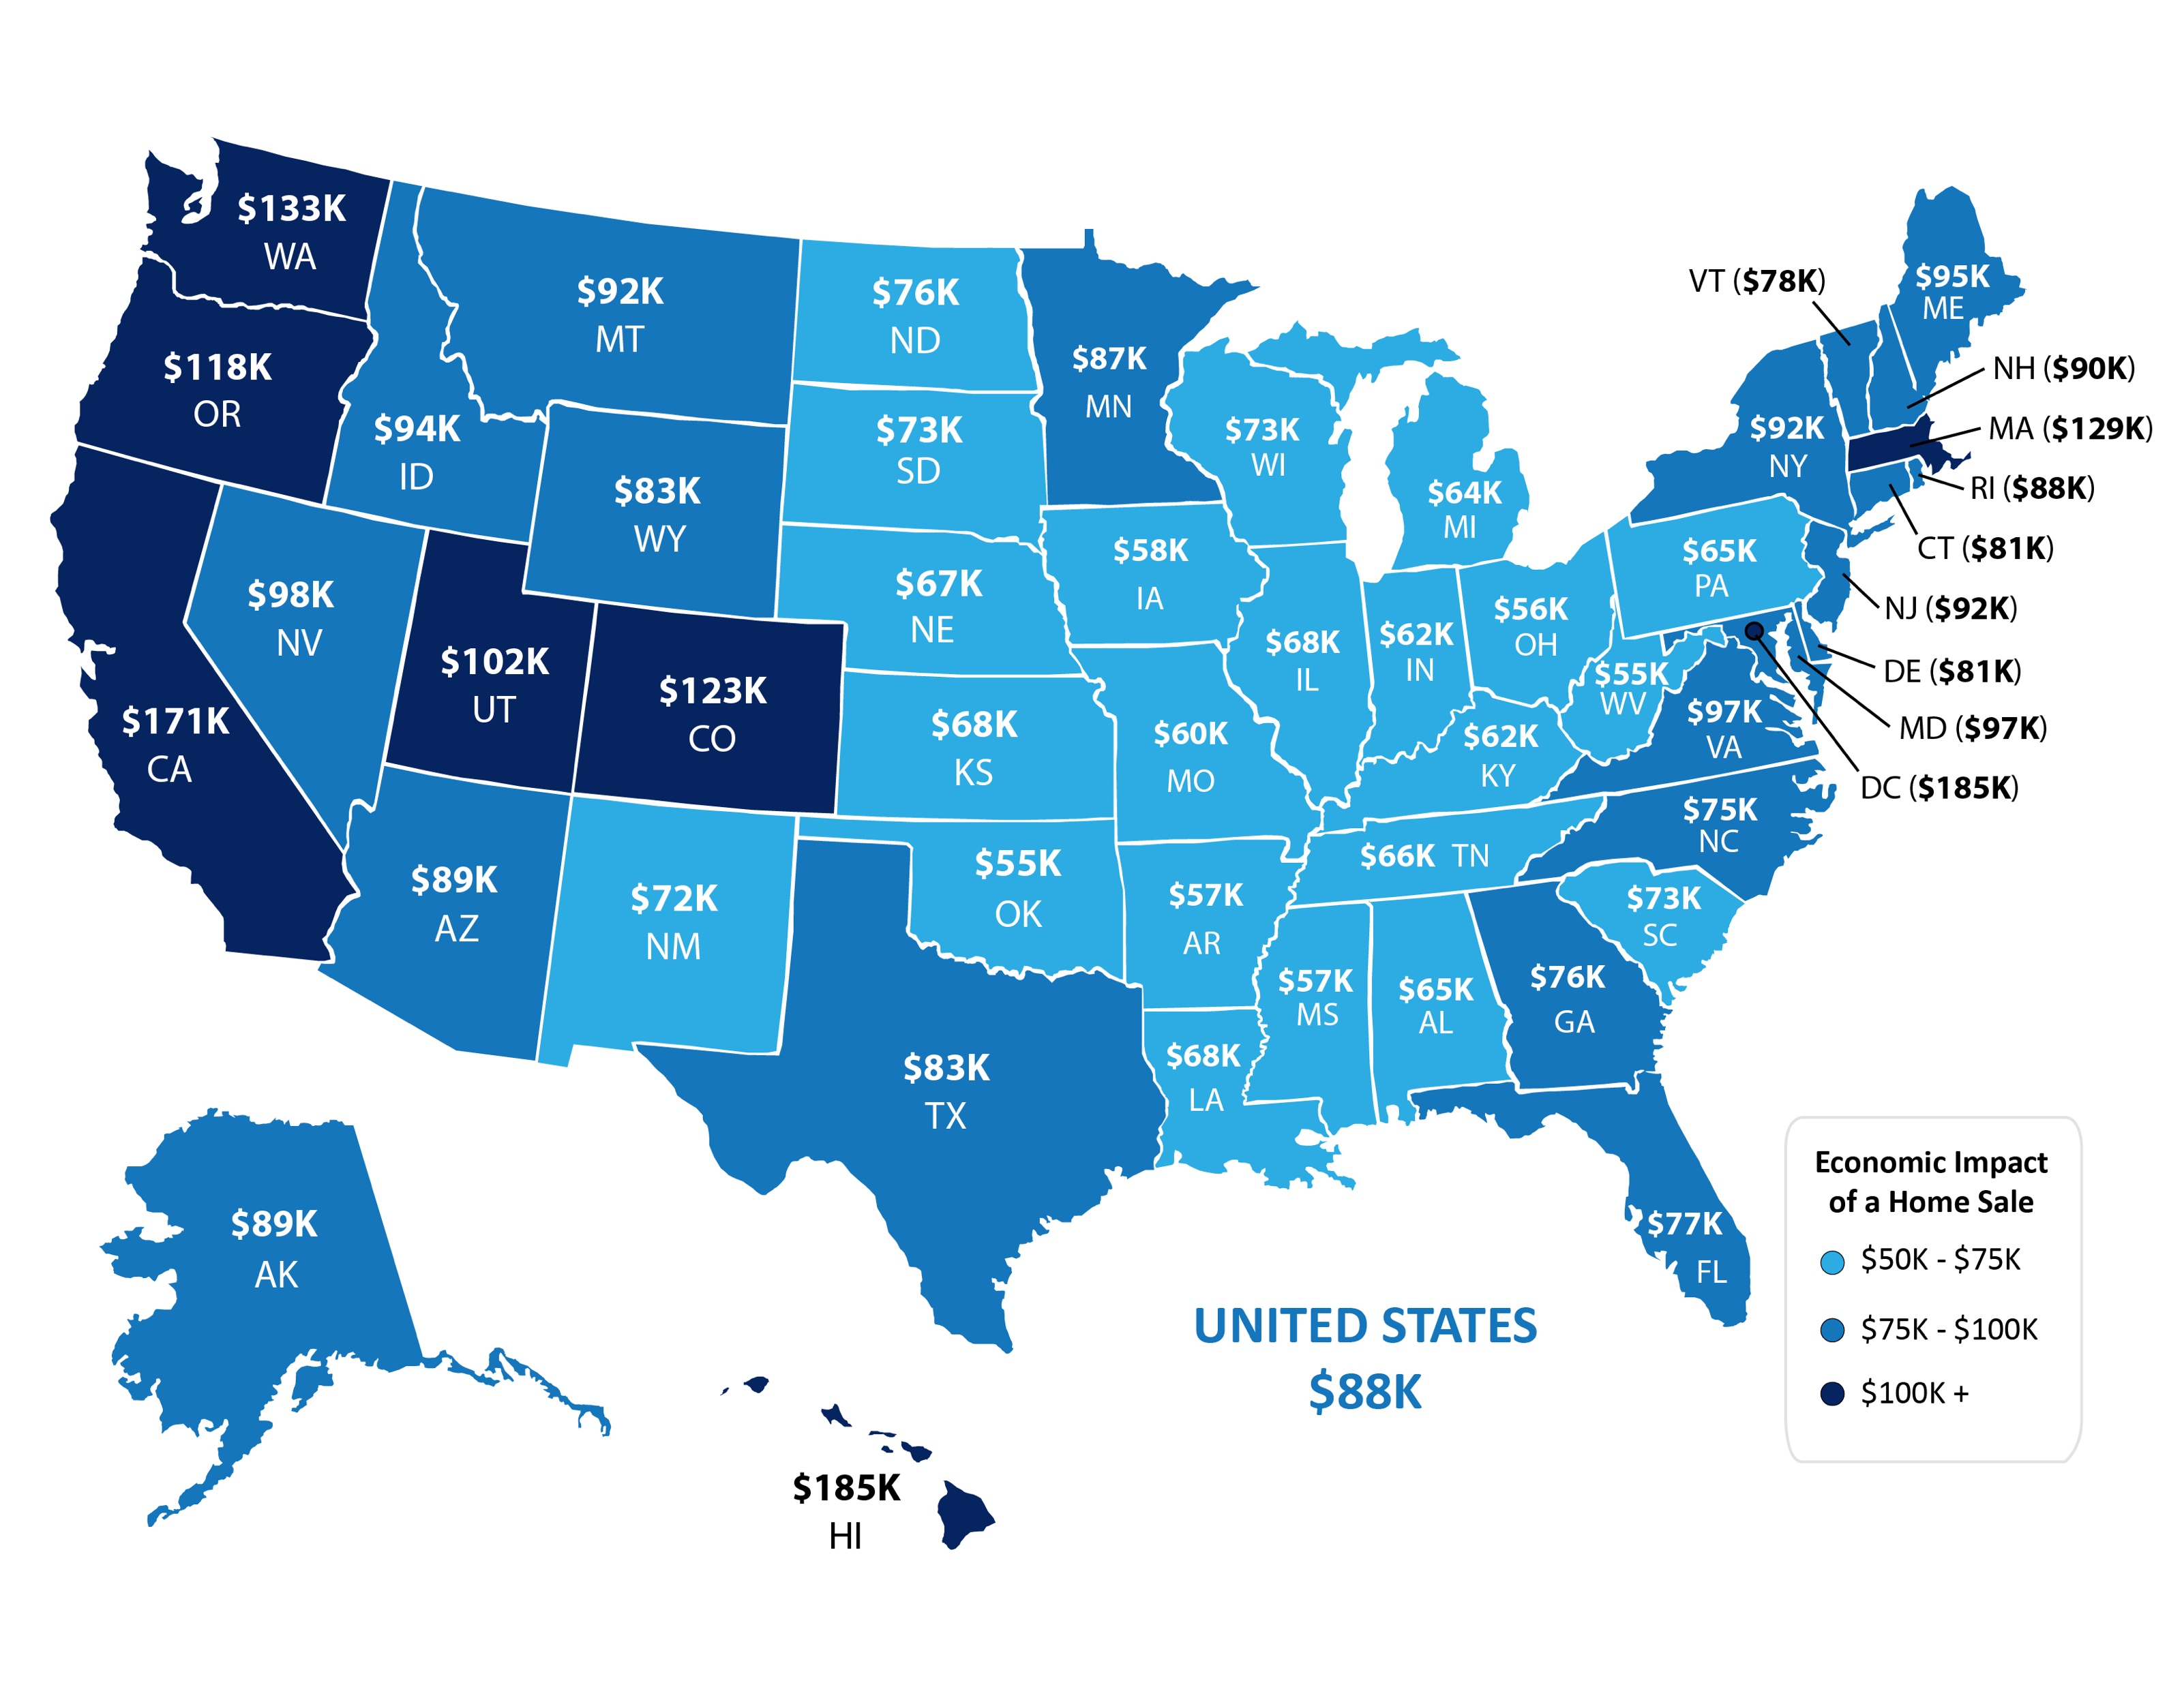
Average Economic Impact of One Home Sale by State
NAR
Notes:
https://www.nar.realtor/sites/default/files/documents/2019-state-economic-impact-of-real-estate-activity-us-04-14-2020.pdf
https://www.nar.realtor/reports/state-by-state-economic-impact-of-real-estate-activity

Slide 6
U.S. Homeownership % Rates
Q1 Results
Census
Notes:
https://www.census.gov/housing/hvs/files/currenthvspress.pdf

Slide 7
Homeownership Rates
U.S. Percentage Last 4 Quarters
Census
Notes:
https://www.census.gov/housing/hvs/files/currenthvspress.pdf

Slide 8
1.) When is the economy going to recover?
2.) Are we going into a recession?
3.) Is this going to be like 2008?
4.) What about all those job losses?
5.) What should I do right now?
Be smart…be patient…but most of all – Stay Safe

Slide 9
Yes, We Are In A Recession.
Recession DOES NOT
Equal Housing Crisis.
This Is NOT Like The Last Time!

Slide 10
1991
2008
HOME PRICE CHANGE
During Last 5 Recessions
CoreLogic
Notes:
https://www.corelogic.com/blog/2019/03/housing-recessions-and-recoveries.aspx

Slide 11
Annual Home Price Appreciation
The 6 years leading up
to the housing crash
The last 6 years
Black Knight
Notes:
https://www.blackknightinc.com/black-knights-december-2019-mortgage-monitor-2/

Slide 12
Total Home Equity Cashed Out
by Refinance in Billions
Then…
Now…
Year | Dollars
2005 | $263B
2006 | $321B
2007 | $240B
Total | $824B
Year | Dollars
2017 | $71B
2018 | $87B
2019 | $89B*
Total | $247B
*Freddie Mac estimate
Freddie Mac
Notes:
http://www.freddiemac.com/research/datasets/refinance-stats/index.page

Slide 13
Percentage of
Homeowner
Equity 2020
John Burns Consulting
Notes:
https://www.realestateconsulting.com

Slide 14
Of all active forbearances which are past due on their mortgage payment, 77% have at least 20% equity in their home and 90% have at least 10% equity.
Black Knight
Notes:
https://cdn.blackknightinc.com/wp-content/uploads/2020/06/BKI_MM_Apr2020_Report.pdf

Slide 16
Housing Bubble 2006: 868.7
MORTGAGE CREDIT AVAILABILITY INDEX
The taller the graph, the
easier it is to get a loan
Today:
181.3
MBA
Notes:
https://www.mba.org/news-research-and-resources/newsroom
https://www.mba.org/news-research-and-resources/research-and-economics/single-family-research/mortgage-credit-availability-index

Slide 17
Months Inventory of Homes for Sale
NAR
Notes:
nar.realtor

Slide 18
What About The Impact of Unemployment?
Will Job Loss Have A Significant Impact On Real Estate?

Slide 19
A Complete Look at Unemployment Numbers
in millions
N/A
Department of Labor
Notes:
file:///C:/Users/Steve%20Harney/AppData/Local/Microsoft/Windows/INetCache/Content.Outlook/VM0A22XH/data.pdf

Slide 20
Economy GAINS
2.5 Million Jobs
Employment Gains/Losses by Sector
Unemployment Report Covering Up Until 5/12
U.S. Bureau of Labor Statistics
Notes:
https://www.bls.gov/news.release/empsit.nr0.htm

Slide 21
Explanation of “miscalculation”
Some people who should have been classified as “temporarily unemployed” during the shutdown were instead misclassified as employed but “absent” for “other reasons”.
“Other reasons” are usually people taking a leave to go on vacation, to serve on jury duty or take care of a child or relative.

Slide 22
Unemployment Rate Improved
even with the correction
19.7%
16.3%
5.4%
BLS
Notes:
www.washingtonpost.com/business/2020/06/05/may-2020-jobs-report-misclassification-error/

Slide 23
When is the economy going to recover?

Slide 24
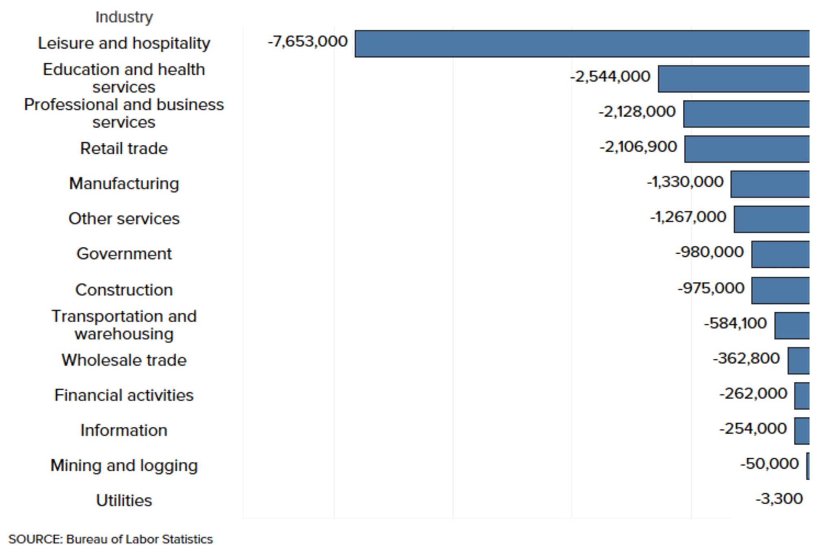
Bureau of Labor Statistics Industry Data - April 2020

Slide 25
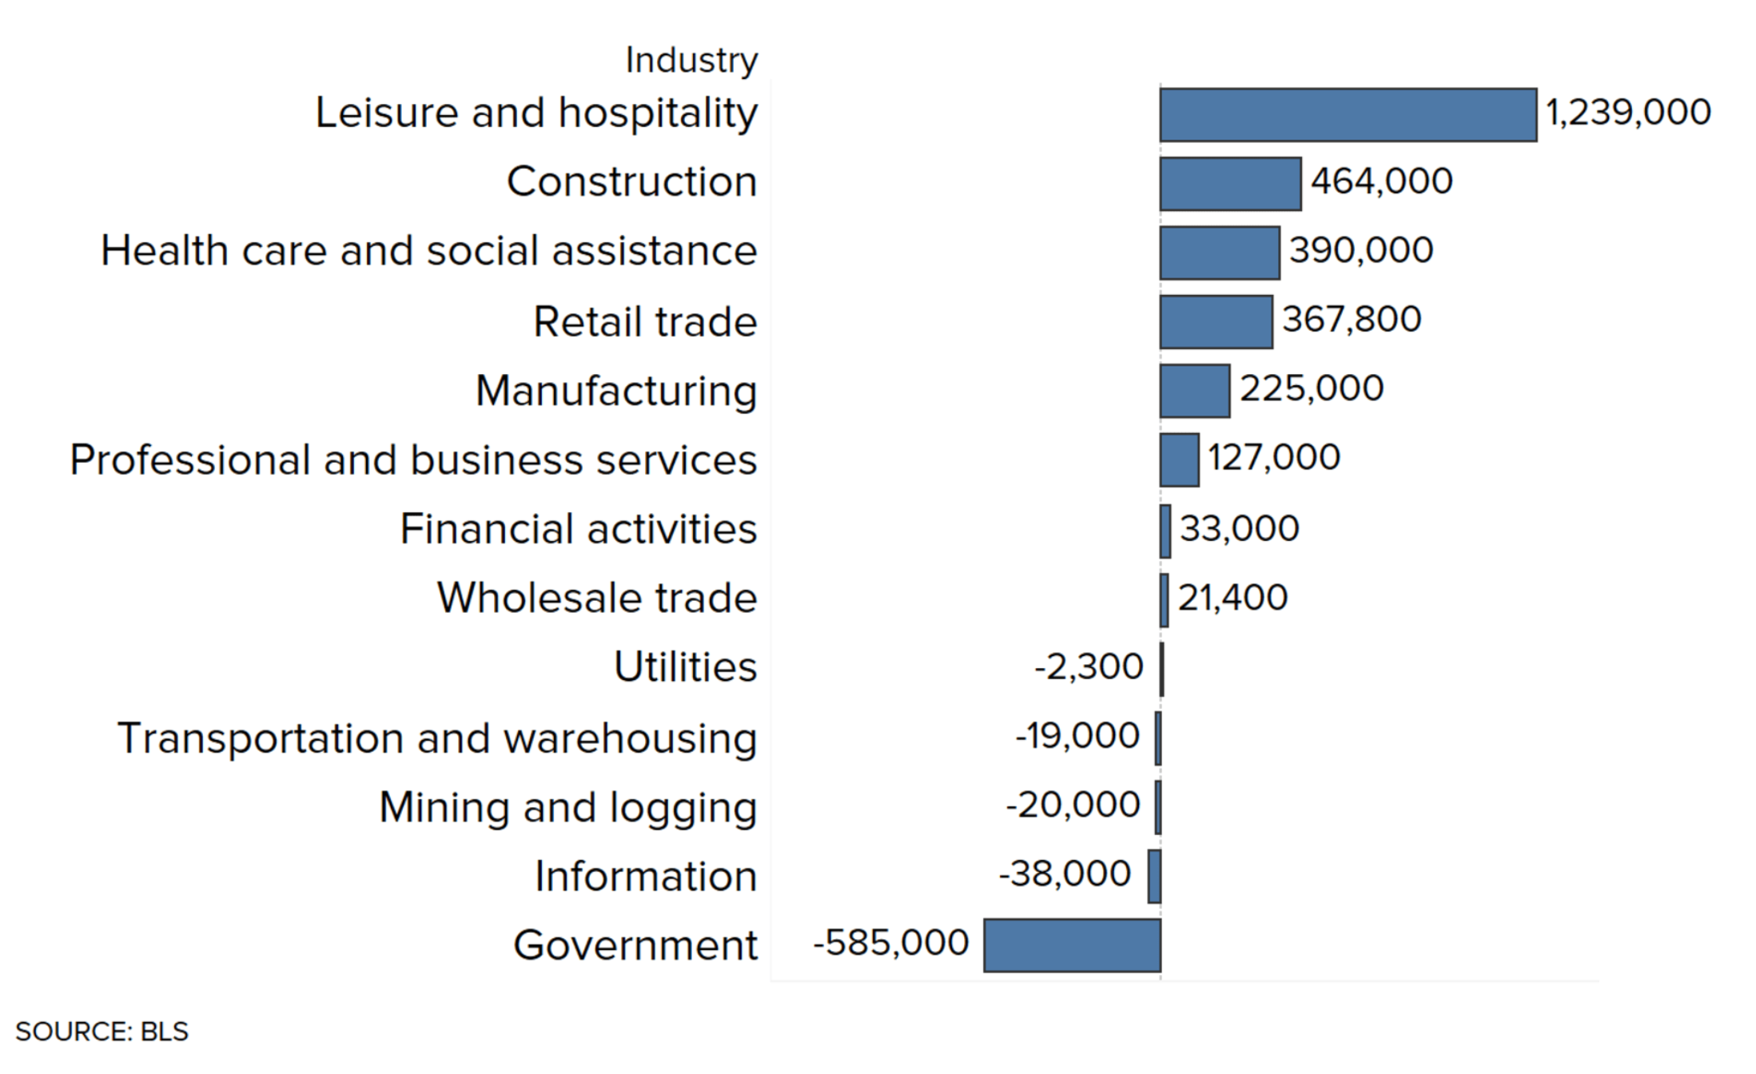
Bureau of Labor Statistics Industry Data - May 2020

Slide 26
“Retail sales shattered already-lofty expectations for May as consumers freed from the coronavirus-induced lockdowns began shopping again.
The 17.7% headline gain…beat the 8% estimate from economists surveyed by Dow Jones.”
CNBC
Notes:
https://www.cnbc.com/2020/06/16/us-retail-sales-may-2020.html

Slide 27
Notes:
https://www.wsj.com/articles/signs-of-a-v-shaped-early-stage-economic-recovery-emerge-11592040600

Slide 28
Notes:
https://www.calculatedriskblog.com/2020/03/the-economic-outlook.html
https://markets.businessinsider.com/news/stocks/us-recession-coronavirus-gdp-plunge-2q-forecast-economy-morgan-stanley-2020-3-1029023137
https://www.foxbusiness.com/markets/coronavirus-gdp-impact-bigger-than-financial-crisis-j-p-morgan

Slide 29
More Depth, Less Length
2nd
Year
9th
Year
12th
Year
Years for unemployment rate to return to pre-crisis level
Notes:
www.thebalance.com/unemployment-rate-by-year-3305506
What about unemployment and the housing market

Slide 30
82.8% of Economists Surveyed by WSJ say the Recovery Will
be in the Form of a ‘V’ Shape
(‘Nike Swoosh’ or a Traditional ‘V’)
WSJ
Notes:
https://www.wsj.com/graphics/econsurvey/

Slide 31
91.2% of Economists Surveyed by WSJ
say the Recovery is Already Underway
or Will be Soon
WSJ
Notes:
https://www.wsj.com/graphics/econsurvey/

Slide 32
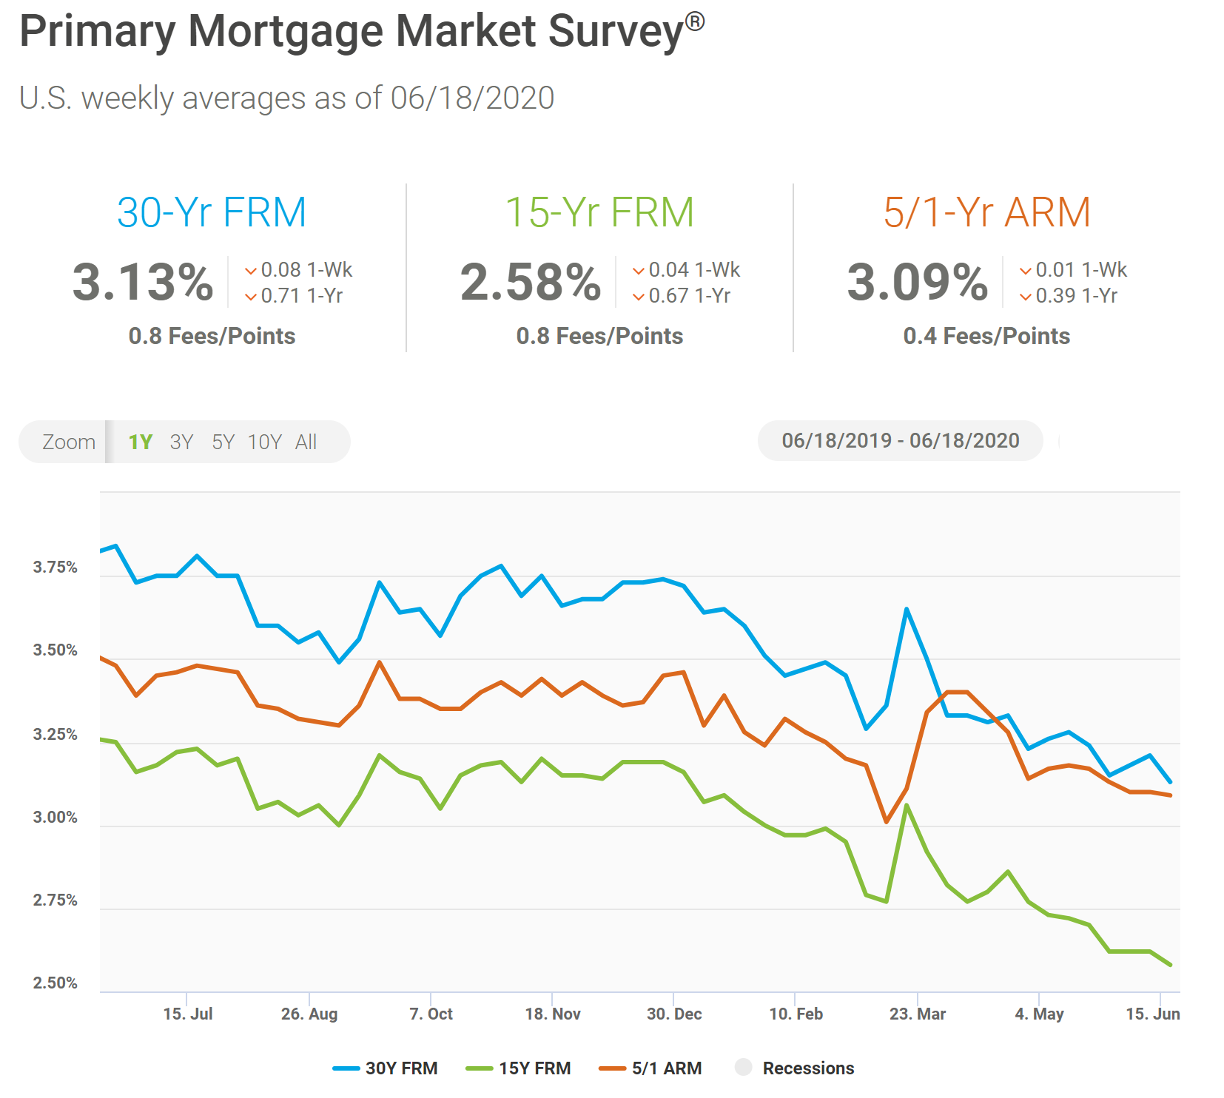

Slide 33
Purchase Applications Increase
Notes:
https://www.housingwire.com/articles/heres-evidence-of-v-shaped-recovery/?utm_medium=email&_hsmi=89073747&_hsenc=p2ANqtz-_Y2M83tn81H8FoLvOm-o-Es_vfAXdHPuXsAxqjUlAt_t4g5Pso1ZzS4lM6LBKvi80hESZpxysyJ0bFFJzbDh8McV_DY7c0CrG2LGa8hVe7NNEitD0&utm_content=89073747&utm_source=hs_email#

Slide 34
Google reports that searches for “homes for sale” are up 54% from 2020 lows.
Zillow reports that traffic is up 51% from last year.
Mortgage Bankers Association reports that new mortgage applications increased 9.3 percent from the prior week.
NAR revised their 2020 Units Forecast to -11% (up from -15%) and home values to +3.8% (up from flat).
Zelman & Associates revised their 2020 Units Forecast to -8% (up from -12%) and forecasts home values to gain 3% due to extremely low inventory.
Fed to purchase Corporate Bonds - $750 Billion. Will support corporations who employ potential buyers!

Slide 35
Home Prices Projected to Continue to Appreciate
Source | 2020 | 2021 | 2022
Home Price Expectation Survey | -0.32 | +0.94 | +2.88
Mortgage Bankers Association | +4.3 | +3.2 | +2.4
Zelman & Assoc. | +3.0 | +4.2 | +4.6
Fannie Mae | +0.4 | +2.1 | N/A
National Association of Realtors | +3.8 | +2.1 | N/A
Freddie Mac | +0.4 | +0.7 | N/A
Notes:
https://pulsenomics.com/surveys/
http://www.freddiemac.com/fmac-resources/research/pdf/202004-Forecast.pdf
https://www.fanniemae.com/resources/file/research/emma/pdf/Housing_Forecast_051320.pdf
https://www.nar.realtor/sites/default/files/documents/forecast-Q2-2020-us-economic-outlook-05-28-2020.pdf
https://www.mba.org/news-research-and-resources/research-and-economics/forecasts-and-commentary
www.zelmanassociates.com (subscription required)
wsj.com (subscription required)

Slide 36
Americans’ Top 4 Choices for Best Long-Term Investment Real Estate Continues to be the Top Choice!
35%
21%
17%
16%
Gallup 2020
Notes:
https://news.gallup.com/poll/309233/stock-investments-lose-luster-covid-sell-off.aspx

Slide 37
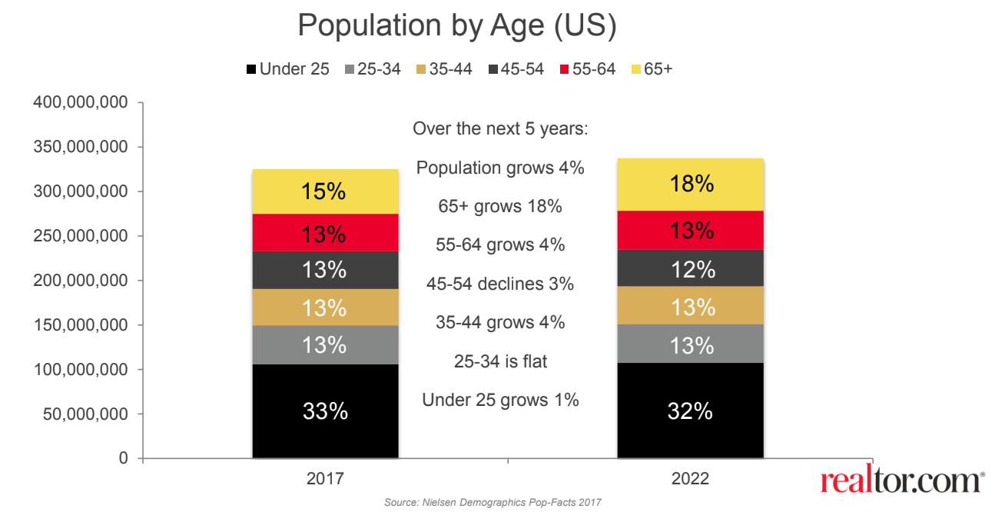
Baby Boomers & Millennials Will Drive The Market!
Millennials will represent over half of all mortgages in 2020 (Realtor.com)
Largest Group of Millennials (4.8 million born in 1990) are turning 30
Baby Boomers are largest buyer segment for Metro Atlanta (marketNsight)

Slide 39
1.) When is the economy going to recover?
2.) Are we going into a recession?
3.) Is this going to be like 2008?
4.) What about all those job losses?
5.) What should I do right now?
Be smart…be patient…but most of all – Stay Safe

