Slide 1
National Economic & Housing Trends

Slide 2
Economy GAINS
2.5 Million Jobs
Employment Gains/Losses by Sector
Unemployment Report Covering Up Until 5/12
U.S. Bureau of Labor Statistics
Notes:
https://www.bls.gov/news.release/empsit.nr0.htm

Slide 3
Explanation of “miscalculation”
Some people who should have been classified as “temporarily unemployed” during the shutdown were instead misclassified as employed but “absent” for “other reasons”.
“Other reasons” are usually people taking a leave to go on vacation, to serve on jury duty or take care of a child or relative.

Slide 4
Unemployment Rate Improved
even with the correction
19.7%
16.3%
5.4%
BLS
Notes:
www.washingtonpost.com/business/2020/06/05/may-2020-jobs-report-misclassification-error/

Slide 5
Total Home Equity Cashed Out
by Refinance in Billions
Then…
Now…
Year | Dollars
2005 | $263B
2006 | $321B
2007 | $240B
Total | $824B
Year | Dollars
2017 | $71B
2018 | $87B
2019 | $89B*
Total | $247B
*Freddie Mac estimate
Freddie Mac
Notes:
http://www.freddiemac.com/research/datasets/refinance-stats/index.page

Slide 6
Percentage of
Homeowner
Equity 2020
John Burns Consulting
Notes:
https://www.realestateconsulting.com

Slide 7
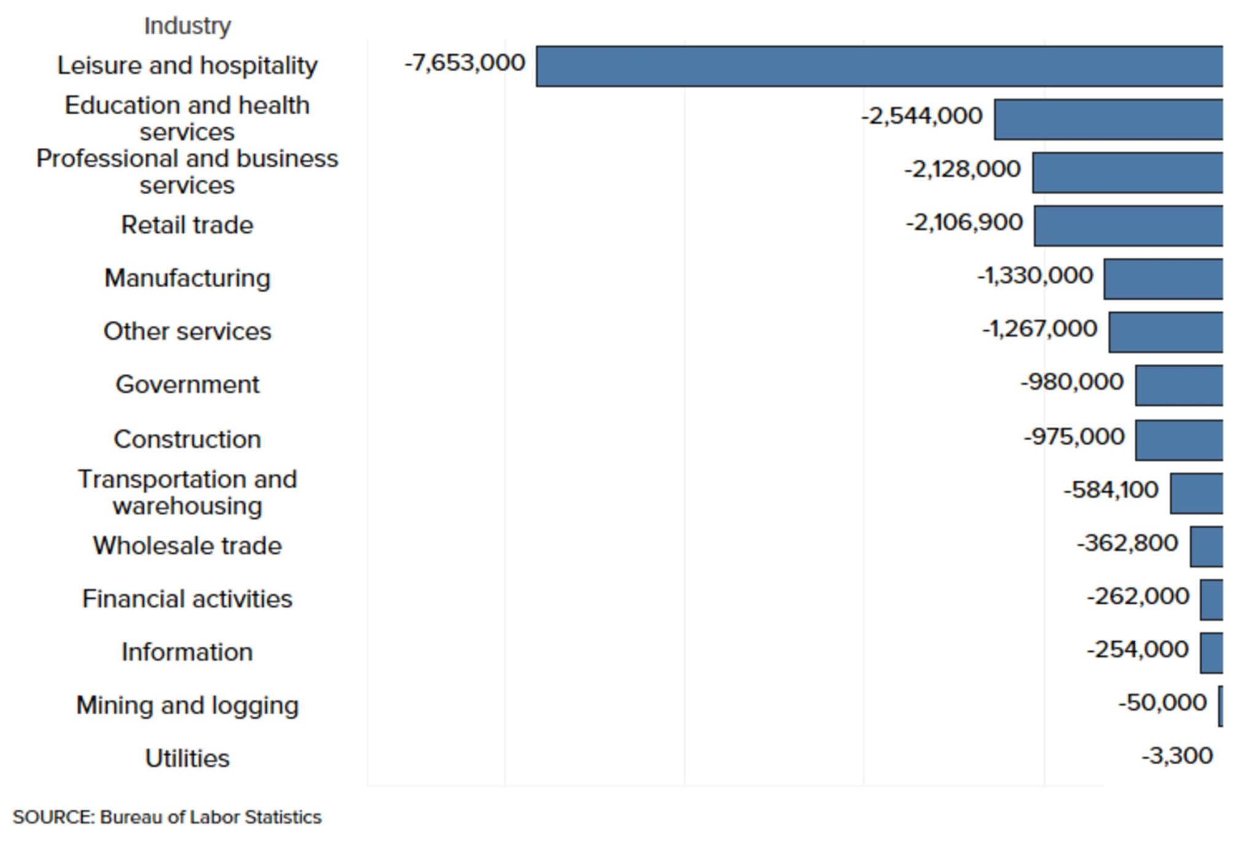
Bureau of Labor Statistics Industry Data - April 2020

Slide 8
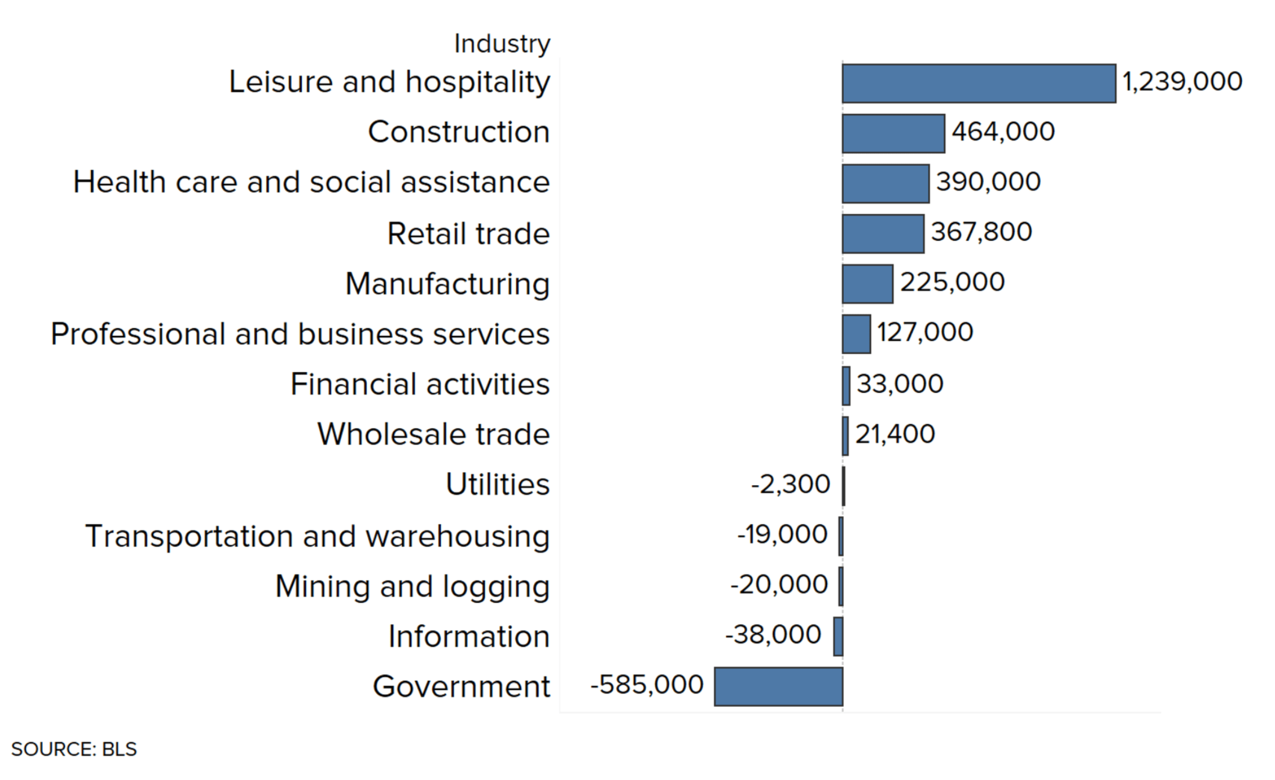
Bureau of Labor Statistics Industry Data - May 2020

Slide 9
Notes:
https://www.calculatedriskblog.com/2020/03/the-economic-outlook.html
https://markets.businessinsider.com/news/stocks/us-recession-coronavirus-gdp-plunge-2q-forecast-economy-morgan-stanley-2020-3-1029023137
https://www.foxbusiness.com/markets/coronavirus-gdp-impact-bigger-than-financial-crisis-j-p-morgan

Slide 10
More Depth, Less Length
2nd
Year
9th
Year
12th
Year
Years for unemployment rate to return to pre-crisis level
Notes:
www.thebalance.com/unemployment-rate-by-year-3305506
What about unemployment and the housing market

Slide 11
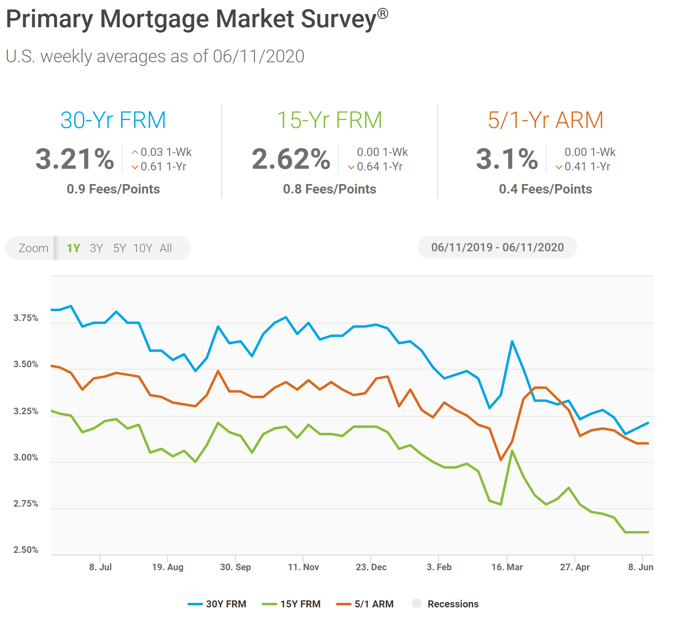

Slide 12
Purchase Applications Increase
Notes:
https://www.housingwire.com/articles/heres-evidence-of-v-shaped-recovery/?utm_medium=email&_hsmi=89073747&_hsenc=p2ANqtz-_Y2M83tn81H8FoLvOm-o-Es_vfAXdHPuXsAxqjUlAt_t4g5Pso1ZzS4lM6LBKvi80hESZpxysyJ0bFFJzbDh8McV_DY7c0CrG2LGa8hVe7NNEitD0&utm_content=89073747&utm_source=hs_email#

Slide 13
Google reports that searches for “homes for sale” are up 54% from 2020 lows.
Zillow reports that traffic is up 51% from last year.
Mortgage Bankers Association reports that new mortgage applications increased 9.3 percent from the prior week.
NAR revised their 2020 Units Forecast to -11% (up from -15%) and home values to +3.8% (up from flat).
Zelman & Associates revised their 2020 Units Forecast to -8% (up from -12%) and forecasts home values to gain 3% due to extremely low inventory.
Real estate is the catalyst to lead our economy back!

Slide 14
Home Prices Projected to Continue to Appreciate
Source | 2020 | 2021 | 2022
Home Price Expectation Survey | -0.32 | +0.94 | +2.88
Mortgage Bankers Association | +4.3 | +3.2 | +2.4
Zelman & Assoc. | +3.0 | +4.2 | +4.6
Fannie Mae | +0.4 | +2.1 | N/A
National Association of Realtors | +3.8 | +2.1 | N/A
Freddie Mac | +0.4 | +0.7 | N/A
Notes:
https://pulsenomics.com/surveys/
http://www.freddiemac.com/fmac-resources/research/pdf/202004-Forecast.pdf
https://www.fanniemae.com/resources/file/research/emma/pdf/Housing_Forecast_051320.pdf
https://www.nar.realtor/sites/default/files/documents/forecast-Q2-2020-us-economic-outlook-05-28-2020.pdf
https://www.mba.org/news-research-and-resources/research-and-economics/forecasts-and-commentary
www.zelmanassociates.com (subscription required)
wsj.com (subscription required)

Slide 15
Americans’ Top 4 Choices for Best Long-Term Investment Real Estate Continues to be the Top Choice!
35%
21%
17%
16%
Gallup 2020
Notes:
https://news.gallup.com/poll/309233/stock-investments-lose-luster-covid-sell-off.aspx

Slide 16
Greater Metro Atlanta
Market
June 2020 Report With Results Through May 2020

Slide 17
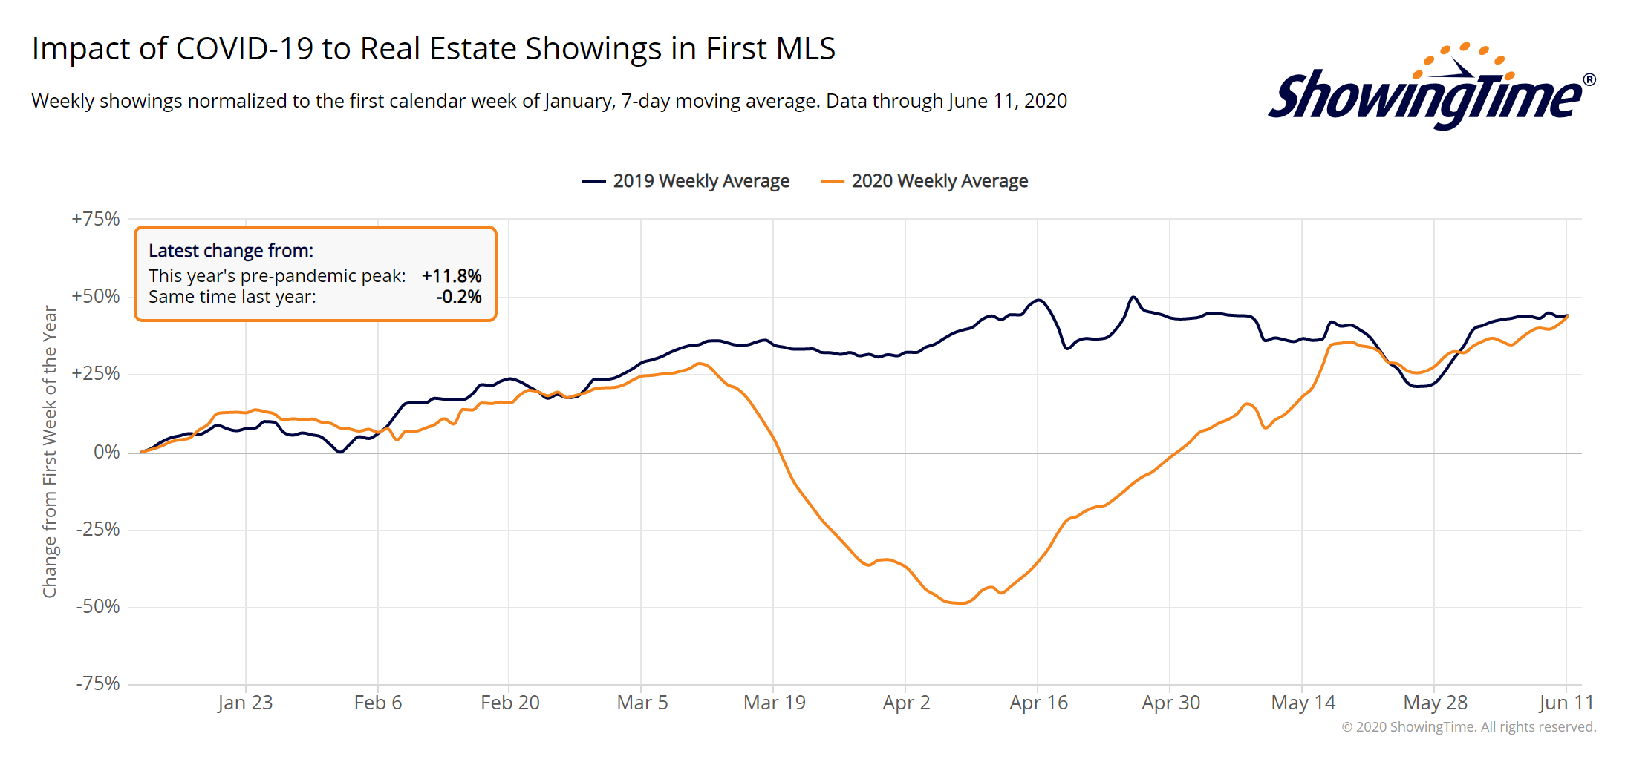
Metro Atlanta Showing Trend
* 2020 showings are higher than shown here due to Virtual Showings and Virtual Open House Showings
Notes:
PGR continues to grow our listing inventory market share. Our Advanced Property Marketing methodology and focused prospecting is making a difference.

Slide 18
Metro Atlanta Under Contract Trend Big Bounce Back!
May Under Contract Up 53.8% Compared To April
May 2020 Under Contract Up 10.1% Compared To May 2019
New Record for Number of Properties Under Contract!
Notes:
PGR continues to grow our listing inventory market share. Our Advanced Property Marketing methodology and focused prospecting is making a difference.

Slide 19
Metro Atlanta 2018-2020 Closing Units
May Closings Down 2.1% Compared To April Closings
May 2020 Closings Down 30.5% Compared To May 2019
Notes:
PGR continues to grow our listing inventory market share. Our Advanced Property Marketing methodology and focused prospecting is making a difference.

Slide 20
Metro Atlanta New Listings Trend
May New Listings Up 15.8% Compared To April
May 2020 New Listings Down 21.3% Compared To May 2019
Notes:
PGR continues to grow our listing inventory market share. Our Advanced Property Marketing methodology and focused prospecting is making a difference.

Slide 21
Metro Atlanta Closings – May 2020 (Number Of Transactions By Price)
86% Of Transactions In $100K-$500K Price Range
Notes:
Months of supply is well below normal in many of our markets. We expect this to continue in 2013.

Slide 22
Metro Atlanta Closed Units By Price Point May 2020 Compared To May 2019
Notes:
Months of supply is well below normal in many of our markets. We expect this to continue in 2013.

Slide 23
Listed Inventory January 2018 – May 2020
All Residential, Metro Atlanta
Inventory Down 4.9% From Last Month Down 16.1% Compared To Last Year
Notes:
PGR continues to grow our listing inventory market share. Our Advanced Property Marketing methodology and focused prospecting is making a difference.

Slide 24
Months of Inventory Change The Market Strategy
GREATER THAN
7 MONTHS
BETWEEN
6-7 MONTHS
LESS THAN
6 MONTHS
SELLERS
MARKET
Home prices
will appreciate
NEUTRAL
MARKET
Home prices
will only appreciate with inflation
BUYERS
MARKET
Home prices
will depreciate
Notes:
Realtor.org

Slide 25
Metro Atlanta Months of Inventory (May 2020, Based On Closed Sales)
6 Months Supply Is Considered Normal Market
Total Metro Atlanta “Months Of Inventory” Is 3.1 Months
Notes:
Months of supply is well below normal in many of our markets. We expect this to continue in 2013.

Slide 26
Metro Atlanta Monthly Average Sale Prices
ASP down 2.7% Compared To Last Month.
Down 2.6% From Last May.
Notes:
PGR continues to grow our listing inventory market share. Our Advanced Property Marketing methodology and focused prospecting is making a difference.

Slide 27
Metro Atlanta Annual Average Sale Prices
Annual ASP Up 80% From Bottom Of 2011
Notes:
PGR continues to grow our listing inventory market share. Our Advanced Property Marketing methodology and focused prospecting is making a difference.

Slide 28
Case-Shiller Index For Metro Atlanta
Jan 2010 Through March 2020 (Reported May 26, 2020)
Home Values Up 87% From Bottom Of March 2012.
Notes:
PGR continues to grow our listing inventory market share. Our Advanced Property Marketing methodology and focused prospecting is making a difference.

Slide 29
Case-Shiller Gain/ Loss For Metro Atlanta
Comparisons Based On The Latest Case Shiller Index Compared
To The Average Index For The Year Property Was Purchased.
Year Property Bought | Gain/ Loss
2003 | 34.24%
2004 | 29.52%
2005 | 23.21%
2006 | 18.11%
2007 | 17.34%
2008 | 28.26%
2009 | 45.11%
2010 | 48.72%
2011 | 59.93%
Year Property Bought | Gain/ Loss
2012 | 73.40%
2013 | 46.52%
2014 | 34.32%
2015 | 27.29%
2016 | 20.24%
2017 | 14.03%
2018 | 7.67%
2019 | 3.14%
2020 | 2.30%
Case Shiller Index For Metro Atlanta - March 2020 As Reported May 26, 2020. Micro-Local Markets And Price Points May Have Significantly Different Outcomes.
Notes:
PGR continues to grow our listing inventory market share. Our Advanced Property Marketing methodology and focused prospecting is making a difference.

Slide 30
Case-Shiller Home Values For Metro Atlanta
Recent Bottom Was March 2012. Metro Average Home Values Back To Normal Trend Line.
Notes:
PGR continues to grow our listing inventory market share. Our Advanced Property Marketing methodology and focused prospecting is making a difference.

Slide 31
Metro Atlanta Brokerage Rankings

Slide 32
Annual Closed Volume – May 2020 FMLS Counties + Southern Crescent
($ Volume in Thousands)
Information Provided By Trendgraphix and BHHS Georgia Properties Internal Reports.
Notes:
In the past three years, our company has consistently grown our market share in both listing inventory and the sales of that inventory. Today, we are Ranked #1 in both categories.

