Slide 1
National Economic & Housing Trends

Slide 2
Economy GAINS
4.8 Million Jobs
Employment gains/losses by sector
Unemployment Report Covering Up Until Mid-May
-10K
U.S. Bureau of Labor Statistics
Notes:
https://www.bls.gov/news.release/empsit.nr0.htm

Slide 3
BLS Unemployment Rate
…as reported
BLS
Notes:
https://www.bls.gov/news.release/empsit.nr0.htm

Slide 4
Breakdown of U.S. Bureau
of Labor Statistics 7/2/2020
Unemployment Report Covering Up Until 6/13
Notes:
https://www.bls.gov/news.release/empsit.nr0.htm

Slide 5
Total Home Equity Cashed Out
by Refinance in Billions
Then…
Now…
Year | Dollars
2005 | $263B
2006 | $321B
2007 | $240B
Total | $824B
Year | Dollars
2017 | $71B
2018 | $87B
2019 | $89B*
Total | $247B
*Freddie Mac estimate
Freddie Mac
Notes:
http://www.freddiemac.com/research/datasets/refinance-stats/index.page

Slide 6
Percentage of
Homeowner
Equity 2020
John Burns Consulting
Notes:
https://www.realestateconsulting.com

Slide 7
Of all active forbearances which are past due on their mortgage payment, 77% have at least 20% equity in their home and 90% have at least 10% equity.
Black Knight
Notes:
https://cdn.blackknightinc.com/wp-content/uploads/2020/06/BKI_MM_Apr2020_Report.pdf

Slide 8
Notes:
https://www.calculatedriskblog.com/2020/03/the-economic-outlook.html
https://markets.businessinsider.com/news/stocks/us-recession-coronavirus-gdp-plunge-2q-forecast-economy-morgan-stanley-2020-3-1029023137
https://www.foxbusiness.com/markets/coronavirus-gdp-impact-bigger-than-financial-crisis-j-p-morgan

Slide 9
More Depth, Less Length
2nd
Year
9th
Year
12th
Year
Years for unemployment rate to return to pre-crisis level
Notes:
www.thebalance.com/unemployment-rate-by-year-3305506
What about unemployment and the housing market

Slide 10
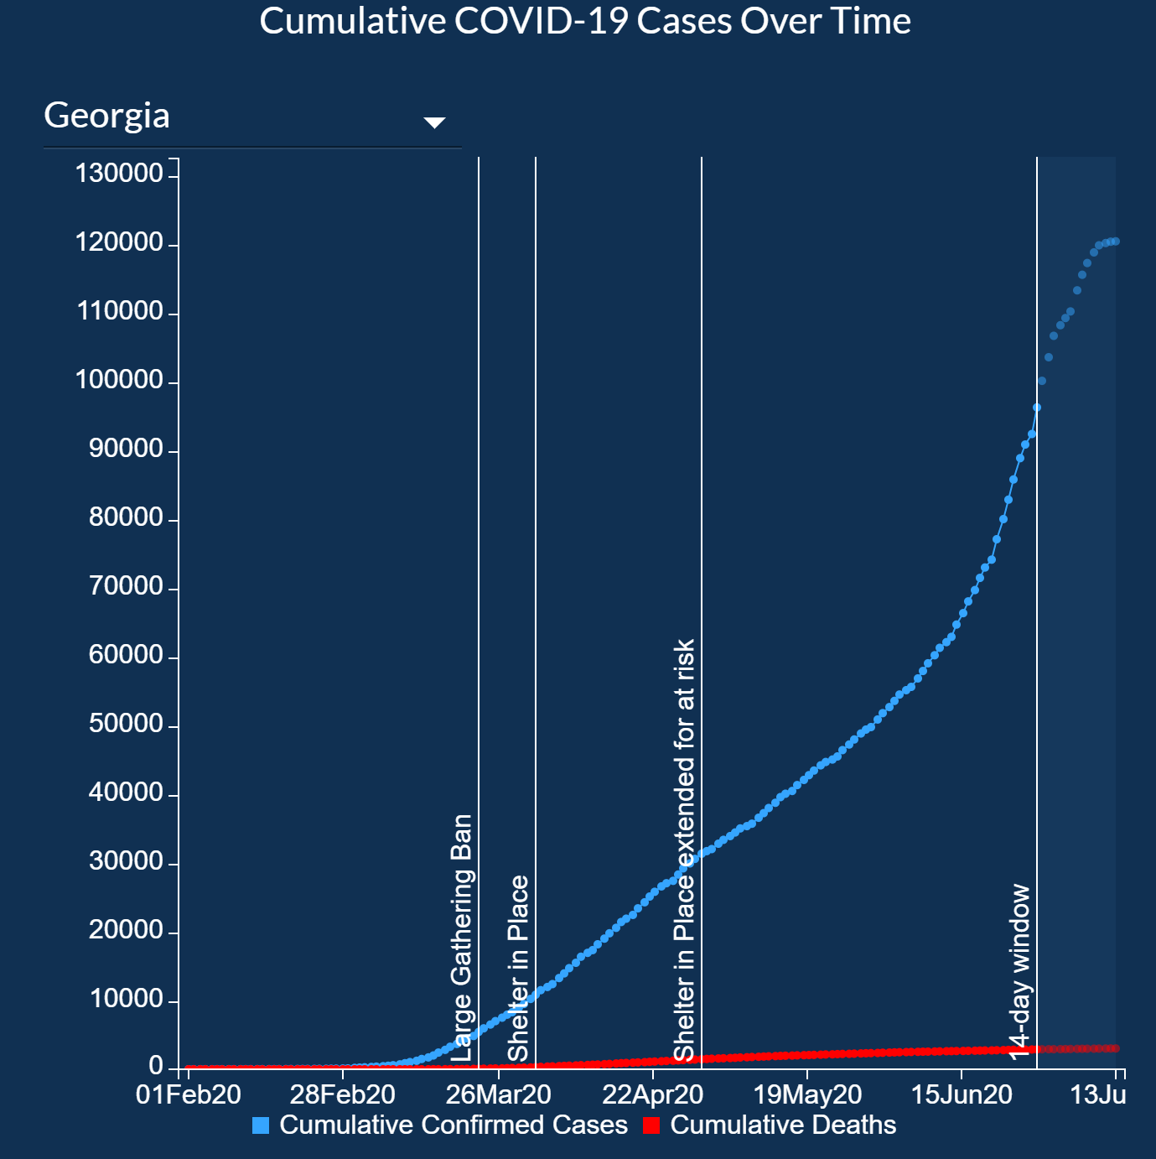
Notes:
https://www.showingtime.com/impact-of-coronavirus/

Slide 11
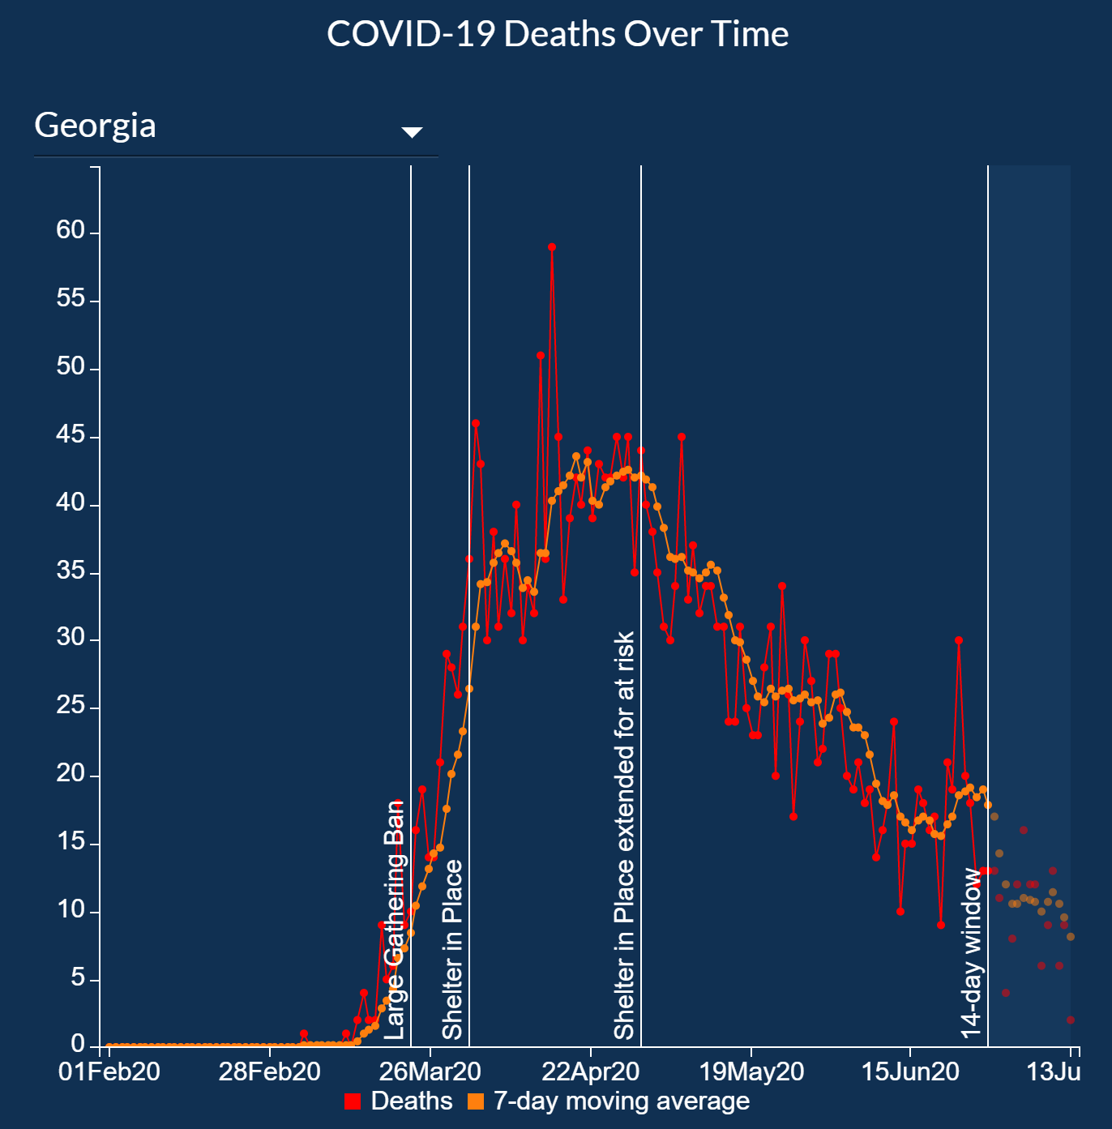
Notes:
https://www.showingtime.com/impact-of-coronavirus/

Slide 12
Showings in North America
Weekly showings normalized
to the first calendar week of
January, 7-day moving average.
ShowingTime
Notes:
https://www.showingtime.com/impact-of-coronavirus/

Slide 13
Year-Over-Year Change in Buyer Viewing Appointments
Virtual and In-Person Combined
NATIONAL
+21.4%
ShowingTime’s Showing Index June 22nd, 2020
Northeast
+19.6%
South
+23.2%
Midwest
+20.1%
West
+19.6%
Notes:
https://www.showingtime.com/blog/may-2020-showing-index-results/

Slide 14
Newly Pending Sales
UP 18.8%
Month-Over-Month
New Listings Taken
UP 5.2%
Month-Over-Month
Zillow’s July 2nd Report
Total Listings
Down 20.7%
Year-Over-Year
New Listings Taken
Down 16.6%
Year-Over-Year
Notes:
http://zillow.mediaroom.com/2020-07-02-Pending-Sales-Dipped-Slightly-Last-Week-But-Homes-Are-Still-Moving-at-Record-Pace

Slide 15
Inventory as a percent of households
is half of the long-run average
…an all-time low!
Notes:
zelmanassociates.com (subscription required)

Slide 16
Home Prices Projected to Continue to Appreciate
Source | 2020 | 2021 | 2022
Home Price Expectation Survey | -0.32 | +0.94 | +2.88
Mortgage Bankers Association | +4.0 | +2.9 | +2.2
Zelman & Assoc. | +3.0 | +4.2 | +4.6
Fannie Mae | +0.4 | +2.1 | N/A
National Association of Realtors | +3.6 | +2.8 | N/A
Freddie Mac | +2.3 | +0.4 | N/A
Notes:
https://pulsenomics.com/surveys/
http://www.freddiemac.com/fmac-resources/research/pdf/202004-Forecast.pdf
https://www.fanniemae.com/resources/file/research/emma/pdf/Housing_Forecast_061520.pdf
https://www.nar.realtor/research-and-statistics
https://www.mba.org/news-research-and-resources/research-and-economics/forecasts-and-commentary
www.zelmanassociates.com (subscription required)
wsj.com (subscription required)
Source Slide: December 2019 Monthly Market Report Slide #8

Slide 17
“The severity of inventory tightness should remain a relative benefit to home
prices, but is also a risk factor to the degree of rebound in unit sales going forward.”
Zelman Associates
June 25th Broker Report
Notes:
zelmanassociates.com (subscription required)

Slide 18
“The housing market is likely benefiting from low mortgage rates, stronger demand for larger spaces as more and more people work from home and a desire to move away from crowded cities to avoid exposure to the coronavirus.”
Rubeela Farooqi
Economist at High Frequency Economics
Notes:
https://economics.cmail19.com/t/ViewEmail/d/444AAA03A7E3F06A2540EF23F30FEDED/5323CD85A2087AFD22947492D9797BBC

Slide 19
“Nearly 30% of respondents living in a high-density urban area say that the pandemic is prompting them to want to move by the end of the year...This is more than double the rate of those living in rural parts of the country, where residents are much more likely to stay put rather than to relocate.”
Realtor Magazine
Notes:
https://magazine.realtor/daily-news/2020/06/24/coronavirus-may-spark-more-moves

Slide 20
Buyers Showing a Greater Desire
for Non-Urban Properties
Year-Over-Year increase
in views per property
Notes:
https://news.move.com/2020-06-17-Suburban-Housing-Markets-Quicker-to-Bounce-Back-from-COVID-19

Slide 21
Since the pandemic altered what buyers value in their homes, builders are predicting how future homes will change as a result, and what people will want most moving forward.
As people spend more time at home during the pandemic, buyers are realizing which features of their homes are working, and not working.
Home builders predict open-concept floor plans will be a thing of the past, as people now value more walls, doors, and overall privacy.
New construction, which offers the chance to personalize home features, saw its listing page views grow by 73% over last May.
Zillow Report
Notes:
http://zillow.mediaroom.com/2020-06-22-The-End-of-Open-Floor-Plans-How-Homes-Will-Look-Different-After-Coronavirus

Slide 22
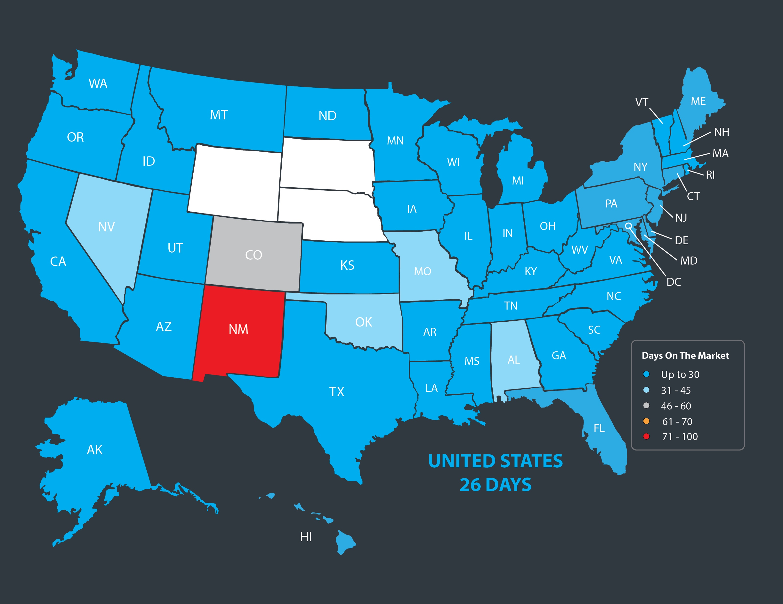
Average Days on the Market
NAR
Notes:
https://www.nar.realtor/research-and-statistics/research-reports/realtors-confidence-index

Slide 23
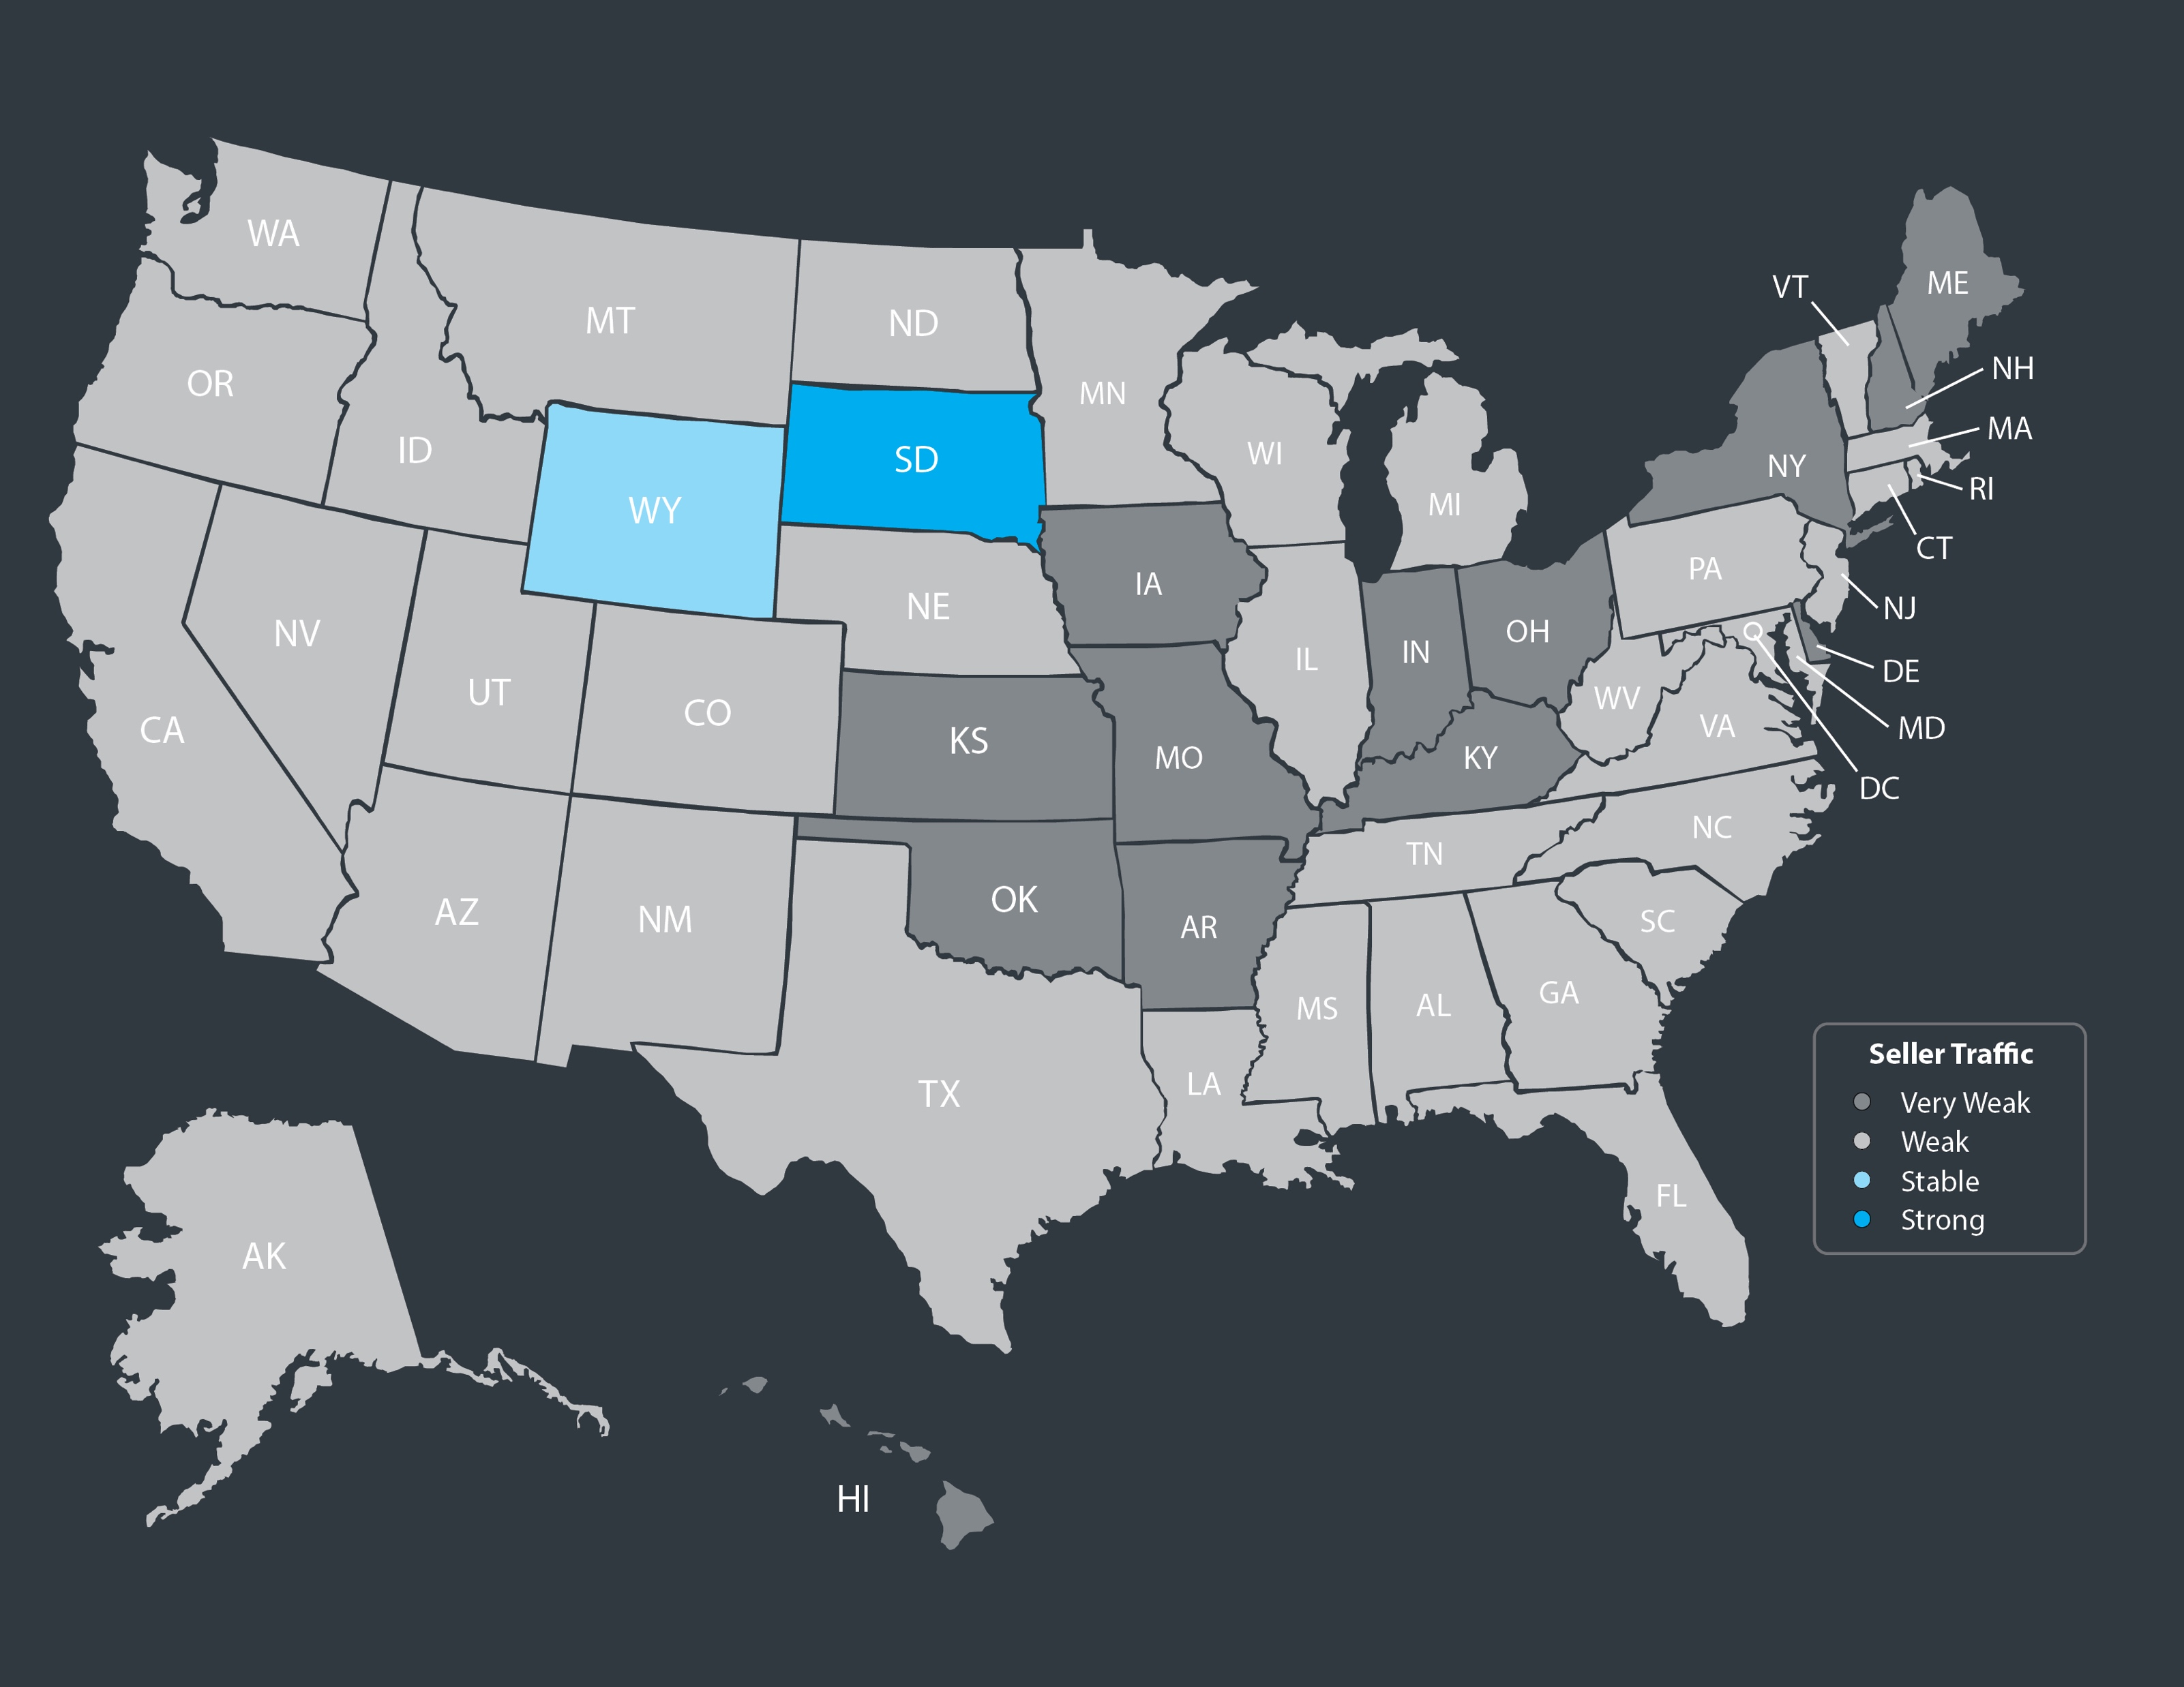
Seller Traffic Index
NAR
Notes:
https://www.nar.realtor/research-and-statistics/research-reports/realtors-confidence-index

Slide 24
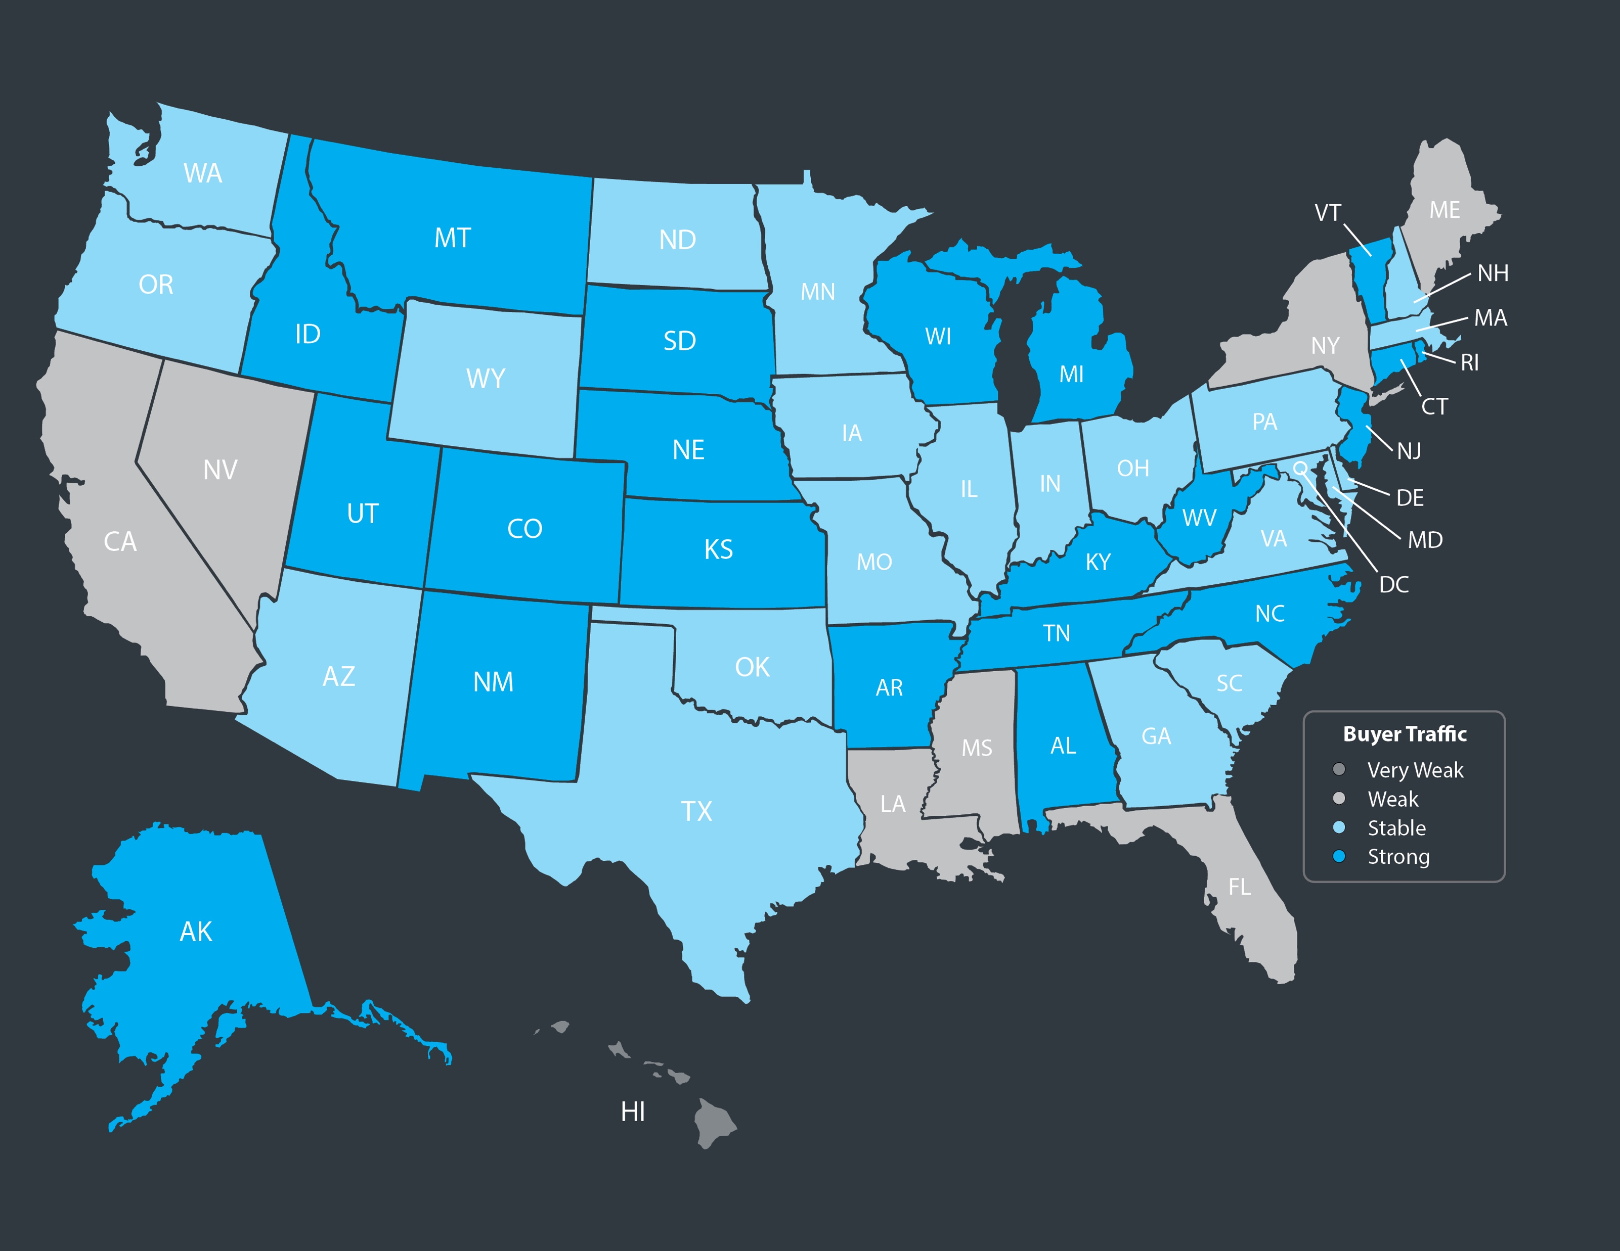
Buyer Traffic Index
NAR
Notes:
https://www.nar.realtor/research-and-statistics/research-reports/realtors-confidence-index

Slide 25
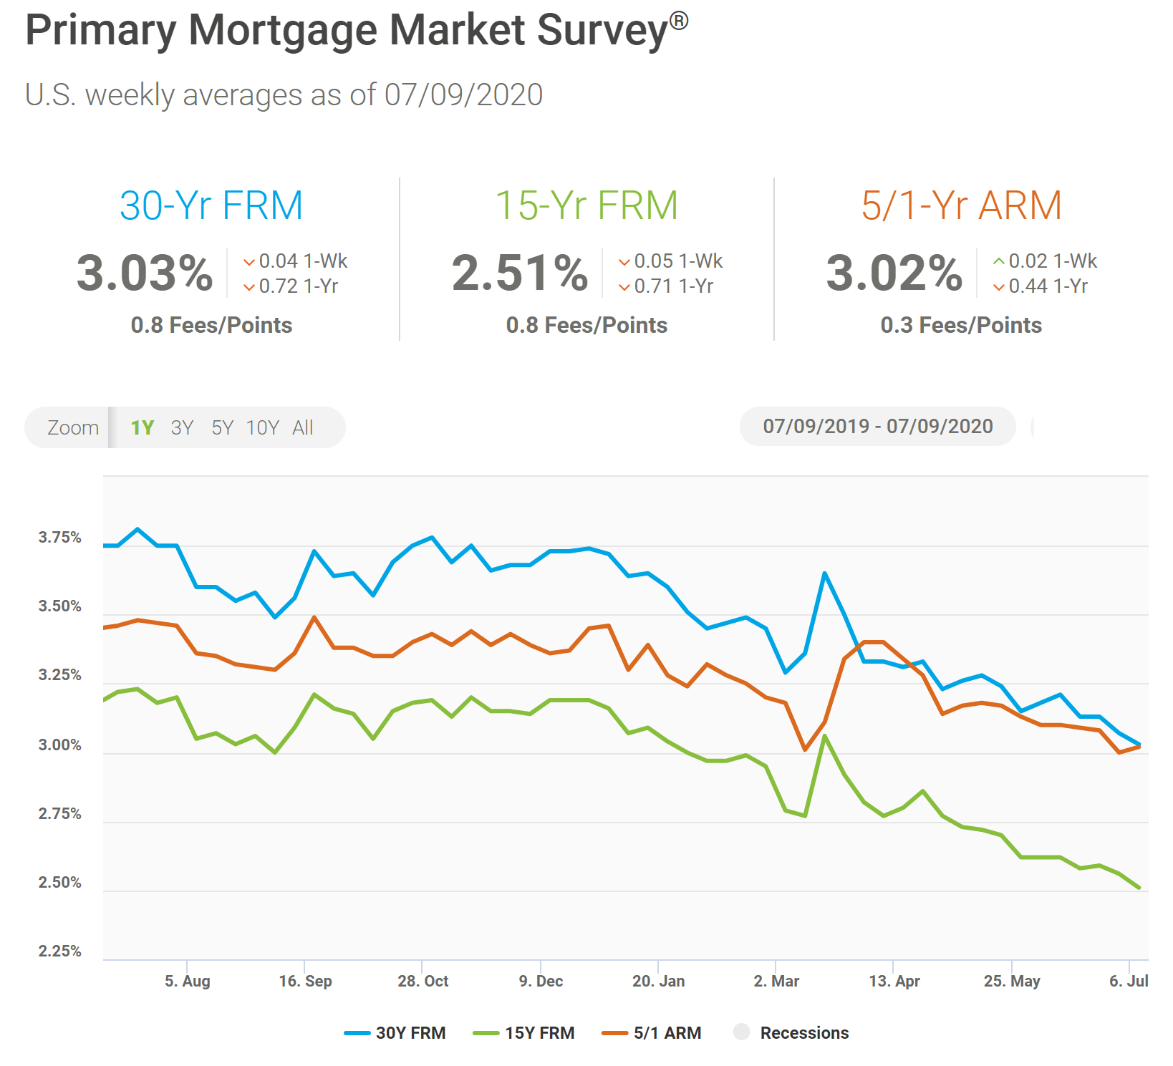

Slide 26
Mortgage Rate Projections
Quarter | Freddie Mac | Fannie Mae | MBA | NAR | Average of All Four
2020 3Q | 3.3 | 3.1 | 3.4 | 3.1 | 3.22%
2020 4Q | 3.3 | 3.0 | 3.4 | 3.0 | 3.17%
2021 1Q | 3.2 | 2.9 | 3.3 | 3.1 | 3.12%
2021 2Q | 3.2 | 2.9 | 3.3 | 3.1 | 3.12%
Notes:
http://www.freddiemac.com/fmac-resources/research/pdf/202006-Forecast.pdf
https://www.fanniemae.com/resources/file/research/emma/pdf/Housing_Forecast_061520.pdf
https://www.mba.org/news-research-and-resources/research-and-economics/forecasts-and-commentary
https://www.nar.realtor/sites/default/files/documents/forecast-Q2-2020-us-economic-outlook-06-29-2020.pdf

Slide 27
Americans’ Top 4 Choices for Best Long-Term Investment Real Estate Continues to be the Top Choice!
35%
21%
17%
16%
Gallup 2020
Notes:
https://news.gallup.com/poll/309233/stock-investments-lose-luster-covid-sell-off.aspx

Slide 28
Greater Metro Atlanta
Market
July 2020 Report With Results Through June 2020

Slide 29
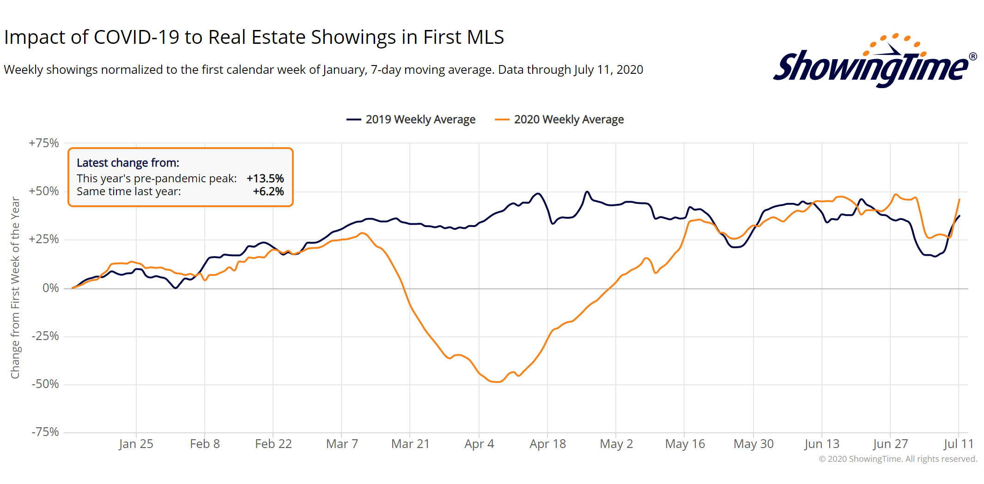
Metro Atlanta Showing Trend
* 2020 showings are higher than shown here due to Virtual Showings and Virtual Open House Showings
Notes:
PGR continues to grow our listing inventory market share. Our Advanced Property Marketing methodology and focused prospecting is making a difference.

Slide 30
Metro Atlanta Under Contract Trend The Big Bounce Back Continues!
June Under Contract Up 12.95% Compared To May
June 2020 Under Contract Up 25.12% Compared To June 2019
Notes:
PGR continues to grow our listing inventory market share. Our Advanced Property Marketing methodology and focused prospecting is making a difference.

Slide 31
Metro Atlanta New Listings Trend
June New Listings Up 5.27% Compared To May
June 2020 New Listings Down 9.45% Compared To June 2019
Notes:
PGR continues to grow our listing inventory market share. Our Advanced Property Marketing methodology and focused prospecting is making a difference.

Slide 32
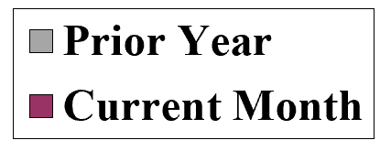
Metro Atlanta 2018-2020 Closing Units
June Closings Up 35.89% Compared To May Closings
June 2020 Closings Up 1.04% Compared To June 2019
Notes:
PGR continues to grow our listing inventory market share. Our Advanced Property Marketing methodology and focused prospecting is making a difference.

Slide 33
Metro Atlanta Closings – June 2020 (Number Of Transactions By Price)
85% Of Transactions In $100K-$500K Price Range
Notes:
Months of supply is well below normal in many of our markets. We expect this to continue in 2013.

Slide 34
Metro Atlanta Closed Units By Price Point June 2020 Compared To June 2019
Notes:
Months of supply is well below normal in many of our markets. We expect this to continue in 2013.

Slide 35
Listed Inventory January 2018 – June 2020
All Residential, Metro Atlanta
Inventory Down 12.1% From Last Month Down 38.6% Compared To Last Year
Notes:
PGR continues to grow our listing inventory market share. Our Advanced Property Marketing methodology and focused prospecting is making a difference.

Slide 36
Months of Inventory Change The Market Strategy
GREATER THAN
7 MONTHS
BETWEEN
6-7 MONTHS
LESS THAN
6 MONTHS
SELLERS
MARKET
Home prices
will appreciate
NEUTRAL
MARKET
Home prices
will only appreciate with inflation
BUYERS
MARKET
Home prices
will depreciate
Notes:
Realtor.org

Slide 37
Metro Atlanta Months of Inventory (June 2020, Based On Closed Sales)
6 Months Supply Is Considered Normal Market
Total Metro Atlanta “Months Of Inventory” Is 2 Months
Notes:
Months of supply is well below normal in many of our markets. We expect this to continue in 2013.

Slide 38
Metro Atlanta Continuous Days on Market June 2020
Total Metro Atlanta CDOM is 53 Days
Notes:
Months of supply is well below normal in many of our markets. We expect this to continue in 2013.

Slide 39
Metro Atlanta List to Sale Ratio June 2020
Total Metro Atlanta List To Sale Ratio is 97%
Notes:
Months of supply is well below normal in many of our markets. We expect this to continue in 2013.

Slide 40
Metro Atlanta Monthly Average Sale Prices
ASP Up 5% Compared To Last Month.
Up 1.8% From Last June.
Notes:
PGR continues to grow our listing inventory market share. Our Advanced Property Marketing methodology and focused prospecting is making a difference.

Slide 41
Metro Atlanta Annual Average Sale Prices
Annual ASP Up 80% From Bottom Of 2011
Notes:
PGR continues to grow our listing inventory market share. Our Advanced Property Marketing methodology and focused prospecting is making a difference.

Slide 42
Case-Shiller Index For Metro Atlanta
Jan 2010 Through March 2020 (Reported June 30, 2020)
Home Values Up 63.53% From Bottom Of March 2012.
Notes:
PGR continues to grow our listing inventory market share. Our Advanced Property Marketing methodology and focused prospecting is making a difference.

Slide 43
Case-Shiller Gain/ Loss For Metro Atlanta
Comparisons Based On The Latest Case Shiller Index Compared
To The Average Index For The Year Property Was Purchased.
Year Property Bought | Gain/ Loss
2003 | 34.69%
2004 | 29.25%
2005 | 21.86%
2006 | 15.72%
2007 | 14.60%
2008 | 24.54%
2009 | 38.69%
2010 | 41.48%
2011 | 46.67%
Year Property Bought | Gain/ Loss
2012 | 52.80%
2013 | 35.91%
2014 | 25.66%
2015 | 20.10%
2016 | 14.89%
2017 | 10.55%
2018 | 6.18%
2019 | 3.10%
2020 | 2.53%
Case Shiller Index For Metro Atlanta - April 2020 As Reported June 30, 2020. Micro-Local Markets And Price Points May Have Significantly Different Outcomes.
Notes:
PGR continues to grow our listing inventory market share. Our Advanced Property Marketing methodology and focused prospecting is making a difference.

Slide 44
Case-Shiller Home Values For Metro Atlanta
Recent Bottom Was March 2012. Metro Average Home Values Back To Normal Trend Line.
Notes:
PGR continues to grow our listing inventory market share. Our Advanced Property Marketing methodology and focused prospecting is making a difference.

Slide 45
Metro Atlanta Brokerage Rankings

Slide 46
Annual Closed Volume – May 2020 FMLS Counties + Southern Crescent
($ Volume in Thousands)
Information Provided By Trendgraphix and BHHS Georgia Properties Internal Reports.
Notes:
In the past three years, our company has consistently grown our market share in both listing inventory and the sales of that inventory. Today, we are Ranked #1 in both categories.

