Slide 1
The Economy
and Real Estate

Slide 2
Americans Choose Real Estate as Safest Investment
What do you believe is the safest
investment over the next 10 years?
(Top 5 Answers)
Porch.com

Slide 3
Average Economic Impact of
One Existing Home Sale in the U.S.
$43,099
Income generated from
real estate industries
Expenditures related to home purchase
Multiplier of housing related expenditures
$24,471
27.7%
of total impact
+
$4,650
5.3%
of total impact
+
$13,978
15.8%
of total impact
NAR calculated the total economic impact of real estate-related industries on the state economy, as well as the expenditures that result from a single home sale.
NAR
Notes:
https://www.nar.realtor/sites/default/files/documents/2019-state-economic-impact-of-real-estate-activity-us-04-14-2020.pdf
https://www.nar.realtor/reports/state-by-state-economic-impact-of-real-estate-activity

Slide 4
Average Economic Impact of
One New Home Sale in the U.S.
$88,416
Income generated from
real estate industries
Expenditures related to home purchase
Multiplier of housing related expenditures
New home construction
$24,471
27.7%
of total impact
+
$4,650
5.3%
of total impact
+
$13,978
15.8%
of total impact
+
$45,317
51.3%
of total impact
NAR calculated the total economic impact of real estate-related industries on the state economy, as well as the expenditures that result from a single home sale, including aspects like home construction costs, real estate brokerage, mortgage lending and title insurance.
NAR
Notes:
https://www.nar.realtor/sites/default/files/documents/2019-state-economic-impact-of-real-estate-activity-us-04-14-2020.pdf
https://www.nar.realtor/reports/state-by-state-economic-impact-of-real-estate-activity

Slide 5
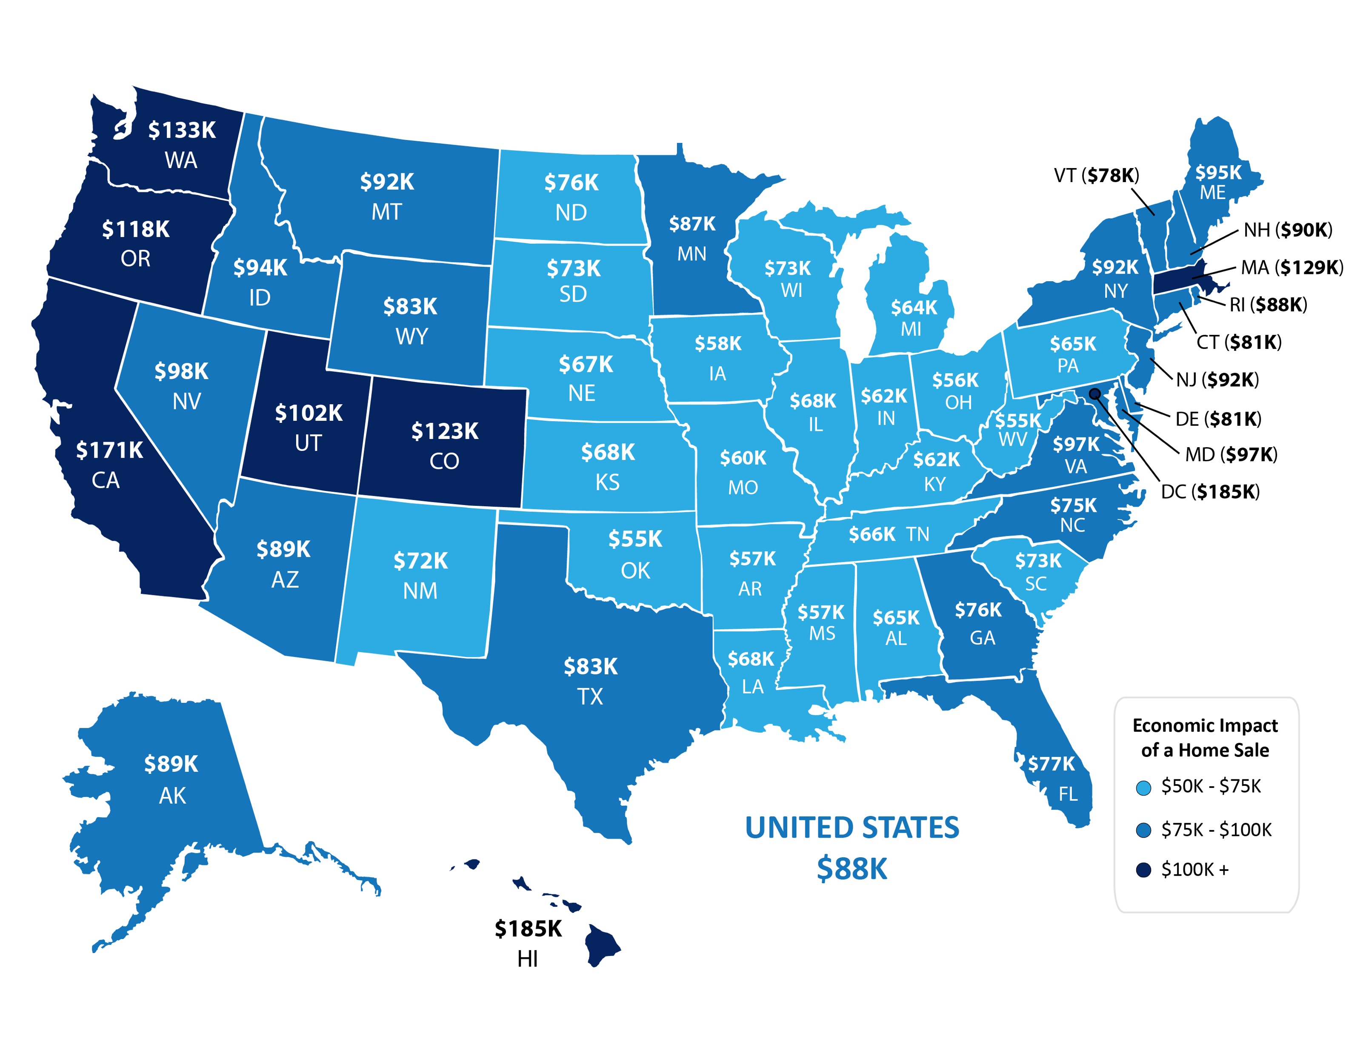
Average Economic Impact of One Home Sale by State
NAR
Notes:
https://www.nar.realtor/sites/default/files/documents/2019-state-economic-impact-of-real-estate-activity-us-04-14-2020.pdf
https://www.nar.realtor/reports/state-by-state-economic-impact-of-real-estate-activity

Slide 6
U.S. Homeownership % Rates
Q1 Results
Census
Notes:
https://www.census.gov/housing/hvs/files/currenthvspress.pdf

Slide 7
Homeownership Rates
U.S. Percentage Last 4 Quarters
Census
Notes:
https://www.census.gov/housing/hvs/files/currenthvspress.pdf

Slide 8
How does the current environment compare to past downturns?
Be smart…be patient…but most of all – Stay Safe

Slide 9
1991
2008
HOME PRICE CHANGE
During Last 5 Recessions
CoreLogic
Notes:
https://www.corelogic.com/blog/2019/03/housing-recessions-and-recoveries.aspx

Slide 10
Annual Home Price Appreciation
The 6 years leading up
to the housing crash
The last 6 years
Black Knight
Notes:
https://www.blackknightinc.com/black-knights-december-2019-mortgage-monitor-2/

Slide 11
Total Home Equity Cashed Out
by Refinance in Billions
Then…
Now…
Year | Dollars
2005 | $263B
2006 | $321B
2007 | $240B
Total | $824B
Year | Dollars
2017 | $71B
2018 | $87B
2019 | $89B*
Total | $247B
*Freddie Mac estimate
Freddie Mac
Notes:
http://www.freddiemac.com/research/datasets/refinance-stats/index.page

Slide 12
Percentage of
Homeowner
Equity 2020
John Burns Consulting
Notes:
https://www.realestateconsulting.com

Slide 13
Of all active forbearances which are past due on their mortgage payment, 77% have at least 20% equity in their home and 90% have at least 10% equity.
Black Knight
Notes:
https://cdn.blackknightinc.com/wp-content/uploads/2020/06/BKI_MM_Apr2020_Report.pdf

Slide 14
Percentage of Income Needed for a Mortgage Payment
Decreasing Dramatically as Mortgage Rates Fall
Historic Norm 21.2%
National Association of Realtors
Notes:
https://www.nar.realtor/blogs/economists-outlook/housing-affordability-in-april-2020?hs_social=twitter&hs_profile=nar_research&hs_sid=38ba364c-382e-45af-b7f3-d8b158832634

Slide 15
Housing Bubble 2006: 868.7
MORTGAGE CREDIT AVAILABILITY INDEX
The taller the graph, the
easier it is to get a loan
Today:
181.3
MBA
Notes:
https://www.mba.org/news-research-and-resources/newsroom
https://www.mba.org/news-research-and-resources/research-and-economics/single-family-research/mortgage-credit-availability-index

Slide 16
Months Inventory of Homes for Sale
NAR
Notes:
nar.realtor

Slide 17
When is the economy likely to recover?
Be smart…be patient…but most of all – Stay Safe

Slide 18
“A strong economic recovery depends on effective and sustained containment of Covid-19, economists said in the latest monthly survey by The Wall Street Journal, with 91% of business and academic economists agreeing ‘somewhat’ or ‘strongly’ that economic recovery depends on containing the pandemic.”
Wall Street Journal
Notes:
https://www.wsj.com/articles/wsj-survey-strong-u-s-recovery-depends-on-effective-covid-19-response-11594303200(subscription required)

Slide 19
91.2% of economists surveyed by the WSJ
say the recovery is already underway
or will be soon
WSJ
Notes:
https://www.wsj.com/graphics/econsurvey/

Slide 20
82.8% of economists surveyed
by the WSJ say the recovery will
be in some form of a ‘V’ shape
(‘Nike Swoosh’ or a Traditional ‘V’)
WSJ
Notes:
https://www.wsj.com/graphics/econsurvey/

Slide 21
“The first stage of the recovery looks V-shaped. After bottoming out in April, economic activity has continued to rise into early June, according to a range of private data… An L-shaped recovery, in which activity stays depressed, now looks remote. And while the overall recovery may not end up a V, it may also be less feeble than many had feared.”
Greg Ip
Wall Street Journal
6/15/2020
Notes:
https://economics.cmail20.com/t/ViewEmail/d/34B2ED34A953B9F82540EF23F30FEDED/5323CD85A2087AFD22947492D9797BBC

Slide 22
Showings in North America
Weekly showings normalized
to the first calendar week of
January, 7-day moving average.
ShowingTime
Notes:
https://www.showingtime.com/impact-of-coronavirus/

Slide 23
“The housing recovery has been nothing short of remarkable. The expectation was that housing would be crushed. It was—for about two months—and then it came roaring back.”
Ali Wolf
Chief Economist of Meyers Research
Notes:
https://www.realtor.com/news/trends/housing-market-rebounds/

Slide 24
The Housing Market Recovery Index
February 1st Baseline = 100
Combines 4 components:
1. Demand
2. Supply
3. Price
4. Time on the market
realtor.com
Notes:
https://news.move.com/2020-07-16-Realtor-com-R-Weekly-Recovery-Report-Fierce-Competition-Ahead-for-Would-be-Home-Buyers

Slide 25
What about the impact of unemployment?
Be smart…be patient…but most of all – Stay Safe

Slide 26
The consensus was for 3,074,000 jobs
to be added in June.
4,800,000 jobs
were added!!
Notes:
https://www.calculatedriskblog.com/2020/07/adp-private-employment-increased.html

Slide 27
Unemployment: Clarifying not Terrifying
Actual
*Actual unemployment rates **WSJ survey of Economists projections
Notes:
https://www.thebalance.com/unemployment-rate-by-year-3305506
https://www.wsj.com/graphics/econsurvey/
https://www.bls.gov/news.release/empsit.nr0.htm

Slide 28
A Complete Look at Unemployment Numbers
in millions
N/A
Department of Labor
Notes:
file:///C:/Users/Steve%20Harney/AppData/Local/Microsoft/Windows/INetCache/Content.Outlook/VM0A22XH/data.pdf

Slide 29
Potential Buyers Coming to the Market
Number of Jobs Added
by Age Group
BLS
Notes:
https://www.bls.gov/news.release/archives/empsit_07022020.htm

Slide 30
“U.S. job growth surged last month, underscoring the economy’s capacity for a quick rebound if businesses continue to reopen and consumers regain confidence.
A recent coronavirus spike, however, could undermine trends captured in the latest jobs report.”
Wall Street Journal
Notes:
https://economics.cmail19.com/t/ViewEmail/d/BA2971B94423D2202540EF23F30FEDED/5323CD85A2087AFD22947492D9797BBC (subscription required)

Slide 31
More Depth, Less Length
4th Year
9th Year
12th Year
Years for unemployment rate to return to pre-crisis level
Notes:
www.thebalance.com/unemployment-rate-by-year-3305506
www.wsj.com (subscription required)
https://www.bls.gov/news.release/empsit.nr0.htm

Slide 32
Unemployment Rates and Home Sales
Do Not Have a Truly Direct Relationship
Existing Home Sales (Bars)
Unemployment Rate (Line)
1
3
2
U.S. Bureau of Labor Statistics, NAR, MBA
Notes:
https://www.nar.realtor/research-and-statistics/housing-statistics/existing-home-sales
https://data.bls.gov/timeseries/LNU04000000?years_option=all_years&periods_option=specific_periods&periods=Annual+Data
https://data.bls.gov/timeseries/LNS14000000

Slide 33
Unemployment Rates, Home Sales
& Mortgage Availability
Mortgage Availability
9.6%
U.S. Bureau of Labor Statistics, NAR, MBA
Notes:
https://www.nar.realtor/research-and-statistics/housing-statistics/existing-home-sales
https://data.bls.gov/timeseries/LNU04000000?years_option=all_years&periods_option=specific_periods&periods=Annual+Data
https://data.bls.gov/timeseries/LNS14000000

Slide 34
“First, your lender or loan servicer may not foreclose on you until at least August 31, 2020.
Second, if you experience financial hardship due to the coronavirus pandemic, you have a right to request and obtain a forbearance for up to 180 days. You also have the right to request and obtain an extension for up to another 180 days (for a total of up to 360 days).
CFPB
Notes:
https://www.consumerfinance.gov/coronavirus/mortgage-and-housing-assistance/mortgage-relief/

Slide 35
Of all active forbearances which are past due on their mortgage payment,, 77% have at least 20% equity in their home.
Black Knight
Notes:
https://cdn.blackknightinc.com/wp-content/uploads/2020/06/BKI_MM_Apr2020_Report.pdf

Slide 36
What will happen to home values?
Be smart…be patient…but most of all – Stay Safe

Slide 37
“Recent home purchase measures have continued to show remarkable strength, leading us to revise upward our home sales forecast, particularly over the third quarter. Similarly, we bumped up our expectations for home price growth and purchase mortgage originations.”
Fannie Mae
Notes:
https://www.fanniemae.com/portal/research-insights/forecast/monthly/economic-developments/july-2020.html

Slide 38
Large Range of Projections on Future Home Prices
Some project for the current year (*)
Others over the next 12 months (**)
Zillow 7/17: “Home prices to fall just 0.5% from their
June peak to August, followed by a rapid recovery.”
Notes:
https://www.reuters.com/article/us-usa-property-poll/u-s-housing-set-to-ride-out-the-pandemics-economic-storm-reuters-poll-idUSKBN23T00R
http://www.freddiemac.com/fmac-resources/research/pdf/202004-Forecast.pdf
https://www.fanniemae.com/resources/file/research/emma/pdf/Housing_Forecast_071420.pdf
https://www.nar.realtor/sites/default/files/documents/forecast-Q2-2020-us-economic-outlook-05-28-2020.pdf
https://www.mba.org/news-research-and-resources/research-and-economics/forecasts-and-commentary
www.zelmanassociates.com (subscription required)

Slide 39
“Home prices are showing resilience against the coronavirus pandemic,
a new analysis shows. Sale price growth has cooled slightly, but
looks to be headed for an upswing in the coming months.”
Zillow
Notes:
http://zillow.mediaroom.com/2020-07-15-No-Bargains-in-Sight-as-Home-Prices-Show-Little-Impact-from-Coronavirus

Slide 40
“A lower-than-normal share of listings with a price cut is another signal the market has tilted in favor of sellers. Only 4.1% of current listings have had a price cut, compared to 5.6% at the same time last year.”
Zillow
Notes:
http://zillow.mediaroom.com/2020-07-09-Fewer-Sellers-are-Cutting-Prices-in-Tight-Housing-Market

Slide 41
Year-Over-Year Change in Listings
move.com
Notes:
https://news.move.com/2020-07-16-Realtor-com-R-Weekly-Recovery-Report-Fierce-Competition-Ahead-for-Would-be-Home-Buyers

Slide 42
“This may be our strongest signal yet that
sellers have the upper hand in the housing market today. Many buyers still think they can make lowball offers…but sellers are holding firm on list prices. For-sale inventory has been setting new record lows this spring, so sellers know
that buyers are starved for options.
Despite the lack of price cuts, sellers are
still able to sell their homes faster than
they did this time last year.”
Jeff Tucker
Zillow Economist
Notes:
http://zillow.mediaroom.com/2020-07-09-Fewer-Sellers-are-Cutting-Prices-in-Tight-Housing-Market

Slide 43
How will home sales be impacted going forward?
Be smart…be patient…but most of all – Stay Safe

Slide 44
“As we navigate the unprecedented impact of COVID-19, home has taken on added significance and there are signs that homeownership remains one of the main tenants of the American Dream.”
Mark Fleming
First American’s Chief Economist
Notes:
https://blog.firstam.com/economics/millennial-homeownership-delayed-but-not-denied

Slide 45
“Summer home buying season is off to a roaring start. As buyers flooded into the market, realtor.com monthly traffic hit an all-time high of 86 million unique users in June 2020, breaking May's record of 85 million unique users.”
move.com
Notes:
https://news.move.com/2020-07-09-Realtor-com-R-Weekly-Recovery-Report-Record-Breaking-Traffic-Signals-Summer-Buying-Season-is-Here

Slide 46
Percentage of agents who say
bidding wars are increasing
HomeLight
Notes:
https://3xlsey17pnzh3nf35w1wwnug-wpengine.netdna-ssl.com/wp-content/uploads/2020/06/real-estate-top-agent-insights-for-q2-2020.pdf

Slide 47
“As states, cities, and counties around the country slowly reopen, we predict The Great American Move. For safety reasons, financial prospects, life change improvements, personal comfort, and employment, we expect a surge in household and business relocations over the next few months that will provide new, strategic opportunities for the real estate market.”
John Burns Consulting
Notes:
https://www.realestateconsulting.com/the-great-american-move/

Slide 48
Americans’ Top 4 Choices for Best Long-Term Investment Real Estate Continues to be the Top Choice!
35%
21%
17%
16%
Gallup 2020
Notes:
https://news.gallup.com/poll/309233/stock-investments-lose-luster-covid-sell-off.aspx

Slide 49
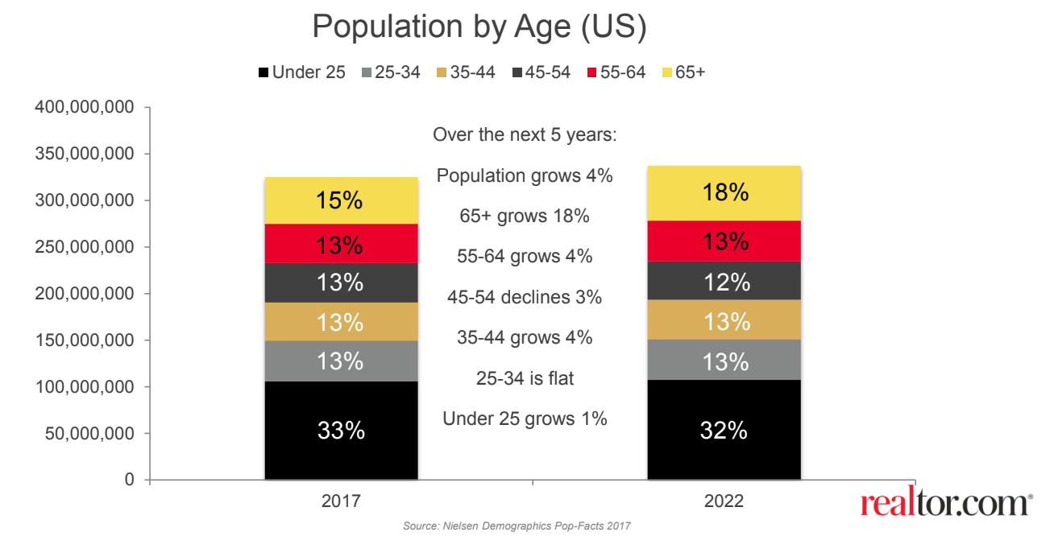
Baby Boomers & Millennials Will Drive The Market!
Millennials will represent over half of all mortgages in 2020 (Realtor.com)
Largest Group of Millennials (4.8 million born in 1990) are turning 30
Baby Boomers are largest buyer segment for Metro Atlanta (marketNsight)

Slide 51
April Survey
What they said they need in their next home:
More interior space
More outdoor space
Updated kitchen
Better technology
July Survey
Top 4 reasons people are actually moving:
1. More interior space
2. Desire to own
3. Move from city to suburbs
4. More outdoor space
Notes:
https://www.realtor.com/research/top-consumer-home-features-coronavirus/
https://3xlsey17pnzh3nf35w1wwnug-wpengine.netdna-ssl.com/wp-content/uploads/2020/06/real-estate-top-agent-insights-for-q2-2020.pdf

