Slide 1
PRICING STRATEGY AND CREATING AND DELIVERING A DYNAMIC CMA

Slide 2
Agenda
The most valuable service an Agent can provide their client is an accurate valuation
When to do a CMA
Appraisal Value vs. Market Value
Study the Market
Automated Valuations
CMA Process
Present the Data to the Client
Pricing Strategy Tips in Today’s Market

Slide 3
When to do a Comparative Market Analysis (CMA)
Quick CMA
Real Estate Reviews
Buyer Presentations (Pre-Showing)
In-Depth CMA
Listing Presentation
Before Writing a Buyer Offer

Slide 4
Appraisal Value vs. Market Value
3rd Party Appraiser
Based on closed sales
Negotiated Price Between Buyer and Seller
Based on current market conditions

Slide 5
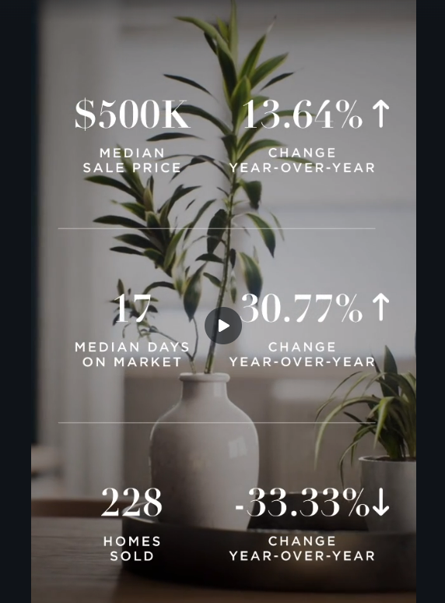
Be a Student of the Market
Monthly Market Trend Videos
TrendGraphix, InfoSparks, etc.
Monthly Market Stats Sent by Local Boards
Inman, and Other Real Estate News Outlets
Your Broker & Each Other!

Slide 6
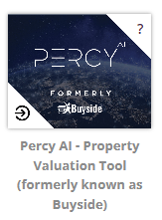
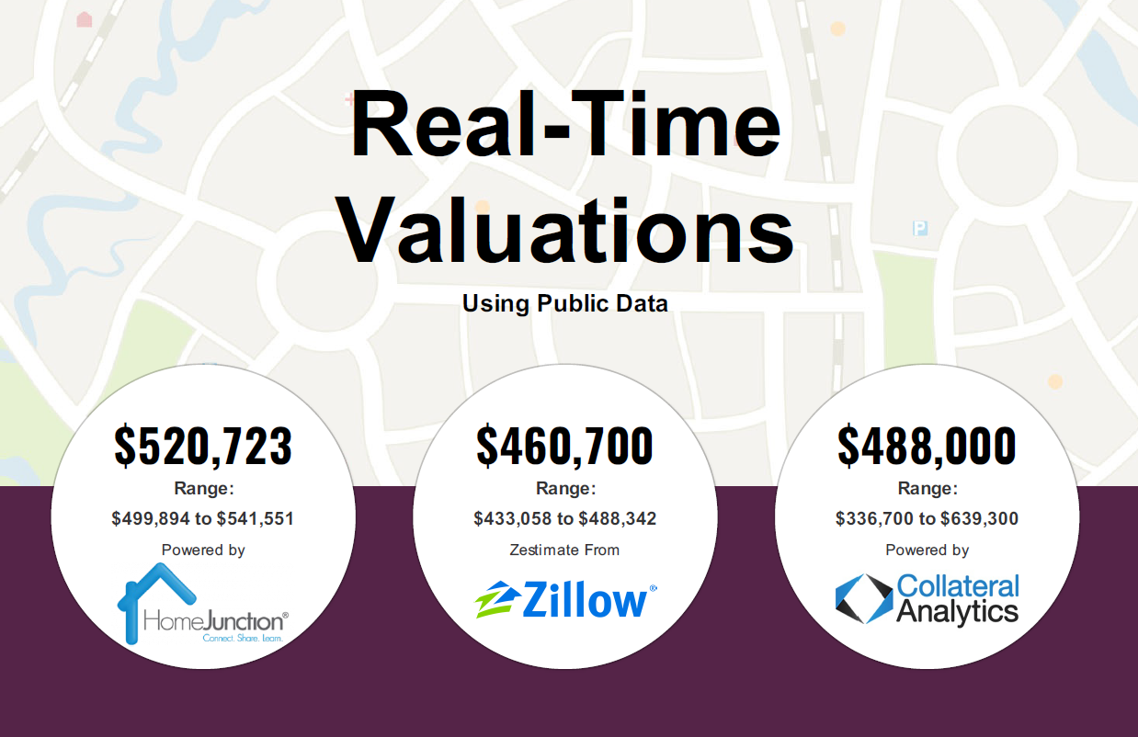
Don’t Shy Away From the Automated Valuators
Percy AI (Buyside)
Collateral Analytics
Zillow
Redfin
RealAVM

Slide 7
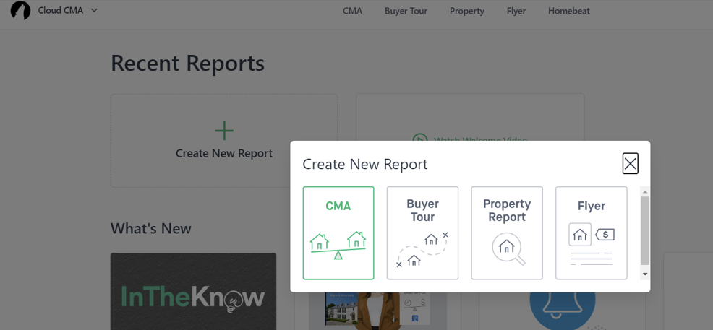
CMA Process: Quick CMA (FMLS/GAMLS)
GAMLS
FMLS

Slide 8
CMA Process: In-Depth CMA
Pull comps like you are a buyer
Make adjustments like you are an appraiser
Do the math (excel, paper, or any CMA tool)
Calculate estimated APPRAISAL VALUE (not market value)
Present information to the client (Moxi)
Discuss pricing strategy that works for the client
Keep the CMA research that you do as back up for the appraisal

Slide 9
Who is the Target Buyer? Put yourself in their shoes
What is their stage of life?
What do they need/want in a home?
Do they have the money, time or desire to renovate?
What does the competition look like at this price point?
Schools, subdivision
Commute vs. WFH, etc.

Slide 10
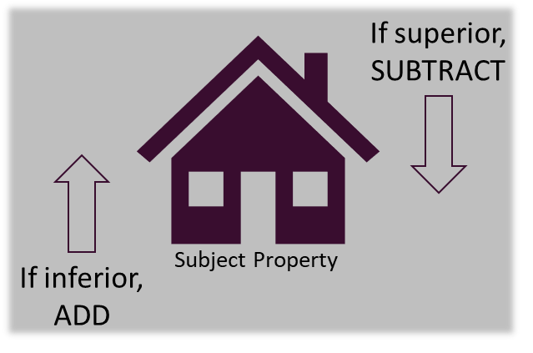
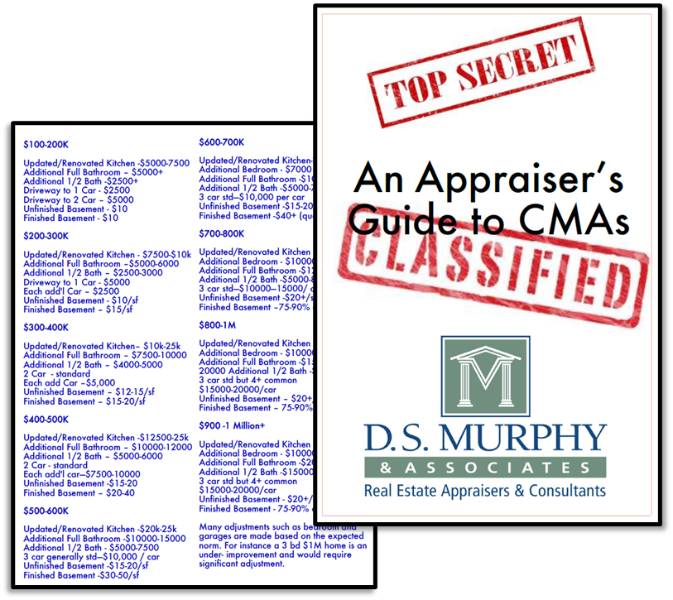
Make Adjustments Like You are an Appraiser

Slide 11
Do the Math
Use Excel, paper, or any CMA tool that you’re comfortable with!
At least 3 CLOSED
Review PENDING and ACTIVE as well
Calculate:
Average adjusted sale price = APPRAISAL VALUE
Range of adjusted sale price (use in your presentation)
Average Pending/Active (major factor in MARKET VALUE)

Slide 12
Present the Data to your Client
Use Moxi Present for a professional presentation
Slides are provided for you, just fill in the information!
Include the adjustment details or not – it’s up to you.

Slide 13
The Pricing Discussion
Explain the difference between Appraisal Value and Market Value to your client
Set the stage for any appraisal concerns
Ask about the seller’s needs – target sale price, timeline, contract terms, etc.
Discuss the target buyer’s needs and desires
Explain your findings and estimates
Determine the pricing strategy together

Slide 14
Pricing Strategies for Today’s Market
Buyers (and Agents) have been trained to expect to offer over asking and for short DOM
Set expectations around DOM
Competition – what is listed?
Rates
Multiple offers are still happening
Keep your eye on the trends!
There is no magic answer, just educated guesses at value!

Slide 15
Thank you!
Resources will be posted on the listing blitz tile
This PowerPoint
The DS Murphy adjustment cheat sheet
The CMA spreadsheet template
The Appraisal Value vs. Market Value slide for you to customize and use in Moxi
Video Recording will be posted on Rev
Scan for Lindsey’s contact info if you have questions
Or Text “Lindsey” to 88500

