Slide 1
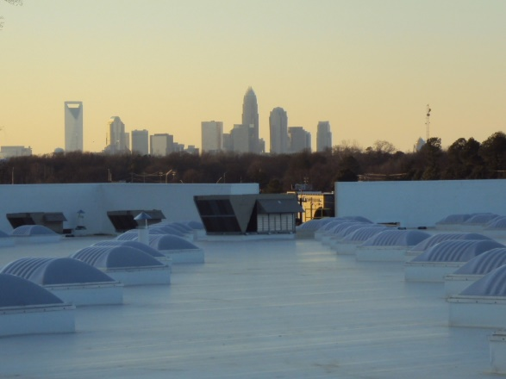
BUILDING ENVELOPE AND ENVIRONMENTAL SERVICES
Notes:
Everyone has been very welcoming.
Thank you for the opportunity. I enjoy what I do, and talking about it.
Talk about my history.

Slide 2
What is the Building Envelope?
The envelope includes everything that separates the interior of a building from the outdoor environment.

Slide 3
What is the Building Envelope?

Slide 4
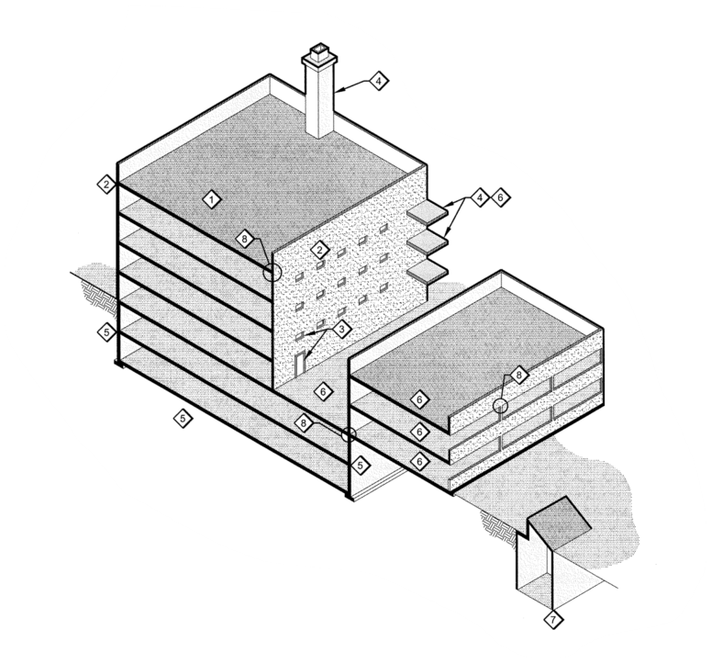
What is the Building Envelope?
ASCE/SEI 30-14, Guideline for Condition Assessment of the Building Envelope identifies 8 systems that comprise the Building Envelope:
Roof Systems
Wall Systems
Fenestration Systems
Building Appendages
Foundation Wall Systems
Deck Waterproofing Systems
Underground Structures
Intersections and Terminations

Slide 5
What is the Building Envelope?
What are the 14 functions of the Building Envelope?
Notes:
This is technically the thermal barrier. To ensure all aspects of the building envelope are considered, we use a trick to ensure continuity; trace the barrier with a different color pen.
The thermal barrier is shown in red, next is the weather barrier, , the air barrier….

Slide 6
Functional Requirements of the Building Envelope
Notes:
Nature is always trying to reach equilibrium.
Gravity is pulling bulk water down, low pressure is trying to equalize with high pressure, low humidity with high humidity, and low temperatures with high.
Eventually, if we do nothing, it will equalize.

Slide 7
Functional Requirements of the Building Envelope
Structural: If the wall is not part of the main building structure, it must still support own weight and transfer lateral loads to building frame.
Notes:
Started as a roof assessment. Noticed the roof was “smiling”
Asked to access their attic, they commented that the ceiling kept dropping
Ask a mechanical engineer vs a structural engineer
If you remember from classes, structures are supposed to fail ductile, which is what this was doing

Slide 8
Functional Requirements of the Building Envelope
Water: Resist water penetration.
40 percent of all building-related problems are due to water intrusion.
water intrusion accounts for more than 70 percent of construction litigation.

Slide 9
Functional Requirements of the Building Envelope
Air: Resist excessive air infiltration.
Condensation: Resist condensation on interior surfaces under service conditions.
Notes:
Talk about the project in Florida, lady set the temperature at 60 degrees. The subflooring was saturated.

Slide 10
Functional Requirements of the Building Envelope
Movement: Accommodate differential movement (caused by moisture, seasonal or diurnal temperature variations, and structural movement).
Energy conservation: Resist thermal transfer through radiation, convection and conduction.
Notes:
Who knows why this crack occurred? Discuss expansion forces at corners of masonry.
Show example of paper expansion joints
Please picture 1/32 of an inch. Ask for a credit card. Is this a big deal?
A thunderstorm with 30 mph winds will produce 2.3 psf. 2.3 psf is equivalent to 0.44”of water column. We are effectively holding ½” of water on the side of the building.

Slide 11
Functional Requirements of the Building Envelope
Sound: Attenuate sound transmission.
Fire safety: Provide rated resistance to heat and smoke.
Security: Protect occupants from outside threats.
Maintainability: Allow access to components for maintenance, restoration and replacement.

Slide 12
Functional Requirements of the Building Envelope
Constructability: Provide adequate clearances, alignments and sequencing to allow integration of many components during construction using available components and attainable workmanship.
Durability: Provide functional and aesthetic characteristics for a long time.
Aesthetics: Do all of the above and look attractive.
Economy: Do all of the above inexpensively.

Slide 13
What Building Envelope Services does Contour Provide?
Property Condition Assessments
Preliminary and Detailed Building Envelope Condition Assessments (ASCE 30-14)

Slide 14
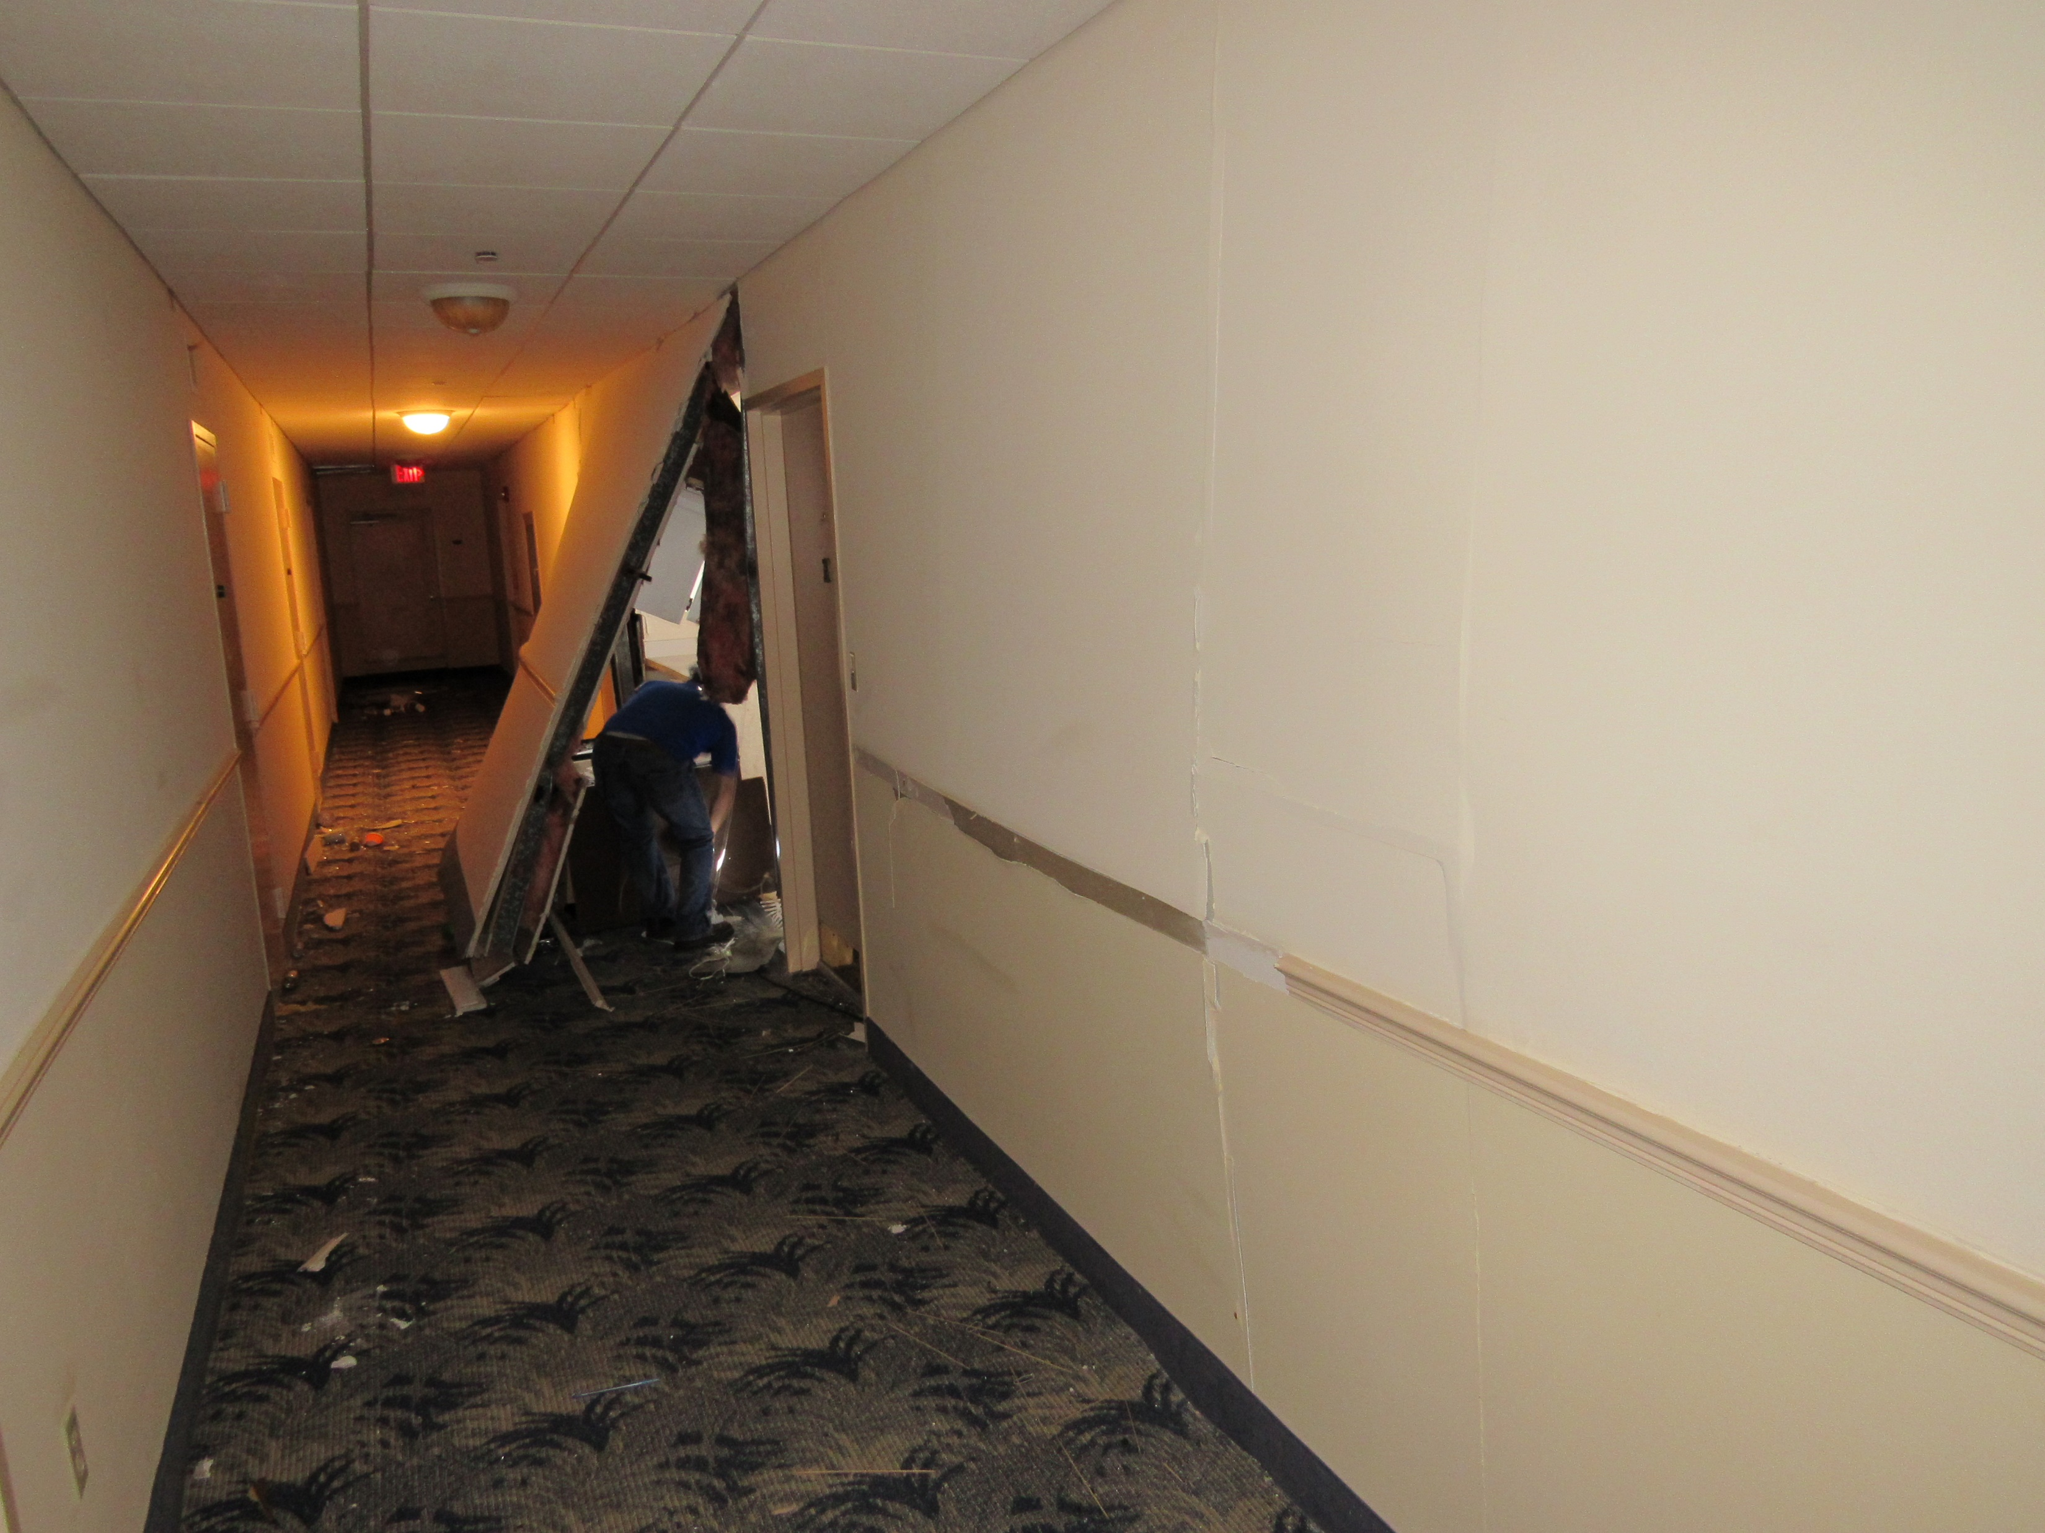
Condition Assessments

Slide 15
What Building Envelope Services does Contour Provide?
Roof Moisture Surveys
Infrared
Capacitance
Forensic Investigations
Damage, Defect & Deterioration
Water Intrusion
Notes:
Describe how infrared and capacitance scans work.
I used infrared to show that a kitchen was flooding the lobby floor of an adjacent condominium

Slide 16
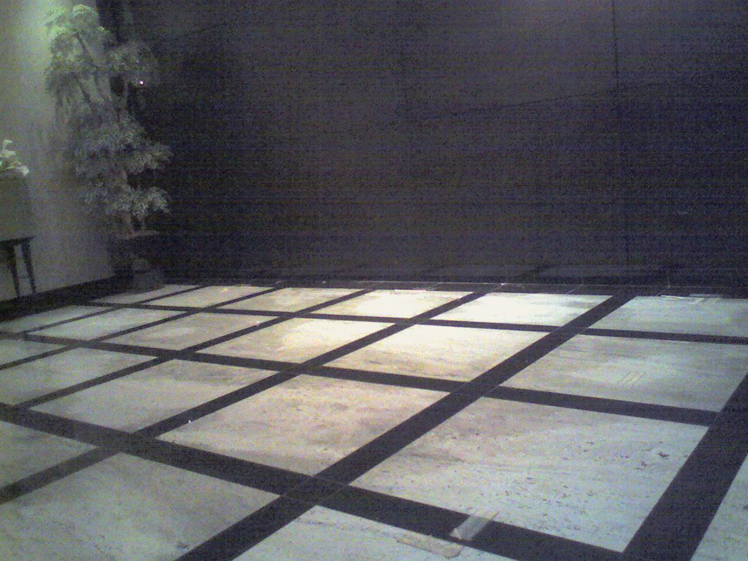
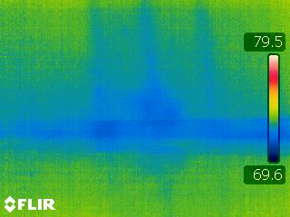
Infrared Surveys
Notes:
Describe how infrared and capacitance scans work.
I used infrared to show that a kitchen was flooding the lobby floor of an adjacent condominium

Slide 17
What Building Envelope Services does Contour Provide?
Roof Field Testing
Fastener Pull Testing
Roof Cores
Uplift Testing
Window/Door Field Testing
Water Penetration
Air Penetration

Slide 18
What Building Envelope Services does Contour Provide?
Design/Design Review
Contractor Procurement
Contract Administration
Quality Assurance Observation/Inspection
Claim Support
Notes:
Contract Administration is what an Architect typically does during construction

Slide 19
When can Contour provide BE Services to our Clients?

Slide 20
Potential Clients?
Existing Clients!
Facility Owners
Developers
Facility Managers
Architects
Contractors
Lending Institutions

Slide 21
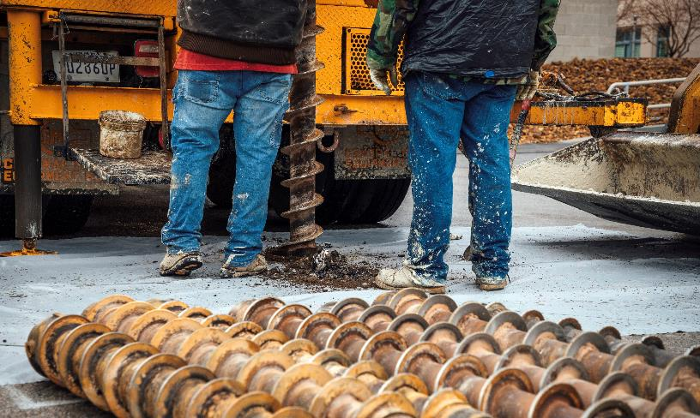
Environmental Services
Due Diligence
Phase I ESA
Phase II ESA
Remediation
Brownfield/VRP Programs
Additional Services
Asbestos/Lead Surveys
Wetlands
Threatened & Endangered
Species Investigation
Vapor Encroachment Screening
PFAS
Cultural/Historical Resources
Investigation
Mold

Slide 22
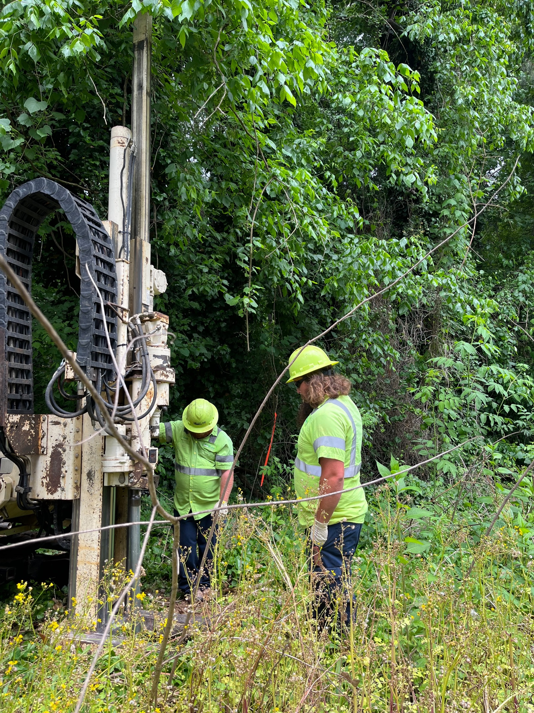
What is a Phase I Environmental Site Assessment?
The process by which a person or entity seeks to determine if a particular parcel of real property (including improvements) is subject to recognized environmental conditions (REC’s).
Recognized Environmental Condition (REC):
The presence or likely presence of any hazardous substances or petroleum products on a property under conditions that indicate an existing release, a past release, or a material threat of a release of any hazardous substances or petroleum products into structures on the property or into the ground, ground water, or surface water of the property. Vapor encroachment can be considered a REC.

Slide 23
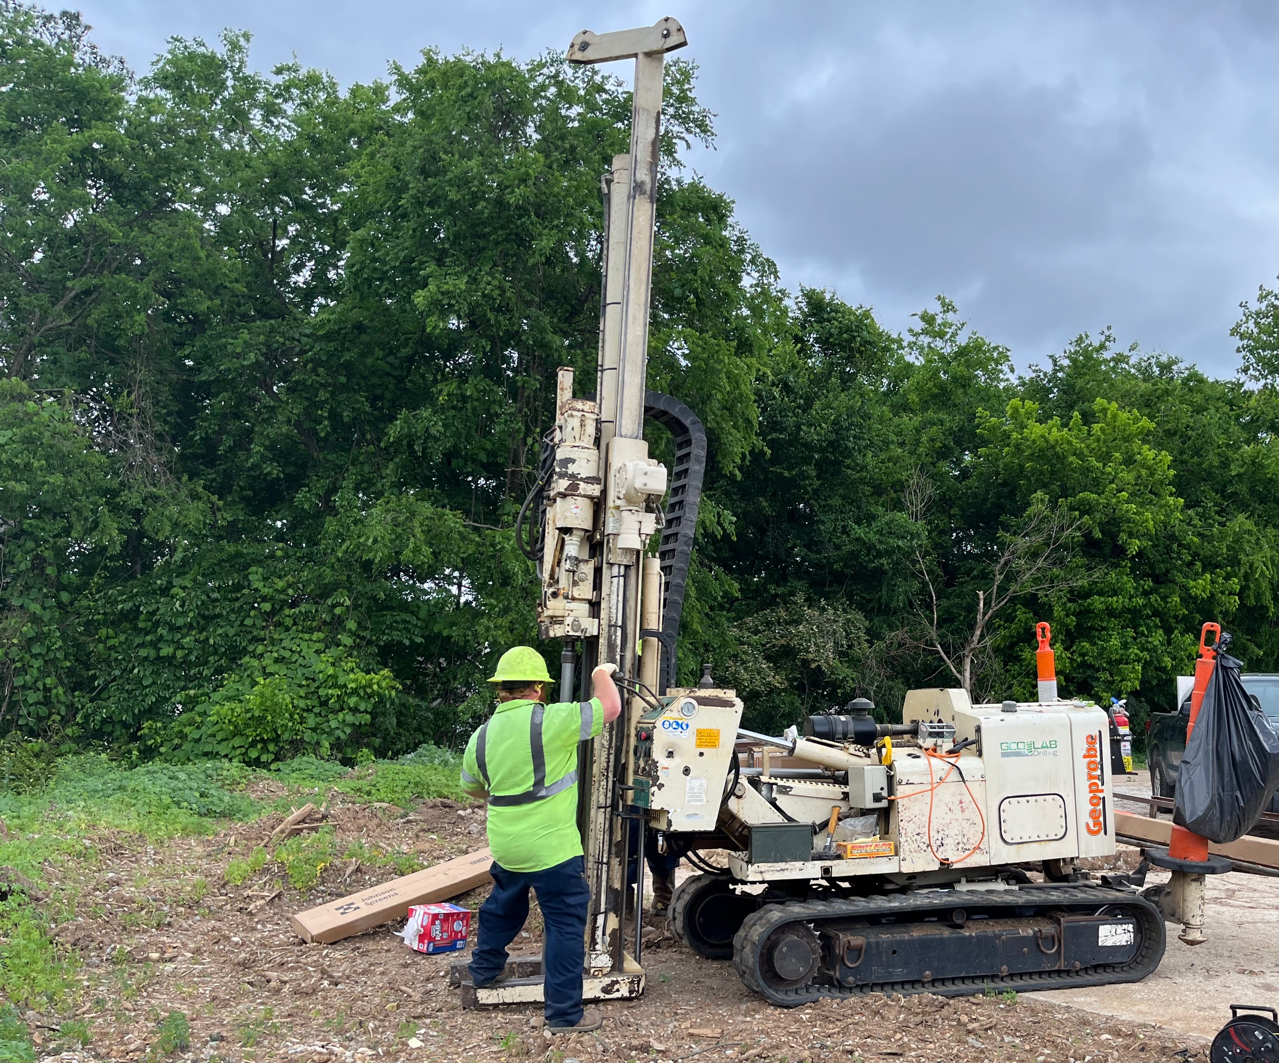
When is a Phase I ESA Performed?
Prior to a real estate transaction (commercial)
When a lender provides a loan for the property
When a property owner wants to know the environmental history of the property
When a property use is changed or re-zoned

Slide 24
Scope of a Phase I ESA
The scope of a Phase I ESA is composed of several sections:
Property Description
Building/Structure Description
Historical Land Use
Interviews
Mapping Review
Government Database
Review of Prior Reports
Site Observation Summary
Findings
Recommendations
These scope items accomplish three key goals of a Phase I:
Documentation of the property’s history
Evaluate the current use and operations of the property to determine if REC’s exist
Determine if there are any environmental impacts from adjoining properties.

Slide 25
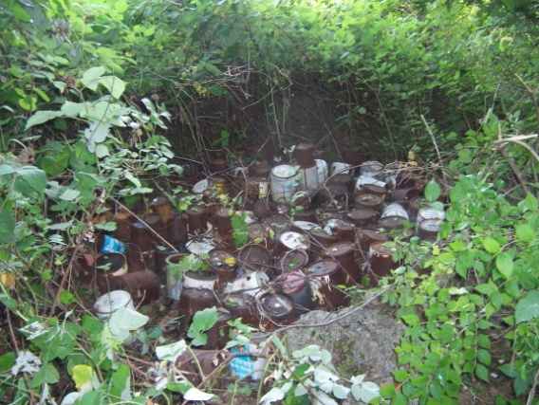
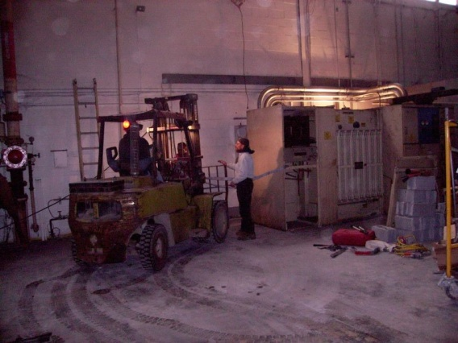
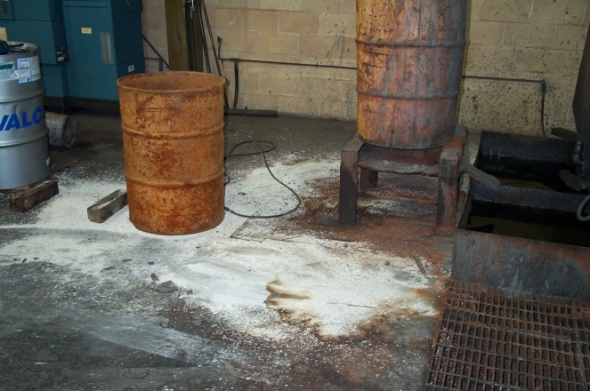
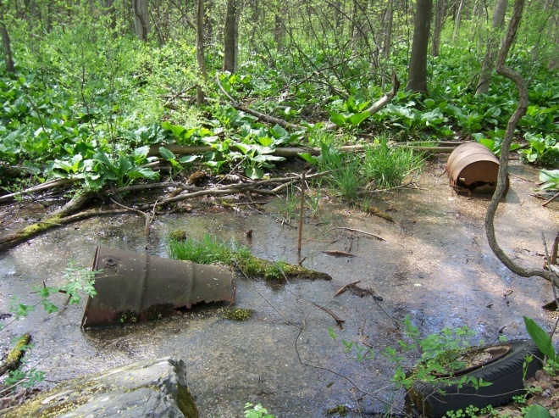
Phase I Examples: On-site REC’s
Dumping of paint, solvent, and thinner cans on vacant property
Transformer with PCB contaminated oils
Dumping of potentially hazardous materials in a wetland
Petroleum products leaking into floor drain

Slide 26
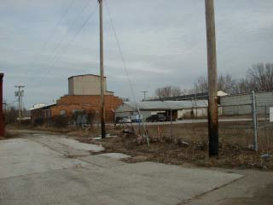
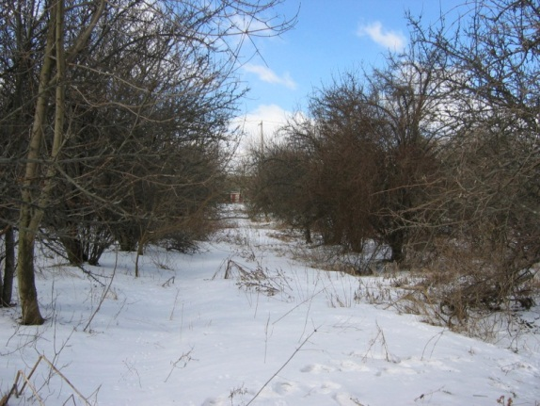
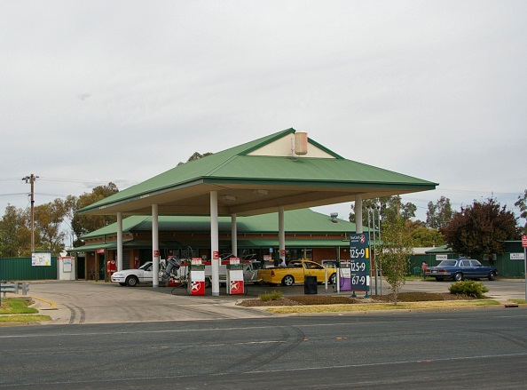
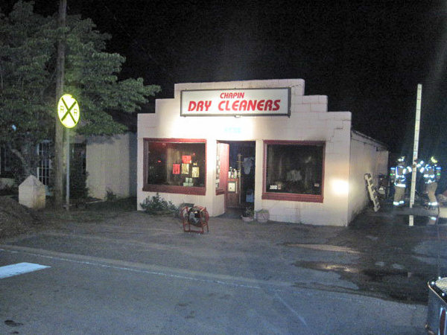
Phase I Examples: Off-site or Historical REC’s
Old Industrial Building may be Historical REC based on past use (VOCs / SVOCs / Metals)
An orchard with historical use of Lead-Arsenate pesticides (lead/arsenic in GW)
Dry-Cleaners at Nearby Property may be an Off-Site REC if dry-cleaning conducted on premises (VOCs)
Gasoline Station at Nearby Property may be an Off-Site REC (BTEX)

Slide 27
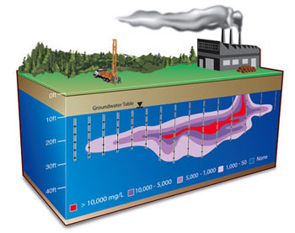
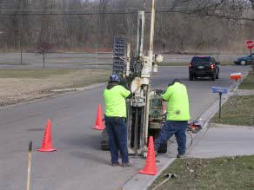
Phase II Scope
A Phase II is conducted to determine if the property has been environmentally impacted by on-site or off-site RECs through soil, groundwater and vapor sampling and analysis
Phase II Scope is dependent on the facility you’re assessing. Typical analysis includes: VOCs, SVOCs, Metals, PCBs
Groundwater plume from nearby property can impact site you’re assessing

Slide 28
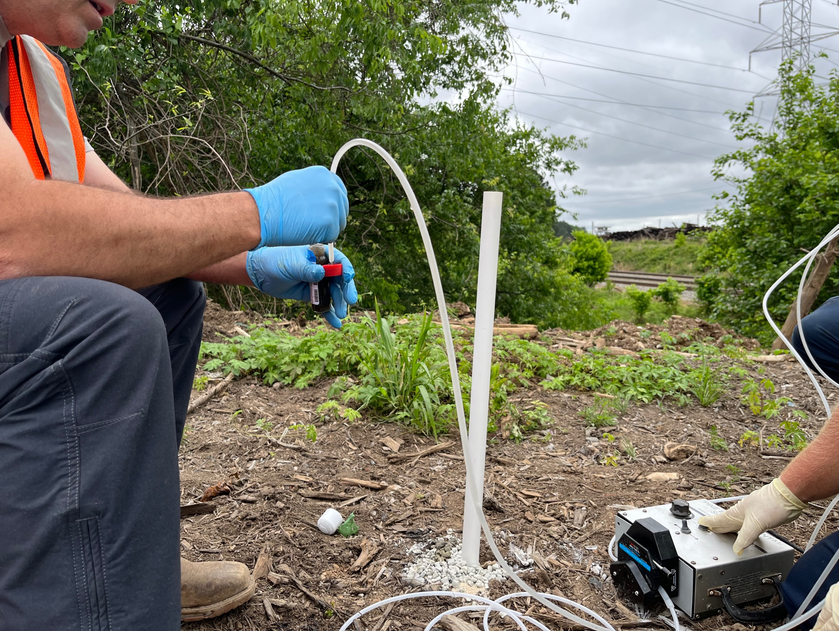
Environmental Due Diligence Timing
A Phase I usually takes around 4-weeks to complete
A Phase II Scope usually takes
4-6 weeks to complete.
Drilling (2-4 weeks)
Lab (1 Week)
Report (1-week)
Due diligence window? 90-Days?

Slide 29
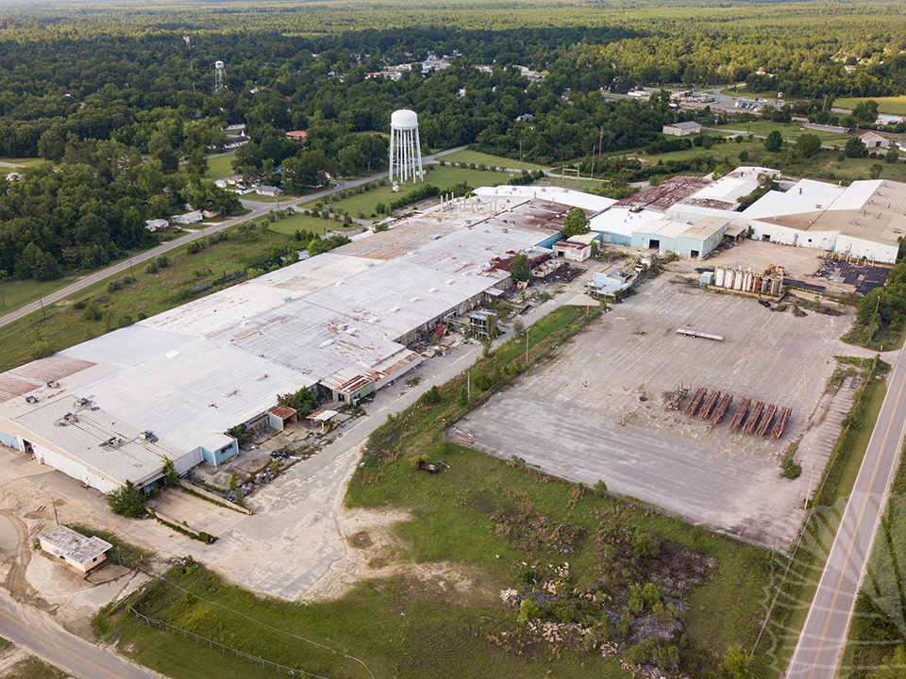
What if Impacts are Discovered?
In most cases, a buyer should not be responsible for prior environmental impacts
Negotiate remediation costs prior to closing?
Seller pays?
Walk away?
Brownfield Program
Addresses Soil
VRP Program
Addresses Soil and Groundwater
Every Site is different

Slide 30
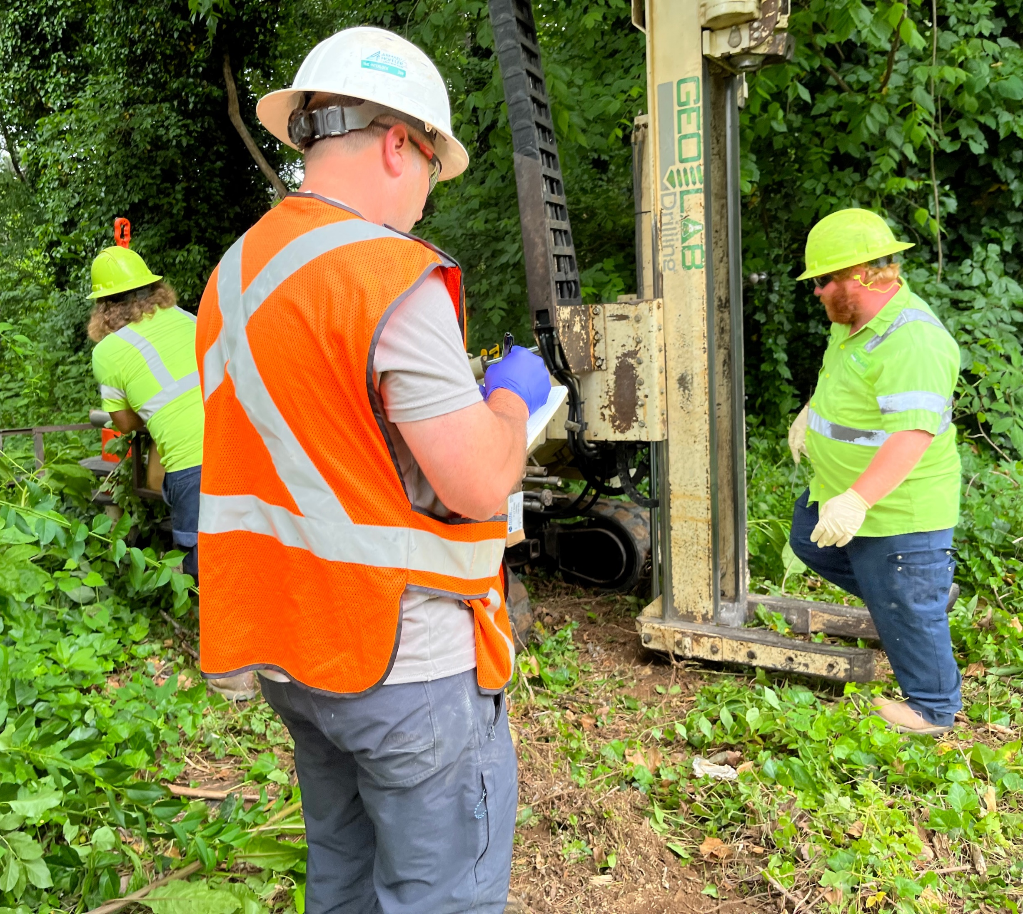
GEORGIA BROWNFIELD PROGRAM WHY
Identified Contaminants in Soil/GW and Purchaser Seeks Liability Protection
Benefits:
Statutory protection against state and third-party claims for pre-existing releases
Benefits all successors-in-interest
Relatively inexpensive
Provides access to property tax abatement (essentially all environmental costs except attorneys’ fees)

Slide 31
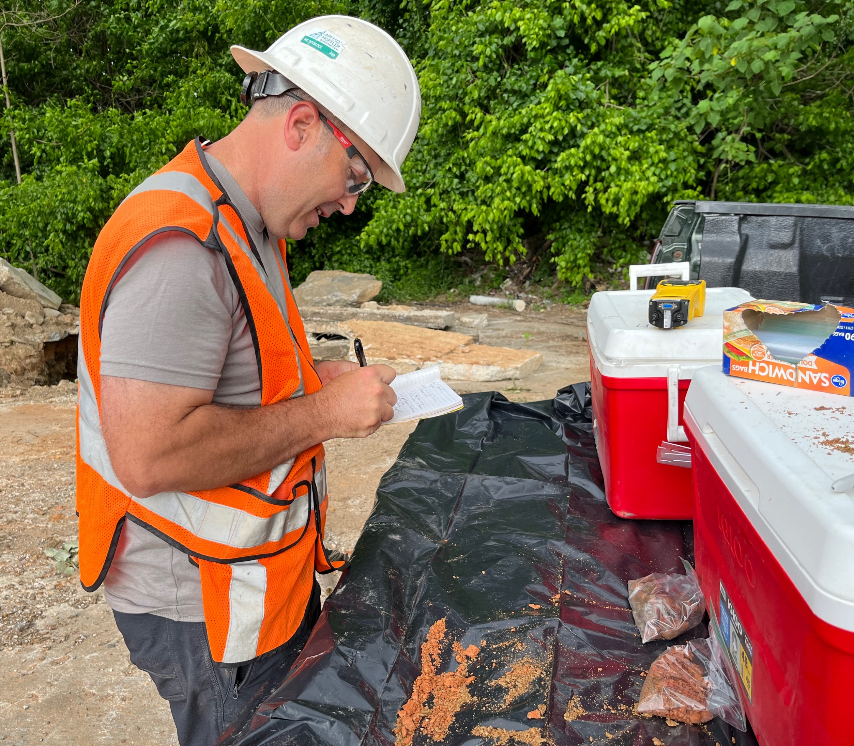
GEORGIA BROWNFIELD PROGRAM HOW
Submit a Brownfield Application and Prospective Purchaser Corrective Action Plan (PPCAP)
Ensure through investigation that no source material is onsite which contributes to GW contamination. If so, source material must be remediated
Submit a Prospective Purchaser Compliance Status Report (PPCSR) which certifies that all soils onsite are in compliance with a Risk Reduction Standard.

Slide 32
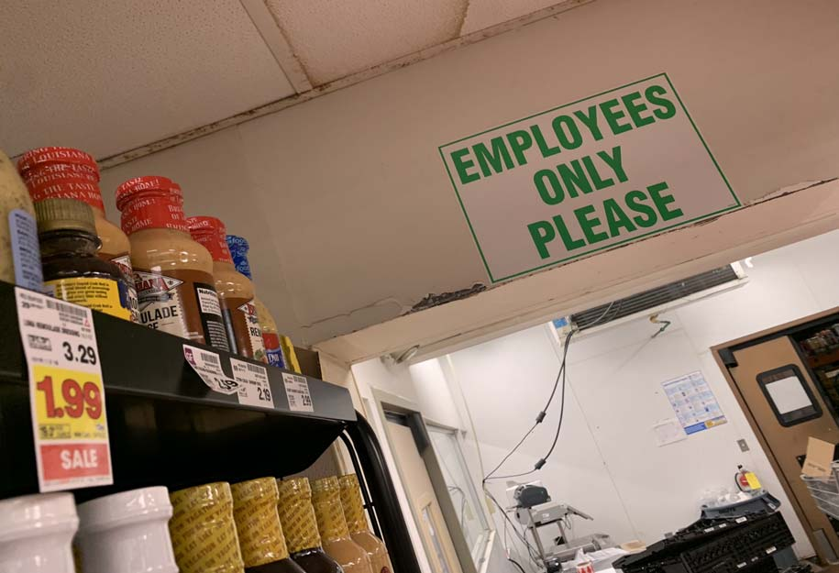
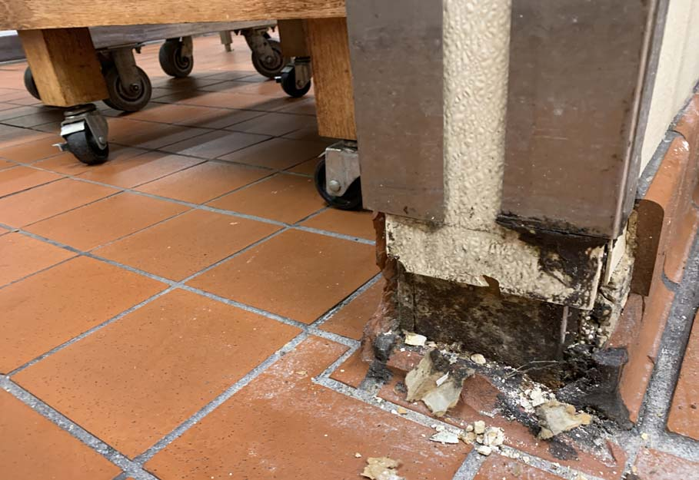
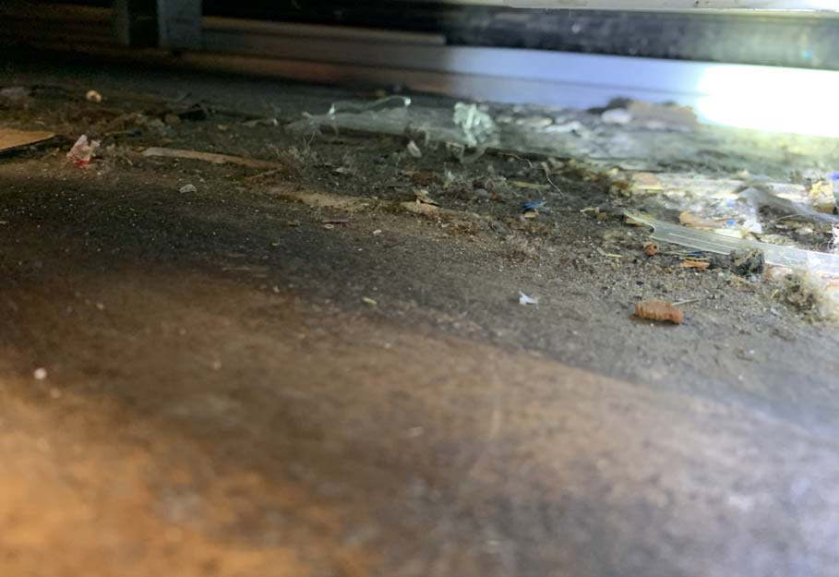
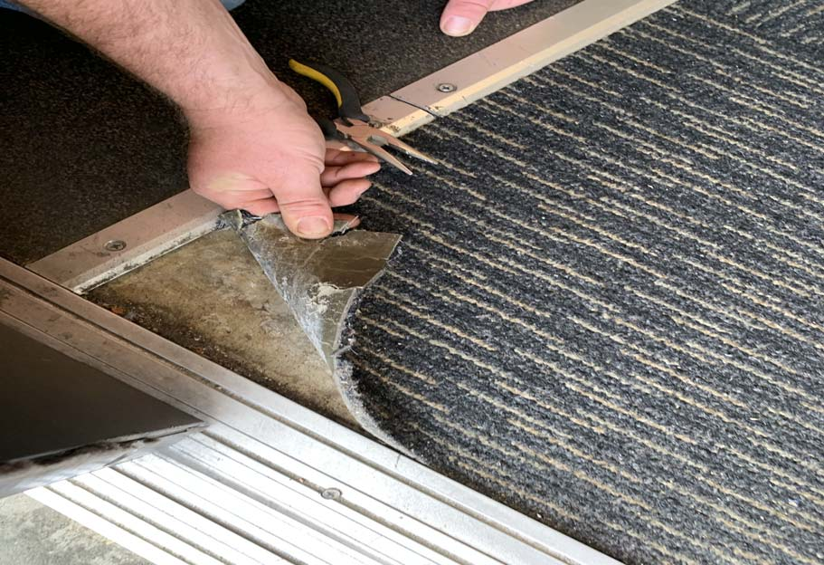
Asbestos Containing Materials (ACM) Survey
Common Suspect ACM Materials
Floor Tile/Mastic
Carpet Glue
Wall Board/Joint Compound
Sink Mastic
Ceiling Tiles
ACM Abatement
If ACM, must be abated prior to disturbance by abatement contractor
Air Monitoring/Clearance during and after abatement by Contour

Slide 33
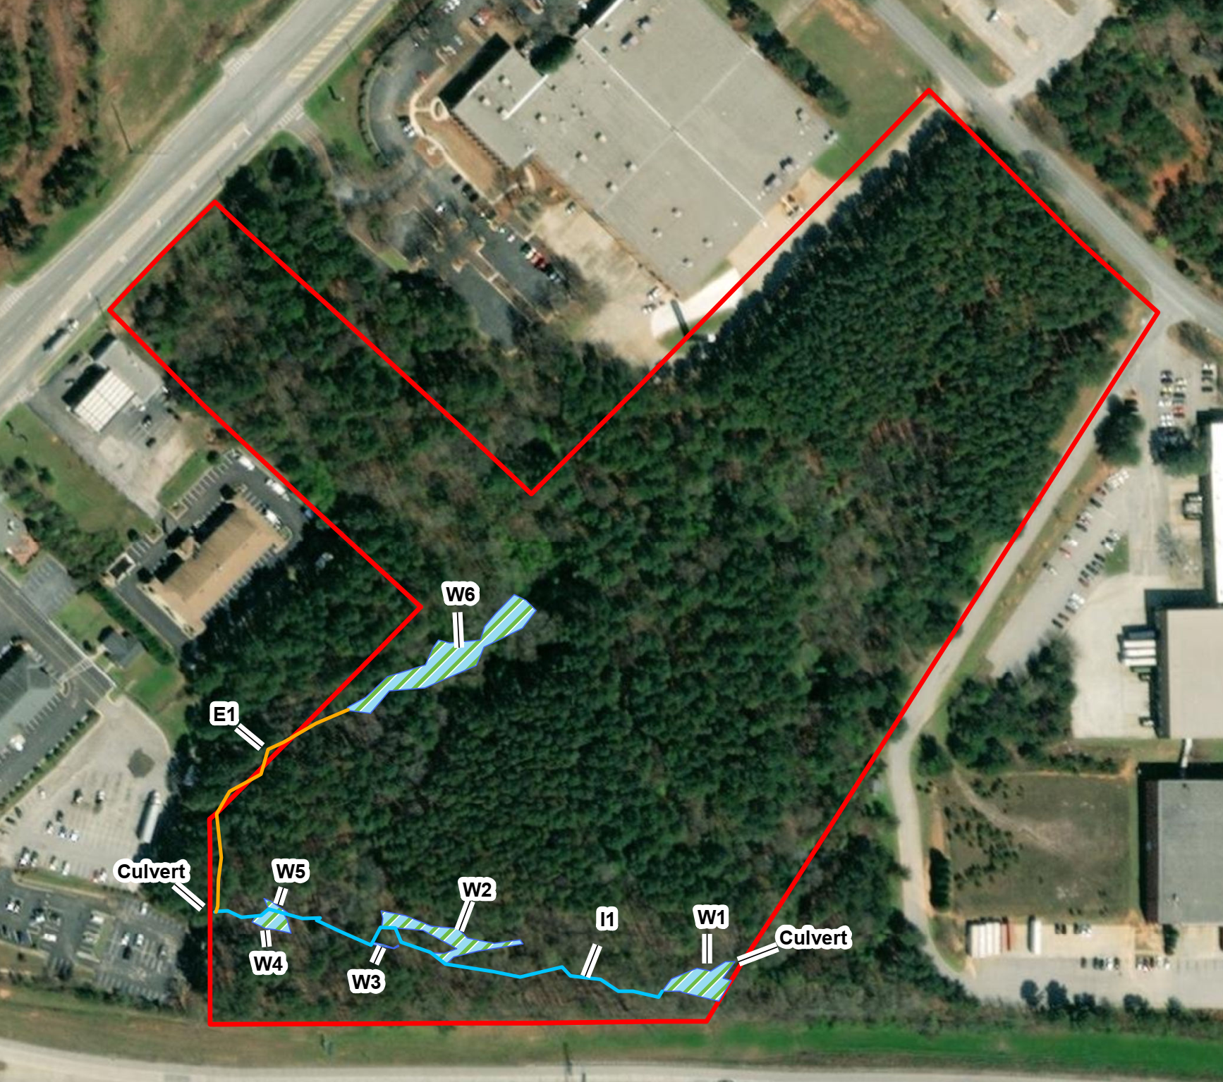
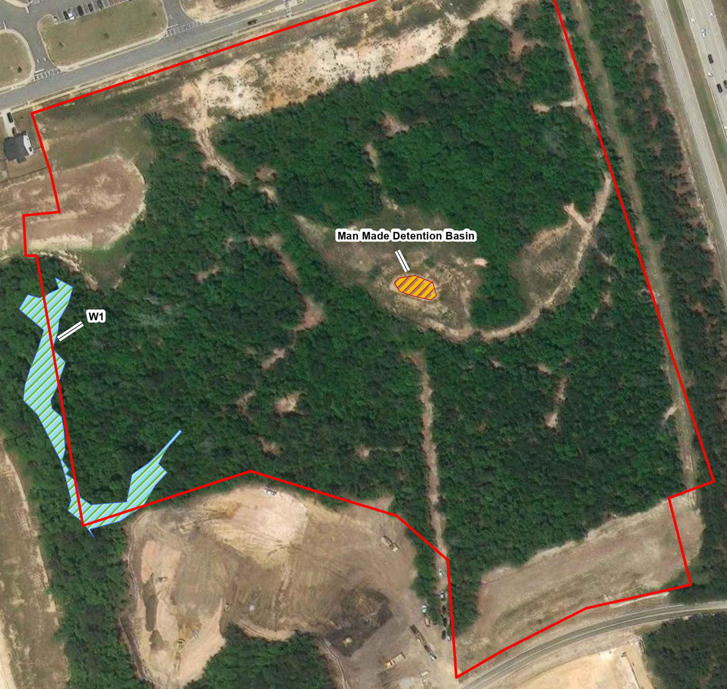
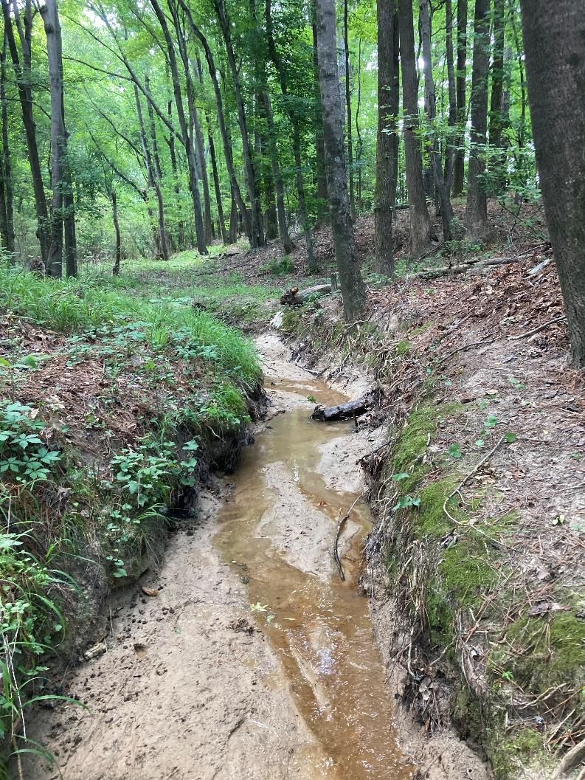
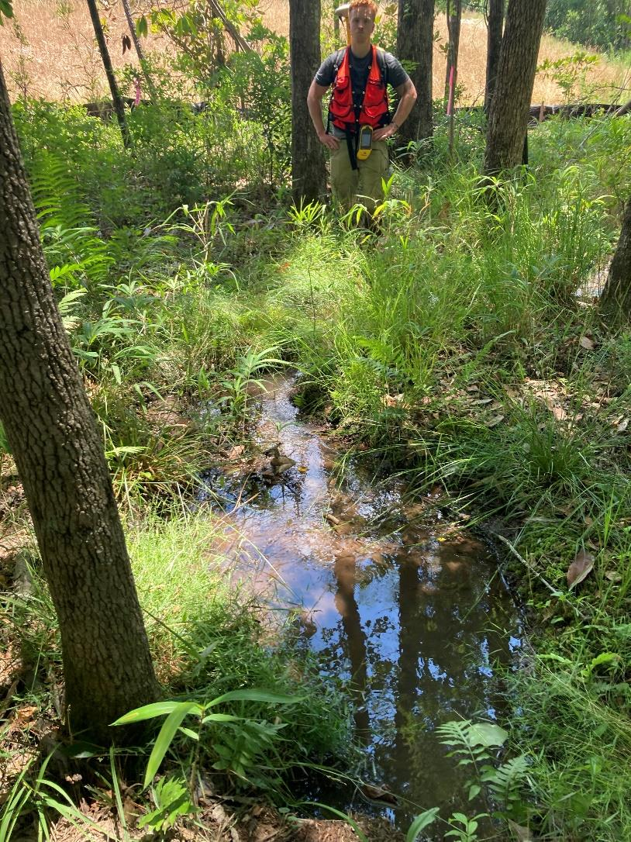
Wetlands/State Waters Investigation
3 Determining Factors When Delineating
Vegetation
Hydric Soils
Geomorphology
Thresholds for Permitting
Wetlands: <0.5-Acre – Nationwide Permit (45-60 Days)
>0.5 Acre – Individual Permit (12-15 Months)
Streams: <0.05 – Acre – Nationwide Permit (45-60 Days)
>0.05 – Acre – Individual Permit (12-15 Months)

Slide 34
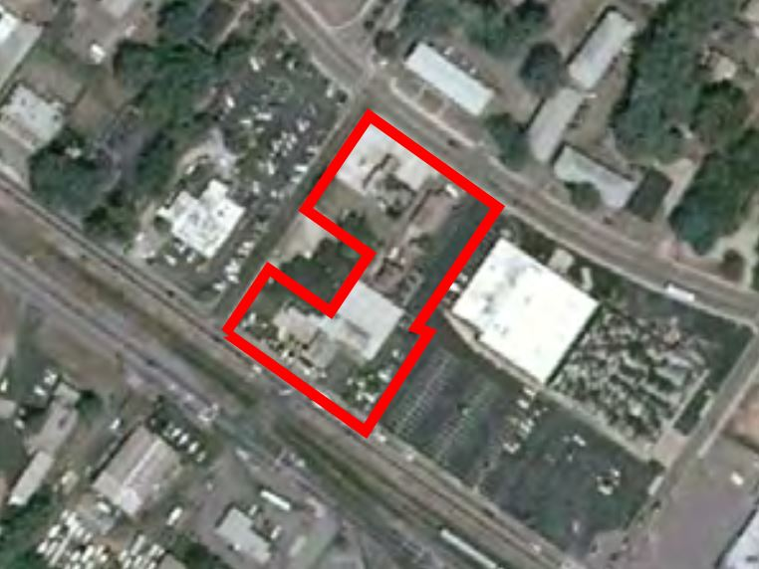
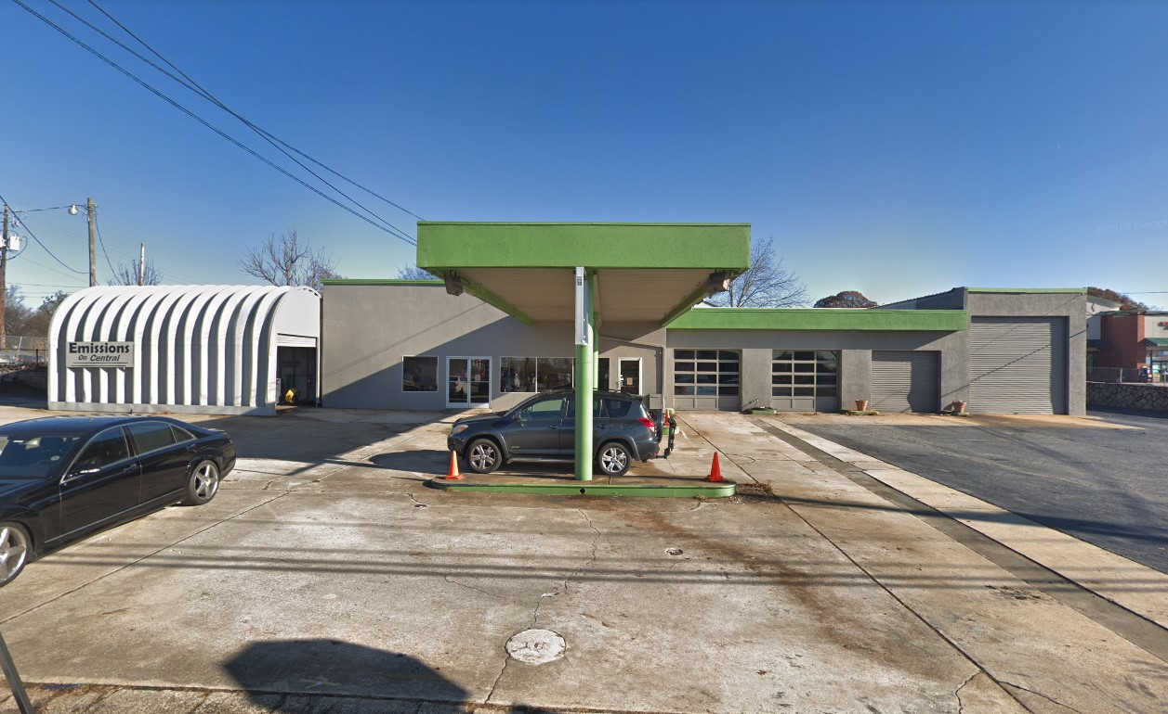
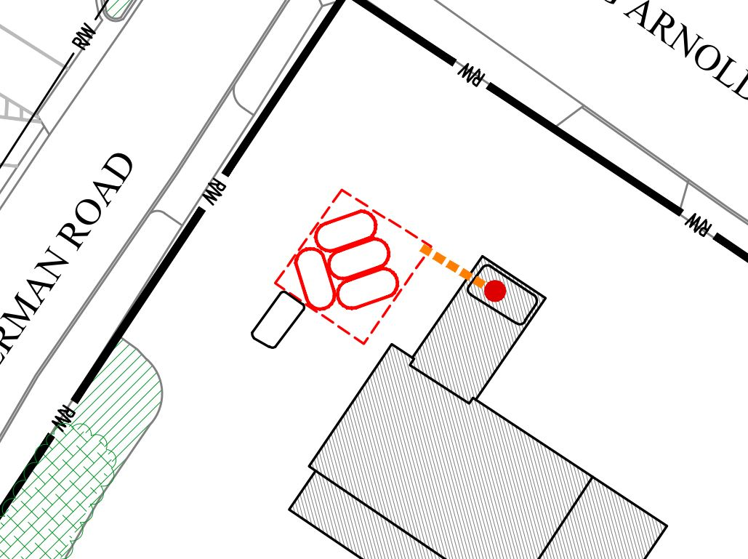
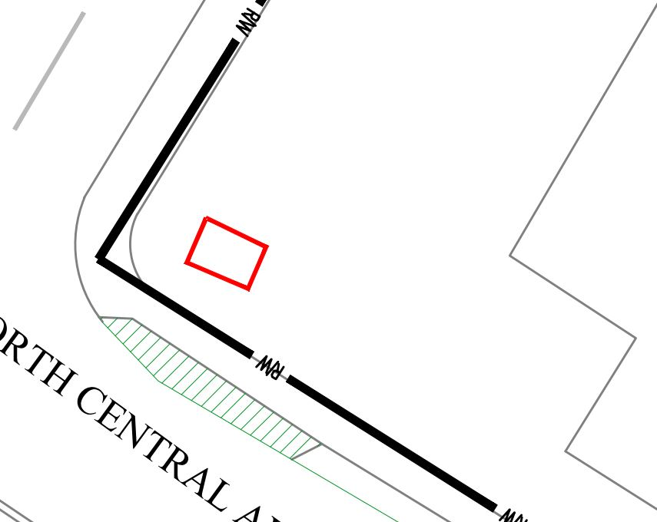
Case Study: Hapeville, GA
Assemblage of Properties that included a church, a auto shop, and a former gas station
Former gas station, Was the Underground Storage Tank (UST) removed?
Surprise UST located in SW corner of the property
Not one, but five USTs were still present onsite

Slide 35
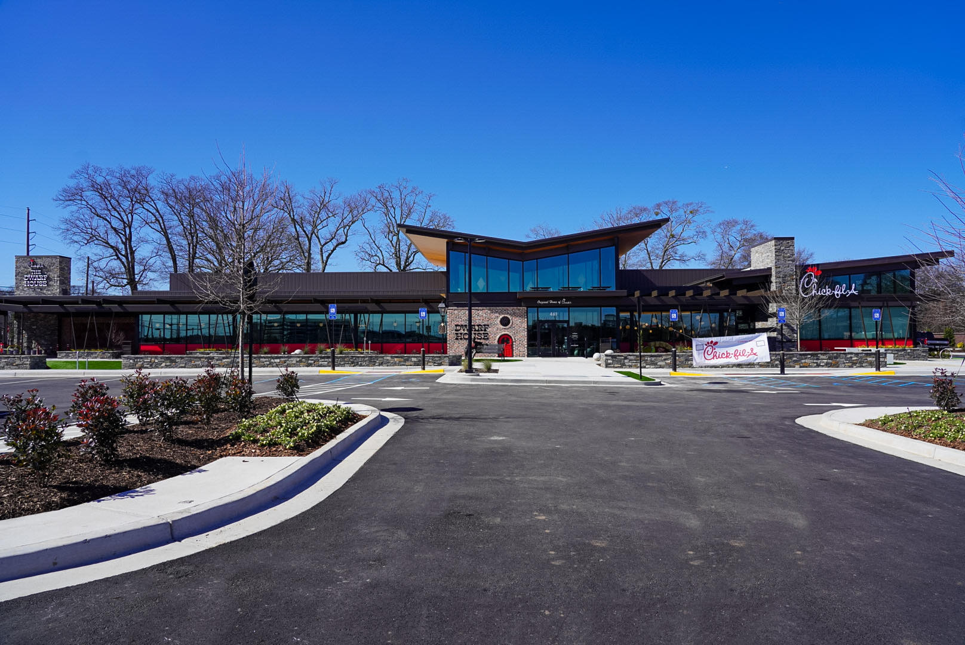
Case Study: Hapeville, GA
Brownfield Program
Addressed Soil Impacts
USTs were removed without delaying construction
Soil impacts were delineated and impacted soil was also removed
Tax Credits were issued
Groundwater impacts were not the buyers responsibility
Site is now the Hapeville Dwarf House

Slide 36
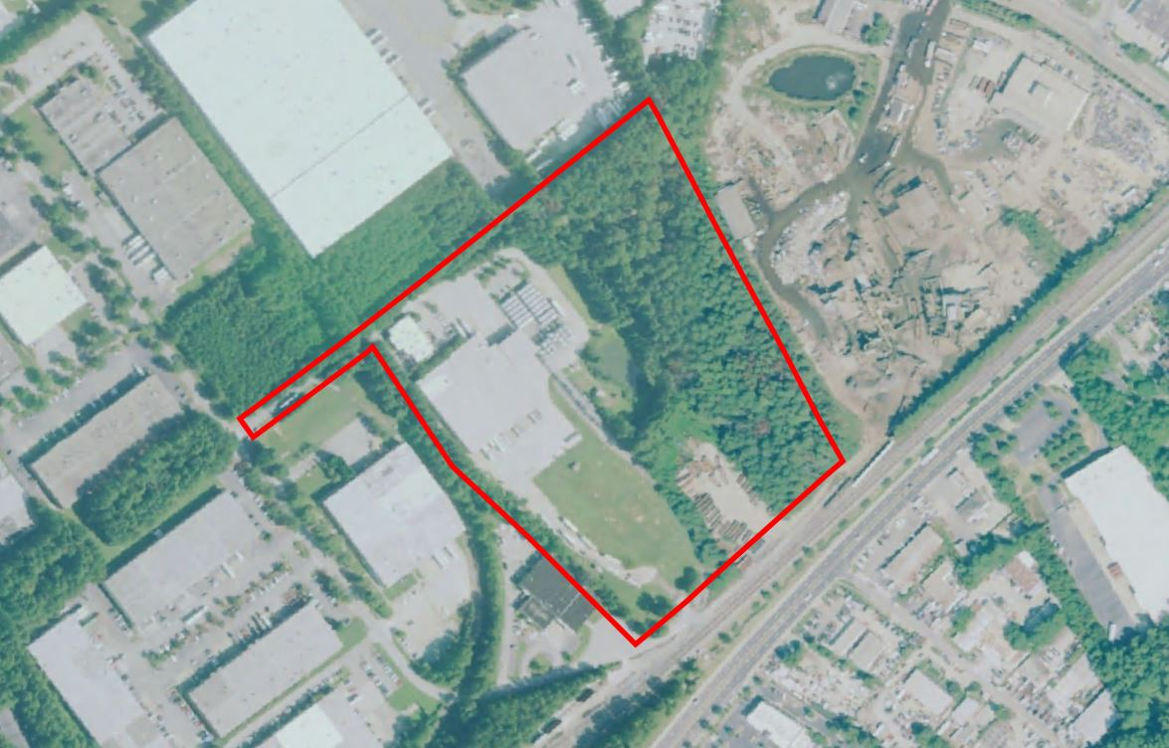
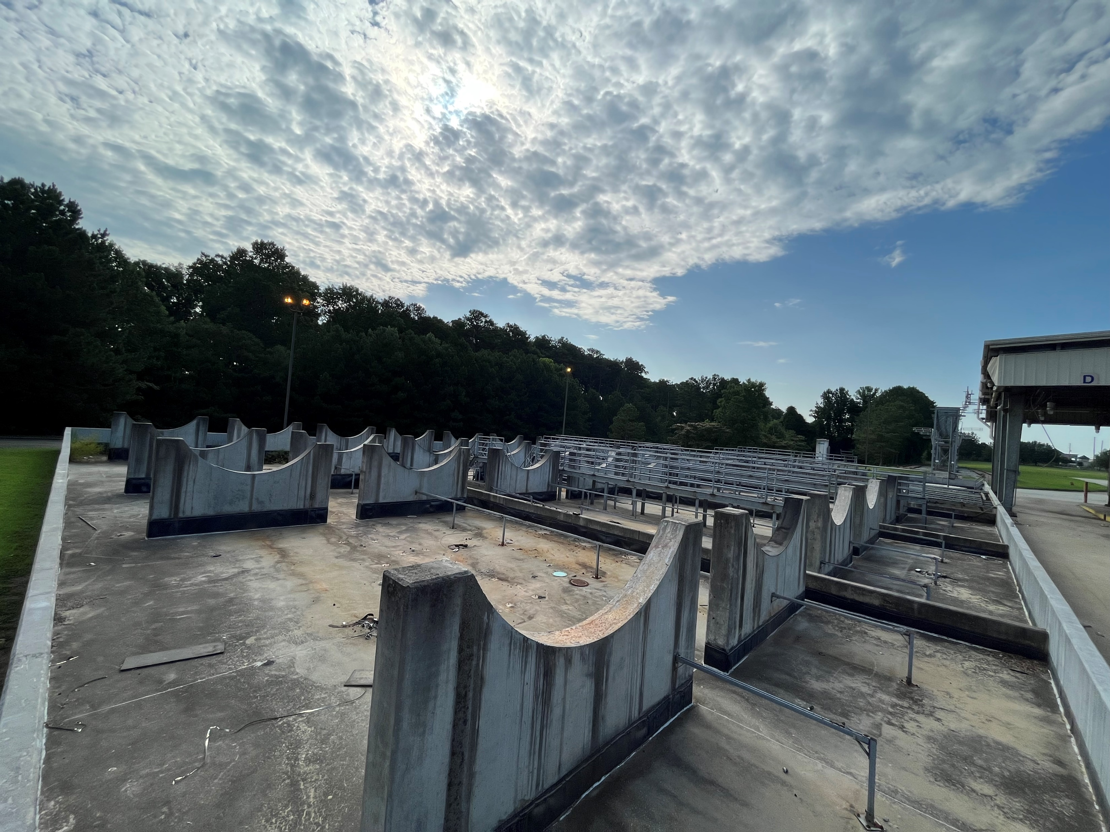
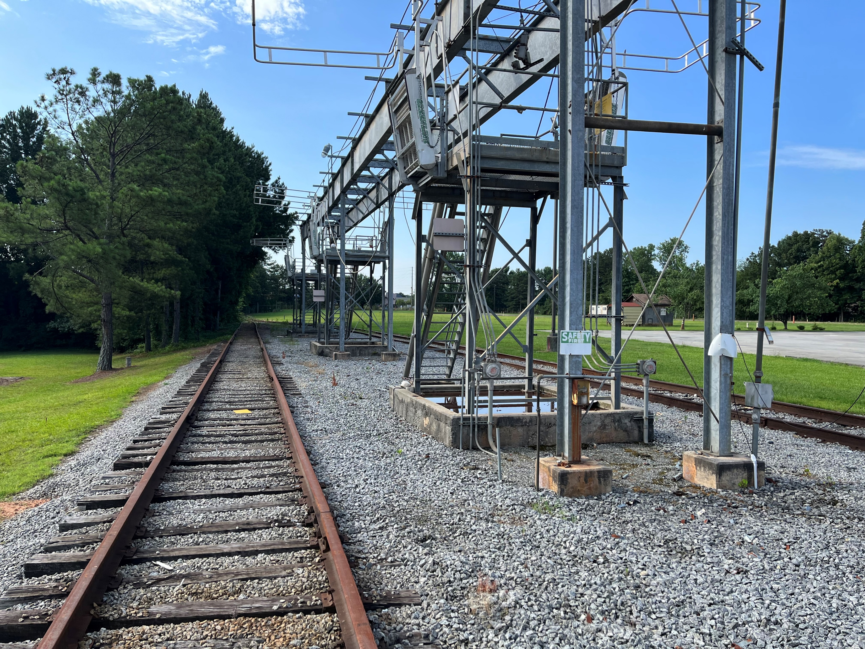
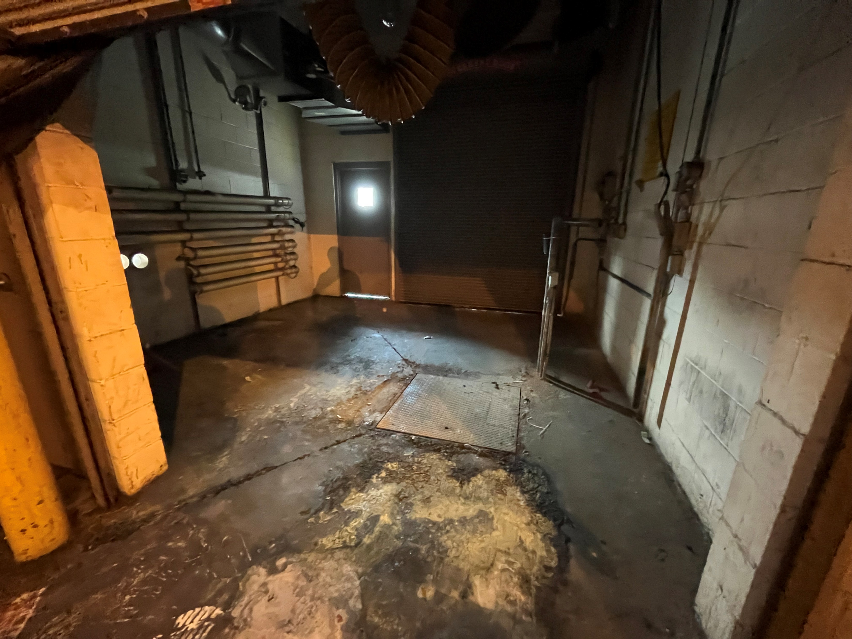
Case Study: Doraville, GA
Former chemical transfer facility. Railroad cars to Trucks
Former Aboveground Storage Tank (AST) area
Former Chemical Transfer Area
Interior Staining

Slide 37
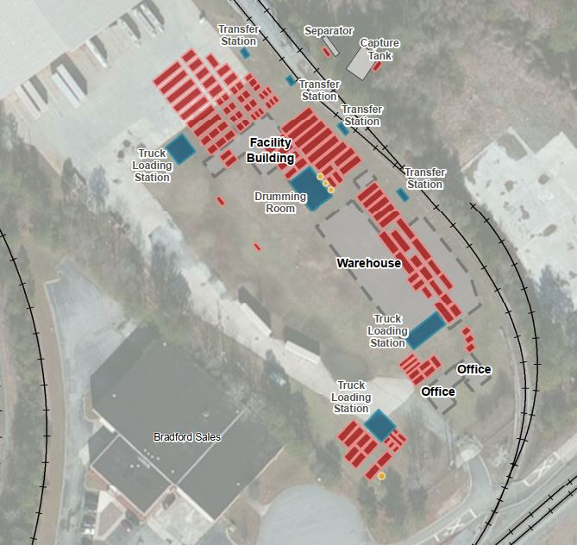
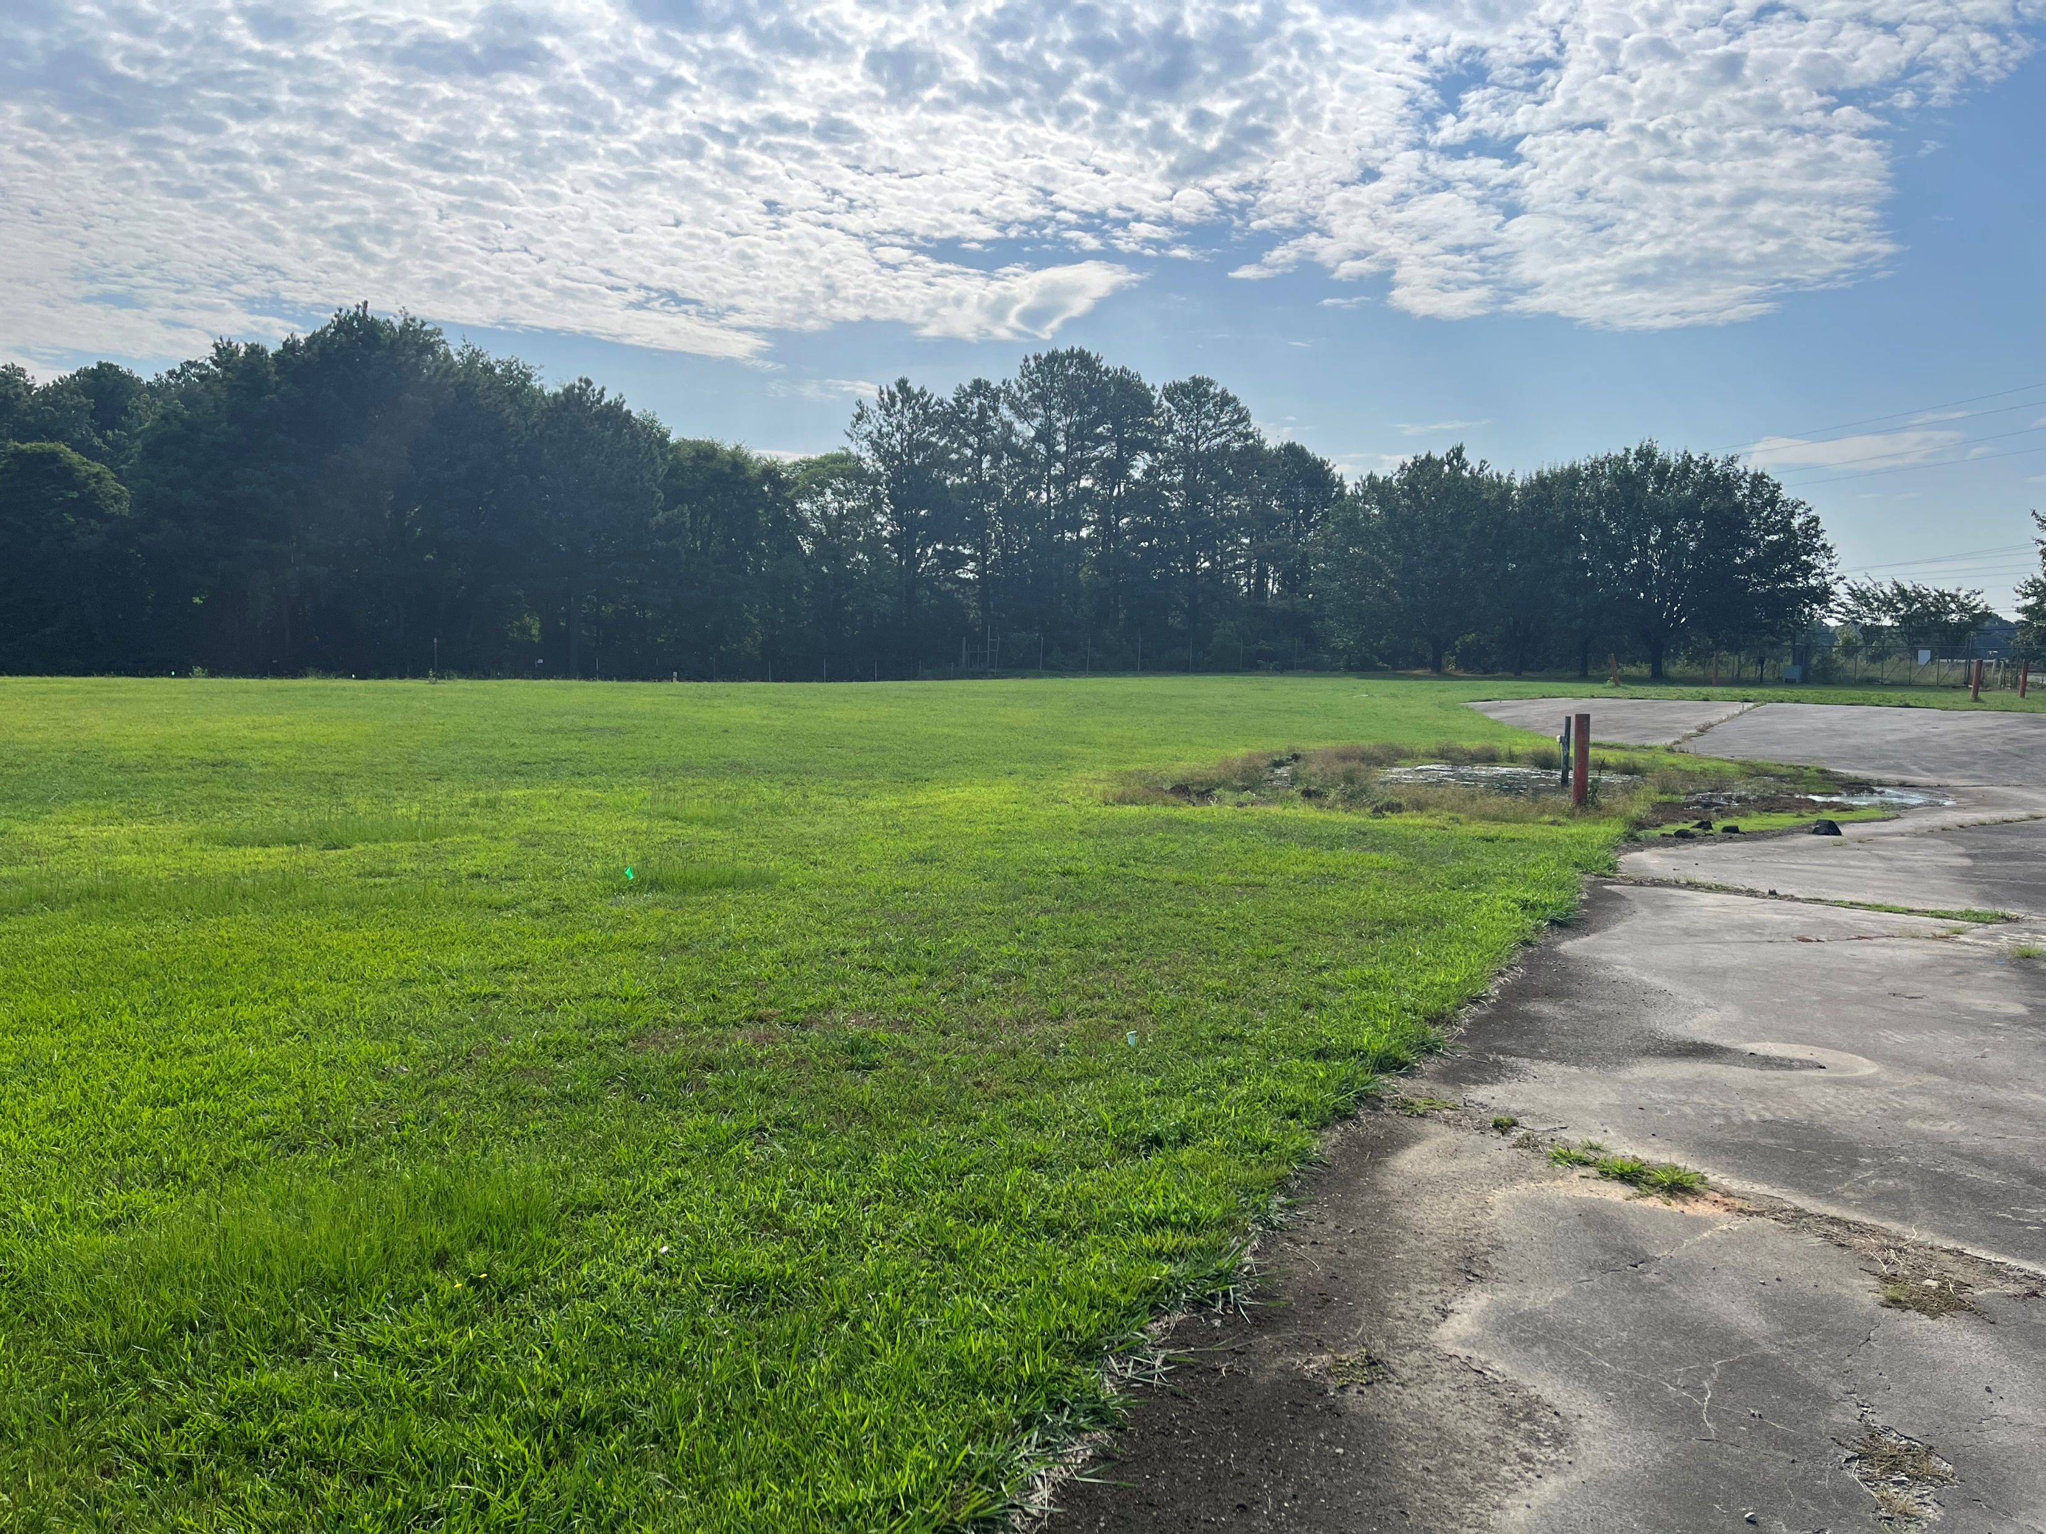
Case Study: Doraville, GA
112 Historical USTs associated with previous onsite buildings
Removed in 1996
USTs were removed with a NFA from Georgia EPD
Phase II ESA revealed that not all soil impacts had been removed

Slide 38
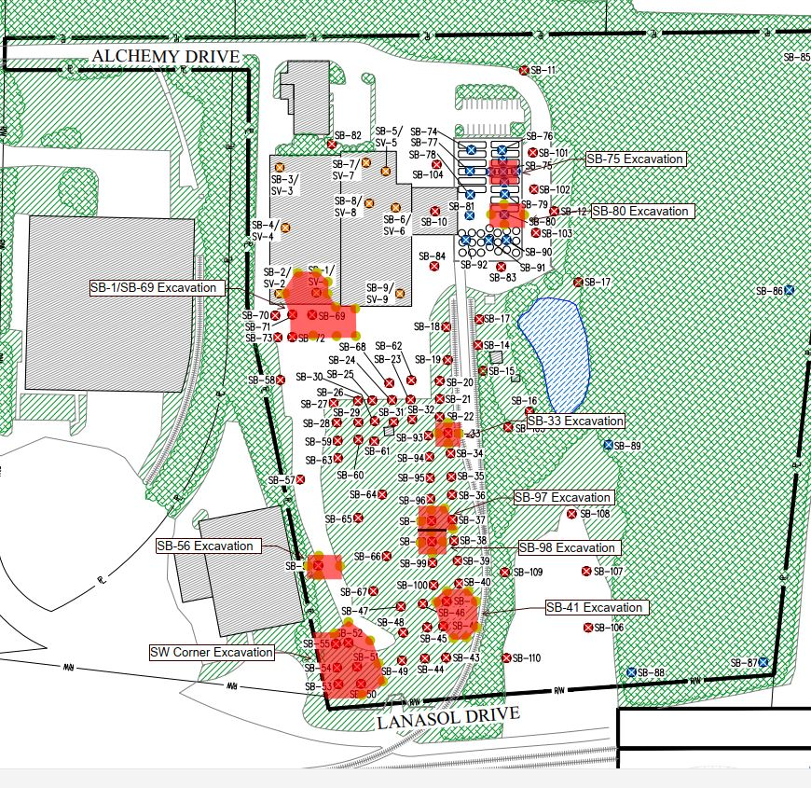
Case Study: Doraville, GA
Planned Remediation Tasks
Seller will address groundwater impacts
Buyer will address soil impacts during redevelopment

Slide 39
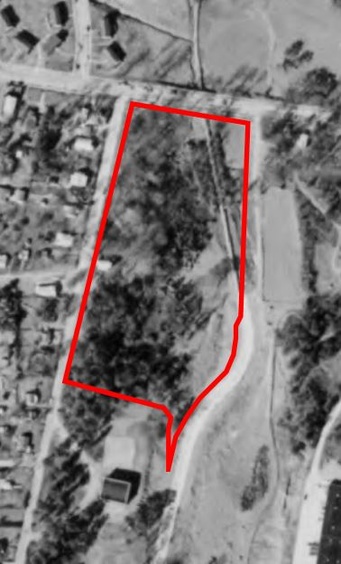
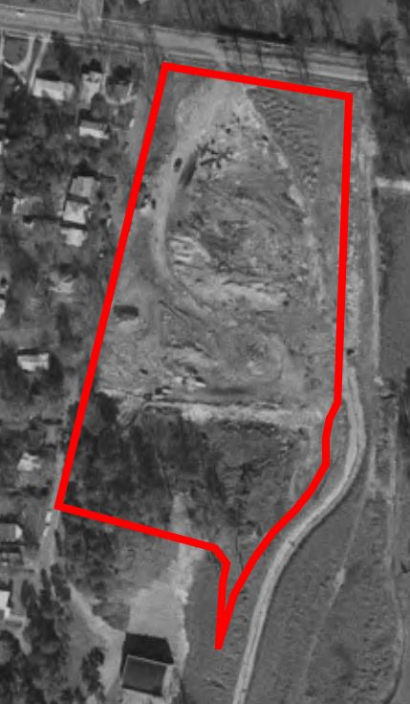
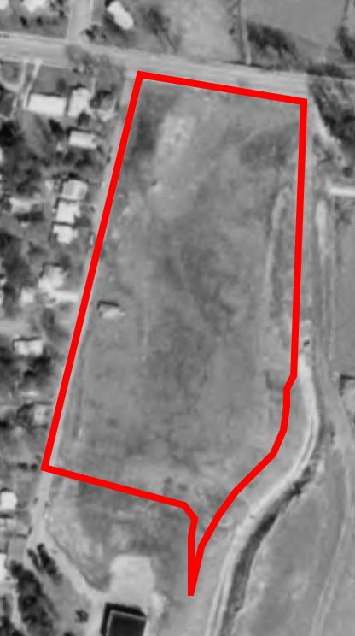
Case Study: Atlanta, GA
Planned residential development
Unpermitted Landfill?
Discovered during Phase I ESA
Brownfield Program
No groundwater impacts
Methane issue
1960
1968
1972

Slide 40
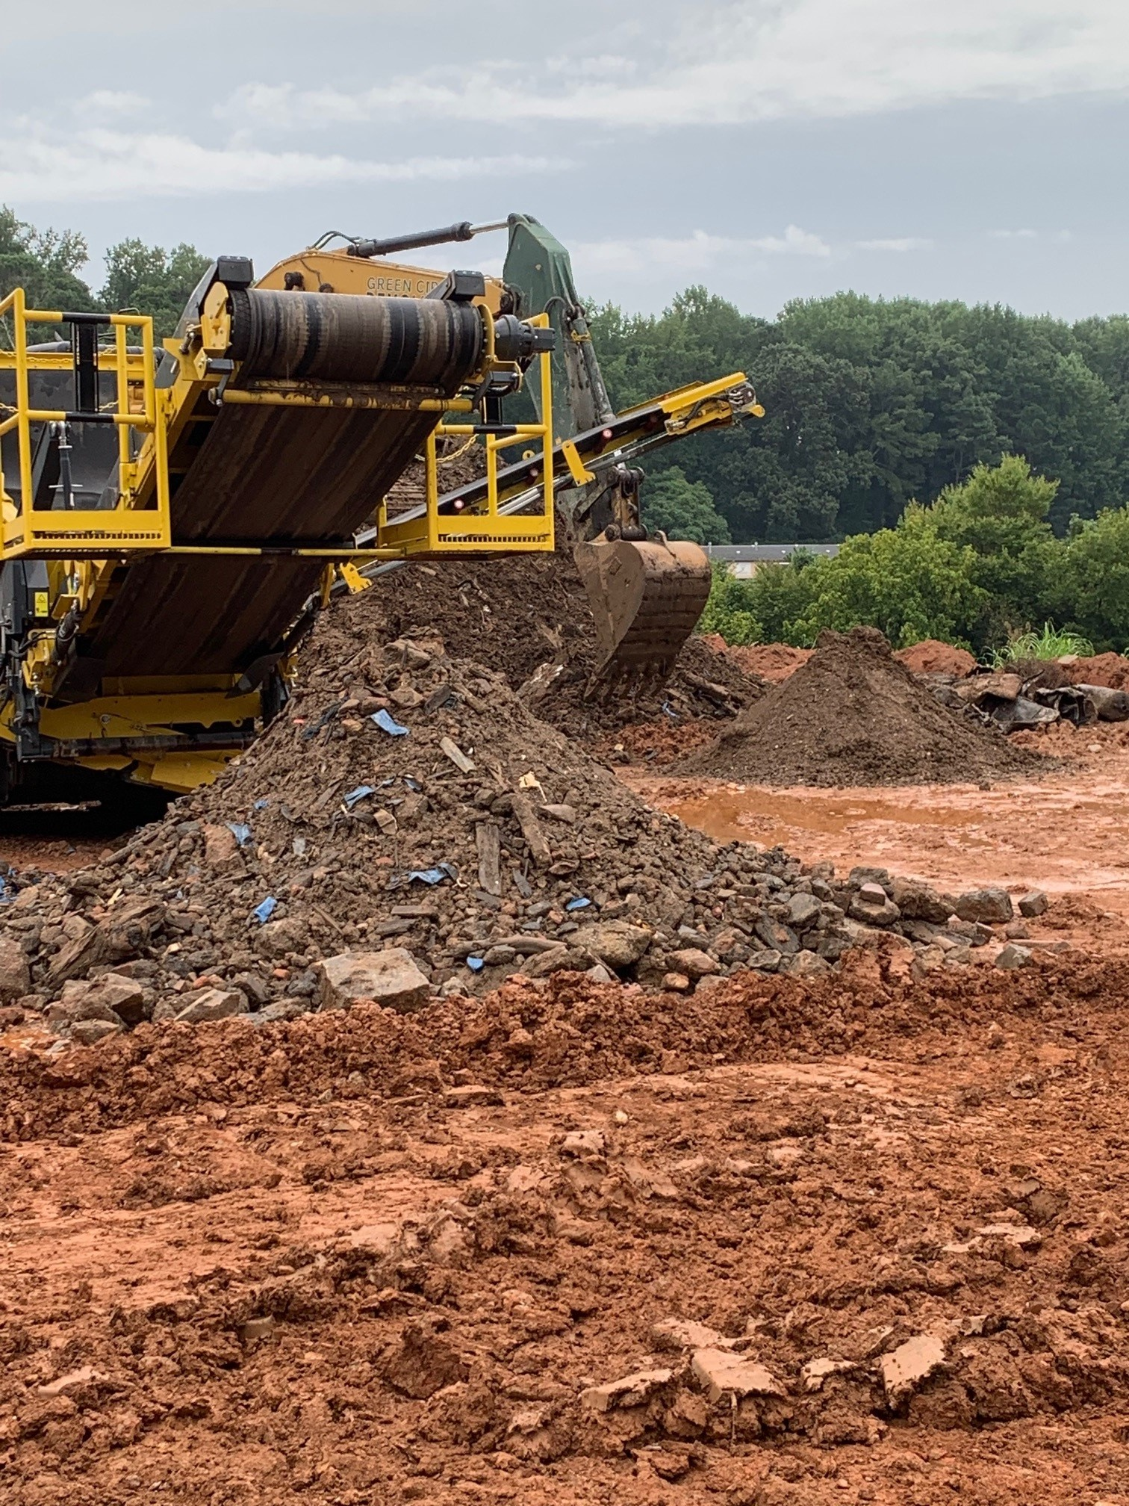
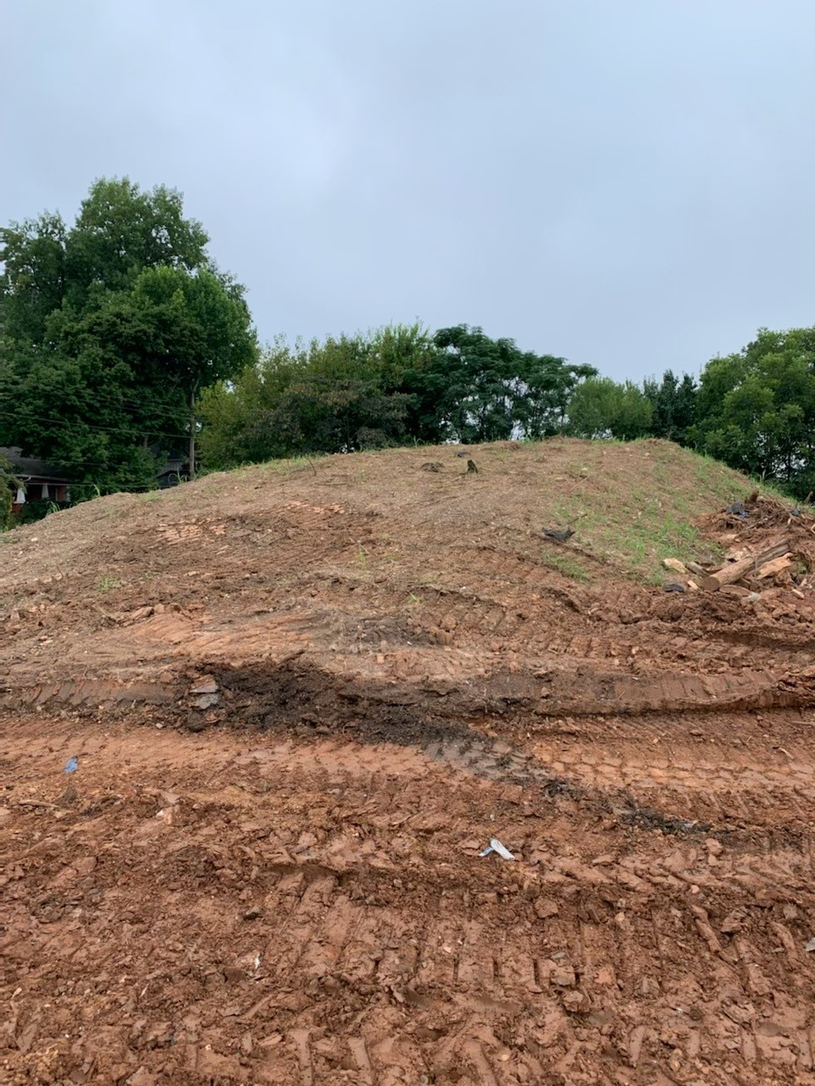
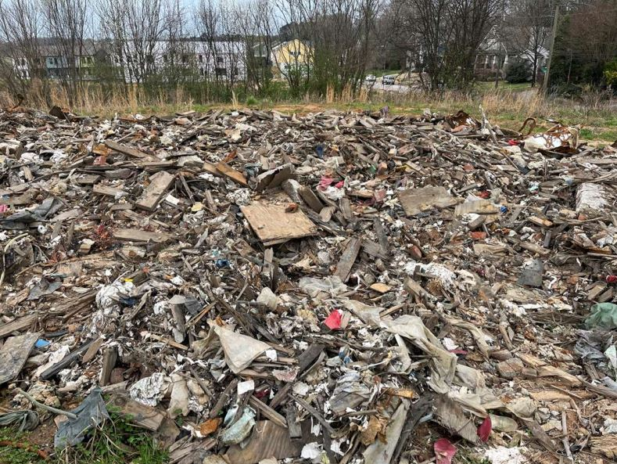
Case Study: Atlanta, GA
Segregated Soil
Segregated Trash

