Slide 1

Market Update
INTERNAL USE ONLY
9/26/2022
MarketNsights by Mr. John Hunt

Slide 2
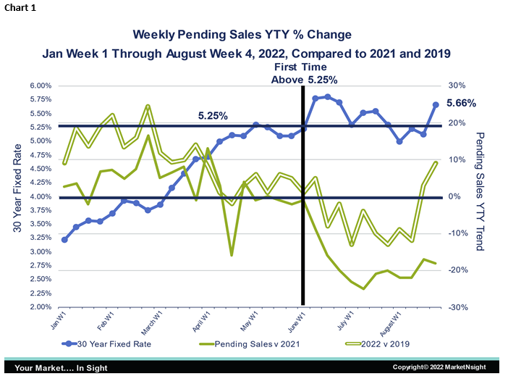
Pending Sales
As it turned out, our reprieve with interest rates under 5.25% was short lived. As of the end of August, 30-Year Fixed Rates were at 5.66%. Despite this, the pending sales trend only moved somewhat sideways compared to 2021 and was up 9% over the same week in 2019. (See Chart 1.)
For the year to date through the fourth week of August, pending sales are down only 5% from 2021 and still up 5% over 2019. There is a lagging effect of rising interest rates on demand, so I would expect pendings to look worse over the next few weeks with rates above the sensitivity threshold of 5.25%.

Slide 3
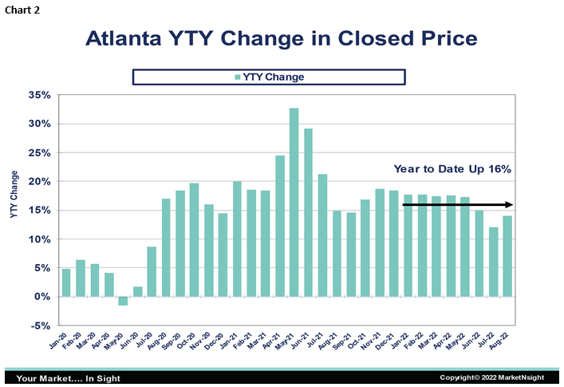
What About Price?
Prices are still showing moderation from the blistering increases of last year, but constraints on supply continue to keep them elevated far above the historical norm of 4 to 5 percent. With August in the books at a 16% year to year increase, I suspect our original price appreciation year to year forecast of 10 to 12 percent will be a little low. With four months to go, I would predict a year-end appreciation of between 12 and 14 percent. While still too high to appease the Fed, it is a welcome retreat from 2021’s 21% increase over 2020. (See Chart 2.)

Slide 4
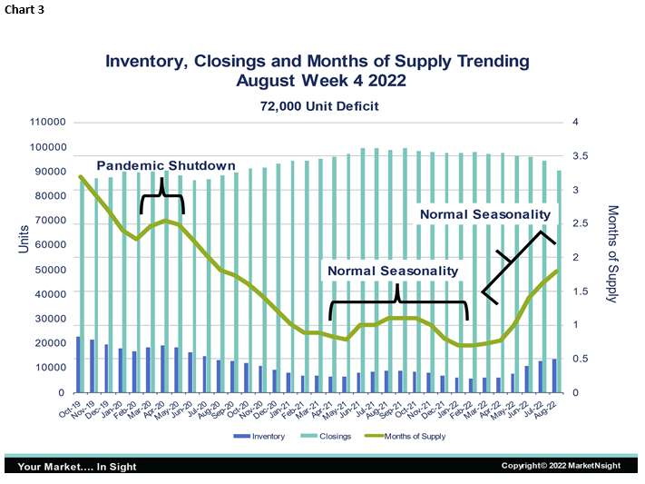
Supply and Demand
For the trailing 12 months ending August 31st, inventory is up 57% from the same period last year (when it was at a historic low) but is still 40% less than October of 2019. Closings are down 8% from August 2021 but still 5% higher than October 2019. (See Chart 3.)
The months of supply remained constant from last week at 1.8. As we have stated before, we believe that supply is at or near the peak and inventory/MOS will trend down from here through the late fall and early winter under normal seasonal housing conditions. The same trend was evident in 2021 with inventory peaking in October and falling through February 2022.
To reach equilibrium of six months of supply, Atlanta would need an additional 72,000 units of housing inventory over the next 12 months.

Slide 5
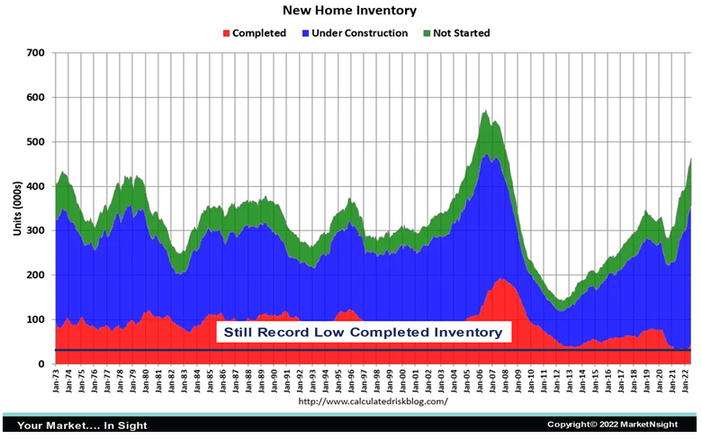
Total Closings, Inventory and Months of Supply
The most important information from the chart is that New completed inventory (red) is still at historical lows. The green section is for New homes not yet started. In 30 years, we have never counted homes not yet started as actual inventory. This is especially true in times like these when builders may purposely be sitting on permits to wait out difficult market conditions. In order to accurately determine current inventory, we must only count New homes where construction has started or been completed.

Slide 6
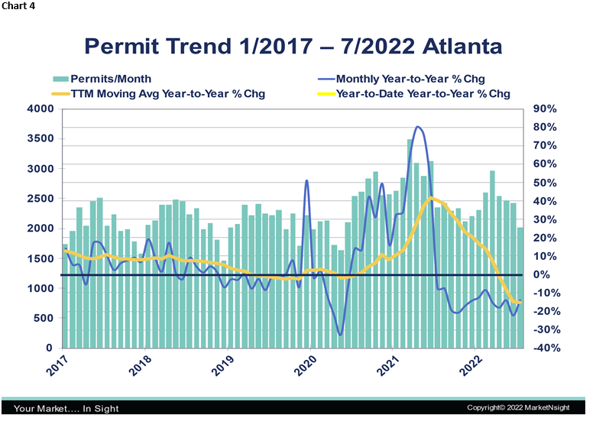
We are not trying to minimize the effects of the Fed’s tightening. It is definitely having a negative effect on housing demand. We do want to emphasize, however, that some of the extremely negative headlines are overblown and that we are nowhere near a 2008-style housing collapse. We still have more demand than we can supply, and prices are not going to crash.
In the near term, we do not see the lack of supply getting much better at all. Permits nationally and in most large markets, including Atlanta, have been negative year to year since September of 2021. Builders and bankers were already being cautious before interest rates started rising and they are even more cautious now. (See Chart 4.)

