Slide 1

Market Update
INTERNAL USE ONLY
9/12/2022
MarketNsights by Mr. John Hunt

Slide 2
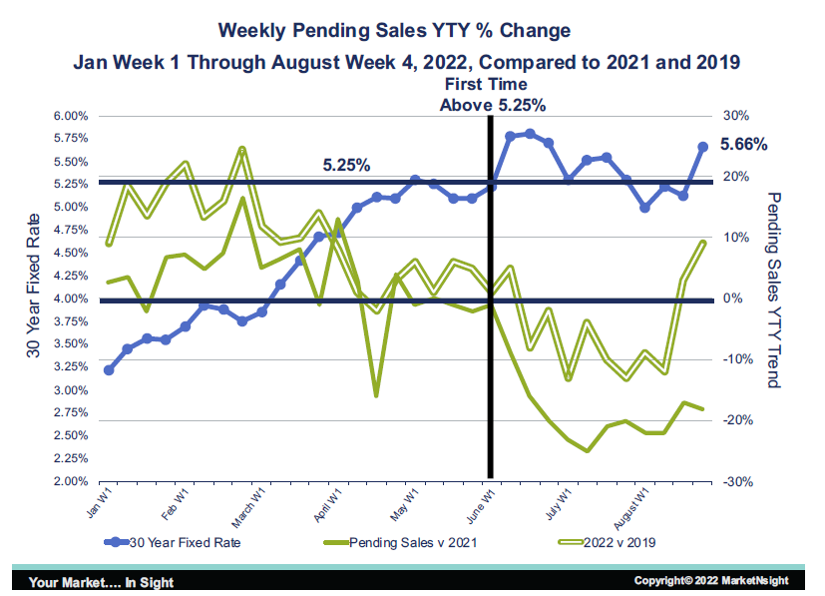
As it turned out, our reprieve with interest rates under 5.25% was short lived. As of the end of August,
30-Year Fixed Rates were at 5.66%. Despite this, the pending sales trend only moved somewhat
sideways compared to 2021 and was up 9% over the same week in 2019. (See Chart)
For the year to date through the fourth week of August, pending sales are down only 5% from 2021 and
still up 5% over 2019. There is a lagging effect of rising interest rates on demand, so I would expect
pendings to look worse over the next few weeks with rates above the sensitivity threshold of 5.25%.

Slide 3
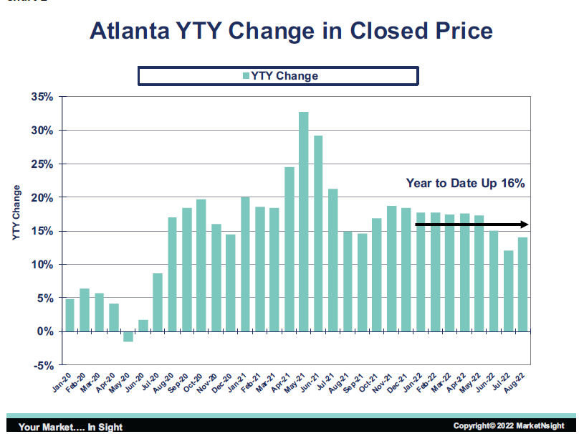
What About Price?
Prices are still showing moderation from the blistering increases of last year, but constraints on supply
continue to keep them elevated far above the historical norm of 4 to 5 percent. With August in the
books at a 16% year to year increase, I suspect our original price appreciation year to year forecast of 10 to 12 percent will be a little low.
With four months to go, I would predict a year-end appreciation of
between 12 and 14 percent. While still too high to appease the Fed, it is a welcome retreat from 2021’s
21% increase over 2020. (See Chart)

Slide 4
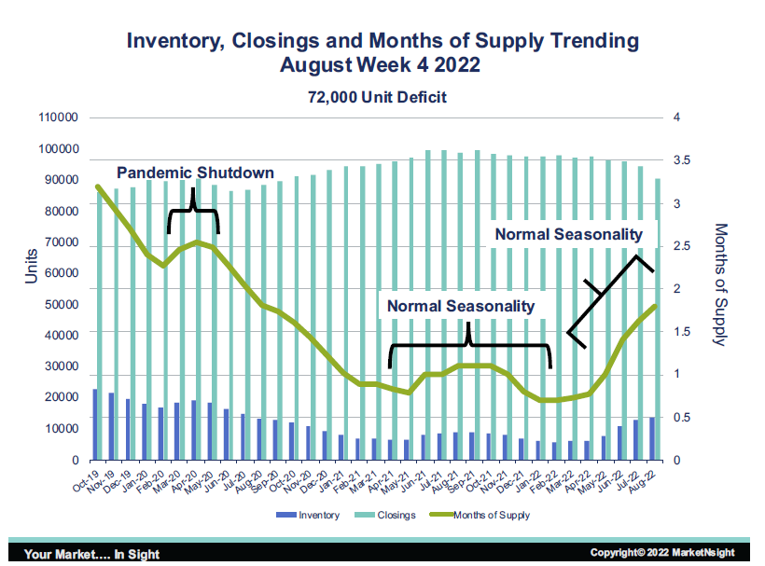
Supply and Demand
For the trailing 12 months ending August 31st, inventory is up 57% from the same period last year (when
it was at a historic low) but is still 40% less than October of 2019. Closings are down 8% from August
2021 but still 5% higher than October 2019. (See Chart)
The months of supply remained constant from last week at 1.8. As we have stated before, we believe
that supply is at or near the peak and inventory/MOS will trend down from here through the late fall
and early winter under normal seasonal housing conditions. The same trend was evident in 2021 with
inventory peaking in October and falling through February 2022.
To reach equilibrium of six months of supply, Atlanta would need an additional 72,000 units of housing
inventory over the next 12 months.

